Slide 1
WWI and Redrawing the Map of the Middle East

Slide 2
Egypt
Khedive Ismail (1863-1879): Opera house, highways, increasing local resentment about development, mismanagement, hard labour. Europeans install advisers and ministers. Huge European encroachment on sovereignty.
Colonel Ahmad Urabi leads 1881 revolt.
British occupy Egypt in 1882
Increasing calls for constitutionalism in late 1870s and early 1880s.
Raise revolt, call for constitution, elections, parliament. British interfere and occupy. Bomb Alexandria in 1882 and battle Urabi at the Nile Delta; control Egypt until 1952.

Slide 3
Racism and Imperialism
Positive connotations: Lord Cromer felt this is in ‘best interest’ of subject races by reforming finances of country. Very shrewd administrator (reformed India’s) and ‘balances Egyptian budget’ and productivity; not interested in health and education.
‘Veiled protectorate’: Egypt is within Ottoman empire but occupied and retains degree of autonomy; odd status.
1906 Dinshaway marks boiling point. Hunting British soldiers kill villager and British officer killed. Jailed the villagers and sent to tribunal with public sentences for the peasants.
British occupier takes drastic measures to control population and underlines moral violations to secure interests. Cromer retires after this.
Anticolonial politics triggers organized revolutionary movements in 1919.

Slide 4
Iran
Call for reform explicitly about Constitution 1906-1911, making a ‘revolution’ to establish a constitutional monarchy under the Qajar Shah (King).
Domestic and outside elements. People agitating against rule of the Qajar Shah and intervention of Great Britain and Russia. Concessions to European prospectors and financiers to use resources of country, especially minerals and railroads:
Reuter Concession (1872) for RR, mining, banking for profits to Qajar shah (strategy to centralize telegraphs, armies, railways).
Tobacco Concession (1891) repealed in 1892 due to tobacco protest in alliance with clergy .
1901: Shah gives Concession to D’Arcy for oil; Pattern of how oil struck and exported through complicity between local rulers and exporters; 1908 discovered oil in commercial quantities
1911-12: British (Churchill and Admiralty) take plunge to transform all British battleships from relying on coal; oil is more energy efficient adds speed to battleships but also ‘scramble for concessions.’
Significance: consequences of British having to depend on resource outside of country. Independence affected fate of constitutional movement in Iran.

Slide 5
‘War to end all Wars’
‘Fateful Plunge’ describes Churchill in 1911, as Lord of the Admiralty, making decision to convert from coal to oil to prepare war for oil.
Cleanse Europe of its ills.
Allies (GB, France, Russia joined later by USA and Italy) v. Central Powers (Ottomans, Austro-Hungarian Empire, and Germany)
Expectation among Europe’s leading figures concerning WWI (1910-1914) welcoming war as ‘ending all wars’: Berlin, Paris, Petrograd, London (August 1-4, 1914). [Freud, Durkheim, Kipling]
But, millions died through 1918; trench warfare on eastern and western fronts (Baltic Sea to Moldova): Russia and Austro-Hungary on the eastern front and Germany and France on western front.
Many words coined reflecting war conditions: ‘home front,’ ‘entrenched,’ ‘lousy’.

Slide 6
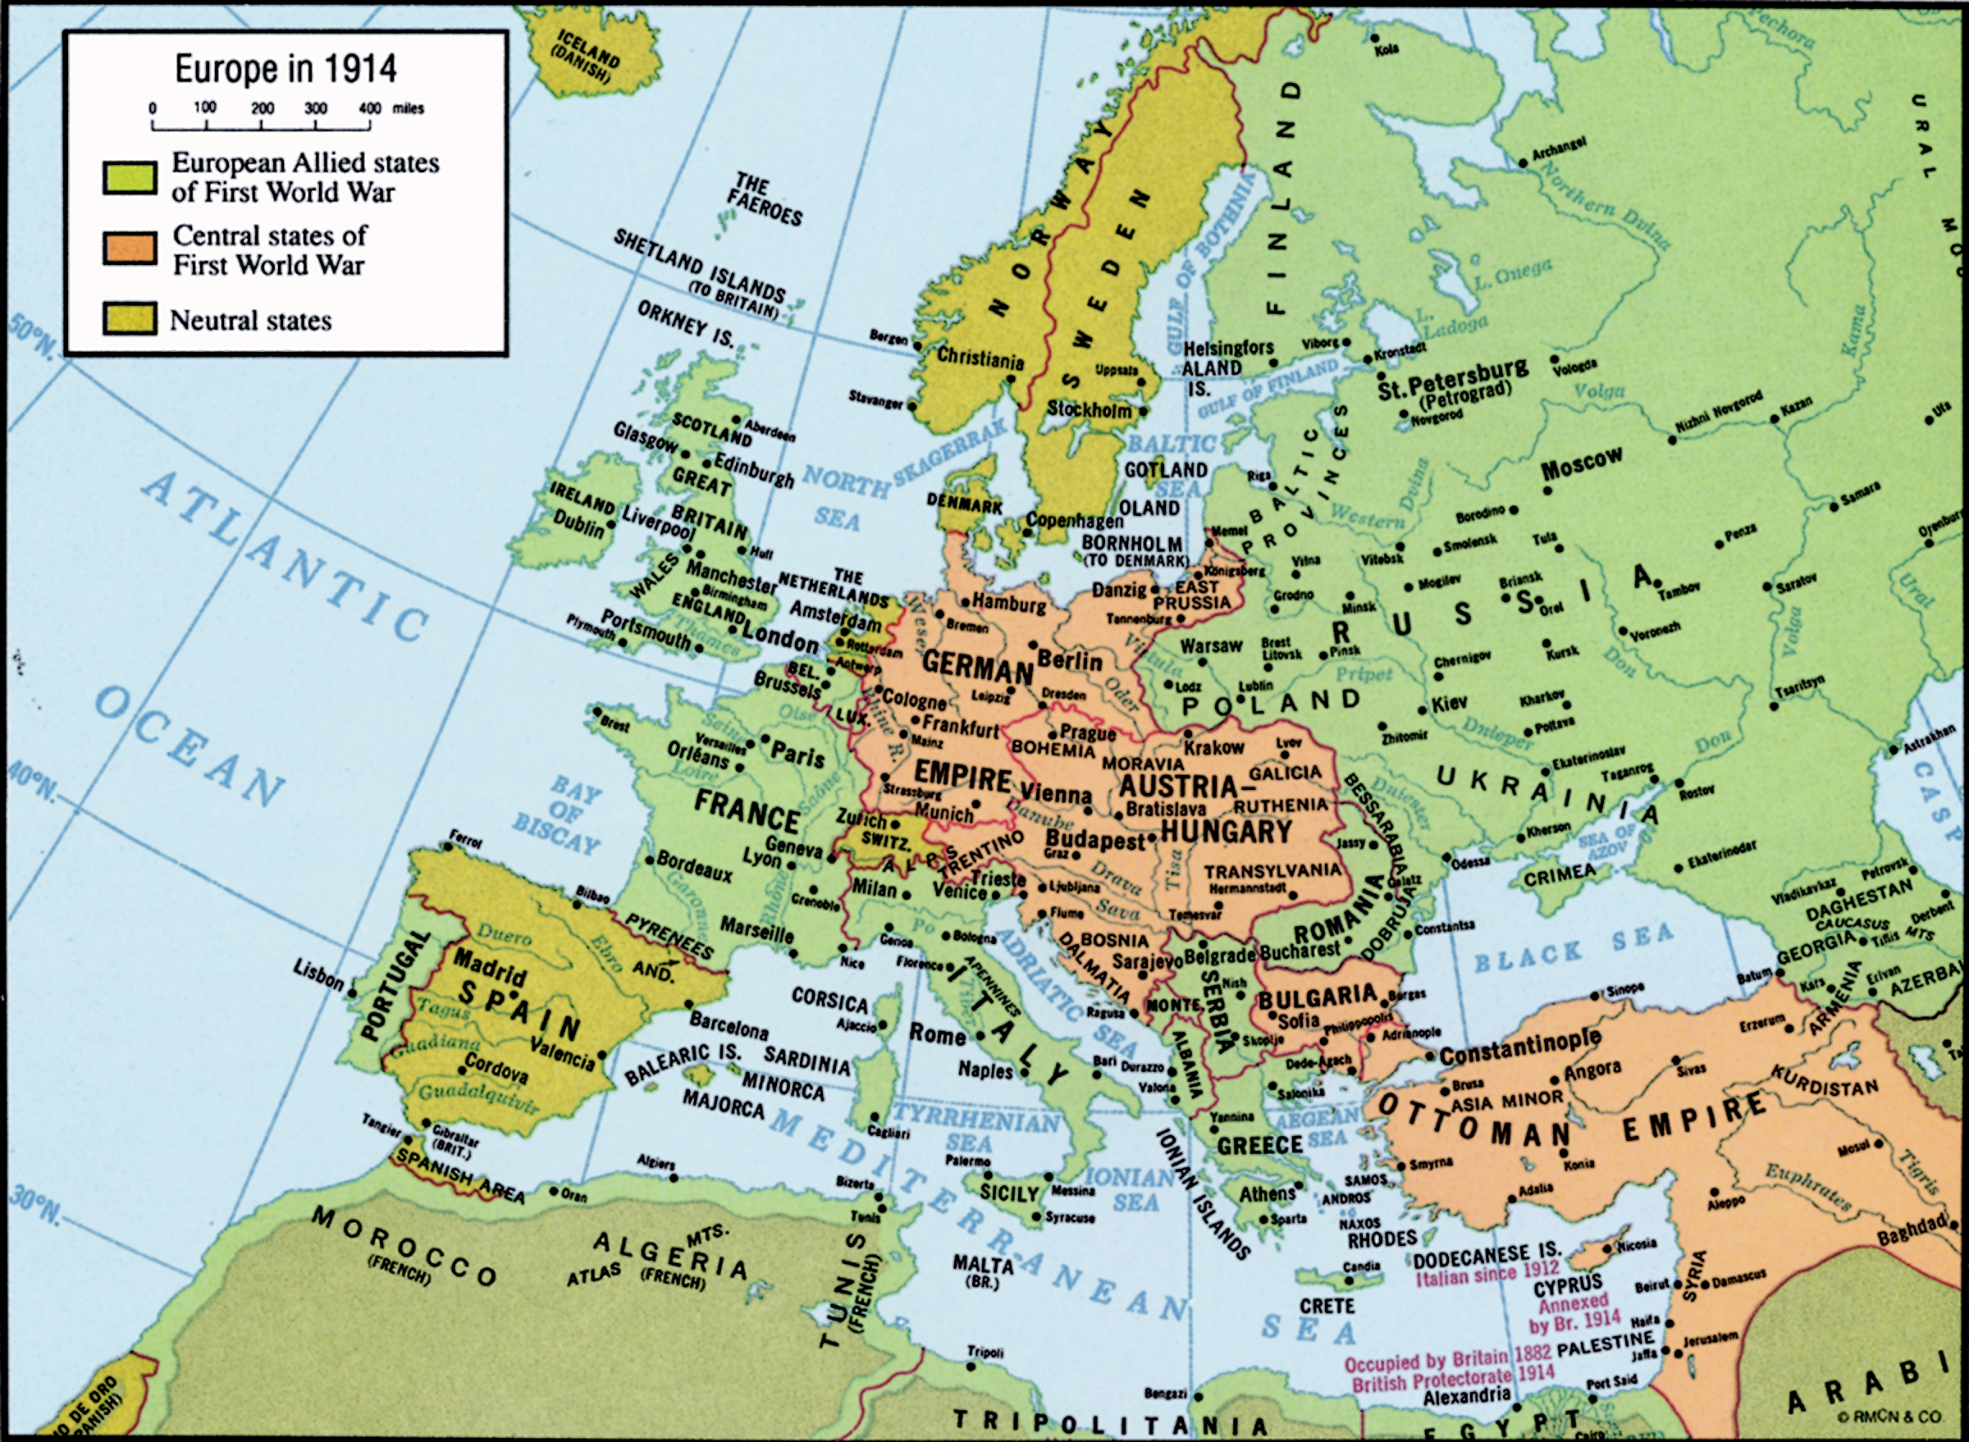
Europe in 1914

Slide 7
Comprehending the atrocities: War poetry
Rupert Brooke, 1887-1915
‘The Soldier’
Wilfred Owen, 1893-1918
‘Parable of Old Man and the Young’

Slide 8
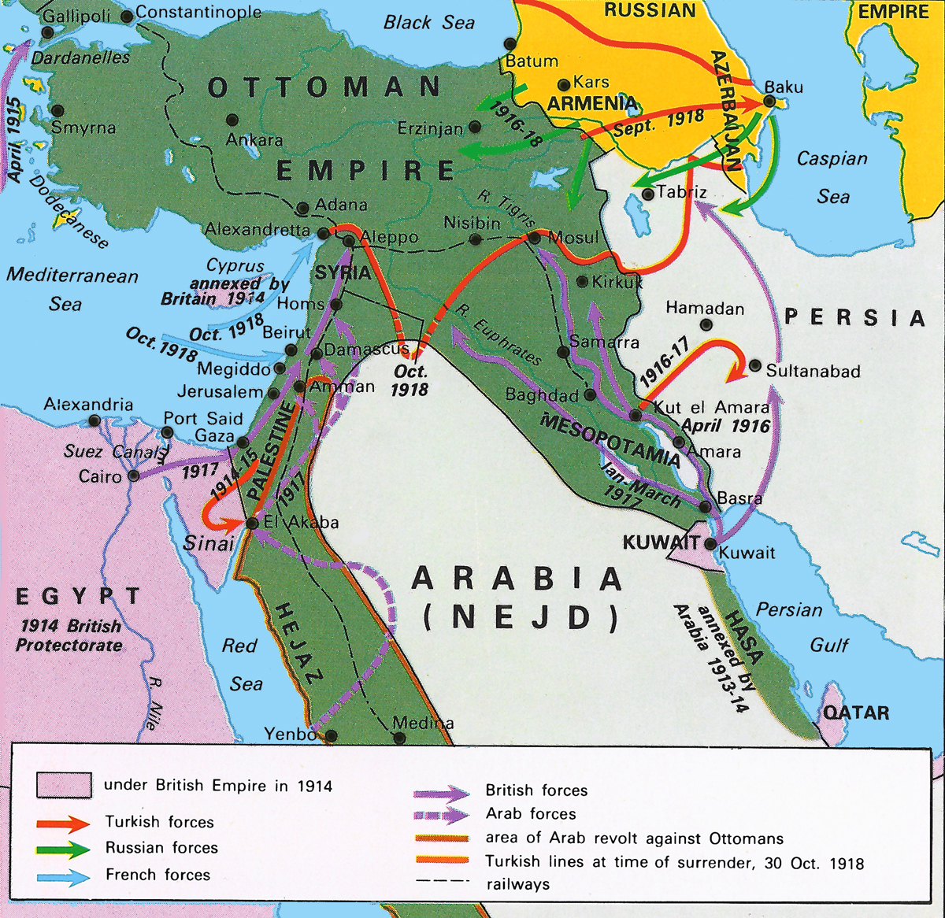
Middle East operations for WWI

Slide 9
Middle East operations for WWI 1) Dardanelles Straits; 2) Arabia
Churchill sees stalemate at the Western front so attacks Germans from the back via Arabia and Dardanelles. Troops from Australia amassed in Egypt and charge to peninsula = Gallipoli (April 25, 1915); a huge blunder.
Dardanelles Straits
Gallipoli Campaign (Anzar Beach)
Aim: Open the Dardenelles Straits and take Istanbul to cut off from Germany and open supply lines to Russia via Black Sea in the Caucasus front; British succeed in diverting some Turkish troops away from Russians.
Shows that centuries of reform in Ottoman military had paid off.

Slide 10
Middle East operations for WWI, cont’d
2) Arabia and the Arab Revolt, 1916
Hejaz region controlled by Hashemites, the Sherifs of Mecca. British, Ottomans, Hashemites involved: Sherif Husayn declared the Sherif of Mecca in 1908, claiming descendancy from Prophet Mohammed.
The Sherif was encouraged by the British to revolt against the Ottoman Sultan and in return, was promised a reward in the postwar settlement. Sherif aspires for kingdom, capitalizing on anti-Turkish feeling of Arab subjects, end of 19th c. when Ottoman Empire is reduced to Turk/Arab speaking populations, coinciding with heightened nationalisms.

Slide 11
Arab Revolt, cont’d
T.E. Lawrence: British officer (Oxford); studied Arabic and Oriental languages; helped in the War Office (Map department). Provided assistance to deal with the Hashemites in Arabia.
Prince Faysal: took Aqaba (with Lawrence) on the Red Sea and army (led by Husayn’s sons) marched to Damascus in 1918, but British beat them from Cairo and captured Jerusalem and Damascus in 1917 (General Allenby forces).
Conclude: WWI ends Nov. 11, 1918. Germany defeated, British and France strengthened position; Russia opts out due to 1917 Bolshevik revolution; Ottomans defeated.

Slide 12
Post-WWI: All multiethnic empires broken
How to settle and reorganize these lands in the postwar order?
US emerges (joined war effort in 1917) behind leadership of President Woodrow Wilson with ’14 points of diplomacy’ to lay foundations of new world order over European ‘gunboat diplomacy’
Wilsonian rhetoric supports ‘national self-determination’ where people have right to declare their interests and how to be governed; forms new basis of international law and diplomacy.

Slide 13
‘Collapse of Empires’
Austro-Hungarian Empire dissolved
Russian Empire dissolved (1917, Bolshevik Revolution)
Germany defeated; social revolution erupts
end of US isolationist policy; President Wilson’s 14 points
Ottoman fragmentation; re-drawing of the map and call for self-determination
growing anti-Turkish and anti-British/French sentiment

Slide 14
Britain’s Moment
War ends with Britain entrenching self very firmly in the Middle East up to Suez Crisis in 1956 = Britain’s moment:
Egypt (since 1882)
Sudan (since 1890s)
Mosul/Basra/Iraq (WWI)
Friendship treaties with ‘Trucial Coast’ or Gulf States. Presence in south Iran, occupied Jerusalem and Damascus in 1917 (not just diplomatic)
Conclude: We are left with 5 states out of the Arabic speaking regions: Iraq, Syria, Transjordan, Palestine, and Egypt

Slide 15
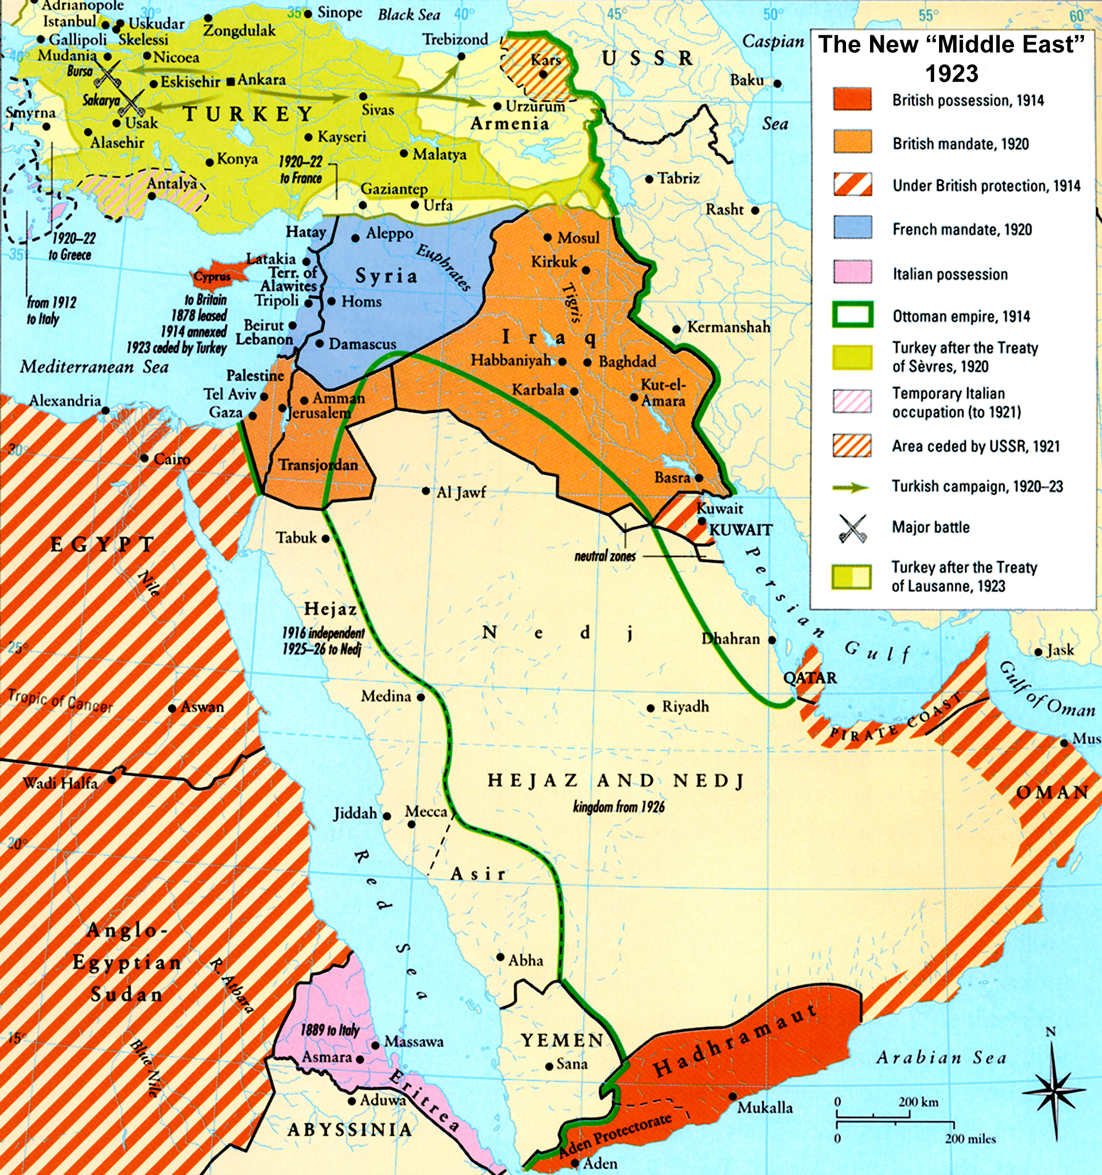
The Middle East after WWI

Slide 16
British double dealing determines future of Asiatic Ottoman Empire
Arab Revolt, 1916: Faysal from the Hijaz to Damascus
Husayn-McMahon Correspondence: British promise to Sherif of newly independent Arab State
Sykes-Picot Agreement, 1916: Secret negotiations conducted by Britain with French (Russians too, who go public in 1917 with agreement to embarrass bourgeois European empires by exposing plans to carve up the Middle East.
Palestine: international zone
Greater Syria: France
Rest (Egypt, Iraq, Transjordan): Britain
Balfour Declaration, Nov. 1917: Balfour is the foreign secretary of Britain.
Balfour supports Zionists led by Rothschild (head of European Jewry) to create ‘national homeland’ for Jews in Palestine while not threatening the ‘civil and religious rights’ of local non-Jewish (negative framing) Arab Palestinian population. In other words, NO political rights stipulated while Jews are simultaneously allowed to reorganize with political rights.
Conclude: Reconfirms ‘British double dealing’ practice vis a vis Arabs, France, Russia, and the Zionists.

Slide 17
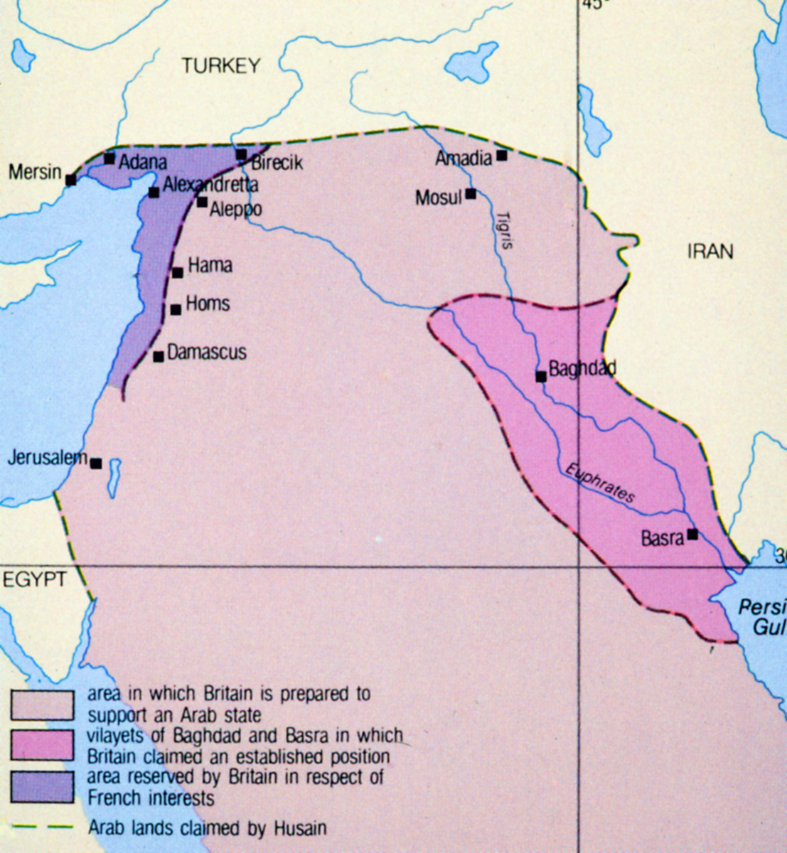
Husayn-McMahon Correspondence, 1915-16: Arab State Outlined

Slide 18
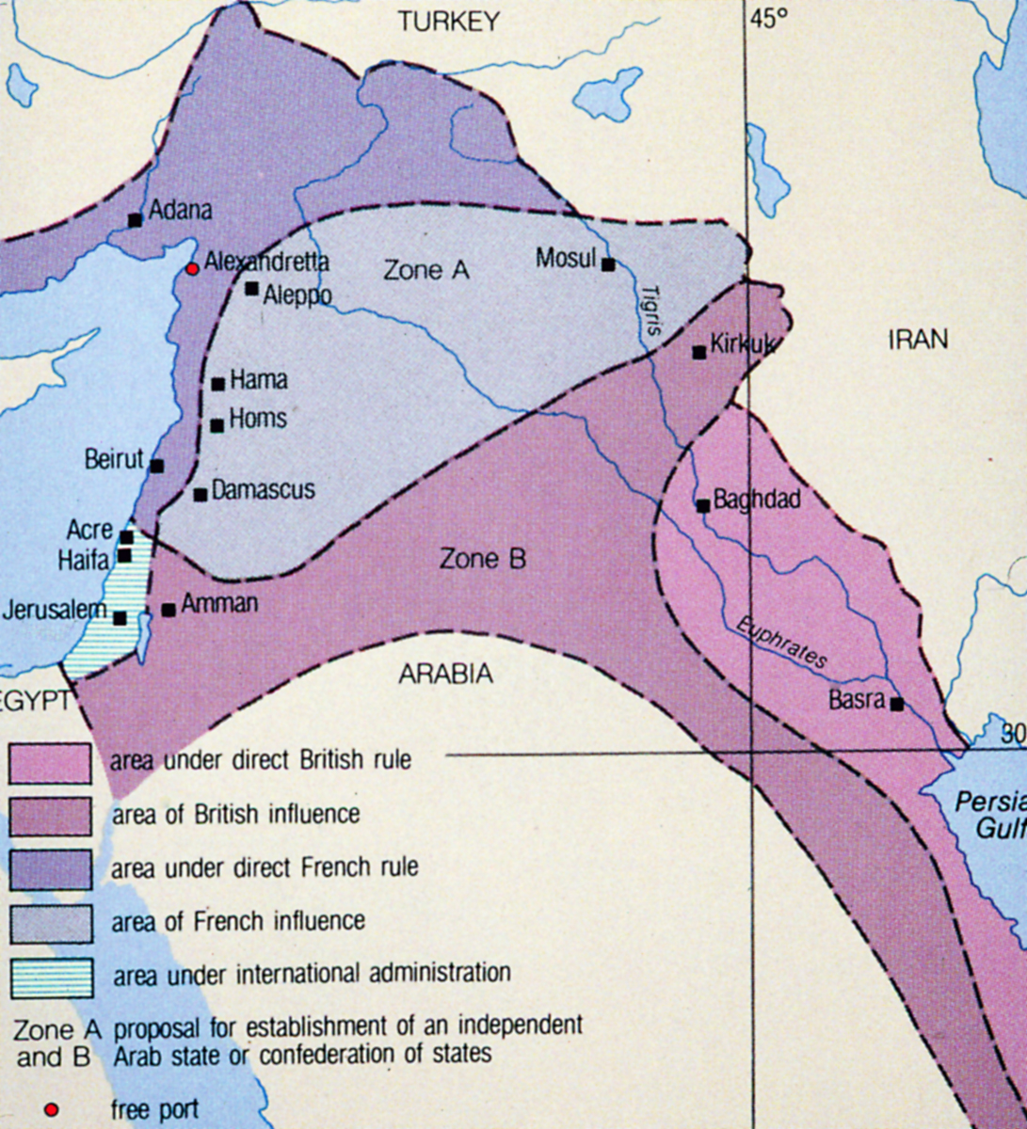
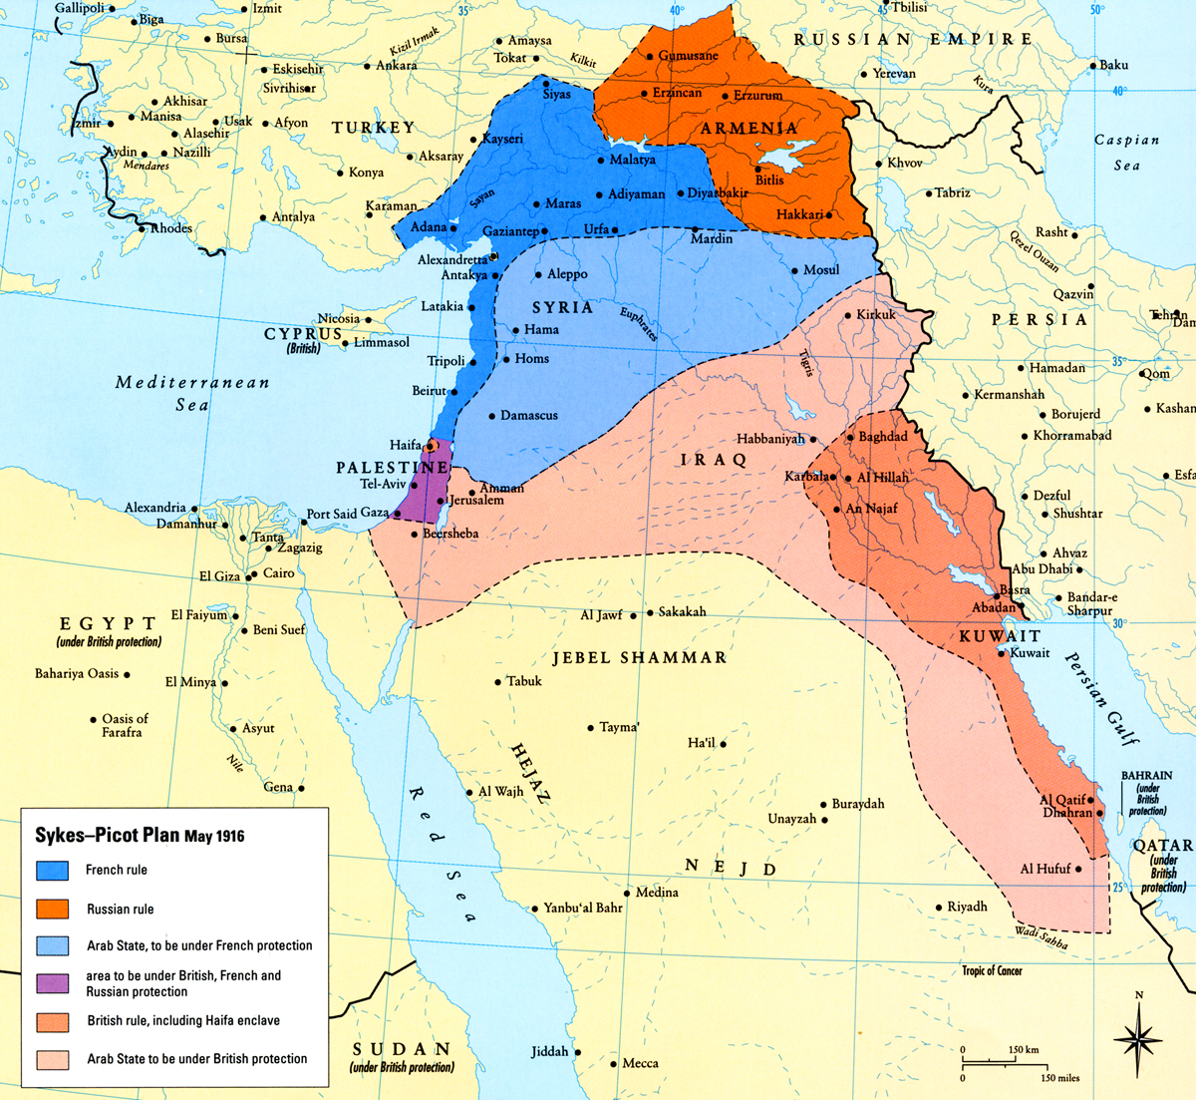
Sykes-Picot Agreement, 1916

Slide 19
Paris Peace Conference, 1919
Lay foundations for new diplomatic and world order
Lloyd-George UK); Orlando (Italy); Clemenceau (France); Wilson (America)
Iran not permitted to attend, but Faysal allowed with T.E. Lawrence, where he discovers promise from Britain to his father is non-binding because GB wants to reward France for losses by giving it Syria.
Wilson’s push at the conference: Arab states and Balkan peoples; claims to ‘14 points’ of rights to self-determination, access to international waters; 19th c. diplomacy is obsolete. Now have ‘League of Nations’.

Slide 20
King-Crane Commission, 1919
Appointed at the request of US president Woodrow Wilson. Sent to investigate opinions of people on the ground in Syria and Palestine and wrote memo to American delegation at the Peace Conference.
Example/ Petitions from dignitaries in Amman opposing any notion of European colonialism or mandate framing; demand all assistance should be American, not European.

Slide 21
Promises to local populations under occupation?
Allenby Proclamation, 1917
Baghdad Declaration, 1917
Declaration of Seven, 1918
British policy of reducing costs, 1920-21:
Install Abdullah in Transjordan and Faysal in Iraq to allow British troops to withdraw from eastern Palestine

Slide 22
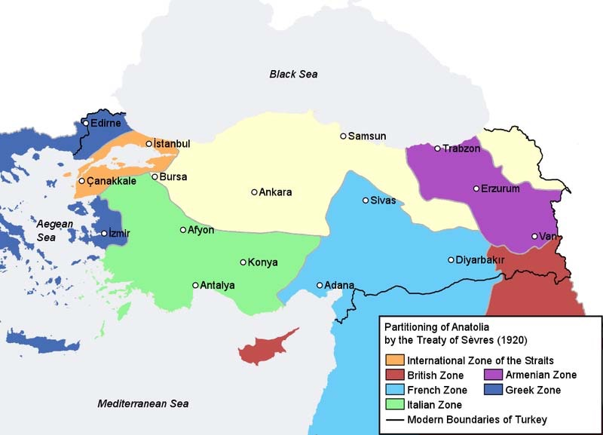
Turkey
Constantinople occupied by Allied troops
Aug. 1920, Ottoman Empire capitulates at Treaty of Sevres -----------------------------------→
Southwest Anatolia for Italy and France
Armenian state in eastern Anatolia
Southeast of Anatolia for Kurds
Greece gets ‘European’ part of Turkey (Thrace), west of Constantinople and allowed to locate in Smyrna/Izmir
Turkey must pay reparations to victors in money and land

Slide 23
Turkey, cont’d
Mustafa Kemal, Ataturk, 1881-1938:
Founder of modern Turkey, est. in 1923
Military commander
Born in contemporary Greece
Important role played at Gallipoli campaign and in Syria
Led force, after treaty, to roll back and recapture Izmir from Greeks
Grand National Assembly: local notables and parliament to represent population’s will
1922 abolishes the Sultanate (to Malta); Abdul Majid II caliphate is abolished in 1924
Armenia divided between Turkey and Soviet Union
Anatolia is freed of foreign troops
Conclude: Marks the end of multi-ethnic empires toward one ethnic nation-state (self-determination).

Slide 24
Turkey, cont’d
We see the rehabilitation of ‘Turkish’ language with conversion to Latin script: ‘Language reform society’ to cleanse the language of borrowed Persian and Arabic words.
Waqf nationalized
religious schools closed down
secularism pursued relentlessly, public religious displays banned to wipe out the past
Ulama no longer has any influence on the state
As Ottoman officer and product of Ottoman reforms, Kemal grants rights to women in education, though framed as a product of break from this past; right to vote granted in 1934

Slide 25
Ethnicity and what happens to minorities
Compare to partition of India (Muslims/Hindus), being on wrong side of borders: e.g. Greeks (1.3 million in Anatolia (Smyrna, Constantinople), speaking Turkish and Orthodox Christian); Turks constitute 400,000 in Greece (Salonika) speaking Greek but Muslim.
Resolved through a population exchange to fit ethnic framing of the nation-state.
1915, Armenians (genocide claims over 1 million lives) because thought to be supporting Russians, forced to march to Syria. The claim is challenged by Turkish government as ‘byproduct of war’ rather than a systematic policy of eliminating the population.
Kurds: also suffer harsh subjection to cultural policy that prevents Kurdish speaking language, etc.

Slide 26
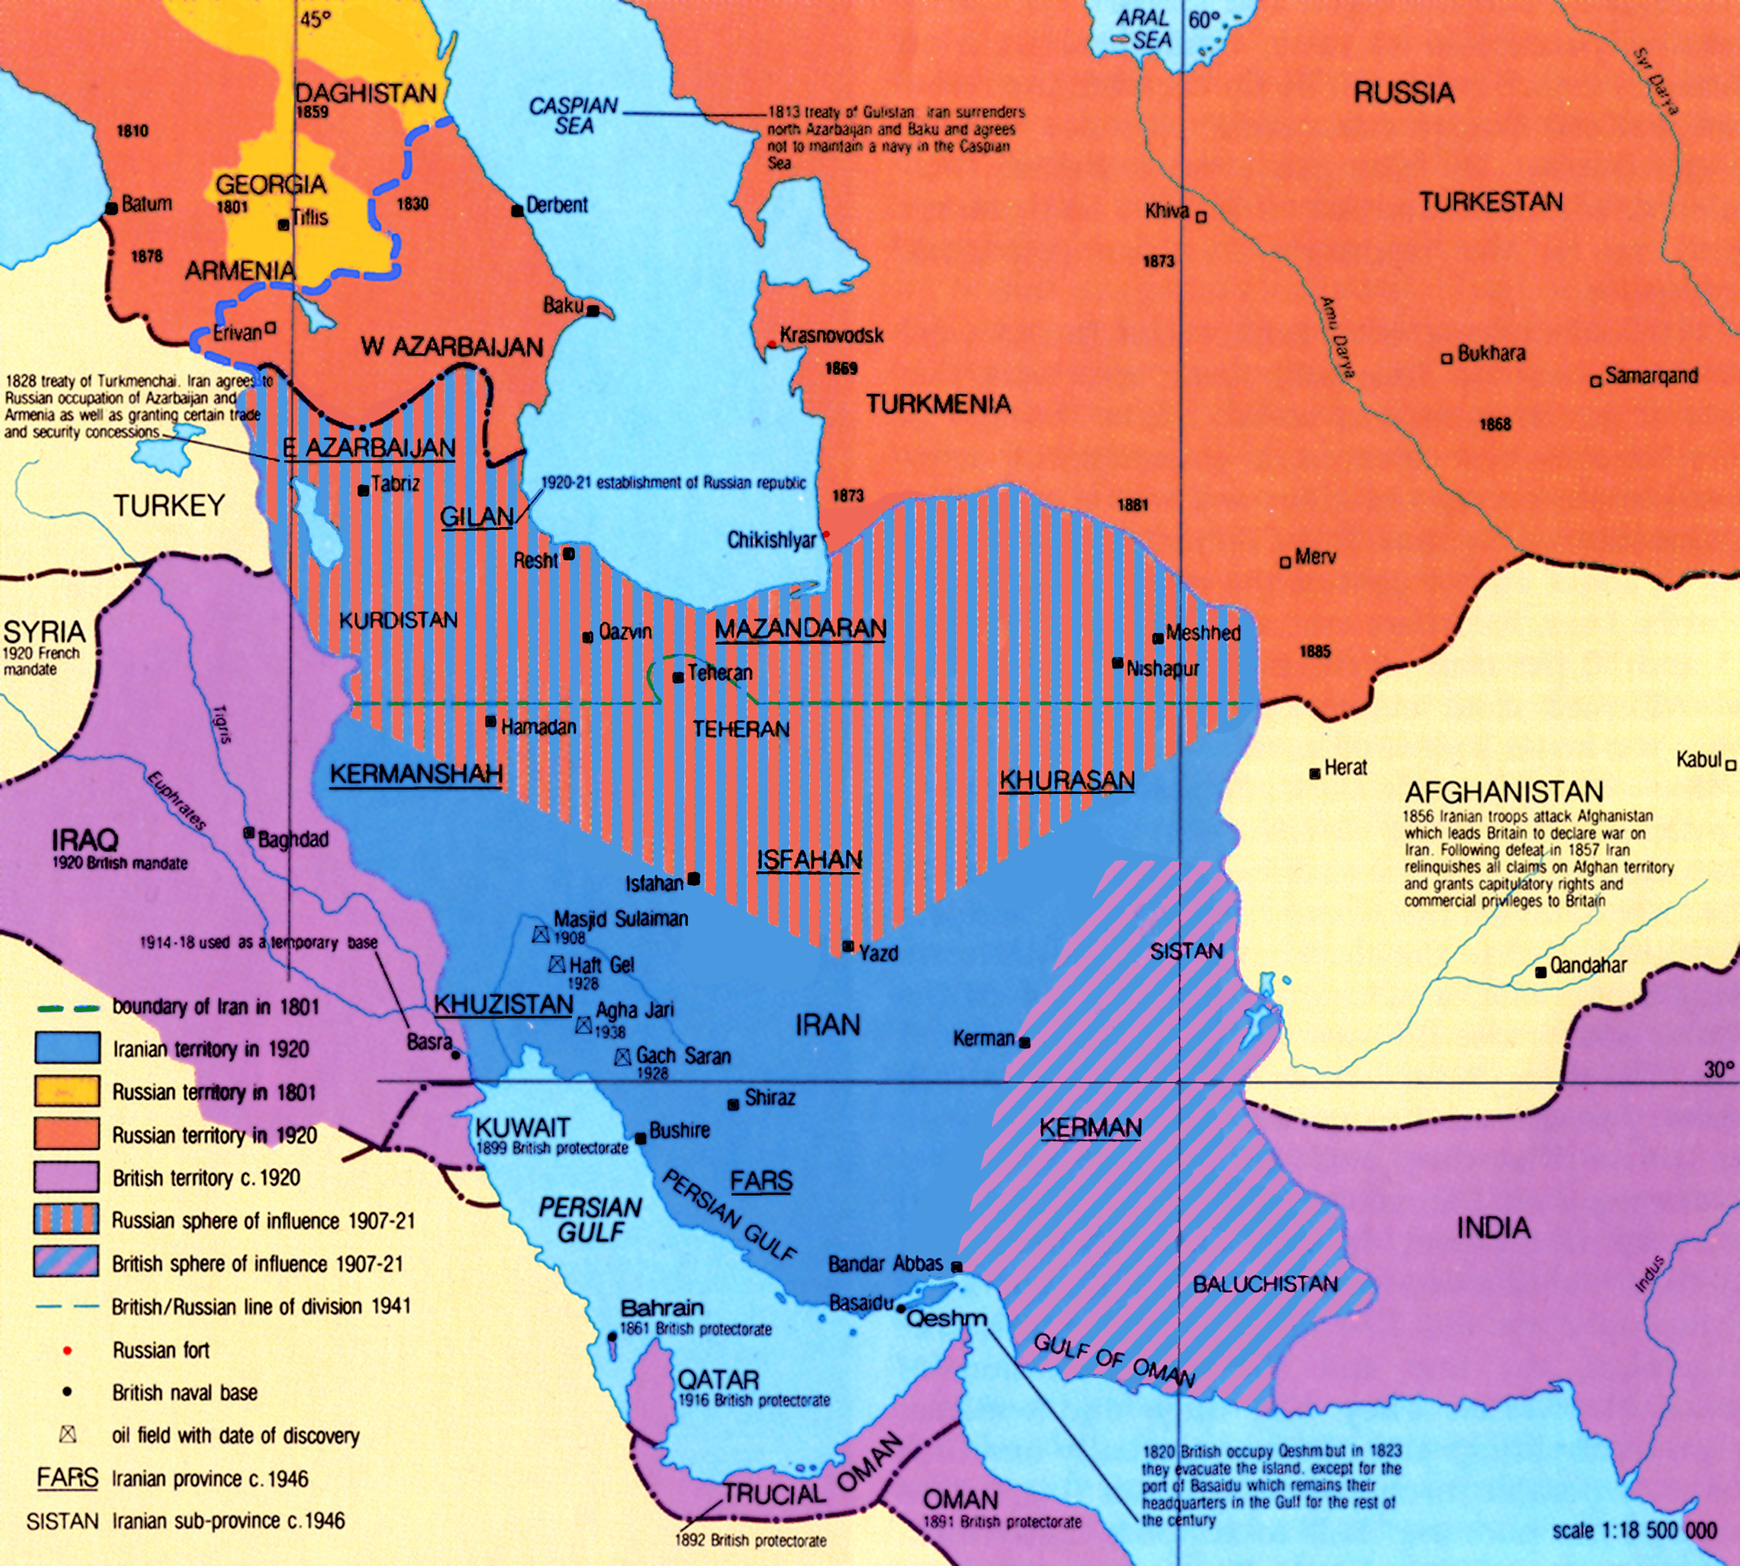
Iran
During WWI, divided into 2 spheres (British in the south, oil) and Russians in the north.
Concern about Bolshevik presence and influence in the north
Reza Khan, officer like Ataturk, head of battalion, Russian trained Cossack brigade
Shah declares himself minister of war in 1921, British backed
Crowned the shah in 1925, End of Qajar period and start of Pahlevi
Reforms: industrialization and modernization; not believer of constitutionalism; establishes self as centralizing force on provinces and semiautonomous tribes; conscription imposed by 1926

Slide 28
Egypt
Anticolonial movement through WWI
1919 Peace Conference where Egyptians want delegation but stopped by the British (Saad Zaghlul stopped and arrested!; becomes future national leader)
Triggers revolution against British occupation and actions; quelled but at a cost
Zaghlul stops exile; to London with case for independence; Egyptian monarch declared king;
British declare Egypt independent in 1922 with strings attached: 1) Suez Canal under British troops remains; 2) Egypt not free to conduct defense policy and must consult with GB first
1922-52: Political deadlock because constitution and division of power into three: Wafd-delegation, Parliament; palace with Fouad; British mission. British have upper hand to intervene in affairs, approve and disapprove. But flourishing effects too in art and culture.
Conclude: Most of reforms of the 19th c. were the result of military reforms and not a coincidence that emerging officer leaders are a product of these reforms and a product of this past.

