Slide 1
Representing, Picturing, and Imagining the Middle East

Slide 2
Oriental Studies
First Professorship of Arabic founded at Oxford University in 1636 by William Laud.
First chair of Arabic in the U.S. at New York University in 1837.
And as ‘Middle East Studies’ or Oriental Languages at Princeton University in 1944.

Slide 3
1958 US Defense Education Act
Founded the study of ‘Russian and Chinese’ foreign languages in the interests of national security and to serve foreign interests. Arabic, Persian, and Urdu were subsequently added.
What makes it possible for you to study the Middle East at the University of Warwick today?
Imagine if people in Tehran, Iran want to study English or ‘American studies’ and have funding or similar resources to do this. In the Middle East, two or three institutions exist: American University in Cairo, the American University in Beirut, and Bosphorous University in Istanbul.
These political and economic interests have enormous influence over the kinds of knowledge produced about the Middle East versus America/UK.

Slide 4
What are the overall contours of images of the Middle East made in the West?
‘At Prayer’ by Ludwig Deutsch, 1923.
Islam is thought to be key to understanding the Middle East region and its ‘culture’.
Muslims are conflated with Arabs…terrorists, sheikhs celebrating death and violence.
Arabs in Hollywood, mistreating women.

Slide 5
Muslims are conflated with Arabs, despotism, lacking democracy
Arabs comprise only 20% of world’s Muslim population
Majority reside in the Indian subcontinent, Indonesia, and elsewhere.
Political ‘failure’ in the Middle East often explained in terms of Islam, lack of separation between ‘church and state’, lack of civil society.

Slide 6
Disentangle Western understandings of roots of despotism in the Middle East
Pre-Islamic ancient Greece
Crusades of the 11th century
Latin scholars started produced scholarship arguing that the ‘Mohammedan’ religion was a ‘false’ religion.
Ottoman expansion from central Asia generates anxiety, capturing Constantinople in 1453.
By the 17th century, as empire expands, the image of the Ottoman is increasingly portrayed as bad, corrupt, and in decline.

Slide 7
Bellini’s portrayal of Sultan Mehmed II, 15th c.

Slide 8
Montesquieu
‘Spirit of Laws’
‘Persian Letters’

Slide 9
Women (as represented by Western man)
Lord Cromer, governor of Egypt 1883-1907, writing about costs of British presence in Egypt and necessity to remain nonetheless because Islam treated women badly, subjugated by political system. There was no way out except through ‘us’ (white man).

Slide 10
Harem, Hamam, Hijab

Slide 11
How can author access the site of the ‘real’ without being there?
Depicting Arabs, Muslims, the ‘Orient’ as essentially different
Difference is defined as an innate factor of the social, economic, political, or geographical realm.
But the boundary between ‘west’ and ‘east’ is more arbitrary
Are there innate, essential characteristics that separate Islam from the West?
Or, should these oppositions be understood as the result of historical, political, social, and economic factors?

Slide 12
How to critique this mode of explanation?
For example, Lawrence Sumners (Harvard professor, former US Treasury Secretary) has stated that women are ‘essentially’ less capable than men in sciences, philosophy…rational modes of thinking and that they are more emotional than men.
Historical examples of important female figures. But are these exceptions?
Differences might be at play but not for innate reasons, rather for reasons of power, economic, social, political, and legal factors.

Slide 13
‘Oriental Despotism,’ by K. Wittfogel, 1957

Slide 14
Differences between ‘Islam’ and the ‘West’
Muslims are irrational, motivated by passions not intellect
Despotic Middle East and no proper calculation of interests
Unbridled sexuality; cannot use rationality and self-discipline to control themselves (refers to Middle Eastern men)
Stagnation due to laziness is the mirror image of what West is as rational; Not despotic but democratic and the masters of their own history.
The origins of such conceptions can be illustrated in representations of Renaissance period observable in western cultural institutions.

Slide 15
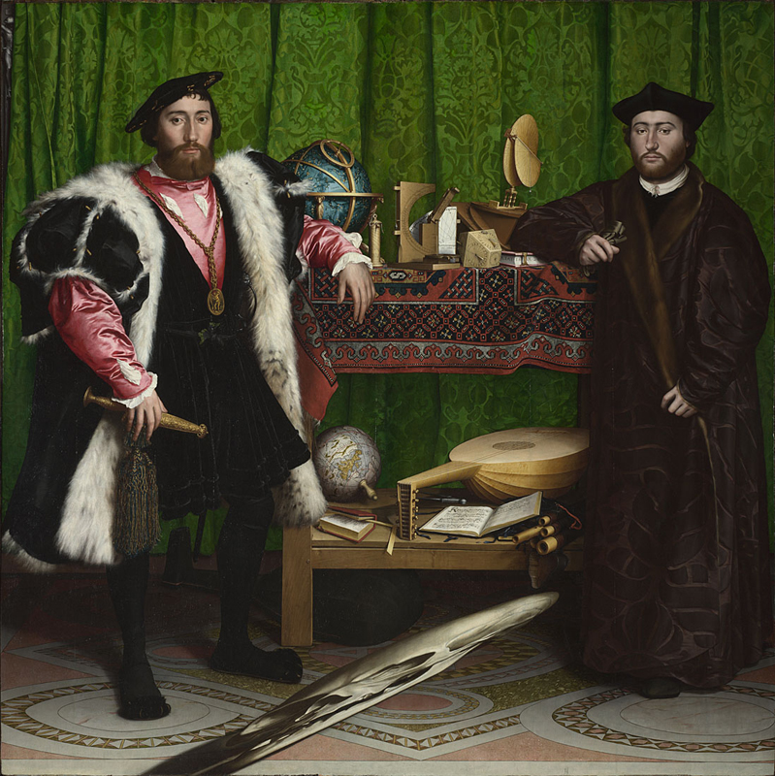
‘The Ambassadors,’ (1533) by Holbein (Dutch painter)

Slide 16
‘Rape of Europa’ by Durer (16th c.)

Slide 17
Representation and Power
Civilizations and cultures try to erect boundaries to highlight their uniqueness.
But a more careful look reveals that civilization is high and mighty when it has confidence to borrow, adapt, and internalize other/culture/differences.
Same for the US, Chinese, Islamic Empires.
Power at its peak when borrowing from elsewhere and internalizing.
Europe’s ‘awakening’ is imbricated with Eastern origins (Africa, Egypt Persia) and contacts; not just about Ancient Greece and Rome.

Slide 18
British Museum: Persia Exhibit

Slide 19
New exhibition at the British Museum: Inspired by the East: How the Islamic world influenced western art
<https://www.britishmuseum.org/whats_on/exhibitions/east.aspx>

Slide 20
(Les) Femmes d’Alger (Women of Algiers)

Slide 21
Edward Said’s Orientalism, 1978

