Slide 1
The Middle East in the Interwar Period

Slide 2
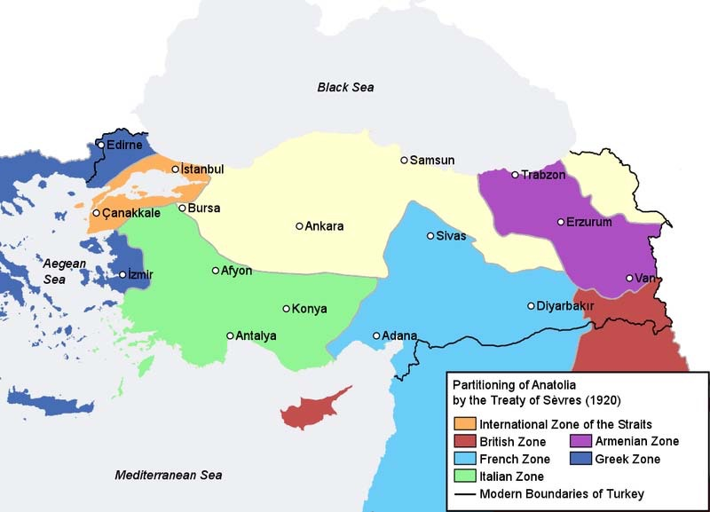
Turkey
Constantinople occupied by Allied troops
Aug. 1920, Ottoman Empire capitulates at Treaty of Sevres -----------------------------------→
Southwest Anatolia for Italy and France
Armenian state in eastern Anatolia
Southeast of Anatolia for Kurds
Greece gets ‘European’ part of Turkey (Thrace), west of Constantinople and allowed to take Smyrna/Izmir
Turkey must pay reparations to victors in money and land

Slide 3
Turkey, cont’d
Mustafa Kemal, Ataturk, 1881-1938:
Founder of modern Turkey, est. in 1923
Military commander
Born in contemporary Greece
Important role played at Gallipoli campaign and in Syria
Led force, after treaty, to roll back and recapture Izmir from Greeks
Grand National Assembly: local notables and parliament to represent population’s will
1922 abolishes the Sultanate (to Malta); Abdul Majid II caliphate is abolished in 1924
Armenia divided between Turkey and Soviet Union
Anatolia is freed of foreign troops
Conclude: Marks the end of multi-ethnic empires toward one ethnic nation-state (self-determination).

Slide 4
Turkey: Erasing the past
We see the rehabilitation of ‘Turkish’ language with conversion to Latin script: ‘Language reform society’ to cleanse the language of borrowed Persian and Arabic words.
Waqf nationalized
religious schools closed down
secularism pursued relentlessly, public religious displays banned to wipe out the past
Ulama no longer has any influence on the state
As Ottoman officer and product of Ottoman reforms, Kemal grants rights to women in education, though framed as a product of break from this past; right to vote granted in 1934

Slide 5
Ethnicity and what happens to minorities
Compare to partition of India (Muslims/Hindus), being on wrong side of borders: e.g. Greeks (1.3 million in Anatolia (Smyrna, Constantinople), speaking Turkish and Orthodox Christian); Turks constitute 400,000 in Greece (Salonika) speaking Greek but Muslim.
Resolved through a population exchange to fit ethnic framing of the nation-state.
1915, Armenians in genocide (claims over 1 million lives) because thought to be supporting Russians, forced to march to Syria. The claim is challenged by Turkish government as ‘byproduct of war’ rather than a systematic policy of eliminating the population.
Kurds: also suffer harsh subjection to cultural policy that prevents Kurdish speaking language, etc.

Slide 6
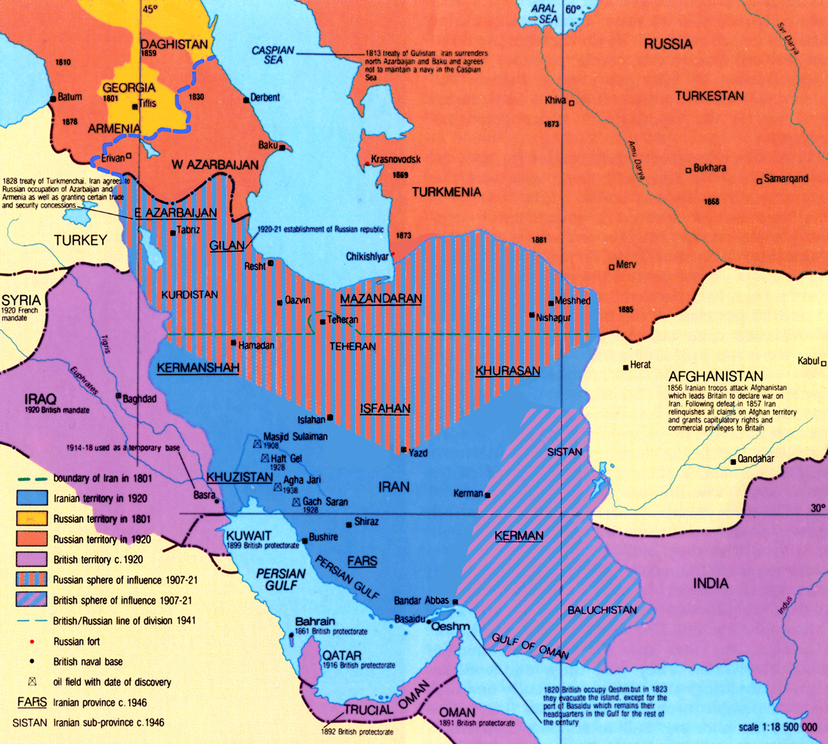
Iran
During WWI, divided into 2 spheres (British in the south, oil) and Russians in the north.
Concern about Bolshevik presence and influence in the north
Reza Khan, officer like Ataturk, head of battalion, Russian trained Cossack brigade
Khan declares himself minister of war in 1921, British backed
Crowned the Shah (king) in 1925; End of Qajar period and start of Pahlevi
Reforms: industrialization and modernization; not believer of constitutionalism; establishes self as centralizing force on provinces and semiautonomous tribes; conscription imposed by 1926

Slide 8
Egypt
Anticolonial movement through WWI
1919 Peace Conference where Egyptians want delegation but stopped by the British (Saad Zaghlul stopped and arrested!; becomes future national leader)
Triggers revolution against British occupation and actions; quelled but at a cost
Zaghlul stops exile; to London with case for independence; Egyptian monarch declared king;
British declare Egypt independent in 1922 with strings attached: 1) Suez Canal under British troops remains; 2) Egypt not free to conduct defense policy and must consult with GB first
1922-52: Political deadlock because constitution and division of power into three: Wafd-delegation, Parliament; palace with Fouad; British mission. British have upper hand to intervene in affairs, approve and disapprove. But flourishing effects too in art and culture.
Conclude: Most of reforms of the 19th c. were the result of military reforms and not a coincidence that emerging officer leaders are a product of these reforms and a product of this past.

Slide 9
Interwar Arrangements
King-Crane Commission, 1919 (sent by Paris Peace Conference):
Arabic speaking population are against European control, especially French control, but favorable to the US.
‘League of Nations’ contradicts the commission and instead of granting independence to Arab peoples, decided to parcel out the area into 5 different countries, to European countries as:
Mandate:
People in the region are entitled to self-determination but not yet ready and in order to prepare, will be under the tutelage and jurisdiction held by Britain and France to rule until ready for self-rule.
British are mandate power to Iraq and Palestine and French to Syria
Conclude: same old-fashioned European imperialism/colonialism
Instead of colonies, as in long 19th century, we have mandates (patronizing): people are entitled to self-rule but ‘not ready’: holding elections and building institutions to result in assemblies of self-government.

Slide 10
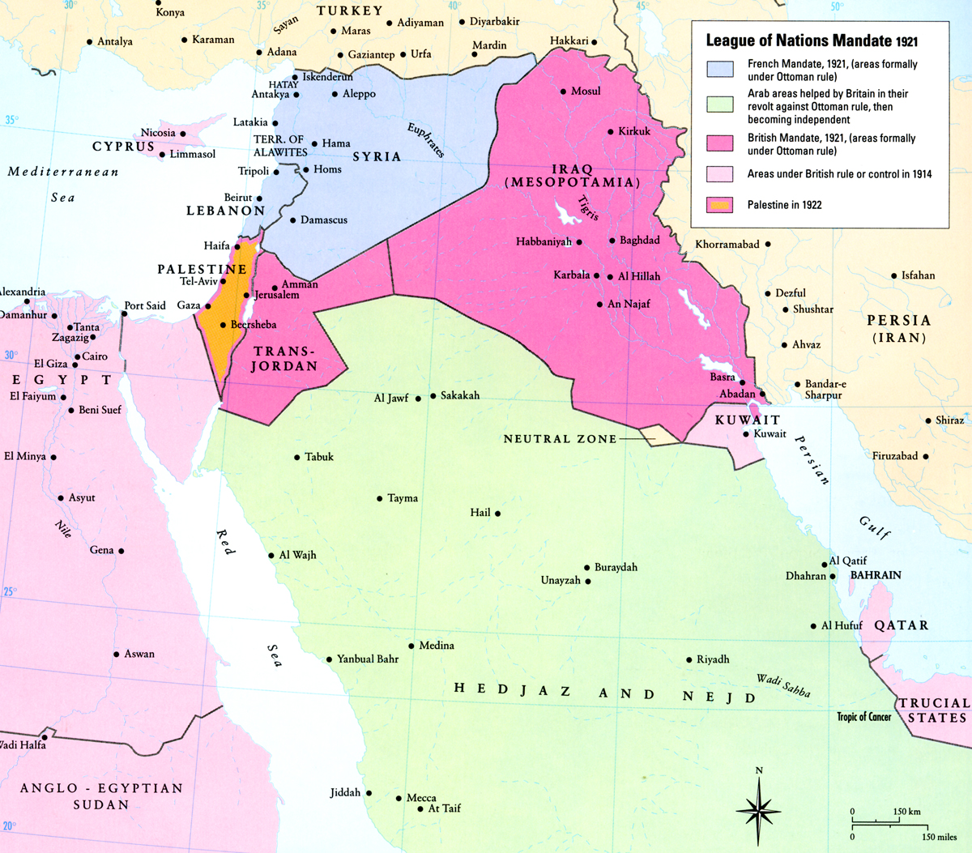
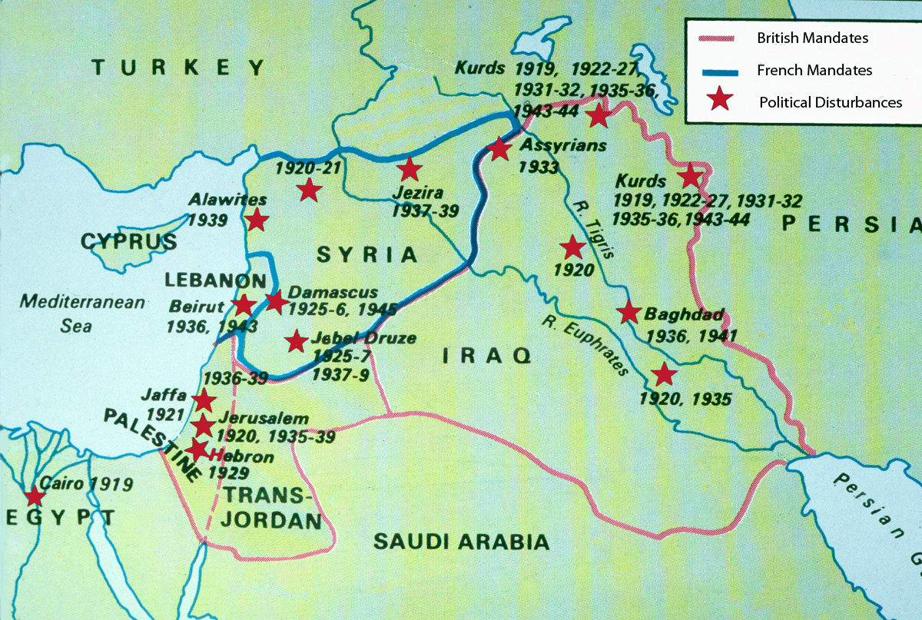
Mandates (British and French)

Slide 11
1920-22, Consolidating the Map
Britain: Iraq; Transjordan; Palestine, within conditions for mandates, also requires implementation of Balfour Declaration, allowing for creation of national Jewish homeland and migration, thus, embedding a contradiction in the mandate itself.
Hashemites: Prince Faysal ends up in Damascus and becomes ‘King’: short-lived mandate because of agreement for France to take over Syria as mandate power.
Iraq (provinces of Basra, Mosul, Baghdad): in WWI, British land at Basra and expanded north through Baghdad and Mosul. Armed resistance in central Iraq, led by ruling Shi’a clerics of Najaf and Karbala, which was quelled at the end of 1920. Over 6,000 Iraqis died, allowing the old Ottoman Sunni order to be restored.

Slide 12
How to Rule? Direct v. Indirect
Gertrude Bell: Oriental secretary to British civil commissioner:
Iraq should be governed by a king, Faysal, 1921-33. British national anthem for a British king.
She spearheaded establishment of the National Museum of Iraq, which was pillaged after the American takeover in the 2000s.
Transjordan/Jordan:
Winston Churchill and Emir Abdullah in Jerusalem, mandate est. in 1921, and made king.
Hijaz:
King Ali, third son of the Sherif Husayn of Mecca, 1924-1925 when deposed by Ibn Saud.
Conclude: All under the impression that the country will be independent but the borders are ambiguous.

Slide 13
Do these arrangements constitute ‘self-determination’, especially from the view of local Arab population?
Region west of Damascus, Lebanon, or Palestine = unclear borders. Rulers; Intermediaries; Masses.
Palestine: Size of today’s Israel/Palestine, approximately size of US state of New Jersey
Agricultural production of olive oil, soap, citrus; notables. Similar impact of Ottoman agreements opening Levant to European trade.
By end of 1918, brought under single British-administration; mandate confirmed at San Remo, 1920.
Muslim-Christian Association (notables) as a nationalist forum.

Slide 14
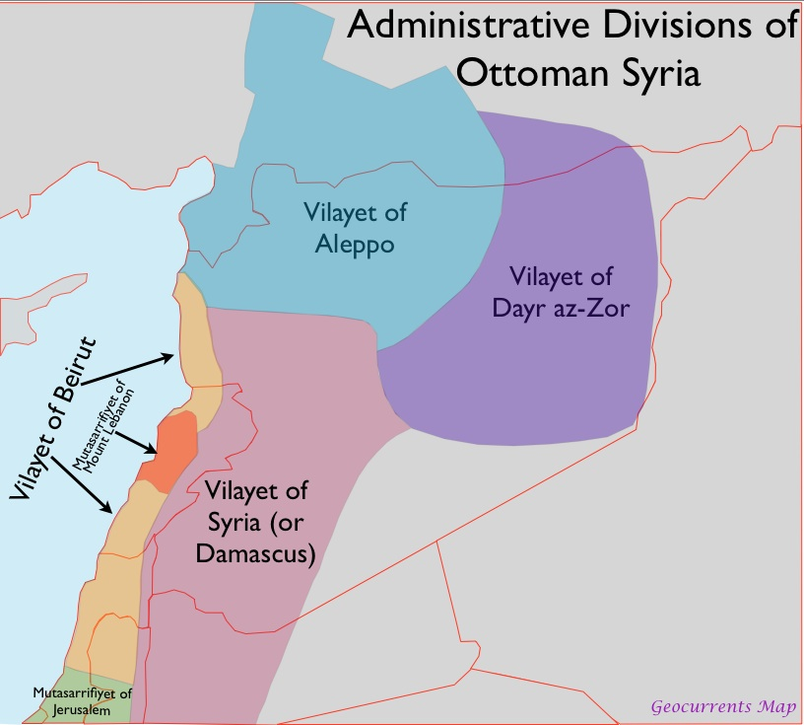
Mount Lebanon, 19th c.

Slide 15
What happens in Palestine?
Key transformations in late 19th- early 20th c.:
1856-58 land reforms: stabilize and regularize land tenure system; title to individual owners creating large landowners; enables control of sheikhs through taxation of land.
2nd half of 19th century sees transformation in development of citrus industry along coastal regions: Jaffa orange. Brings wealth to Palestinians, employs large numbers of labour and development of ports.
Railway system linking cities along the coast.
World financial depression 1873-78 creates debt crises.
Rise of schools, newspapers, intellectual class; different political identifications.

Slide 16
Zionism (messianic form)
Later third of the 19th century, idea emerges that Jews throughout the world should return to Zion or Jerusalem with a messianic connotation of redemption, which is an old idea.
Refers to exile of Jews from 1 C.E.
By 1850, Jewish Palestinians not more than 5% of the population; many of whom ‘Zionists’ in the sense of making the pilgrimage to Zion/Jerusalem, to die, to live in Jerusalem.
Majority religious tied to land for religious reasons

Slide 17
Zionism: Secular Political Movement
Transformation product of developments in the West (France) and Eastern Europe (Russia).
Russian Jewry: persecuted in pogroms 1871-1906 which were state orchestrated attacks against Jews and conscription. The ‘pale’.
Alex II Czar: Russian revolutionaries assassinate him in 1881.
Rumor it was Jews is false. Wave of anti-Jewish riots in 'Pale of Settlement’ from 1881-84 = ‘pogroms’.
Institutionalized reprisals to punish Jews; expelling out of Moscow; pauperization of rural communities --> rise of anti-Semitism
European Jewry: in spite of advances in liberal thought, argued that Jews killed Christ. During Crusades, most of victims were Jewish and eastern Orthodox Christians not Muslims, especially in Constantinople.
French Revolution 1789: Equality, citizenship, civil law, liberal democracy; fiercely secular. Not subjects but citizens dealt with on an equal footing by the state.
Anti-Semitic theme ensues in France (e.g. Franco-Prussian war, 1870-71, defeat of France, take out reprisals on Jews)
Still see discrimination by virtue of religious marker in spite of ‘equality’ ideal: Alfred Dreyfus: officer wrongly accused of treason for Germans; convicted and sent to penal colony; protested by Emile Zola in ‘J’accuse’ French society of racism and anti-Semitism

Slide 18
Theodore Herzl, 1860-1904:
Jews took these developments as a sign of the end of assimilation in European society
Founder of political Zionism; covered the Dreyfus affair; argued that aim of the state is for it to be Jewish; concept of proprietorship is central to notion of nationalism.
Jews represent a people bound together by common ancestry reading of Jewish future, not past, by reading alternative Jewish past.
Conflict today is not about the past but about future and conceptions. 19th century European history is product of triumph of European nation state peoples; ethnicities should belong to nation-state not multiethnic order and reflects one ethnicity, language, religion, homogenous unit of political entity, the state.

Slide 19
Zionism and Anti-Semitism
Jews are dispersed in the world according to orthodox Jewish rabbis who thought political Zionism was blasphemous, including the migrants to Palestine.
1900-1949: Herzl convenes first Zionist Congress in Basel, Switzerland
State to be in Palestine within Ottoman Empire at this point
Create Jewish National Fund and use to buy land in Palestine
Argument with Great Powers to leave Palestine to Jews
Forge new Jew: especially for those in western Europe. Not passive eastern Jew but assertive, aggressive, deeply secular idea of Zionism
Pushing for granting pieces of land (Pope, King of Italy, Kaiser Wilhelm) all approached by Zionist leaders asking for piece of land; also in Africa (Uganda and Kenya).

Slide 20
Politics of Zionism, cont’d
No solution to Jewish question
Similar assumptions about looking down on old Jewish religious communities (especially eastern Europe) and their practices; ‘Ghettos and Shtetls’ are medieval and backward; we need a new secular Jew
There were always Jews living in Palestine (Jerusalem and Hebron) as a small minority of 5% of the population.
1850-1919: 400,000 Muslim Arabs
42,000 Christian Arabs
13,000 Jews (Arabic speaking)

Slide 21
1914-1917
1914: rises from 5% to 12% or 80,000 Jews but also 600,000 for Christians and Muslims
Lord Balfour and Rothschild make Declaration backing Zionist movement, Balfour Declaration, 1917: ‘National home for Jewish people.’
Promises of political freedom for Palestinian Arabs not contained in the Declaration: protection of ‘civil and religious rights of non-Jewish population in Palestine’.
Arab majority of 90% in Palestine (Cleveland).

Slide 22
Israel Zangwill, 1864-1926
Jewish English writer, ‘land without a people to a people without a land’
Early mechanical logic; ‘fit the gem into the ring’

Slide 23
Chaim Weizmann, 1874-1952
World Zionist Org. member
Zionism: Jewish people have no country
Must unite with ‘land without people’ and convince owners (Ottomans) of ‘country’
Head of World Zionist Organisation (London)

Slide 24
How to explain popularity of the slogan?
1) Zionists needed slogan cynically to sell idea of immigration to Jews
2) Jews belong to Zion, from which evicted 2,000 years ago; diaspora history must be erased; land of Palestine given by God to Jewish people = religious tendencies within secular Zionism.
3) Inherent connection between people and land. Whoever is there is irrelevant; not essential; just accidental.
Local population can move elsewhere because they do not constitute ‘a people,’ not individuals, following nationalism logic, connected by ethnicity, language, blood ~ German nationalism in late 19th c. also connected to woods and landscape rather than law.

Slide 25
David Ben-Gurion, 1886-1973
Zionist leader and first prime minister of Israel
Notion from 1930s-40s of ‘transfer’ or relocation or ethnic cleansing
Locals will welcome technology of capital and ideas that Jews would bring – not really true
If there is politically conscious Arab, he will protest Jewish state if he knows math. We are foolish to think Arabs unaware of impact of migration.

Slide 26
Vladmir Jabotinsky, 1880-1940
For left wing Zionists to think Arabs would welcome European Jews is ridiculous
‘Revisionism’ – Palestine Mandate (for Balfour) has to be revised to unite Palestine both east and west of the Jordan River, incorporating region of Transjordan. Early 1920s increasing popularity.
Arabs: every local person will resist alien settlers and as long as they have hope to protect Palestine from the Jews.
Said that Zangwill told him it was foolish to let country be of ‘two peoples’ and must find different place either for Jews or for neighbors because ‘mutual coexistence untenable’.

Slide 27
1931-35: Jewish migration to Palestine
Growth of Jewish immigration to Palestine; nearly 400,000 since WWI
Jump in migration in 1933 when Nazis come to power. People heed to calls of Zionism
But prior to rise in migration; tensions rising. Many confrontations with Arab Palestinian population in 1929, 1933, 1936.
Yishuv (Jewish communities) consolidated and much more stable.
Triggers 1936-39 Arab Revolt.

Slide 28
Peel Commission, 1937
Appointed to investigate motives for Arab resistance.
British: see folly of country for 2 people so cut country in half
Independent mandate sphere to Jerusalem with access to Mediterranean Sea
This marks the first time British acknowledge ‘Jewish state’ rather than a ‘national home’.

Slide 30
Hagana (‘Defense’)
Precursor to Israeli Defense Forces (IDF).
Jewish paramilitary defense organization formed in 1920 to protect Zionist settlers in British mandatory Palestine.
Already fighting between Jewish and Palestinians. British left. Palestinians had no time to develop under the British. Zionist Yishuv mimicked British institutions.

Slide 31
1939 White Paper
Outlines new (reversal of) policy:
Never been British policy to support creation of a Jewish state in Palestine; just a ‘Jewish national home.’
Instead supporting principle that Palestine should be an independent state (not divided or Jewish).
But, postpones date for Palestinian independence for another decade. Hopes that the acknowledgement will abate concerns of Arab side and wait until 1949.
Limits to be placed on Jewish immigration and extent of Zionist purchases of land for Jewish state.

Slide 32
1945-46/7
Jewish National Fund has bought land but not more than 10% of land surface of Palestine = still have majority of land not owned by Jews and the population is still predominantly Arab
From 10% in 1919 to 30% in 1939-40. Arab population in Palestine is still double that of Jews after WWII.

Slide 33
Keeping 2 mandate principles viable failed
1) Preparing country for self-rule - Failed
2) British pass laws against immigration, not one man/vote but quota system for Jews and Arabs equally represented in an Assembly – Failed
After WWII, Britain gives conflict to UN representative of international legitimacy, newly established (like League of Nations after WWI).
UN General Assembly meets in 1947 and decides to partition Palestine into two entities: Jewish (56%) land area or 490,000 Jews/320,000 Arabs and Arab (43%) 807,000 Arabs/10,000 Jews
Jerusalem put under international trusteeship to % population between Arab and Jews (100,000 Arabs and 105,000 Jews)
Yishuv (Jewish communities) are against this but Ben Gurion et al triumphed and see land disproportionately larger than proportion of Jewish in the local population. So, they accept.
Arabs reject the resolution. Understand the contested logic
UN Resolution 181 of Partition Accepted. So, mandate expires in 1948 and following day, May 15, 1948, Ben Gurion accepts UN 181 and declares founding of Jewish state of Israel.
US and USSR and others recognize state and Arab countries reject and declare war against Israel

Slide 34
1948 Arab-Israeli War (1)
Jewish jubilation
Palestinian exodus of refugees and now stateless people
Religious conflict; borders/water/state; but at core is Palestine Question of Refugees and Right of Return
Egypt; Transjordan; Syria; Saudi Arabia; Iraq; Lebanon attack new state to abort
Jewish troops and defense forces roll back attacks and extend borders of state beyond UN 181 borders (see Map), adding ‘Gaza’ and northern Palestine

Slide 35
Traditional Zionist Narrative
Arabs are responsible for what happened by rejecting UN resolution 181.
Before war, Arab armies invaded after mandate to strangle the infant state pitting a Jewish David (one army) against an Arab Goliath (7 armies)
Righteousness of the cause and principles explain triumph and after end, new state peaceful resolution but aims for Arab states intransigent and reject peace
Palestinians who left, did so because their leaders made them leave through radio and return after hostilities so Israel not responsible for eviction and tried to seek amicable solution

Slide 36
1980 revisionist narrative based on archives
Golda Meir (Yishuv) and Amir Abdullah (leader commander of Arab forces) made agreements about where armies should capture (just West Bank in return for Zionists not to cross over)
Reveal expulsion of 700,000 refugees to make Arabs a minority in the new state from 1914-1950. Product of war of fighting; Arabs did not incite villagers to leave
Benny Morris: birth of Palestinian Refugee Problem
His Critique: on refugees; this approach is too neat and ignores disparity of power between Arab armies and 1) IDF and 2) ‘transfer’ was an aim present not an unintended consequence but a policy to end, through war, with as little number as possible of Arabs because Jewish state with 315,000 Arab minority is too large to contend with.
Issue is the question of systematic policy or war; no simple incitement by leaders

Slide 37
Where are the 1948-49 Refugees?
300,000 Palestinians fled or driven out of Palestine before May 14, 1948. Additional 450,000 Palestinian refugees after.
700-800,000, now majority of Palestinian population diaspora reside in Lebanon, the Gulf, Syria, Egypt
Key Question: Who is responsible for the refugee problem?

