Slide 1
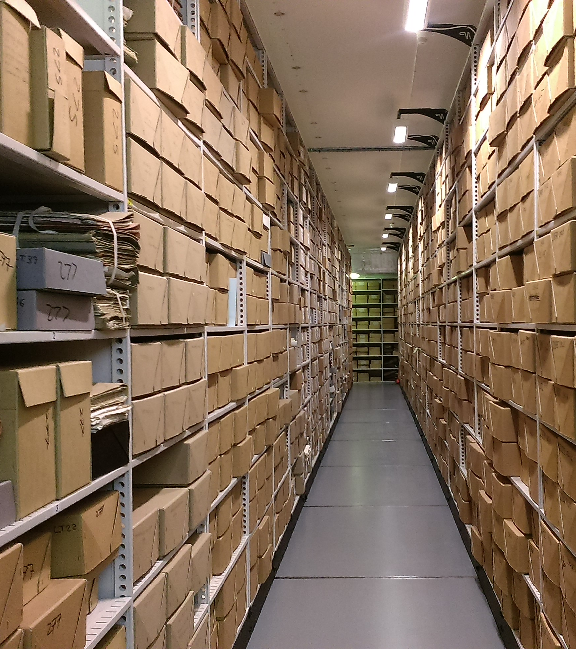
Archives & Your Research
Modern Records Centre

Slide 2
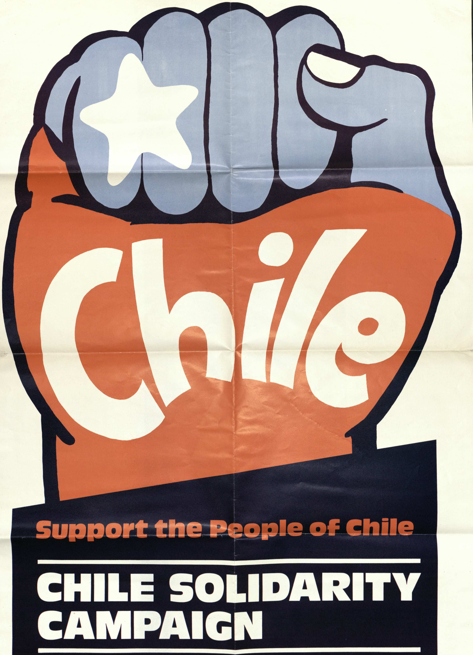
Today’s session
Key points about archives: context and provenance
Different sorts of documents you may find in archives
Handling do’s and don’ts
Overview of Latin American sources: https://warwick.ac.uk/services/library/mrc/research_guides/latin_america/
Study of selected sources

Slide 3
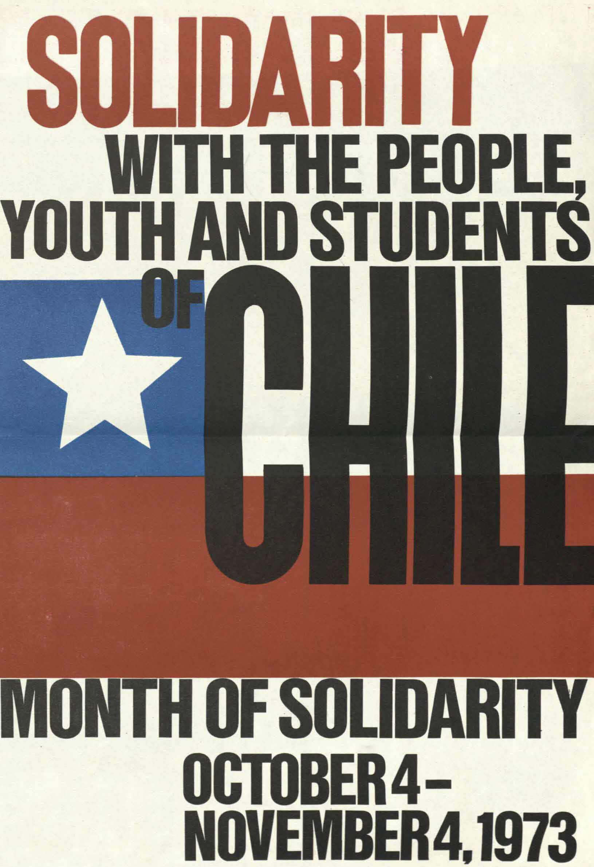
Context
What do we mean by context?
Why is it important?
Who, what, when, where, why?
Names of people, places, organisations
Dates, events
Broader societal and historical context

Slide 4
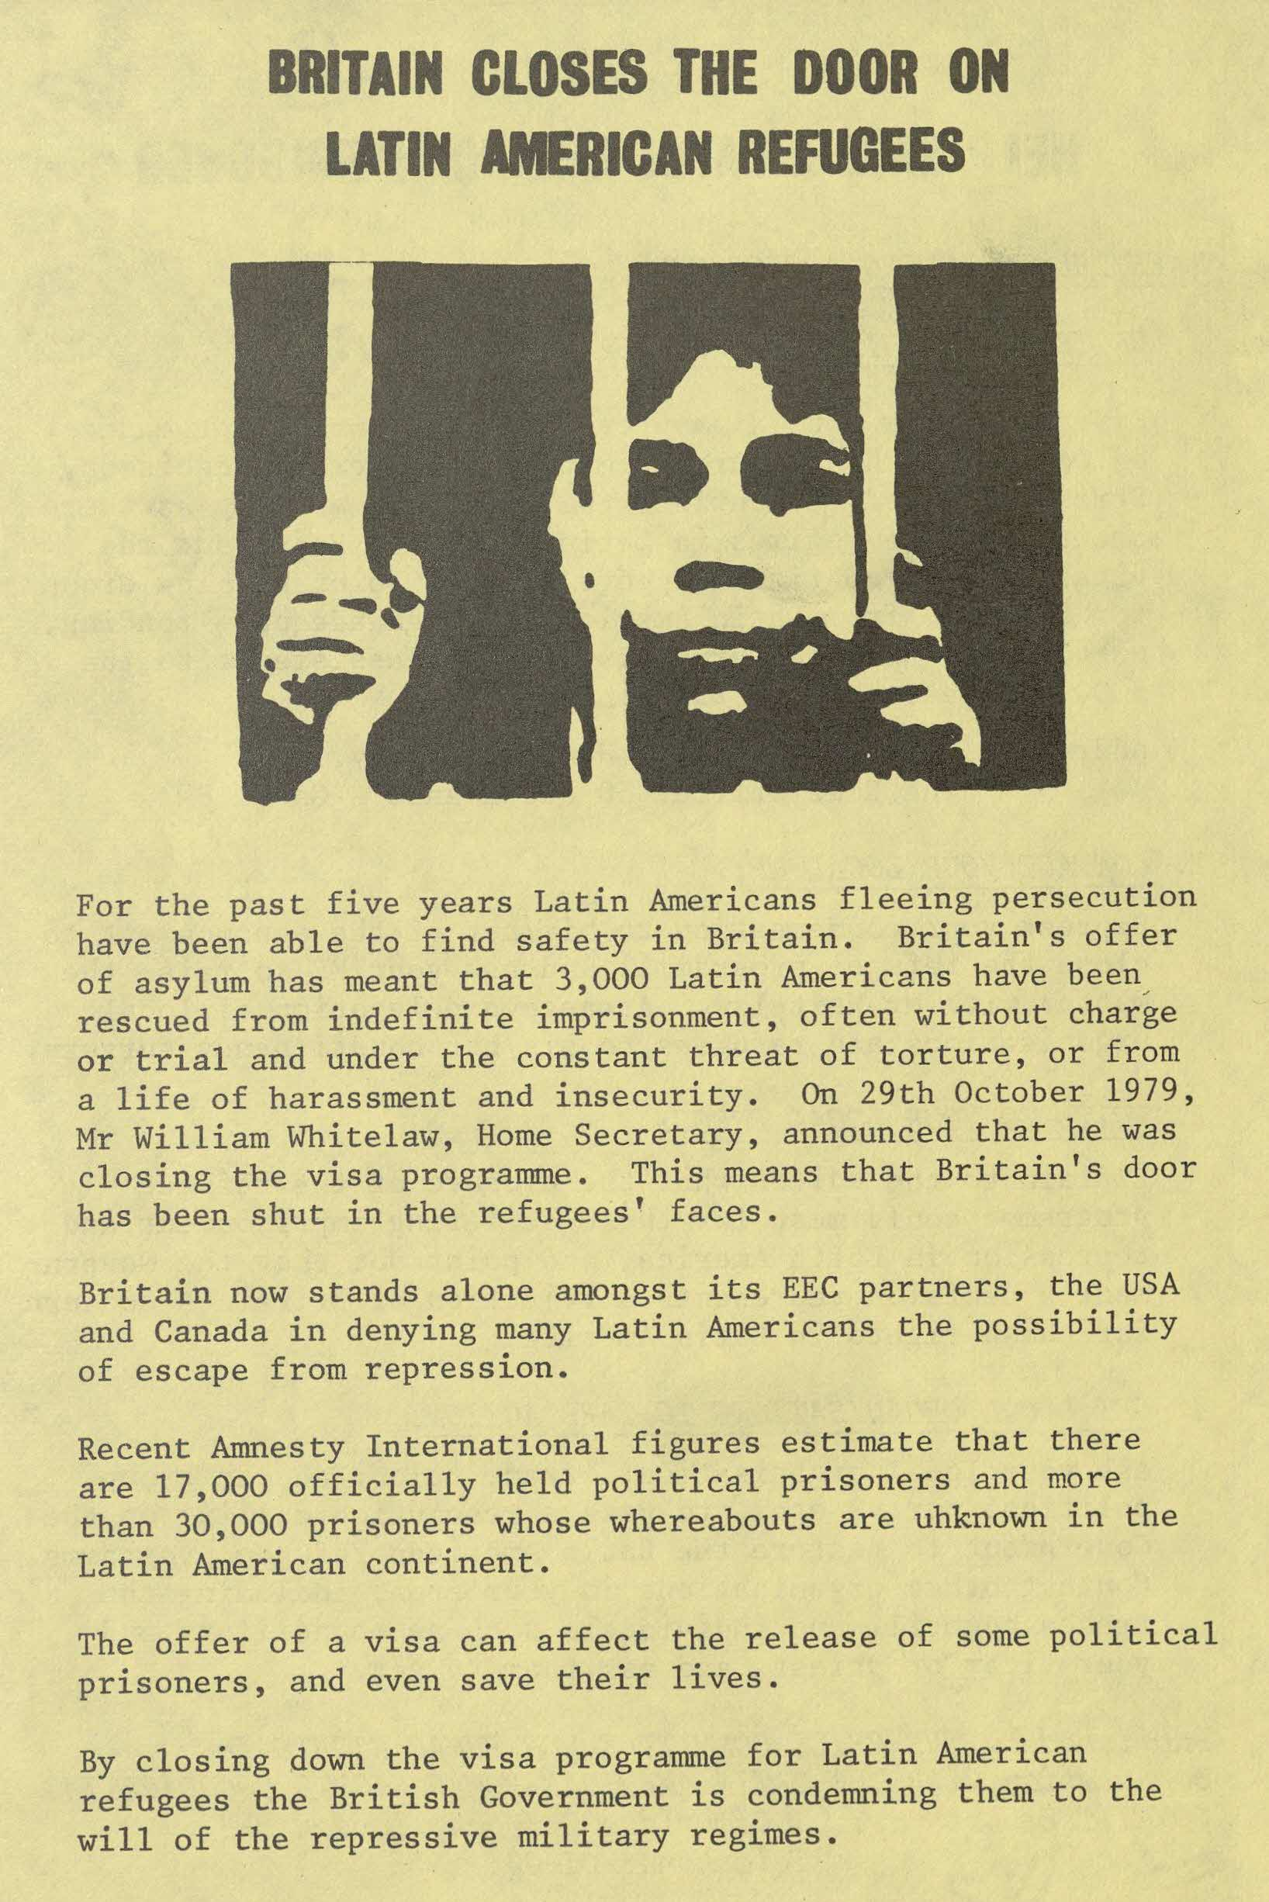
Provenance
Context within the archive: who owned it, how did the archive acquire it?
Where the document sits in the Catalogue’s hierarchy:
Collection -> Series -> Sub-Series -> Item
Can lead you to other relevant documents
What does provenance mean?
Why is it helpful to understand this?
https://mrc-catalogue.warwick.ac.uk/records/WUS/2/1/3/5

Slide 5
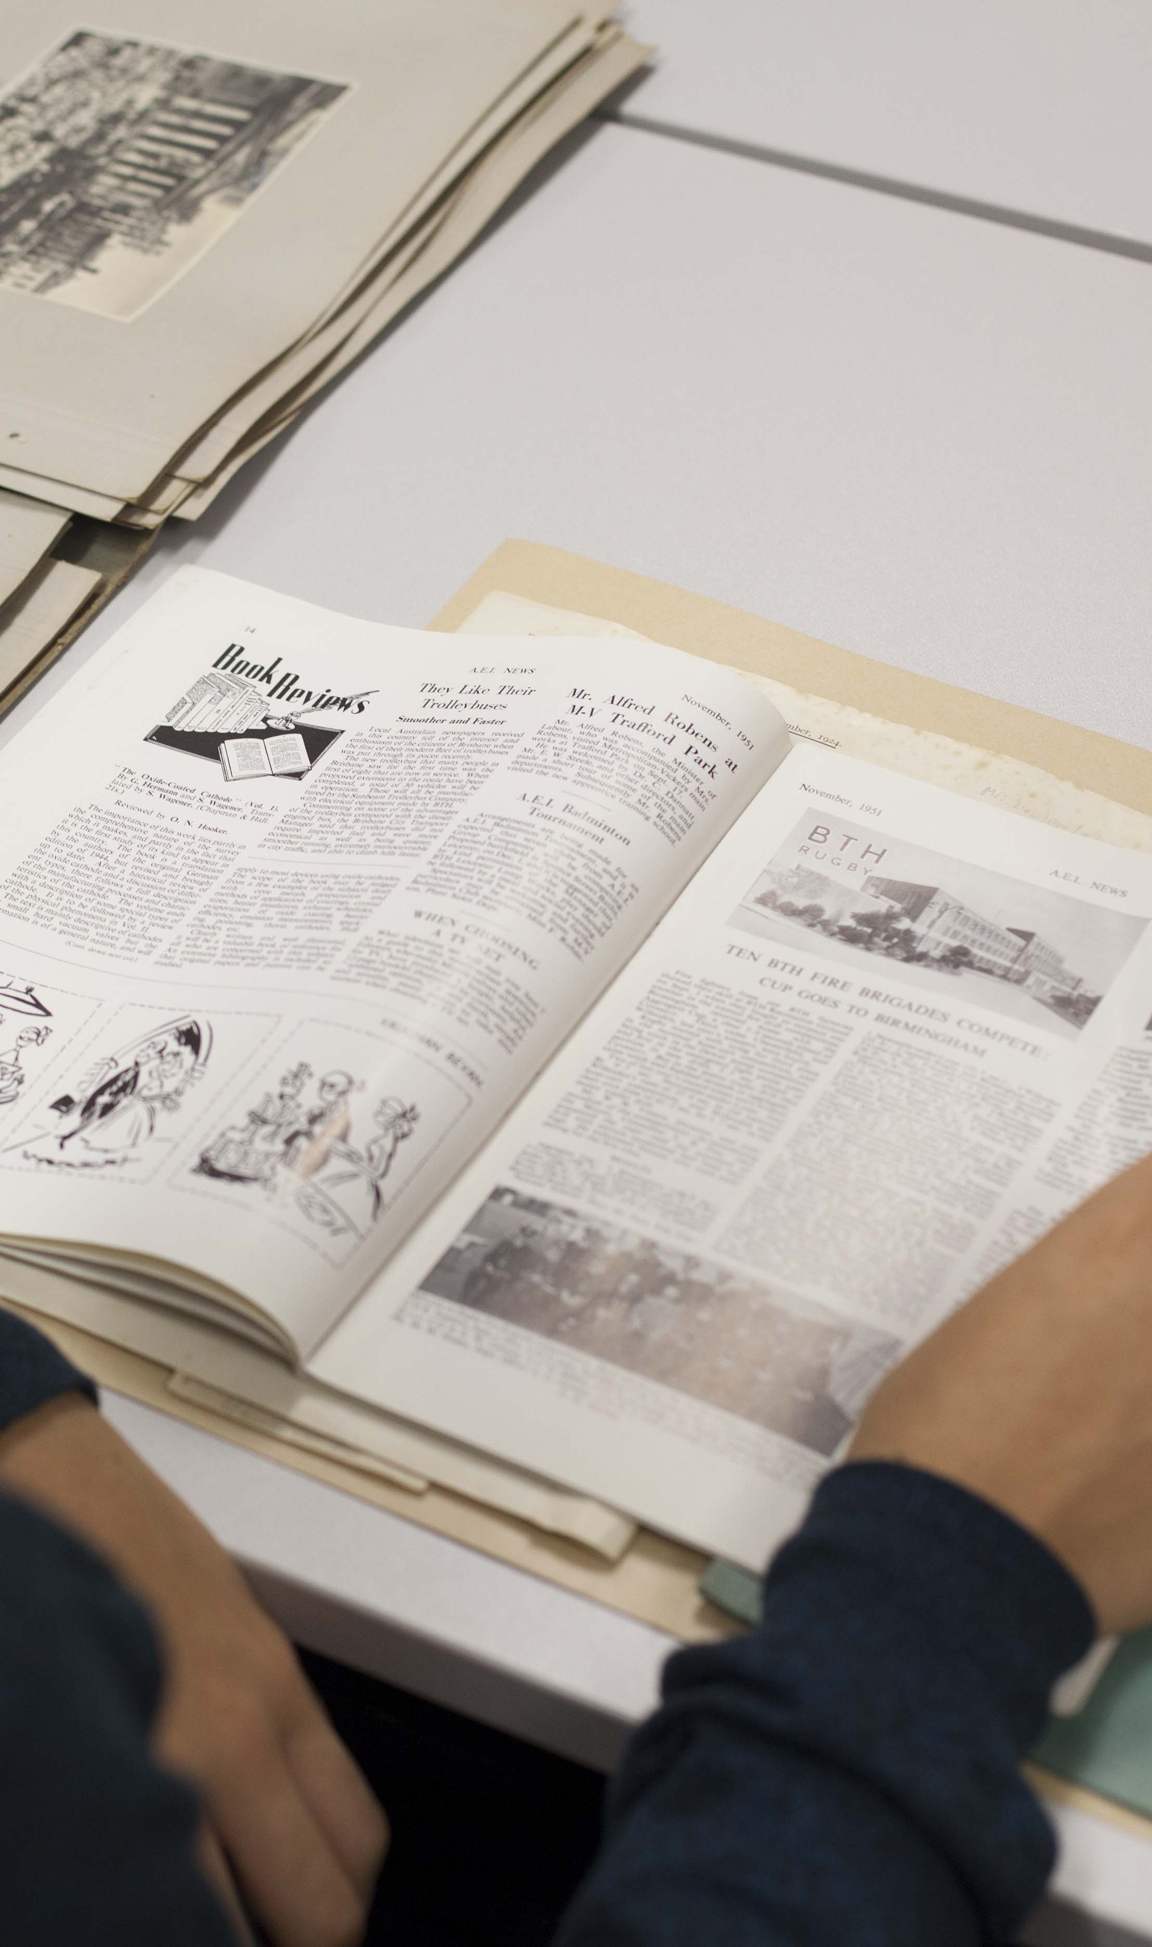
Some of the many different sorts of documents found in archives
Deeds/legal documents
Minutes and other internal communications
Personal diaries and journals
Letters (personal and official)
Pamphlets, leaflets, ephemera
Journals, newsletters, newspapers, zines
Official reports and publications
Photographs, paintings, videos
Obsolete/outmoded media
Digitised and “born digital” archives

Slide 6
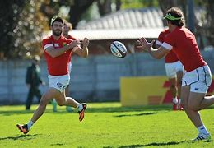
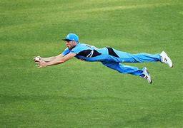
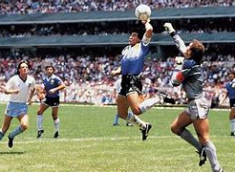
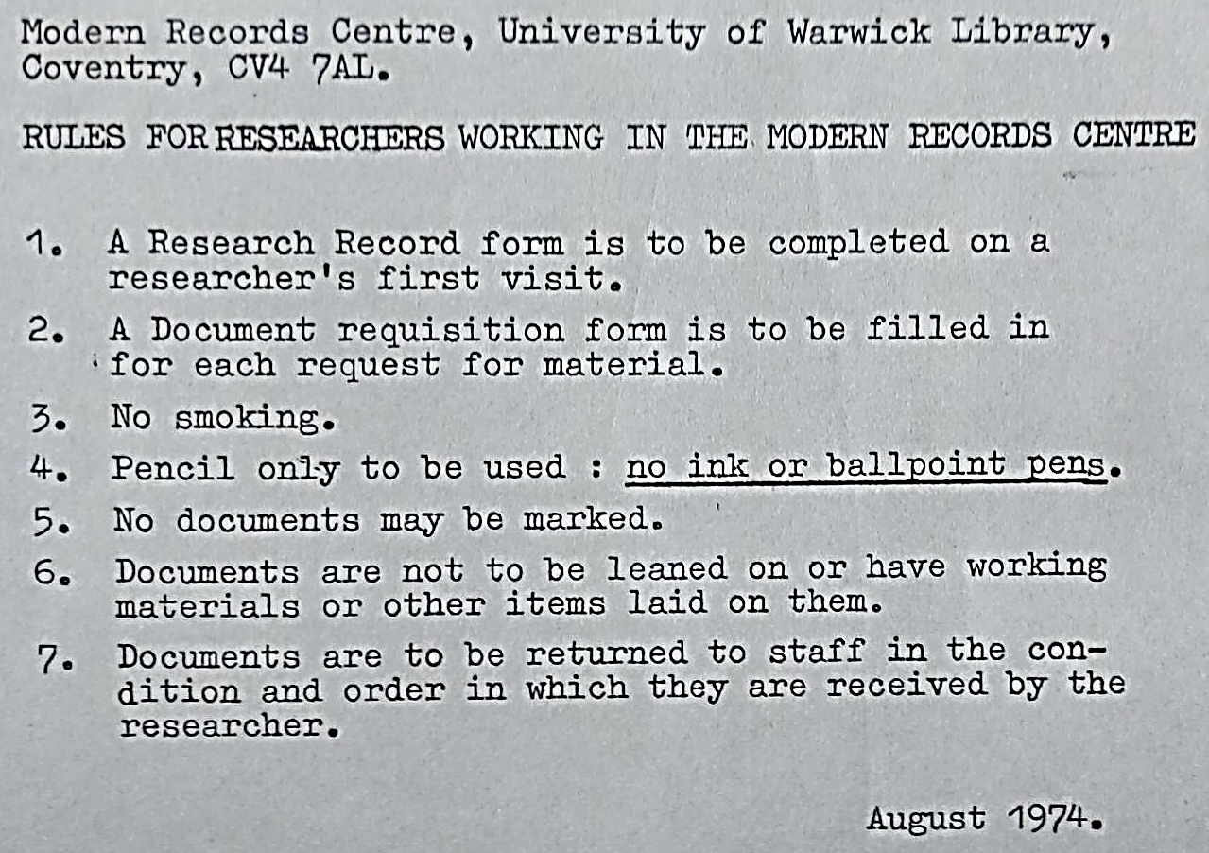
Handling do’s and don’ts
No pens, drinks, or food near the documents
Make notes in pencil or on your computer
Follow archive’s rules re photographs/scanning
Ensure hands are clean and dry
No leaning on the documents
Do not crease or fold or mark the documents
Do not alter the order of documents within a file, or the order of files within a box
Use gloves when handling photographs
Use weights, cushions, and rests when required

Slide 7
Latin American sources at the MRC
https://warwick.ac.uk/services/library/mrc/research_guides/latin_america/

Slide 8
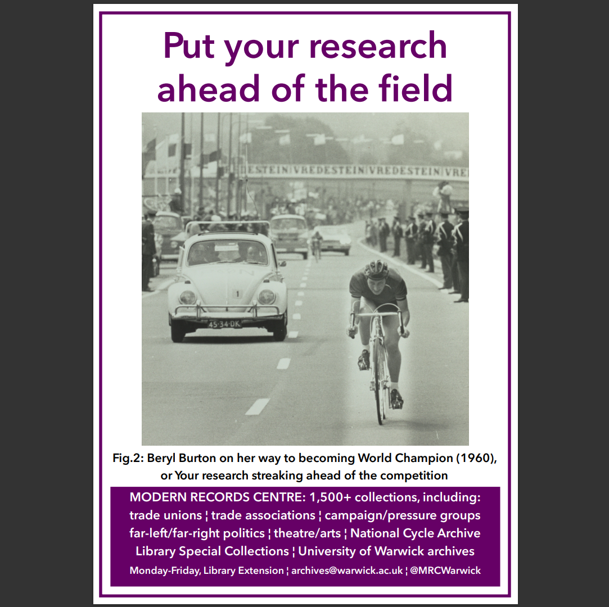
If you build it…
archives@warwick.ac.uk
@MRCWarwick
Behind the Library, 09.00-17.00 Mon-Thurs & 09.00-16.00 Fri

