Slide 1
Latin America Today

Slide 2
During the 1990s, Latin America became a model for post-Cold War development
Left-wing activists lauded
Cross-class social movements
End of military dictatorships
Movements for indigenous rights
Growth of the Latin American left (Evo Morales in Bolivia; Hugo Chavez in Venezuela; Luiz Inácio Lula da Silva in Brazil)
Right wing political scientists like Francis Fukuyama lauded
Eradication of trade barriers (Neoliberalism, NAFTA)
Establishment of pluralist democracies
Opening up of media

Slide 3
2000-2021: What happened?
1) Crime and Homicide
The Latin American and Caribbean region is home to nearly 9% of the global population but accounts for over 30% of the world’s homicides.
Seven of the 10 countries with the world’s highest homicide rates are in the region
Of the 50 cities with the highest rates in the world, 43 are in Latin America or the Caribbean. (2017)
Homicides measured as homicides per 100,000 of population. Cities on list have homicide rates of around 100 per 100,000.

Slide 4
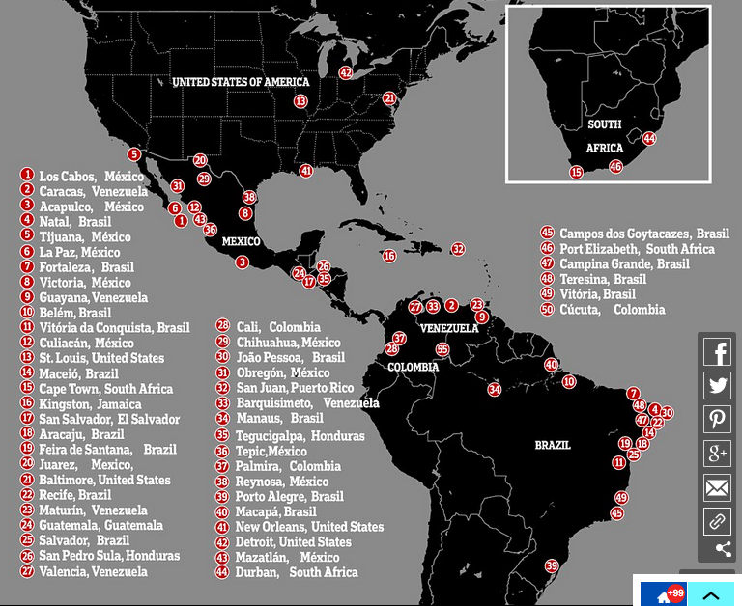

Slide 5
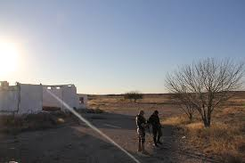
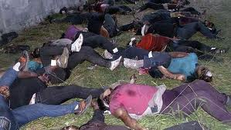
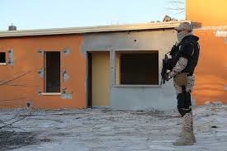
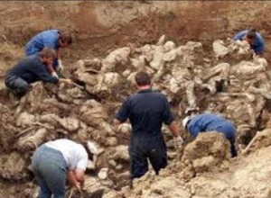
Tip of the iceberg: Disappearances

Slide 6
Why?
Economic factors
High unemployment
Low rates of economic growth
High rates of inequality which generates high consumer demand and limited means to fulfill this demand.

Slide 7
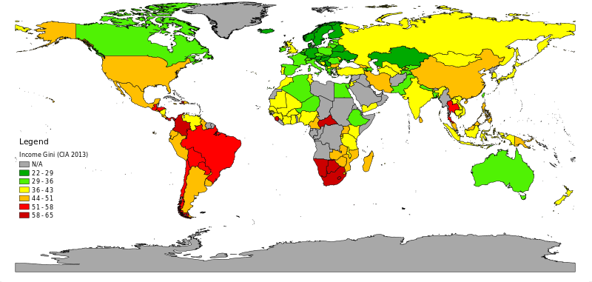
Global GINI Coefficient

Slide 8
2) The Legacy of the Cold War
1) Civil wars left Latin American countries with paramilitary organizations intact (e.g. Kaibiles in Guatemala; United Self-Defense Forces of Colombia)
2) Civil wars also left states with limited state apparatus. Many areas of the countries were simply off limits for state institutions (Colombia under the FARC; Peru under the Sendero Luminoso)

Slide 9
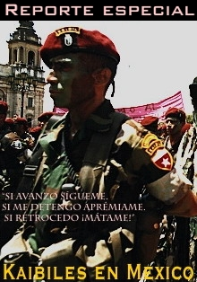
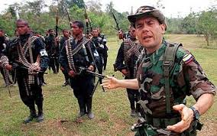

Slide 10
3) Proximity to the United States.
1) United States is still the largest market in the world for illegal narcotics. Despite antidrugs measures, in the last decade, drug use has risen. (Worth an estimated $100 billion)
2) United States is also large exporter of high caliber automatic weapons.

Slide 11
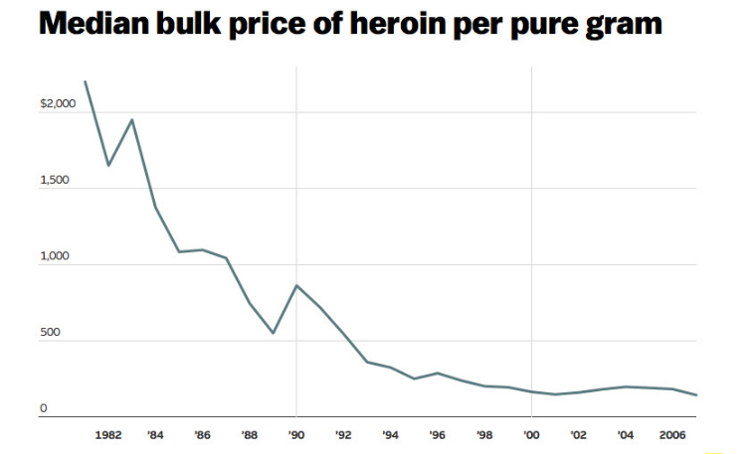
e.g. United state opium epidemic

Slide 12
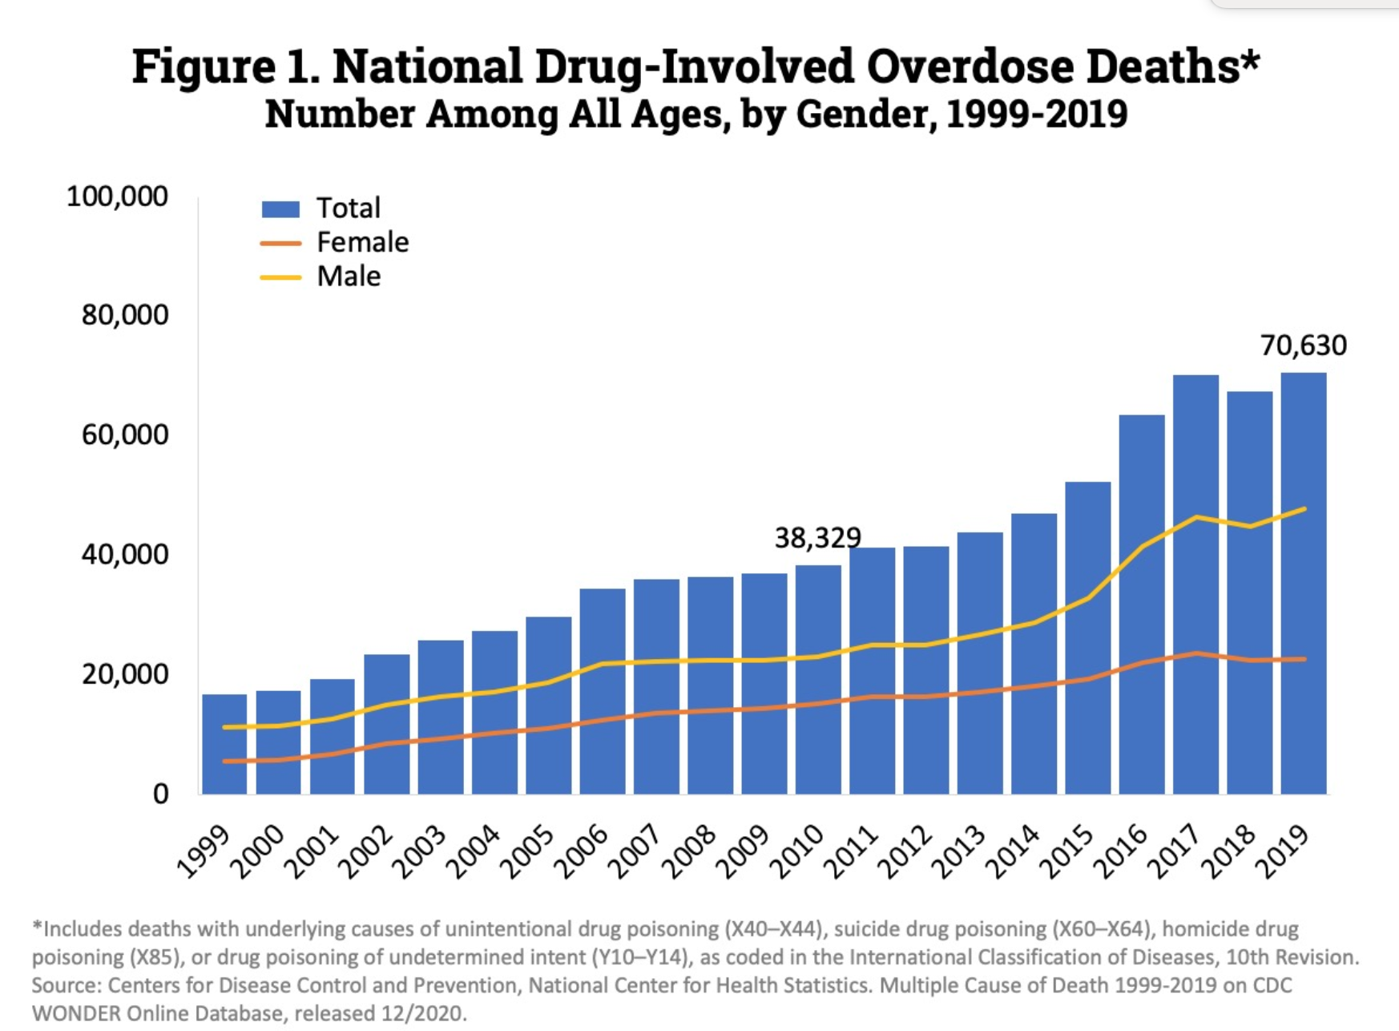

Slide 13
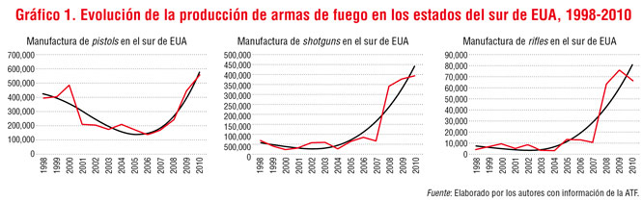
Gun sales vs homicides in northern Mexico

Slide 14
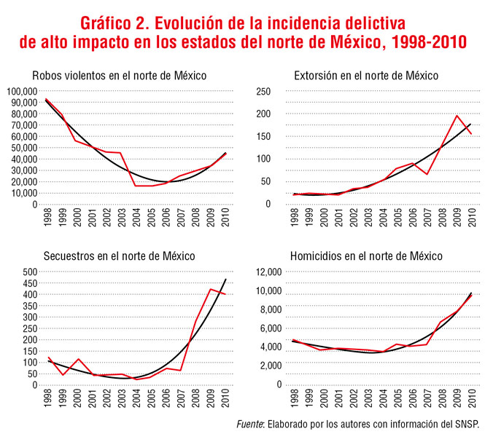

Slide 15
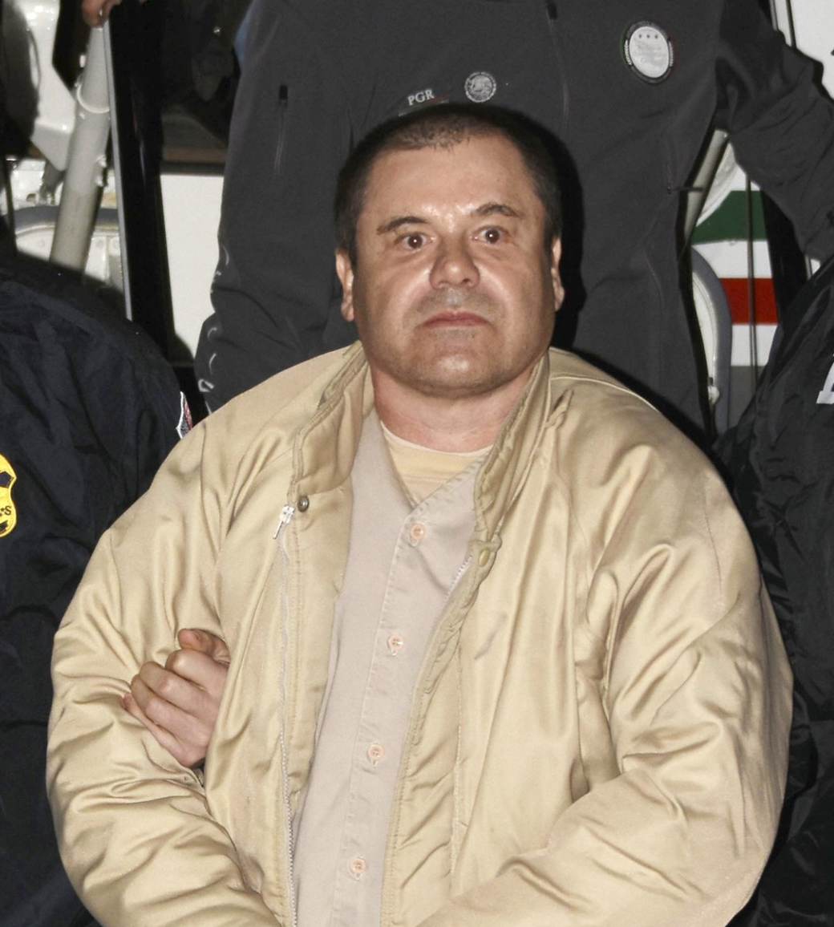
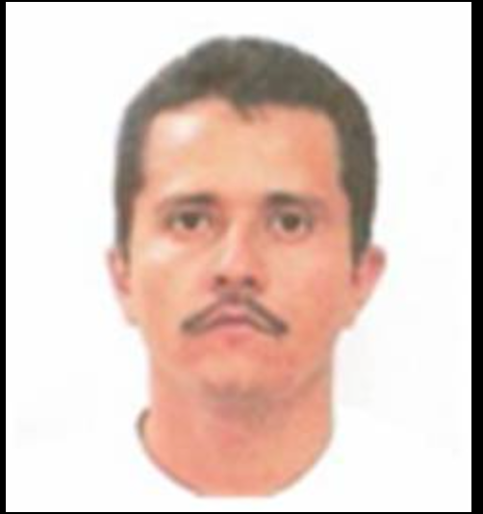
Growth of transnational drug organizations

Slide 16
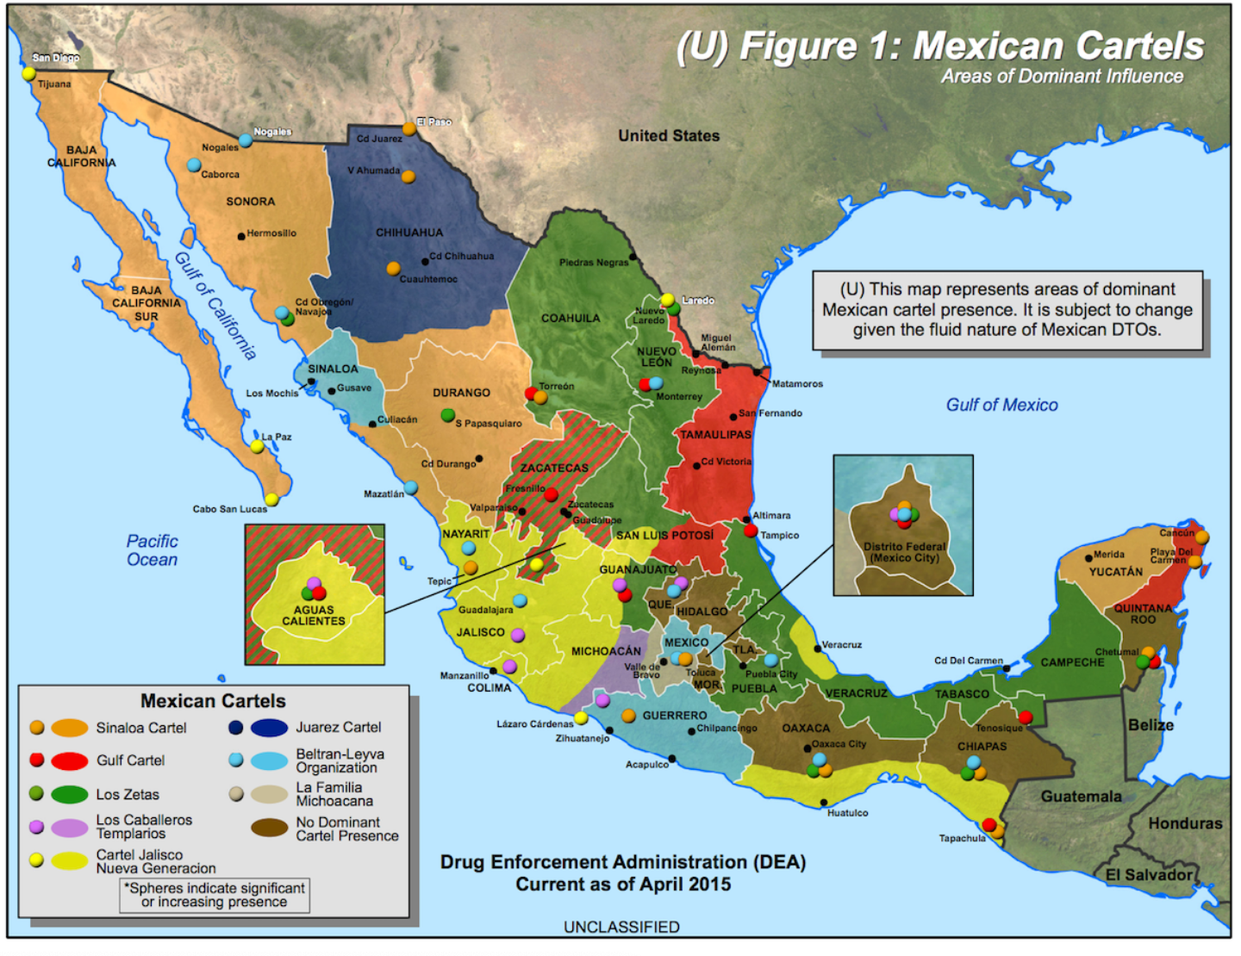
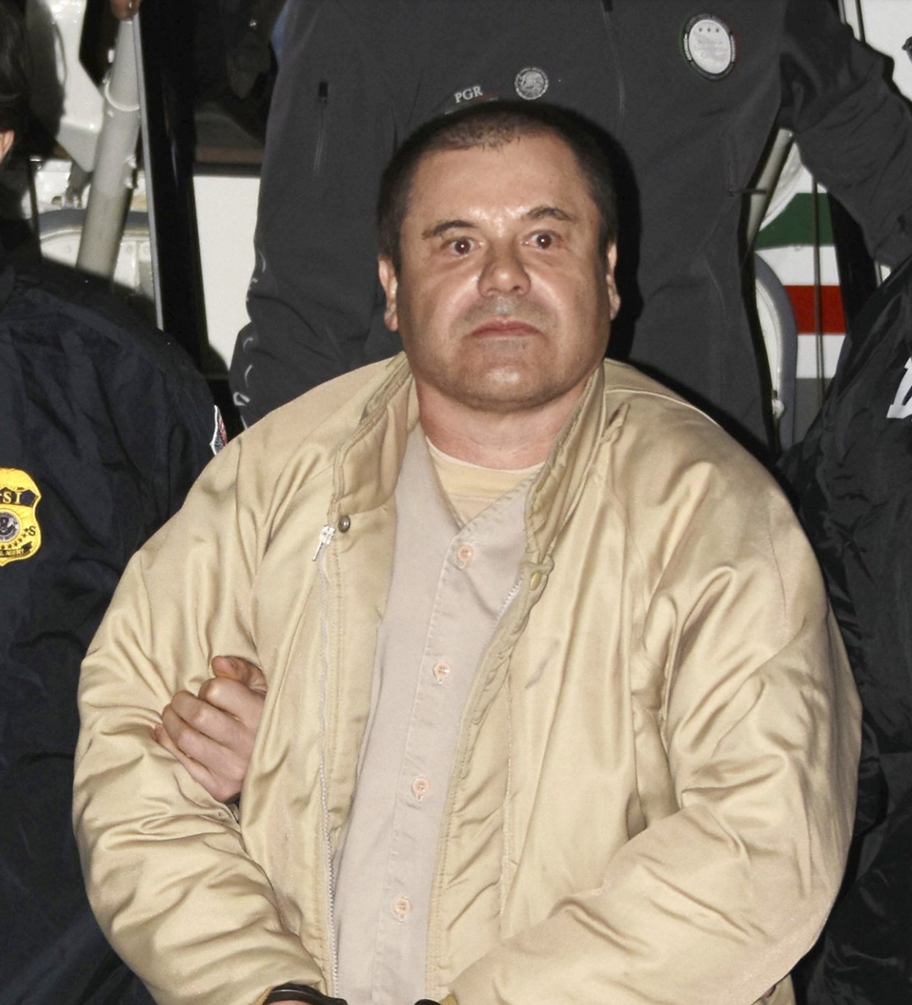
Growth of sophisticated transnational drug organizations or cartels

Slide 17
4) Impunity
Judicial system in many Latin American countries has completely ceased to function.
In Mexico, impunity for serious crimes runs at around 96 per cent.
Civilians have increasingly taken law into own hands. (Self Defense Units; Lynching)

Slide 18
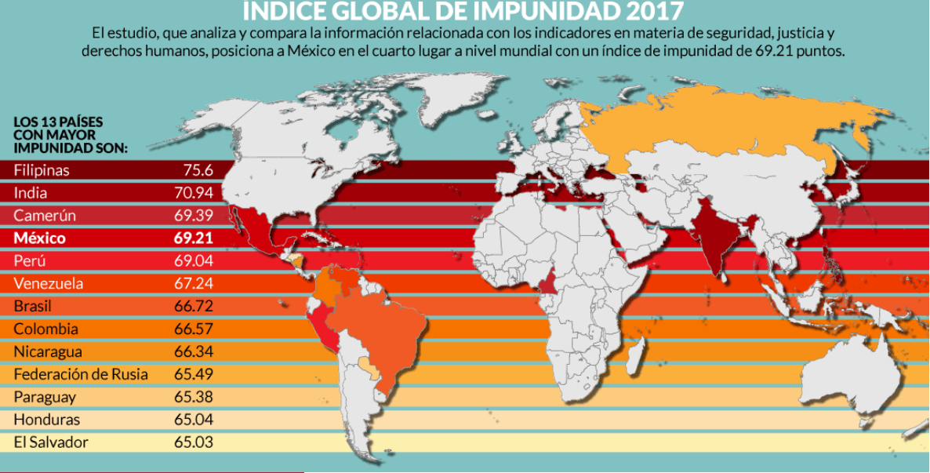

Slide 19
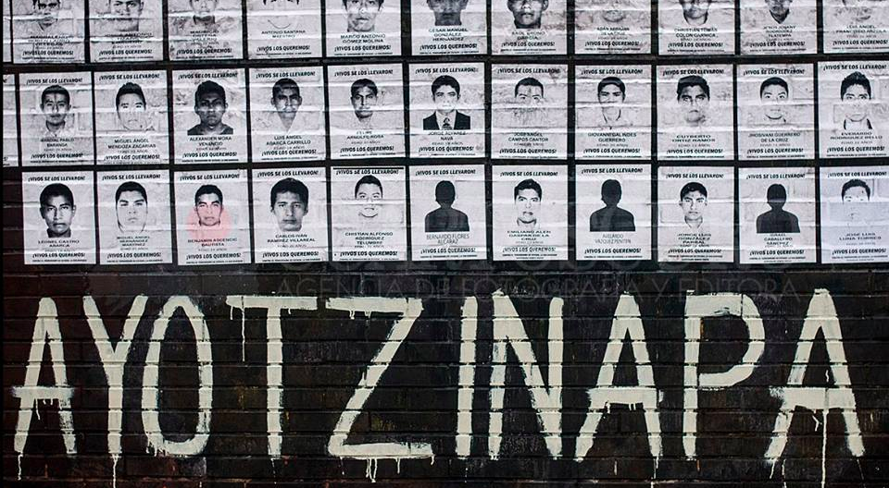
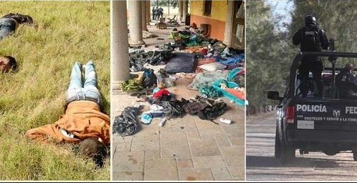
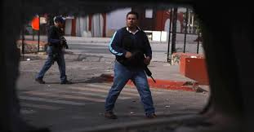
Tlatlaya (2014), Ayotzinapa (2014), Apatzingan (2015), Tanhuato (2016)

Slide 20
State Impunity
Apatzingan Massacre
http://revolution-news.com/mexico-federal-police-implicated-in-apatzingan-massacre/

Slide 21
Popular justice
Self Defense Units of Michoacán
https://www.youtube.com/watch?v=dzalpuffwFI&t=9s
Lynching?

Slide 22
2) Democracy and Inequality
“Liberal” or “pluralist” ideal of democracy
Conceives of democracy as free elections
Unconcerned with equitable distribution of wealth
Fundamental problem: Massive inequalities in wealth generates massive inequalities in power and media control. As a result, political parties see no need to include demands of the poor.

Slide 23
Two outcomes
1) Mexico/Colombia
Voter disinterest increasing. Voter turnout has dropped from 70-80% in 1990s to 40-50% in 2000s.
Disintegration of inclusive party machinery.
Return of anti-democratic parties e.g. PRI in Mexico
Violent actors have increasing autonomy and act increasingly like the state.

Slide 24
2) Venezuela/Bolivia
- Attempts at redistribution of wealth.
- Increasing polarization of voting public over race/class lines.
- Increasing violent confrontations.

Slide 25
