Slide 1
Nation-building in the Nineteenth Century
Rebecca Earle

Slide 2
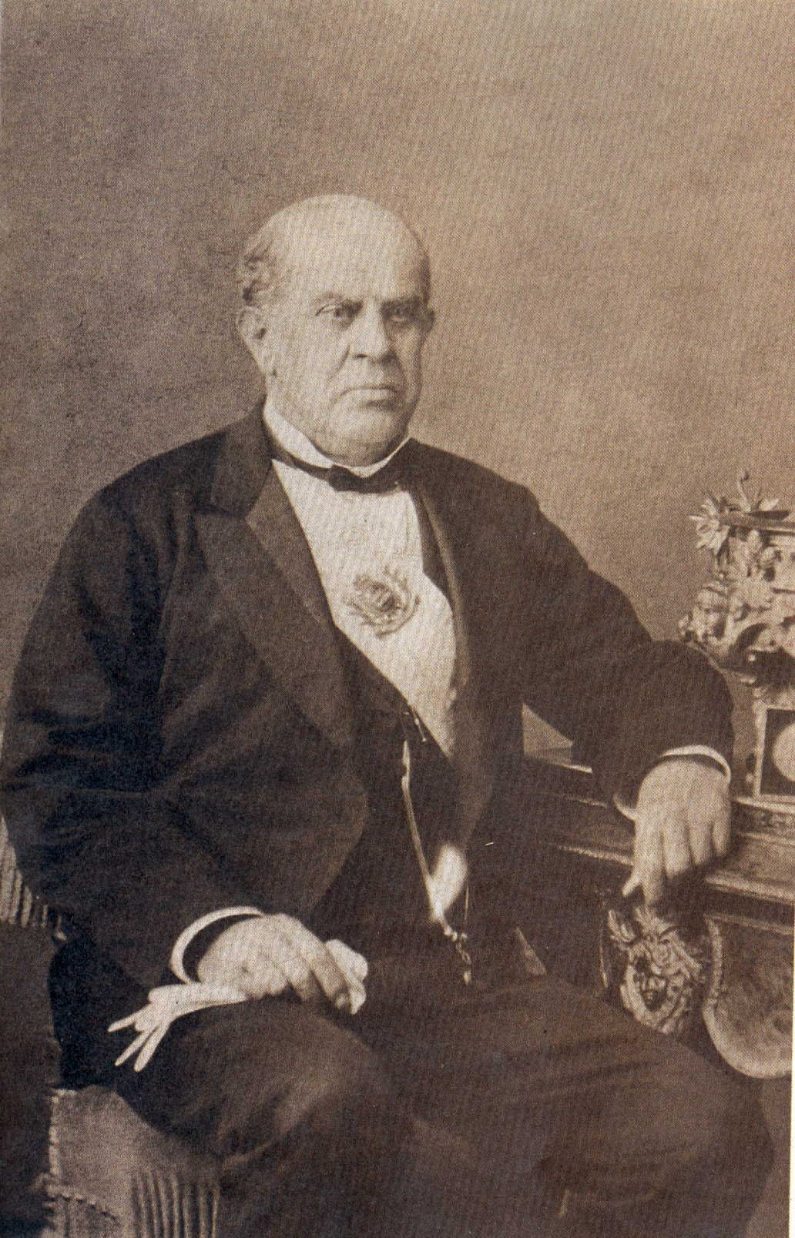
Domingo Faustino Sarmiento (1811-1888)
Argentine president (1868-74), writer and educationalist

Slide 3
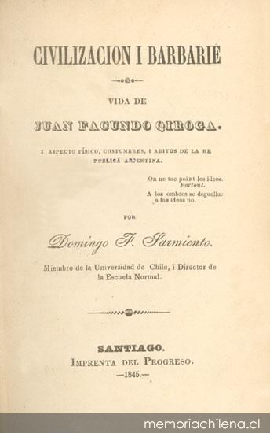
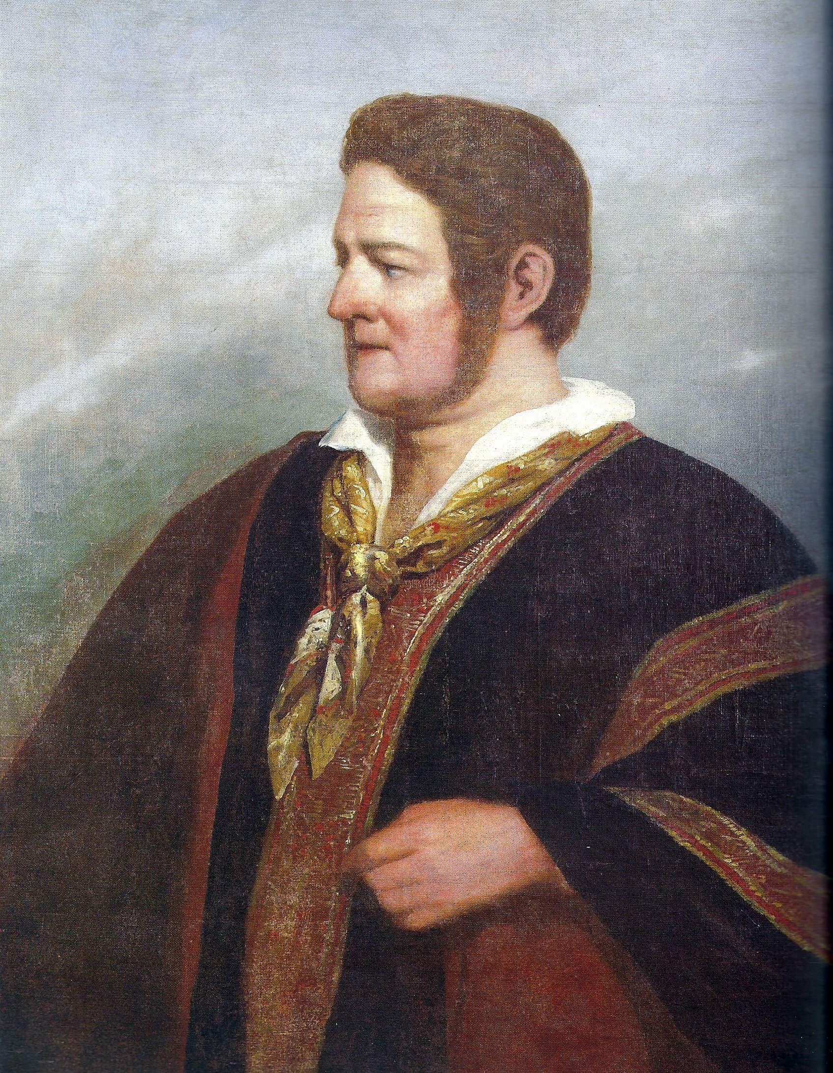
An Important Book
Domingo Faustino Sarmiento, Civilisation or Barbarism: The Life of Juan Facundo Quiroga (1845)
Juan Manuel de Rosas (1793-1877)
(Portrait by Raymond Monvoisin, 1842)

Slide 4
Lecture Structure
'Civilisation and Barbarism’: a governing metaphor for elite views of postcolonial Latin America.
Non-elite perspectives: subaltern nationalism and popular liberalism
The material culture of civilization.

Slide 5
'Civilisation and Barbarism’:
a governing metaphor for elite views of postcolonial Latin America.

Slide 6
Domingo Faustino Sarmiento, Facundo, or, Civilization and Barbarism, trans. Mary Mann (1868).
During the colonial period, ‘two distinct, rival and incompatible forms of society, two differing kinds of civilisation existed. . . : one being wholly Spanish, European and cultivated, the other barbarous, American and almost wholly of native growth’.

Slide 7
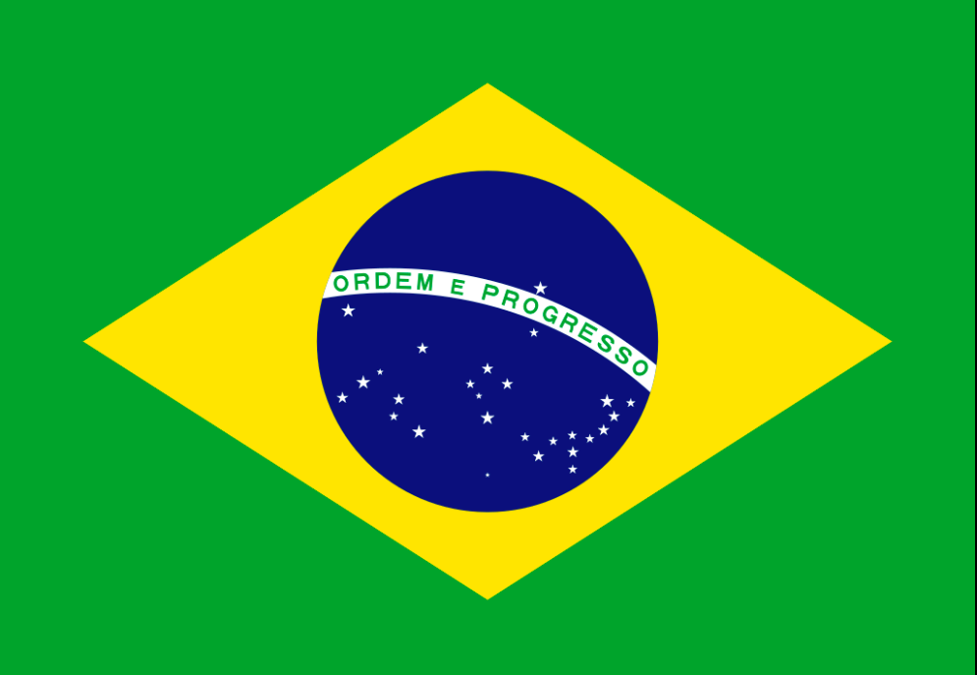
Key Words for the 19th Century
Civilisation and Progress
Argentine newspaper called ‘Progress’, founded 1895
Brazilian flag: the motto reads: ‘Order and Progress’
The design was adopted in 1889.

Slide 8
More Key Words
citizenship
nation
Argentine newspaper The Nation, founded 1870

Slide 9
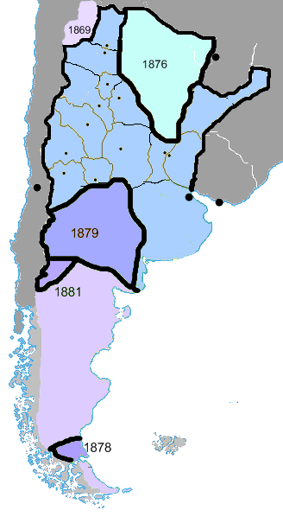
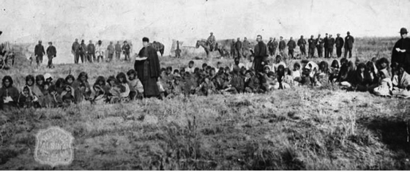
‘Civilisation’
‘Conquest of the Desert’: the Argentine state expands massively into areas previously governed by autonomous indigenous groups (1879-1880s)
‘If anything justifies our fight against the original owners of this land [the Amerindians], it is the goal of civilising them.’
An Argentine politician, speaking in the Argentine Congress in 1878.

Slide 10
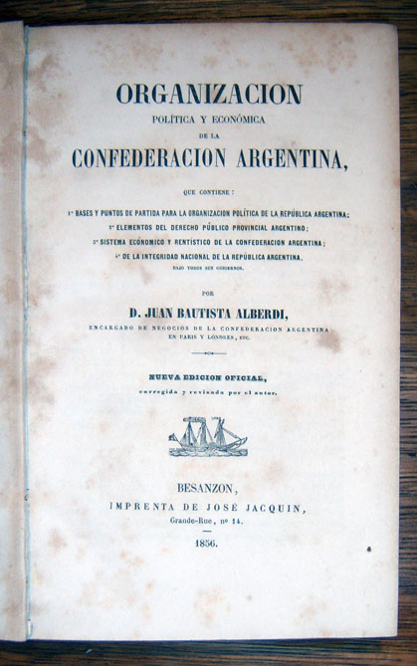
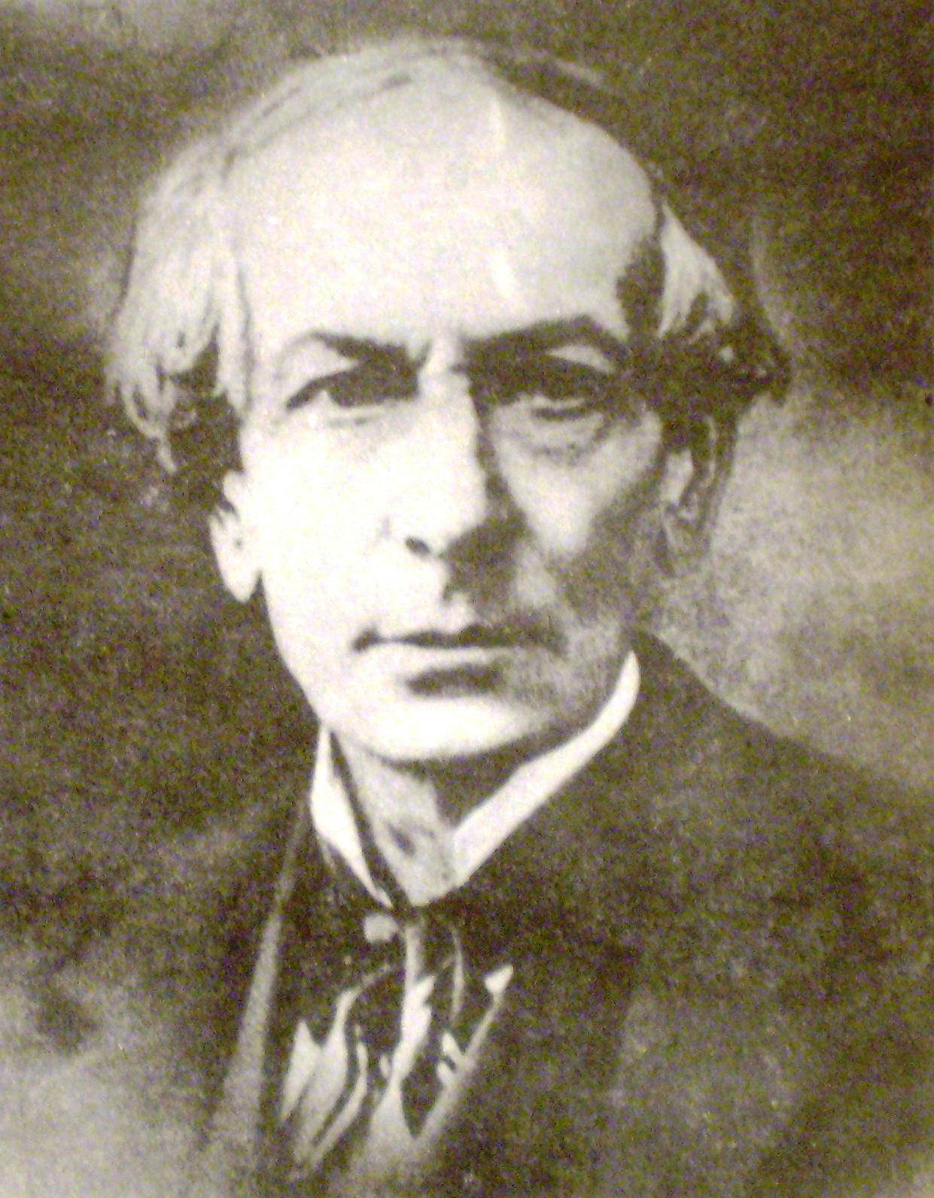
Juan Bautista Alberdi, Political and Economic Organisation of the Argentine Confederation
(1856 edition)
Juan Bautista Alberdi (1810-1884)

Slide 11
Juan Bautista Alberdi, ‘The Civilising Action of Europe in the South American Republic’, in Bases y puntos de partida para la organización política de la República Argentina .
‘All the civilisation in our land is European. . . In America everything that is not European is barbarous: this is the only distinction that matters.’

Slide 12
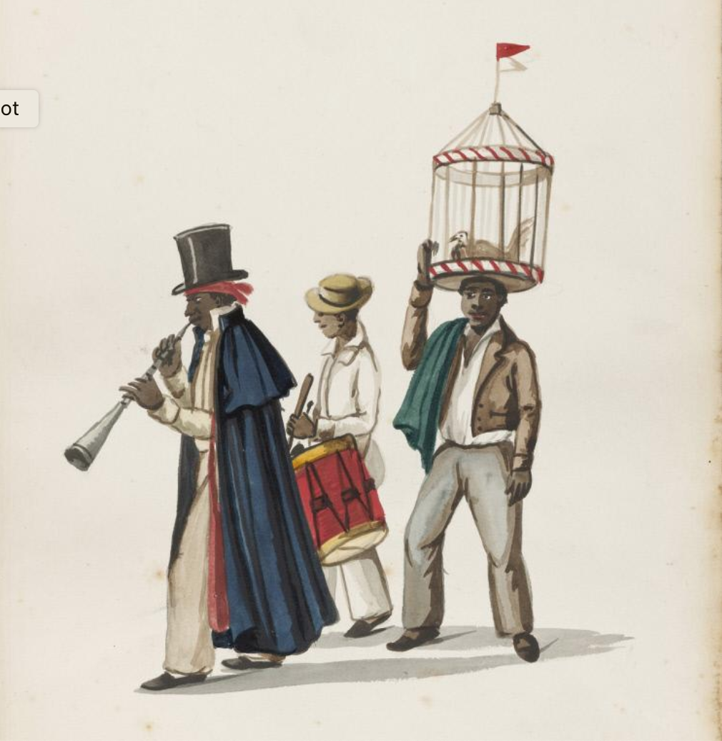
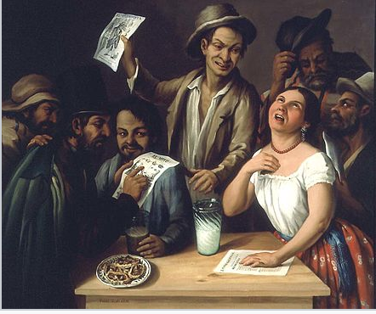
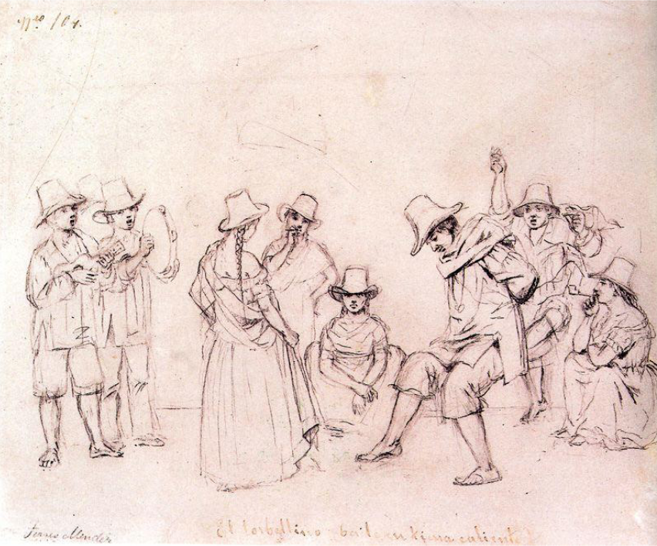
‘Barbarous’ popular culture
Agustín Arrieta, ‘A Drinking Scene’, 1851 (Mexico)
Pancho Fierro, ‘Invitation to the Cockfight’, 1830-60 (Peru)
Colombian peasants dancing ‘the whirlwind’,

Slide 13
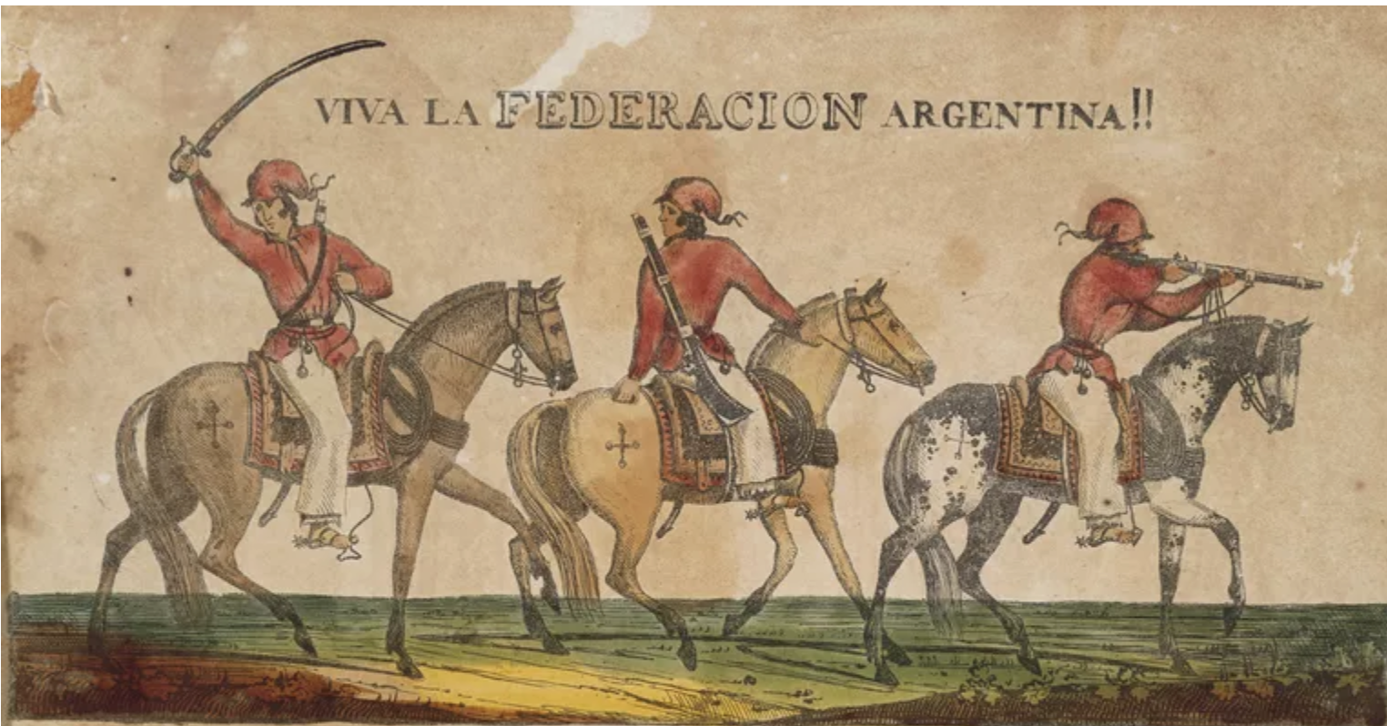
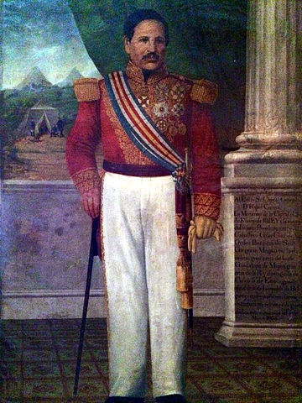
Vocabulary ‘Caudillo’
Supporters of Juan Manuel de Rosas (Argentina)
Rafael Carrera, president of Guatemala from 1844-48, 1851-65

Slide 14
Non-elite, Non-white People: An Obstacle to ‘Progress’
Native peoples are ‘a powerful . . . obstacle to the progress of our institutions’.
(El Aguila Mexicana, Mexico City, 3 April 1826.)

Slide 15
Gaceta de Guatemala, 1848.
Amerindians have been called ‘to participate in the splendid banquet of citizenship, whose delicacies they are unable to digest, and we attempt to govern them with laws that they neither want nor understand’.

Slide 16
Non-elite perspectives
Subaltern Nationalisms; Popular Liberalism

Slide 17
Nineteenth-Century Latin America: the Vanguard of Democracy
1853: universal male suffrage introduced into New Granada (aka Colombia).
1857: all men over the age of 21 with ‘an honest way of life’ were given the vote in Mexico.
1834: the UK’s Great Reform Act gave the vote to about 18% of the male population.

Slide 18
Subaltern Nationalisms; Popular Liberalism some examples
A petition sent in 1871 by the indigenous villagers of Ixtacamaxtitlán (Mexico) was written in the name of
‘the resident citizens of Iztacamastitlan’.
A petition sent in 1874 by Indigenous groups in the Colombian Cauca Valley insisted that they were:
‘free citizens, like any other civilized Caucano’.

Slide 19
Some Important Research into How Non-Elites Engaged with the Ideas and Language of Democracy
José Antonio Aguilar Rivera, Eduardo Posada-Carbó, Eduardo Zimmermann, ‘Democracy in Spanish America: The Early Adoption of Universal Male Suffrage, 1810–1853’, Past & Present vol. 256 (2022).
James Sanders, “Atlantic Republicanism in Nineteenth-Century Colombia: Spanish America's Challenge to the Contours of Atlantic History,” Journal of World History, vol. 20:1 (2009).
James Sanders, The Vanguard of the Atlantic World Creating Modernity, Nation, and Democracy in Nineteenth-Century Latin America (2014).
Guy Thomson, “Popular Aspects of Liberalism in Mexico, 1848-1888,” Bulletin of Latin American Research, vol. 10 (1991).
Peter Guardino, “Barbarism or Republican Law. Guerrero’s Peasants and National Politics, 1820-1846,” Hispanic American Historical Review, vol. 75:2 (1995).

Slide 20
The Material Culture of Civilisation

Slide 21
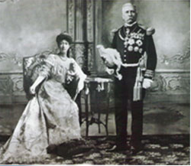
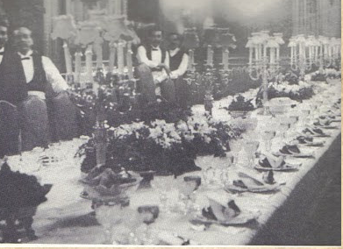
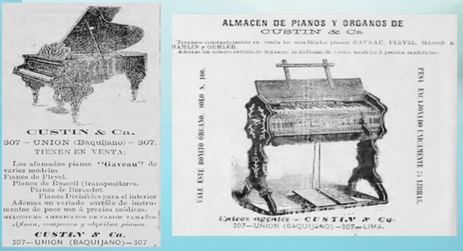
Civilisation as a material condition

Slide 22
Vocabulary: Arnold Bauer’s terms
‘civilising goods’
‘modernising goods’
Arnold Bauer, Goods, Power, History: Latin America’s Material Culture (Cambridge, 2001).

Slide 23
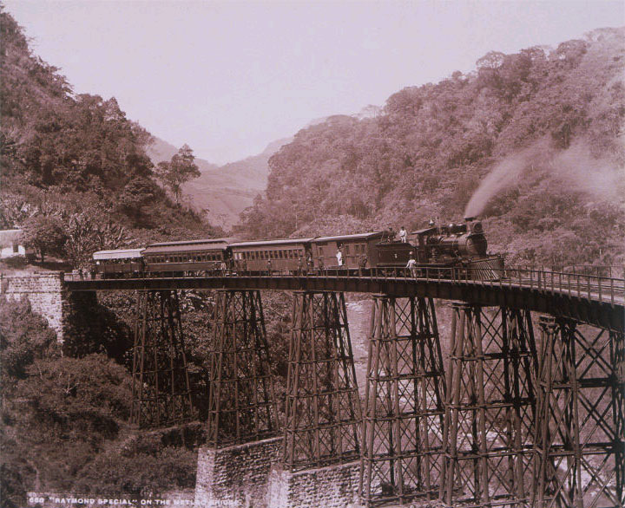
‘Civilisation’ ?
The Bridge over the Metlac Canyon, Veracruz State, Mexico built in 1873
The Raymond Special on the Metlac Bridge, Veracruz, Mexico, ca. 1897. Charles Burlingame Waite. Gelatin silver print. Getty Research Institute.
‘The locomotive symbolized the unbridgeable gap between the civilized and the savage.’
Michael Adas Machines as the Measure of Men (1989)

Slide 24
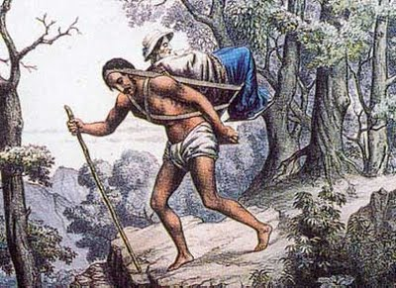
‘Barbarism’ ?
Crossing the Quindío Pass in the Colombian Andes

Slide 25
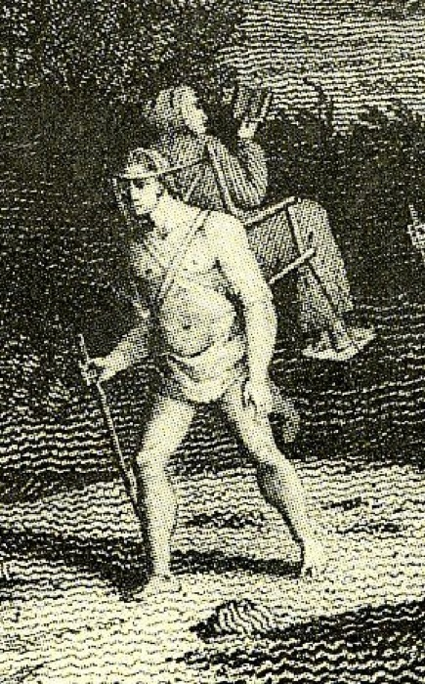
Barbarism vs. civilisation?
Crossing the Quindío Pass in the Colombian Andes
The Bridge over the Metlac Canyon, Veracruz State, Mexico

Slide 26
Some concluding comments
Sarmiento’s idea of a dichotomy between civilisation and barbarism encapsulated the elite vision of Latin America’s post-independence future.
‘Civilisation’ was associated largely with Europe. European goods themselves were a powerful emblem of civilisation.
Material objects were not the only thing Latin American elites hoped to import from Europe. The second half of the 19th-century saw serious efforts to induce European immigrants to settle in the region.
The concept of ‘civilisation’ provided an excuse for elites to exclude non-elites from the new political spaces created with independence.
These new political spaces were strikingly democratic, much more so than those of 19th-century Europe.
Many ordinary people nonetheless actively claimed the rights they were accorded with democracy.
Democracy in short posed challenges to the region’s rulers, for the rhetoric of republicanism often clashed with the profoundly hierarchical, stratified nature of Latin American society.

