Slide 1
Week 1: Nation-Building in the Nineteenth Century

Slide 2
Adopt a country!
Please sign up to “adopt” a Latin American country for this half of the term [Mexico, Argentina, Brazil, Cuba, or add your own!]
How to adopt:
Do the seminar readings as normal, but..
pay special attention to your adopted country in your reading (especially in the survey texts, e.g. Williamson)
Look it up on Wikipedia or similar; discover some interesting facts about it to share with the class
Think about how its history looks similar or different to the general narrative each week (and why).

Slide 3
Essays: talk to your partner/ group about how you’re finding (some of) …
the transition from school to university essays
turning the plan into a full essay
finding primary/ secondary sources
engaging with historians’ views and finding your own ‘voice’
introductions/ conclusions
how to construct an argument
essay structure: chronological? Thematic? Country comparisons?

Slide 4
Readings
Earle, Rebecca, “Sobre Héroes y Tumbas: National Symbols in Nineteenth-Century Spanish America,” Hispanic American Historical Review, vol. 85:3 (2005), pp. 375-416.
Jose Murilo de Carvalho, “Political Elites and Statebuilding: The Case of Nineteenth-Century Brazil,” Comparative Studies in Society and History, 1982

Slide 5
Discussion questions
How did nineteenth-century elites “imagine” their nations and their pasts?
What obstacles to "effective" government did they identify?
Did all sections of society share this vision?
Why was political stability so hard to achieve after independence? Why did some countries achieve it sooner than others?
Do you see more similarities or more differences between the Hispanic American republics and the case of Brazil? Why did Brazil remain united?
How "liberal" were the new nations?

Slide 6
What is a “nation”? A couple of useful classic references
Benedict Anderson Imagined Communities 1983
Eric Hobsbawm and Terence Ranger, eds. The Invention of Tradition, 1983

Slide 7
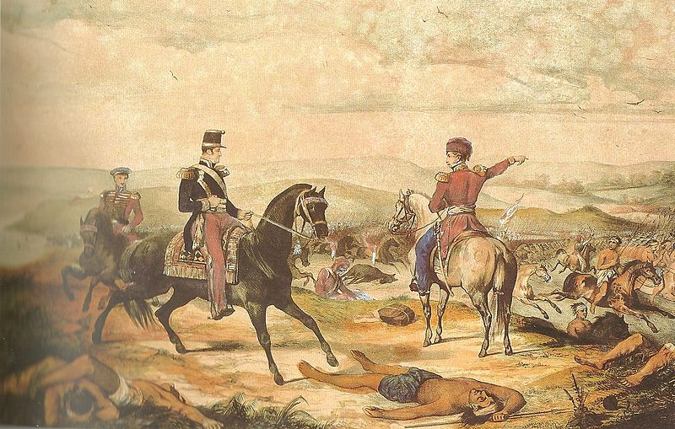
Argentina: Rosas’ first desert campaign, 1833
Notes:
Campaign against the Mapuche and Ranqueles tribes.
Wikipedia commons.
Description Retrato "Expedición en los desiertos del Sud contra los indios salvajes, en el año de 1833, ejecutada con el mayor acierto y saviduría por su digno jefe el gran Rosas". Conservado en el Museo Saavedra Date 19th century Source "Juan Manuel de Rosas y los bloqueos al Río de la Plata de Francia e Inglaterra" Author Calixto Tagliabúe, 1797-1850

Slide 8
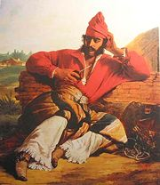
La Mazorca: a federal gaucho
Notes:
“El gaucho federal,” obra de Raymond Quinsac de Monvoisin. www.revisionista.com.ar/
Dressed in red – colour of mazorca movement in support of Rosas.

Slide 9
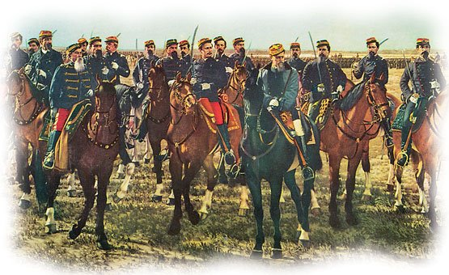
Argentine desert campaigns, 1870s-80s
Notes:
Wikipedia Commons.
Description Español: Fragmento del cuadro "Conquista del desierto" de Juan Manuel Blanes
Date 1889 Source Museo histórico nacional Author Juan Manuel Blanes (1830 - 1901)

Slide 10
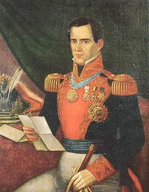
Lopez de Santa Anna (Mexico)

Slide 11
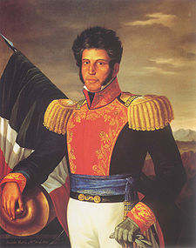
Vicente Guerrero (Mexico)

Slide 12
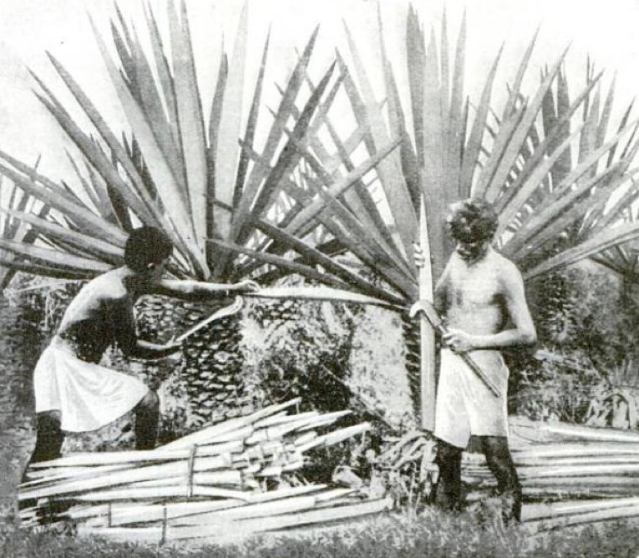
Henequen
Notes:
Harvesting henequen to make paper. 1922. Wikipedia Commons. Original caption from book: How natives of Yucatan, Mexico, harvest hanequen, the abundant Sisal hemp that promises to relieve our depleted pulpwood forests in supplying America's enormous demand for newspaper print. The mature plants yield from 12 to 20 stiff, pulpy leaves, which the harvesters cut with sickle shaped knives. About an ounce of marketable fiber is obtained from one leaf.

Slide 13
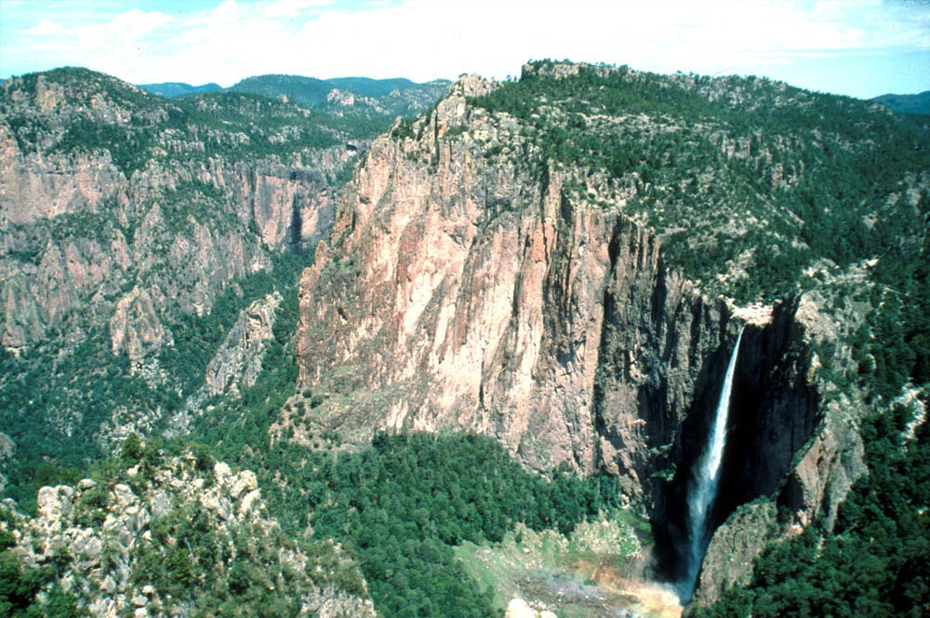
Sierra Madre mountains, Mexico
Notes:
Sierra Madre mountains, Sonora, Mexico.

Slide 14
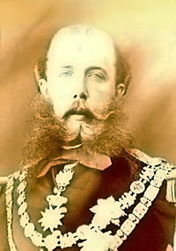
Maximilian of Mexico
Notes:
Emperor Maximilian of Mexico. 1864-7.

Slide 15
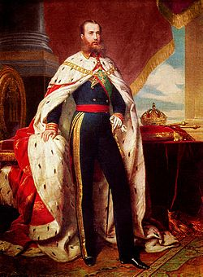
Emperor Maximilian (1864-7)
Notes:
Maximilian: portrait as emperor of Mexico. 1864.

Slide 16
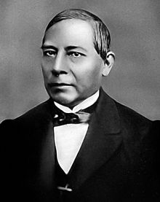
Benito Juarez (Mexico)

