Slide 1
Some Themes and Problems in Latin American History

Slide 2
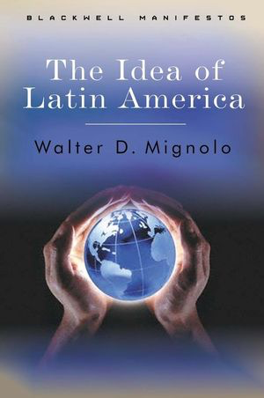
Latin America: historical concept or geographical fact?
What is ‘Latin America’?
the term ‘Latin America’ began to be used in the 19th century so you could argue that before that ‘Latin America’ didn’t exist.
So perhaps the idea of ‘Latin America’ is itself a theme and a problem . . .

Slide 3
Three more ‘themes and problems’
land
labour
race

Slide 4
All three run through the whole module.
They are addressed in different ways in different countries at different times.

Slide 5
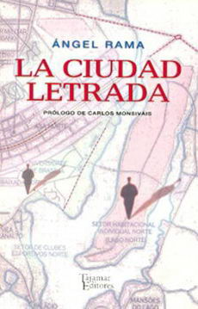
Land: colonial era
Spanish and the Portuguese settlers wanted RURAL LAND for mining, commercial agriculture, ranching . . .
CITIES become cultural and political centres. Angel Rama’s influential 1984 book discussed idea of the ciudad letrada or ‘lettered city’.

Slide 6
Land: a comparative perspective
Brazil 1850 Lei de Terras (land law): makes it hard for small purchasers to buy land.
US 1862 Homestead Act: deliberately makes land available to small farmers and families.

Slide 7
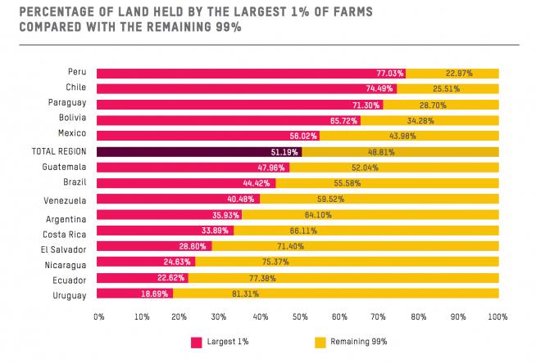
Land reform in the twentieth century
Latin America entered the 20th century with huge LAND CONCENTRATION.
Most land was in the hands of very few people.
This is still the case.

Slide 8
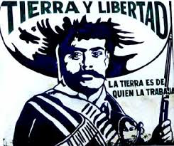
Land reform in the twentieth century
Unequal distribution of land helped inspire the MEXICAN REVOLUTION of 1910. Peasant struggles helped put land reform on the Mexican Constitution of 1917.
Similar conflicts occurred elsewhere (Bolivia, Nicaragua, Peru, Chile, Ecuador, Costa Rica, Colombia. . .)
Fidel Castro’s 1953 ‘History will Absolve Me’ speech addressed the problem of land; the hemisphere’s most radical land reform occurred in CUBA after 1959.

Slide 9
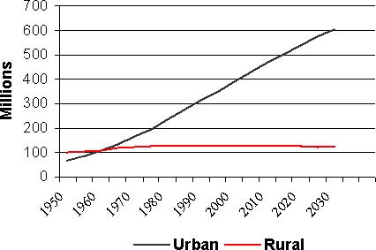
Land and politics in the twentieth century
Link between the problems facing small farmers and rapid urbanisation: most people can’t make a living on the land.
Projected Latin American population, 1950-2030

Slide 10
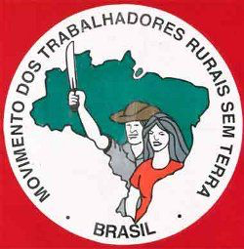
Land and politics in the twentieth century
Land as a social problem: addressed by peasant movements, such as the Brazilian Landless Workers’ Movement (MST)
According to the MST, in 1998, 1% of Brazilians owned 46% of the land.

Slide 11
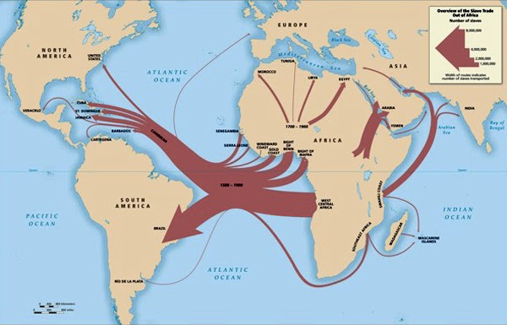
Labour in the colonial era
Settlers wanted labour for mining (such as at Potosí in Bolivia), for agriculture (sugar production, etc.) and for ranching.
Spanish America: colonial laws forbade enslavement of indigenous people but many indigenous workers were effectively enslaved. Enslavement of Africans was ‘legal’.
Colonial Brazil: indigenous, then African, slavery.
50% of all African slaves brought to the Americas went to Latin America; 40% went to Brazil.

Slide 12
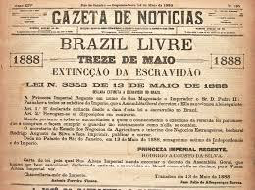
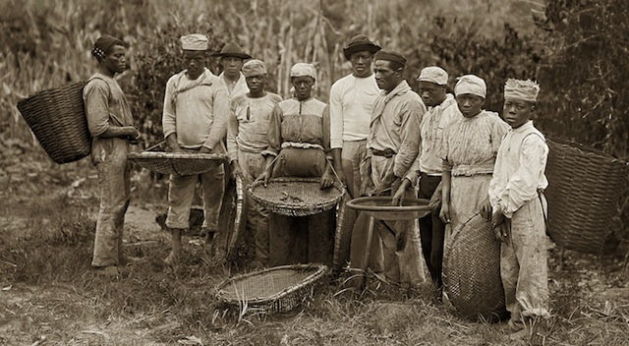
Labour: free and unfree
Slavery abolished everywhere by 1880s
But problem of labour rights left for the twentieth century to solve

Slide 13
Urban labour and politics in the twentieth century
Mexican Constitution (1917) pioneered social guarantees for workers (length of working day, child labour, etc.).
Tendency for state to take responsibility for social/ labour reform was echoed elsewhere,
Demands of working classes shaped politics in the mid-20th century (populism and corporatism).
Juan Perón (Argentina), Getulio Vargas (Brazil), Fulgencio Batista (Cuba): harnessed workers’ demands in their own interests.

Slide 14
‘Race’
Most scholars view ‘race’ as a social construct, not a biological reality.
In Latin America it has always been about social status, reputation, and wealth, not merely skin colour: ‘money whitens’.

Slide 15
‘Race’ in the colonial era
Contradictory aims of the colonial state:
Separate ‘Republics’ of Spaniards and Indians were enshrined in law, but the colonial state also thought that contact with Europeans would help ‘civilise’ Amerindians, Africans and those of mixed ancestry.

Slide 16
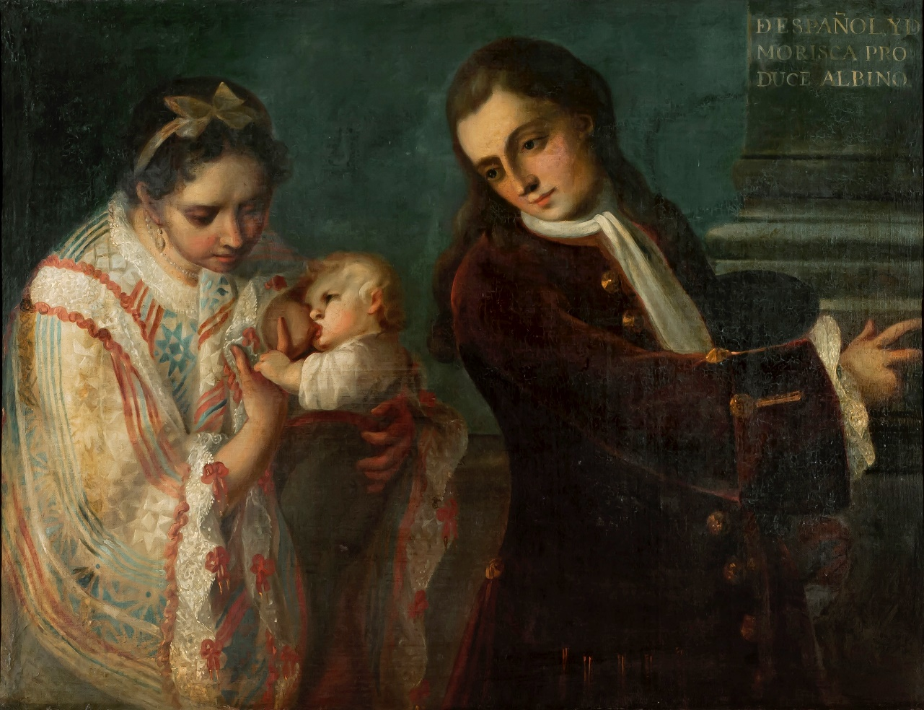
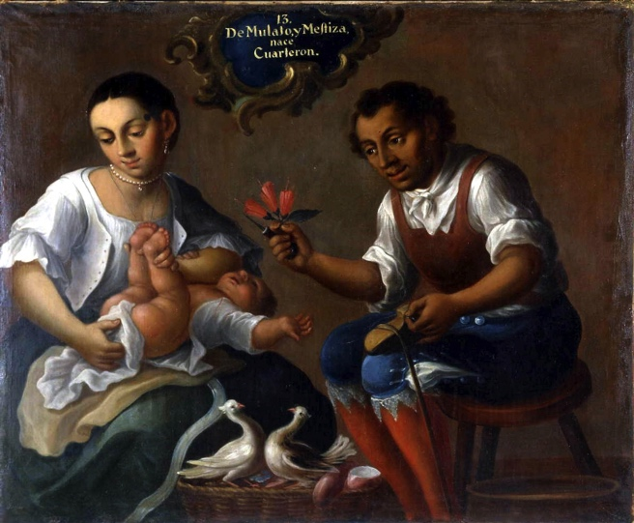
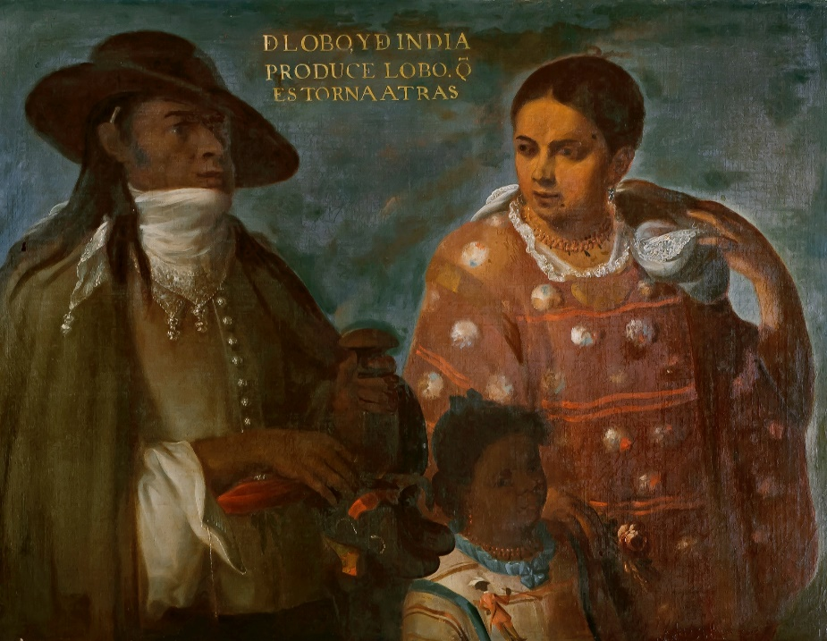
‘Race’ in the colonial era
Daily reality of MIXTURE – mestizaje (Spanish) / mestiçagem (Portuguese)

Slide 17
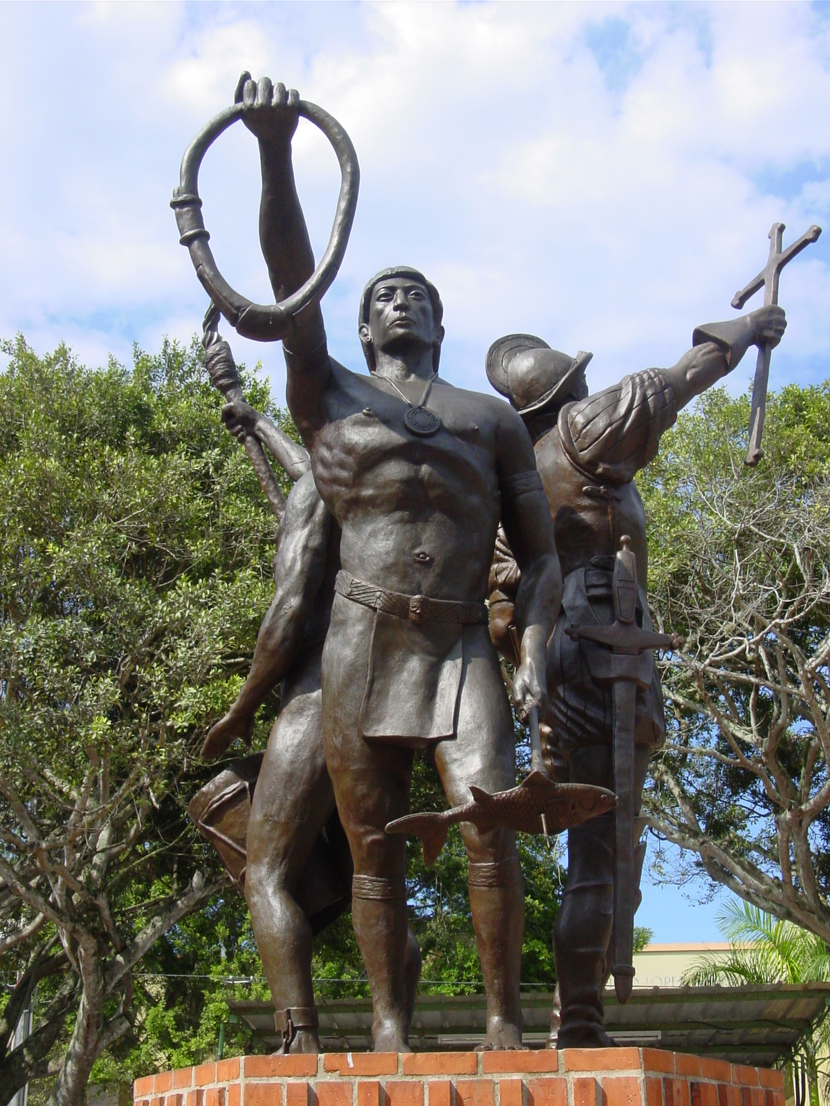
Race and National Identity
In popular and nationalist mythology, Latin America is the result of a meeting of three peoples (Indians, Iberians, Africans).
The image shows a statue in Puerto Rico that depicts ‘the three races’ that make up the heritage of Puerto-Ricans.

Slide 18
Race and National Identity
But: ‘Indians’ not a single group. There are hundreds of ethnic groups and over 57M people.
‘Iberian’ is also a poorly-defined category. The Iberian peninsula was home to different ethnic and cultural groups (Muslims, Christians, Jews).
Ditto ‘Africans’ . . .
Late C19: millions of other Europeans arrived (Germans, Italians…) especially in Argentina and Brazil
So the idea of ‘three races’ is a nationalist construction, not a simple reflection of reality.

Slide 19
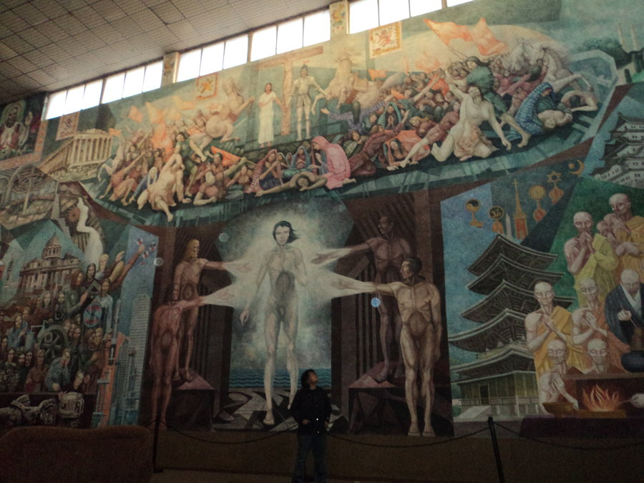
The twentieth century
Aaron Piña Mora, ‘The prophecy of the cosmic race’ (1978)
New national imaginings and representations of the population
Revolutionary Mexico:
idea of raza cósmica (murals, literature, educational policies; influence of José Vasconcelos)

Slide 20
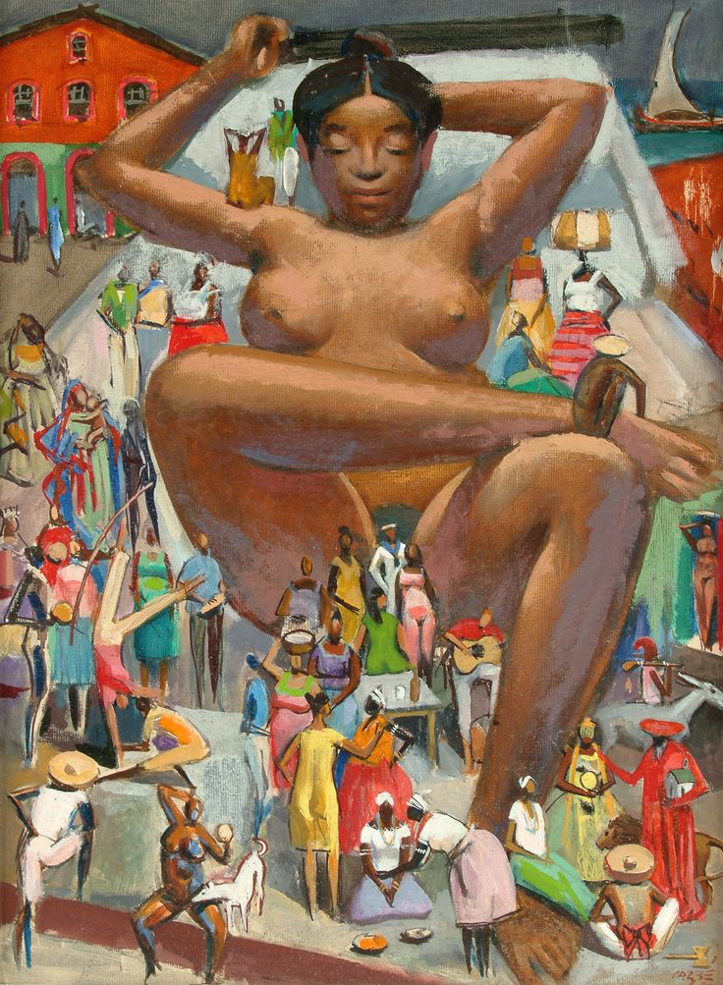
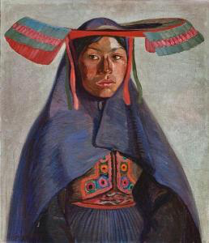
The twentieth century
José Sabogal
New national imaginings and representations of the population
Peru: indigenismo helps found new political party (APRA – American Popular Revolutionary Alliance, 1924).
Brazil: new notion of ‘racial democracy’, associated with sociologist Gilberto Freyre
Carybé, ‘Mulata Grande’ (1980)

Slide 21
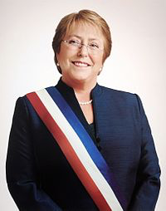
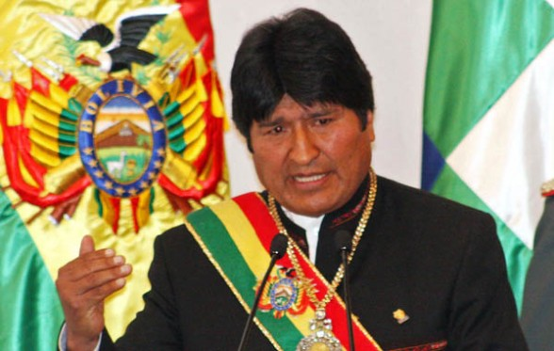
Some Latin American presidents
Evo Morales: Latin America’s first indigenous president (elected 2006)
Michelle Bachelet: Chile’s first female president (first elected 2006)

Slide 22
Other Latin American ‘themes and problems’?
nation-building and democracy
Economic ‘dependence’ and economic nationalism
Latin American revolutionary histories
the military
Latin American’s relationship with the United States
. . .

