Slide 1
Why “Latin” America?
Like most other terms, the notion of “Latin America” has a HISTORY, steeped in struggles for power and control in the region
First used as an idea by French writer Michel Chevalier, 1830s
Took on further currency during the French invasion of Mexico, 1861-7
Notion of non-Anglophone Americas as sharing history/ culture based on romance languages; tied in with cultural dominance of France for many Latin American countries in C19, after independence from Spain/ Portugal
Generally used to differentiate Anglophone North America (especially the increasingly dominant US) from the rest of the region
Hence, a series of dichotomies: easy association with economic backwardness, non-whiteness/ race mixture, “non-western” – see Jose Moya’s article in this week’s seminar reading for these arguments…

Slide 2
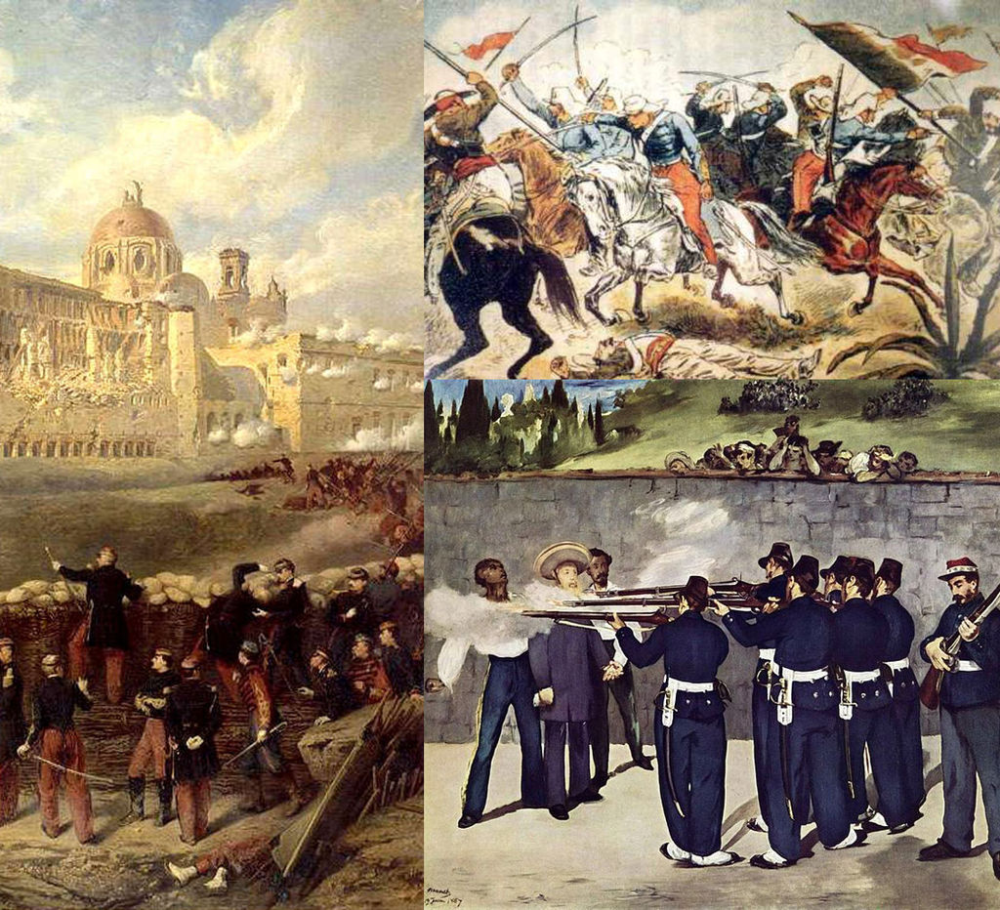
The French invasion of Mexico, 1861-7
Notes:
Image:
By Brigade Piron, CC BY-SA 3.0, https://commons.wikimedia.org/w/index.php?curid=29086973

Slide 3
How useful is the term?
Used more outside the region than inside; people in “Latin America” think of themselves more in terms of local or national identities;
Those who travel internationally often go to the US or Europe more than their immediate neighbours; extensive influence of US and Northern Europe culturally, economically
Significant geographical, climatic differences as well as national and social ones…
Deserts; Andean highlands; tropics and subtropics; temperate plains of southern cone (look more like the US mid-west)
Major differences between Spanish and Portuguese colonial experiences…
But overall, very long, thoroughgoing history of Iberian colonisation does create a large number of similarities between “Latin American” countries
Many places in the Americas don’t ‘fit’ very well within the categorisations… Haiti? The Caribbean in general (what about Cuba)? Quebec? Texas, California, Florida..? What about the huge Latino presence in the US?...

Slide 4
