Slide 1
Inequality
Social; racial; economic
Stems in first instance from violently unequal colonial encounters…
And from labour demands of Spanish and Portuguese
Existence of dense populations for work in mines helps determine which areas become centres of empire, esp in Spanish case
Other areas: no native labour supply
Arrival of enslaved Africans in huge numbers - early C16 to late C19
Polities/ societies rested on complex systems of hierarchy; combined notions of religious purity with elements of what we’d now call race, class, gender…
Important evolution of social hierarchies, and resistance/ subversion to them; but they nonetheless endure long after colonial rule; legacy felt today

Slide 2
More inequality: economic components:
Profoundly unequal economic situation for different parts of society, during colonial rule; worsens if anything after independence
Land inequality: massive land grants to privileged Europeans is tool of empire-building; phenomenon of hacienda/ fazenda is about social and political inequality as well as economic;
Late C19: Lat Am economies and lands drawn on huge scale into Atlantic economy/ industrialising north Atlantic; process compounds economic inequality
Periods of very fast economic growth in C20 generally widen economic inequality
Lat Am countries (with notable exceptions) score really highly on the Gini coefficient (measure of economic inequality)
Rapid, uncontrolled urbanisation is part of this process; urban inequality, shantytowns (favelas) very general Latin American phenomenon
Notes:
prii

Slide 3
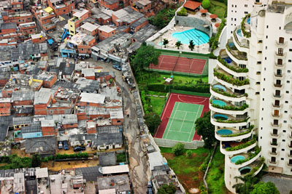
Morumbi neighbourhood, São Paulo, with Paraíso favela next door

Slide 4
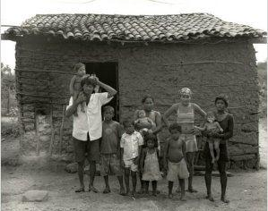
Garapa, dir. Jose Padilha, 2009
A documentary film about people living with chronic hunger in Brazil’s arid north-eastern region
Garapa is a sugar solution given by parents to their children to assuage their hunger when they don’t have enough food to eat
Brazil is currently the world’s ninth richest country…

Slide 5
Resistance and politics “from below”
Indigenous and enslaved rebellions and resistance from earliest colonial times
C19 “popular democracy”: non-elite, enslaved, indigenous people adopt notions of liberalism and anticolonial struggle to their own ends
Mexico 1910: world’s first “social revolution”
Mid-twentieth century revolutions (Cuba is only the most famous…)
Late-twentieth-century social movements – Zapatistas, land reform/ peasant leagues, racial equality movements, women’s movements…

Slide 6
Ideas about race, and race mixture
Particular mix of different peoples is synonymous with region
Nationbuilding founded on notions about race mixture - mestiçagem, mestizaje
Mixture is part of reproductive history under conditions of extreme inequality, conquest, slavery, rape
Traditionally, history told as a meeting of “three groups”: Europeans, indigenous peoples, Africans…
In fact, all of them (especially Africans and indigenous Americas) made up of hundreds of entirely separate ethnic groups; indigenous people lumped together as “Indians” after 1492 (misnomer)
African history of Americas often marginalised…

Slide 7
Africans in the Americas
More Africans went to the Americas before 1800 than did Europeans…
…and more enslaved Africans went to Latin America than any other part of the Americas.
Africans and their descendants were not at synonymous with slaves.
They arrived as sailors with the earliest European voyages;
In many societies of Latin America, for much of the colonial period, there were more free than enslaved people of African descent
Nonetheless, African slavery played a huge role in shaping the region, politically, socially, economically.
See Henry Louis Gates, Jr, Black in Latin America (book and PBS TV series, some episodes and interviews on YouTube)
See George Reid Andrews, Afro-Latin America: Black Lives, 1600-2000 (at library)

Slide 8
