Slide 1
Welcome to HI115,
Latin America:
Themes and Problems
Course Coordinator: Camillia Cowling
C.Cowling@warwick.ac.uk

Slide 2
Introduction:
What is “Latin America” and why study its history?
Dr. Camillia Cowling (course convenor)
c.cowling@warwick.ac.uk

Slide 3
Some interesting upcoming events
We Were Here: The Untold History of Black Africans in Renaissance Europe is an internationally acclaimed documentary that explores the presence and contributions of Africans in Europe during the Renaissance, challenging familiar narratives about European history and culture.
The event will feature:
  A screening of the documentary
  An introduction from filmmaker Fred Kudjo Kuwornu
  A panel discussion with academic colleagues from the Faculty.
  Audience Q&A
The film draws on art history, archival research and contemporary scholarship to tell stories that have often been omitted from mainstream accounts of Renaissance Europe.
Whether your interests lie in history, literature, languages, culture, media, race and identity, or simply expanding your understanding of the past, this promises to be a thought-provoking and engaging evening.
Date: Wednesday 21st October Time: 5.00pm Venue: Cinema Room, FAB.
Register to attend here.

Slide 4
Some interesting upcoming events
LAWN talk: Mexico's Watchdog Journalists: Reporting on Crime Syndicates and the Corrupt
Join the Latin America at Warwick Network for our first event of the year, featuring Professor Andrew Paxman of CIDE, Mexico City.
When: Monday, 19 October, 2-3:30 pm
Where: S1.50 (Social Sciences)
Over the past two decades, Mexico has been the most dangerous country for journalists outside a war zone. The phenomenon broadly correlates to the spiralling homicide rate detonated by President Calderón’s 2006 declaration of “war” against the “drug cartels”, but the reasons are more complex. A growing body of research ascribes as much blame to agents of the state, from governors to local police. There is also a gubernatorial culture of violent repression and discursive nonchalance towards the press, which has roots in the late 19th century and persists with the aid of a parallel culture of impunity, recently bolstered by presidential hostility towards the press. Andrew Paxman considers factors past and preset behind the murder of Mexico’s media workers.
https://warwick.ac.uk/fac/arts/schoolforcross-facultystudies/research/centre_and_networks/lawn/activitieslawn/

Slide 5
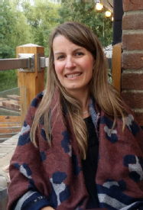
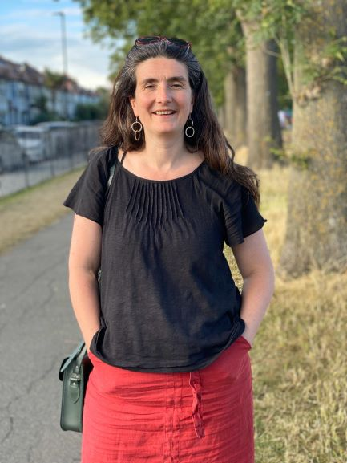
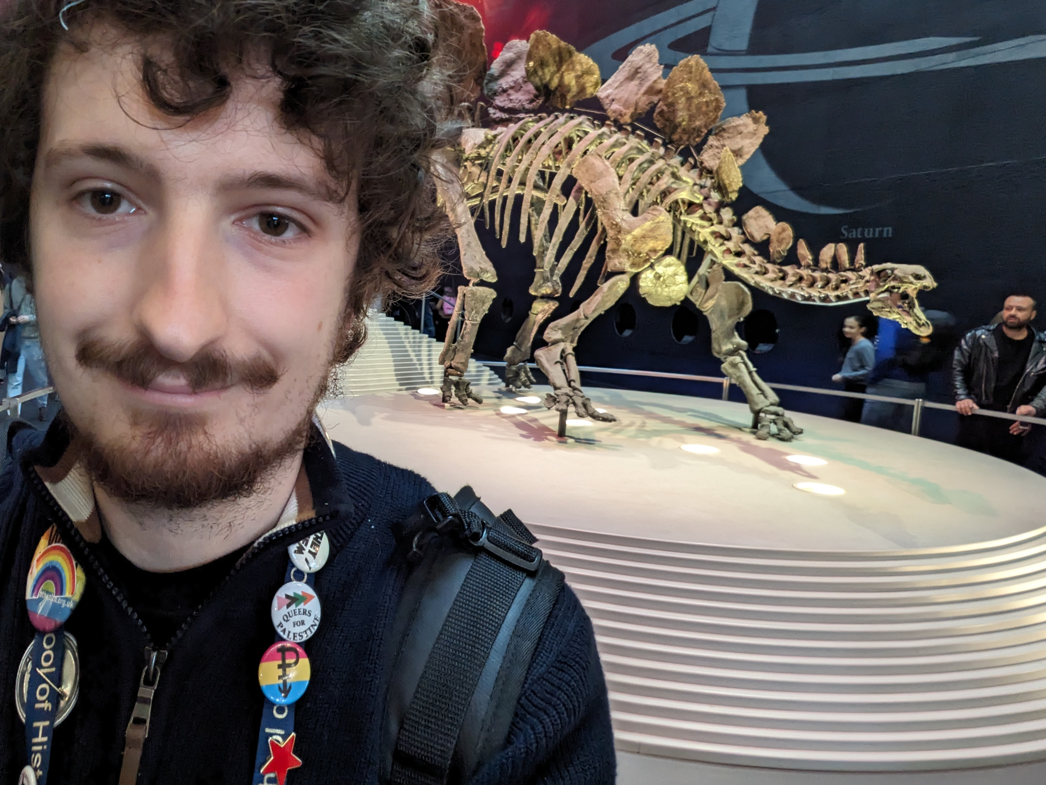
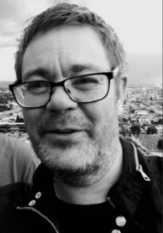
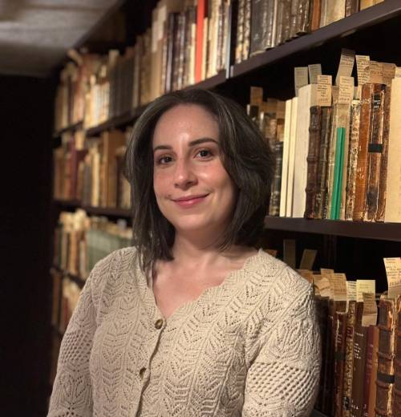
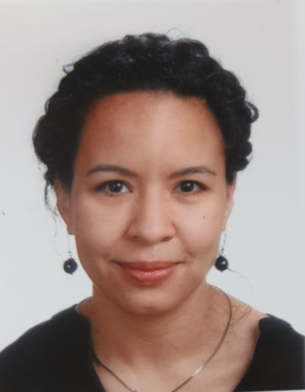

Course team
Seminar Tutors ͢͢
Lecturers with a variety of research interests and expertise in
Latin American History

Slide 6
How the course will work…
Weekly in-person lectures, will all be recorded
Weekly seminars (see Tabula for your group)
Before seminars: do at least the core readings; follow the overall “story” each week in one of the survey texts
Check the module webpage and your email for updates (not Moodle or Talis).
Moodle: only for the lecture capture links/ end of term feedback

Slide 7
Assessment
Seminar participation (10%)
1000-word essay plan (10%) (this can then form the basis for your 2000-word essay).
2000 word essay or equivalent (30%).
3000 word essay or equivalent: (50%)
Details of submission and feedback dates can be found on Tabula
Some assessments vary for visiting students. Check Tabula and Assessment guidance on module webpage

Slide 8
Learning about Latin American history at Warwick
Very broad range of staff interests and specialisms across a huge history department
Americas interests among many historians, many of whom you’ll meet on other courses this year or others: Caribbean, US…
Very broad course, from precolonial times, imperial conquest and processes of empire-building; independence movements and nation-building; revolutions, dictatorships, but also a long tradition of democracy; to recent political swings in the region, first to the left and then a recent right-wing reaction..

Slide 9
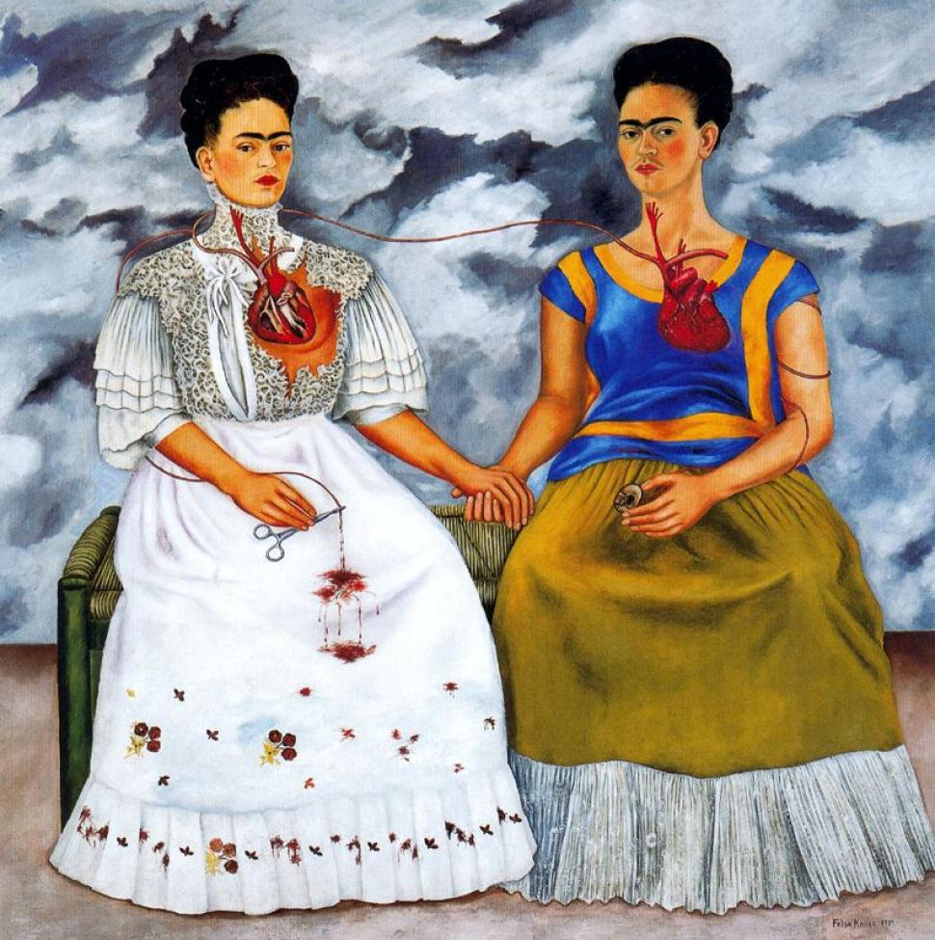
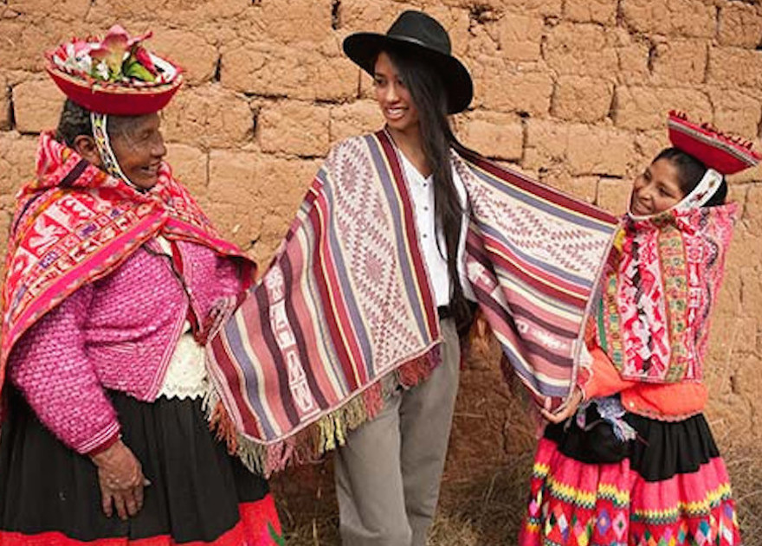
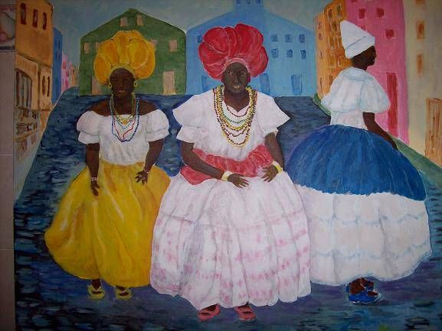
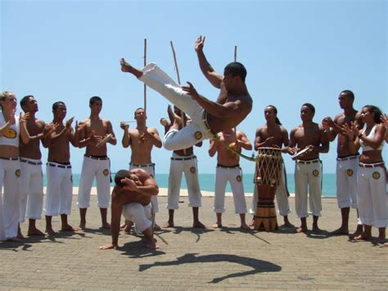

Slide 10
Why study Latin America?
Unique meeting and mixing of peoples to create rich, vibrant set of cultures
Arguably, Lat Am is at the centre of processes of “modernity”:
New World encounters are what first allow the world to be “globalised”
Lat Am important within trajectory of liberalism, incl popular liberalism
Latin America at forefront of urbanisation; relatively industrialised compared to much of the rest of the world
Centrally important political developments: nationalism; populism in mid-C20, first social revolution (Mexico, 1910), 1950s revolutions (especially Cuba)
Early, specific ideas about race as part of development of social hierarchies and polities; then, important ideas about race mixture and nationhood

Slide 11
Why “Latin” America?
Like most other terms, the notion of “Latin America” has a HISTORY, steeped in struggles for power and control in the region
First used as an idea by French writer Michel Chevalier, 1830s
Took on further currency during the French invasion of Mexico, 1861-7
Notion of non-Anglophone Americas as sharing history/ culture based on romance languages; tied in with cultural dominance of France for many Latin American countries in C19, after independence from Spain/ Portugal
Generally used to differentiate Anglophone North America (especially the increasingly dominant US) from the rest of the region
Hence, a series of dichotomies: easy association with economic backwardness, non-whiteness/ race mixture, “non-western” – see Jose Moya’s article in this week’s seminar reading for these arguments…

Slide 12
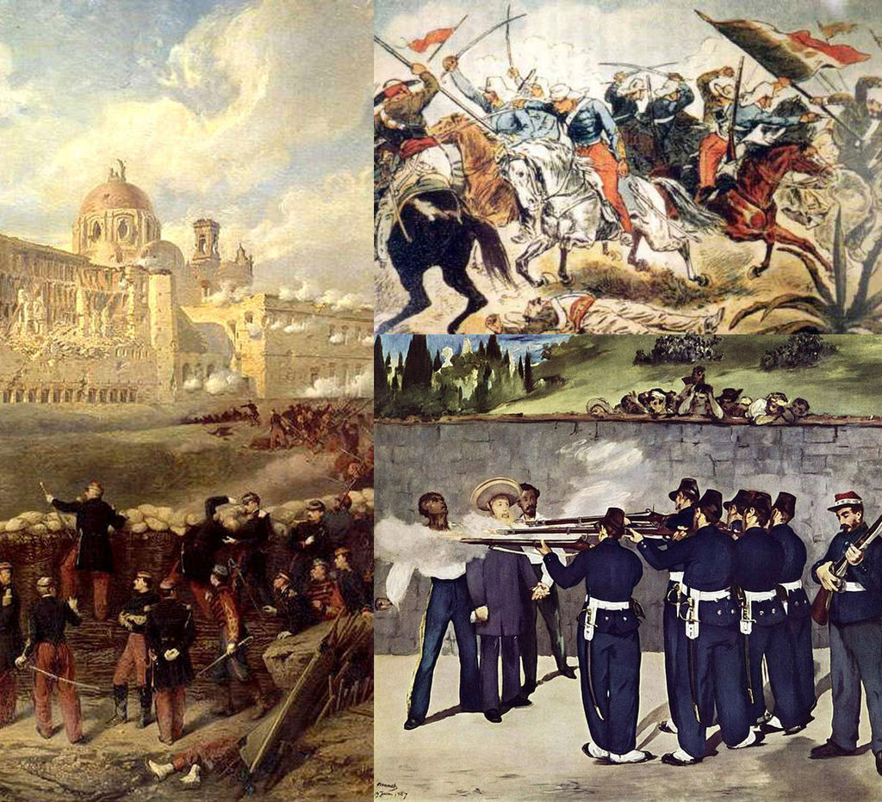
The French invasion of Mexico, 1861-7
Notes:
Image:
By Brigade Piron, CC BY-SA 3.0, https://commons.wikimedia.org/w/index.php?curid=29086973

Slide 13
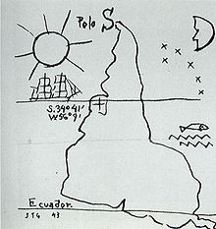
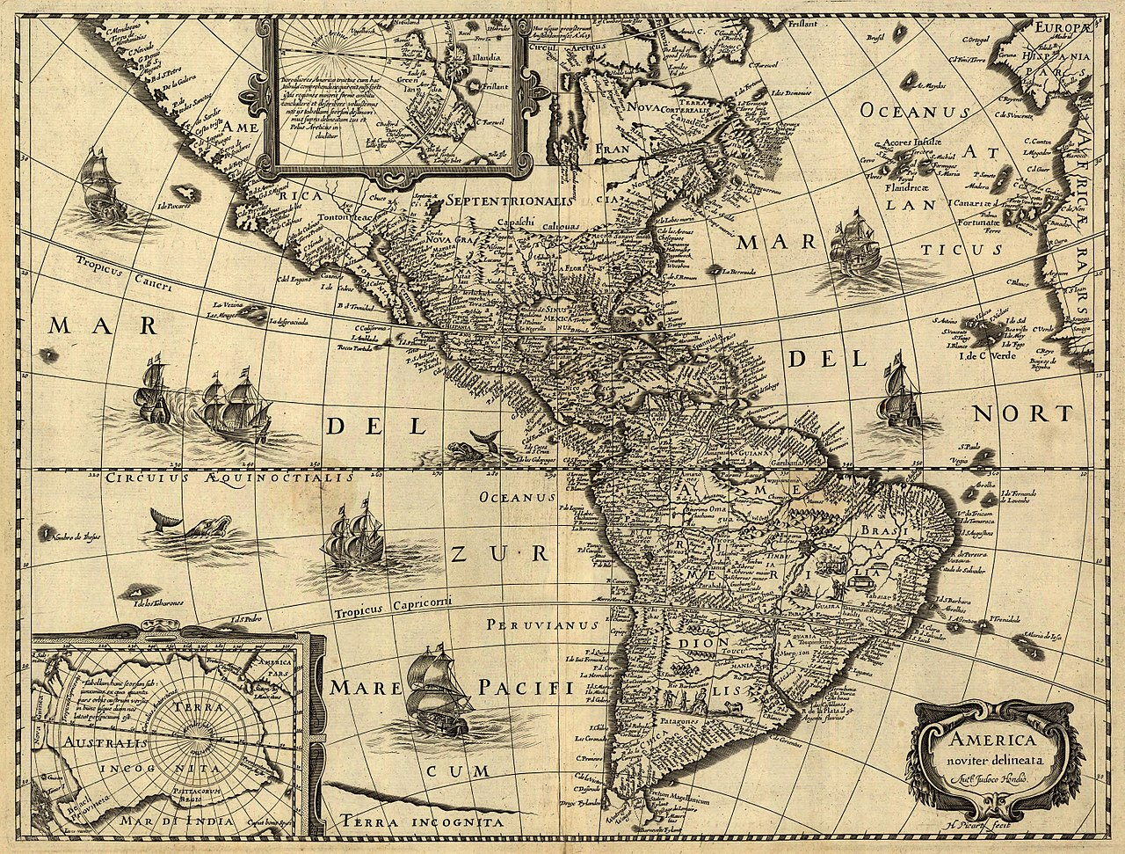
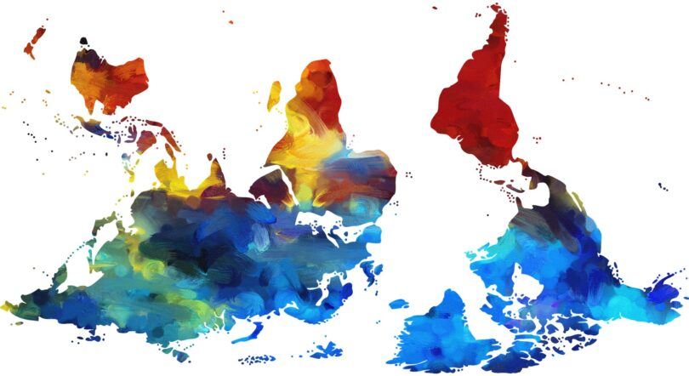
Joaquín Torres García (1878-1949), América Invertida.
Jodocus Hondius (1563-1612),
America newly deliniated, Library of Congress

Slide 14
How useful is the term?
Used more outside the region than inside; people in “Latin America” think of themselves more in terms of local or national identities;
Those who travel internationally often go to the US or Europe more than their immediate neighbours; extensive influence of US and Northern Europe culturally, economically
Significant geographical, climatic differences as well as national and social ones…
Deserts; Andean highlands; tropics and subtropics; temperate plains of southern cone (look more like the US mid-west)
Major differences between Spanish and Portuguese colonial experiences…
But overall, very long, thoroughgoing history of Iberian colonisation does create a large number of similarities between “Latin American” countries
Many places in the Americas don’t ‘fit’ very well within the categorisations… Haiti? The Caribbean in general (what about Cuba)? Quebec? Texas, California, Florida..? What about the huge Latino presence in the US?...

Slide 15
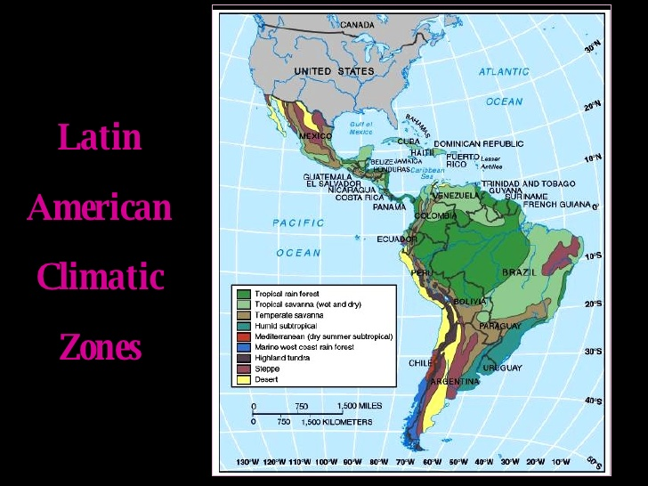

Slide 16
Inequality
Social; racial; economic
Stems in first instance from violently unequal colonial encounters…
And from labour demands of Spanish and Portuguese
Existence of dense populations for work in mines helps determine which areas become centres of empire, esp in Spanish case
Other areas: no native labour supply
Arrival of enslaved Africans in huge numbers - early C16 to late C19
Polities/ societies rested on complex systems of hierarchy; combined notions of religious purity with elements of what we’d now call race, class, gender…
Important evolution of social hierarchies, and resistance/ subversion to them; but they nonetheless endure long after colonial rule; legacy felt today

Slide 17
Economic inequality
Profoundly unequal economic situation for different parts of society, during colonial rule; worsens if anything after independence
Land inequality: massive land grants to privileged Europeans is tool of empire-building; phenomenon of hacienda/ fazenda is about social and political inequality as well as economic;
Late C19: Lat Am economies and lands drawn on huge scale into Atlantic economy/ industrialising north Atlantic; process compounds economic inequality
Periods of very fast economic growth in C20 generally widen economic inequality
Lat Am countries (with notable exceptions) score really highly on the Gini coefficient (measure of economic inequality)
Rapid, uncontrolled urbanisation is part of this process; urban inequality, shantytowns (favelas) very general Latin American phenomenon
Notes:
prii

Slide 18
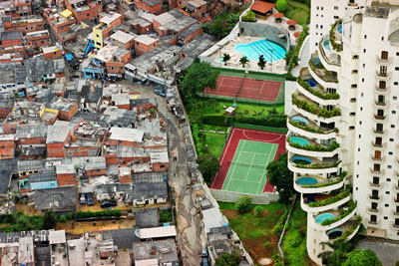
Morumbi neighbourhood, São Paulo, with Paraíso favela next door

Slide 19
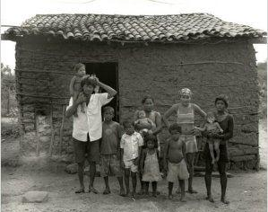
Garapa, dir. Jose Padilha, 2009
A documentary film about people living with chronic hunger in Brazil’s arid north-eastern region
Garapa is a sugar solution given by parents to their children to assuage their hunger when they don’t have enough food to eat
Brazil is currently the world’s ninth richest country…

Slide 20
Resistance and politics “from below”
Indigenous and enslaved rebellions and resistance from earliest colonial times
C19 “popular democracy”: non-elite, enslaved, indigenous people adopt notions of liberalism and anticolonial struggle to their own ends
Mexico 1910: world’s first “social revolution”
Mid-twentieth century revolutions (Cuba is only the most famous…)
Late-twentieth-century social movements – Zapatistas, land reform/ peasant leagues, racial equality movements, women’s movements…

Slide 21
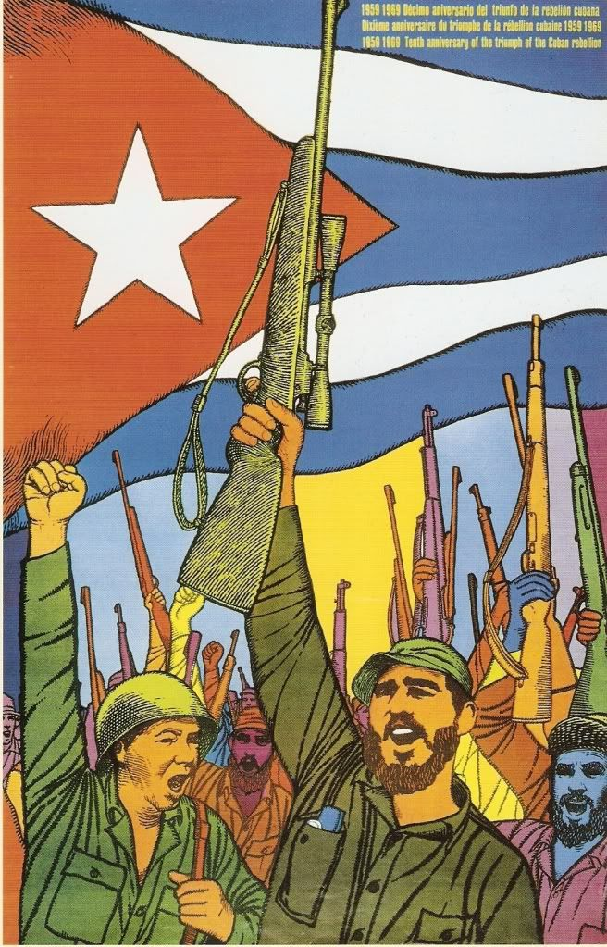
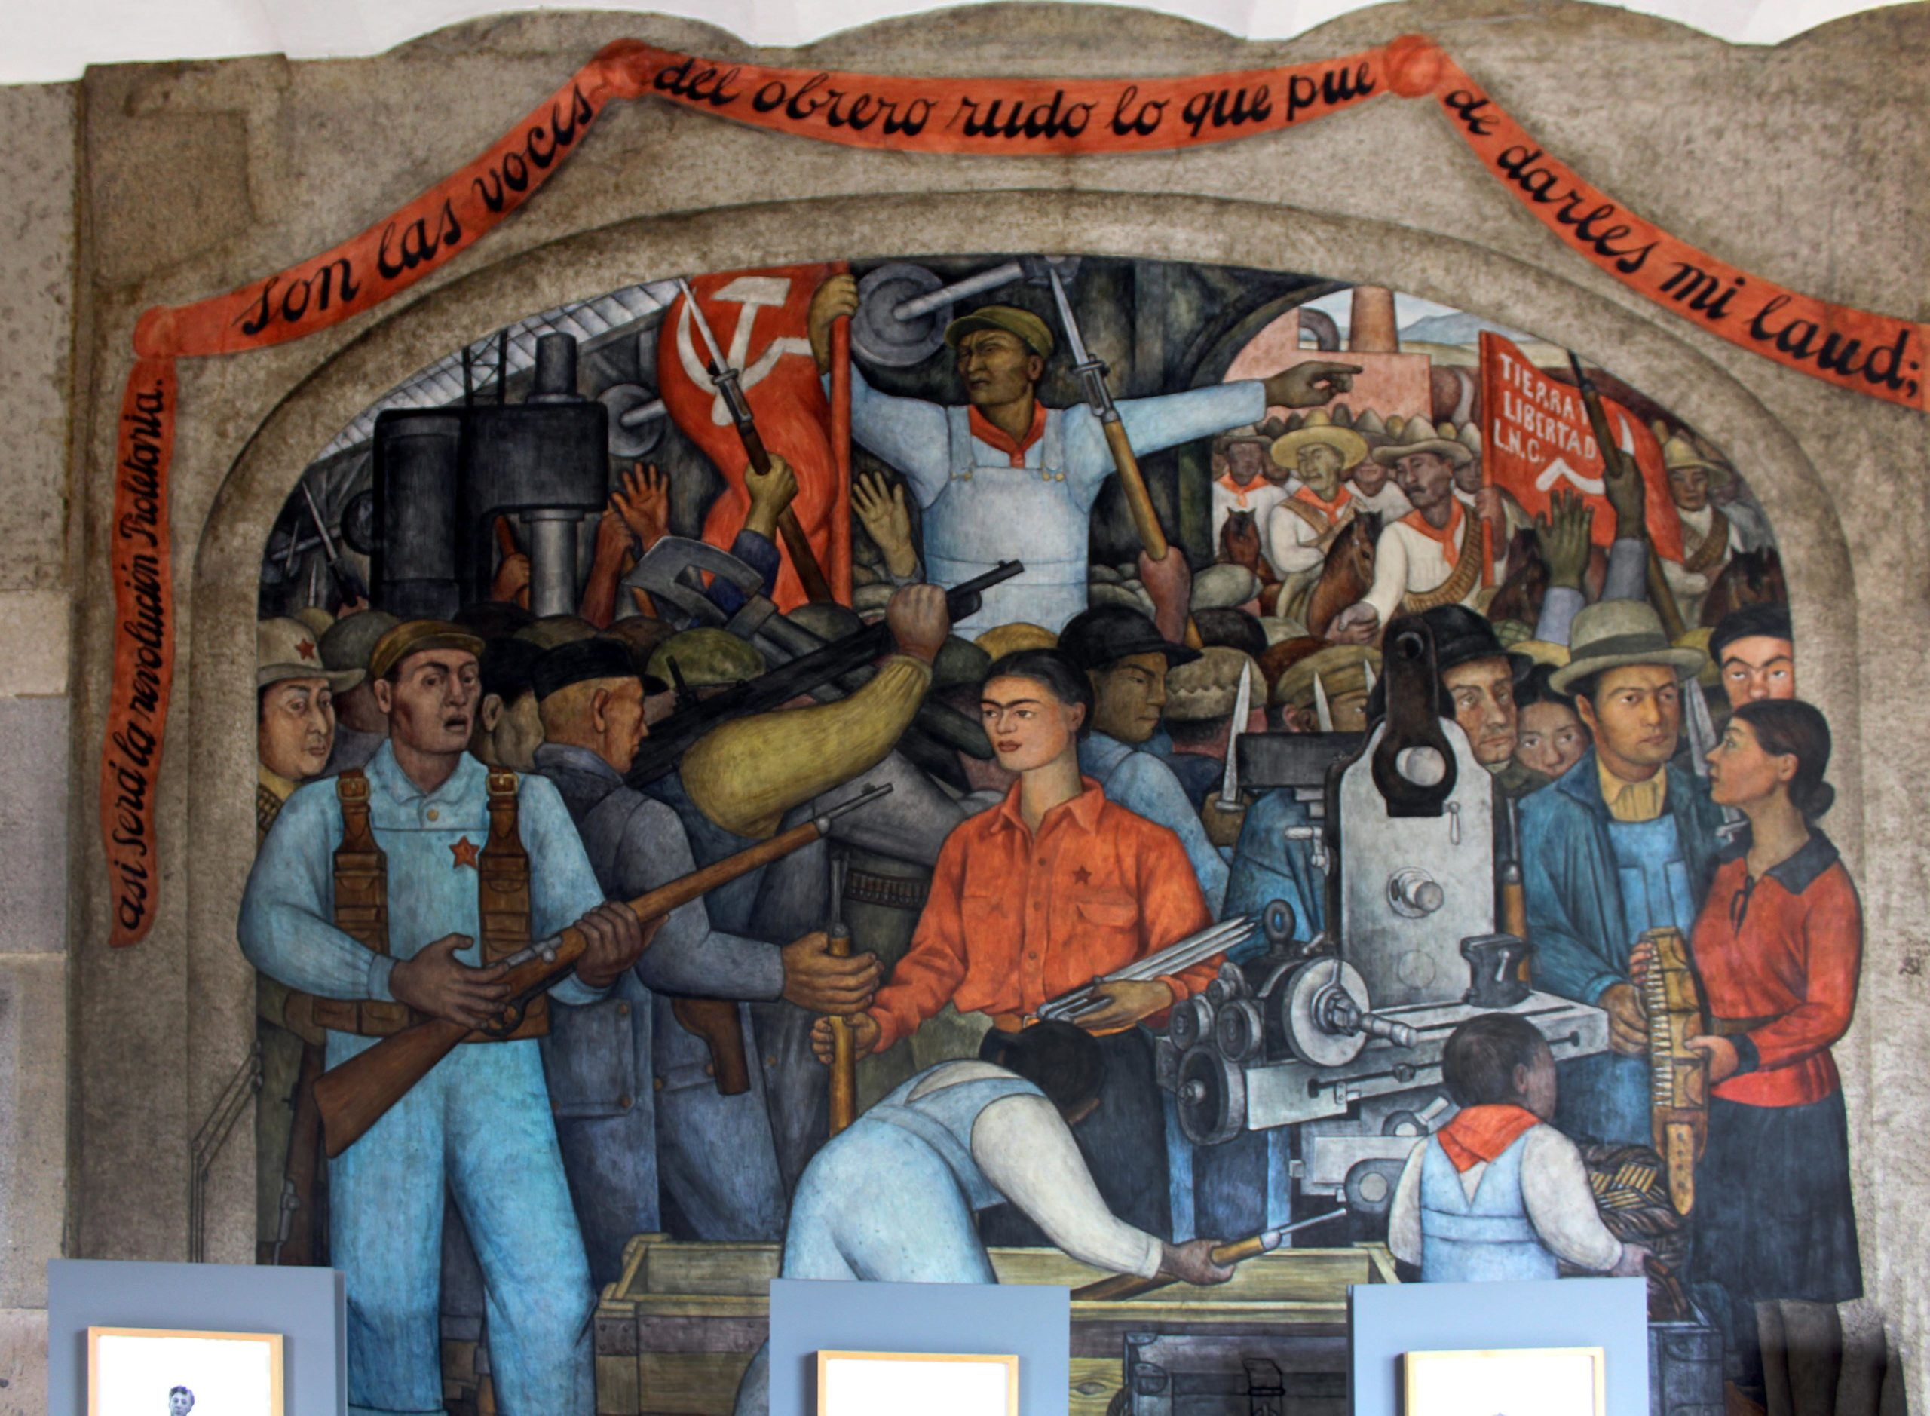

Slide 22
Ideas about race, and race mixture
Particular mix of different peoples is synonymous with region
Nationbuilding founded on notions about race mixture - mestiçagem, mestizaje
Mixture is part of reproductive history under conditions of extreme inequality, conquest, slavery, rape
Traditionally, history told as a meeting of “three groups”: Europeans, indigenous peoples, Africans…
In fact, all of them (especially Africans and indigenous Americas) made up of hundreds of entirely separate ethnic groups; indigenous people lumped together as “Indians” after 1492 (misnomer)
African history of Americas often marginalised…

Slide 23
Africans in the Americas
More Africans went to the Americas before 1800 than did Europeans…
…and more enslaved Africans went to Latin America than any other part of the Americas.
Africans and their descendants were not synonymous with slaves.
They arrived as sailors with the earliest European voyages;
In many societies of Latin America, for much of the colonial period, there were more free than enslaved people of African descent
Nonetheless, African slavery played a huge role in shaping the region, politically, socially, economically.
See Henry Louis Gates, Jr, Black in Latin America (book and PBS TV series, some episodes and interviews on YouTube)
See George Reid Andrews, Afro-Latin America: Black Lives, 1600-2000 (at library)

Slide 24
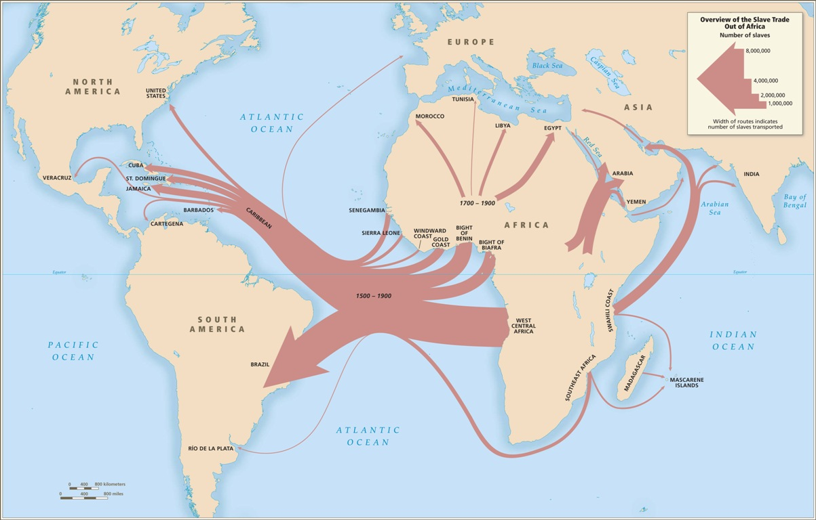

Slide 25
Seminar Reading
Moya, Jose C. (ed). "Introduction: Latin America—The Limitations and Meaning of A Historical Category." The Oxford Handbook of Latin American History. : Oxford University Press, September 18, 2012.
1 Historiography of New Spain
2 Colonial Spanish South America
3 The Historiography of Early Modern Brazil
4 Sexuality in Colonial Spanish America
5 Independence in Latin America
6 Slavery in Brazil
7 Postcolonial Brazil
8 Race in Postabolition Afro-Latin America
9 Indigenous Peoples and Nation-States in Spanish America, 1780–2000
10 Rural History
11 Latin American Labor History
12 Gender and Sexuality in Latin America
13 The Historiography of Latin American Families
14 The New Economic History of Latin America: Evolution and Recent Contributions
15 Disease, Medicine, and Health
16 Popular Religion in Latin American Historiography

