Slide 1
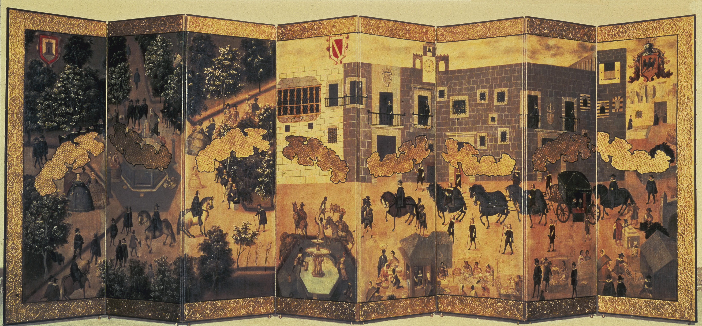
Week 2:
Welcome to
Latin America: Themes & Problems!
“View of the Palace of the Viceroy in Mexico City,” 1600-1700, artist unknown
Vistas: Visual Culture in Spanish America, 1520-1820
https://vistasgallery.ace.fordham.edu/exhibits

Slide 2
Part 1: Nice to meet you!
What degree are you doing at Warwick?
Have you ever been to/ studied Latin America before? What made you choose the course?
How do you think it will fit with (or not) your other modules?

Slide 3
Part 2: some quick “housekeeping”
Have you found the course website? Had a look at the online bibliography?
Have you been able to find a course textbook: these are listed on the Schedule of Lectures and Seminars page of the website
Assessments – covered in the lecture this week; see Tabula for deadlines; class participation component is 10%
The History Undergrad Hub is your go-to source of all info…
Essay plans: 1,000 words (about 2 pp)
Presentations: in class, individual or groups, from week 4; liaise among group in own time to prepare; for more info, see Presentations Guidelines under Module Details, on course webpage.
Presentations are NOT assessed but they are a good chance to contribute to class overall (seminar participation)

Slide 4
Exercise 1: What is “Latin America”?
What do you think of when you think of “Latin America”?
Is “Latin America” a useful term? What definitions, and problems with the definitions, does Jose Moya offer?

Slide 5
Exercise 2:
Look at a map of the Americas on Google Maps. What do you know about the different regions/countries? What similarities/ differences do you see in terms of climate, culture, language, politics? Where does “Latin America” start and end?
How might you use any of the online databases listed for this week’s discussion to help with your presentations and essays? These are:
Early Americas Digital Archive
Vistas: Spanish American Visual Culture, 1520-1820
LANIC data base
Transatlantic Slave Trade Database
Slavery Images: A Visual Record

Slide 6
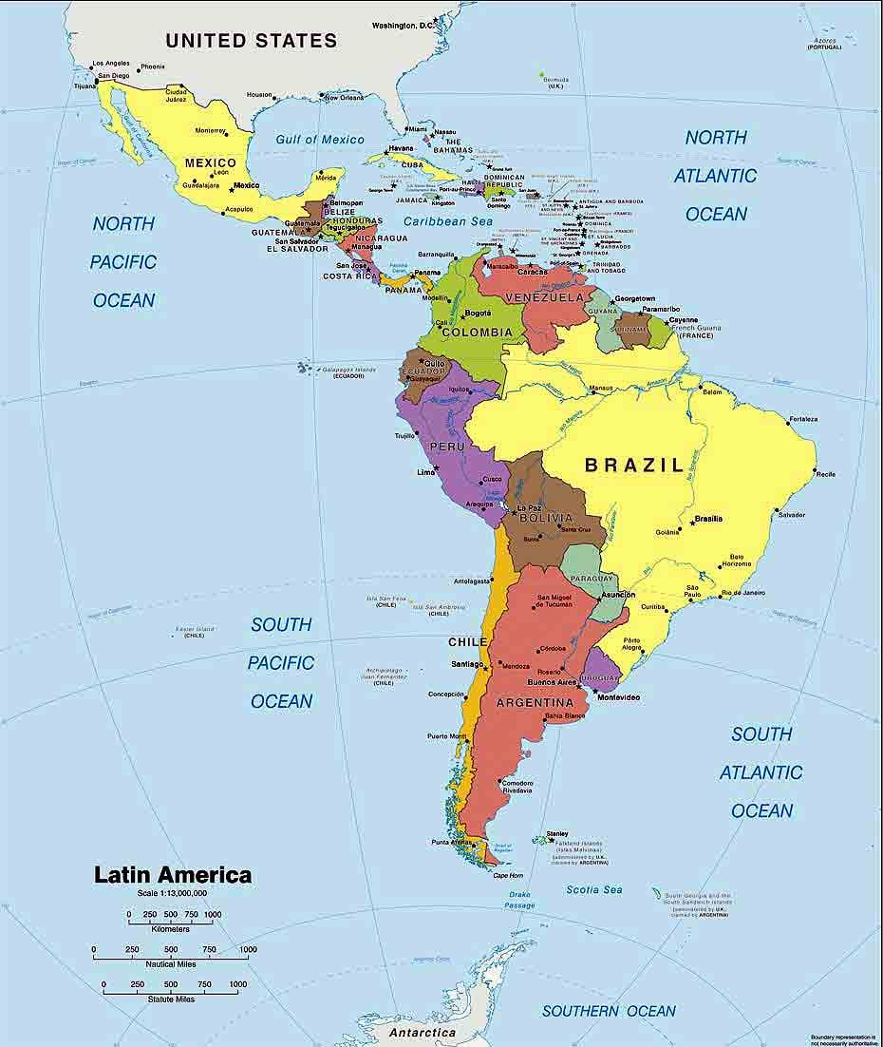

Slide 7
