Slide 1
The U.S. in Latin America
Latin American Themes and Problems 2026
Dr Liana Beatrice Valerio

Slide 2
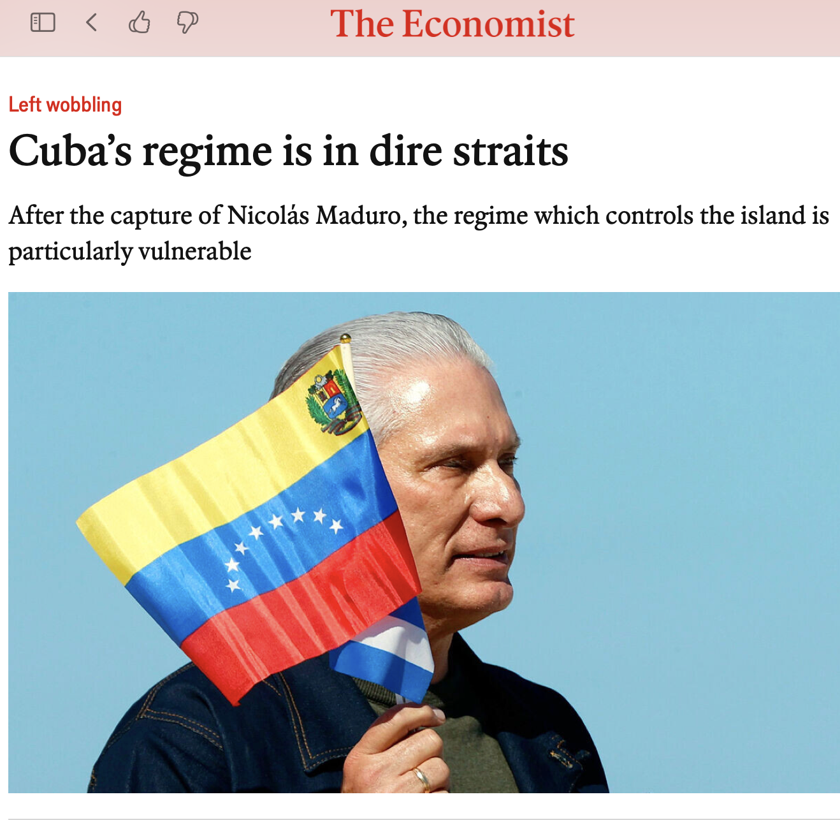
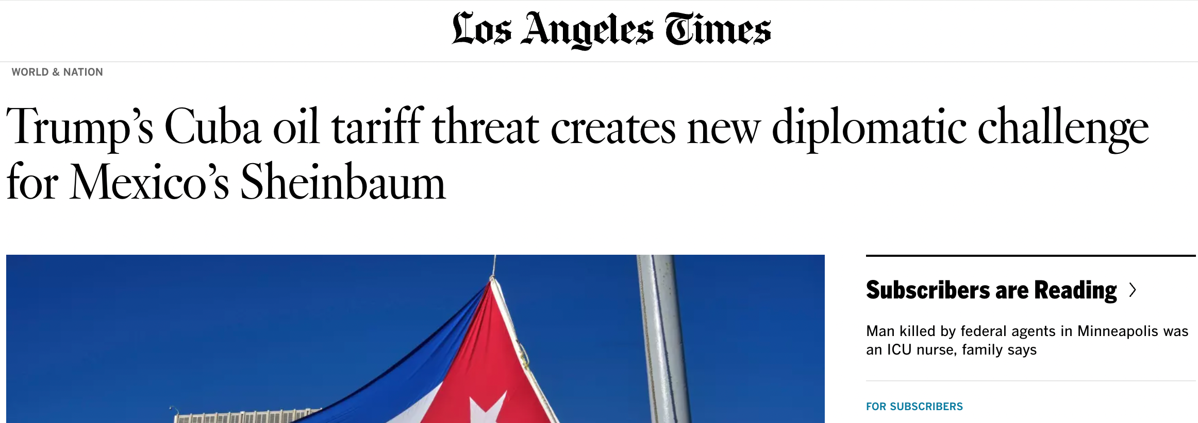
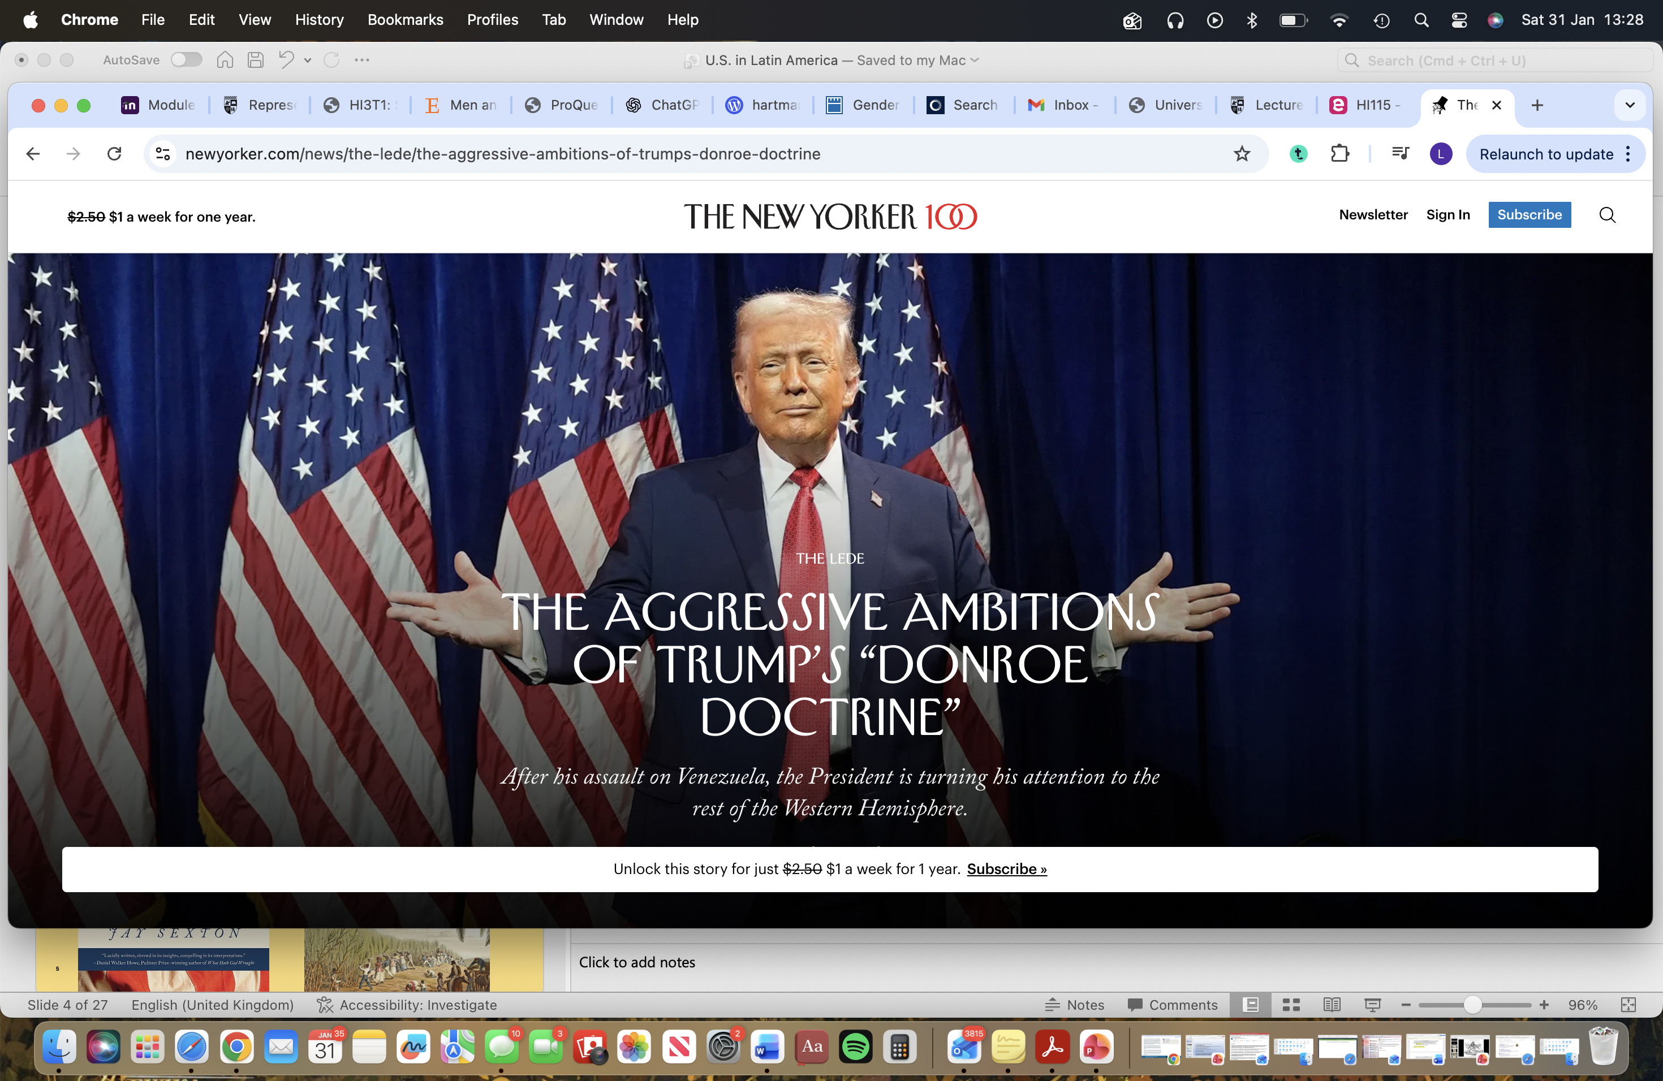
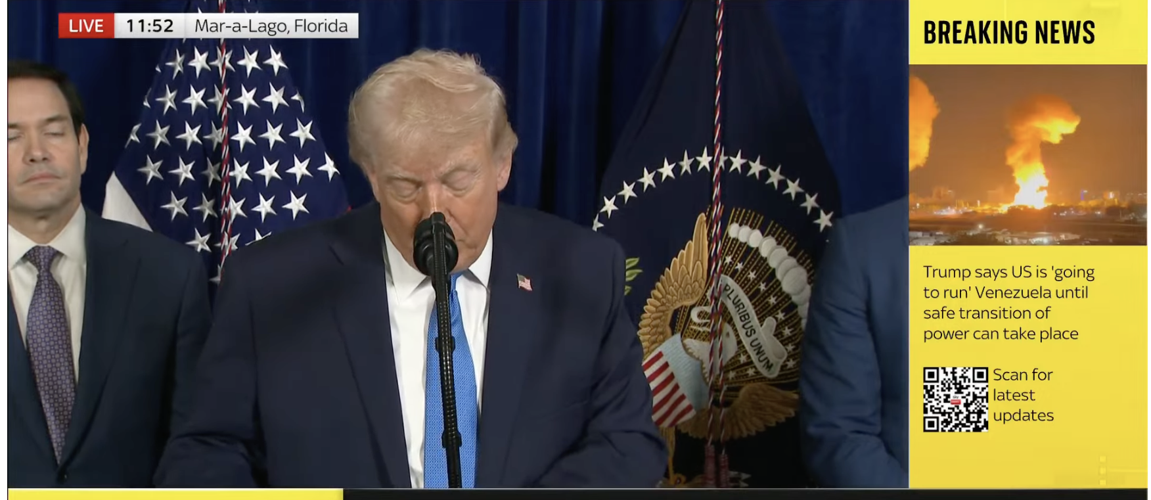

Slide 3
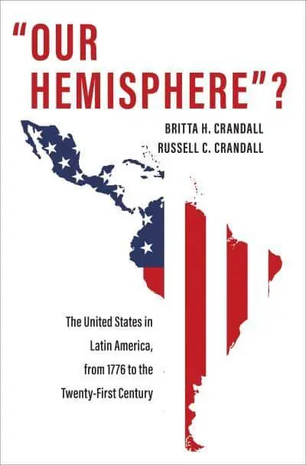

Slide 4
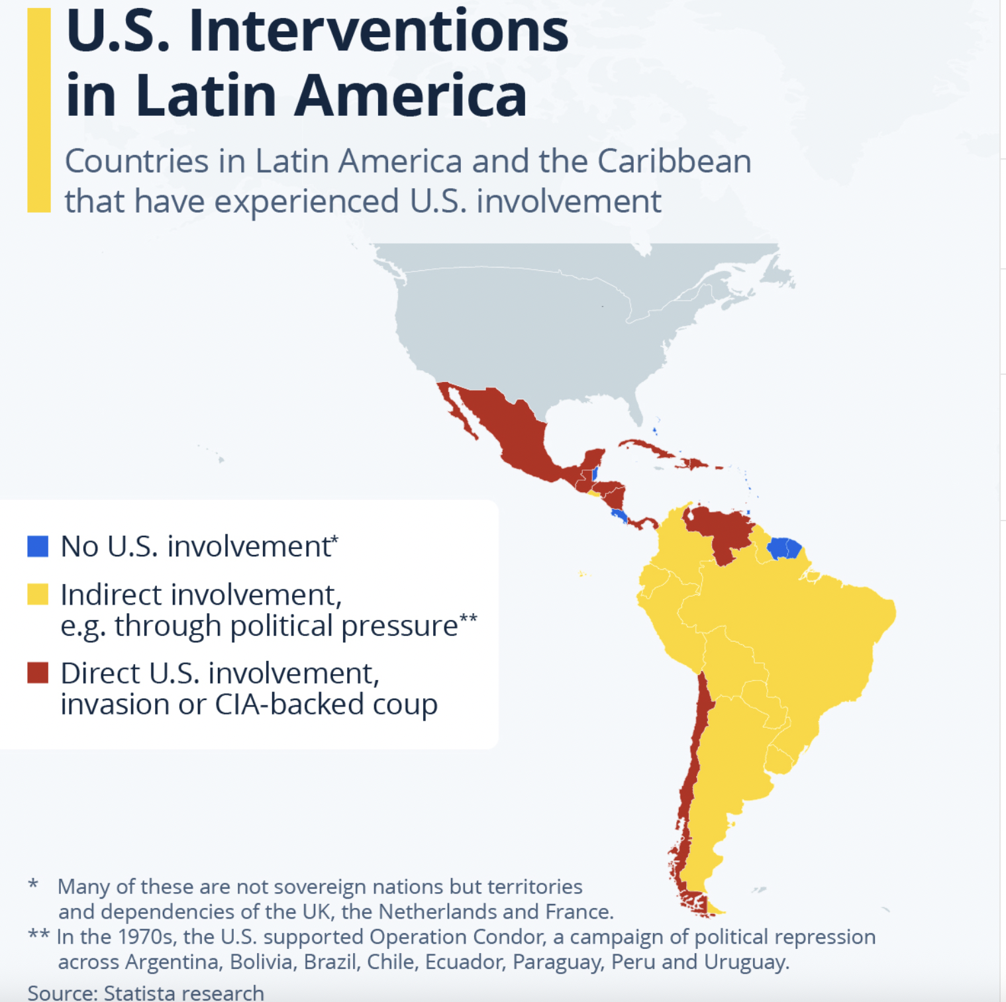

Slide 5
5 Phases
1 - 1780s-1840s
2 - 1840s-1890s
3 - 1890s- early 1930s
4 - 1930s-1940s
5 – 1945 onwards: The Cold War
6 – Modernity…?

Slide 6
Phase 1, 1780s – 1840s
U.S. as new nation: Declaration of Independence signed 250 years ago this year. Regional vulnerability paired with expansion.
Expanding by purchase from European powers (Territory gained from France via the Louisiana Purchase in 1803, U.S. purchases Florida from Spain, 1819) and forced migration of Native American peoples.
Continued European designs in the hemisphere: Determination to protect new independence against Britain, France (and Russia) how to do so with vulnerable frontiers?
Revolutionary Wars across the Americas (including the Caribbean: remember Haiti)
Monroe’s declaration of policy: The ‘Monroe Doctrine’ (1823)

Slide 7
The Monroe Doctrine, 1823
‘The American continents, by the free and independent condition which they have assumed and maintain, are henceforth not to be considered as subjects for future colonization by any European powers.’
---
Based on a particular ideology: republicanism, liberal principles, anticolonial sentiment. US seeing itself as championing rebellion against forces of Empire.
Why is this doctrine so fundamentally important, and why are we hearing so much about it in the news today? It seems quite fair and just… right?

Slide 8
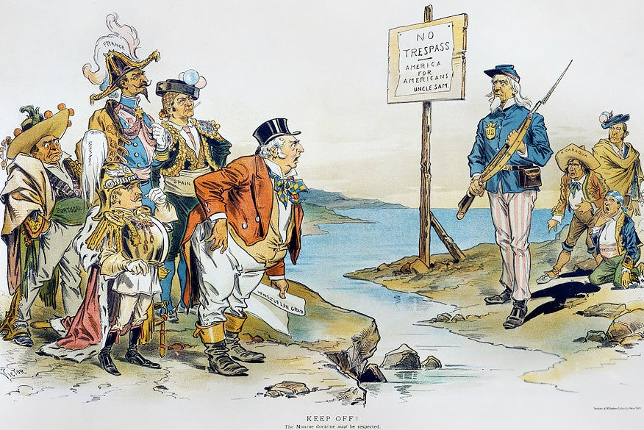

Slide 9
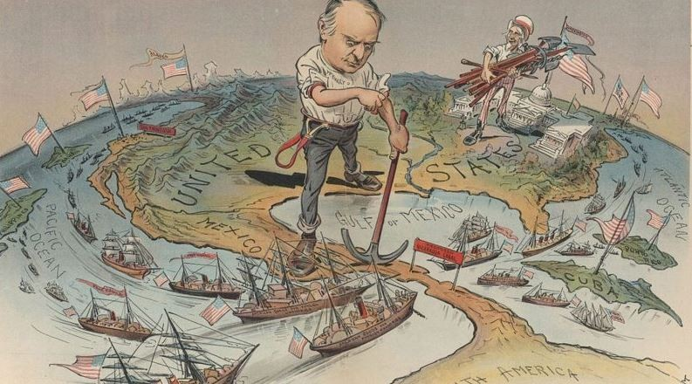

Slide 10
Phase 2:
More confident (after 1812 ‘victory’ over Britain)
More expansive territorially (across what we now know as the U.S. but wasn’t yet)
Growing private interest in Latin America, sometimes backed by the state, e.g. Nicaragua in 1850s
Texas: 20,000 US settlers move to Texas from 1820s; 1836 rebellion against Mexico and Texan Republic 1836-45.
Mexican War 1846-8: loss of California, Arizona, New Mexico. Profound impact on Mexico.

Slide 11
Manifest Destiny
Strengthened confidence following…
- victory in Mexican war
US Civil War 1861-5
- Rising industrial and military power of U.S.
linked to deterministic notions of race supremacy - ‘Social Darwinism’ – and from there, idea of “tutoring” non-white peoples/ countries (link to post-emancipation segregation in the US South)
Later bound up with ideas of American brawn and masculinity: frontiersmen. Defined in contrast against…

Slide 12
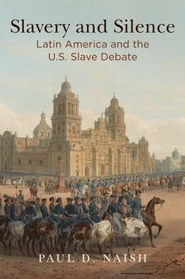
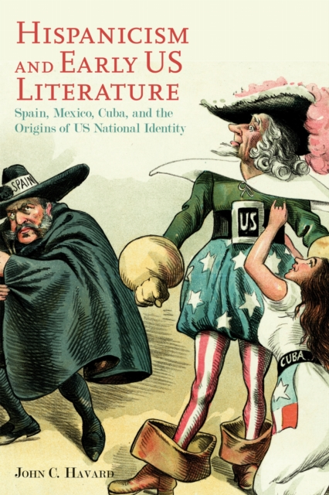

Slide 13
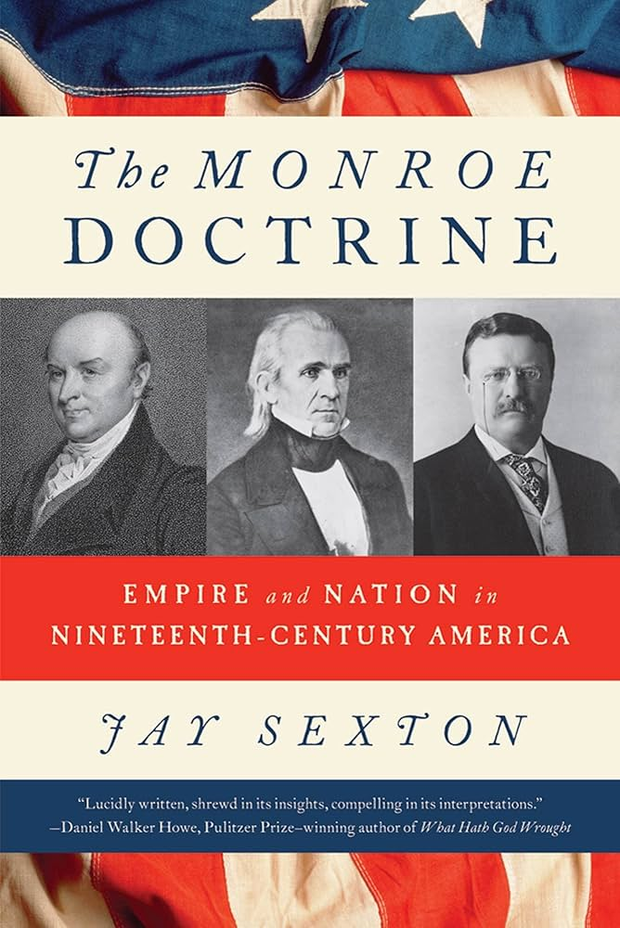
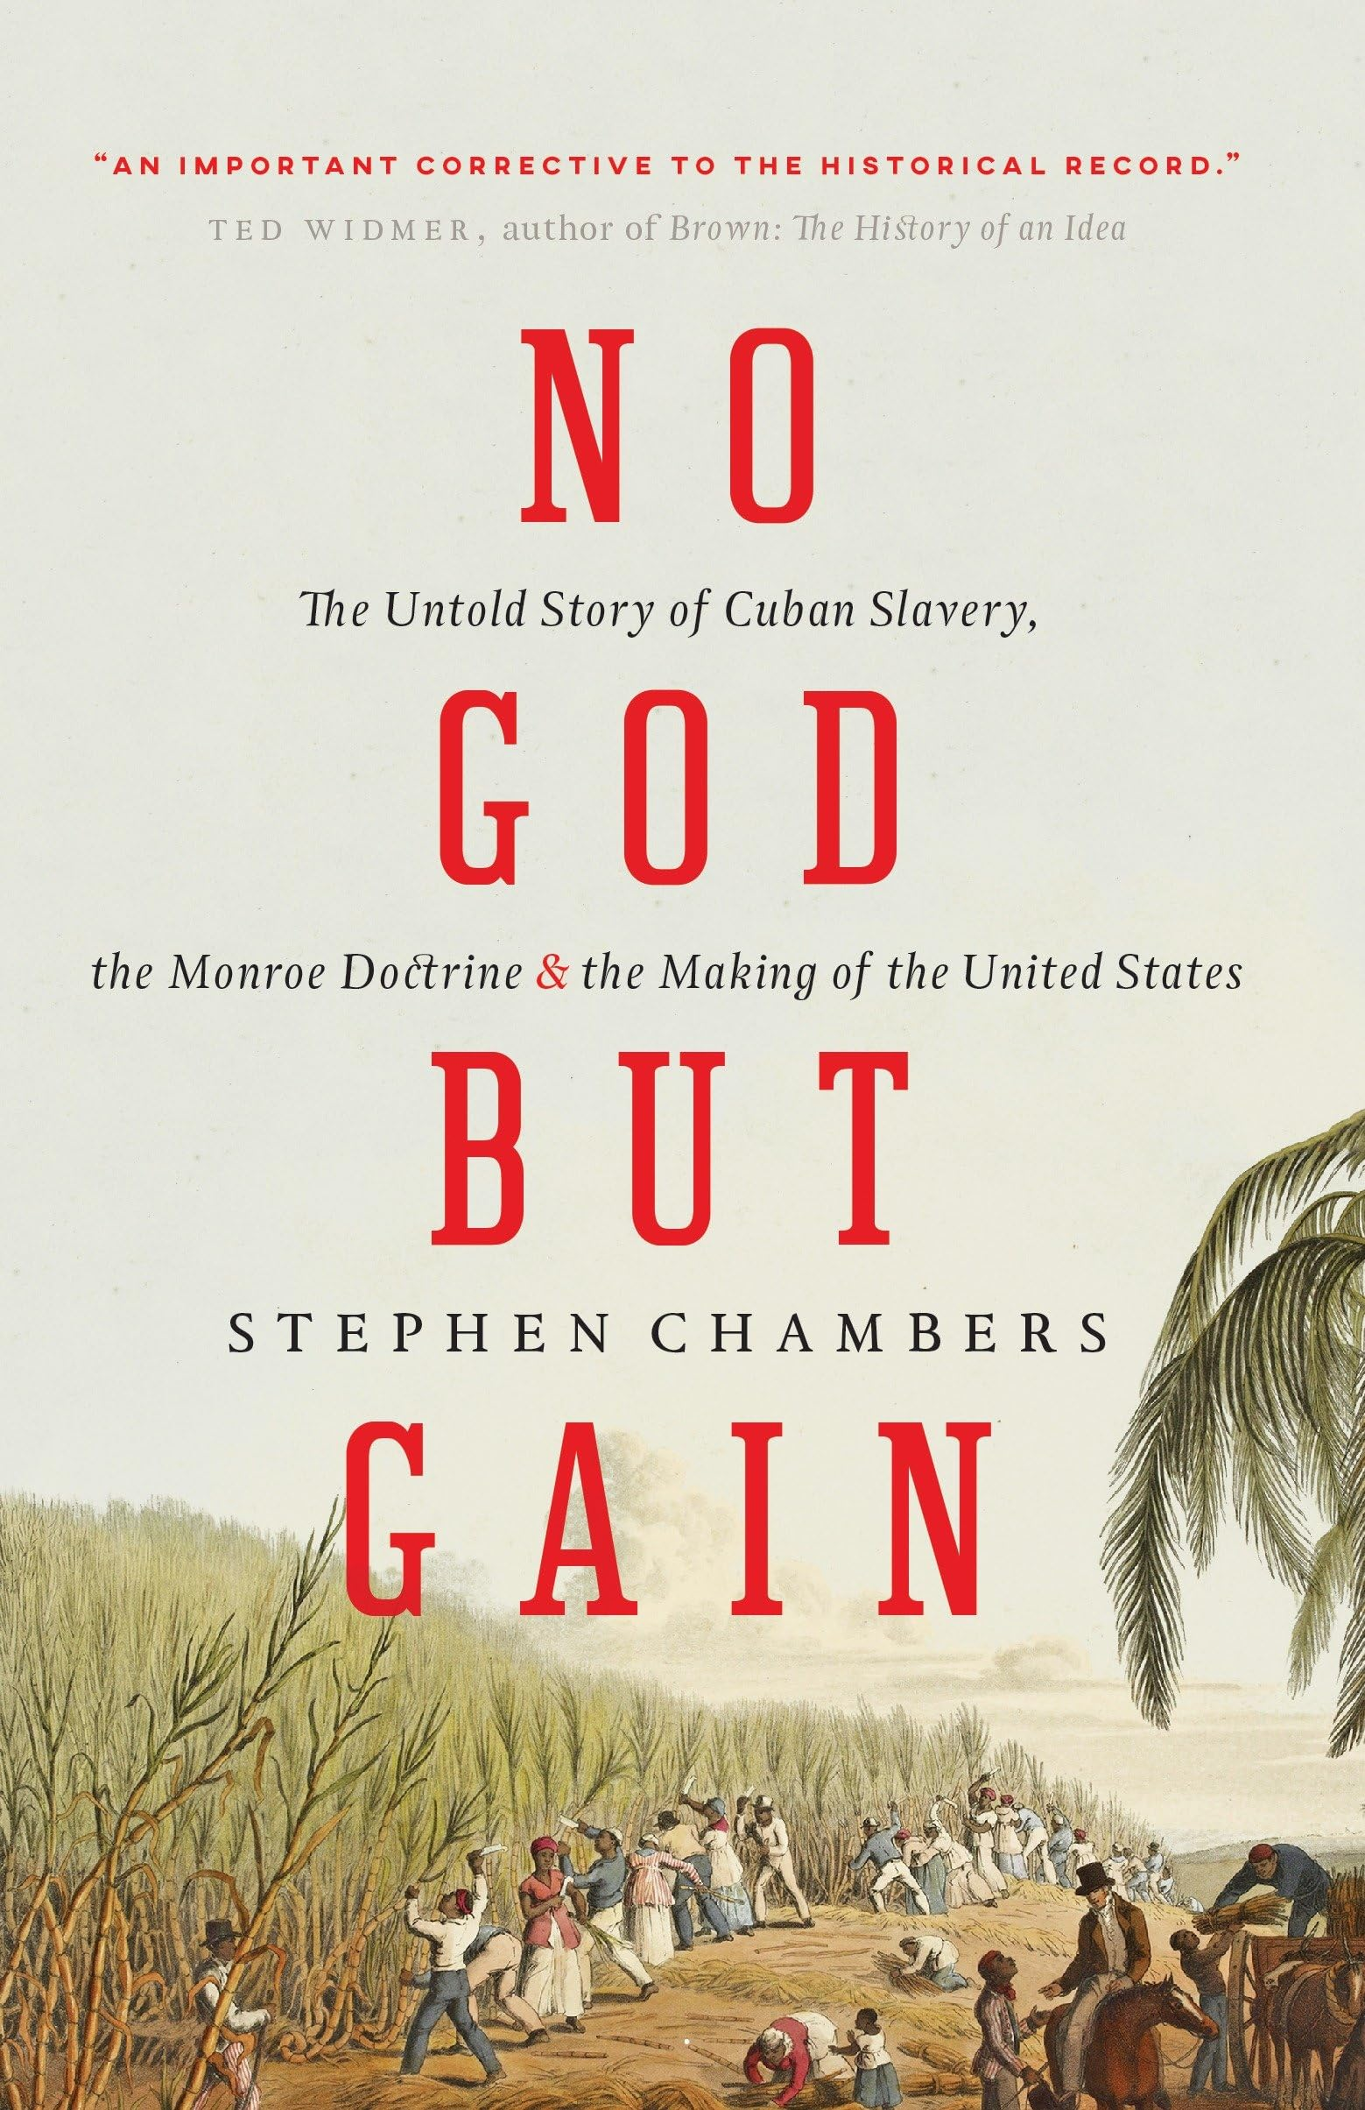

Slide 14
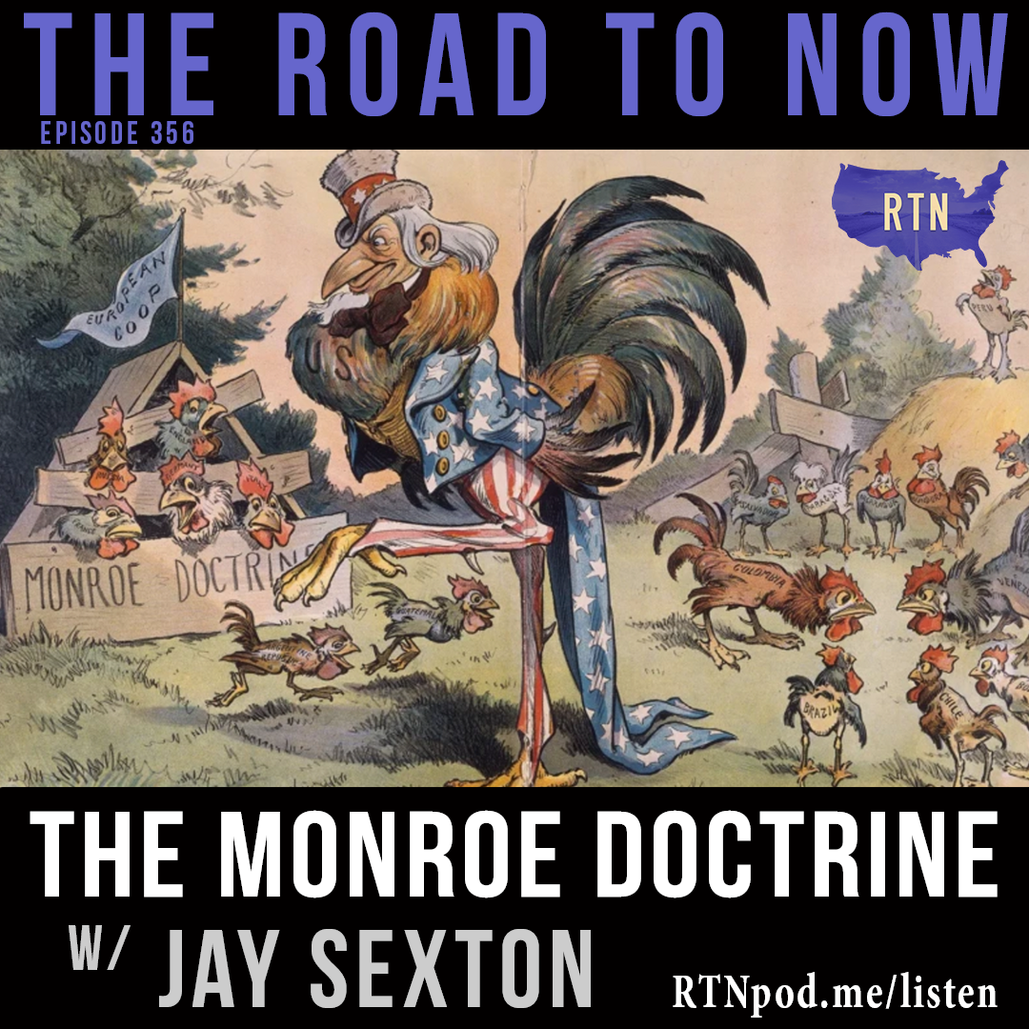
Jay Sexton
The Road to Now Podcast
https://www.youtube.com/watch?v=I5oiYGID0I0

Slide 15
Cuba
Monroe Doctrine: Aimed at Britain (in Cuba) and Russia (in Alaska)
U.S. presidents had been openly coveting Cuba since Jefferson. Wanted to annex it as a “slave-state.” Remember, Cuba was a major sugar producer = treasure-trove.
Spain left with Cuba, Puerto Rico, Philippines.
Slavery keeps elites loyal (outnumbered by population of colour by mid-C19)
But: growing separatism
US repeatedly tries to buy Cuba, sees as “natural” acquisition
Long anticolonial struggle, forging of black-white alliances and nationalism in Cuba: Ten Years’ War (1868-78) and War of Independence: 1895-8

Slide 16
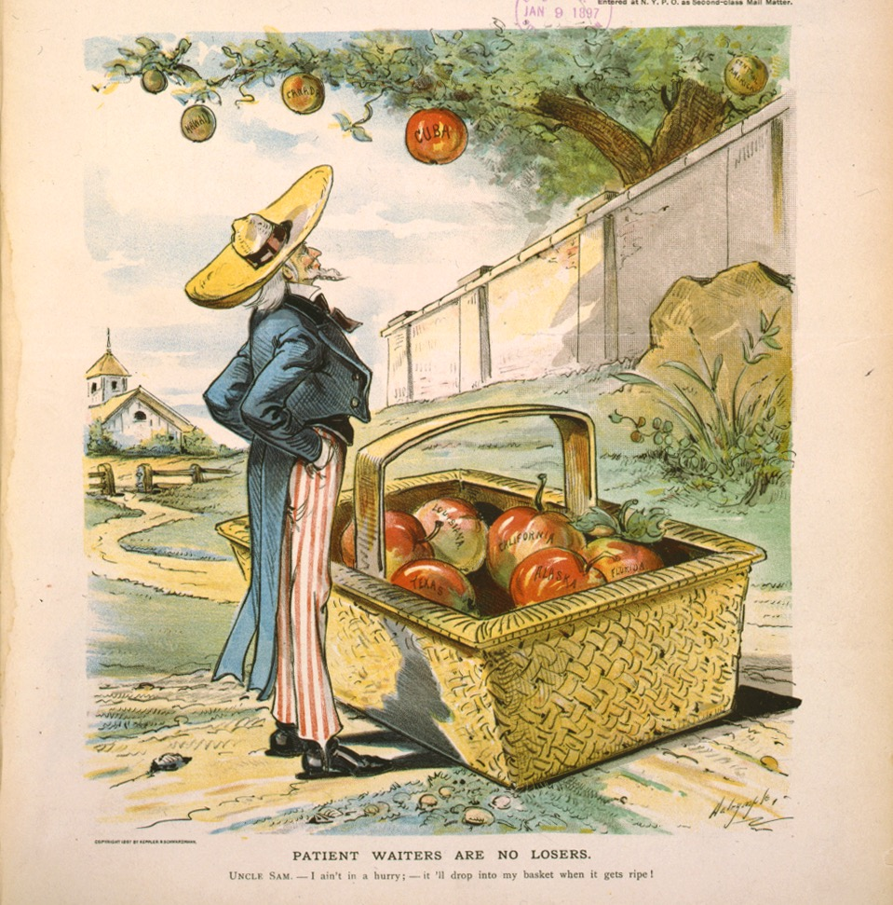

Slide 17
Cuban-Spanish War 1898
How the U.S. sees (and presents) its role in the world…
Phase 3: 1890s – early 1930s

Slide 18
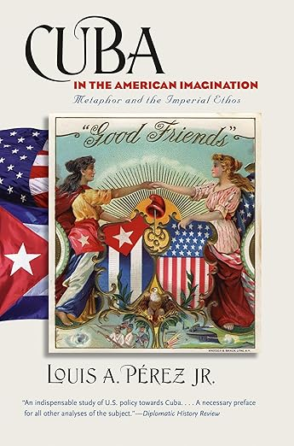

Slide 19
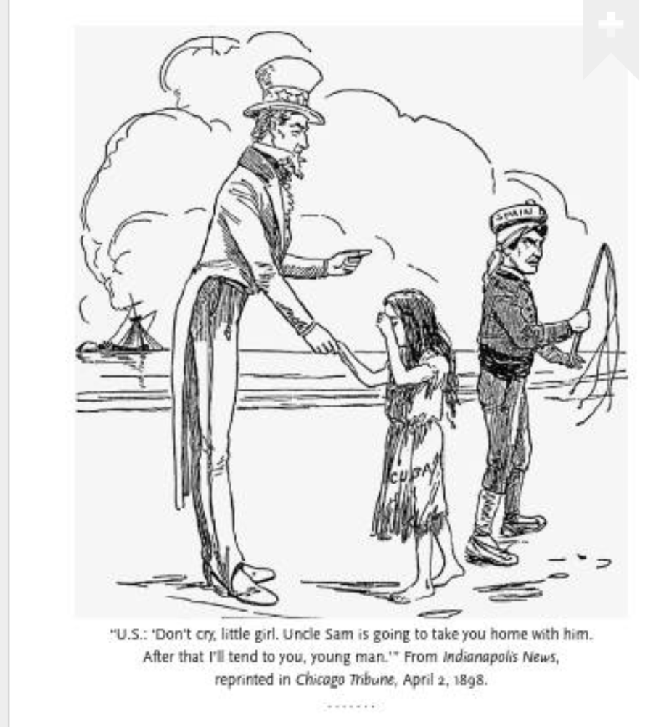

Slide 20
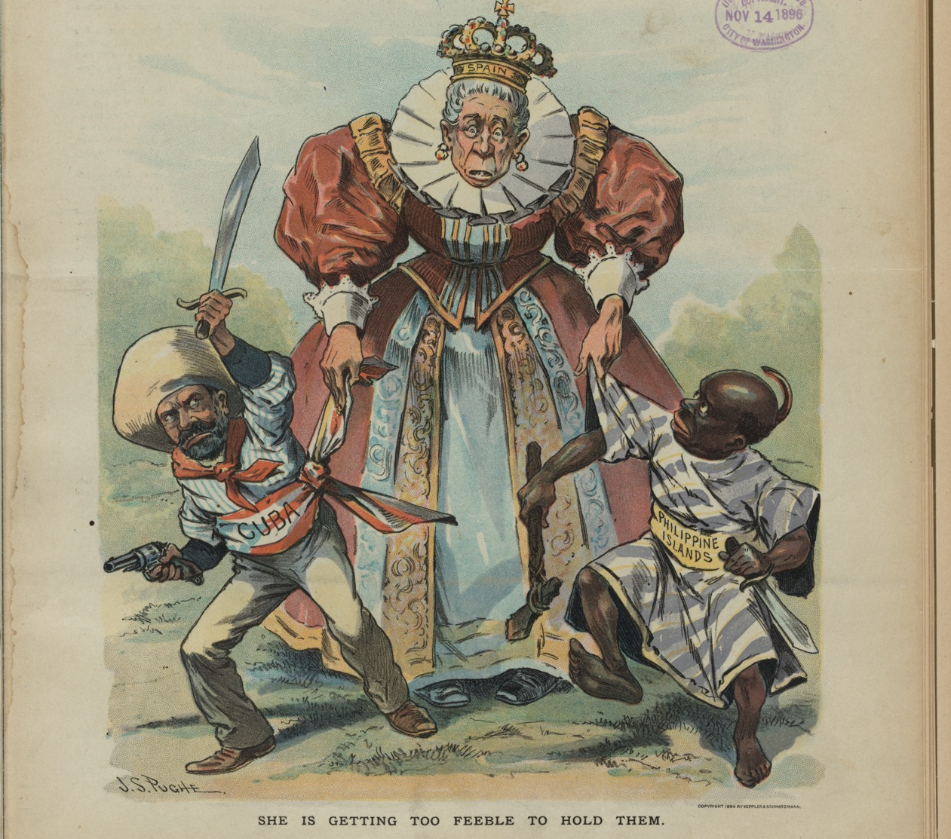
.

Slide 21
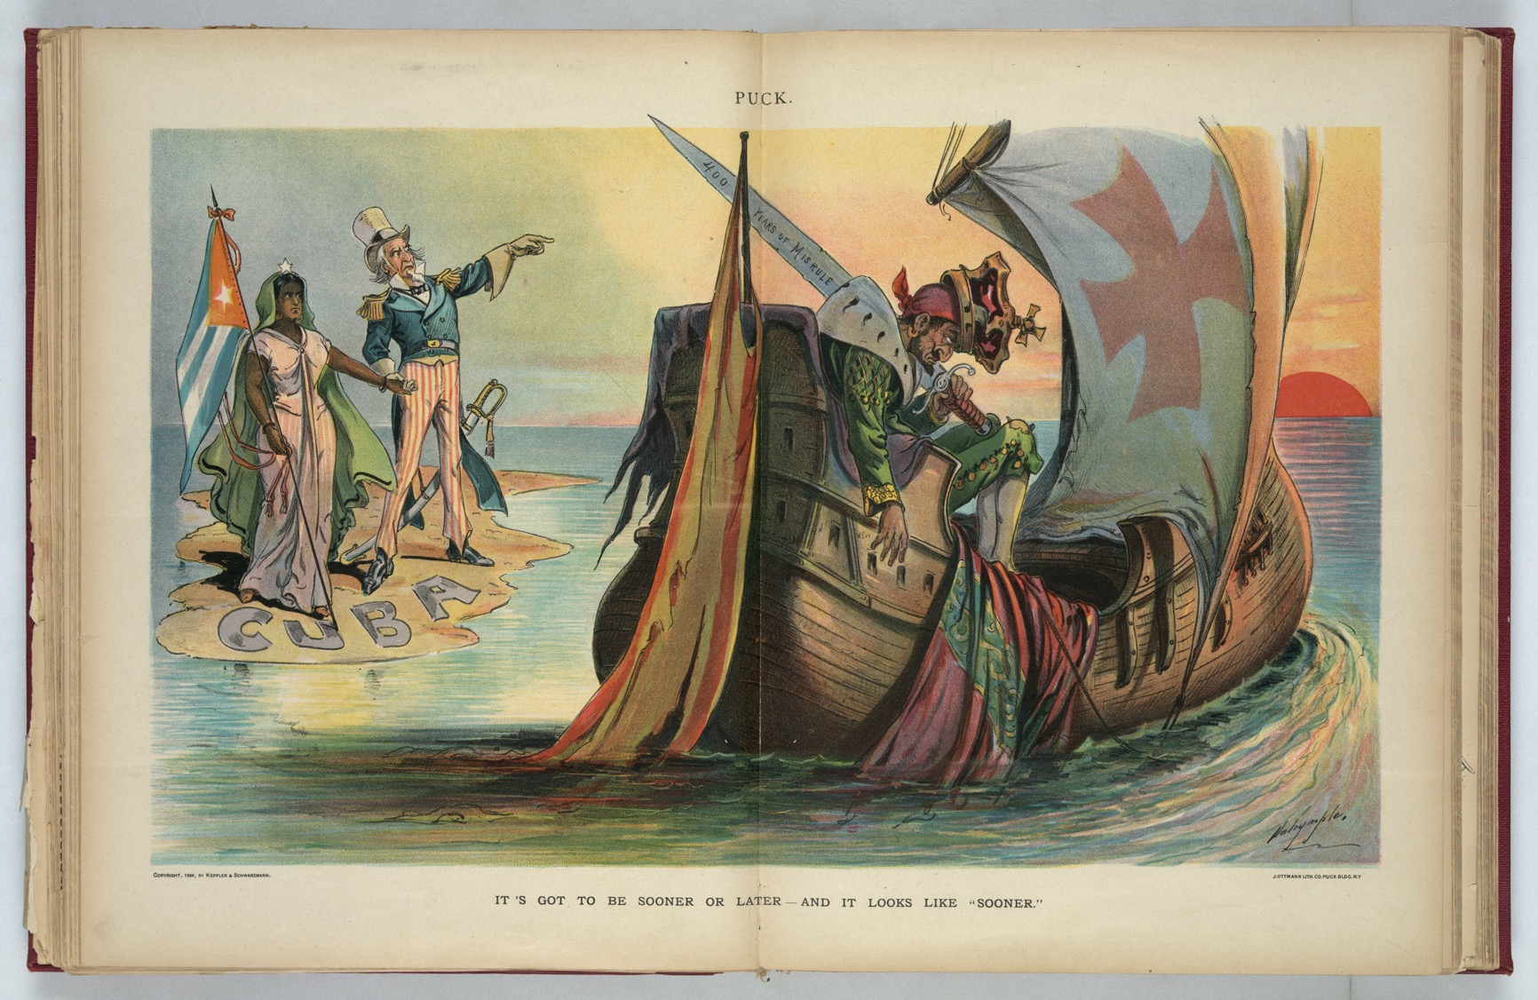

Slide 22
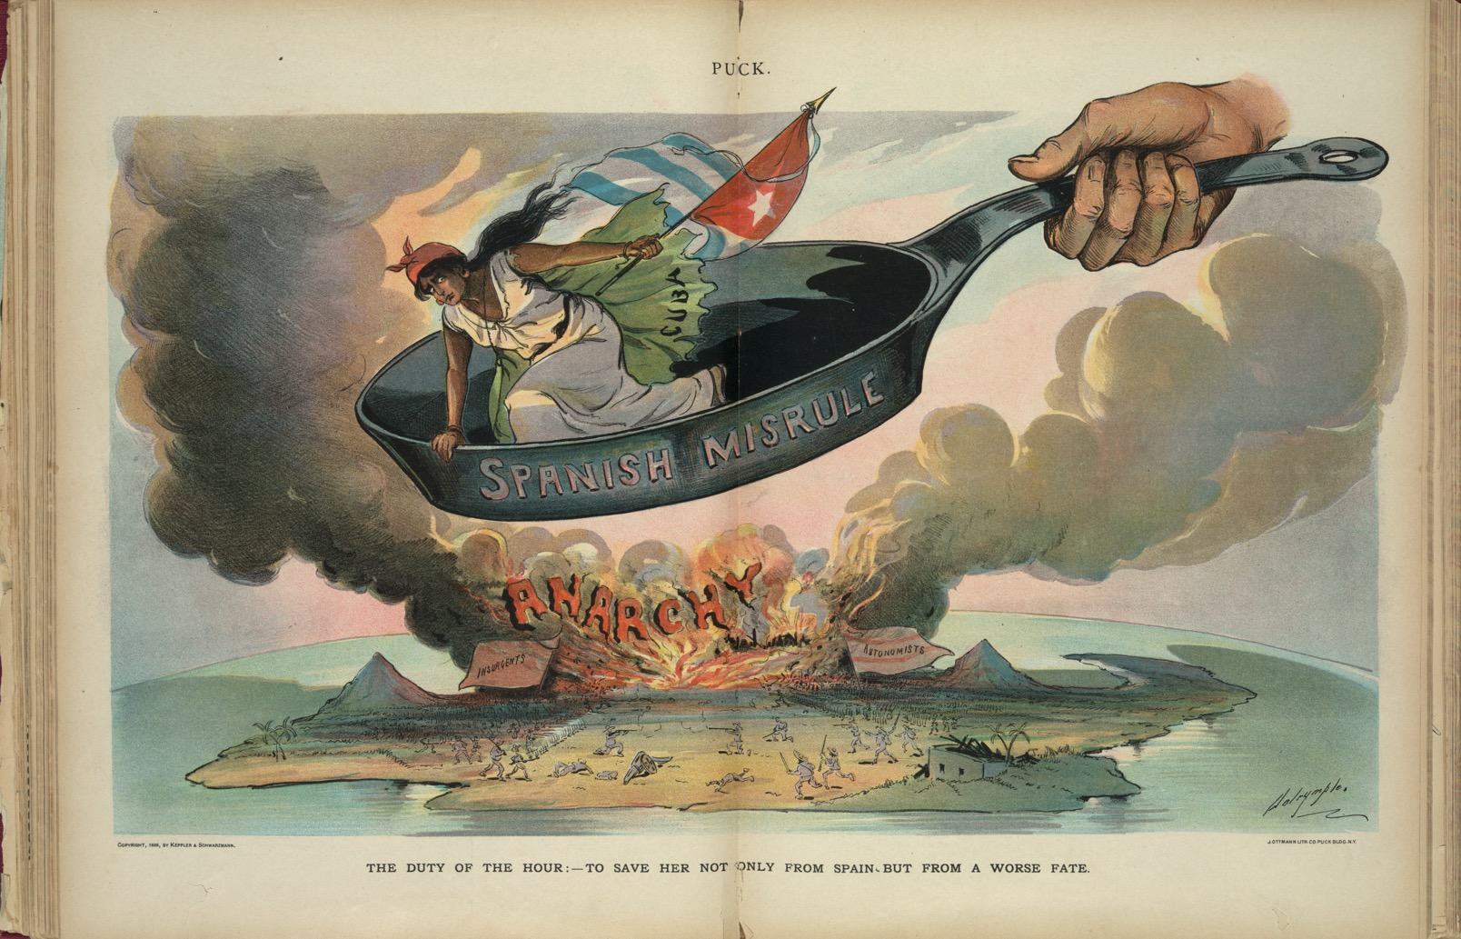

Slide 23
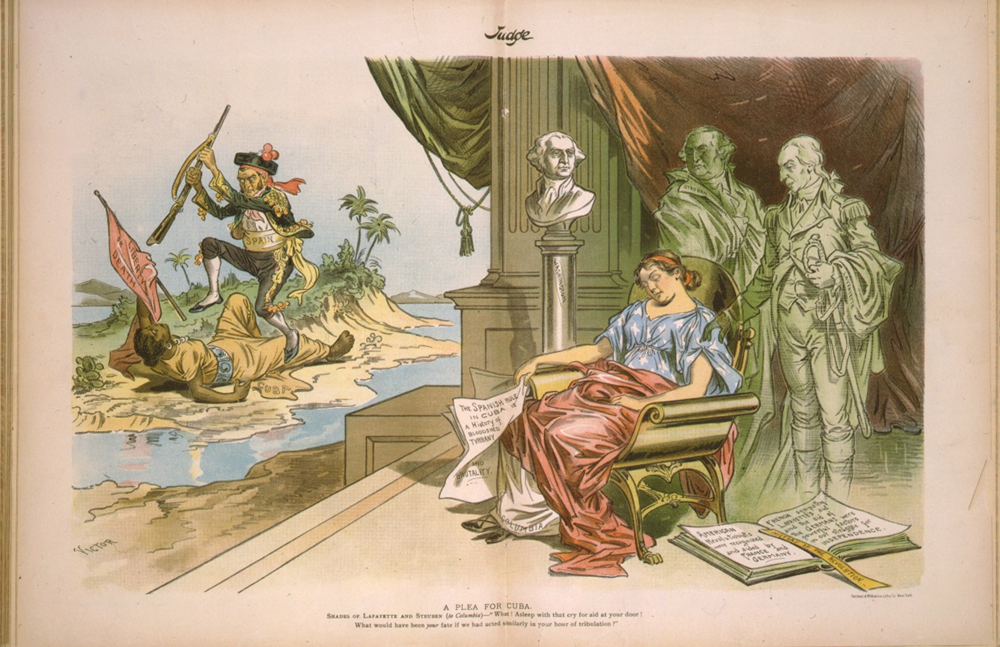

Slide 24
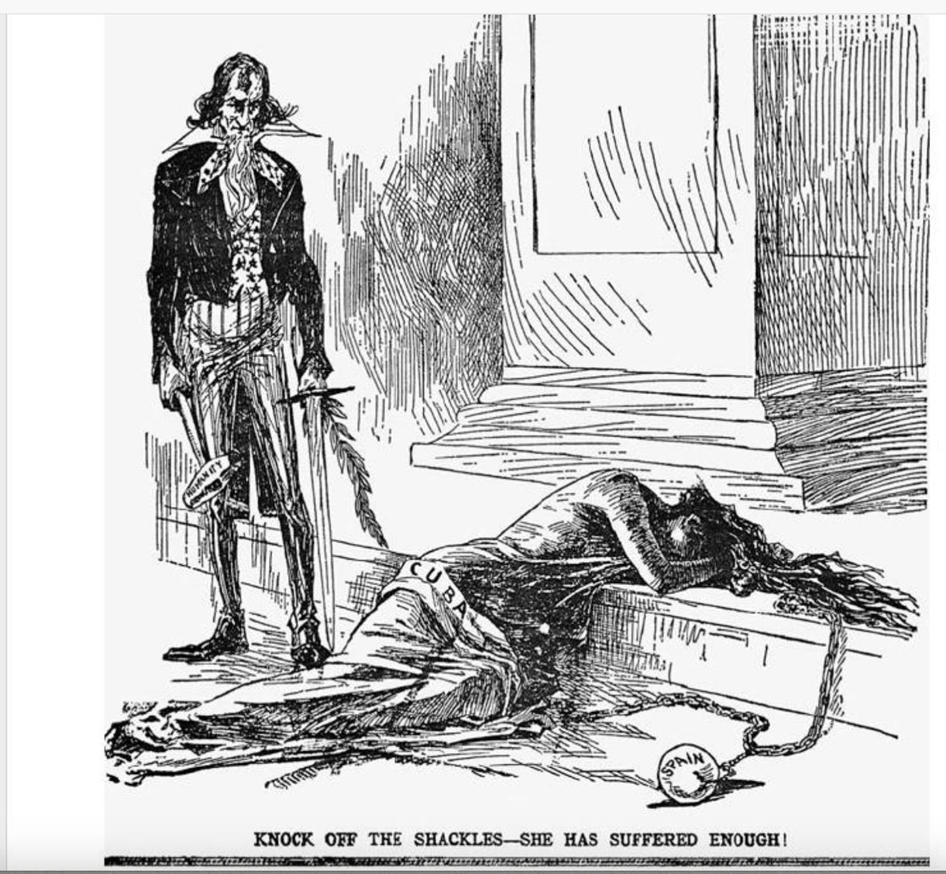

Slide 25
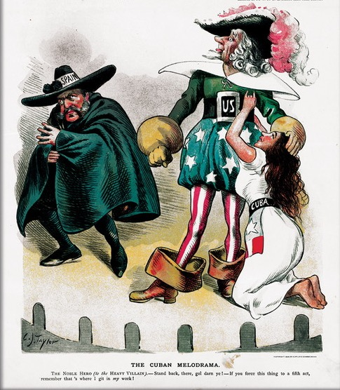

Slide 26
Cuban Independence…?
US intervention; final end of Spanish empire; Cuba officially a protectorate to 1902 but unofficially US-controlled in many ways for decades afterwards.

Slide 27
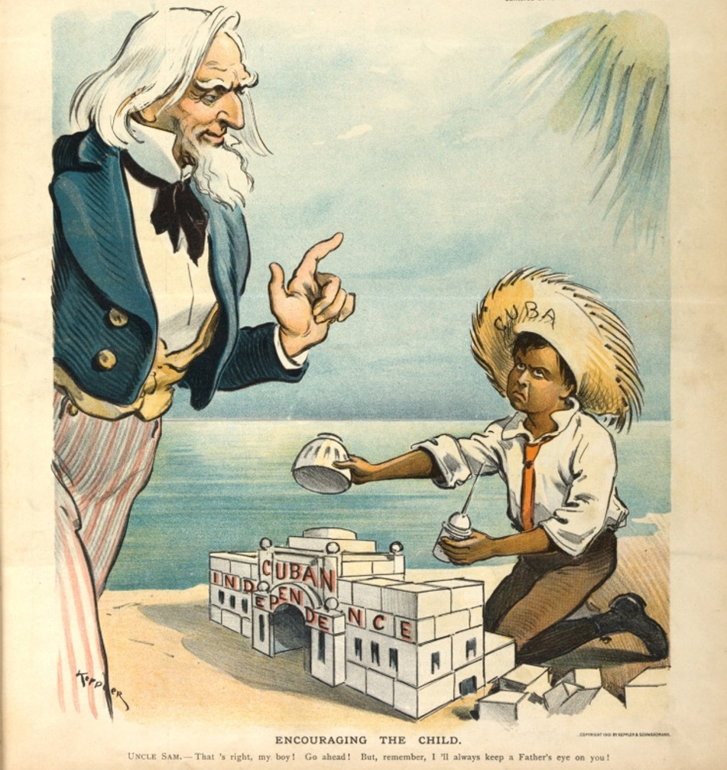
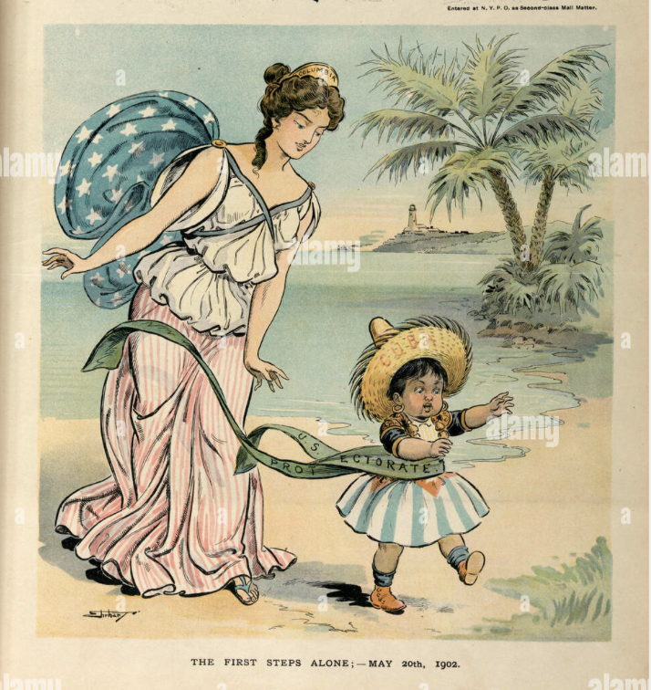

Slide 28
The Roosevelt Corollary (1904) and the “Big Stick” era
Declaration to ‘protect’ Latin America – vs ‘threat’ of European intervention in the region
i.e. Monroe Doctrine used to justify intervention,
In reality protecting Latin Americans against themselves – ‘protective imperialism’
“speak softly and carry a big stick,”

Slide 29
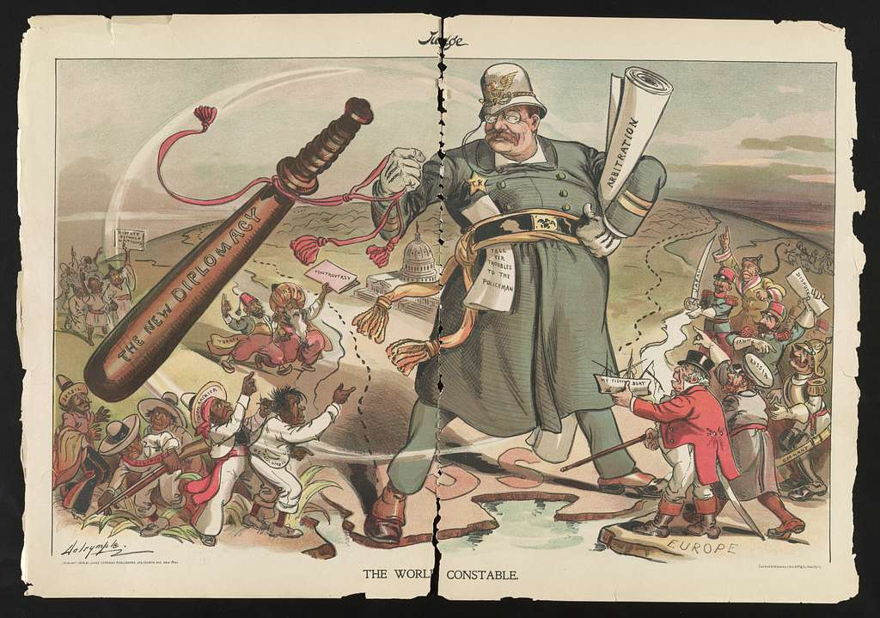

Slide 30
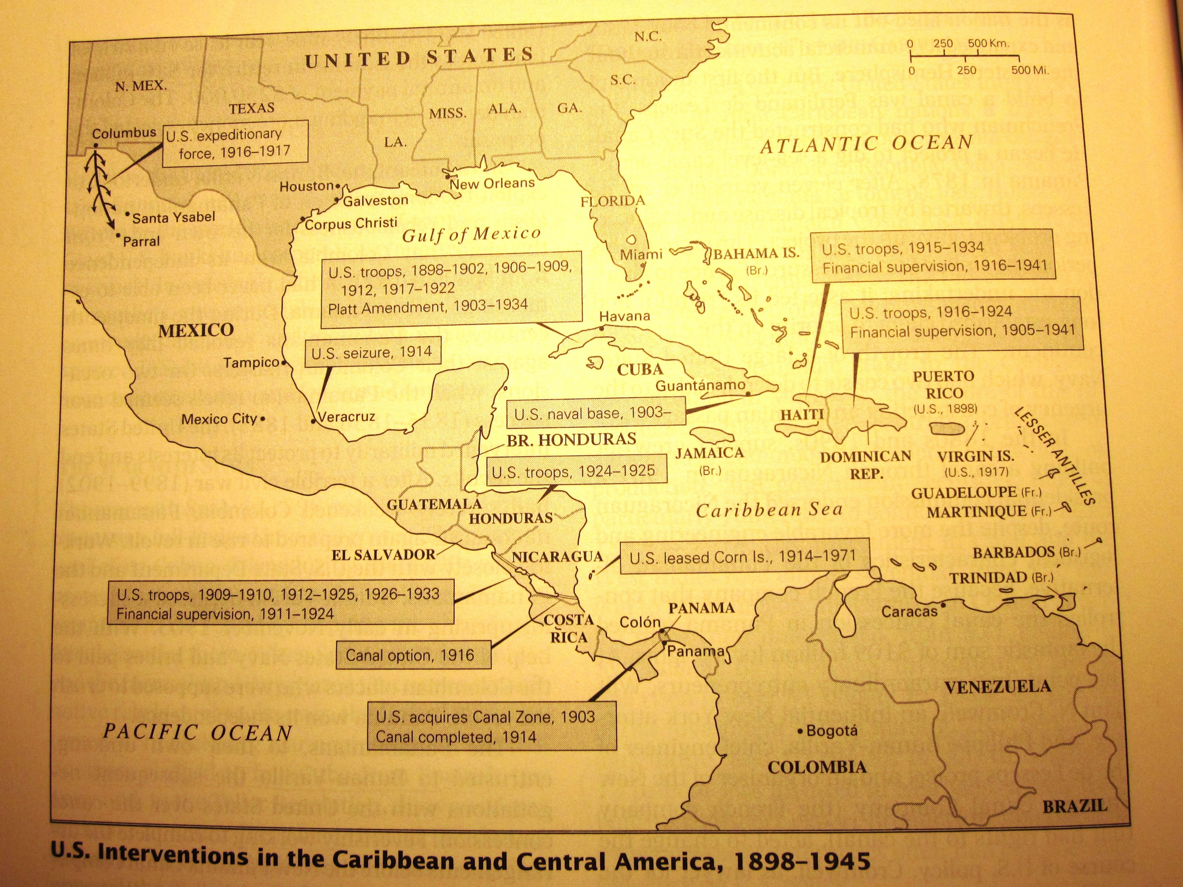

Slide 31
"There is no room for any outside influence other than ours in this region. We could not tolerate such a thing without incurring grave risks... Until now Central America has always understood that governments which we recognize and support stay in power, while those which we do not recognize and support fall. Nicaragua has become a test case. It is difficult to see how we can afford to be defeated." --Undersecretary of State Robert Olds

Slide 32
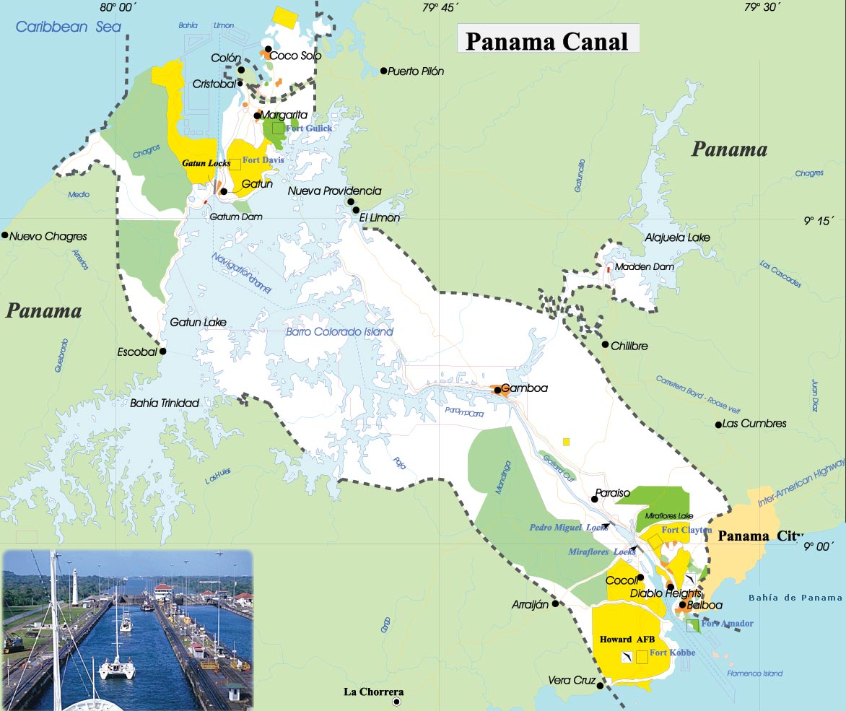
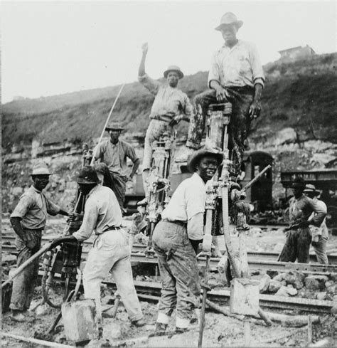
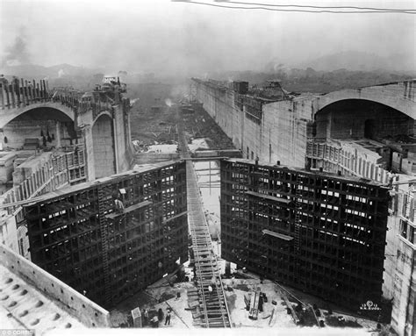
The Panama Canal

Slide 33
Phase 4: From Big Stick to Good Neighbour (briefly)
3 decades of interventions in: Cuba, Mexico, Dominican Republic, Haiti, Panama, El Salvador, Honduras, Nicaragua;
rising Latin American resentment (esp. 1920s)
But the election (1932) of Franklin Roosevelt, plus…
The Depression and growing isolationism in USA >
new policy of non-intervention in Latin America: ‘Good Neighbour’ policy, 1933
Cuba: no intervention, rights under Platt relinquished;
Mexico (no response to oil nationalisation, 1937)

Slide 34
Phase 5, from 1945 - The Cold War
School of the Americas 1946, in the US-controlled zone in Panama (now located in Georgia): has trained over 57,000 Latin American military officers.
1947-8: Rio Treaty & Organisation of American States
‘National Security Doctrine’: only the military can be trusted to defend Latin America against communism—democracy unreliable
‘The real threat of communism is the economic transformation of the Communist powers in ways which reduce their willingness and ability to complement the industrial economies of the West.’ (Woodrow Wilson Foundation, Harvard University, 1955)

Slide 35
U.S. Intervention and Decades of Consequences
1954, Guatemala
Dictators backed by the U.S. in the Dominican Republic (Trujillo) and Nicaragua (Somoza)
Countless more as the module continues…

Slide 36
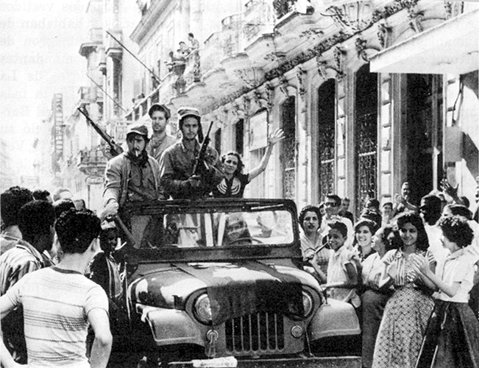

What about Cuba today?

Slide 37
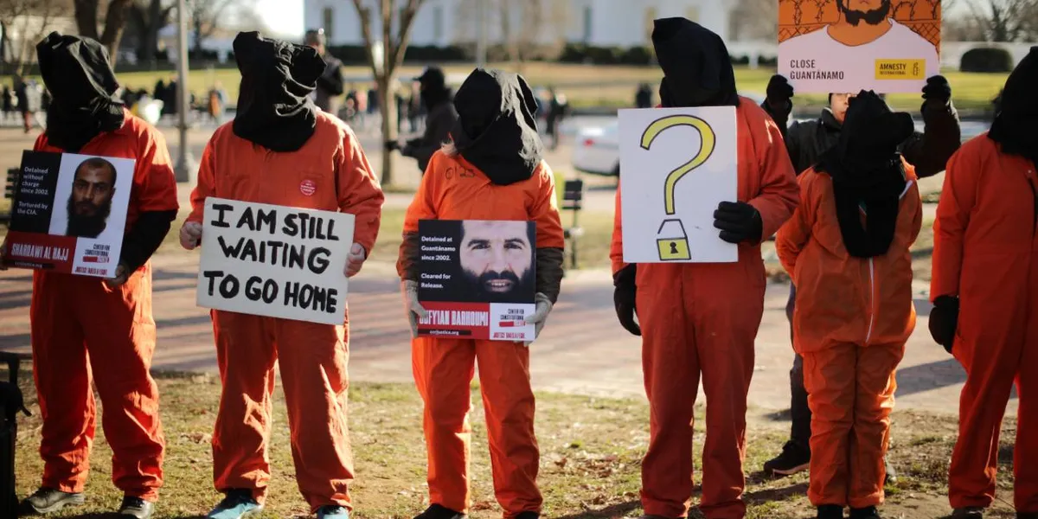

Slide 38
2026: A New World Order?

Slide 39
On Weds 25 Feb, Prof Hugh Wilford will give a talk on his most recent book,
The CIA: An Imperial History (Basic Books, 2024)
L5 from 5-7pm.

