Slide 1
Long essays
Design own title (consult with tutor)
Due week 3 of Term 3
Start thinking about these now; finalise title well before Easter break

Slide 2
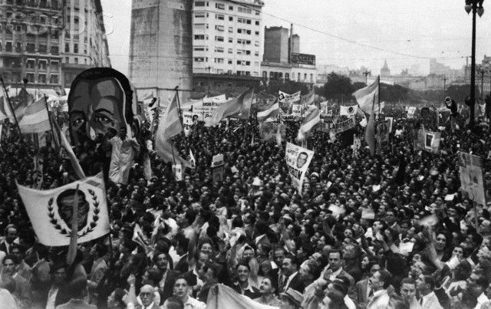
Week 8: The Politics of the Masses: Mid-Twentieth Century Latin America

Slide 3
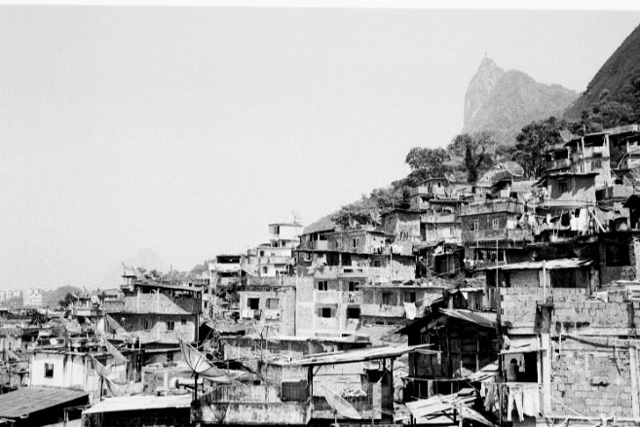
The economic and social context
- Economic nationalism from 1930: away from dependence on export economies
- Industrialise by replacing imported goods: import substitution industrialisation (ISI)
- Massive rural-urban migration
- Rural crisis
- Urban sprawl, growth of slums and urban social problems
Notes:
Rio’s Santa Marta favela in 1948.

Slide 4
Who had held power in Latin America previously?
Oligarchs: liberal consensus from late C19; rule by small elite; powerful families; haciendas linked to the export economies
Early C20: gradual urbanisation and small-scale industrialisation
pressure from urban middle classes for political representation…
E.g.: Argentina: 1912: Saenz Peña law widens the franchise to include urban MC;
→ 1916 election of the Radical Party (Yrigoyen) : urban interests in Argentinian politics

Slide 5

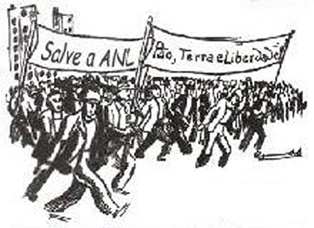
Politics of the large urban working class
Slow growth of socialism, anarchism
Associated with Spanish/ Italian immigrants
Communist Parties founded after 1917: Chile, Cuba, Brazil, Argentina, Mexico.
Working people seek better conditions…
STRIKES and labour protest…
exacerbated by economic DEPRESSION from 1930.
National politicians have to INCORPORATE some of these demands

Slide 6
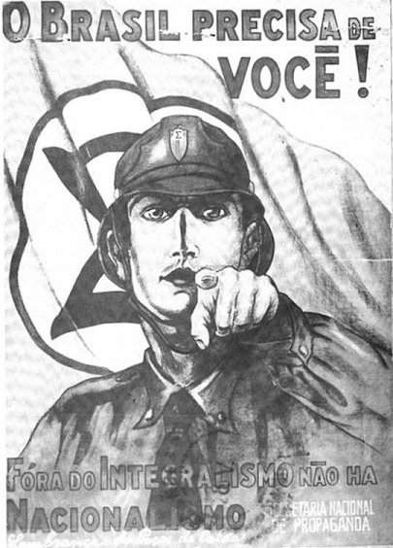
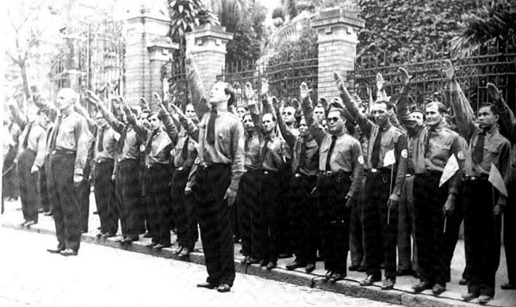
Latin American fascism
A volatile political moment
- Radical groups on right as well as left: influence of European fascism
- Volatile and polarised politics
Politicians need to juggle working-class demands AND keep industrialists on side…
→ What solutions do they seek??

Slide 7
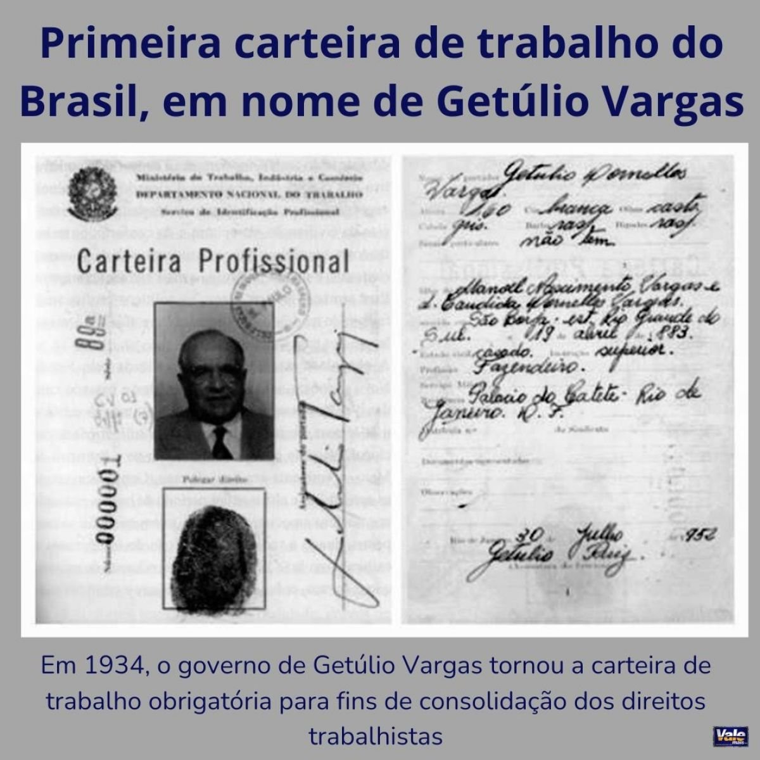
Solution 1: Corporatism
Bring different corporate entities (e.g. trade unions, industrialists’ associations, white-collar workers) into the bureaucratic apparatus of the state
these groups receive state favours and patronage
State is arbiter of conflict between competing groups; but none can challenge the power of the state itself.
→ Growth of the STATE
E.g. Vargas: trade unions gain benefits, but can’t go on strike
Notes:
Workers’ cards like this one became compulsory in order to get basic labour rights under Vargas from 1934. This one was his own!
https://valemaisrs.com.br/noticia_ver.php?news=8456

Slide 8
Not everyone got these new Brazilian labour rights.
industrial, urban workers benefited more than rural workers
Men benefited more than women
When do you think domestic workers got equivalent rights in Brazil? Write down your answer.

Slide 9
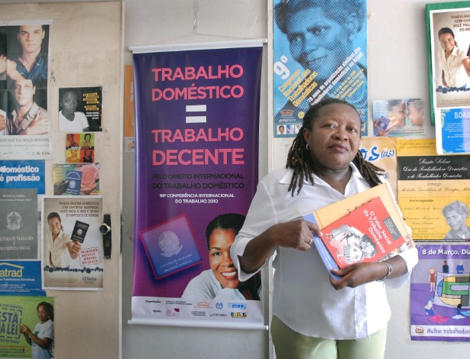
Brazilian domestic workers – in their majority, Black women – did not get equivalent labour rights until 2013!

Slide 10
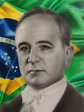
Corporatism and authoritarianism
Getulio Vargas (Brazil), ruled as a dictator under Estado Novo, 1937-1945
Corporatism was modelled on southern European fascist states e.g. Spain, Portugal, Italy.
It was often underpinned by force…
Brazil under Getulio Vargas: full-blown DICTATORSHIP in Brazil from 1937-45 (Estado Novo)
E.g. “soft” authoritarianism in Mexico: unions, peasants groups etc controlled through state funding & patronage
authoritarian tendencies but not full dictatorship

Slide 11
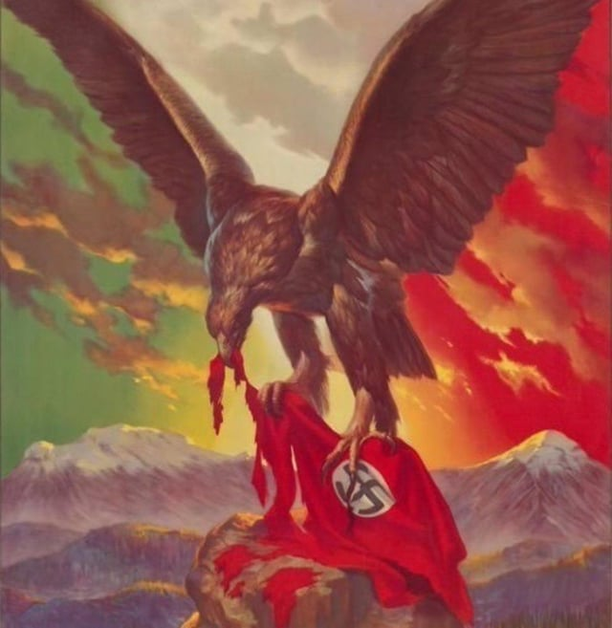
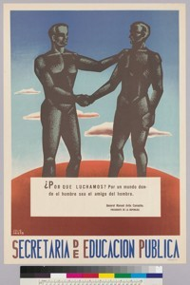
World War II: a political watershed
Lat Am comes in on American side; supposedly support democracy over dictatorship
Defence & economic pacts with US
Lat Am govts keen to show their democratic credentials
So.. former dictators go to the polls…
…e.g. Vargas in Brazil; Batista in Cuba; and Perón in Argentina

Slide 12
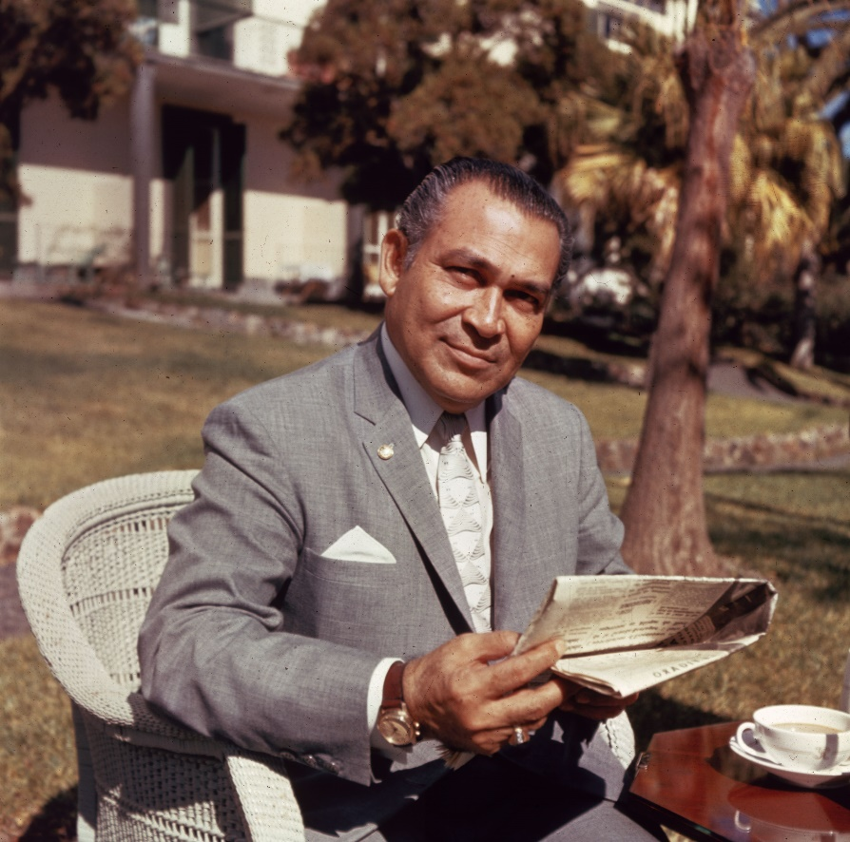
Fulgencio Batista (Cuba):
1933-40 (control through coup and puppet leaders);
1940-44, elected president (democratic interlude)
And again 1952-59 as US-backed dictator, to be overthrown by the Cuban Revolution…

Slide 13
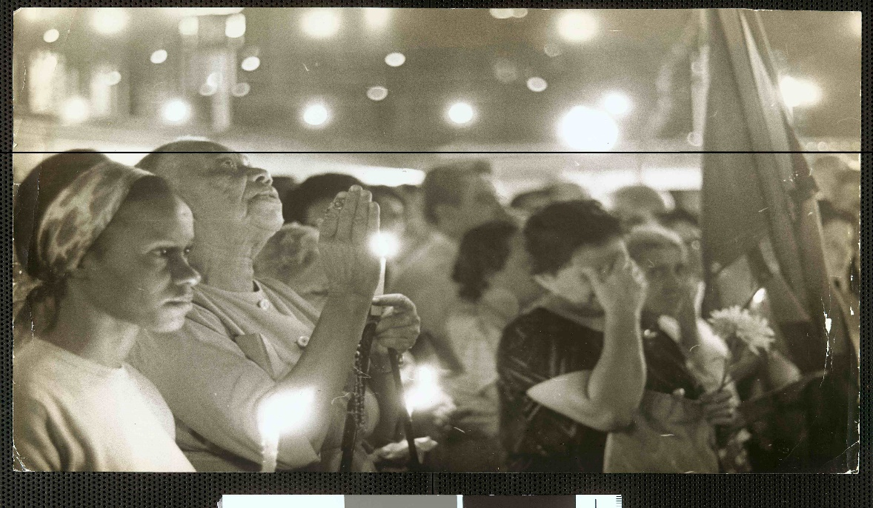
Solution 2: Populism
“the phenomenon whereby a politician tries to win power by courting mass popularity with sweeping promises of benefits and concessions to large interest-groups, usually drawn from the lower classes. Populist leaders lack a coherent programme for social change or economic reform, but try to manipulate the existing system in order to lavish favours on underprivileged sectors in return for their support” (Edwin Williamson)
[images: Peron rally; Vargas’ funeral]

Slide 14
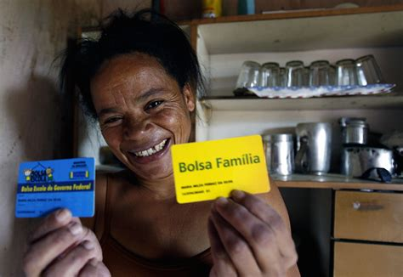
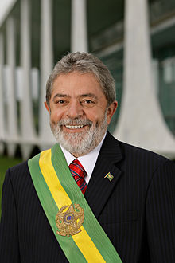
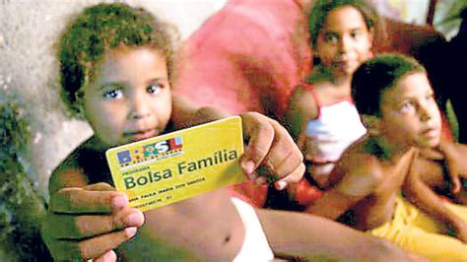

Slide 15
Brazilian labour history: not just manipulation by Vargas
Labour movement long pre-dated Vargas
Activists avoided Vargas-controlled unions during Estado Novo (-37-’45)
but labour movement later decides to work WITH Vargas in the democratic period after 1945
Organised labour pushes him to fulfil promises to workers…

Slide 16
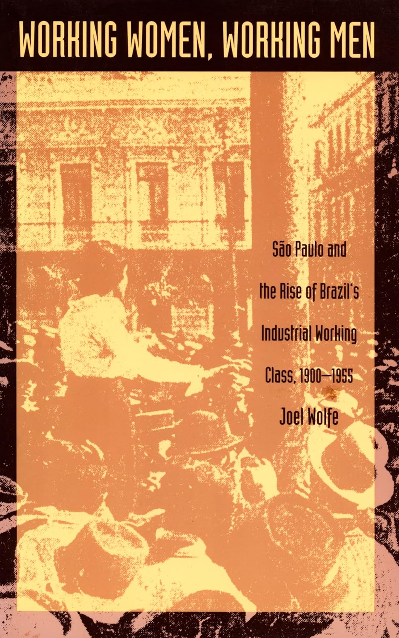
“Working people in São Paulo were not mobilized from above by politicians; they gave populists their votes in exchange for the populists’ support of their demands.”
Joel Wolfe, São Paulo and the Rise of Brazil’s Industrial Working Class, p.194

Slide 17
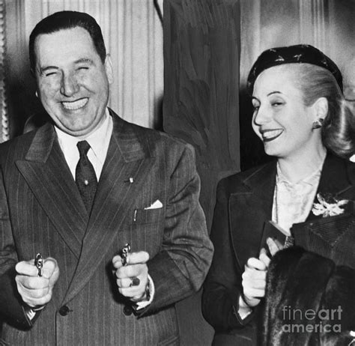
Argentina: Juan and Eva Perón
Juan Perón of Argentina (in power 1946-55)…
image as saviour of the poor
massive popularity through WELFARE BENEFITS: Eva Perón Foundation
Clip: Eva resignation speech
https://www.youtube.com/watch?v=ayRWr1K0Mew

Slide 18
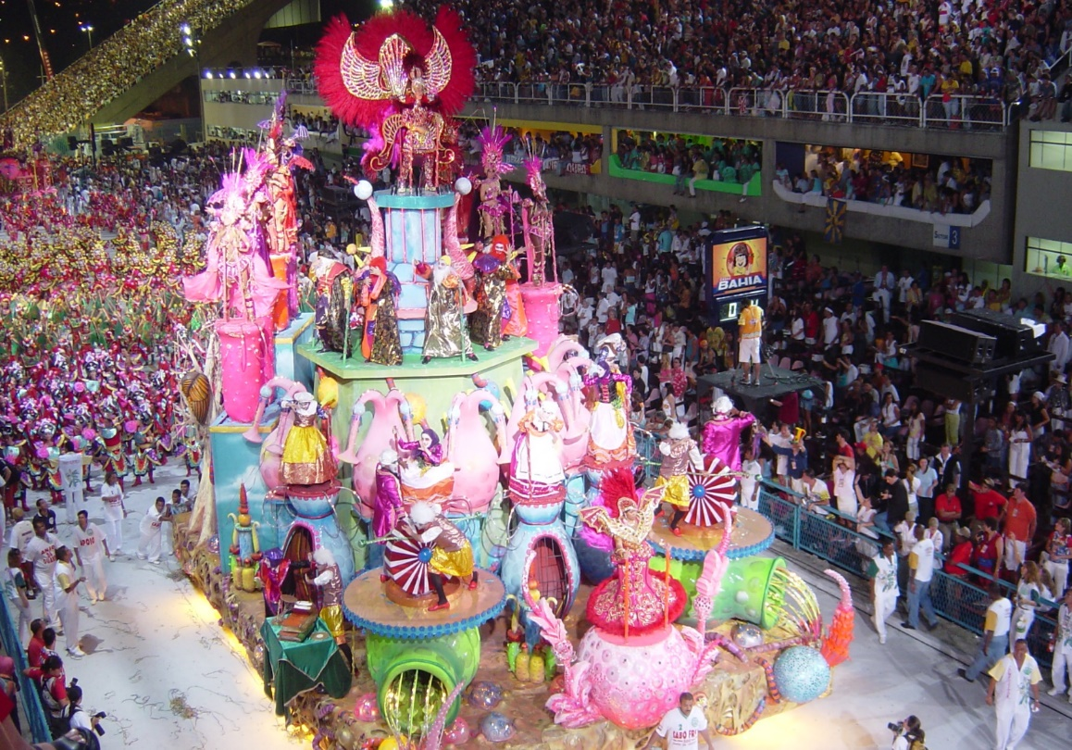
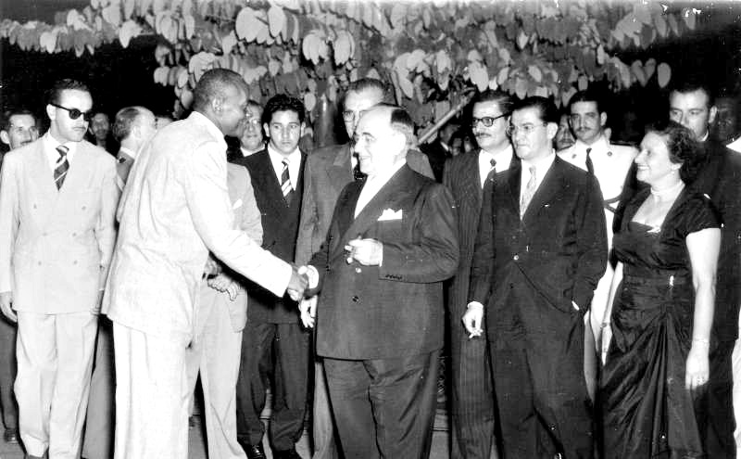
Solution 3: Nationalism
- Ties in with economic nationalism and industrialisation…
But also: CULTURAL nationalism…
Rethink the “nation”…
E.g. in Brazil: Vargas helps incorporate popular, non-elite cultural phenomena to mainstream
- e.g. Rio’s samba schools; - - e.g. the Afro-Brazilian martial art of capoeira

Slide 19
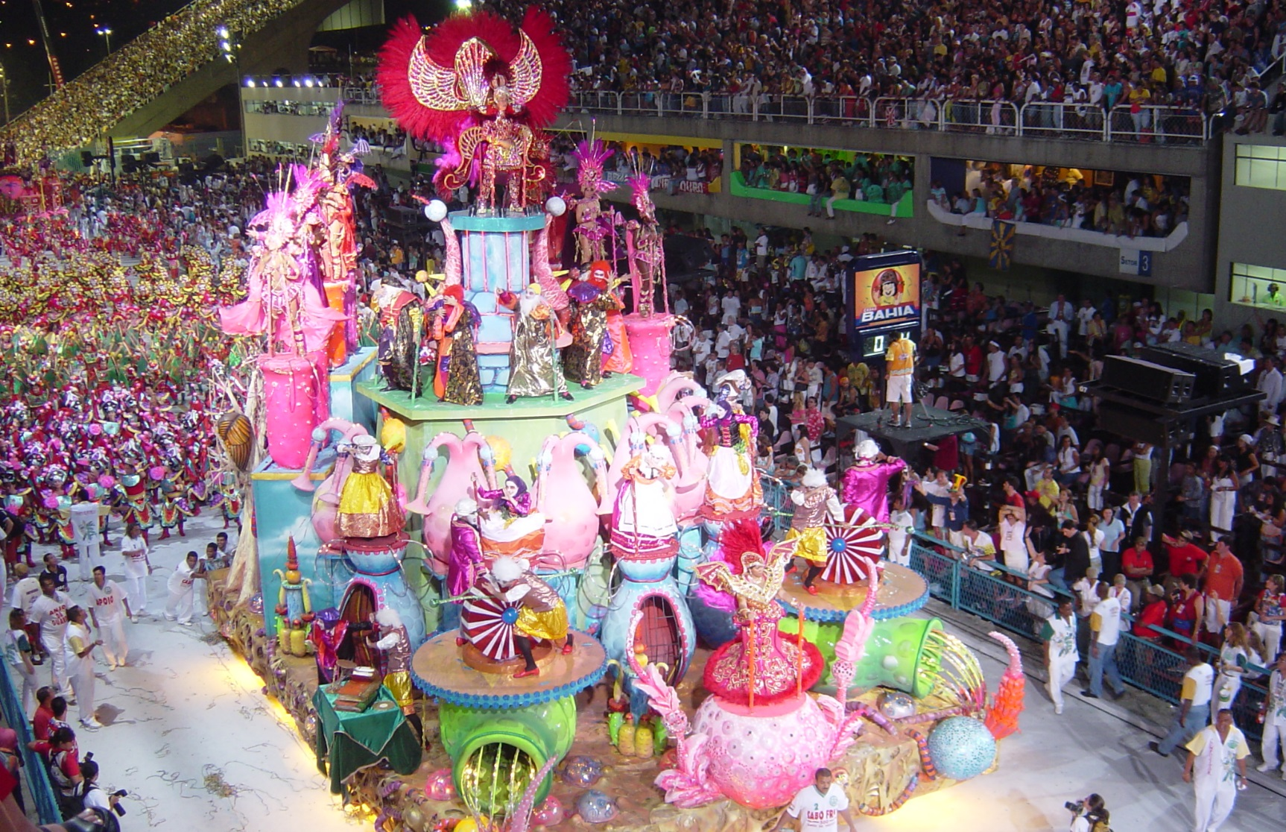
Carnival in Rio

Slide 20
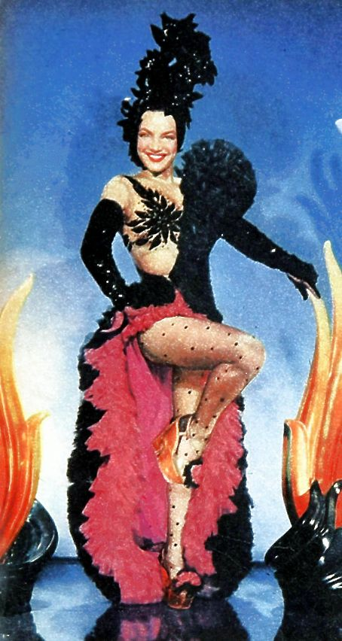
Exporting samba: Carmen Miranda
Notes:
Carmen Miranda

Slide 21
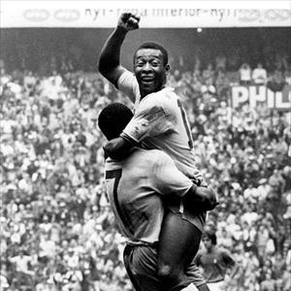
Brazilian futebol: the first world cup win in 1958

Slide 22
Latin America by 1959: the demise of populism?
Fragility of new order built on corporatism/ populism/ nationalism
Ongoing polarisation of politics
Stresses of industrialisation
Destabilising influence of Cold War internationally; spectre of Communism…
Military always waiting in the wings…
And meanwhile, revolutionary politics from 1959…

