Slide 1
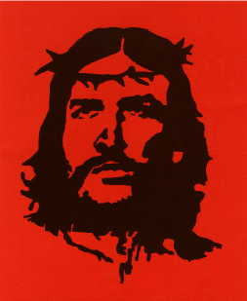
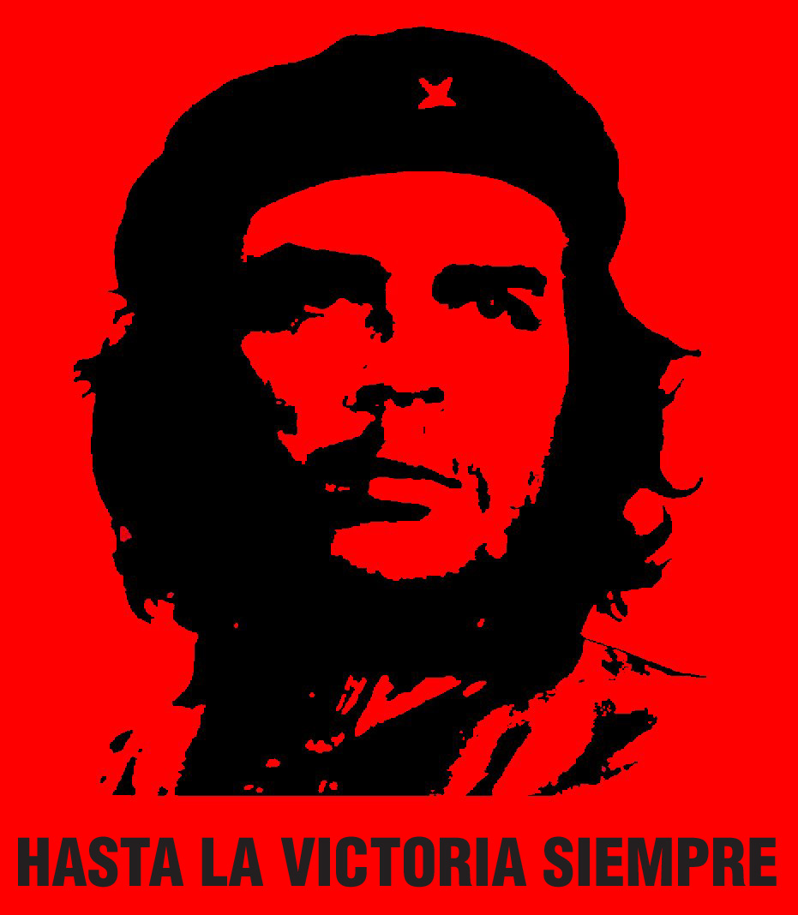
Revolutionary Latin America: The Cuban Revolution and Liberation Theology

Slide 2
U.S. in Post-WWII
Context of the Cold War
Political interference in countries with left-leaning governments e.g. Guatemala 1954 (Che Guevara was there)
Economic policy of developmentalism.

Slide 3
Two Reactions
Marxism and left-wing revolutionary movements: Cuban Revolution
Liberal theological movements in Catholic Church: Liberation Theology

Slide 4
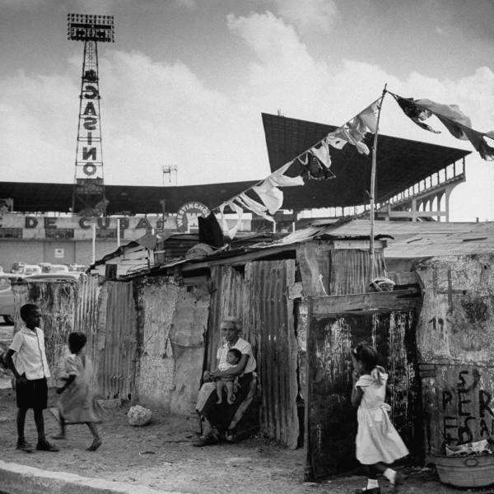
Cuba
1952: Military Coup of Fulgencio Batista against Carlos Prio
Support of US economic interests – by 1959, US companies own 40% of sugar lands, 90% of minerals, 80% of utilities.
Widespread poverty throughout Cuba.

Slide 5
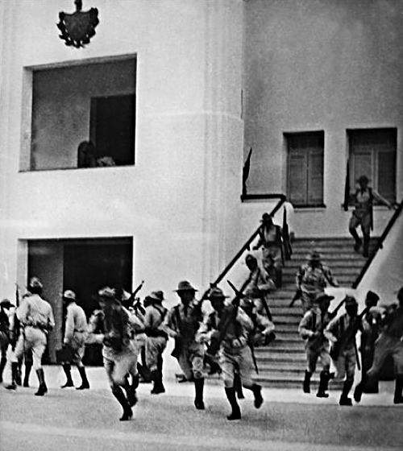
26th July 1953: Revolutionary group attacks Moncada Barracks in Santiago de Cuba, led by Fidel Castro

Slide 6
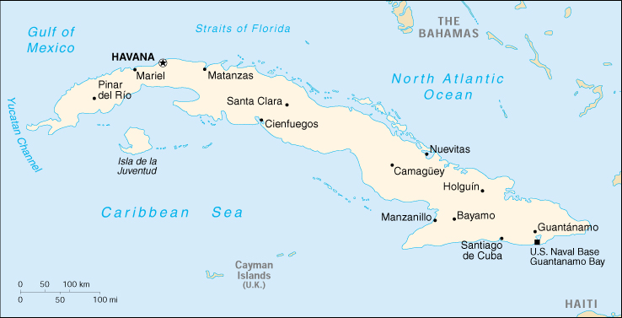
Moncada Barracks Attack

Slide 7
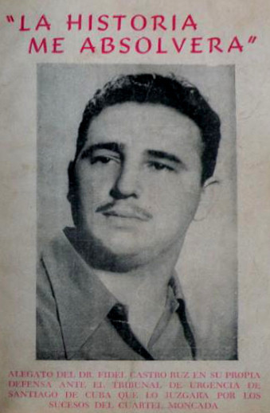
History will Absolve Me (La historia me absolverá)
Attack on US-backed dictator Fulgencio Batista
Criticises economic disparity in Cuba. Cites 700,000 Cubans without work, 30% illiteracy
Demands economic reforms including:
Land reforms
right of industrial workers to 30% share in profits
right of sugar workers to 50% of profits

Slide 8
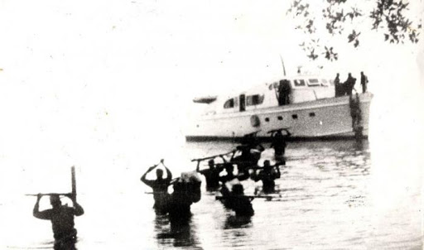
Cuban Revolution
1955: Castro released after amnesty by Batista
Travels to Mexico to plan new offensives
1956: Returns to Cuba with 80 other guerrilla fighters

Slide 9
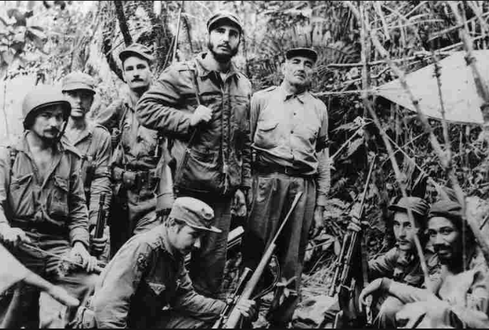
Uses guerrilla “foco” strategy to defeat US-armed Batista forces 21 August 1958: After several failures, begin final offensive, taking cities on the way to Havana

Slide 10
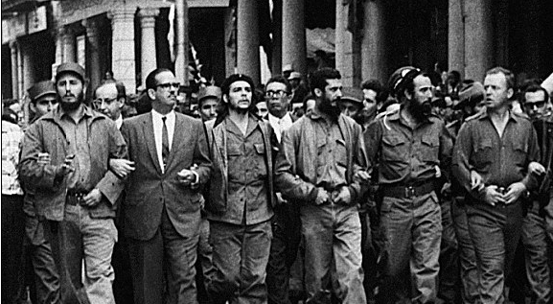
2 January 1959: Revolutionaries take Havana

Slide 11
Castro’s Cuba
Progressive social reforms:
Racial equality for black Cubans
Women’s rights movements
Healthcare, hygiene and sanitation improved
Increased education and literacy rates
Economic reforms: Nationalises land (Ministry of Misappropriated Assets), imposes socialist economy
Repression of dissidents, Church, political opponents.

Slide 12
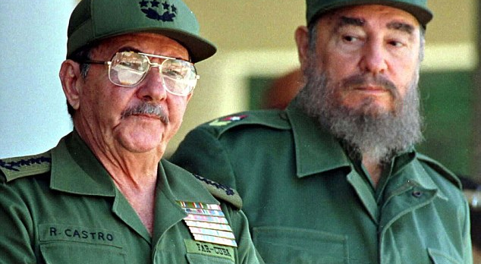
Fidel and Raúl Castro

Slide 13
Latin American Reactions
Heralds new sense of self-determination: ‘Now we are the citizens of all humanity’ (Octavio Paz)
Inspires guerrilla foco movements throughout Latin America

Slide 14
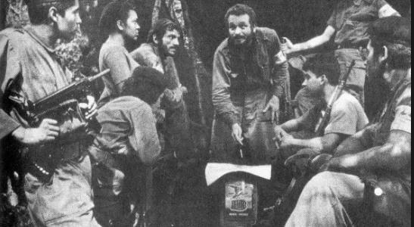
e.g. Douglas Bravo in Venezuela

Slide 15
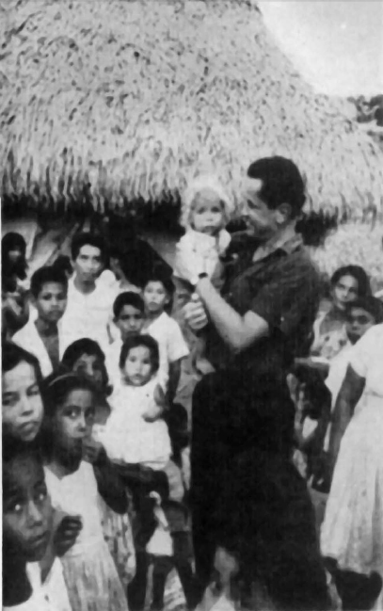
eg. Colombian Guerrilla-ELN/ FARC

Slide 16
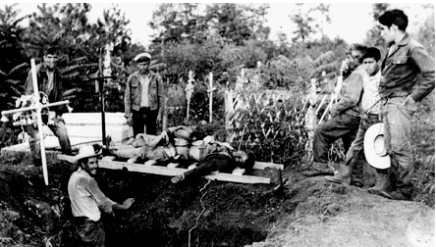
1965 Ciudad Madera (Mexico) barracks attack

Slide 17
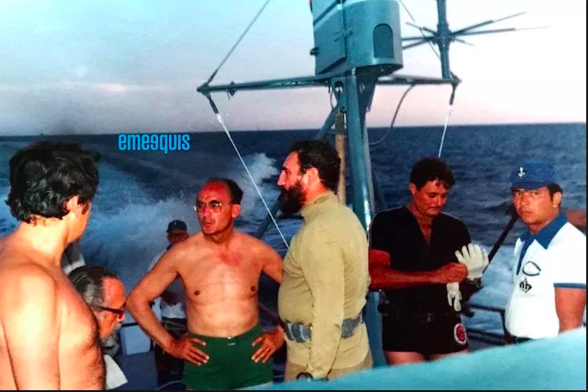
Revolutionary Credentials

Slide 18
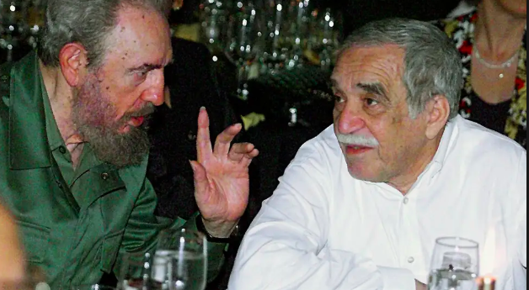
Initial political and creative optimism (‘Boom’ literature)

Slide 19
US Reactions
Cold War and fear of spread of Communism – Cuba is 90 miles from Florida coast
Economic and political sanctions
Florida becomes hub of Cuban refugees
U.S. training of Cuban paramilitaries
Bay of Pigs
Assassination Plots

Slide 20
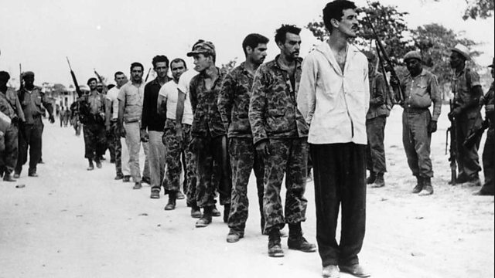
Bay of Pigs

Slide 21
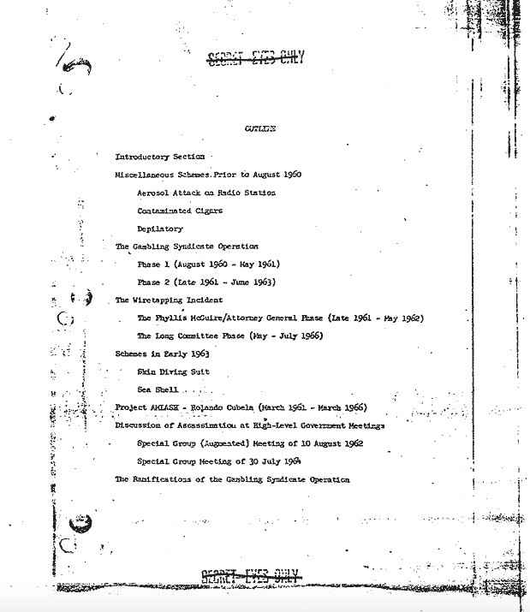
1967 CIA internal report on assassination attempts

Slide 22
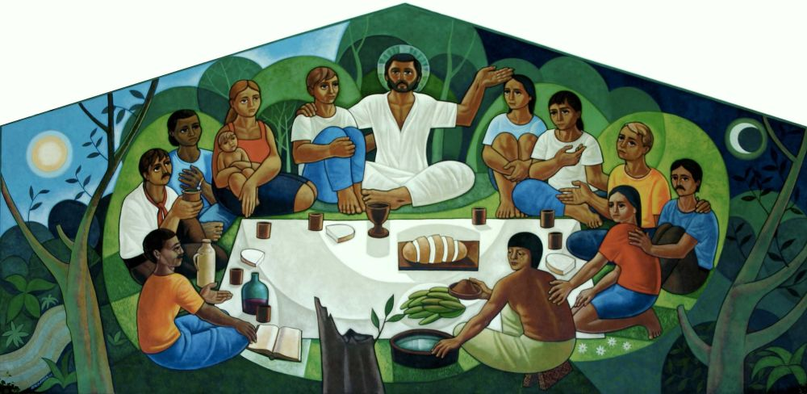
Liberation Theology
Theological reaction to poverty and marginalisation in Latin America.
How can one preach a gospel of love and hope in a context of poverty and suffering?
Best formulated by Gustavo Gutiérrez Teología de la Liberación (1971)
Brings together social analysis with Christian belief.

Slide 23
Context
Second Vatican Council (Vatican II) – 1962-1965
Concern with secularism among labour movement
Recognition of importance of the poor to the Catholic Church
Particularly relevant to Latin American – both poor and highly Catholic
Concerns taken up by Conference of Latin American Bishops in Medellín (1968): Formulation of ‘preferential option for the poor’

Slide 24
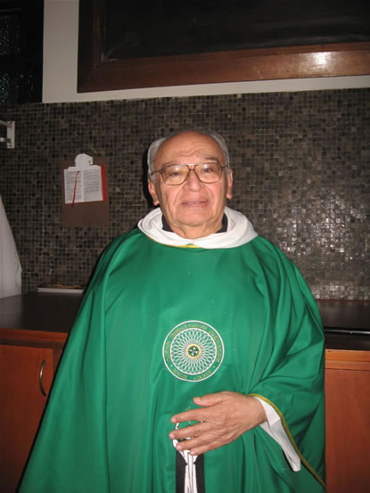
Gustavo Gutiérrez
Born Peru, 1928. Of Quechua and Spanish descent.
Dominican priest
Vocation to work with the poor of Lima
Major work: A Theology of Liberation

Slide 25
Liberation Theology
This attitude is ‘the way’ described by Jesus
Grounded in the teachings of Christ, and Latin American tradition (Las Casas).
By ‘putting the poor first’ it communicates the love of God, and inaugurates a movement of liberation, against oppression and exploitation
The Practice of Liberation Theology
Ecclesial Base Communities (CEBs).
“ver, pensar, actuar.” (observe, reflect, act).
Participants would reflect on their social reality and develop strategies to overcome inequalities and injustice.

Slide 26
Camilo Torres and the ELN in Colombia

Slide 27
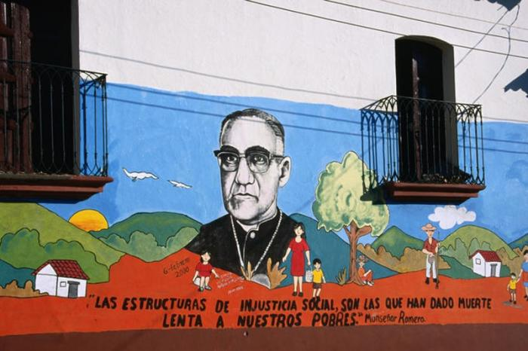
Archbishop Oscar Romero
Appointed Archbishop 1977
Assassinated 1980

Slide 28
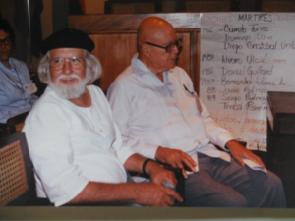
Ernesto Cardenal
Poet, priest and Member of the Nicaraguan Revolutionary Government (1979-1990)

Slide 29
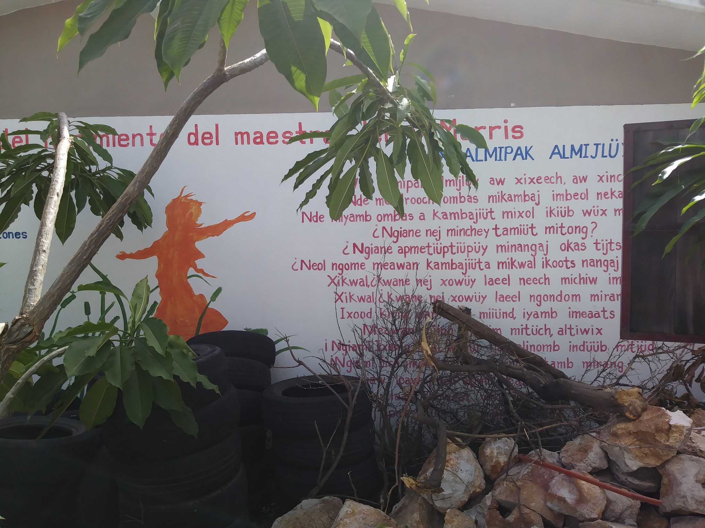
Indigenous Pastoral

Slide 30
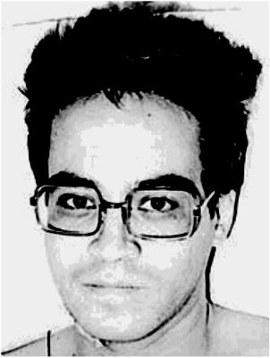
Ignacio Arturo Salas and the Liga Comunista 23 de Septiembre, Mexico

Slide 31
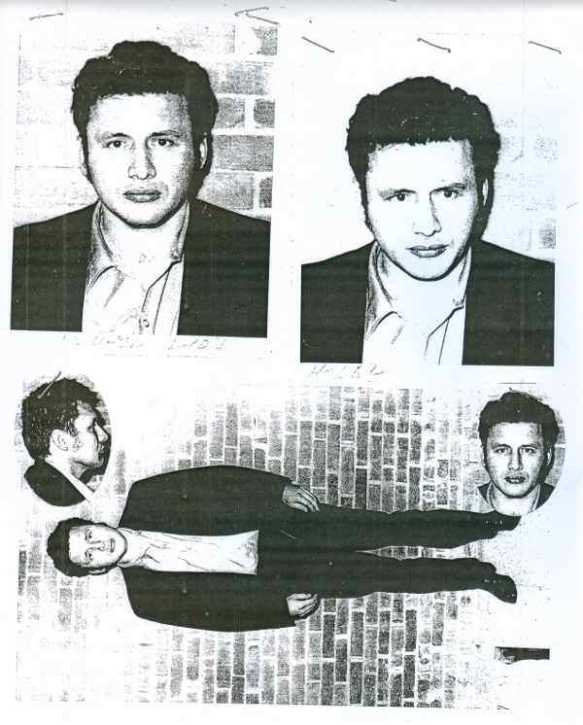
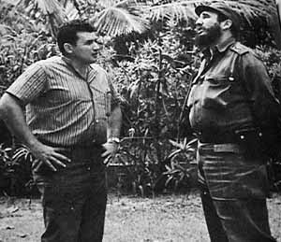
Mario Menéndez and revolutionary journalism in Latin America

Slide 32
Legacy
Awareness of role of Global South in Catholic Church.
Pope Francis
Appointment of Global South Cardinals, including first Caribbean Cardinal
Emphasizes aspects of Liberation Theology and ‘preferential option for the poor’ – rejection of Papal trappings, emphasis on Church’s duty to poor.

Slide 33
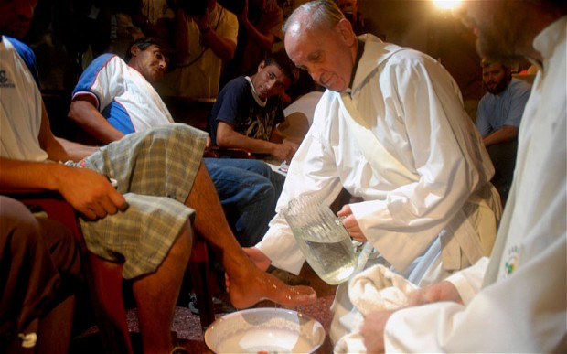
Preferential Option for the Poor

