Slide 1
Latin America Today
Dr Rosie Doyle

Slide 2
Violence
In Mexico over 100 journalists have been murdered since 2000 and, as a result of the War on Drugs since 2006 160,000 Mexicans are dead and 28,000 missing.
Bolivia- world’s highest rates of vigilante lynchings
Brazil and Venezuela- street crime
Brazil- Police impunity
Gangs in Central America
Colombian Peace Process- Demilitarization

Slide 3
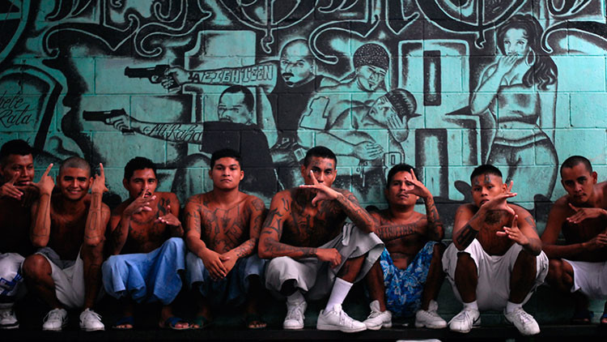
Maras transnational youth gangs Central America

Slide 4
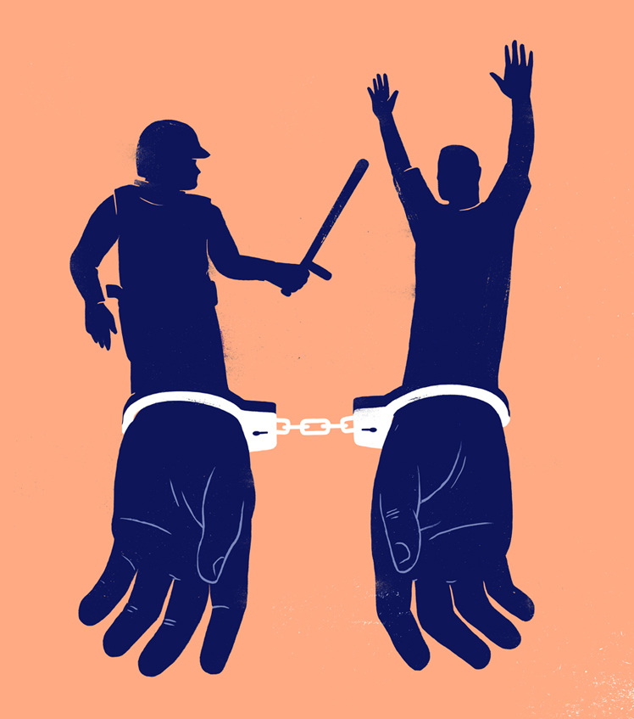
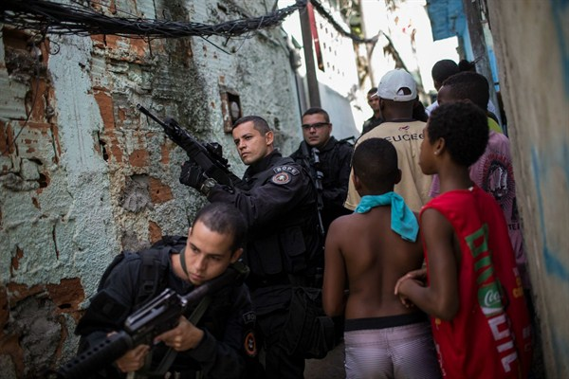
Police Impunity in Brazil

Slide 5
Violence and sub-state actors
Political scientist, Guillermo O’Donnell (2004)
‘even in countries where aspirations for democracy have been satisfied by the inauguration of democratic regimes, the rule of law may be compromised. Indeed, most contemporary Latin American countries, like new democracies in other parts of the world are cases where national-level democratic regimes co-exists with undemocratic subnational regimes and severe gaps in the effectiveness of basic civil rights’

Slide 6
Sub-state actors
Organized violent non-state actors and substate order interact with state-sanctioned rule of law:
Paramilitaries, security firms, guerrilla
Criminal organisations and multi-national cartels
Changing civil or (un)civil society includes violent actors:
Vigilantes, paramilitaries, alternative justice organisations, base communities
In terms of law and Human Rights which are legimate/ illegitimate or legal/illegal?

Slide 7
The Ideal of Democracy
A historian’s view: ‘Latin American democracy as an ideal and a practice was always more participatory and egalitarian than it was procedural and individualistic’ Grandin, 2004
Anthropology of Democracy ‘strategic deployment of the term’ (Paley 2000)

Slide 8
Context
Post Cold War
New social movements
Neoliberal reform
Civil (and un-civil) society
The politics of Human Rights and Human Rights Discourse
Rights-based development
NGOs and NGO-ization

Slide 9
State Policies
Transitional justice, truth commissions, peace processes
Electoral reform
Constitutional reform
Justice reform
Police reform
Human rights institutions and legislation

Slide 10
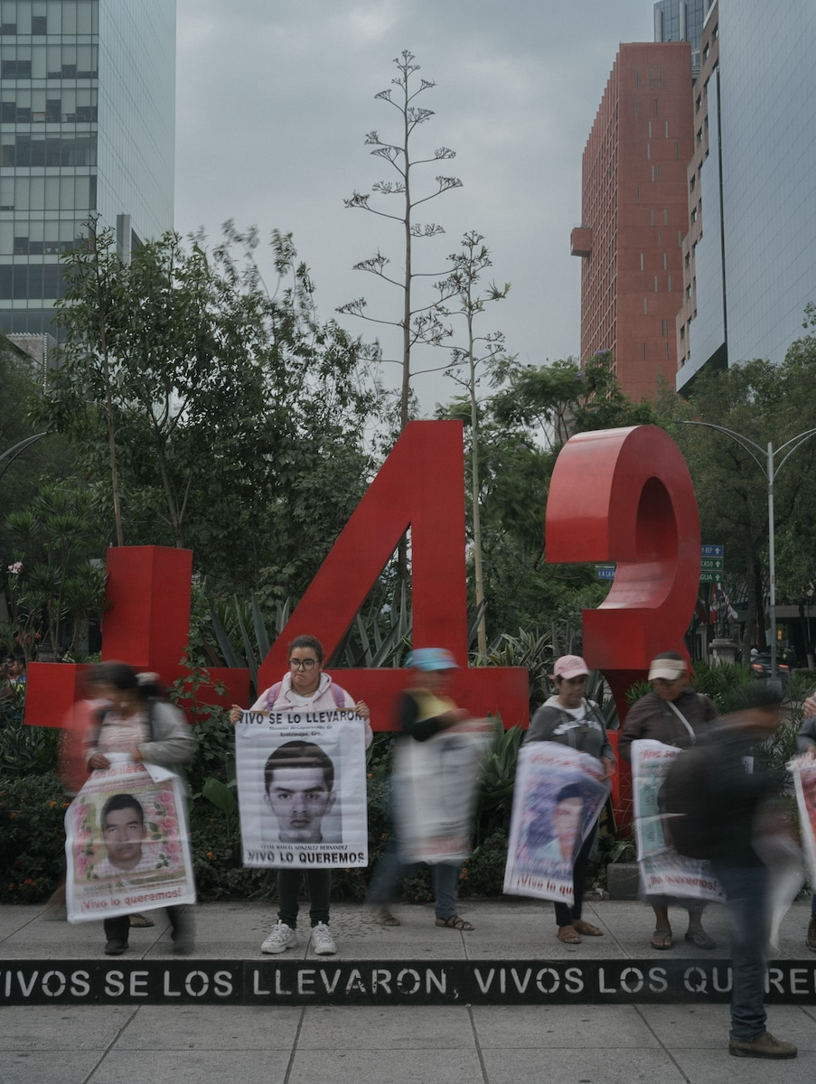
Human Rights Issues and Legislation: Human Rights, Violence and Justice
Race and indigeneity
Torture and forced disappearance
Violence against:
Women
Indigenous groups
Journalists
Human Rights Defenders
Migrants
Impunity is a major concern- Truth and Justice

Slide 11
National, Inter-American and International Institutions
Since 1945-The United Nations
Since 1959- Inter-American Commission on Human Rights (IACHR) Organization of American States (OAS)
Since 1979- Inter-American Court of Human Rights (OAS)
Since 1990- Comisión Nacional de los Derechos Humanos (Mexico)
2011, the Mexican Constitution amended to state that international human rights treaties are part of Mexican law and are binding on all authorities at all levels, country-wide.

Slide 12
Democratisation
Transitions from authoritarian regimes and civil conflict
Chile post 1990
Guatemala Peace Agreements 1996
‘after decades of naked military rule, the Guatemalan military have crafted a unique Counterinsurgent Constitutional State in which State violence has been reincarnated as democracy” Schirmer, 1998

Slide 13
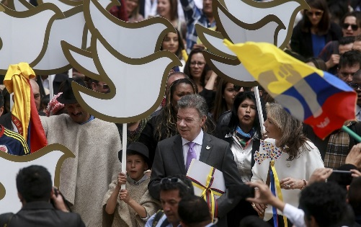
Colombia Peace Agreements
2012-2016 Peace talks: land reform, combatting drug trafficking, guerrillas’ political participation and punishment for war crimes on both sides
Peace agreement establishes transitional justice institutions: 1) Truth Commission, 2) Special Unit for the Missing, 3) Special Jurisdiction for Peace, 4) Reparation and 5) Non-repetition. Among the most controversial provisions is the Special Jurisdiction for Peace (JP).
Referendum 2 October 2016, Colombians asked Do you support the peace agreement to end the conflict and to build peace. 50.2 % opposed the peace agreement, 49.8 % supported it.

Slide 14
Accounting for the Past Abuses in Mexico
2021 Commission for Access to Truth, Historical Clarification and the Promotion of Justice for serious human rights violations committed between 1965 – 1990
Transnational Mechanism for Access to Justice for Migrants
2020 Search Table for Disappeared Migrants (MBPMD) within the National Search System (SNBP).

Slide 15
Democratisation: The failure of democracy in Latin America?
Guillermo O’Donnell
Ideas on democracy and citizenship, democratisation, rule of law, quality of democracy, ‘delegative democracy’ and ‘low intensity citizenship’
‘Polyarchies and the (Un)Rule of Law in Latin America’ in Juan Méndez, Guillermo O’Donnell and Paulo Sérgio Pinheiro (eds.) The (Un)Rule of Law and the Underprivileged in Latin America.University of Notre Dame Press, 1999.
The Quality of Democracy: Theory and Applications (edited with Jorge Vargas Cullell and Osvaldo Iazzetta) University of Notre Dame Press, 2004.
Democracy, Agency and the State: Theory with Comparative Intent Oxford University Press, 2010.

Slide 16
Violent Pluralism? (Daniel and Goldstein, 2010)
Plural nature of regimes
Violence does not necessarily mean regime failure
Violence-lived political experience and the production and maintenance of democratic transition and the operations of democratic states and civil societies
‘rather than understanding Latin America’s endemic violence as simply a failure of democratic governance and institutions, we call attention to violence as an element integral to the configuration of those institutions, as a necessary component of their maintenance, and as an instrument for popular challenges to their legitimacy.’
Latin America= ‘violently plural’. States, social elites and subalterns employ violence to establish or contest regimes of citizenship, justice, rights and a democratic social order’

Slide 17
What’s Democratic?
Free and fair elections (eg. Mexico following 1996 electoral reform- Establishment of IFE)
Free press
Balances to presidential powers-more separation of powers- independent judiciary and legislature
Multi-party democracy- (eg. In Mexico) 2 presidential terms under PAN 200-2006 Fox, 2006-2012 Calderon, 18 Years PRD in Mexico City
Pluralism noticeable in development of NGOs and Civil Society organisations- Citizens can meaningfully make demands and negotiate with the government

Slide 18
Limitations and Barriers to Democratization
Weak rule of law-corrupt police and security services, citizens have poor protection of human rights, weak judiciary and slow, impunity.
Authoritarian legacy
Expanded bureaucracy
Tax reform
Social divisions- worsened
Legitimacy of elections questioned-strength of civil society-legacy of corruption and limits

Slide 19
The Pink Tide
At the start of the twenty first century, in the process of transitions to democracy from authoritarian regimes electorates in many Latin American countries turned to left leaning leaders.

Slide 20
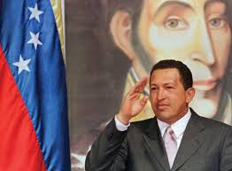
1998 Hugo Chávez and the
Bolivarian Revolution

Slide 21
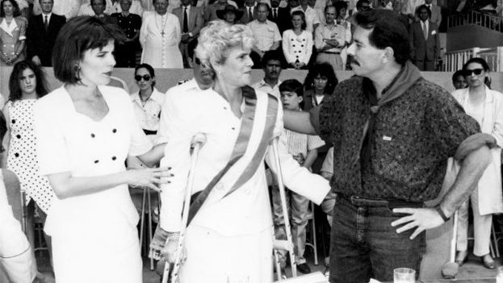
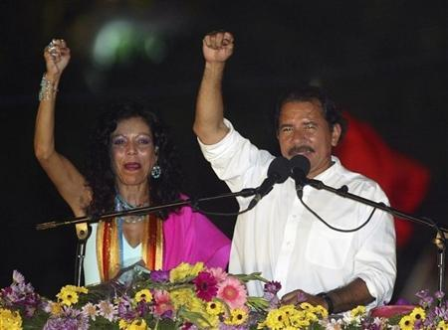
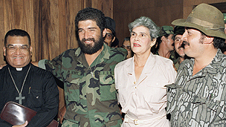
Nicaragua 1990-Neoliberalsim and 2006 Return of the Left ‘Pink Tide’
2006 Daniel Ortega and Rosario Murillo
1990 -1995 Violetta Chamorro

Slide 22
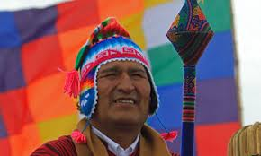
2005 Evo Morales

Slide 23
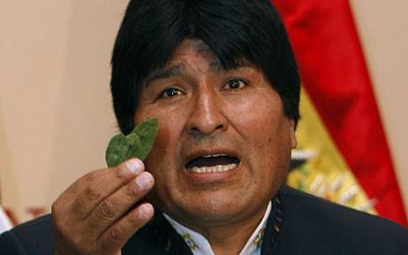
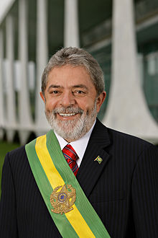
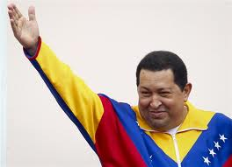
Populism? Democracy?

Slide 24
Democracy, Neoliberalism and Multiculturalism
1989 International Labour Organization 169
Rights of indigenous and tribal peoples
Cultural rights- identity, language, traditions, ways of life
Collective rights- land, autonomous self-government
Social rights- health care, education
Political rights- participation and consultation

Slide 25
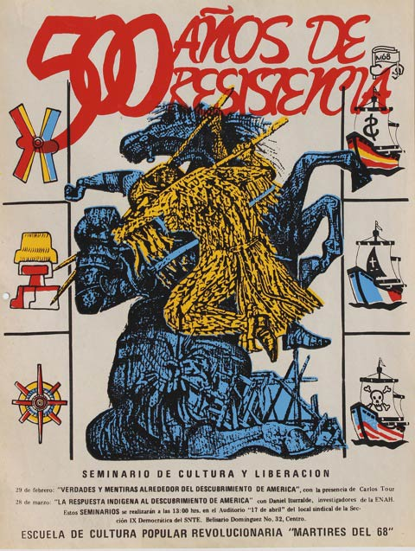
1492-1992
1992
500 Years

Slide 26
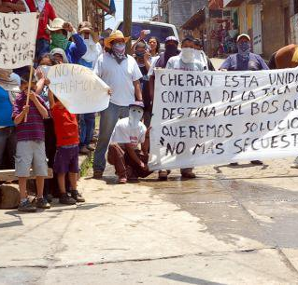
E.g. Cherán
In 2011 Comuneros of San Francisco Cherán, Michoacán start a movement against deforestation and criminal violence.
Judicial process-Mexican state recognises indigenous peoples’ claims to autonomy and self-determination and self-government as a judicial right.
Cherán becomes the first formally recognised indigenous municipality governed by a government structure chosen according to usos y costumbres (customary law).

Slide 27
Multiculturalism and Afro-Descendants
2001 World Conference Against Racism, Racial Discrimination, Xenophobia and Related Intolerance at Durban defines “Afro-descendant”
2002- The Working Group of Experts on People of African Descent of the UNHCR established

Slide 28
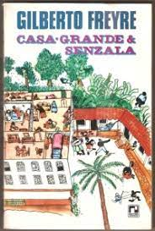
Afro-Latin American Activism
Mestizaje and Racial Democracy
Eg Gilberto Freire, The Masters and the Slaves (1933) Brazil Eg. José Marti Our America (1891)
In the 1800s “Afro-Brazilians”, “Afro Cubans”, “Afro-Nicaraguans”, Until the 1970s no “Afro-Latin Americans”
Transnational Anti-Racism in the Americas
Pan Africanism- Decolonisation
Changes on the part of institutions and national government on thinking about “Racial Democracy” in the 1940s
1980s and 1990s New Social Movements
Transition to democracy, constitutional courts, recognition

Slide 29
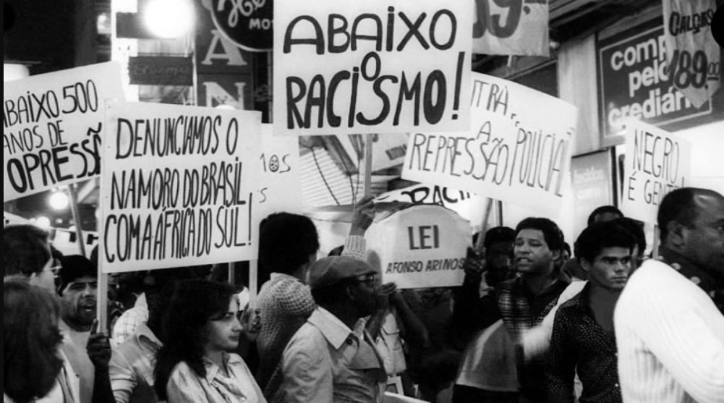
Movimento Negro Unificado in 1978, named their movement the Grupo Afro-Latino-América

Slide 30
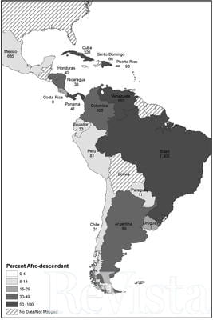
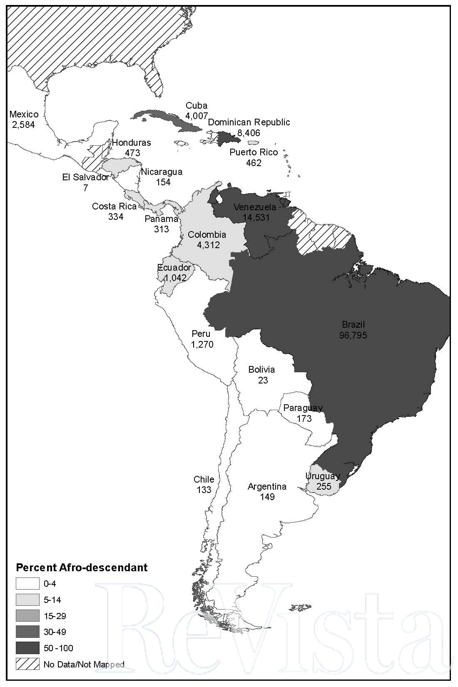
Map 1. Afro-Latin America, 1800. Numbers under country names indicate the size of the black and brown (pardo) population, in 000s. (Map by Lena Andrews.)
Map 2. Afro-Latin America, 2010). Numbers under country names indicate the size of the black and brown (pardo) popu- lation, in 000s. (Map by Lena Andrews.)
“Afro-Latin America by the Numbers The Politics of the Census”
by George Reid Andrews | Revista Harvard Review of Latin Ameirca Jan 4, 2018

Slide 31
Democratization and Neoliberalism
Conservative Movements v Radical Movements
Representation, participation in the state v anti-systemic activism (eg. Black Freedom Day)
Economic and structural inequalities
Issues around state-sanctioned versions of liberation

Slide 32
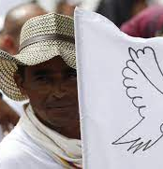
Colombia and the Peace Process
Understandably, the Ethnic Chapter produced high expectations among afro-Colombians, above all in the Pacific coast (a region that has been hard hit by violence during the last decades). However, several political and judicial decisions taken in the first months of implementation progressively dismantled its binding force. This raises imperative questions for the current and future Colombian governments on peacekeeping strategies in the Pacific coast and other conflict-affected areas with significant presence of ethnic groups. Without alternative binding force mechanisms or minimal legal guarantees, the Ethnic Chapter could easily become another in a long history of broken promises.”
Manuel Gongora Mera, “The Ethnic Chapter of the 2016 Colombian peace agreement and the afro-descendants' right to prior consultation: a story of unfulfilled promises,” International Journal of Human Rights. 23:6, 2019, 938-956, 17.

Slide 33
New Constitutions
Bolivia Buen Vivir and the Rights of Mother Earth
Brazilian Constituion

Slide 34
Civil Society and Un-Civil Society
Eg. Mexican Zapatistas
Eg. Bolivia MAS Gas Wars Water Wars and Santa Cruz
Eg. El Estallido in Chile 2019
Eg. Grassroots feminism Ni una menos

Slide 35
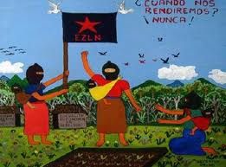
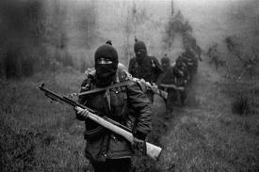
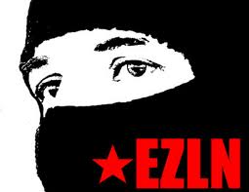
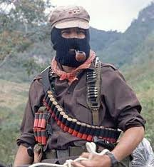
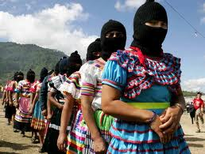
Mexico: The Zapatista Army of
National Liberation

Slide 36
Mexico: ‘El Cambio’
2000- Institutional Revolution Party PRI lose elections (to the PAN) for the first time since the party was established and came to power in 1929.
2000-2006- Vicente Fox (PAN) President
2001: Iniciativa a la Ley COCOPA
Recognize indigenous peoples in the constitution as well as their right to self-determination (autonomy).
Recognize indigenous rights in a national context.
Participatory democracy and consensus building (Nash, 2001)

Slide 37
Bolivia
MAS and Evo Morales
2000 ‘water wars’ in Cochabamba- Bechtel Corporation forced out.
2001 Camba nation declaration
2003 ‘gas wars’ over the exportation of natural gas from Chile to the US via Bolivia. Roadblocks by highland Aymaras. El Alto-miners-La Paz middle class. Renationalization of gas.
Clip from the film Even the Rain, Iciar Bollain, 2010
https://www.youtube.com/watch?v=3JKs8aSb7eo

Slide 38
Bolivia
MAS and Evo Morales
2005- Evo Morales a unionist and leader of Moviemiento a Socialismo becomes the first indigenous president of Bolivia (where 60% of the population are indigenous)
2006-January 50,000 indigenous people from the Americas gather at Tiwanaku to confer the ‘Power of the Original Mandate’ on Morales.

Slide 39
Bolivia
MAS and Evo Morales
2007- Tensions over a proposed new constitution- Resource rich Santa Cruz in the east refused to accept constitutional protections for indigenous groups, languages and election procedures.
2008- 4 May: Santa Cruz referendum in about autonomy from La Paz
10 August: Morales wins recall referendum by 68%
2009 Morales re-elected with a sizeable majority.

Slide 40
Bolivia
Successful democratic elections coexist with:
state violence against coca growers, unionists, political demonstrators
police corruption
domestic abuse
private security firm mafias

Slide 41
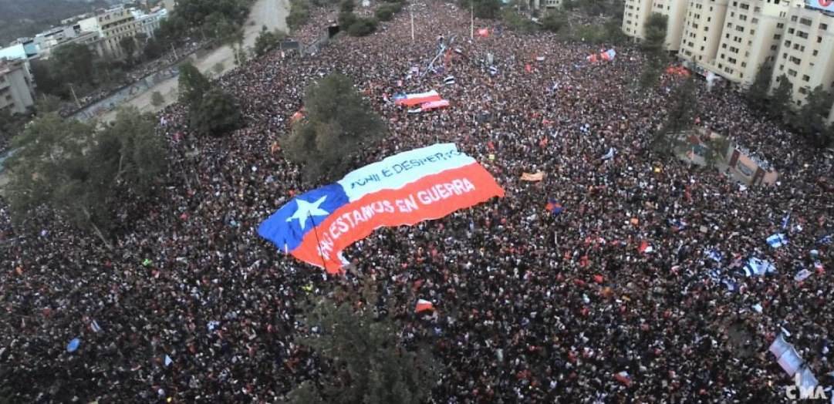
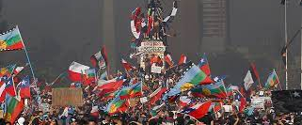

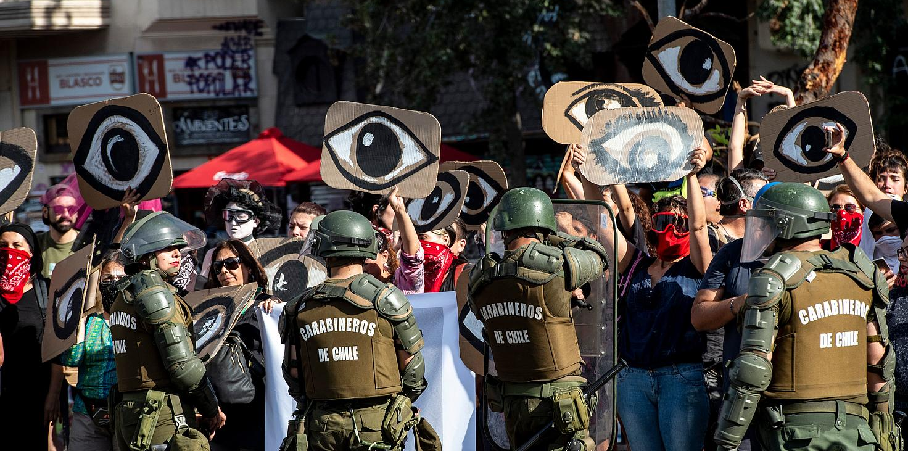
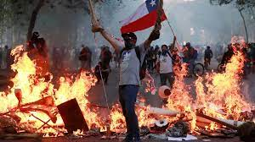
Chile 2019-2022

Slide 42
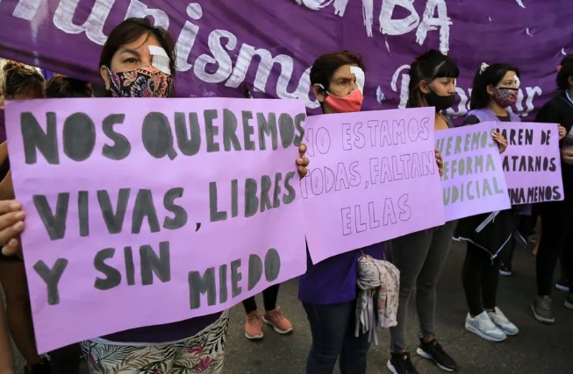
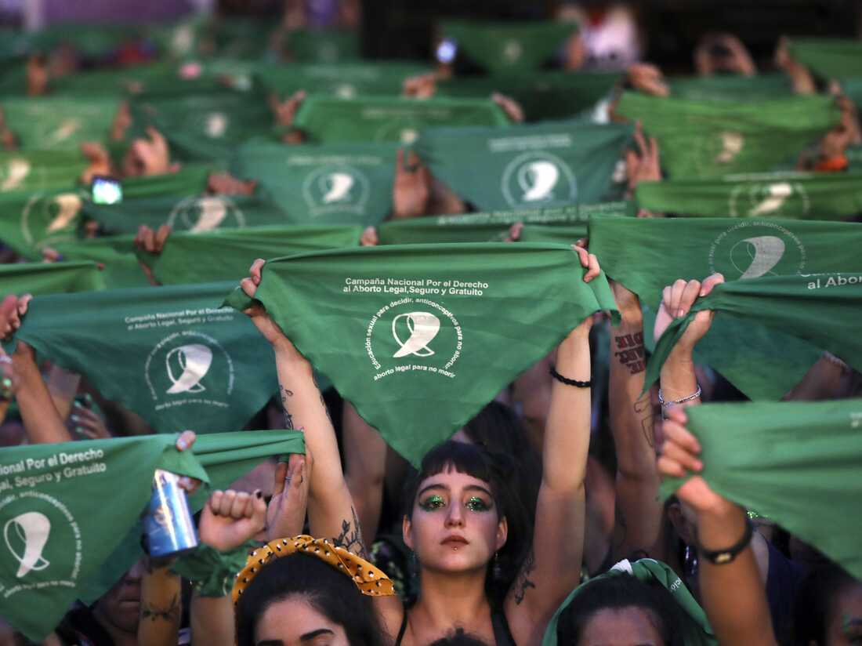
Ni Una Menos Argentina from 2015 and the ‘green wave’ from 2019

Slide 43
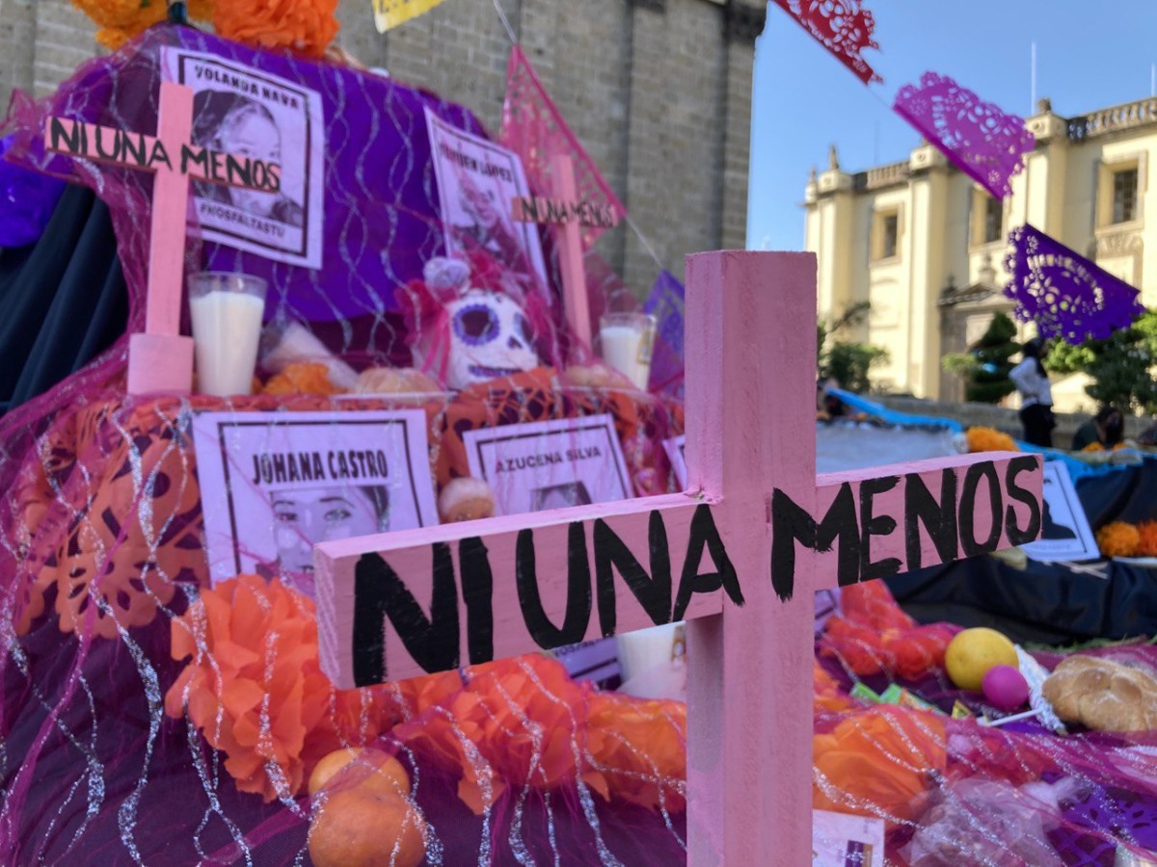

Slide 44
Femicide/ Feminicide Ni una menos
Femicide as a criminal category-broader patterns of gender-based violence. Feminicide- includes the wilful ignorance on the part of the state. ‘All women experience violation of their human rights stemming from the subaltern social status and political subordination of gender that affects them. It is in that framework that feminicide must be explained’ (Lagarde y de los Ríos 2010), xix The government is complicit in avoiding or colluding in the problem of gender-based violence.
2003 Marcela Lagarde wins a seat in the Chamber of Deputies and pushes for fully-funded research.
2007 Ley General de Acceso de las Mujeres a una Vida Libre de Violencia (General Law on Women’s Access to a Life Free of Violence), identifies violencia feminicida (feminicidal violence) as a violation of women’s human rights in the public and private sphere as linked to the state’s tolerance of cases of gender violence.
2012 reform to Article 325 of the Federal Criminal Code that codified feminicidio as a crime, defining it as the murder of a woman for “gender reasons,” and includes provisions to punish public servants when they hinder the administration of justice. Feminicidio carries a maximum 60-year prison sentence. Public servants may be punished with a three- to eight-year prison term and the removal from their post. These laws recognize the state as a perpetrator of violence and make the state itself a target of its own punitive power.

Slide 45
Civil Society Organisations, IGO and National Human Rights
Comisión Mexicana de Defensa y Promoción de los Derechos Humanos, (CMDPDH)
Founded 1989, consulting status with UN, International Federation of Human Rights member.
Member of the following networks:
Coalición por la Corte Penal Internacional
Observatorio Ciudadano Nacional del Feminicidio
Observatorio Ciudadano del Sistema de Justicia
Red Internacional para los Derechos Económicos, Sociales y Culturales
Coalición Internacional de Organizaciones por los Derechos Humanos en las Américas
Consejo Internacional para la Rehabilitación de las Víctimas de la Tortura.
https://cmdpdh.org/quienes-somos/

Slide 46
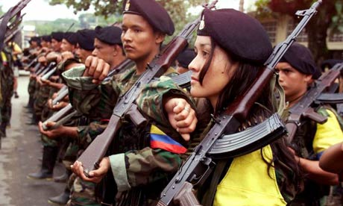
Violence and the War on Drugs
Colombia
Democratic Government
Guerrilla conflict- 1964-2017 (FARC-drug-funded from 1970)
Guerrilla de facto control of large areas v. state-trained paramilitaries
Kidnapping (2002 Ingrid Bethancourt presidential candidate)
Internally displaced communities
State violence against unions
War on Drugs- Medellin- 2000 Plan Colombia

Slide 47
Mexico: The War on Drugs Effects 2006-2017
160,000 dead, 28,000 missing.
Increasing use of terror tactics especially but not exclusively by Zetas
Increasing involvement in other forms of crime (petrol tapping, kidnapping, extortion)
Human rights violation (Ayotzinapa, Tlatlaya, Tanhuato)
http://mexico.anyoneschild.org/index_2.html

Slide 48
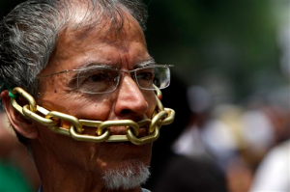
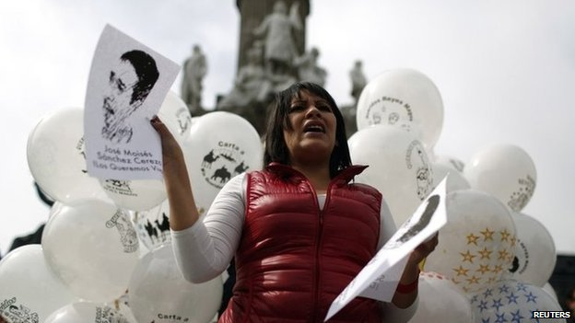
The Curtailing of the Public Sphere in Mexico

Slide 49
Murder of journalists (over 100 since 2000)
Increasing self-censorship of newspapers, TV and Radio (e.g. 2009 Ciudad Juarez)
Increasingly complex collusion between state/cartels
Drug war as war on people’s understanding of the world

Slide 50
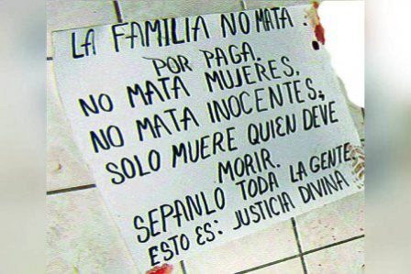
Everyday knowing: The Narco-Sphere
Narcomantas/narcomensajes

Slide 51
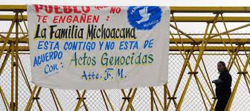

Slide 52
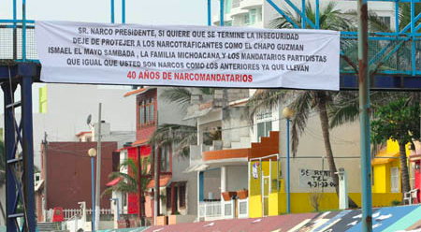
Propaganda (Campbell) or part of the narcosphere (Paul Eiss)

Slide 53
Narcomedia
Use of youtube/facebook/blogs/twitter
Massive rise in internet usage.
30 per cent of Mexicans have facebook account
Rise of Blogdelnarco during Calderon era
Alternative public sphere?

Slide 54
Vigilantes and Autodefensas
Cartel Land, Matthew Heineman, 2015
https://www.youtube.com/watch?v=xC5bpPfltOI

