Slide 1
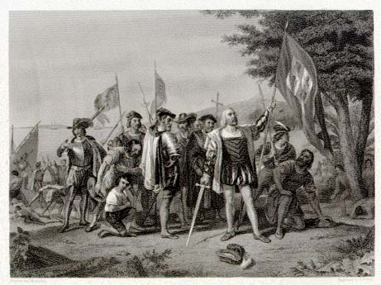
Early contact in the Caribbean and Brazil

Slide 2
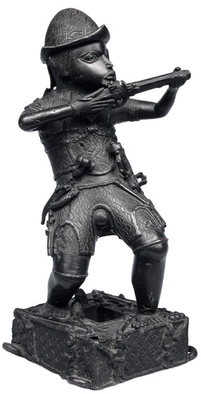
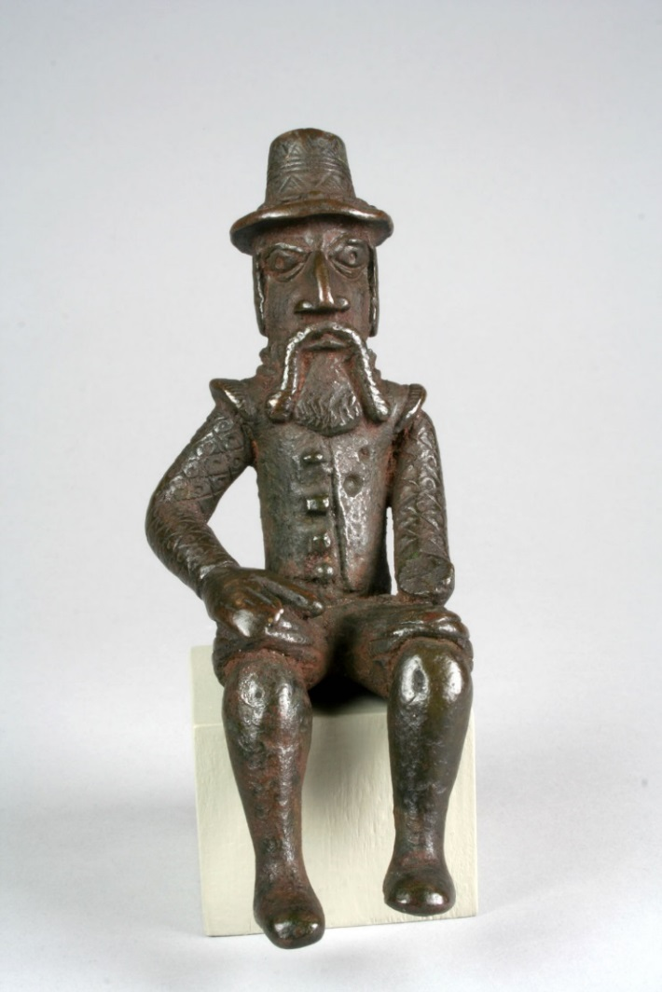
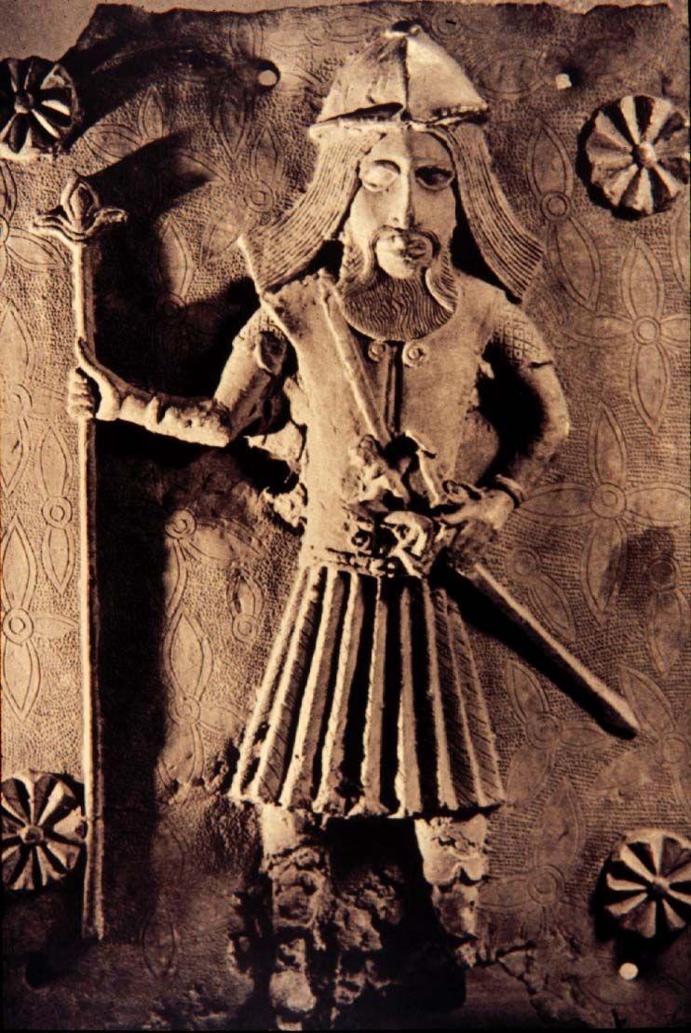
Portuguese soldiers and traders depicted in brass castes made by the Edo people of Benin (Nigeria) c17 and c18

Slide 3
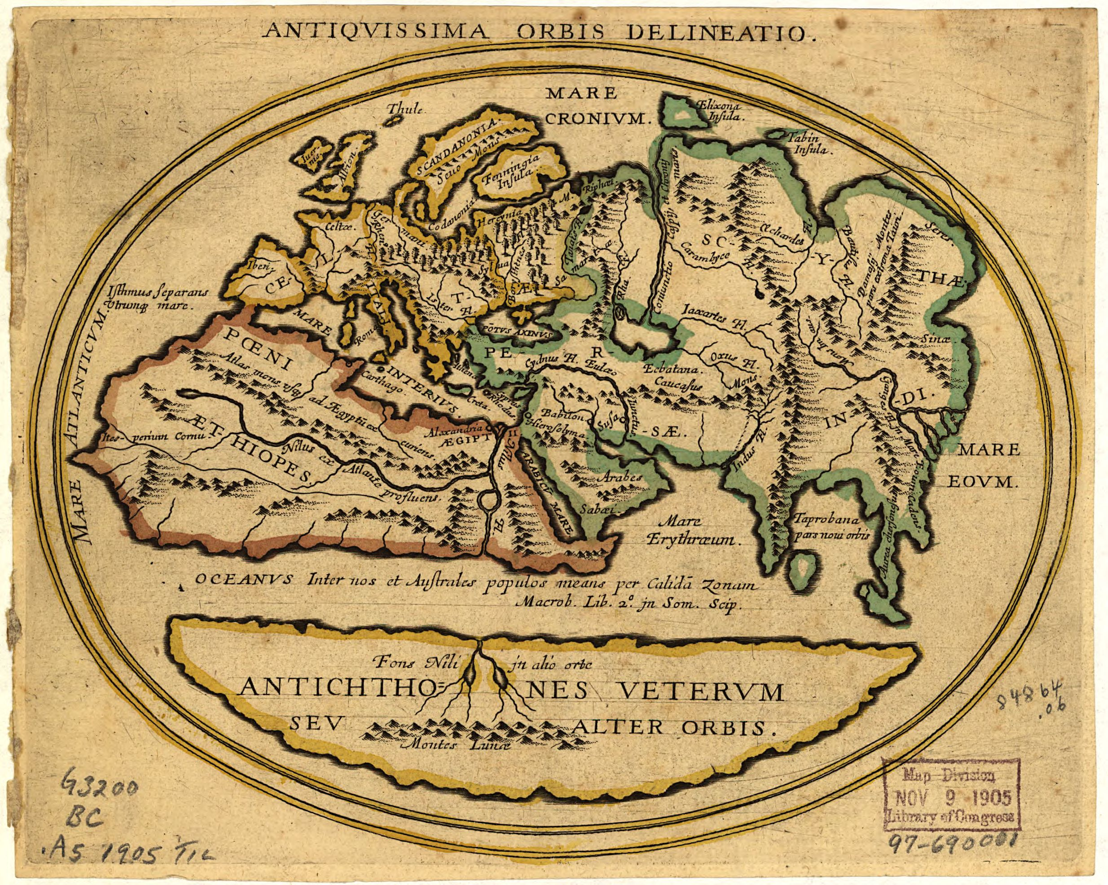
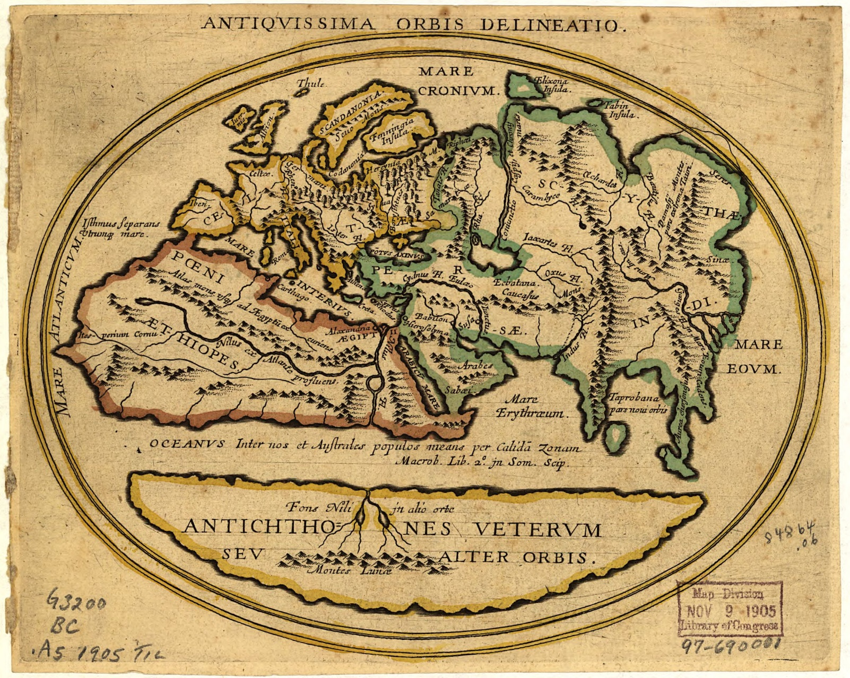
Antiquissima Orbis Delineatio
European Map of the World before 1492 (Source: Library of Congress)

Slide 4
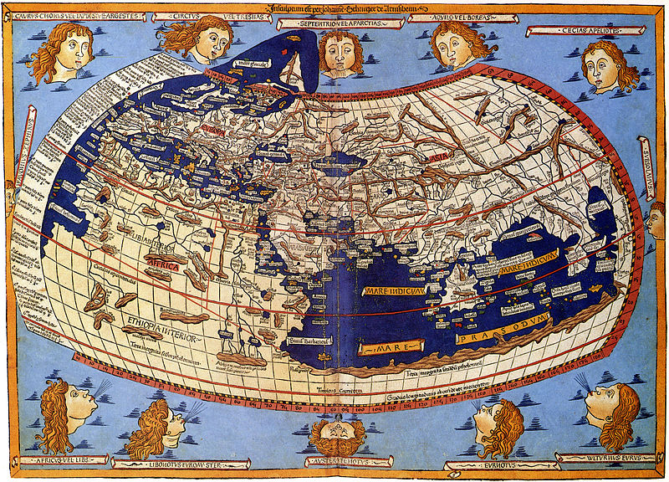
Cosmographia, Claudius Ptolemaeus, Ulm, 1482.

Slide 5
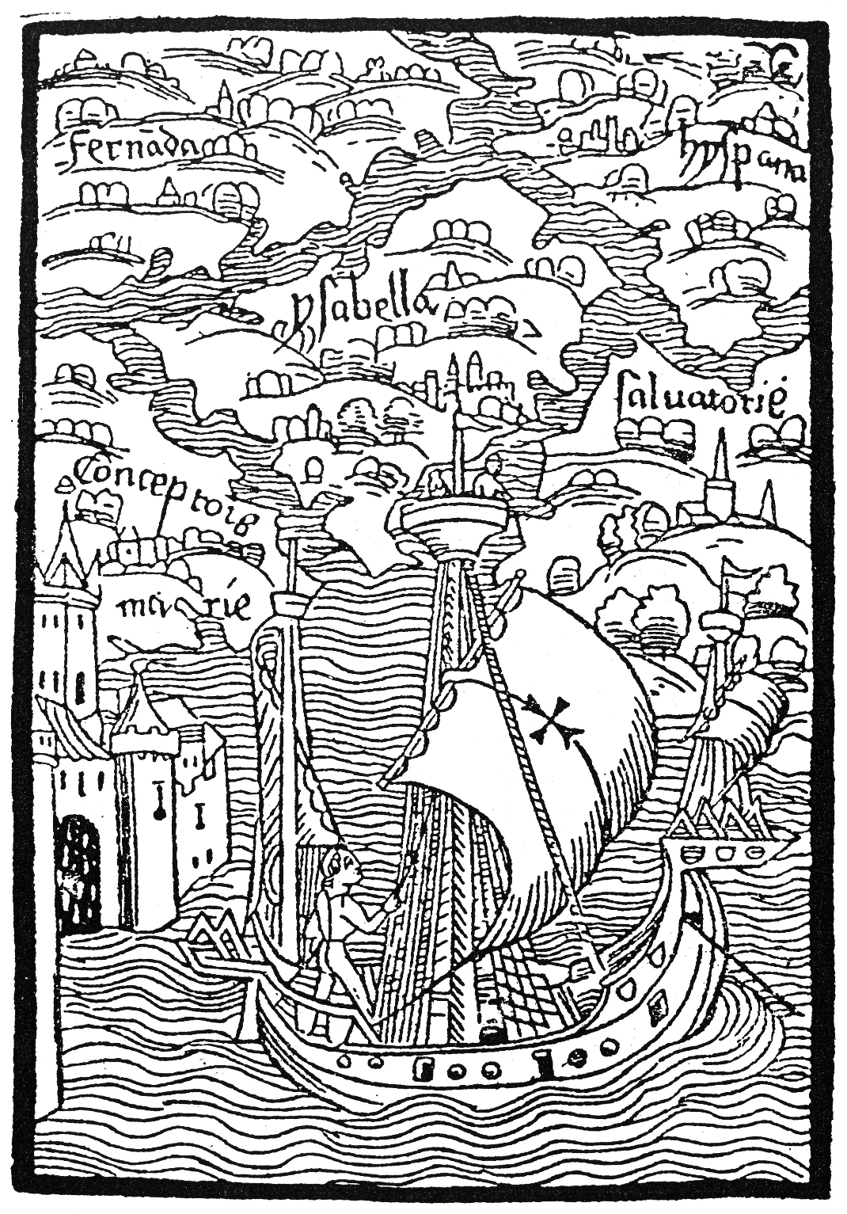
Woodcut from the manuscript
Christophorus Colombus, Epistola de insulis nuper inventis

Slide 6
Last week… the Iberian Peninsula
Iberians: Reconquista Reconquest from Umayyad califates, Al Andalus
desire for social advancement, conquest of new territory;
but also: Catholicism, conversion of souls for God & for Catholic Monarchs
Significant historic role of mestizaje (mixing); co-existence of racial and religious groups; North and Sub-Saharan Africa…
More recent turn away from tolerance and co-existence towards a crusading Christianity
Portuguese: similar in some ways but different in others (earlier Reconquest; turn out towards Atlantic trading empire)

Slide 7
Patterns in the pre-Columbian Americas
Tremendous diversity of pre-Columbian peoples
But, some significant PATTERNS help shape the conquest/ colonisation process
Mexico and Peru: densely settled, urban people; recognisable political structures; TRIBUTE
Caribbean and Brazil: “semi-sedentary” or “non-sedentary” peoples: Tupi; Arawaks; Taino; Caribs
Less familiar social organisation; less easy to put to WORK.
Plus: especially susceptible to European DISEASES.
Early contact phase: shapes PATTERNS that later mainland conquests will spring from
Think about: SIMILARITIES between Spanish Caribbean and Portuguese patterns, as well as differences between empires…

Slide 8
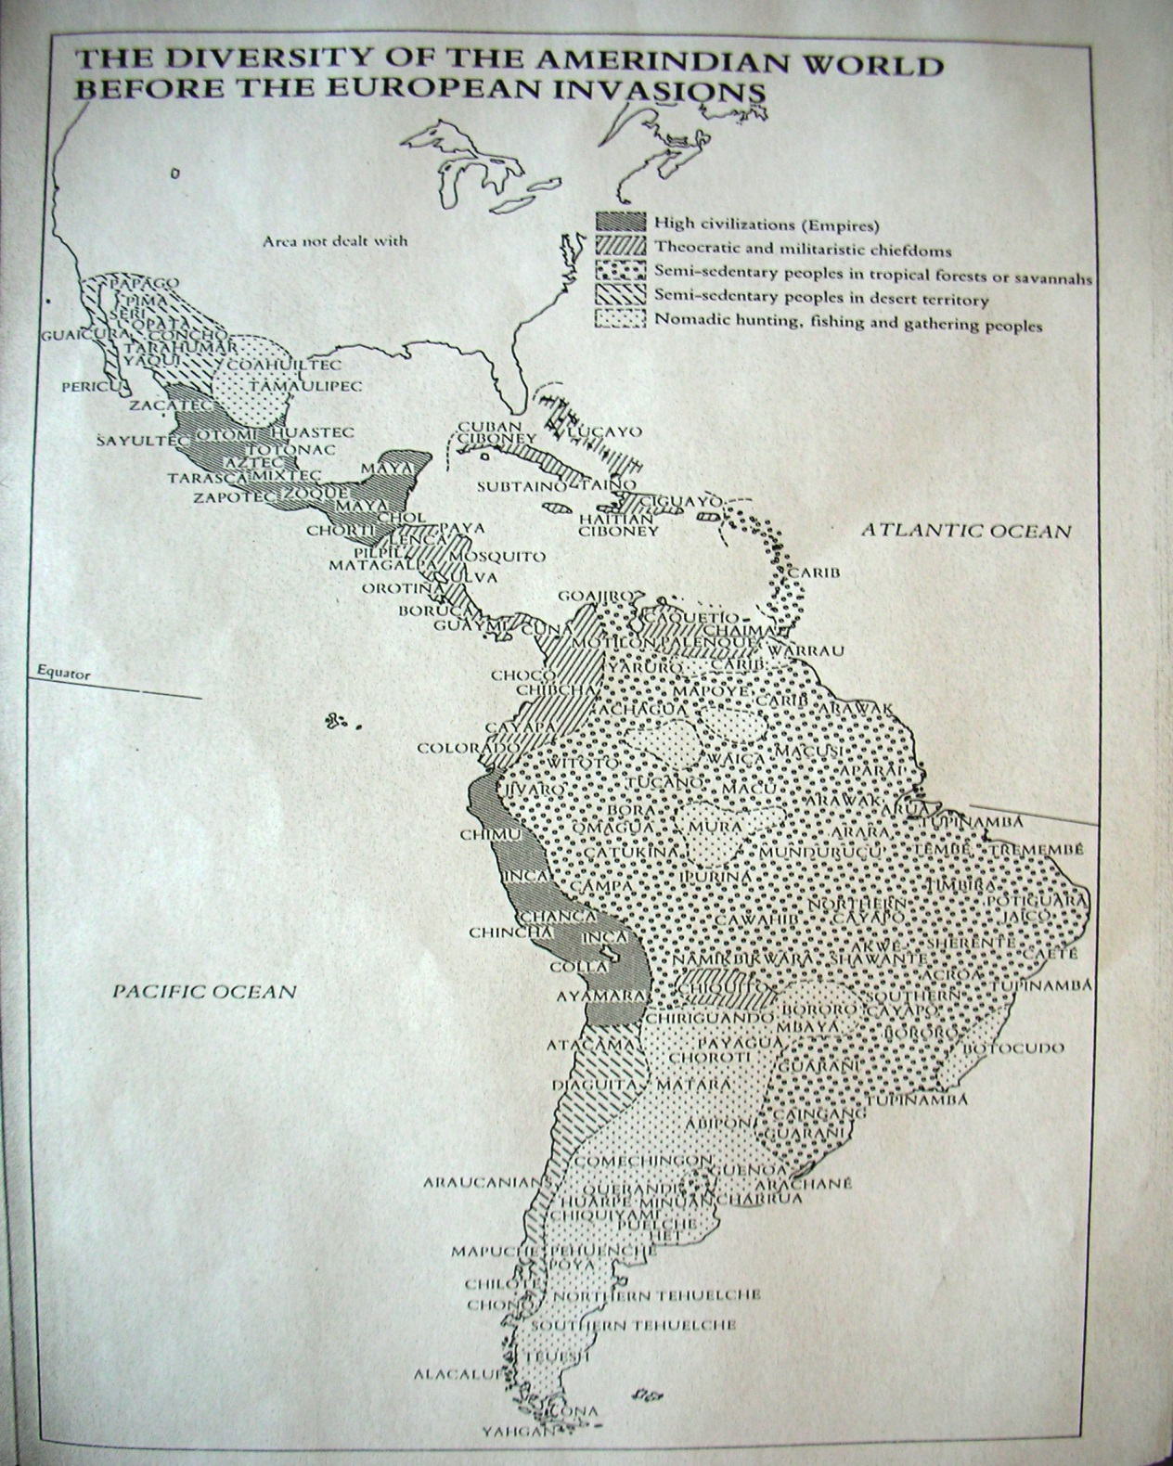

Slide 9
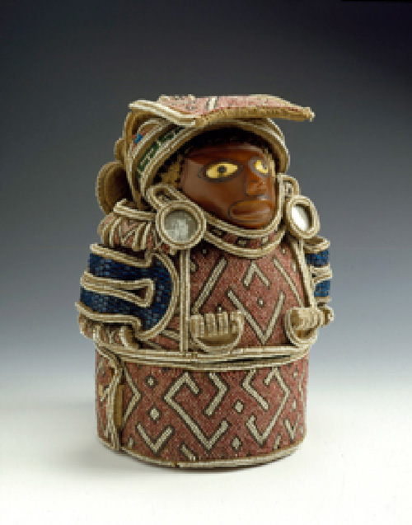
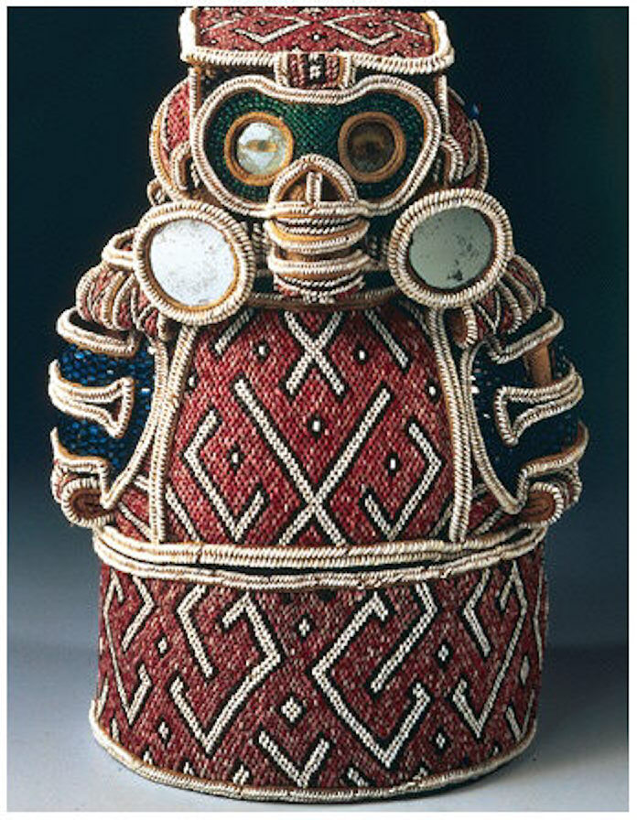
Colonial Encounters: a Taino Zemi

Slide 10
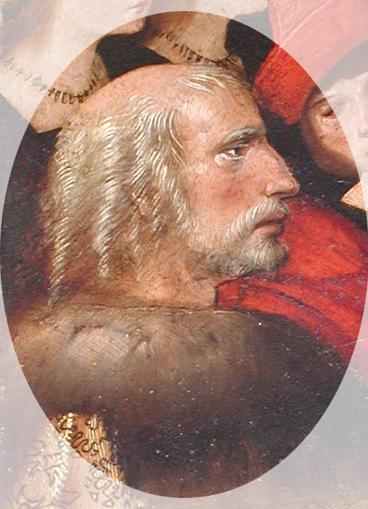
Notes:
Christopher Columbus

Slide 11
Columbus’ Background
Part of merchant trading, maritime community in Portugal
“Discovers” Americas for Castile, but approaches Portuguese King (John II) first
Experience at West African Portuguese trading stations (feitorias) and West African people in Europe; plus, trading in gold, enslaved humans.
Ferdinand and Isabella grant him right to explore; governorship of all lands “discovered”
Contradiction between his role as explorer and governor: symbolises important contradictions of Iberian conquest of Americas

Slide 12
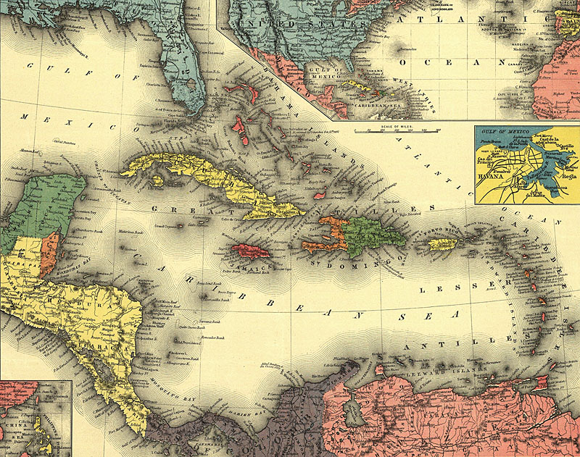
Notes:
Caribbean (in 1898!)

Slide 13
Caribbean Colonisation
Columbus: Arrives at San Salvador (Bahamas): 12 October 1492
Reaches Cuba; then Hispaniola (today Haiti/ Dominican Republic); will become centre of Spanish colonisation in Caribbean
Treaty of Tordesillas (1494): allots Western Hemisphere to Castile, but inadvertently grants Brazil to Portugal
Problems on Hispaniola: Spanish settlers’ expectations anger Indians: slaughter of settlers; eventually civil war.
Anticipates general problems for Crown: private individuals involved in conquest versus saving souls/ good governance

Slide 14
From Columbus’ first letter, describing the island of Hispaniola (and the Taíno people) 9 re-printings in 1493:
‘This island is to be desired and very desirable’
‘there are great and beautiful mountains, vast fields, groves, fertile plains, very suitable for planting and cultivating’
Hispaniola ‘abounds in different kinds of spices, in gold, and in metals’
All these people lack … every kind of iron; they are also without weapons … they are timid and full of fear’
‘when they perceive that they are safe, putting aside all fear, they are of simple manners and trustworthy, and very liberal with everything they have, refusing no one who asks for anything they may possess’

Slide 15
‘those people are very amiable and kind, to such a degree that the said king [i.e. chief] gloried in calling me his brother’
‘I promise this, that if I am supported by our most invincible sovereigns with a little of their help, as much gold can be supplied as they will need, indeed as much of spices, of cotton, of mastic gum [a type of resin]… also as much of aloes wood [Asian tree prized for its resin, used in, e.g., medicines], and as many slaves … as their Majesties will wish to demand. Likewise rhubarb and other kinds of spices’
‘Let Christ rejoice on earth, as he rejoices in heaven, when he foresees coming to salvation so many souls of people hitherto lost. Let us be glad also, as well on account of the exaltation of our faith, as on account of the increase of our temporal affairs, of which not only Spain, but universal Christendom will be partaker’

Slide 16
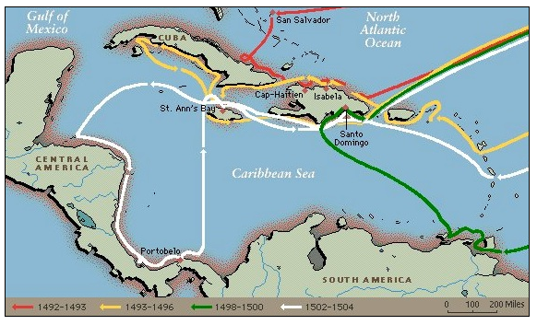
Voyages to the Carribbean

Slide 17
Columbus’ Voyages
1492- San Salvador Bahamas, North of Cuba and Hispaniola (“The Antilles”)
1493-1496- Canaries to Lesser Antilles, Pueto Rico and Hispaniola-South coasts of Cuba and Jamaica.
1498-1500- South America-continental coast. Mouth of the Orinoco
1502-1504-Honduras to Panama

Slide 18
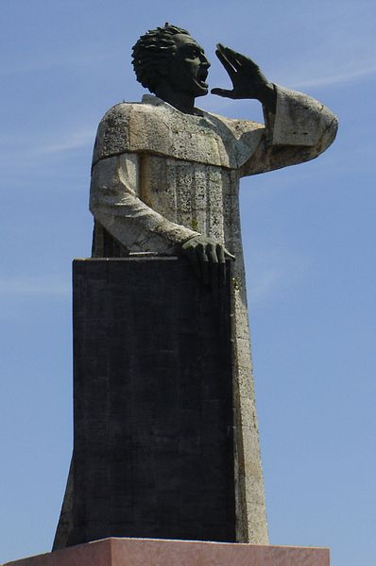
… I who am the voice of Christ crying in the wilderness of this island … it behoves you to listen … this is going to be the strangest voice that you have ever heard, the harshest and hardest … This voice says that you are in mortal sin, that you live and die in it, for the cruelty and tyranny you use in dealing with these innocent people. Tell me, by what right or justice do you keep these Indians in such a cruel and horrible servitude? On what authority have you waged a detestable war against these people, who dwelt quietly and peacefully on their own land? …. For with the excessive work you demand of them they fall ill and die … what do you care that they should be instructed in religion? … Are these not men? Have they not rational souls? Are you not bound to love them as you love yourselves?
Antonio de Montesinos, 1511
Antonio de Montesinos, by Mexican sculptor Antonio Castellanos Basich (in Dominican Republic)

Slide 19
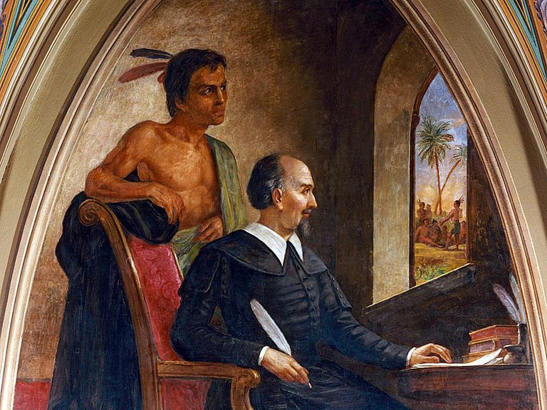
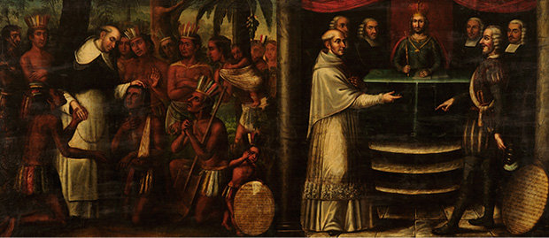
Bartolomé de las Casas
1484-1566
Notes:
Las Casas

Slide 20
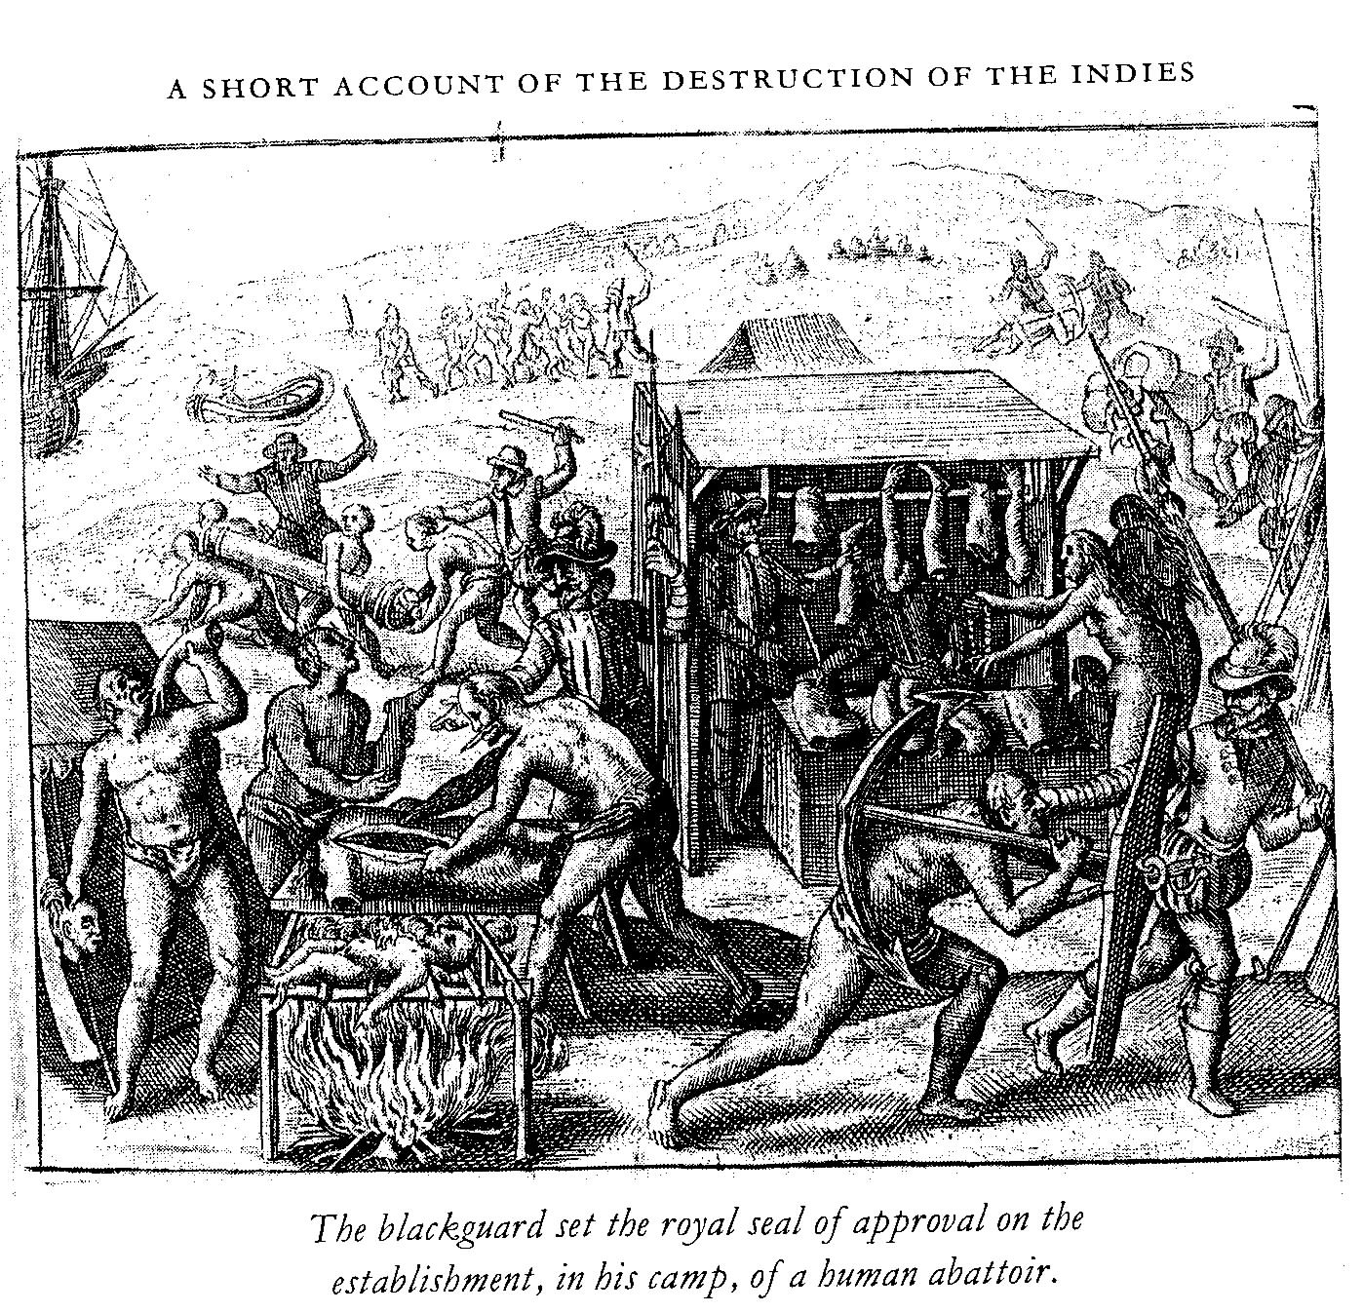
Bartolomé de las Casas,1542 (published in 1552) illustration from the 1548 edition (Frankfurt Theodore de Bry)

Slide 21
“Endless testimonies…prove the mild and pacific temperament of the natives…But our work was to exasperate, ravage, kill, mangle and destroy; small wonder then, if they tried to kill one of us now and then…The admiral, it is true, was blind as those who came after him, and he was so anxious to please the king that he committed irreparable crimes against the Indians.”
Bartolomé de las Casas

Slide 22
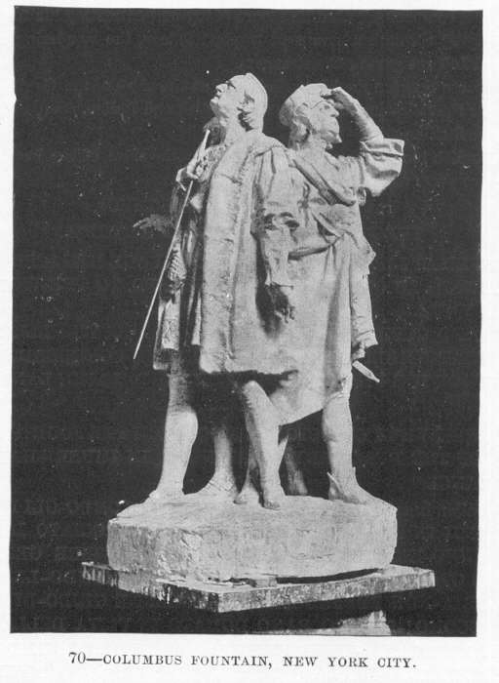
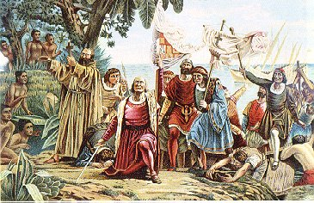
Columbus: changing scholarly conceptions
visionary bearer of civilisation to a “backward” continent

Slide 23
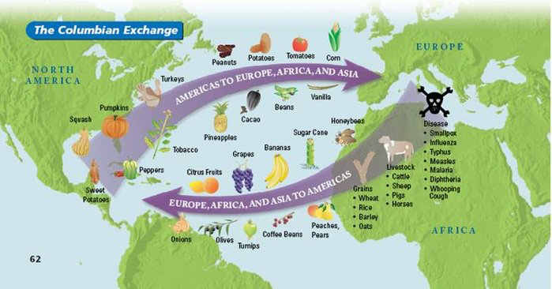
Columbian Exchange
Also manioc (aka cassava)

Slide 24
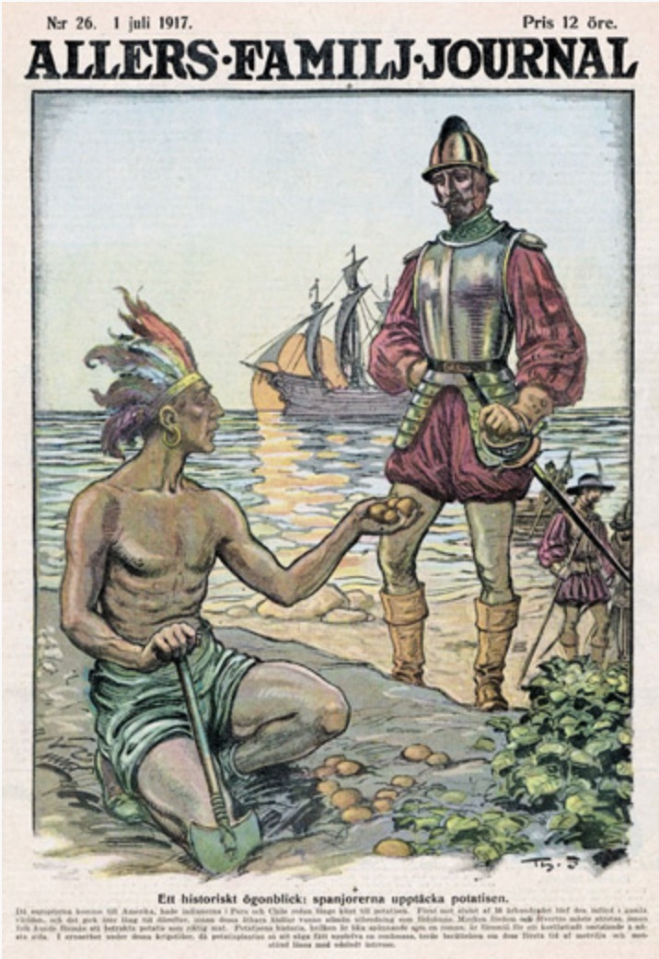
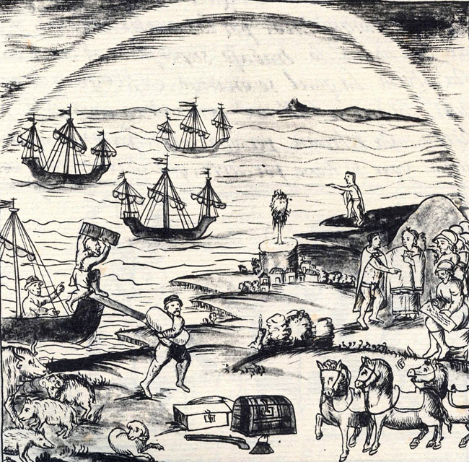
The ‘Columbian Exchange’: Alfred Crosby, The Columbian Exchange: Biological and Cultural Consequences of 1492 (1972).
Meso-Americans encounter European livestock
Florentine Codex (16th century)
Europeans encounter the potato

Slide 25
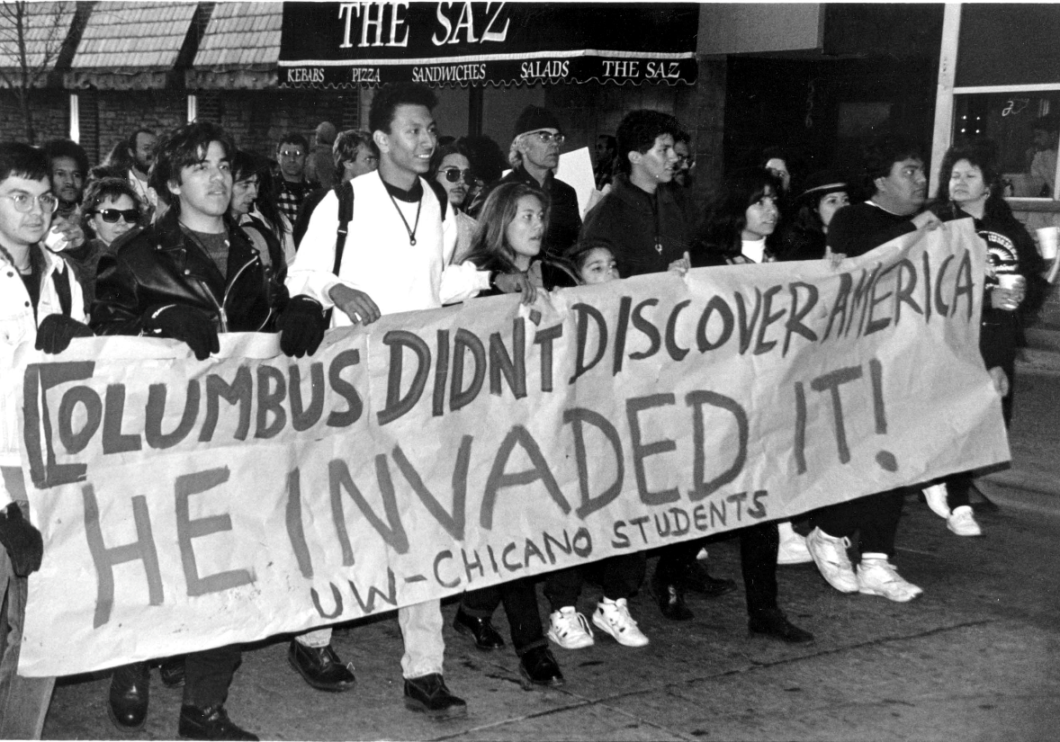
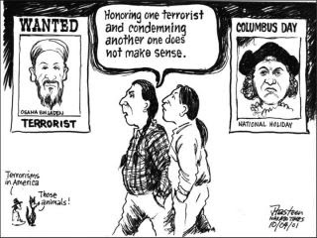
Columbus: changing scholarly conceptions
indigenous voices (1992 500 yrs) invasion?

Slide 26
Columbus: changing scholarly conceptions
linguistic turn
language constitutes reality
historical documents as ‘texts’
focus on questions of language, communication and understanding to deconstruct European discovery texts
QUESTIONS Columbus’s ‘mastery’

Slide 27
Columbus: changing scholarly conceptions
history of science
Longstanding awareness that the earth was a sphere
Columbus ‘sailed south’ in search of India

Slide 28
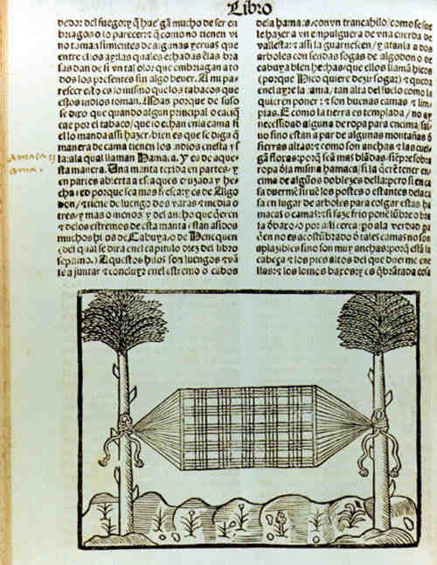
Colonial Encounters: Gonzalo Fernández de Oviedo’s image of a hammock (1535)

Slide 29
Colonial Encounters: a Taino Zemi

Slide 30
Importance of the Caribbean “Phase”
Indian population decimated within about 25 years
But, patterns established which will be repeated in Mainland Hispanic America:
Settlement through founding cities
Encomienda (allotting of “Indian” labour)
Base for new “discoveries” stimulated by desire for gold; labour; dissatisfaction of small bands of Spaniards
Caribbean: becomes “backwater” not focus of Empire; but important as stopping-off point for shipping routes to Indies (carrera de Indias)

Slide 31
Spanish Colonisation of the Caribbean
Many indigenous people died (disease? abuse?)
Patterns were repeated in Mainland “Hispanic” America:
Settlement founding of cities and establishment of an administrative structure
Coercive Labour regimes: Encomienda (grants of Indian labour) and slavery.
Hybrid colonial culture

Slide 32
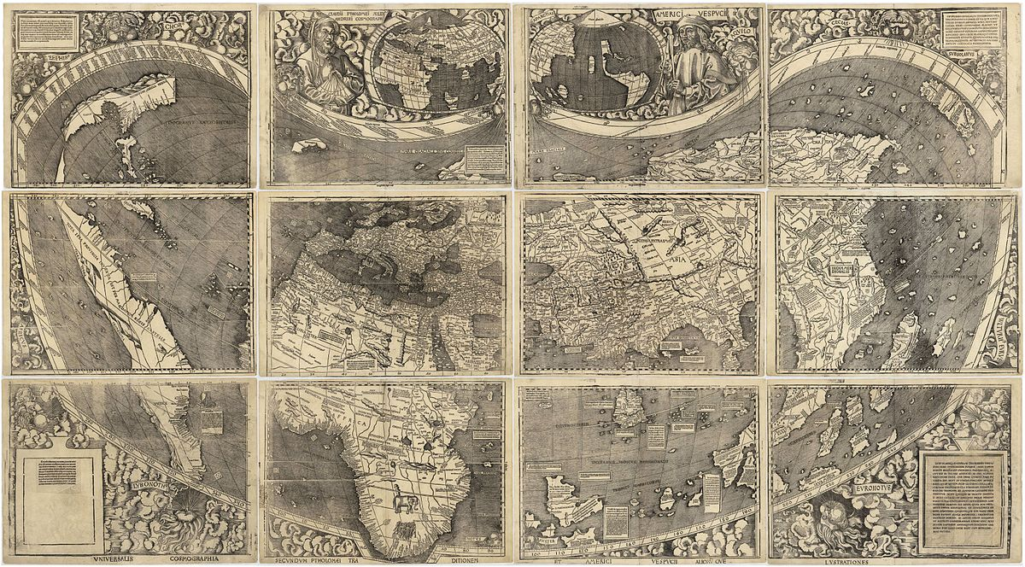
The Waldseemüller map, printed in 1507, depicted the New World in a new way.

Slide 33
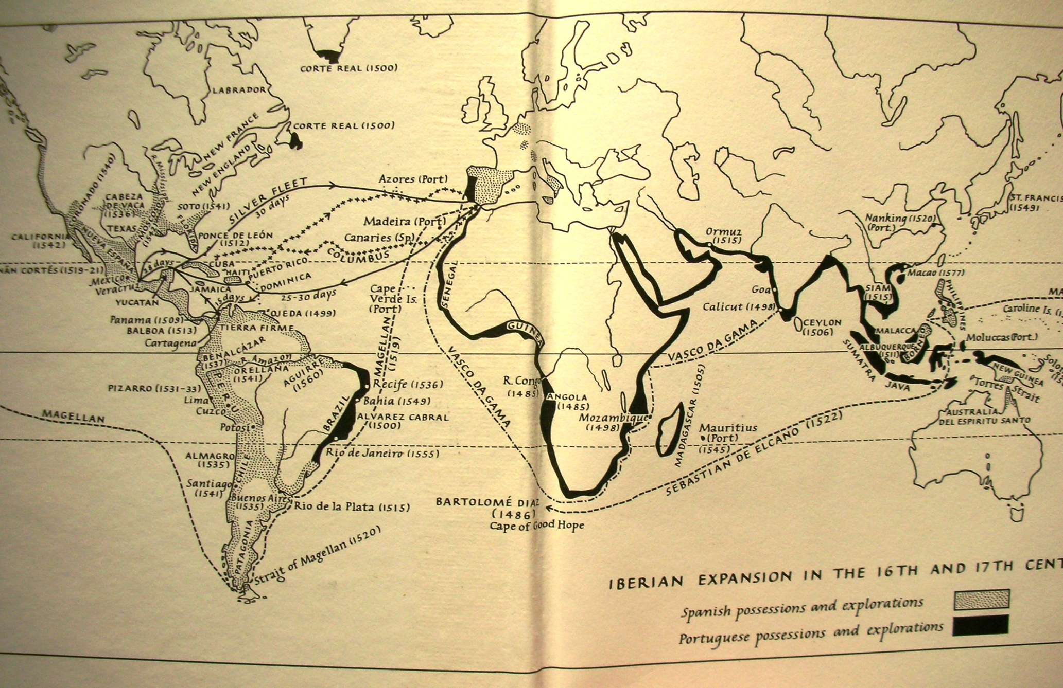
Notes:
Iberian expansion in 16th / 17th centuries (J Elliott, Imperial Spain)

Slide 34
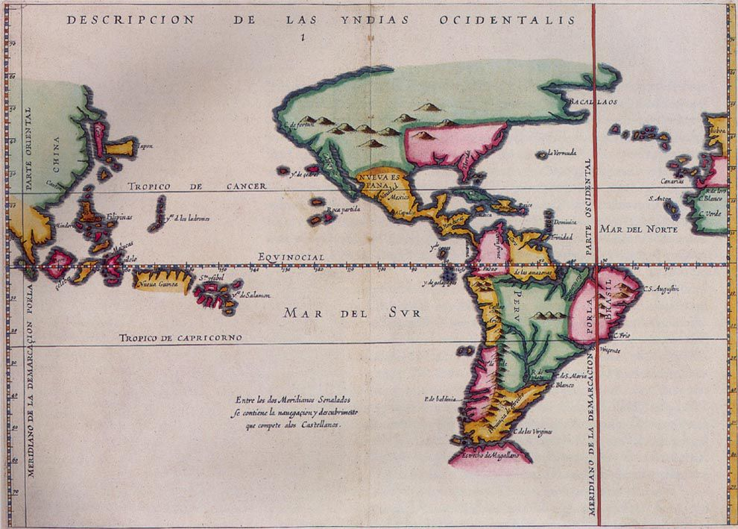
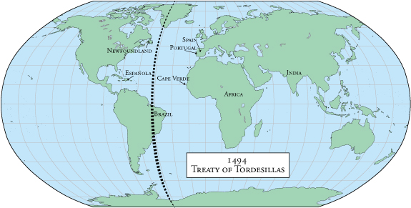
Treaty of Tordesillas (1494)

Slide 35
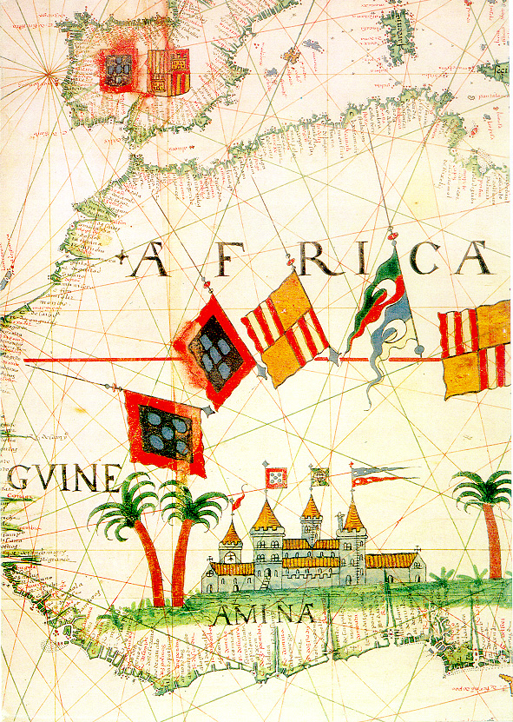
Portuguese expansion into Africa: 16th-century coastal trading feitorias

Slide 36
“Discovery” and Colonisation of Brazil
Major Portuguese trading empire: Azores, Madeira, Africa; Asia; trading stations
1500 Pedro Alvares de Cabral reaches N.E. Brazil (Terra da Santa Cruz)
Crown neglects Brazil for 30 years – left to private enterprise
Threat from other European powers: by 1530s, Portuguese take more interest
15 donatary-captaincies allotted; power to award sesmarias;
By 1570s: Crown authority fairly well imposed on coasts (governors Tomé de Sousa; Mem de Sá)

Slide 37
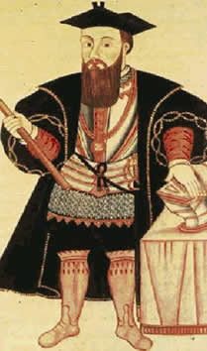
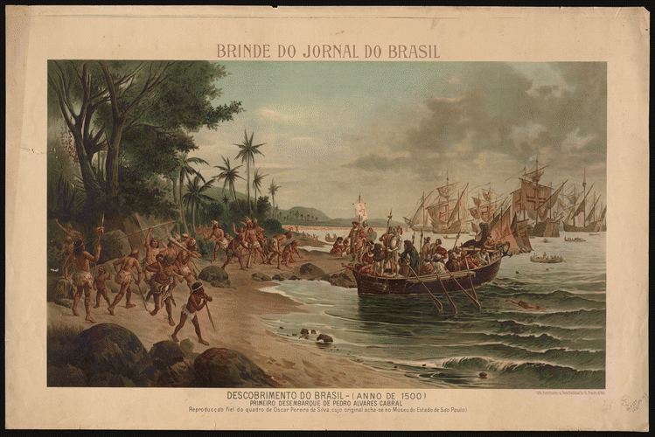
Pedro Alvares de Cabral

Slide 38
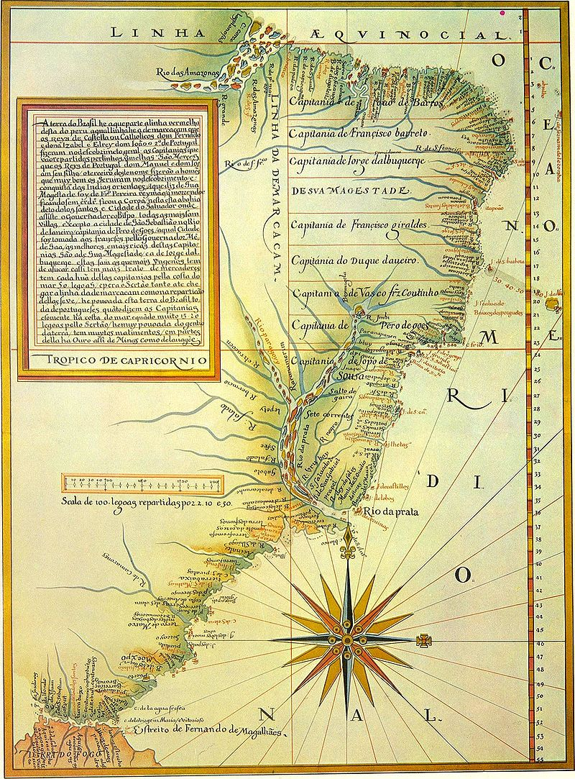
Donatary captaincies

Slide 39
Portuguese-Indigenous Relations
Brazilian indigenous peoples: forest dwellers; semi-sedentary; villages of up to 800 (contrast with Mexico/ Peru)
First 30 years: Mainly trading (barter) between Portuguese and Indians
By 1530s: Colonists want more intensive development, extraction, profits, hence “Indian” labour
Indians difficult to put to intensive labour; settlers want to enslave them → resgate
Conflict between: Jesuit missions; Crown; Portuguese settlers
Amerindians-Indians, Indigenous groups decimated by disease
With development of sugar plantations, Portuguese turn to importing enslaved Africans

Slide 40
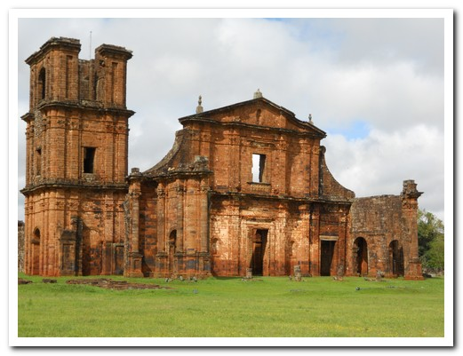
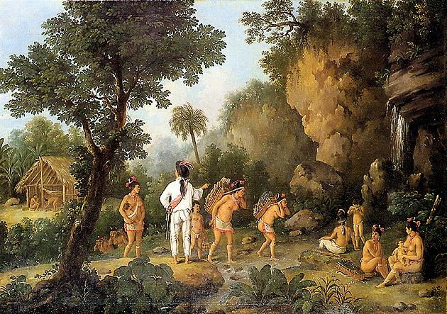

Slide 41
Brazil and the Caribbean
Similar conflict over LABOUR (settlers v indigenous peoples)
Crown in EACH wants to protect indigenous and save souls
But: more debate and soul-searching in Spain
Tropical climates make the indigenous especially susceptible to European diseases
Sugar plantations help spur the turn to enslaved African labour (especially Brazil, but Spanish Caribbean too): 90% of Africans in the Americas before 1800 are there as a result of SUGAR

Slide 42
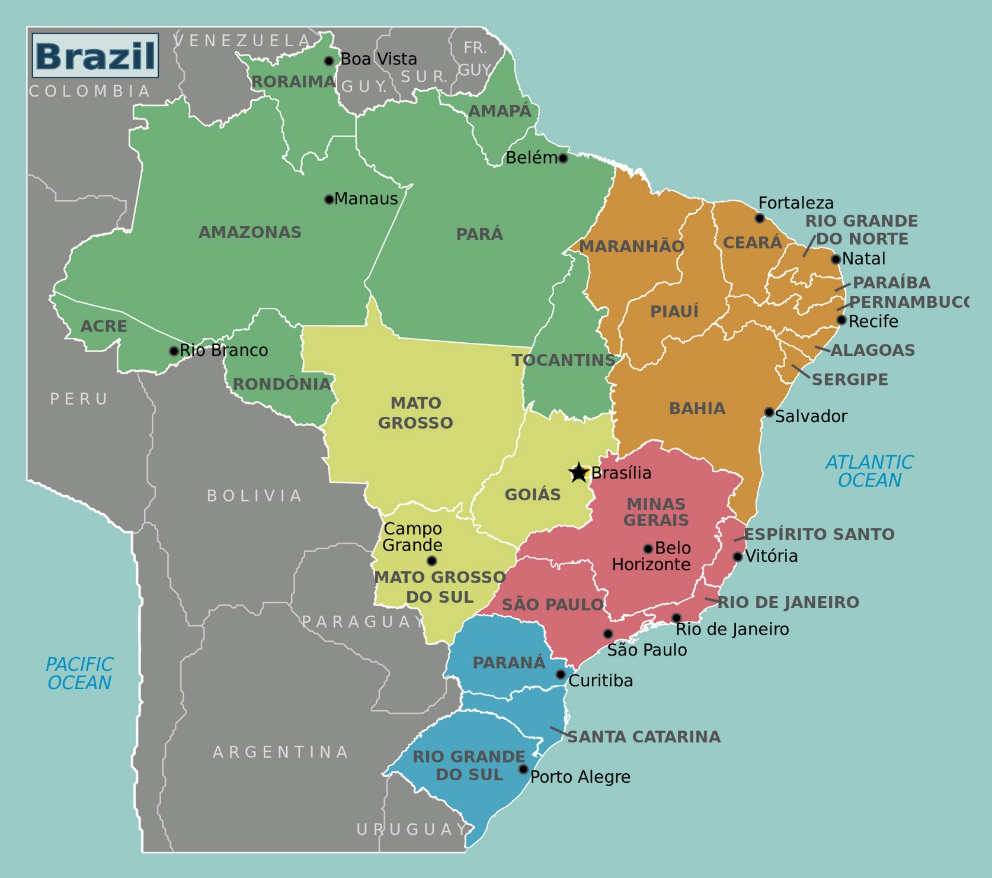


Slide 43
Changing Approaches to Early-Colonial Brazil
1970s- Social history
Post 1980s Ethnographic research on Arawak, Tupi and indigenous Brazilians.
Cultural Histories- Studies of private life- families etc. festivals, religious rites and rituals.
Go-betweens, Schwartz and Metcalfe

