Slide 1
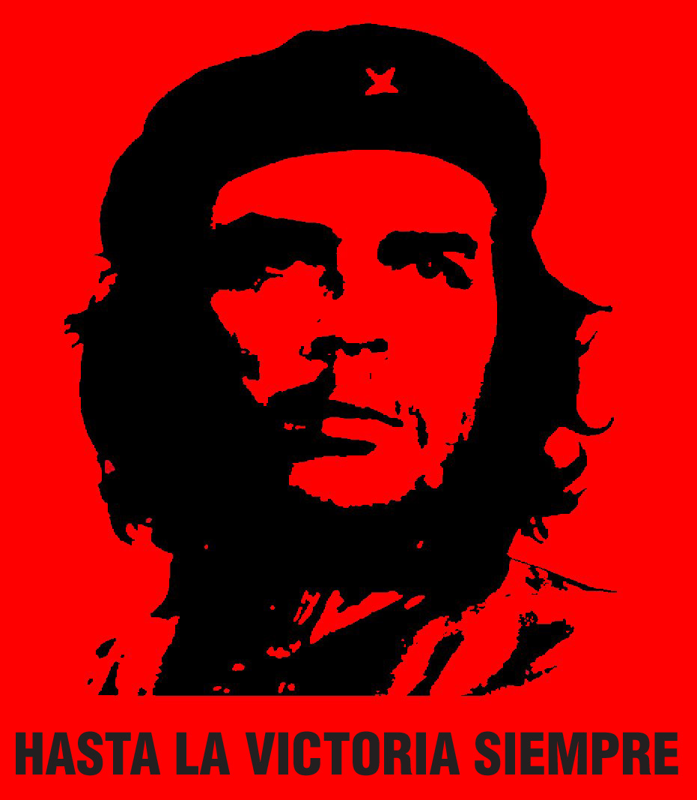
Revolution and Reaction

Slide 2
Gabriel García Marquez Nobel Prize Speech, 1982
““We have not had a moment’s rest… There have been five wars and seventeen military coups; there emerged a diabolic dictator who is carrying out, in God's name, the first Latin American ethnocide of our time. In the meantime, twenty million Latin American children died before the age of one - more than have been born in Europe since 1970. Those missing because of repression number nearly one hundred and twenty thousand, which is as if no one could account for all the inhabitants of Uppsala. Numerous women arrested while pregnant have given birth in Argentine prisons, yet nobody knows the whereabouts and identity of their children who were furtively adopted or sent to an orphanage by order of the military authorities… One million people have fled Chile, a country with a tradition of hospitality - that is, ten per cent of its population. Uruguay, a tiny nation of two and a half million inhabitants which considered itself the continent's most civilized country, has lost to exile one out of every five citizens. Since 1979, the civil war in El Salvador has produced almost one refugee every twenty minutes. The country that could be formed of all the exiles and forced emigrants of Latin America would have a population larger than that of Norway.”
http://www.nobelprize.org/mediaplayer/index.php?id=1496 6.30

Slide 3
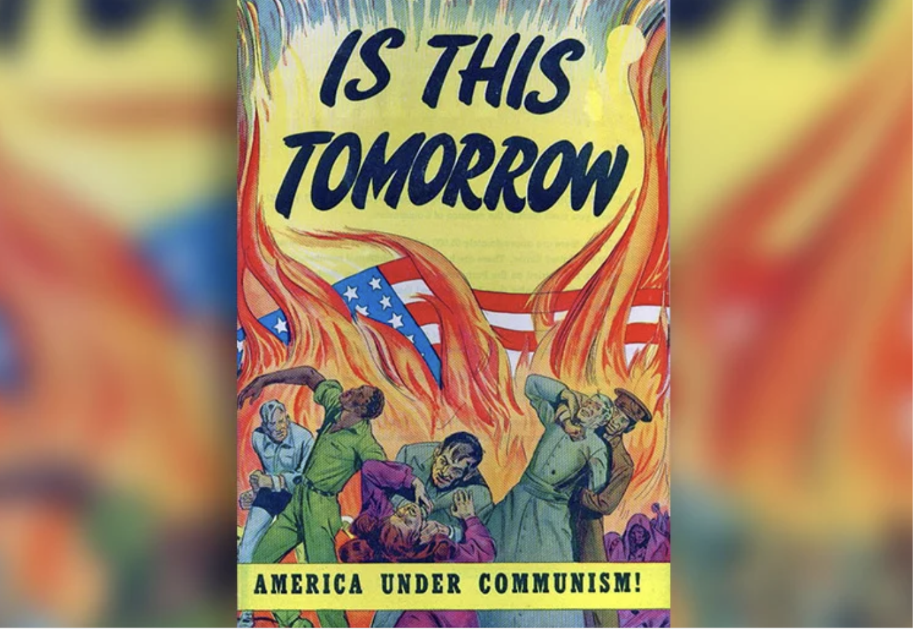
U.S. anti-communism
U.S. feared that communists sought to take over elected socialist democracies through internal coups.
They didn’t. Russia didn’t really care about Latin America. Latin Americans rarely asked Russia, China, North Korea or Vietnam for help.
However, they had a model. East Europe.

Slide 4
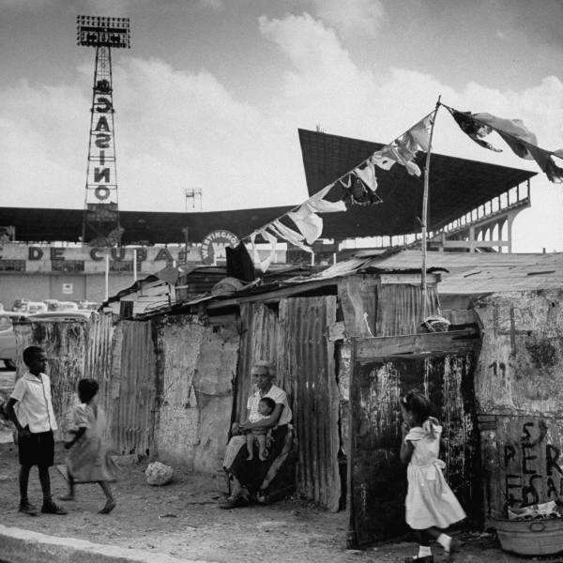
Cuba
1952: Military Coup of Fulgencio Batista against Carlos Prio
Support of US economic interests – by 1959, US companies own 40% of sugar lands, 90% of minerals, 80% of utilities.
Havana, mafia-run Las Vegas
Widespread poverty throughout Cuba.

Slide 5
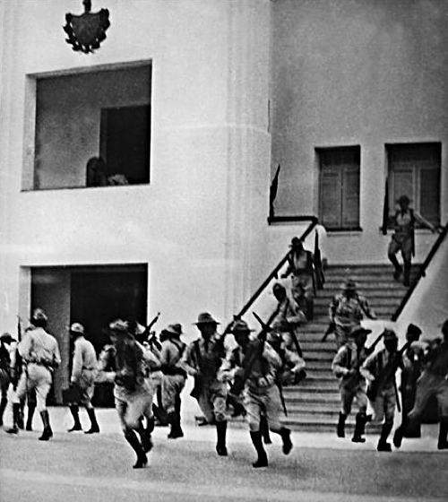
26th July 1953: Revolutionary group attacks Moncada Barracks in Santiago de Cuba, led by Fidel Castro

Slide 6
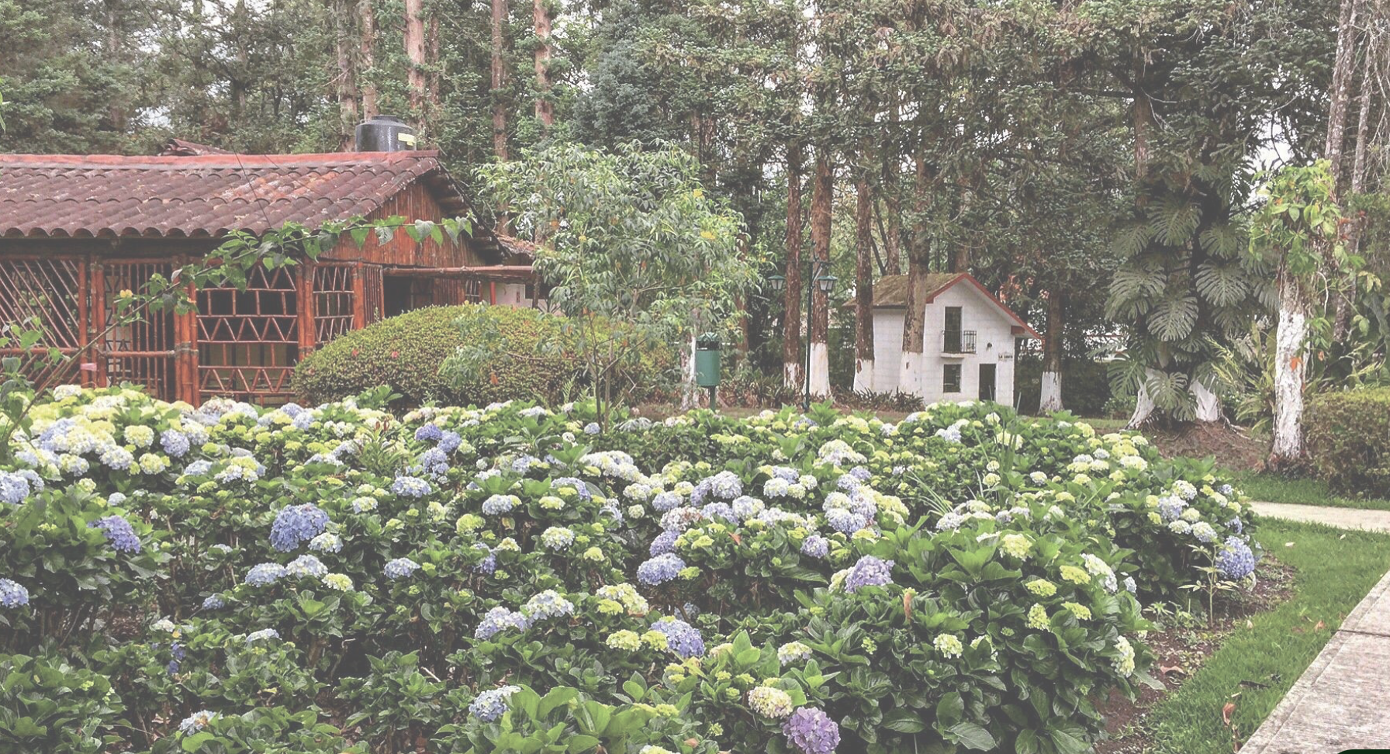

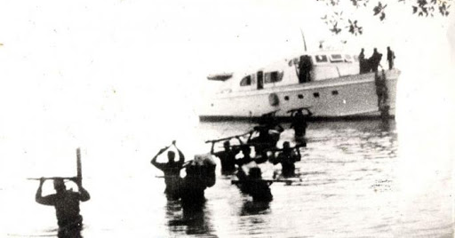
Cuban Revolution
1955: Castro released after amnesty by Batista
Travels to Mexico to plan new offensives
1956: Returns to Cuba with 80 other guerrilla fighters

Slide 7
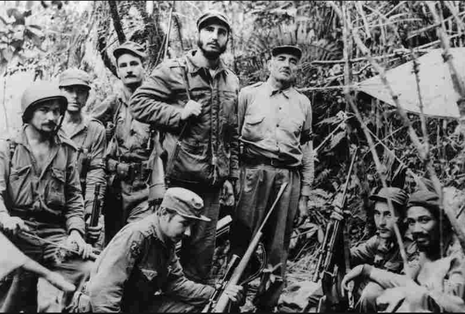
Allies with peasants, uses guerrilla “foco” strategy to defeat US-armed Batista forces Also, importance of mass media and urban insurgents. 21 August 1958: After several failures, begin final offensive, taking cities on the way to Havana

Slide 8
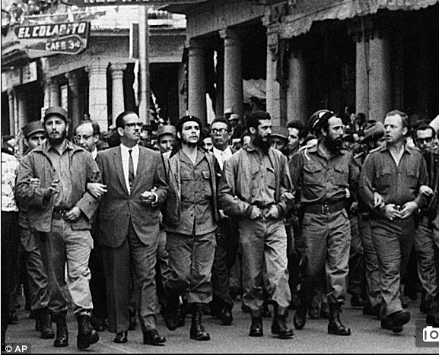
2 January 1959: Revolutionaries take Havana

Slide 9
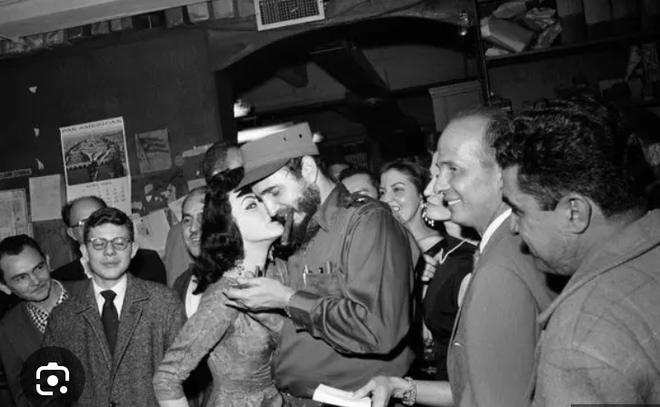
Castro’s Cuba
Cuba did not start communist. It started as a socialist state. The first foreign dignitary they invited was Lázaro Cárdenas. Wary of U.S.A, but not anti-U.S.
1959-1961, progressive social reforms:
Racial equality for black Cubans
Women’s rights movements
Healthcare, hygiene and sanitation improved
Increased education and literacy rates
Then in 1961: Nationalises land (Ministry of Misappropriated Assets). This creates division with United States.
Repression of dissidents, Church, political opponents.

Slide 10
Latin American Reactions
Heralds new sense of self-determination: ‘Now we are the citizens of all humanity’ (Octavio Paz)
Inspires guerrilla foco movements throughout Latin America.
Inspires electoral, socialist success.

Slide 11
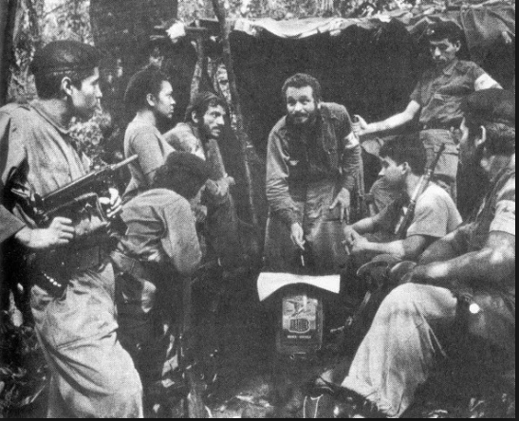
e.g. Douglas Bravo in Venezuela

Slide 12
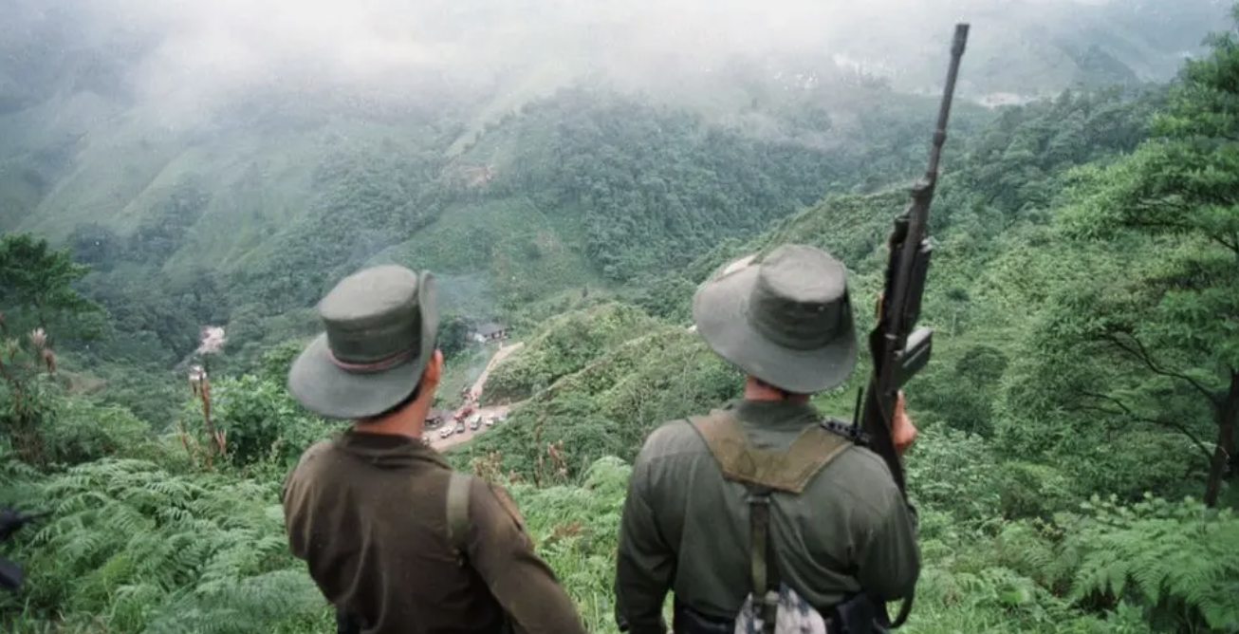
eg. Colombian Guerrilla-ELN/ FARC

Slide 13
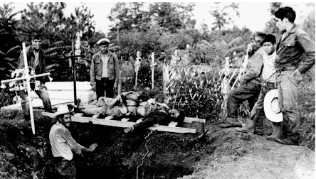
1965 Ciudad Madera (Mexico) barracks attack

Slide 14


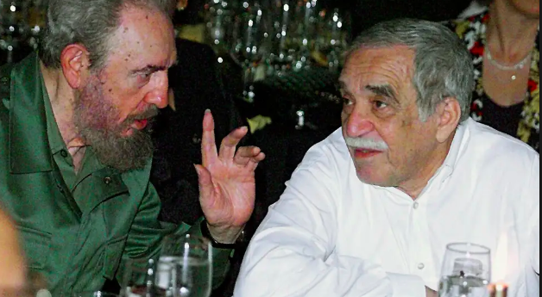
Cultural capital: Latin American literature “boom”

Slide 15
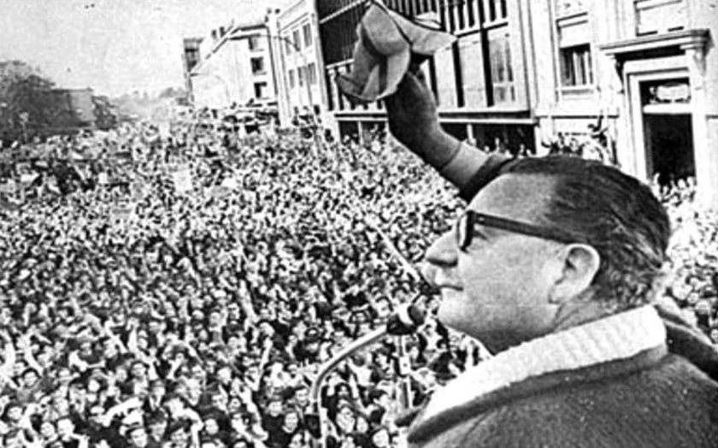
Electoral Succes: Chile 1970

Slide 16
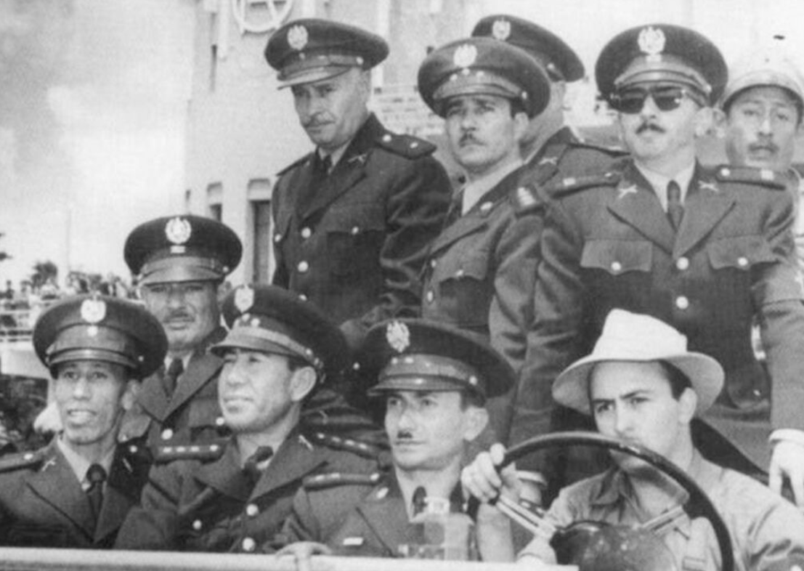
Reaction
1954 Guatemala coup against Jacobo Arbenz was the example,
Use of psyops (paid journalists, fake radio stations) used to
persuade U.S. public that Guatemala a threat
to persuade Guatemalans that their country was in chaos, and that only strong military figure could bring order
Use of military

Slide 17
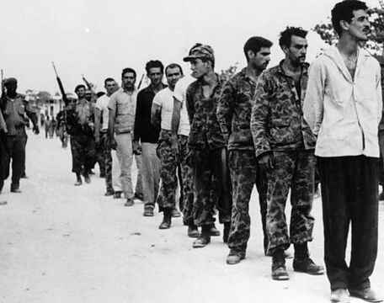
Over the decades, U.S. added to its strategies
1) Training of paramilitaries e.g. Bay of Pigs

Slide 18
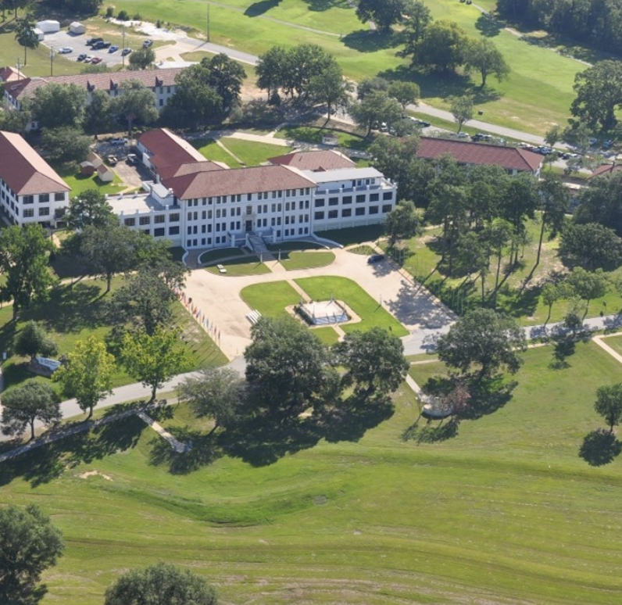
2) Training of military officials
1961 Kennedy administration demands that School of the Americas in Georgia concentrates on training “anti-communist counter-insurgency techniques”
1961-1990, School of the Americas trains 55,000 Latin American soldiers.
Counter-insurgency techniques include lessons of torture and the extortion of information.
Former teacher, Major Joseph Blair:
“The doctrine that was taught was that if you want information you use physical abuse, you use false imprisonment, you use threats to family members, you use virtually any method necessary to get what you want... [including torture] and killing. If there's someone you don't want you kill them. If you can't get the information you want, if you can't get that person to shut up or to stop what they're doing you simply assassinate them, and you assassinate them with one of your death squads.”

Slide 19
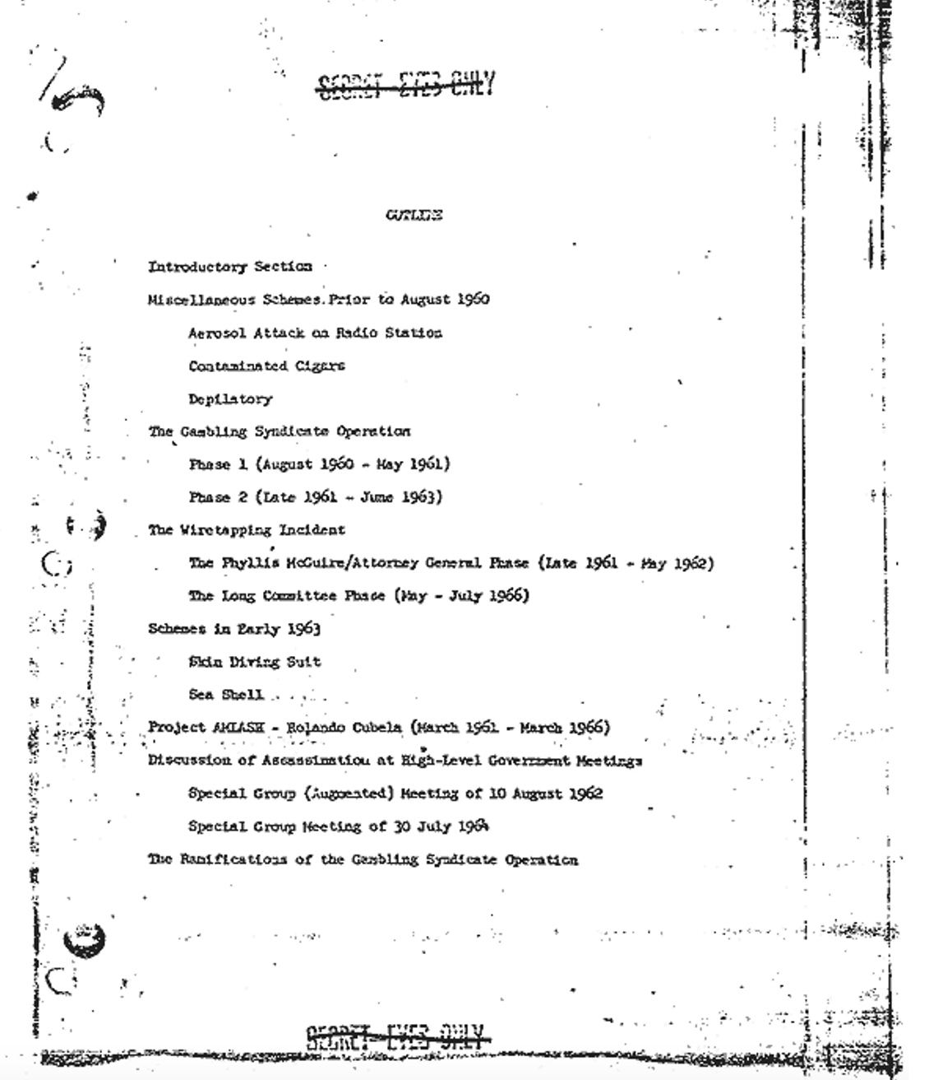
3) Assasination

Slide 20
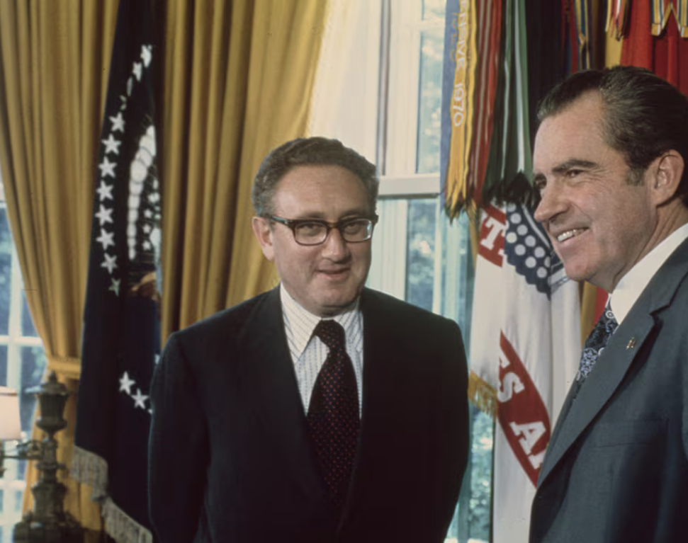
4) Economic pressure
In 1970 President Nixon demanded that the CIA “make the Chilean economy scream” and hence create a “coup climate”.
Pulled U.S. investments
Funded strikes
Vetoed international loans.
By 1972, inflation in Chile ran at 150%

Slide 21
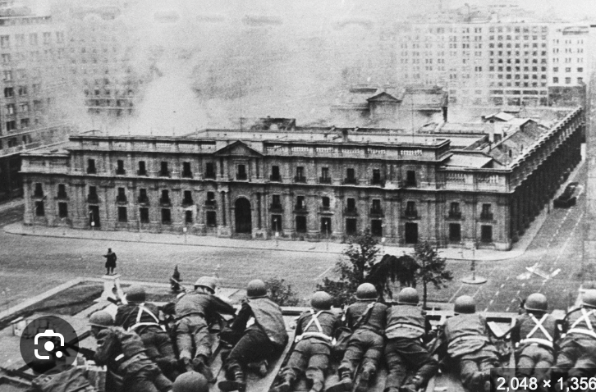
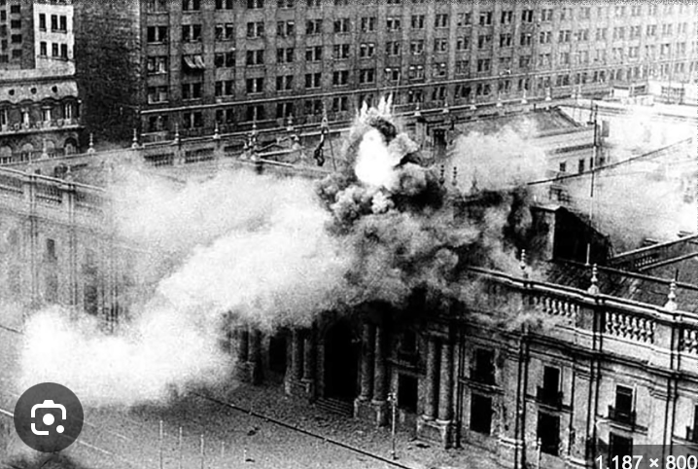
Combination of these strategies resulted in military coups e.g. Chile 1973

Slide 22
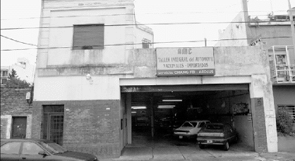
And paramilitary and military “dirty wars”, which involved torture and disappearance of dissidents. e.g. Brazil, Uruguay, Mexico, Argentina, Chile

Slide 23
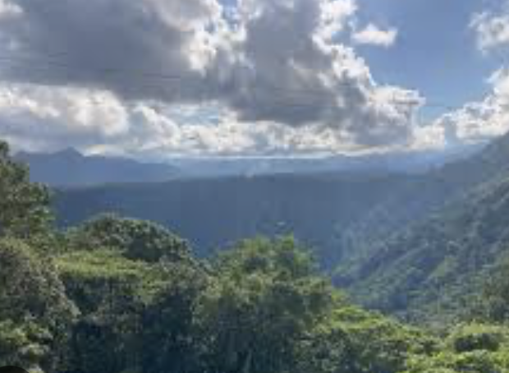
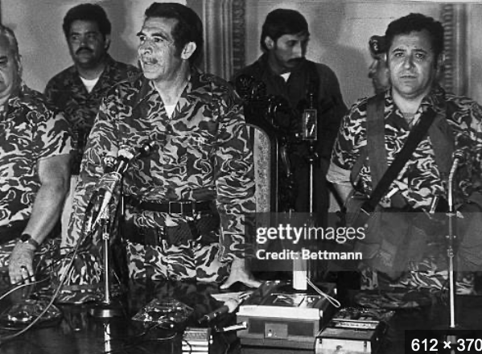
And rolling bloody civil wars, which often overlapped with racial divisions e.g. Guatemala, El Salvador, Colombia, southern Mexico

