Slide 1
Early Contact and ‘Conquests’ in Mesoamerica and the Andes
How did indigenous people understand and make sense of the 'conquest'?
How did Europeans understand and make sense of the 'conquest'?
Can we create a single, coherent history of the 'Spanish conquest of America'?
What can reading these different accounts tell us about how to write history, in general?

Slide 2
Readings
Patricia Seed, “Failing to Marvel: Atahuallpa’s Encounter with the Word,” Latin American Research Review, 1991
The Broken Spears: An Aztec Account of the Conquest of Mexico, ed. Miguel León Portilla, chapter 13 “The Surrender of Tenochtitlán”
Matthew Restall, Seven Myths of the Spanish Conquest, OUP 2003, Introduction and Epilogue

Slide 3
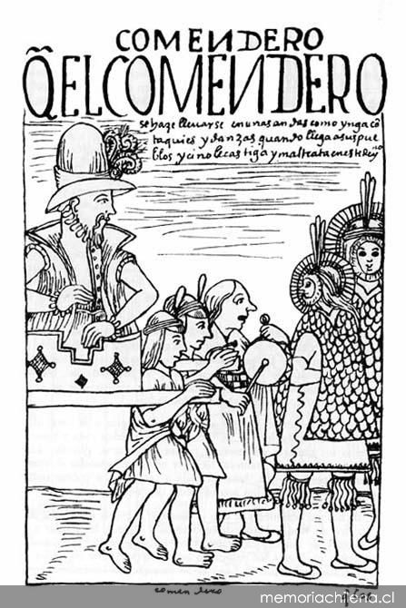
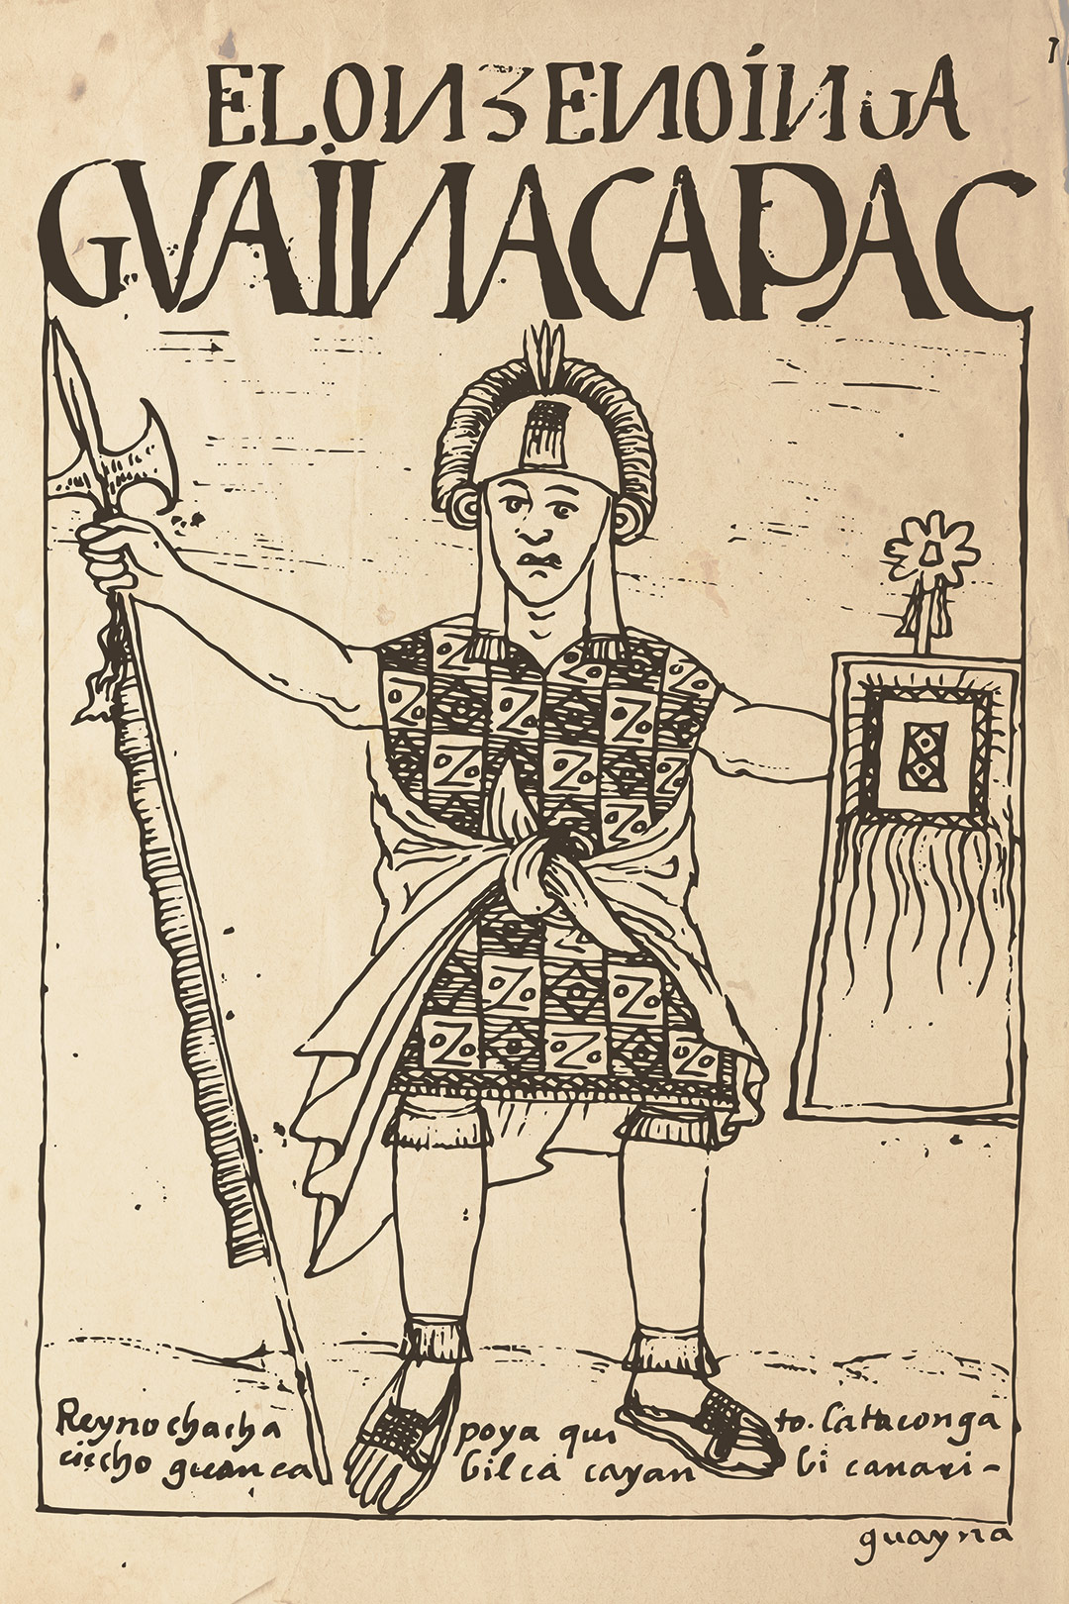
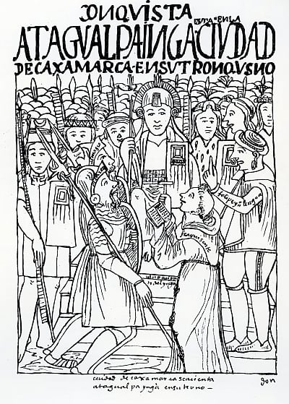

Slide 4
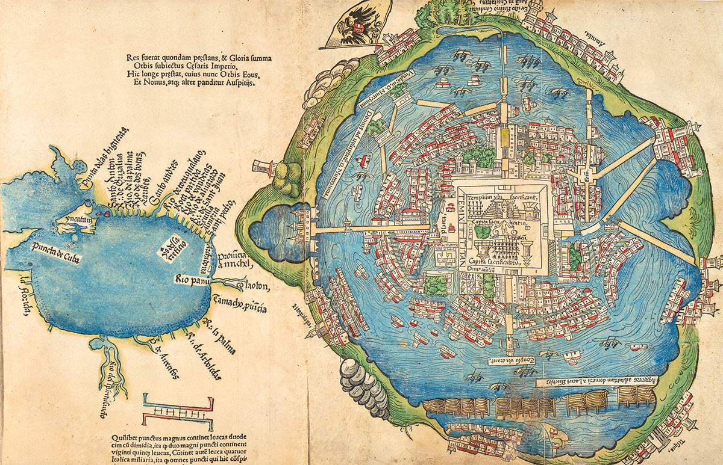
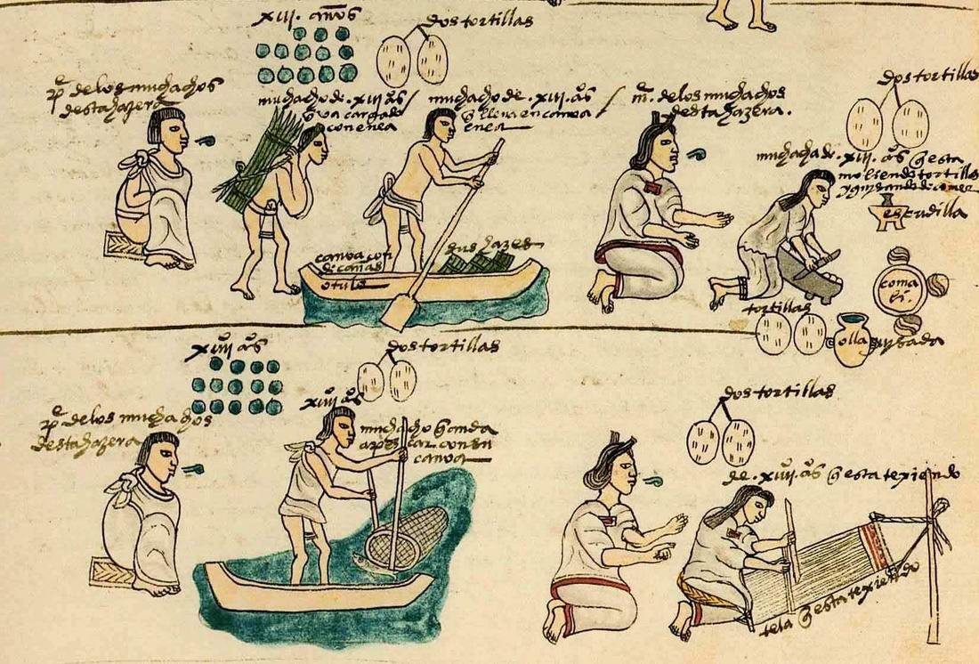
The Mexica of Central Mexico
The capital city of Tenochtitlán from a 1524 map
Mexicas preparing food, etc., from the Codex Mendoza, c.1540

Slide 5
Vistas website activity: https://vistas.ace.fordham.edu/themes/pre-columbian-surveying/
Watch the slide show/ look at the Discussion Points together.
How does it help historians to think about sources that might be useful for understanding the conquest and the Early Colonial Period?
How might you discuss specific visual sources in an essay?

