Slide 1
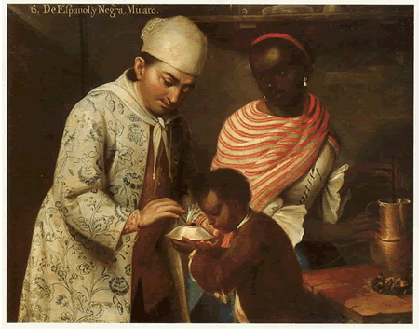
Week 8: Colonial Society
Notes:
José de Alcíbar (attrib.), From a Spanish Man and a Black Woman a Mulatto is Born (Denver Art Museum, c.1760-70), courtesy of Rebecca Earle’s lecture slides!

Slide 2
Casta paintings exhibition, Leicester, to 3 December
https://www.leicestermuseums.org/CastaOriginsOfCaste

Slide 3
Race or “race”?
Many scholars choose to always talk about “race” with speech marks
Reflects the consensus that, biologically, “race” as we think of it doesn’t exist
But, the idea of race is very much a SOCIAL reality, with a long, complex, changing history of its own. It VARIES across human cultures, across spaces and times. It responds to, and creates, relations of power.
Scholars thus increasingly talk about “race-making” – race as a process, not pre-ordained outcome.
See “Race: The Power of an Illusion,” https://www.racepowerofanillusion.org/
You will come across outdated racial terms in English in older reading; good to think carefully about your language in writing and class discussions
Also note that Latin American terminology may look different from what you are familiar with in English. Terms like mulato/a, mestizo/a, pardo/a, negro/a remain in standard use.

Slide 4
“Slave” or “enslaved”?
Many scholars today refer to “enslaved people” more than “slaves”; recognise that this was a condition imposed on people, not “natural” or one they accepted
Leaving aside issues of morality or acceptability, many people were enslaved ILLEGALLY. The African trade (the mainstay of enslaved populations in most of Latin America and the Caribbean) was illegal for much of the C19 yet experienced its greatest upswing precisely in that period. Had the law been followed, most Africans living in the Americas were technically free, not enslaved.
Also remember: in most places in Latin America, at most times, there were more free people of African descent than enslaved. Some African-descended people owned enslaved people themselves.

Slide 5
Readings
PBS documentary “Race: The Power of an Illusion”
Cope, R. Douglas, The Limits of Racial Domination: Plebeian Society in Colonial Mexico City, 1660-1720 (1994). Chapter 1, pp. 9-26.
Cook, Karoline. "Navigating Identities: The Case of a Morisco Slave in Seventeenth-Century New Spain." The Americas, (2008)
Ireton, Chloe. ""They Are Blacks of the Caste of Black Christians": Old Christian Black Blood in the Sixteenth- and Early Seventeenth-Century Iberian Atlantic". The Hispanic American Historical Review 2017

Slide 6
Questions
What is race? It has been described as a “social construct” and as a “floating signifier” (Stuart Hall); but what does this mean?
What role did race or caste play in structuring and maintaining social control in colonial Latin American societies?
How did race intersect with other social hierarchies like class, gender, religion?
How did these categories change over time?
Was there anything that ordinary people could do to change the way they were categorised, or shape the categories themselves??

