Slide 1
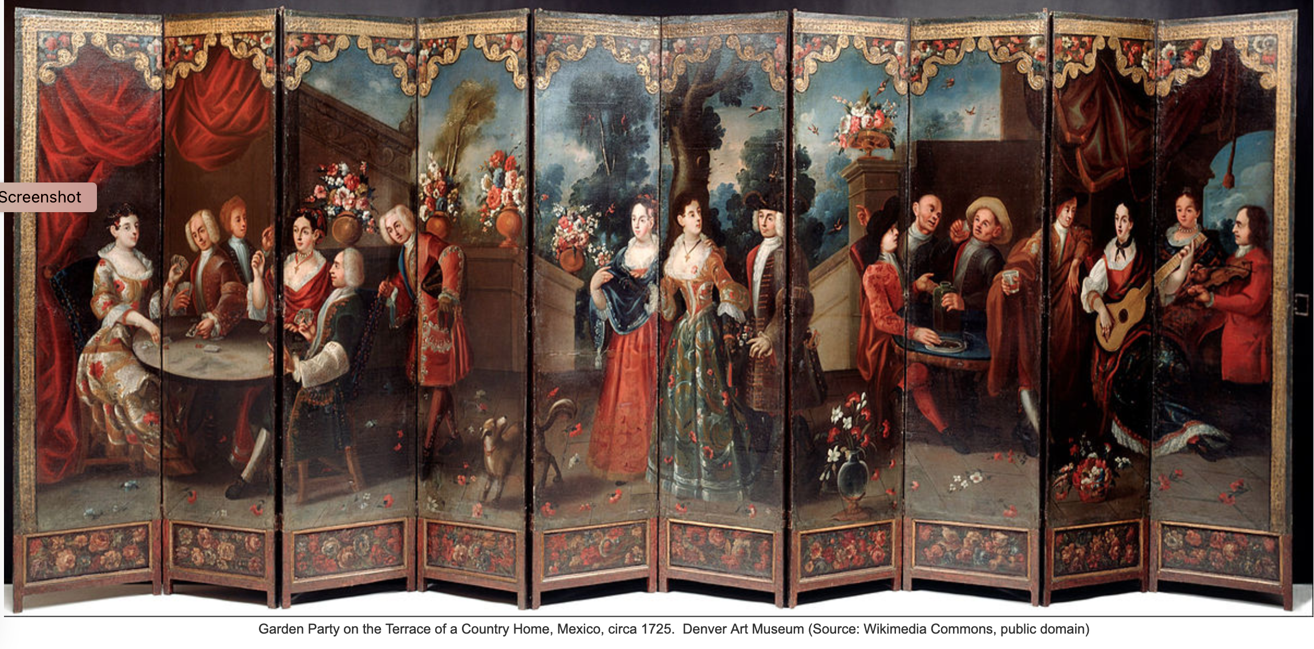
The Eighteenth Century in
Latin America

Slide 2
Dynastic change in Spain:
Hapsburg to Bourbon
Hapsburg monarch Charles II (1661-1700), King of Spain, naming Philip Bourbon (1683-1746), Duke of Anjou, as his successor.

Slide 3
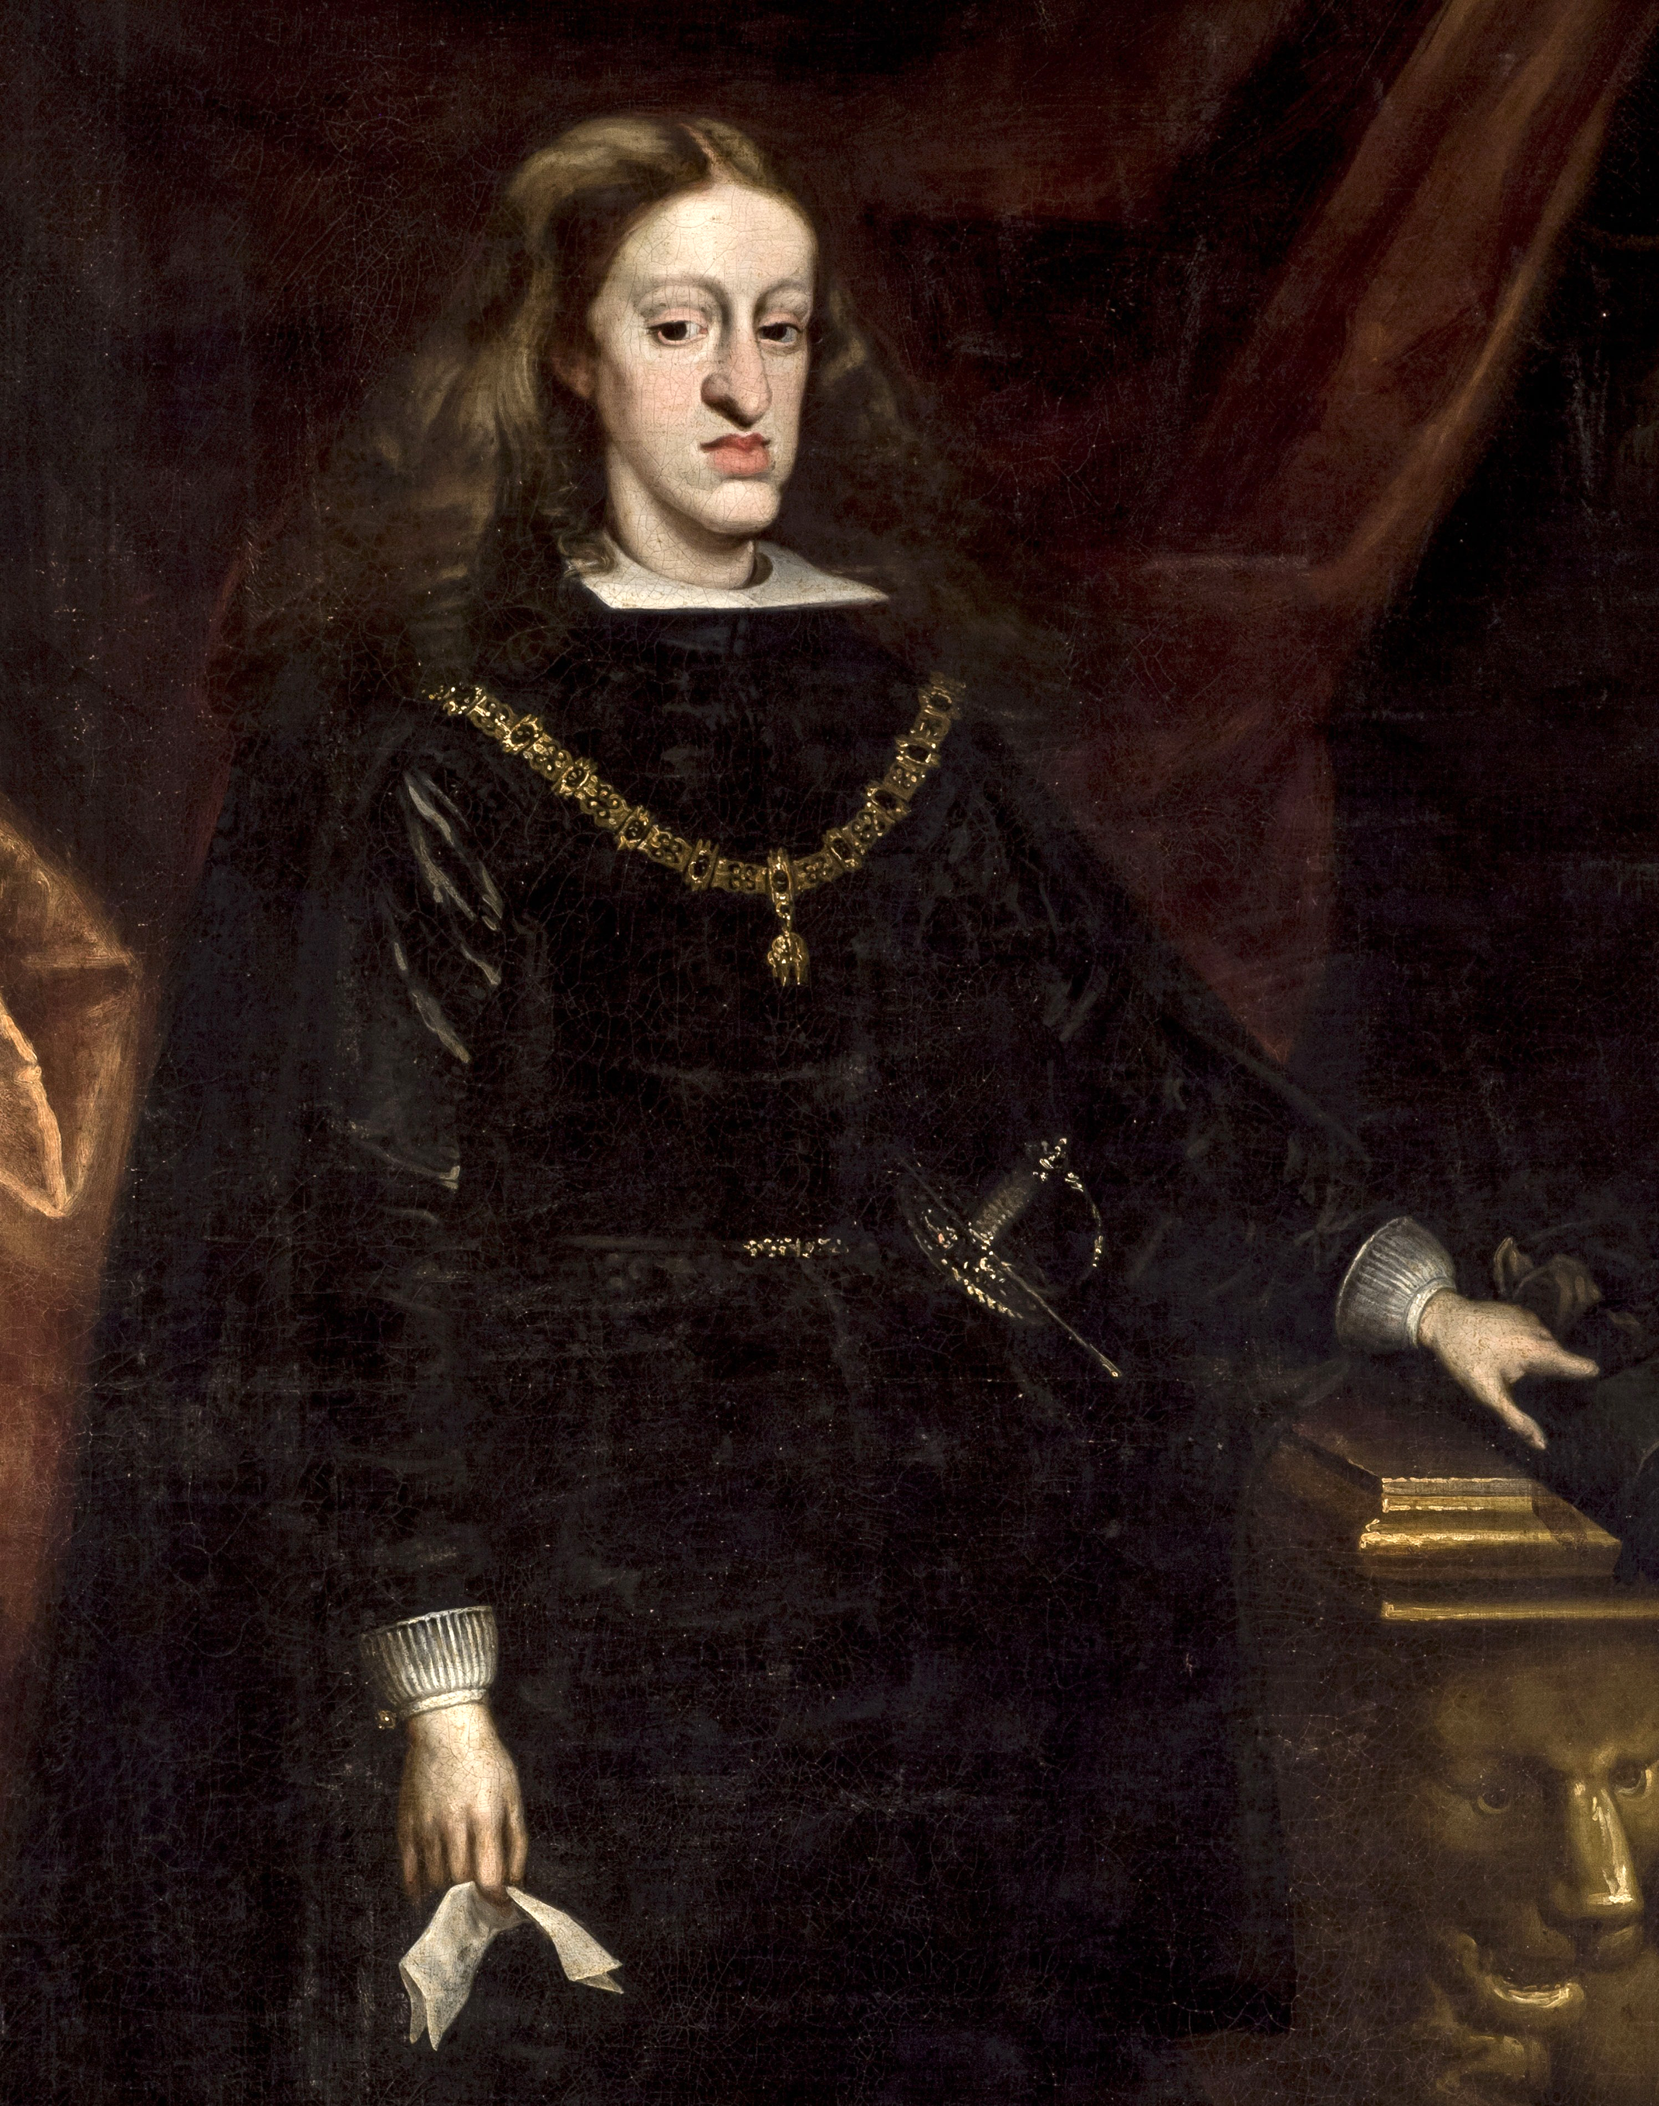
Charles II ‘the bewitched’
(portrait by Juan Carreño de Miranda, c.1685)

Slide 4
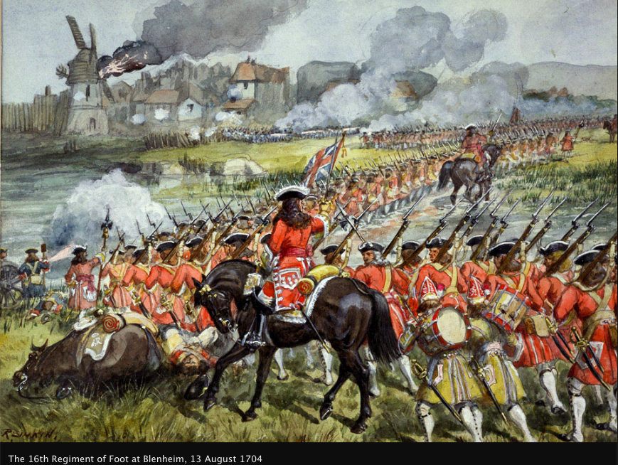
War of the Spanish Succession
1701-1714
France and Charles II himself backed Bourbon prince Phillip d’Anjou (grandson of Louis XIV).
England, Dutch Republic, Austria and Holy Roman Empire backed Hapsburg Holy Roman Emperor Charles.
Battle of Blenheim

Slide 5
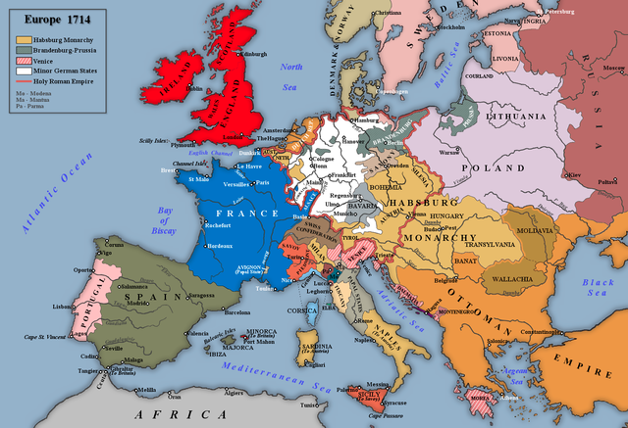
Treaties of Utrecht (1713) and Rastatt (1714) allocated the eastern portions of Spain’s European empire to Austria, and the Iberian portion to Phillip d’Anjou.

Slide 6
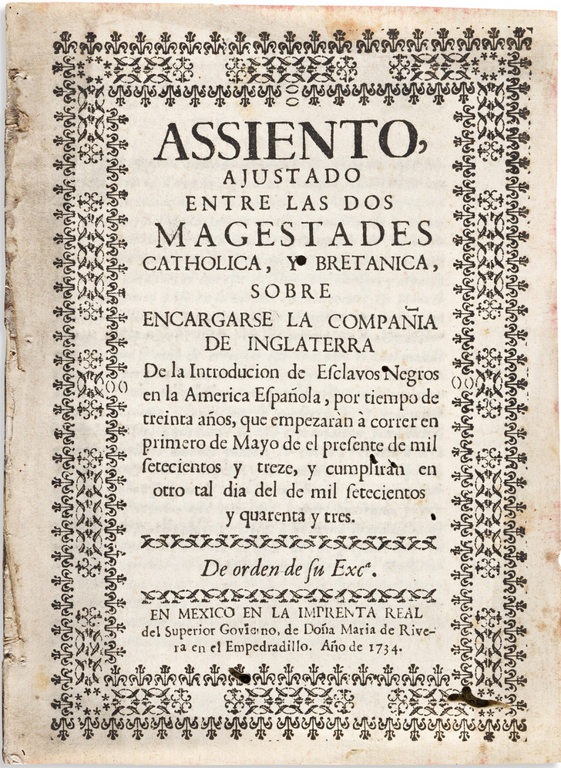
Outcomes of the War of the Spanish Succession
Bourbon Spain became an ally of Bourbon France.
Britain acquired the asiento –the lucrative contract to ship enslaved Africans to Spain’s American colonies.
Spain’s European power was greatly reduced.

Slide 7
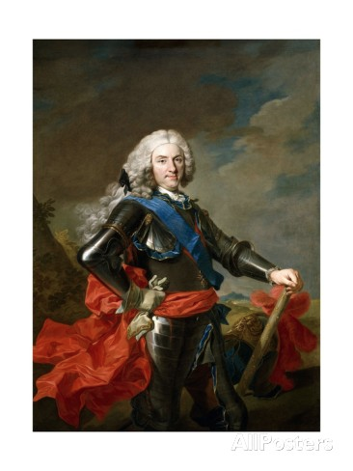
A New Dynasty in Spain
Felipe V of Spain
(aka Phillip d’Anjou)
portrait by Louis-Michel van Loo, c.1739

Slide 8
A new Bourbon Dynasty for Spain
. . . with ambition to reverse decline through sweeping changes to governance:
BOURBON REFORMS
political
military
economic
administrative
cultural

Slide 9
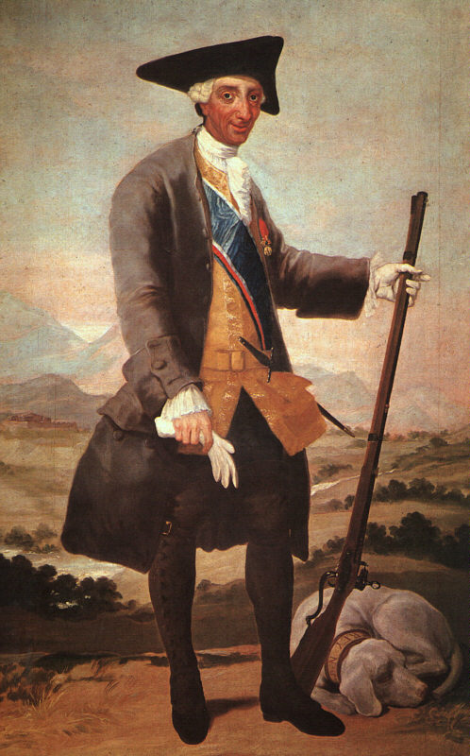
Charles III
(ruled 1759-88)
portrait by Francisco Goya, 1786-88.

Slide 10
Political Reforms
Regalism: subordination of the church to the state
Centralism and the creation of a ‘modern’ state

Slide 11
Political Reforms: regalism
Changing Political Metaphors
‘The parental metaphor of the ‘Two Majesties’ (Dos Magestades)—with the crown as father and the church as mother of the Hispanic family, or the two together as the collective head of the social body—gave way to a fully masculine conception of politics, with only one head and one parent, the king.’
William Taylor, Magistrates of the Sacred: Priests and Parishioner in Eighteenth-Century Mexico (1996).

Slide 12
Political Reforms: centralism less local autonomy
In the Americas. . . for example. . . .
Until 1750 majority of Audiencia posts holders were creoles.
After Bourbon Reforms, of 266 appointees, 200 were peninsular (i.e. 75% were peninsular).
The end of ‘se obedece pero no se cumple’.

Slide 13
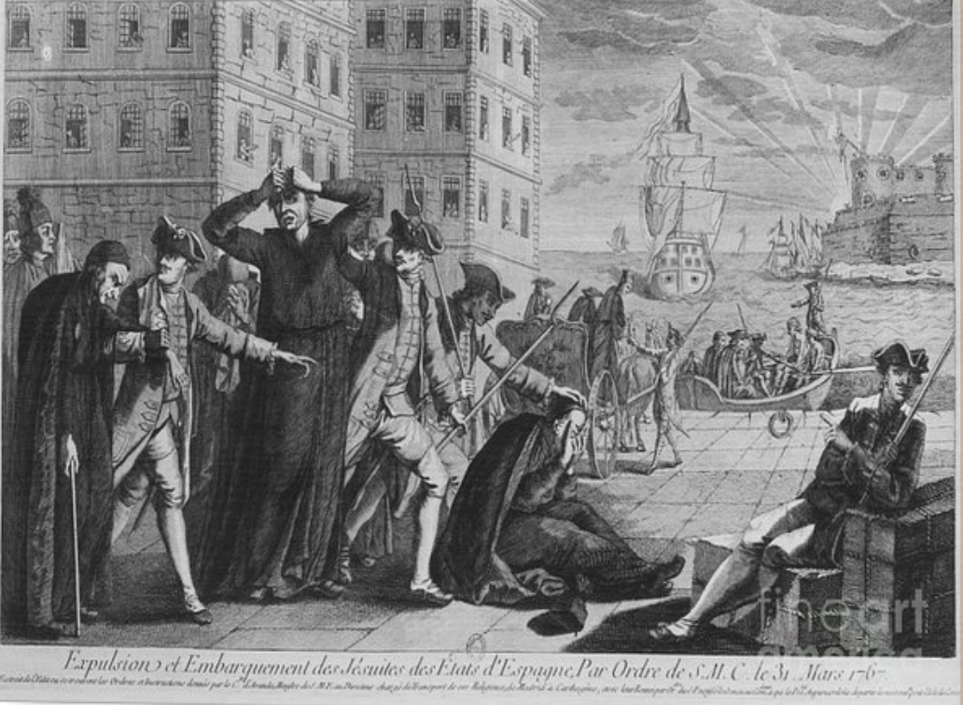
Political Reforms: centralism attacks on independent institutions
expulsion of Jesuit Order (1767)
attacks on fueros (the separate legal systems for the clergy, the military and guilds)
dismantling of independent structures of governance for indigenous communities

Slide 14
Military Reforms
Provoked particularly by the (temporary) loss of Havana to Britain (1762) in the Seven Years’ War (1756-1763)
new fortresses
standing army
Dominic Serres,
The Captured Spanish Fleet at Havana, 1768.

Slide 15
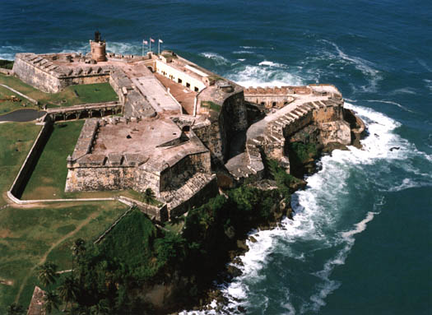
Military Reforms new fortresses
San Felipe del Morro
(San Juan, Puerto Rico)

Slide 16
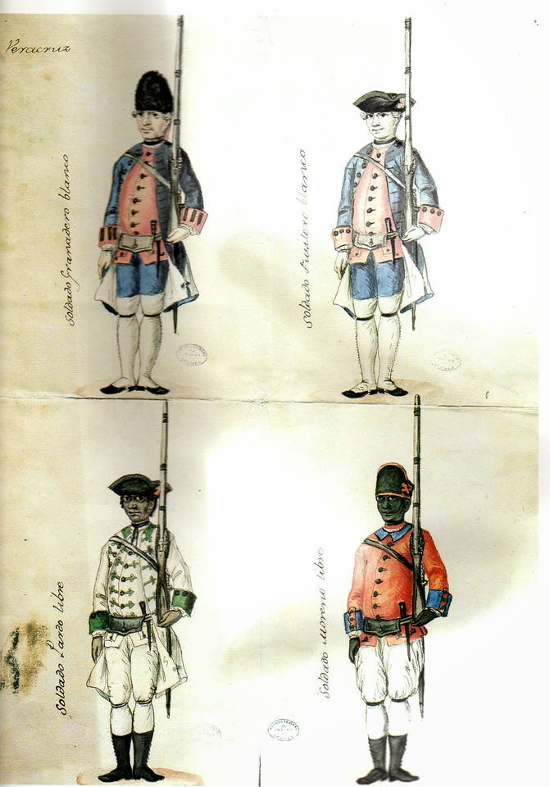
Military Reforms
A standing army and revitalized local militias
Veracruz Militia, 1767.
Militias included regiments of ‘Free People of Colour’

Slide 17
Economic Reforms
New economic ideas
Free trade
Physiocracy
A chart from François Quesnay’s
1758 economic analysis

Slide 18
Economic Reforms
New economic ideas
‘Commerce is not a mystery. The light of nature, which illuminates us all, reveals to us the principles on which it must be based for its establishment and increase. We can benefit from the experience of the greatest men of Europe, who for a century and a half have dedicated themselves to perfect this fundamental branch of political science, and who have left us such certain and secure rules, that we can and do err only in deviating from them, or in failing to follow them.’
José del Campillo y Cosío, Nuevo sistema de gobierno económico para la América [New System of Economic Governance for the Americas] (1789).

Slide 19
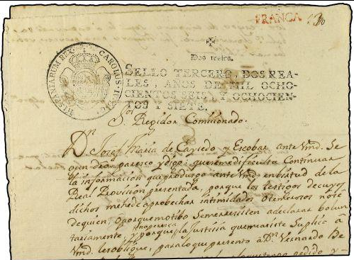
Economic Reforms new taxes and state monopolies
tobacco
aguardiente
stamped paper
playing cards
ice . . .

Slide 20
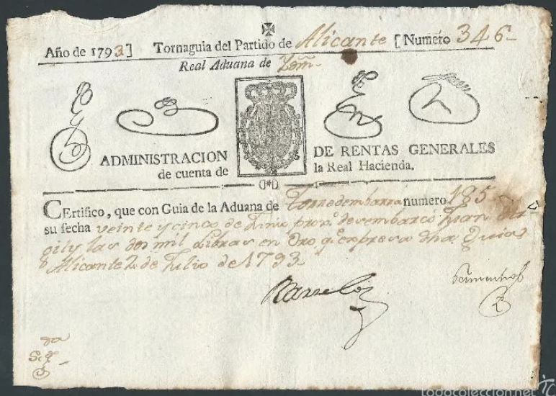
Economic Reforms
tax increases
alcabala sales tax increased
tighter controls over smuggling
guías and tornaguías (customs documents)

Slide 21
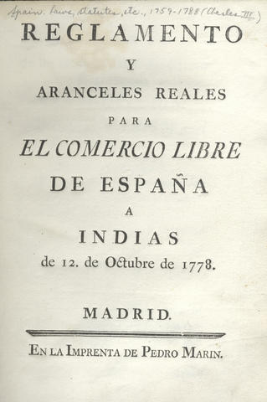
Economic Reforms
Introduction of
comercio libre
(‘free trade’)
1778

Slide 22
Economic Reforms
Vast increase in transatlantic trade and in revenue to the Spanish state.
1782-1796: exports from Spain to the Americas increased by 400%
Taxes paid by Mexico to Spain:
early 18th century 6 million pesos
mid 18th century 20 million pesos

Slide 23
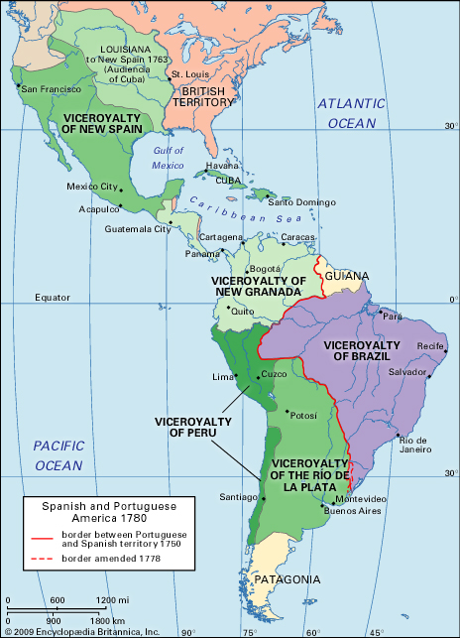
Administrative Reforms
creation of new administrative units
new viceroyalties and ‘intendencies’
new officials were increasingly military men
Manuel Antonio Flórez Maldonado Martínez Ángulo y Bodquín, who was a general in the Spanish navy prior to serving as viceroy in Mexico and New Granada

Slide 24
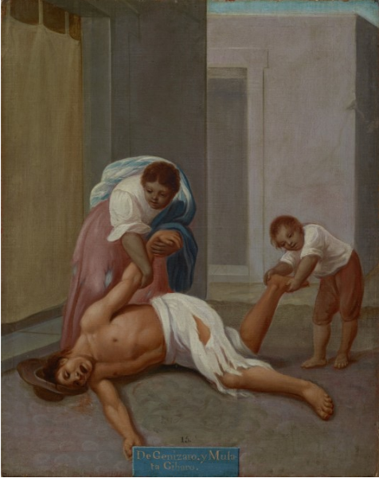
Cultural Reforms
influence of the Enlightenment
scientific expeditions
aim to create ‘rational’ subjects
clampdown on popular culture (hostility to popular religiosity, fiestas, drinking, etc.)
civil reforms (street lighting, etc.)

Slide 25
A ‘Second Conquest’ of the Americas?

Slide 26
Responses
unprecedented number of local uprisings and rebellions
Some examples of large or long-lasting uprisings:
Juan Santos Atahualpa, 1742-56 (Peru)
Rebellion of the Barrios, 1765 (Quito)
Túpac Amaru Rebellion, 1780-2 (Pan-Andean)
Túpac Katari, 1781 (Bolivia)
Comunero Rebellion, 1781 (New Granada)
Inconfidência Mineira, 1789 (Brazil)

Slide 27
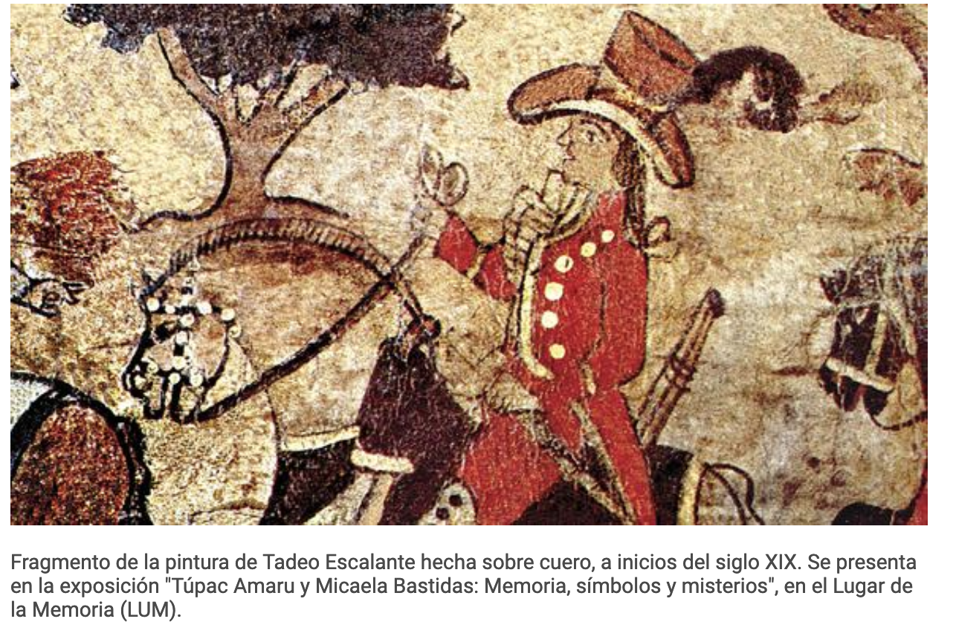
Túpac Amaru
(José Gabriel Condorcanqui)

Slide 28
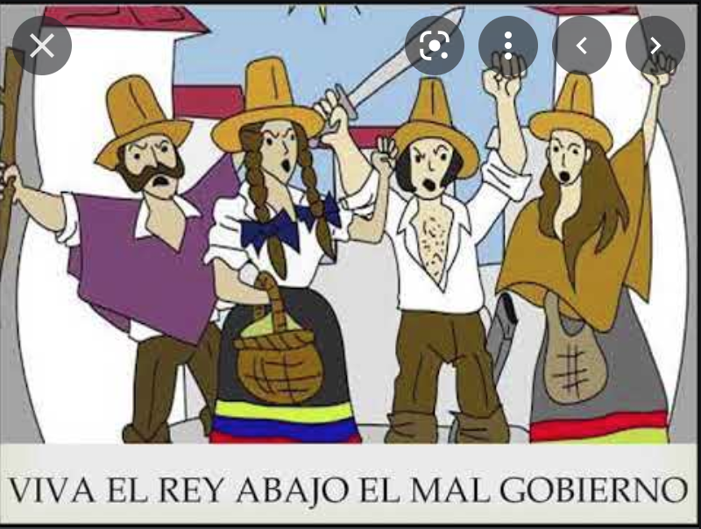
Responses
Popular Unrest
Anti-colonial or ancien regime?
‘Long live the king and death to bad government.’

Slide 29
Responses policing and repression
‘Where the Habsburgs used priests the Bourbons employed soldiers.’
David Brading, Miners and Merchants in Bourbon Mexico (1971).

Slide 30
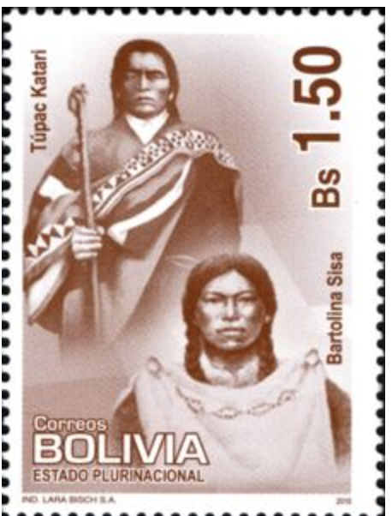
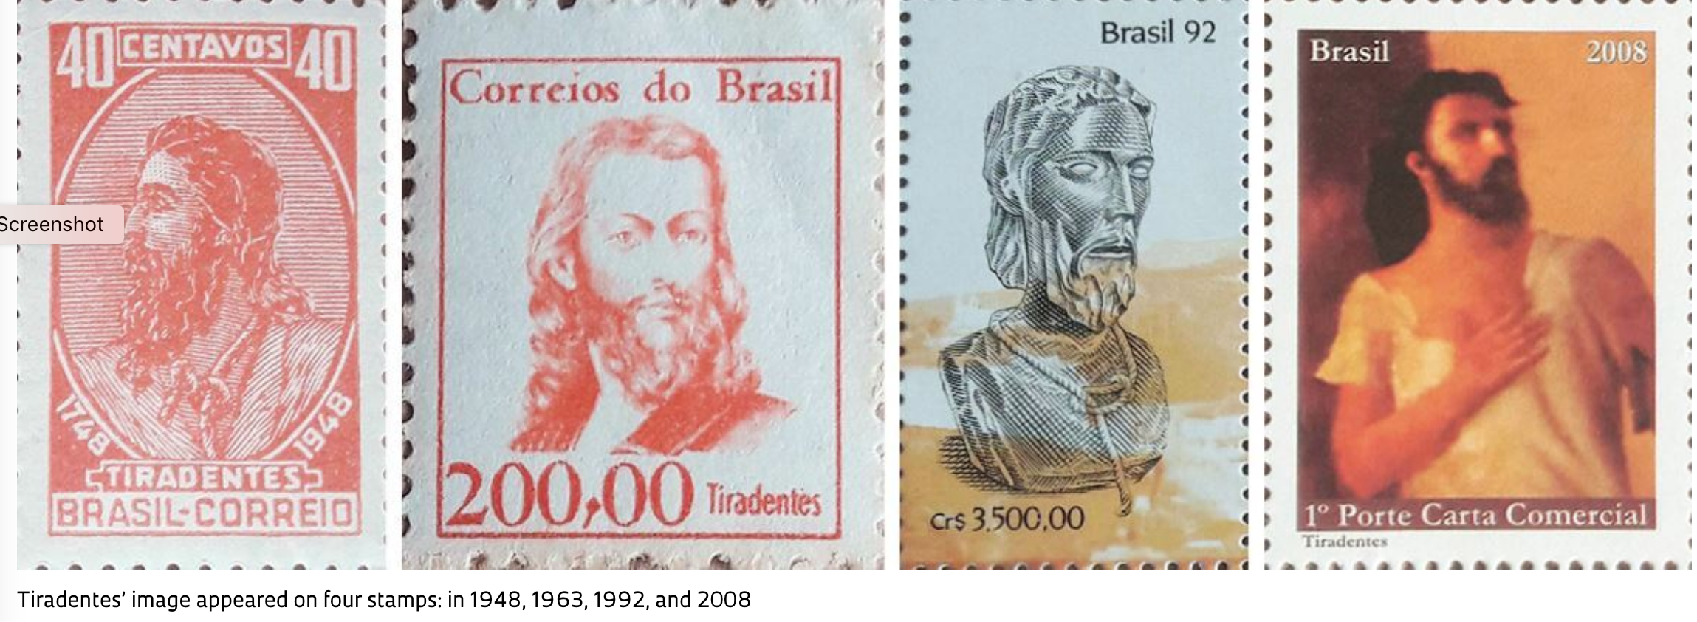
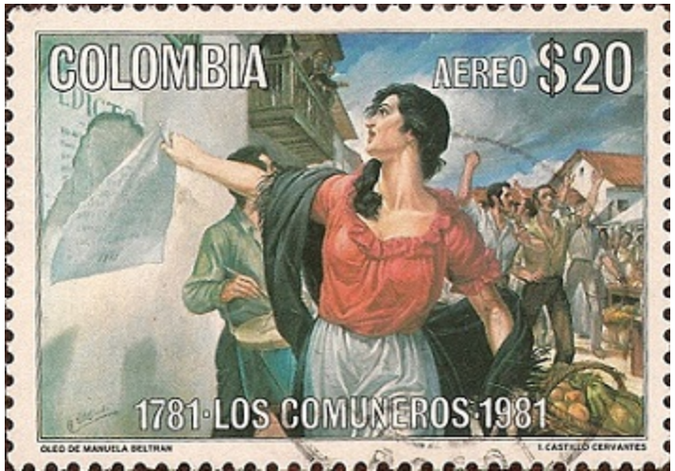
18th-century rebellions in Latin American historical memory

Slide 31
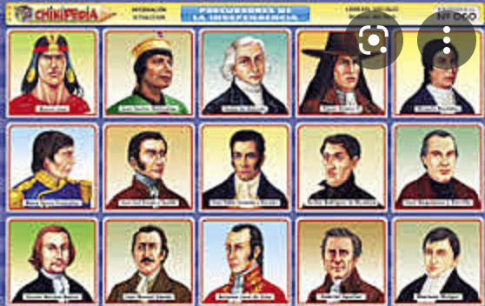
Legacies
Elite disaffection and increasing hostility between local elites and Spaniards
Rise of ‘creole patriotism’
damage to local industry (cheaper Spanish imports)?
loss of legitimacy for the Spanish crown?
prelude to independence?
Túpac Amaru presented as a ‘precursor’ to the early 19th-century independence movement

