Slide 1
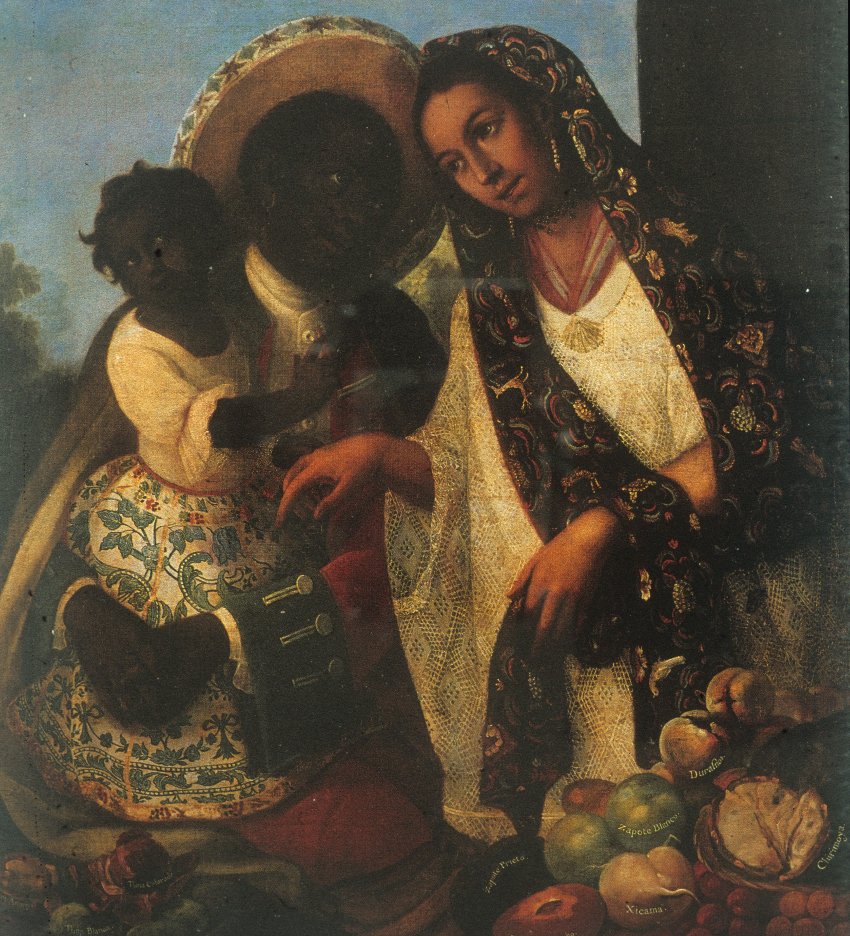
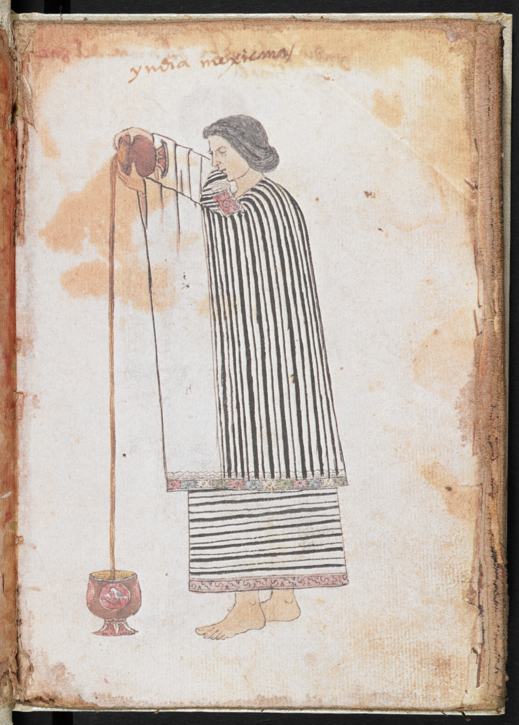
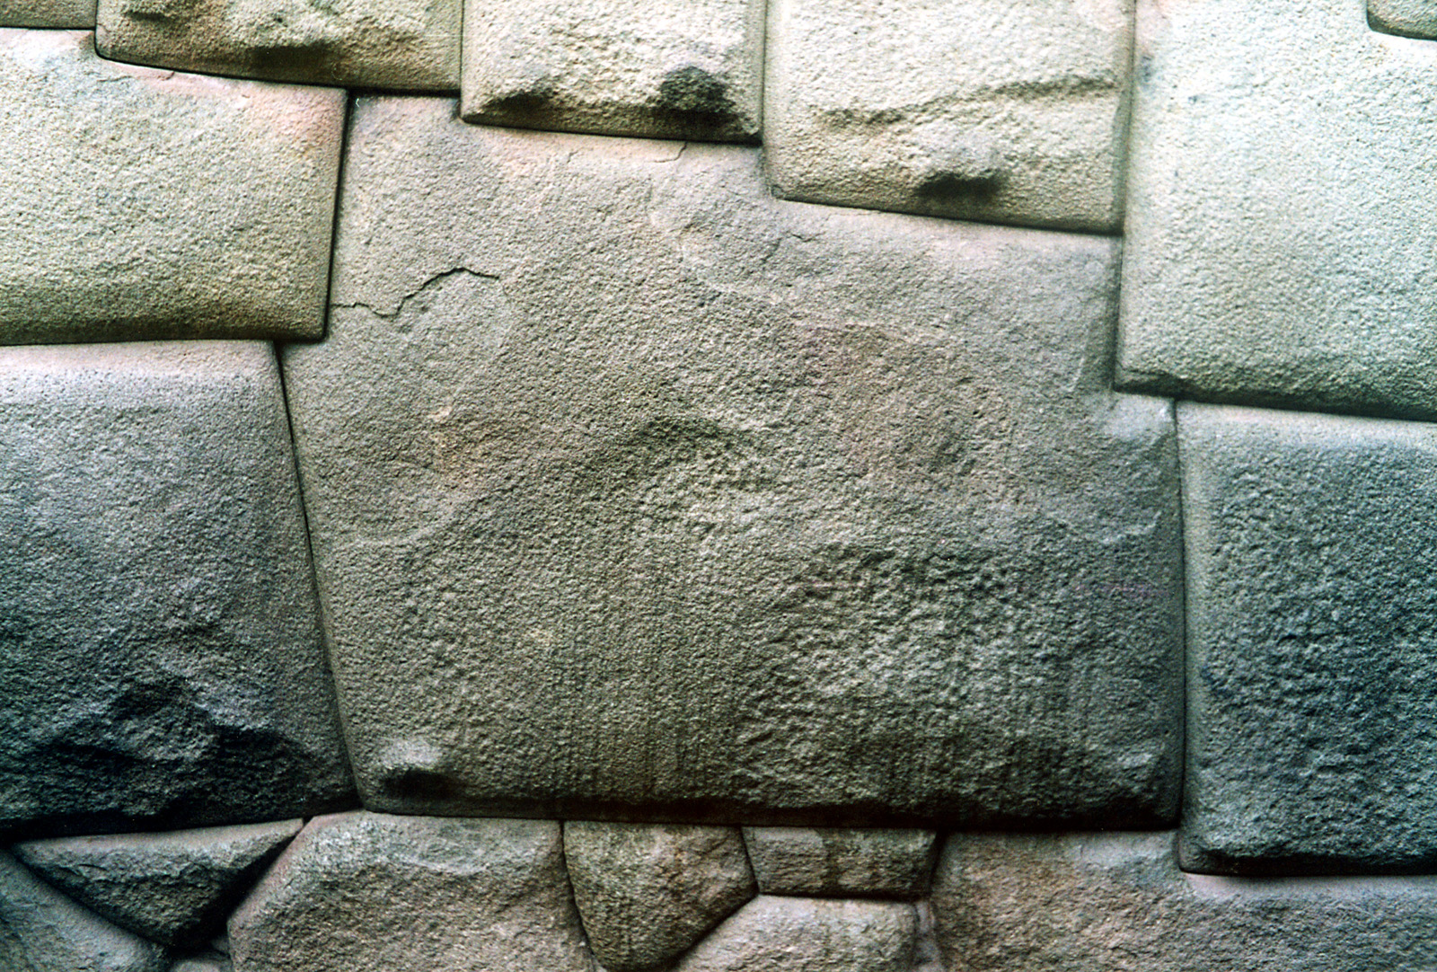
Colonial Society and Culture

Slide 2
A Reminder of Last Week’s Topics
Settlement through the founding of cities and establishment of an administrative structure
Demography: millions of indigenous people died
Coercive Labour regimes: encomienda (grants of indigenous labour) and slavery.

Slide 3
The Transatlantic Slave Trade in Colonial Latin America
This time with correct figures. . .
Over 7,000,000 Africans were brought as enslaved persons to Latin America during the colonial era (1492-1886).
Nearly 1,000,000 Africans were taken to Latin America between 1500 and 1650 alone.
During the same period less than half that number (roughly 438,000) of Spaniards travelled to the Americas.
You can get much more detailed information from the Slave Voyages Database, https://www.slavevoyages.org/assessment/estimates

Slide 4
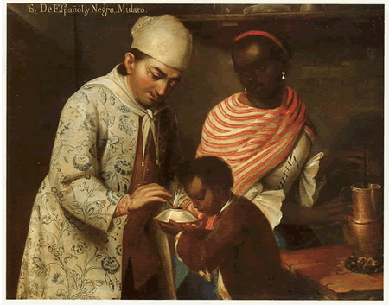
The Formation of a ‘Hybrid’, Multicultural, Multi-ethnic Colonial Society
One Key Point
‘race’ or ‘caste’ was central to structuring colonial society
José de Alcíbar (attrib.), From a Spanish Man and a Black Woman a Mulatto is Born (Denver Art Museum, c.1760-70)

Slide 5
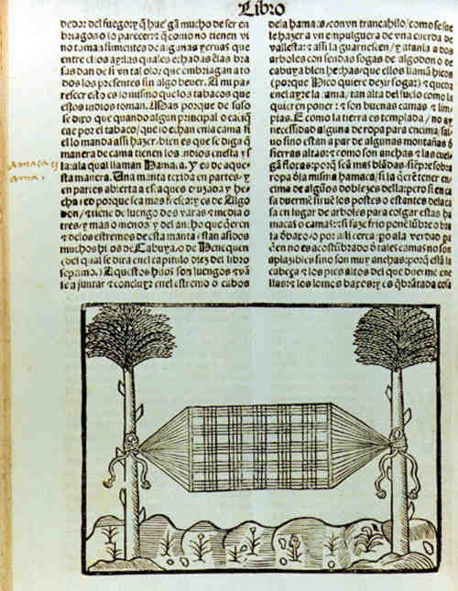
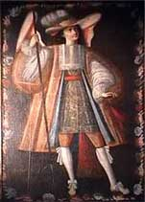
Colonisers and the colonised/enslaved interacted in many ways.
This lecture will explore cultural interactions
  Everyday life
  Religious cultures
A colonial ángel arcabucero (or angel with an arquebus)
Gonzalo Fernández de Oviedo’s image of a hammock (1535)

Slide 6
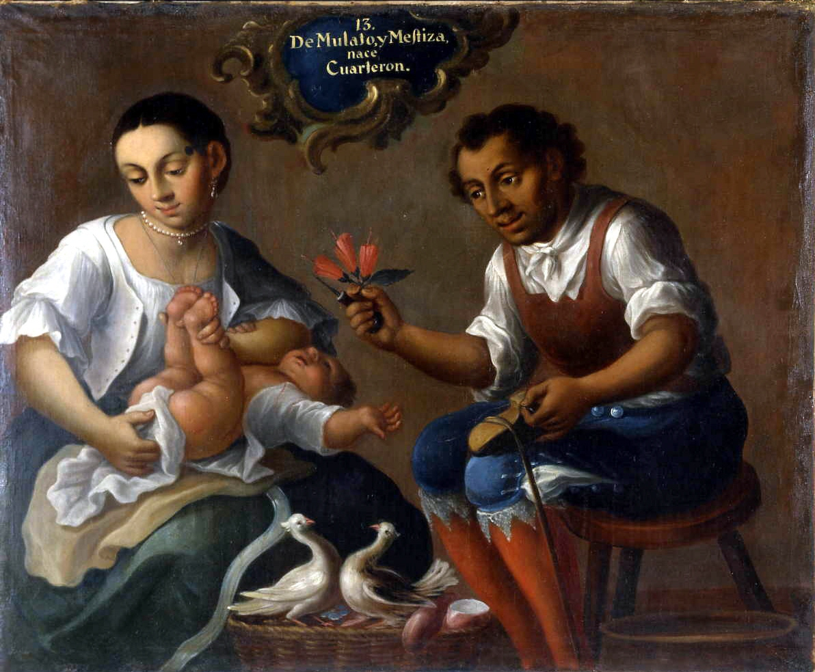
Everyday Life in the Indies
How can we study this?
Some sources:
Court records
Letters
Material culture
José Joaquín Magón, From a Mulato and a Mestiza is Born a Quadroon, c.1770, Museo de Antropología, Madrid.
This is an example of a Mexican ‘Casta Painting’: these 18th-century paintings depict interracial colonial families.

Slide 7
Court records
Colonial society was very litigious!
Domestic disputes between husbands and wives, petitions from enslaved men and women, conflicts between neighbours (violence, insults, lawsuits) . . .
Good source of information about gender norms
Reveal the central role of honour.

Slide 8
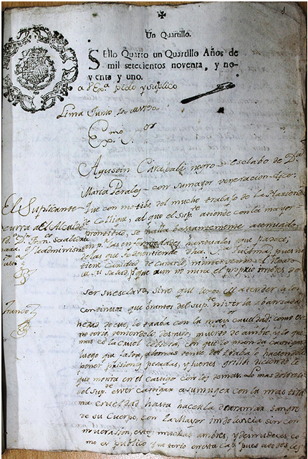
Many people went to court
The first page of a petition by the African-born, nonliterate enslaved man named Agustín Carabali.
It was submitted to the court in Lima in 1790.
Carabali accused his owner of abuse.
From Peru’s Archivo General de la Nación.
Notes:
The African-born slave Agustín Carabali, who charged his owner with abuse in civil court, wandered these back alleys. He first paid a popular legal writer—whose name he could not later remember—to pen an opening petition for him. Apparently, the rough language or legal faults of the petition caught the eye of the court receptor when Agustín attempted to submit it, so the receptor told the slave to have the petition rewritten. While the court receptor probably referred him to an official writer, Agustín ended up finding his next legal amanuensis in a tavern. A “negro criollo” named José, who rented a room in the house of one of the city’s licensed attorneys, was a frequent customer in the establishment. Presumably, José’s residence with the lawyer gave him access to legal knowledge. Putting this know-how to use, José rewrote the petition in the third person, signing at the end with squiggles and flourishes that were supposed to replicate the escudo, or coat of arms, a public notary might use to distinguish his signature, as shown in Figures 1 and 2. It appears that the receptor accepted this second, more elaborate but still rough, copy, making a few amendments and grammatical corrections.

Slide 9
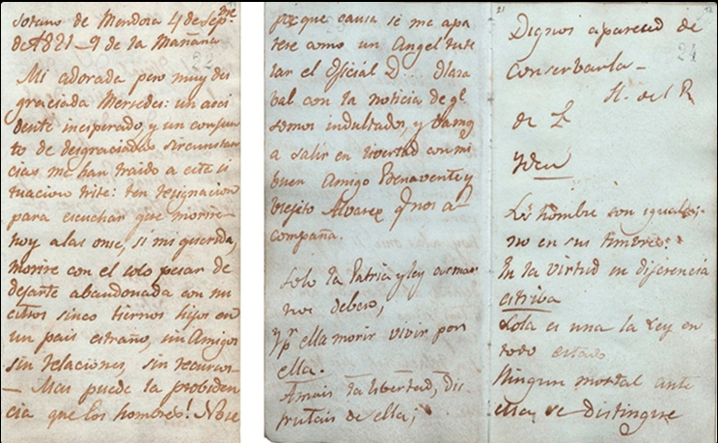
Letters (just one example)
Farewell letter sent by José Miguel Carrera to his wife Mercedes Fontecilla, 4 Sept. 1821 .

Slide 10
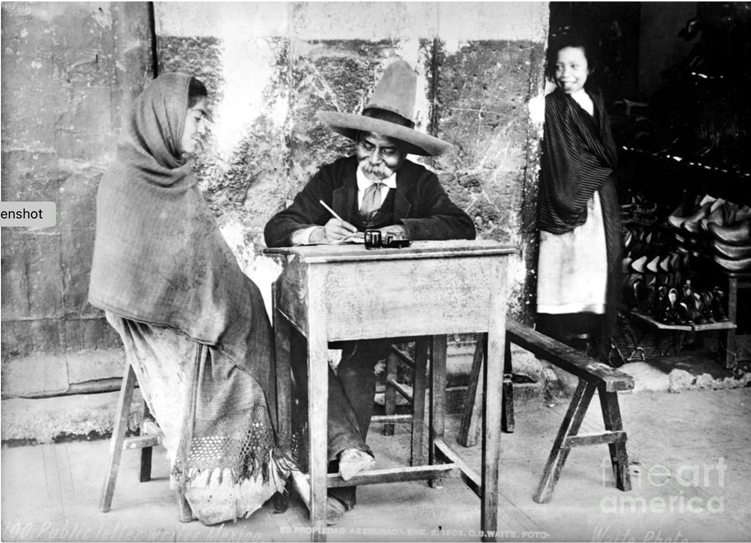
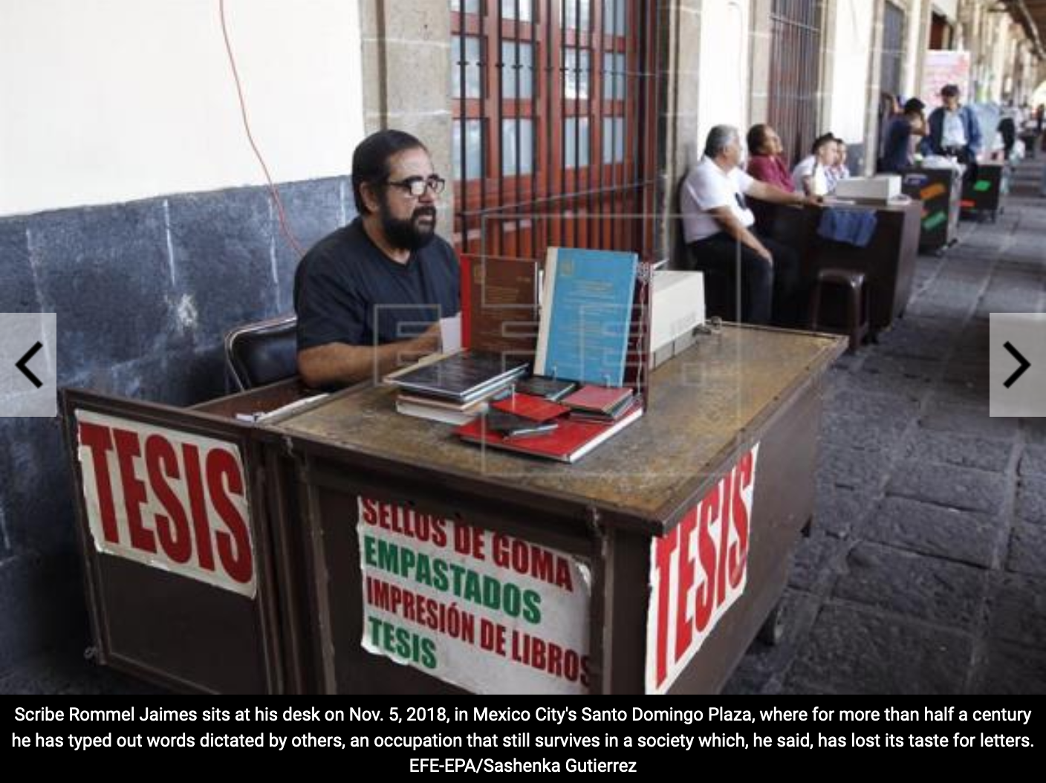
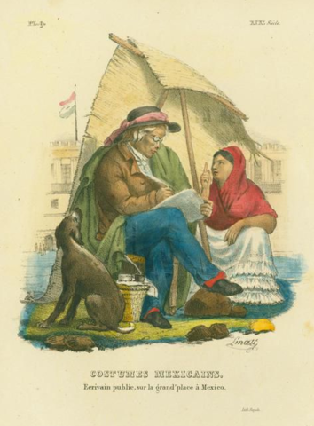
‘Escribanos’, ‘Tintorillos’ or Public Writers
Above is a rather staged photograph of a public writer in early 20th-century Mexico
Claudio Linati, ‘Public writer in the great square of Mexico’, 1828.

Slide 11
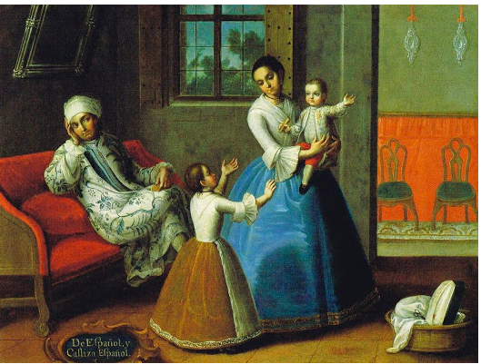
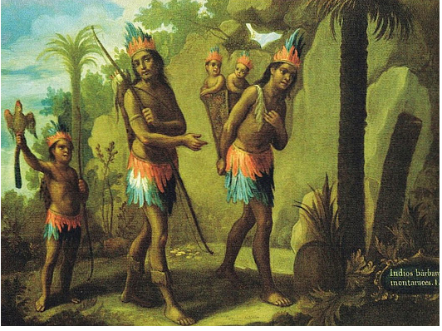
Material Culture (‘stuff’)
‘Civilising goods’
Arnold Bauer, Goods, Power, History: Latin America's Material Culture (2001).
A Spanish Family
José de Paez, ‘From a Spanish Man and a Castiza Woman, A Spaniard’, 18th century.
‘Barbarian Indians’, 18th century

Slide 12
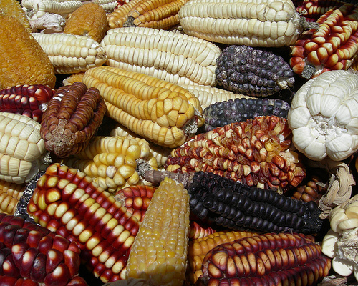
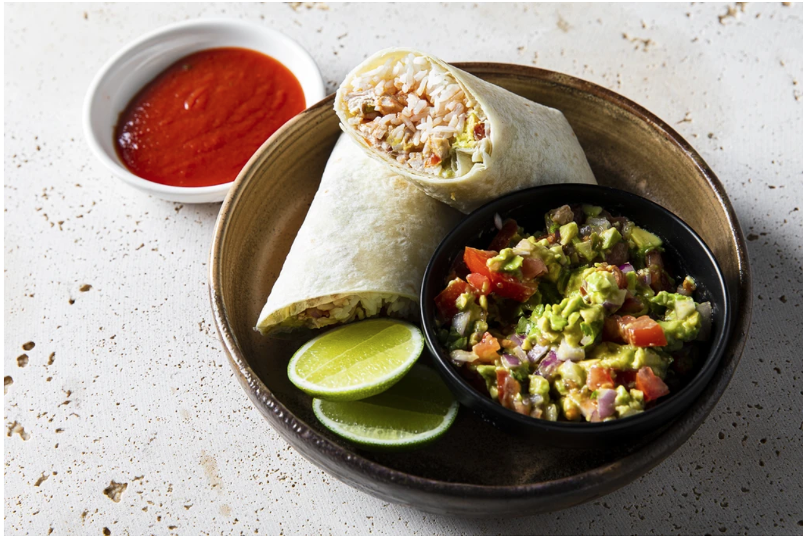
New food cultures

Slide 13
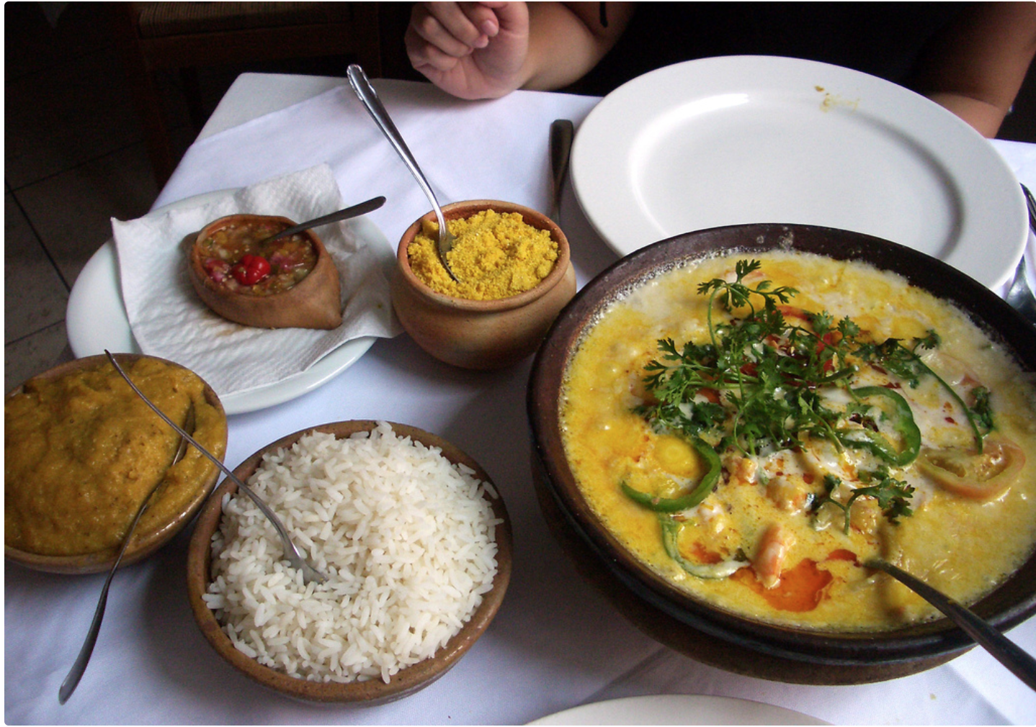
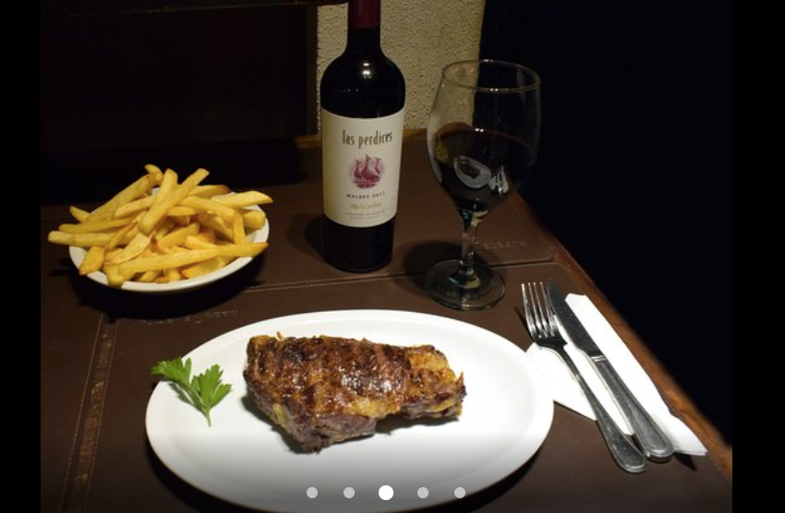
Moqueca a Brazilian stew made with coconut milk and palm oil, served with rice. The name comes from a word in the Kimbundu language of Angola.
An Argentine bifé de chorizo (steak) with chips and a nice malbec.
Many of Today’s Latin American Foods are Hybrid Blends of European, African and American Foodways

Slide 14
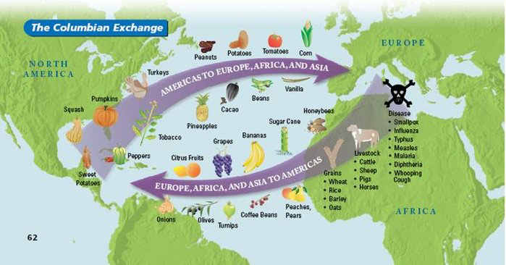
The ‘Columbian Exchange’
(Here is a rather Euro-centric map of what was a much more global process)

Slide 15
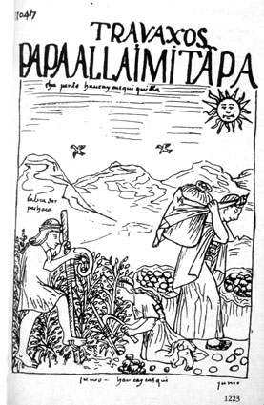
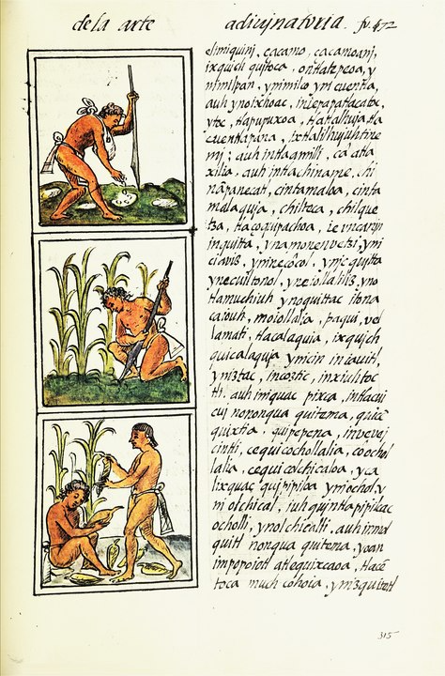
Pre-Colonial agriculture did not usually require fences
Harvesting potatoes,
Felipe de Guamon Poma de Ayala, Nueva corónica y buen gobierno, c. 1615
Tending maize plants, Florentine Codex, c.1585

Slide 16
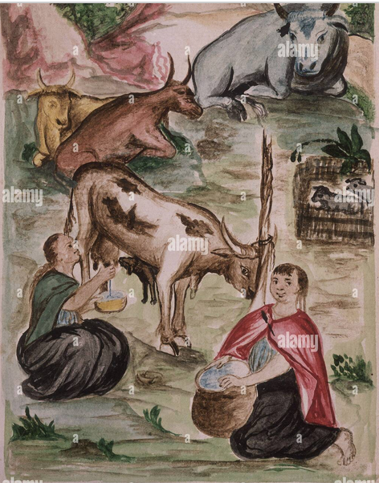
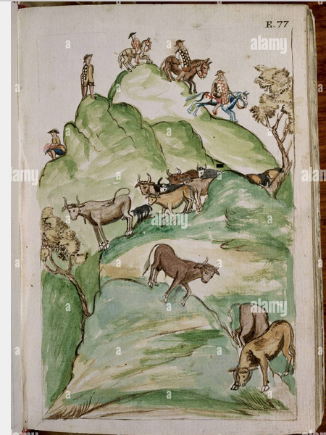
Some indigenous cultures did embrace European livestock
‘Indian women milking cows’ and ‘A rodeo of cattle’, from Baltasar Jaime Martínez Compañón’s Trujillo Codex, from the 18th century Andes.

Slide 17
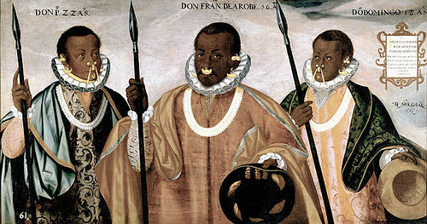
Hybrid Material Cultures
Andrés Sánchez Gallque, The Mulatto Gentlemen of Esmeraldas (1599), Prado Museum.

Slide 18
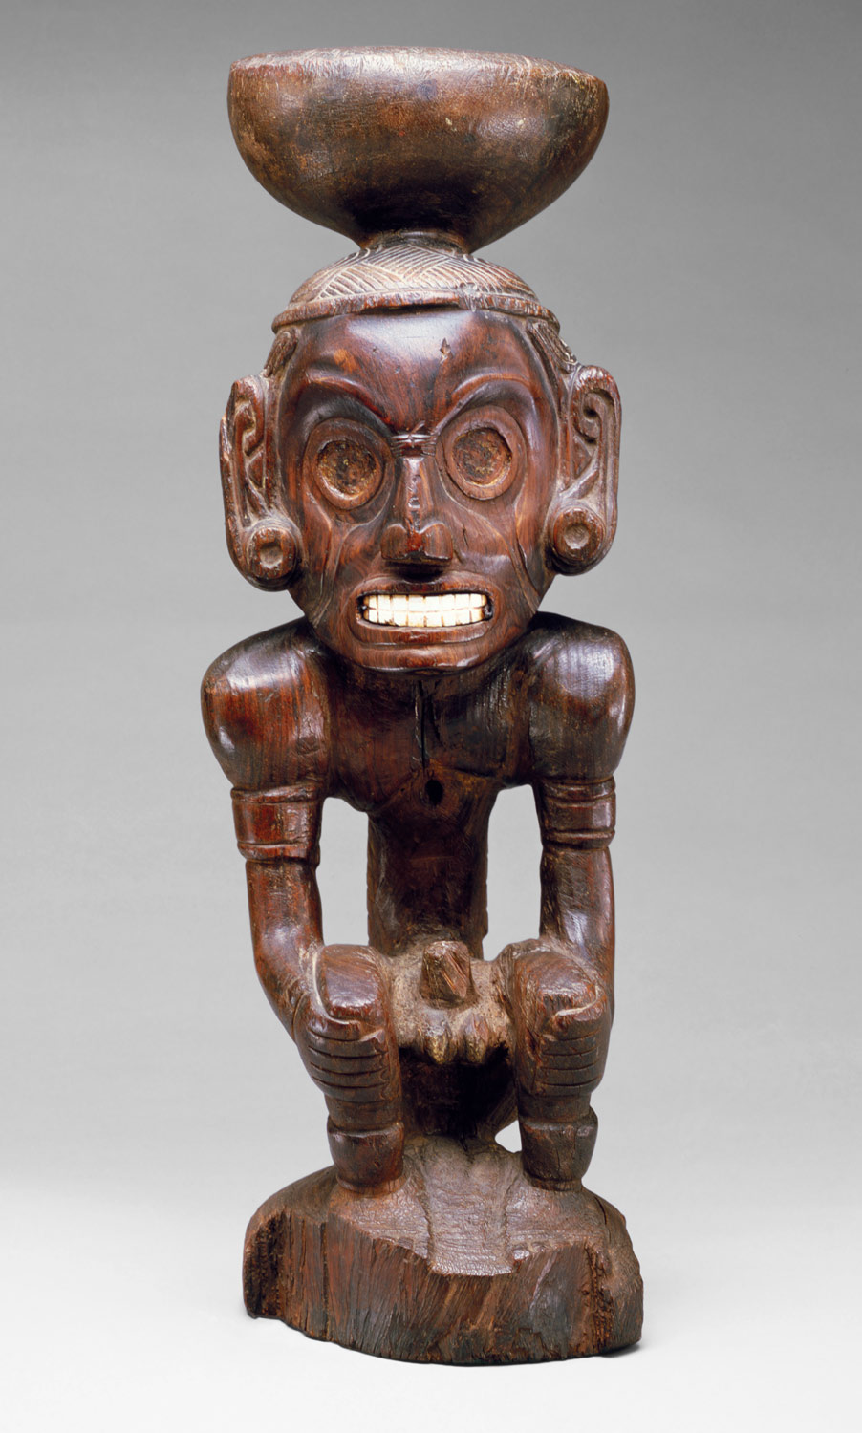
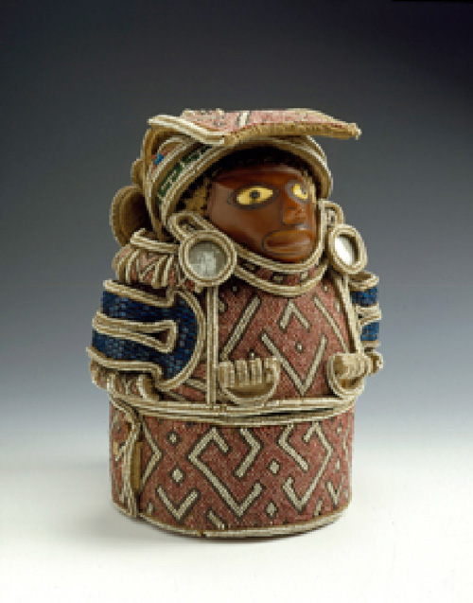
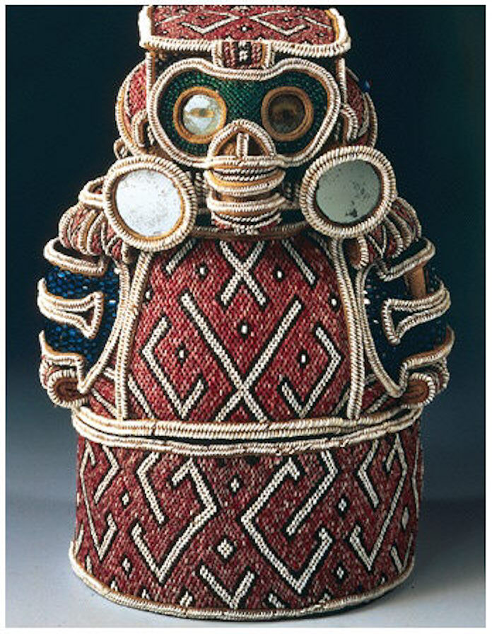
Hybrid Material Cultures
Taino Zemis
Front and back views of a 16th-century zemi
a pre-colonial zemi from around 1000 CE

Slide 19
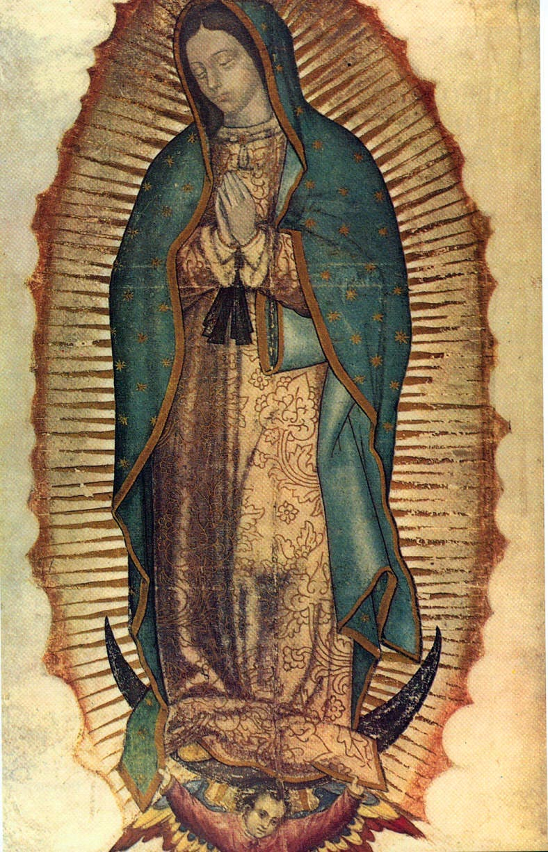
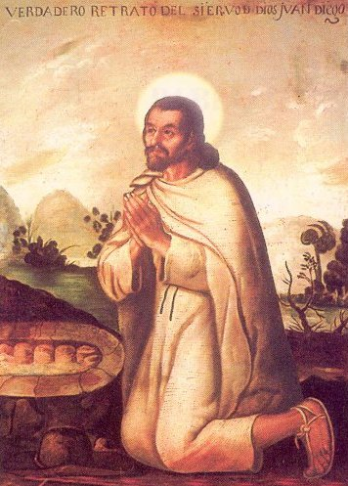
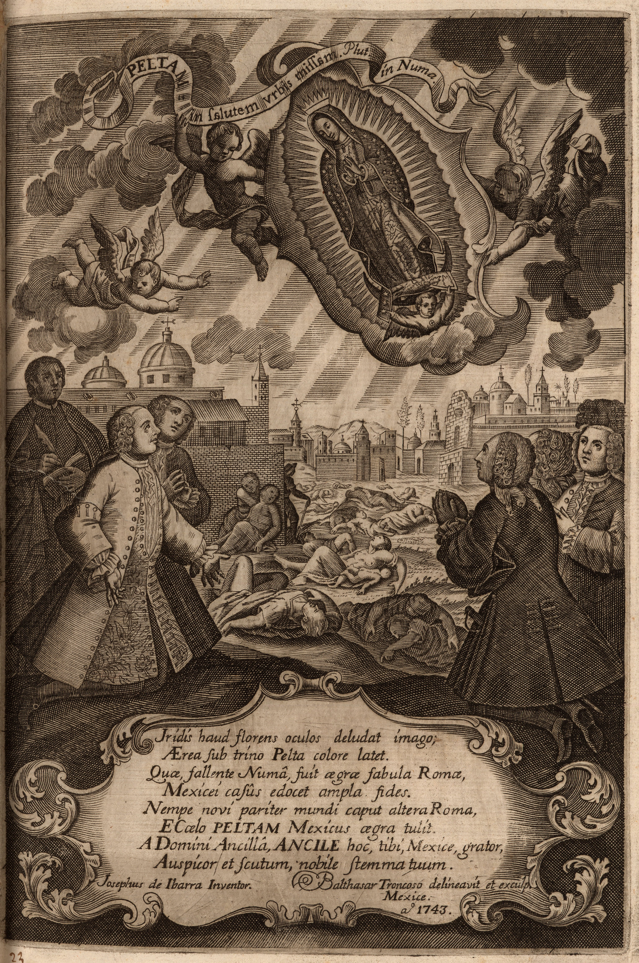
Religion another site of hybridity
Virgin of Guadalupe
Tonantzin
Tepayac
Juan Diego
Miguel Cabrera, ‘Portrait of Juan Diego, Servant of God’, 18th century

Slide 20
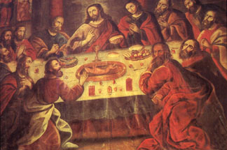
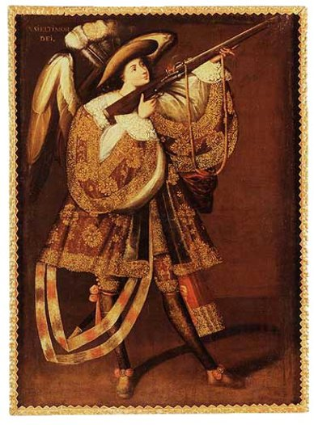
Colonial Catholicism
An Arquebusier Angel, c.1680
Marcos Zapata, ‘The Last Supper’, 1753, Cuzco Cathedral

Slide 21
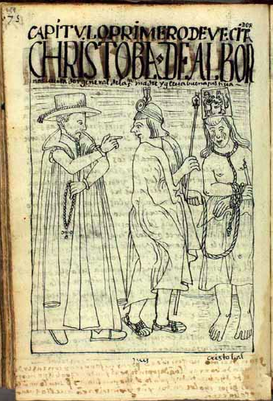
Concerns about ‘idolatry’
Jesuit José de Acosta (1588) on ‘our Indians’ way of life and religiosity’:
‘They give worship to Christ and they serve their gods; they revere the Lord and they do not revere Him; . . . They venerate Him only in word, . . . they venerate Him, in short, only with the appearance of Christianity. They do not venerate Him from deep inside, they do not give true worship nor hold the faith in their hearts as is truly required. But what use is there to carry on? [They] continue doing as their ancestors did.’
An Andean man punished for ‘idolatry’, from Guamon Poma, c. 1615

Slide 22
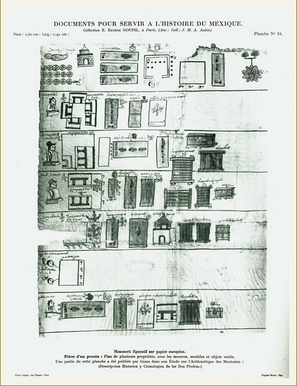
. . . Nonetheless, many indigenous (and West-African) people embraced Christianity
The Last Will and Testament of Don Miguel Damián
Ink and watercolor on amatl paper, 1576
The indigenous Don Miguel Damián, deceased and wrapped in a shroud, is at the upper left in this list of his goods and heirs.
Circles with crosses represent money given to the church for masses and prayers to be said in his name.

Slide 23
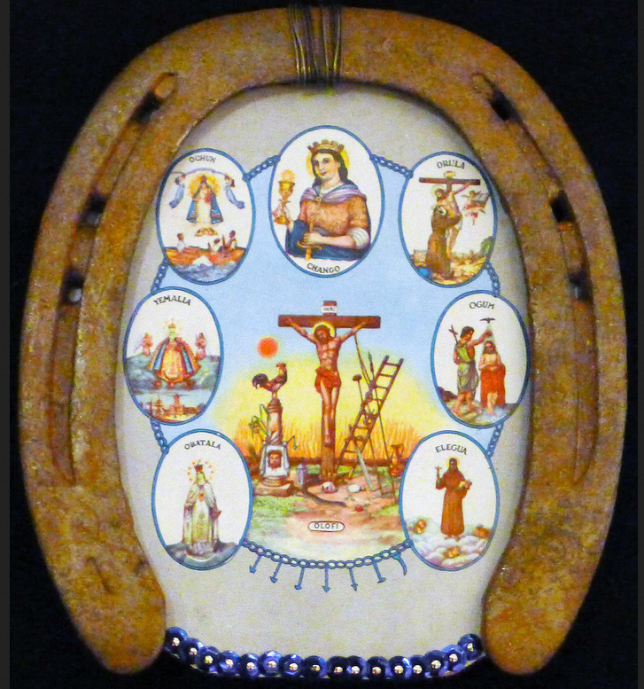
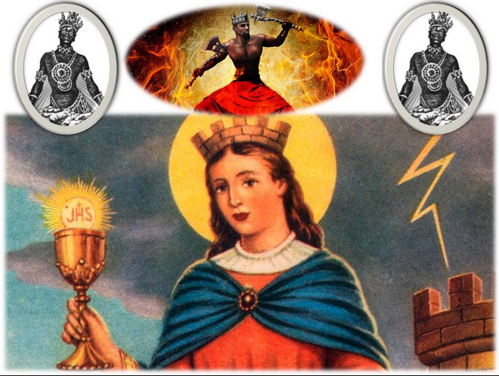
Syncretism santería, vodou, candomblé
‘the seven African powers’
Santa Barbara/Shango

Slide 24
Colonial Society
Hierarchical and unequal
Fluid and hybrid

