Slide 1

The eighteenth century in Latin America

Slide 2

Previously… growth of colonial society
  16th century: Early conquest & colonization
  17th century: consolidation of colonial society, maritime expansion
  18th century: period of accelerated change & growth
  Colonial society in Latin America
    Hierarchical organization structured through ethnic, gender, racial, categories
    Racial mixing, new socioracial categories different from the Peninsula

Slide 3

Today
  01
The 1700s in the Americas & the Peninsula
  04
Second conquest?
Legacies of bourbon reformation
  02
  05
Monarchic change
  03
Bourbon reforms

Slide 4
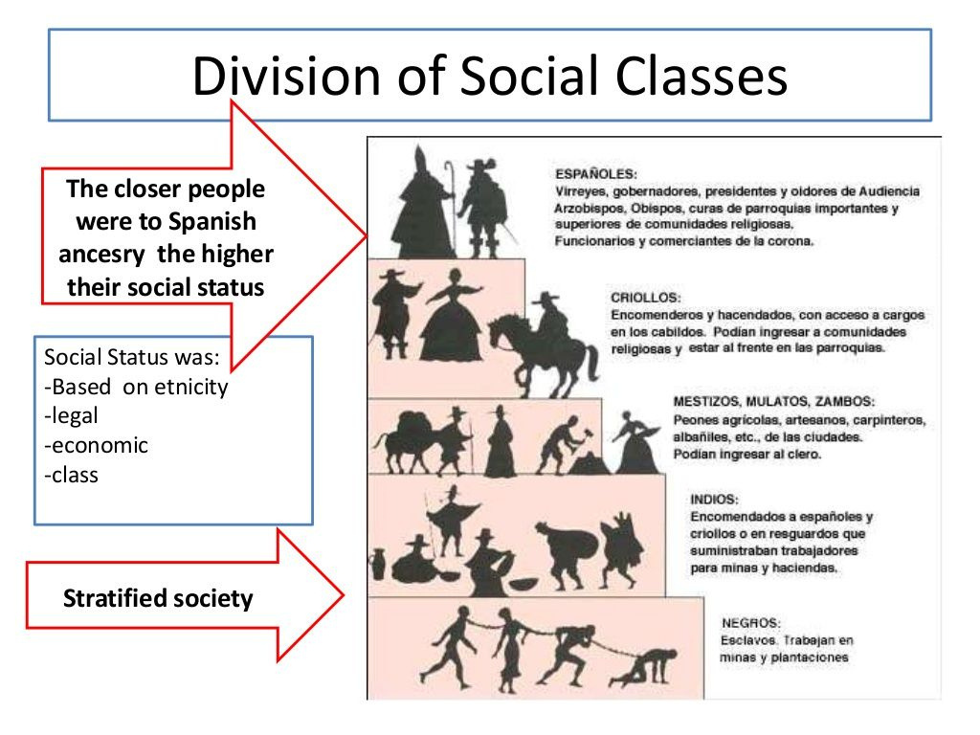
  01
The 1700s in the Americas & the Peninsula
The Americas in 1700s
- Indigenous repopulation in Central America and the Andes
- Expansion of urban networks
- Development of local industries (beyond extraction/mining)
- Steep demographic growth

Slide 5
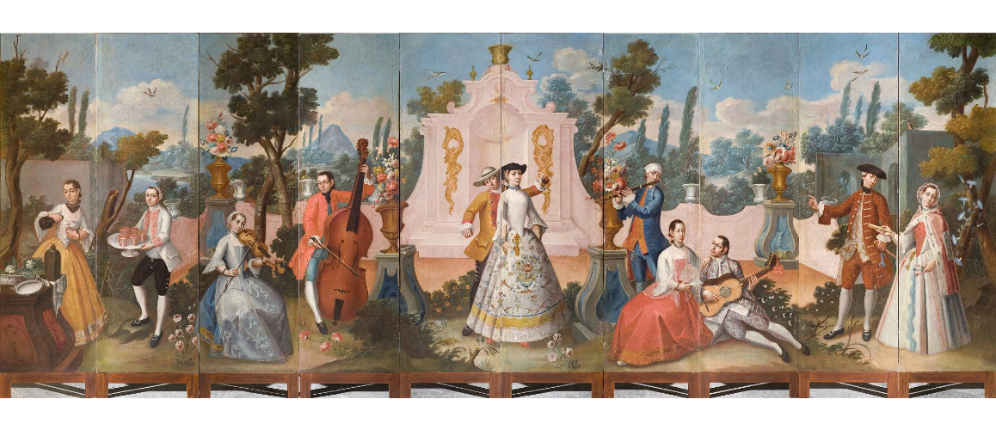
  01
The 1700s in the Americas & the Peninsula
The Americas in 1700s
  Increased power (economic and political) of white creole elites
  Increased power of missionaries (esp. Jesuits)
  Rampant smuggling
A scene depicting many criollos at a soiree in the garden of Chapultepec, ca. 1780-1790

Slide 6
  01
The 1700s in the Americas & the Peninsula
Spain in 1700s
  “Declining” empire?
    17th century little ice age = issues with harvests
    Power struggle with illegitimate (older) half-brother Juan Jose de Austria (coup 1677-79)
  HUGE geographical reach & wealth from the colonies of the Spanish empire = interest of other European crowns in controlling Spanish kingdom
  Spain’s crown was central to European diplomacy in this period

Slide 7
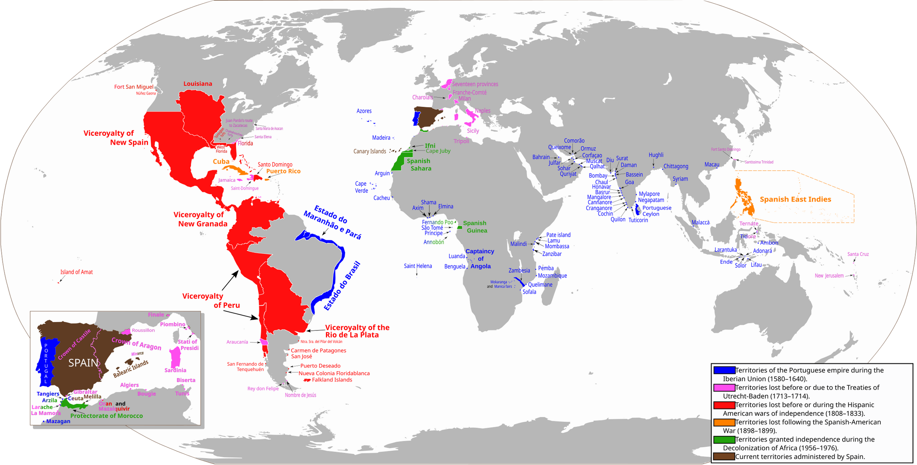

Slide 8

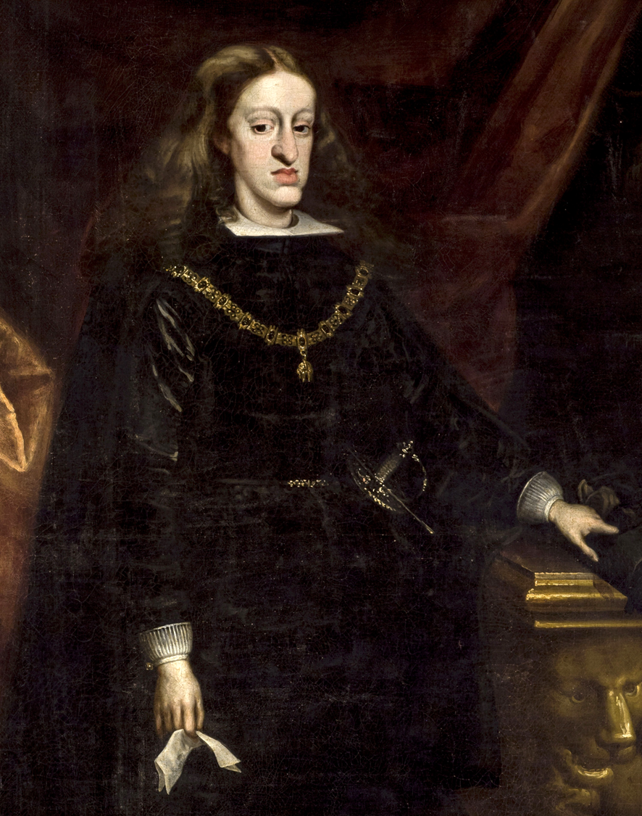
  02
Monarchic change
Dynastic change in Spain:
Hapsburg to Bourbon
Hapsburg monarch Charles II (1661-1700), King of Spain, naming Philip Bourbon (1683-1746), Duke of Anjou, as his successor.
Charles II of Spain. Portrait by Juan Carreño de Miranda, c. 1685

Slide 9
  02
Monarchic change
Dynastic change in Spain:
Hapsburg to Bourbon
  Charles II (1665-1700) - famously ill
  Died childless (2 marriages)
  Succession conflict started before his death
Charles II of Spain. Portrait by Juan Carreño de Miranda, c. 1685

Slide 10
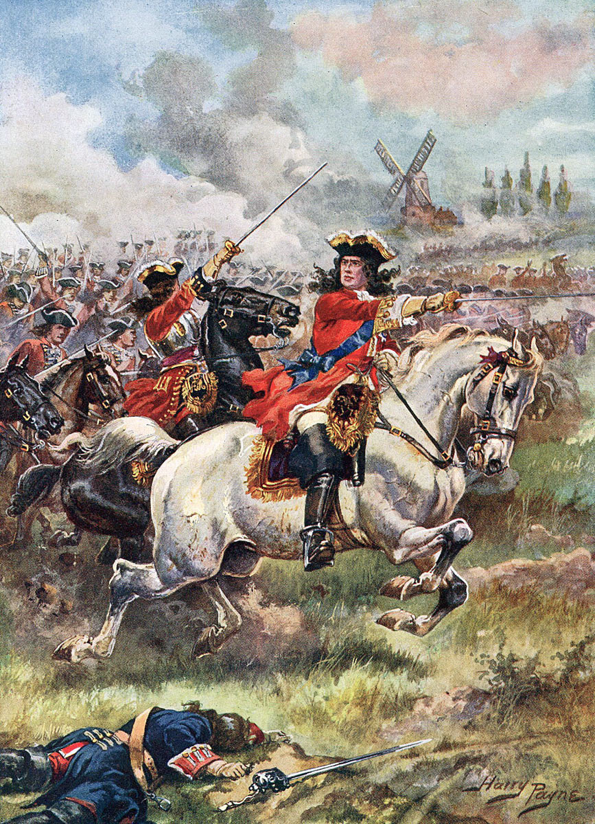
  02
Monarchic change
War of the Spanish Succession
1701-1714
  France and Charles II himself backed Bourbon prince Phillip d’Anjou (grandson of Louis XIV).
  England, Dutch Republic, Austria and Holy Roman Empire backed Hapsburg Holy Roman Emperor Charles.
Battle of Blenheim, 1704

Slide 11
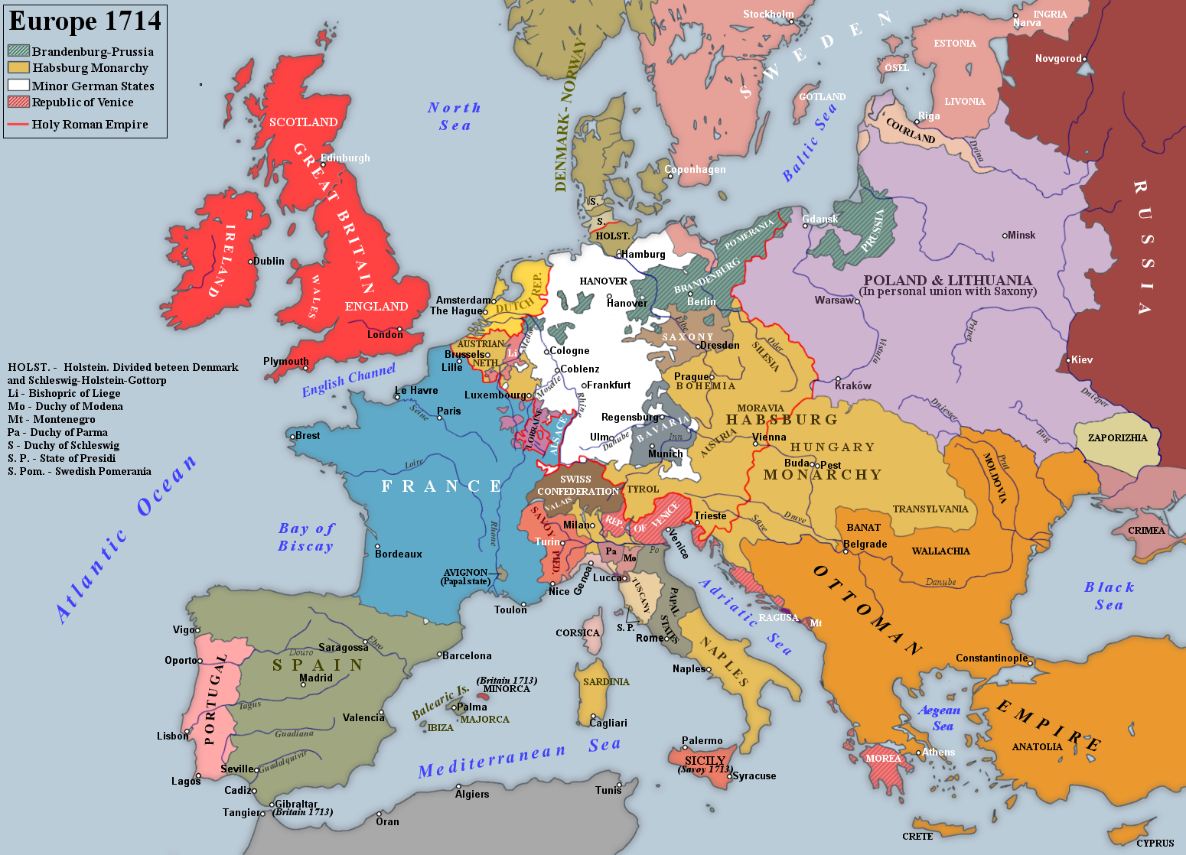
  02
Monarchic change
Treaties of Utrecht (1713) and Rastatt (1714) allocated the eastern portions of Spain’s European empire to Austria, and the Iberian portion to Phillip d’Anjou.

Slide 12
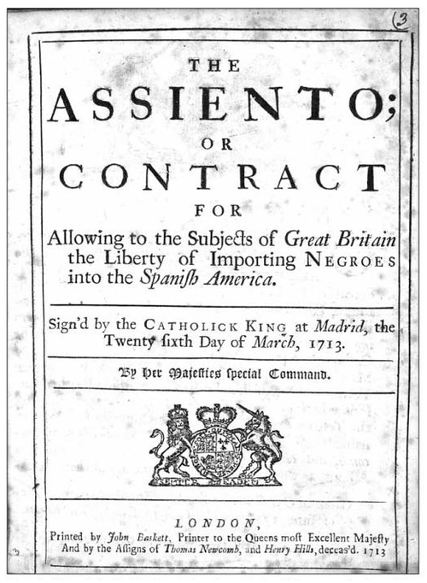
  02
Monarchic change
  Bourbon Spain became an ally of Bourbon France.
  Britain acquired the asiento –the lucrative contract to ship enslaved Africans to Spain’s American colonies.
  Spain’s European power was greatly reduced.
Cover of the English translation of the Asiento contract signed by Britain and Spain in 1713 as part of the Utrecht treaty that ended the War of Spanish Succession.

Slide 13
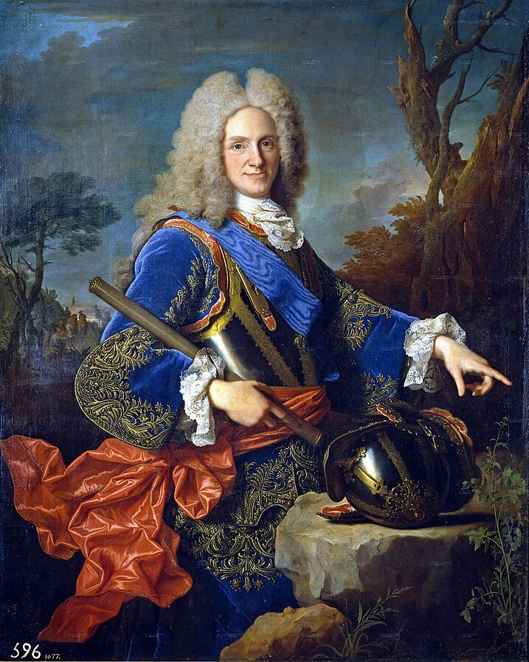
  02
Monarchic change
New dynasty in Spain: Bourbons
Felipe V of Spain
(aka Phillip d’Anjou) reigned from 1700-1724, 1724-1746)
portrait by Louis-Michel van Loo, c. 1739

Slide 14

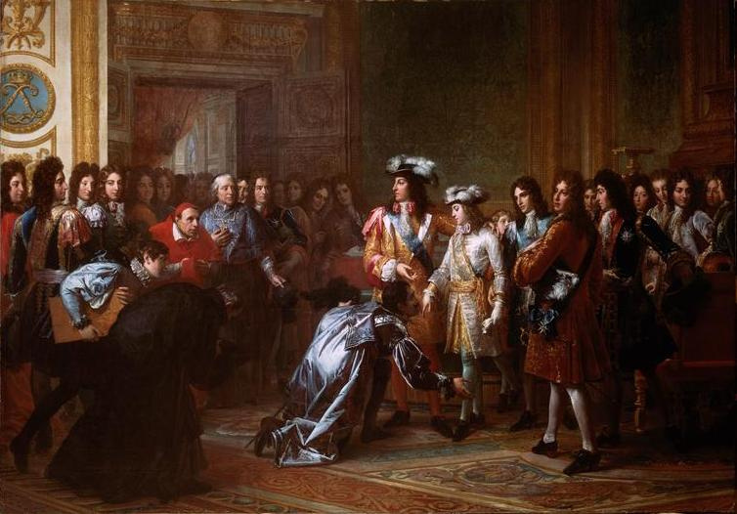
  03
Bourbon reforms
Bourbon reforms
  This was a LONG PROCESS
  NOT a single group of policies
  Name change: Spanish Empire to Spanish and Indies' kingdom
  Started in the first decades of 1700s, until 1810s
Proclamation of Philip of Anjou as Philip V of Spain, Versailles, 16 November 1700

Slide 15
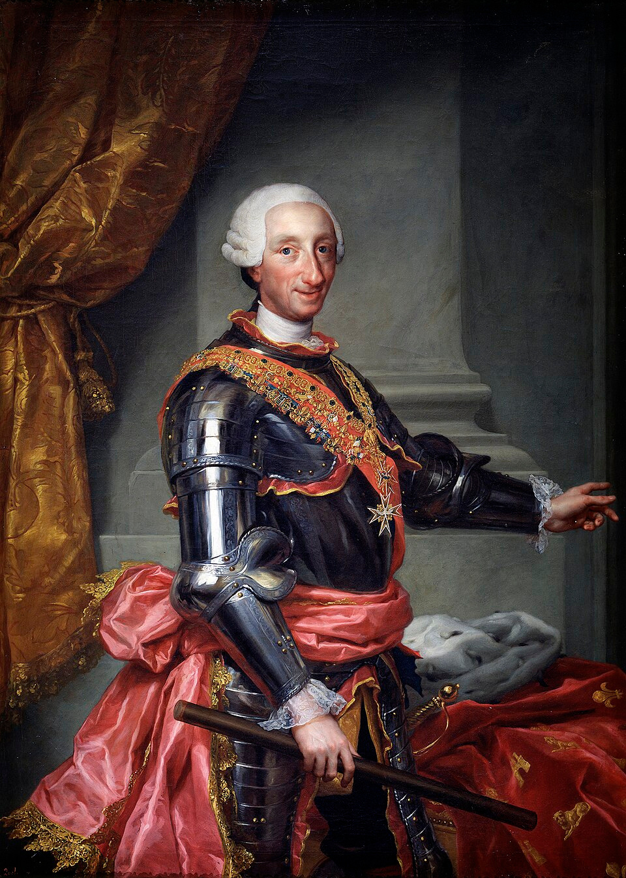
  03
Bourbon reforms
  Political
  Military
  Economic
  Administrative
  Cultural
Charles III of Spain (1716-1788, reigning from 1759)

Slide 16
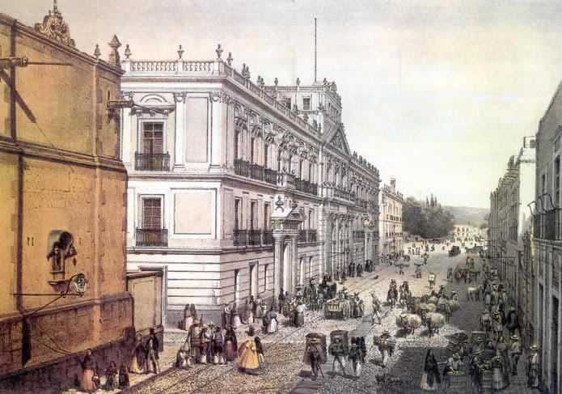
  03
Bourbon reforms
Political reforms
  REGALISM: Subordination of the Church to the State
  CENTRALISM: and the creation of a modern state
Palacio de Mineria, Mexico, built in the 18th century

Slide 17
  03
Bourbon reforms
Political reforms: Regalism
‘The parental metaphor of the ‘Two Majesties’ (Dos Magestades)—with the crown as father and the church as mother of the Hispanic family, or the two together as the collective head of the social body—gave way to a fully masculine conception of politics, with only one head and one parent, the king.’
William Taylor, Magistrates of the Sacred: Priests and Parishioner in Eighteenth-Century Mexico (1996).

Slide 18
  03
Bourbon reforms
Political reforms: Centralism
LESS LOCAL AUTONOMY
In the Americas. . . for example. . . .
Until 1750 majority of Audiencia posts holders were creoles.
Between 1751 and 1808, of 266 appointees, 200 were peninsular (i.e. 75% were peninsular).
The end of ‘se obedece pero no se cumple’.

Slide 19
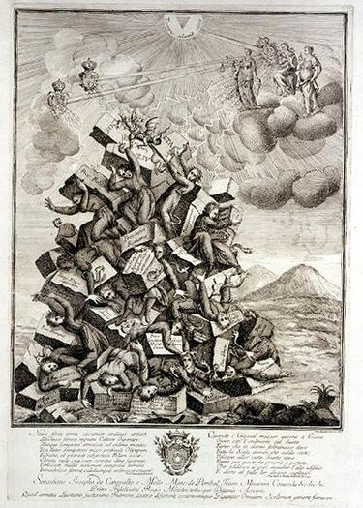
  03
Bourbon reforms
Political reforms: Centralism
•Expulsion of Jesuit Order (1767)
•Atacks on fueros (the separate legal systems for the clergy, the military and guilds)
•Dismantling of independent structures of governance for indigenous communities
Expulsión de los jesuitas de Portugal en 1759

Slide 20
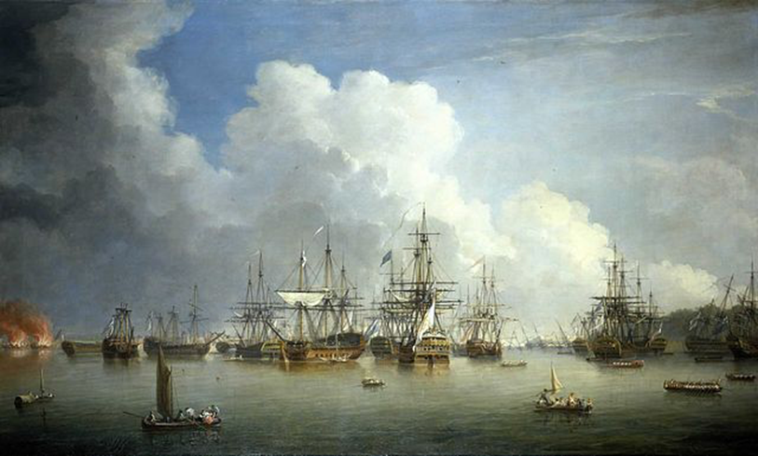
  03
Bourbon reforms
Military reforms
  Increased political control = need for military control
  Also, caused particularly by the (temporary) loss of Havana to Britain (1762) in the Seven Years’ War (1756-1763)
Dominic Serres,
The Captured Spanish Fleet at Havana

Slide 21
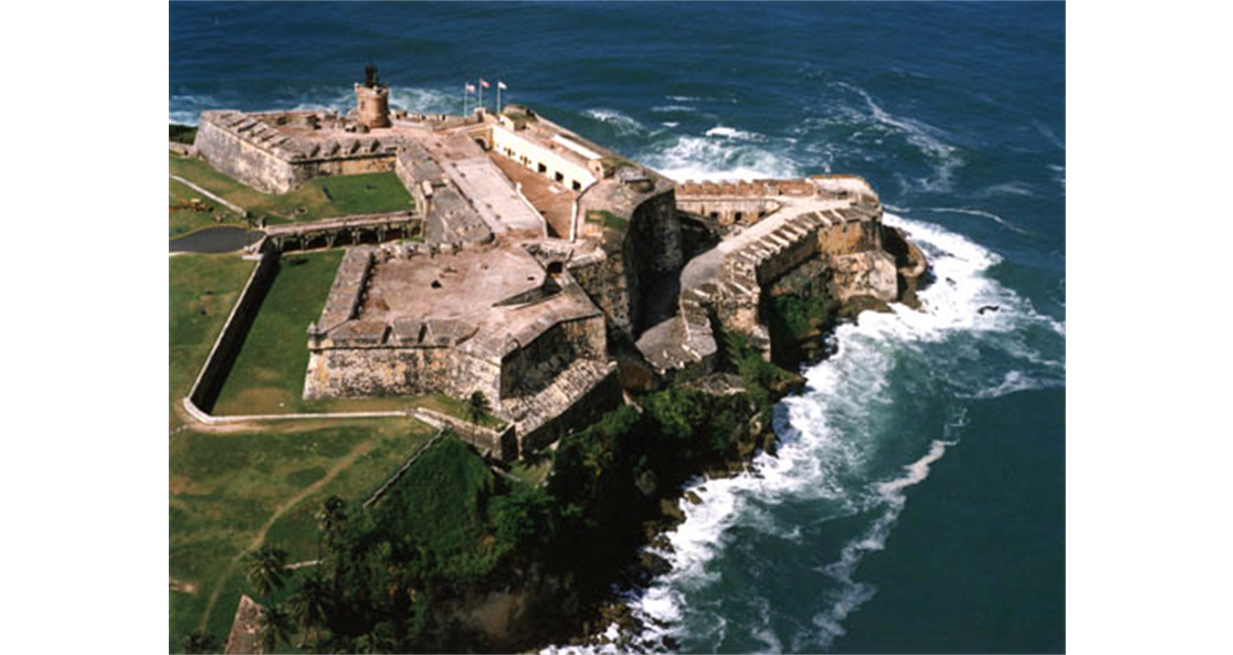
  03
Bourbon reforms
Military reforms
  New fortresses
San Felipe del Morro
(San Juan, Puerto Rico)

Slide 22
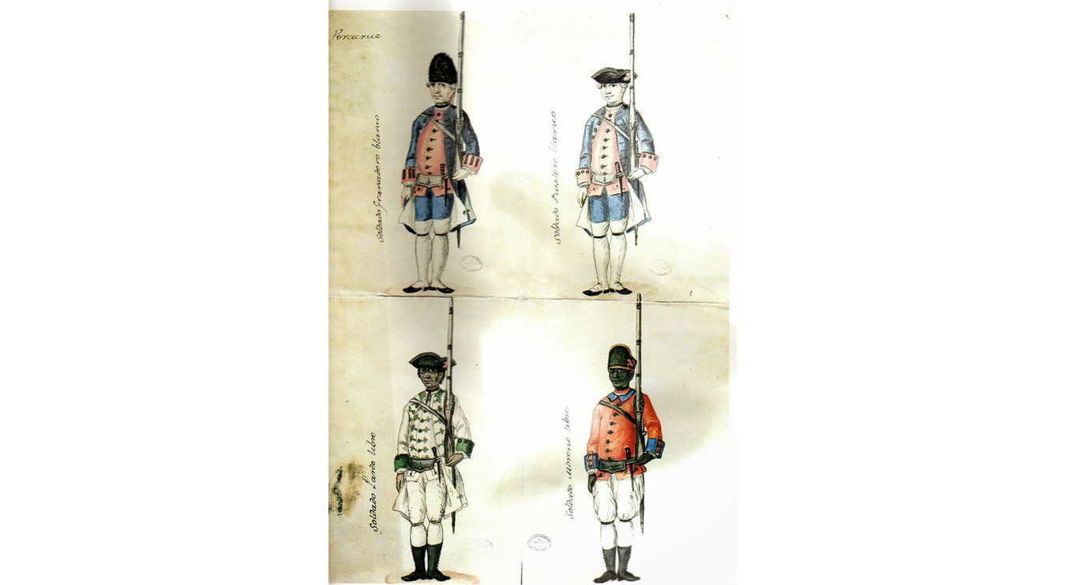
  03
Bourbon reforms
Military reforms
  Standing army
  Revitalized local militias
  Including regiments of “free people of color” and pardos
  Shaped by socioracial dynamics in the Americas
Uniforms of Veracruz’ militias. 1767

Slide 23
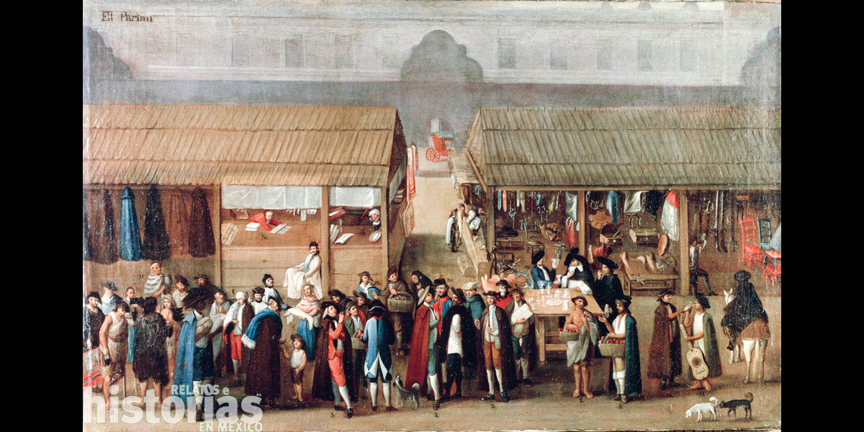
  03
Bourbon reforms
Economic reforms
  Free trade (from 1750s onwards)
  Modernization
  Physiocracy (French influence) : wealth came exclusively from land and agricultural production, not manufacturing or commerce
Elite merchants in 18th-century Mexico

Slide 24
  03
Bourbon reforms
Economic reforms
New economic ideas: rationaility
‘Commerce is not a mystery. The light of nature, which illuminates us all, reveals to us the principles on which it must be based for its establishment and increase. We can benefit from the experience of the greatest men of Europe, who for a century and a half have dedicated themselves to perfect this fundamental branch of political science, and who have left us such certain and secure rules, that we can and do err only in deviating from them, or in failing to follow them.’
José del Campillo y Cosío, Nuevo sistema de gobiernoeconómico para la América (1789).

Slide 25
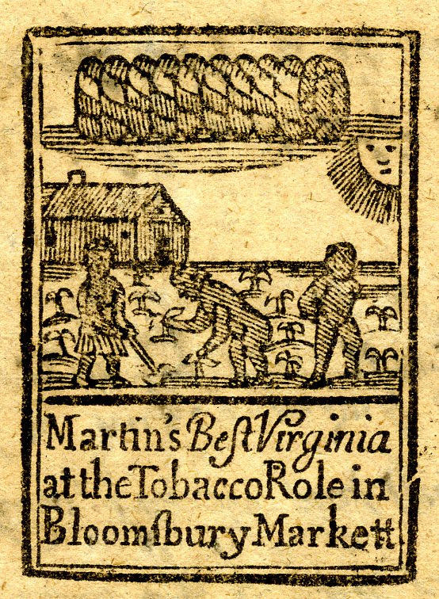
  03
Bourbon reforms
Economic reforms
- Taxes & state monopoly
Tobacco
Aguardiente
Stamped paper
Playing cards...
Tobacco advertisement in 18th-century London

Slide 26
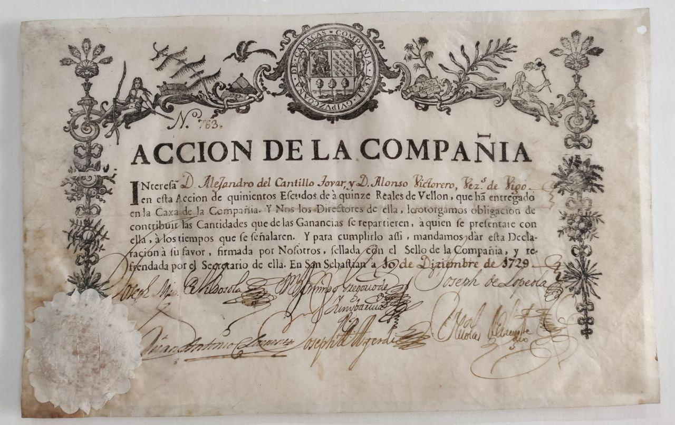
  03
Bourbon reforms
Economic reforms
  Tax increases (ie. alcabala tax)
  Tighter control over smuggling
  Bureaucracy
Stock from the Caracas COmpany, charged with control of smuggling along the coast of Venezuela

Slide 27
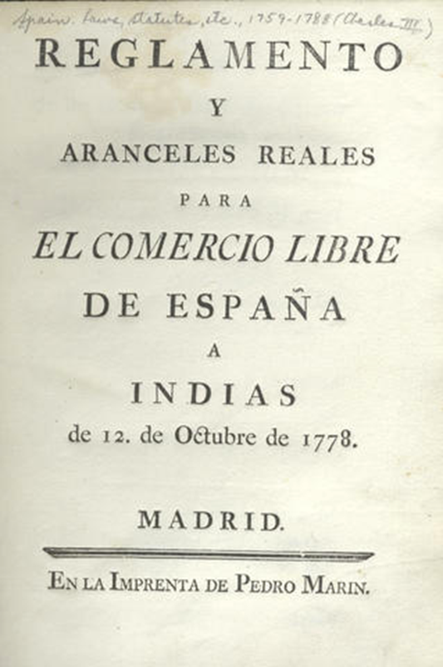
  03
Bourbon reforms
Economic reforms
  Introduction of free trade from 1770s onwards (‘comercio libre’, 1778)

Slide 28
  03
Bourbon reforms
Economic reforms
  Vast increase in transatlantic trade and in revenue to the Spanish state.
  1782-1796: exports from Spain to the Americas increased by 400%
  Taxes paid by Mexico to Spain:
    early 18th century = 6 million pesos
    mid 18th century = 20 million pesos

Slide 29
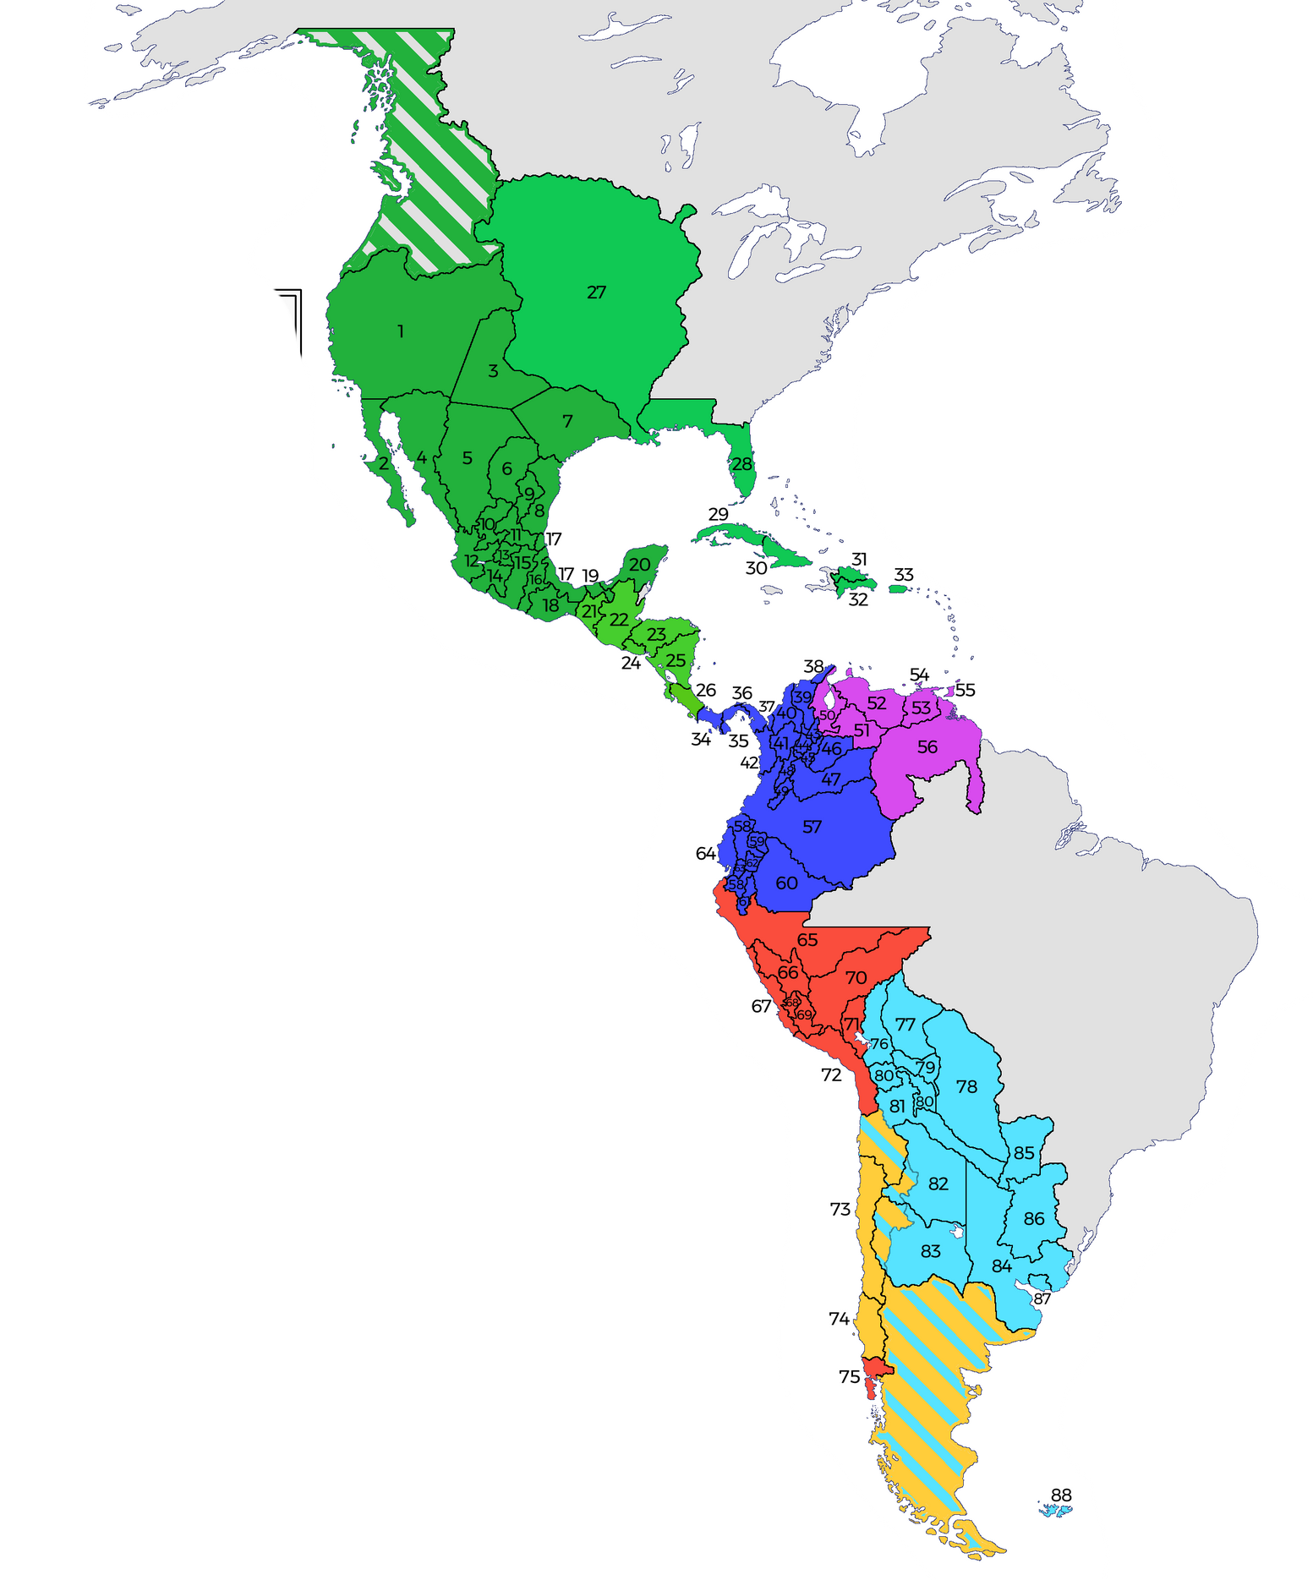
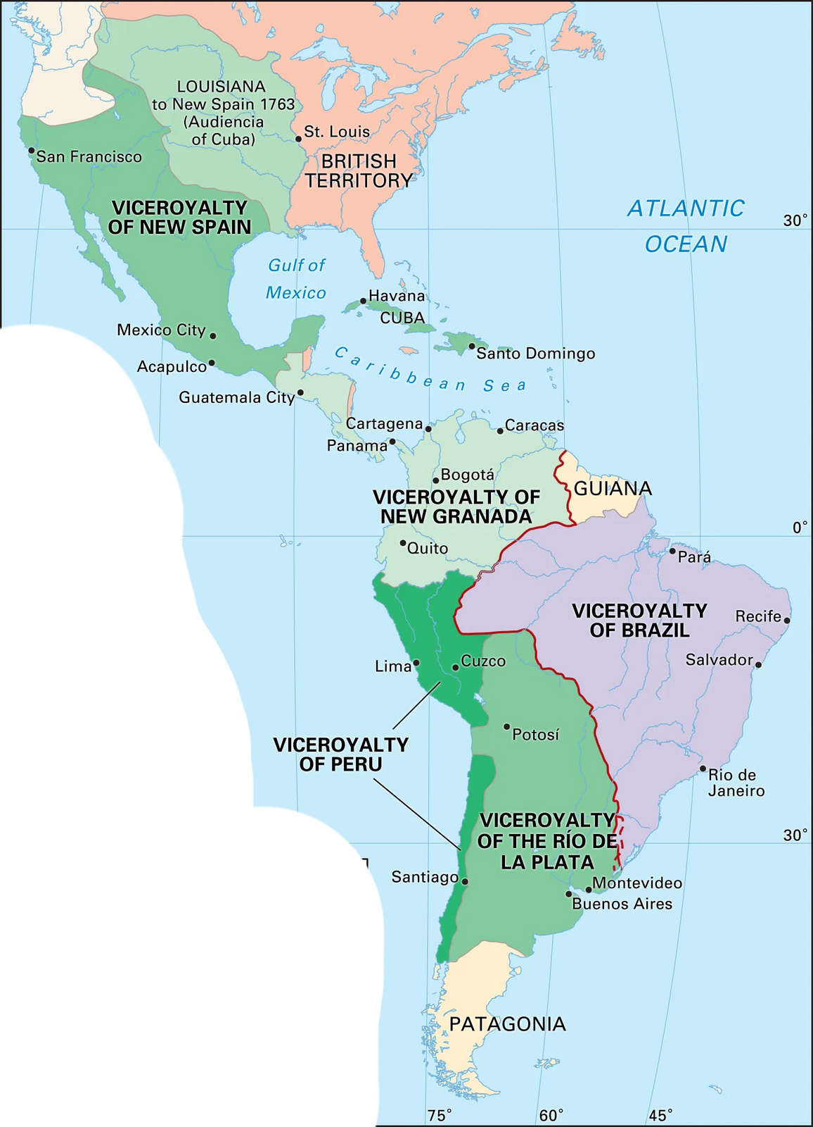
Administrative reforms
  Creation of Provinces, elimination of courts
  All Provinces had to follow new laws (Castilian laws)
  Provinces in the peninsula and the Indies now have the same administrative role (questionable?)
Provinces & viceroyalties in 1780s

Slide 30
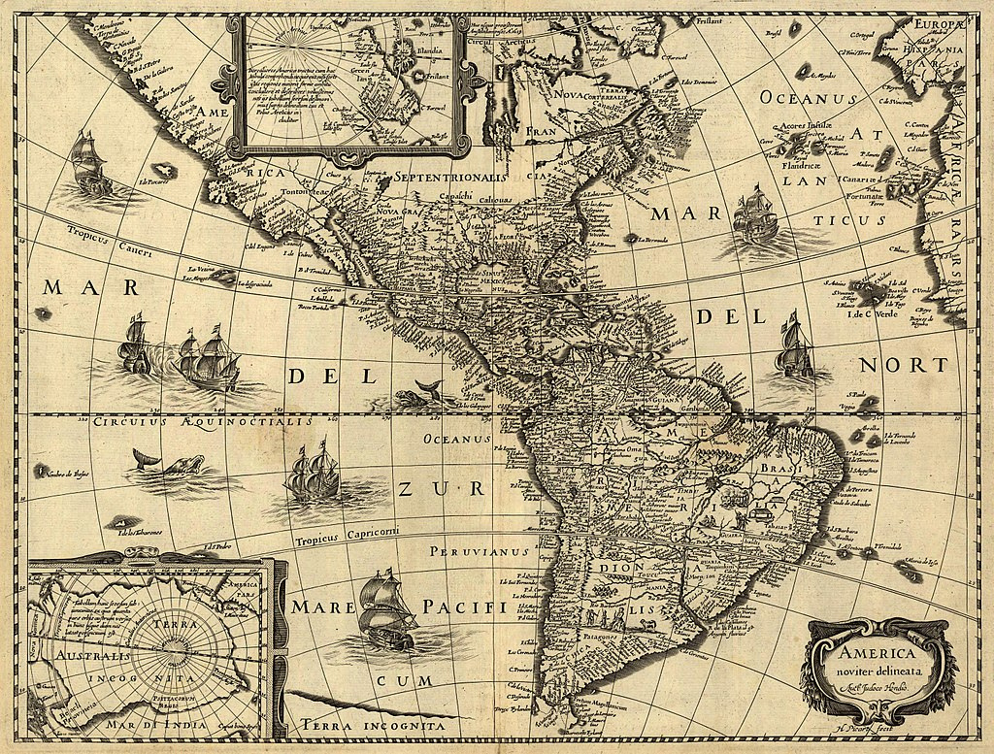
  03
Bourbon reforms
Administrative reforms
  creation of new administrative units
  new viceroyalties and ‘intendencies’
  new officials were increasingly military men

Slide 31
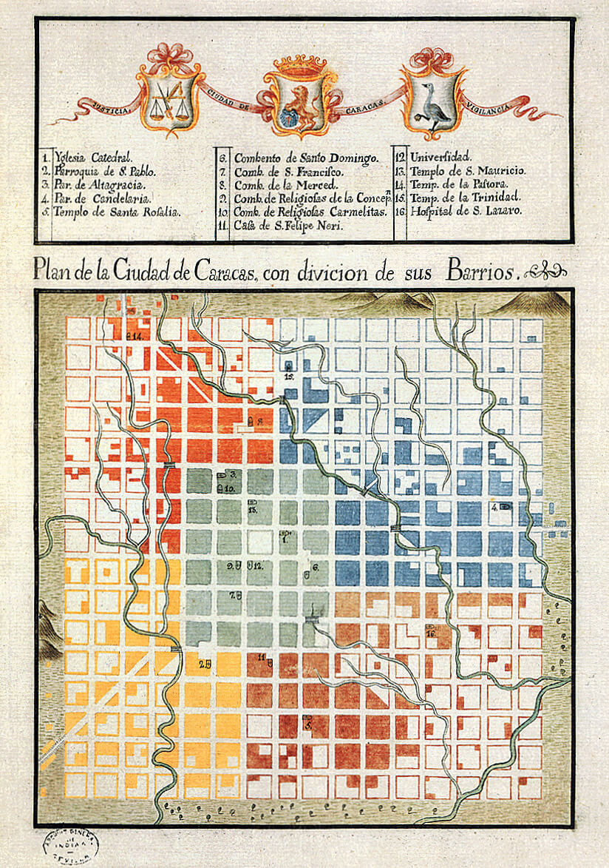
  03
Bourbon reforms
Cultural reforms
  Influence of the Enlightenment
  Scientific expeditions
  Aim to create ‘rational’ subjects
  Clampdown on popular culture (hostility to popular religiosity, fiestas, drinking, etc.)
  Civil reforms (street lighting, etc.)
Caracas City Plan, with neighborhoods divisions, Joseph Carlos de Agüero, 1775. Archivo General de Indias.HC-14

Slide 32
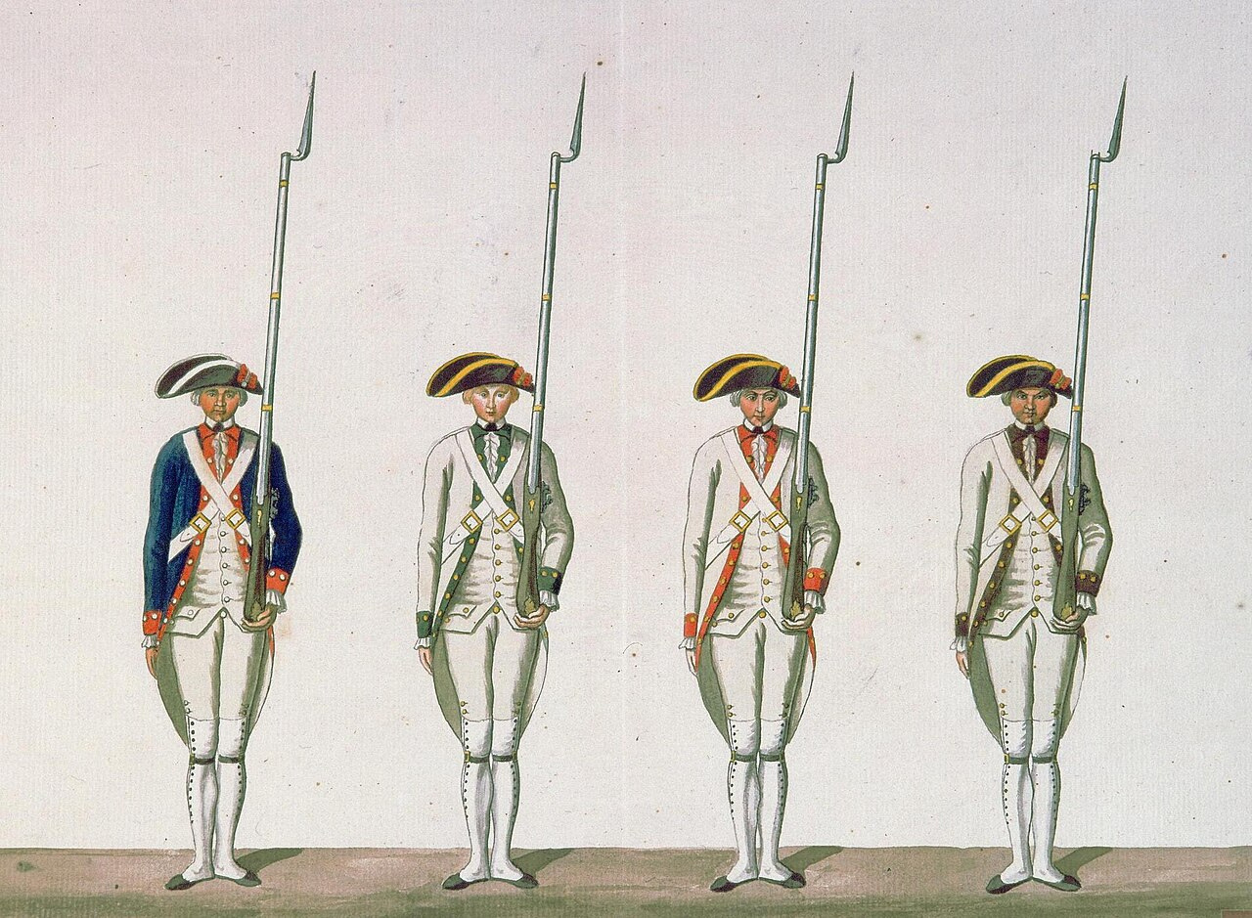
  04
A ‘second conquest’?
Enlightened absolutism
  American responses to increasingly centralized control
  Negative reactions in the Americas exacerbated imperial control

Slide 33
  04
A ‘second conquest’?
Local responses to Bourbon reforms
unprecedented number of local uprisings and rebellions
e.g.
  Juan Santos Atahualpa, 1742-56 (Peru)
  Andresote’s revolt 1730-1733 (Venezuela)
  Rebellion of the Barrios, 1765 (Quito)
  Túpac Amaru Rebellion, 1780-2 (Pan-Andean)
  Túpac Katari, 1781 (Bolivia)
  Comunero Rebellion, 1781 (New Granada)

Slide 34
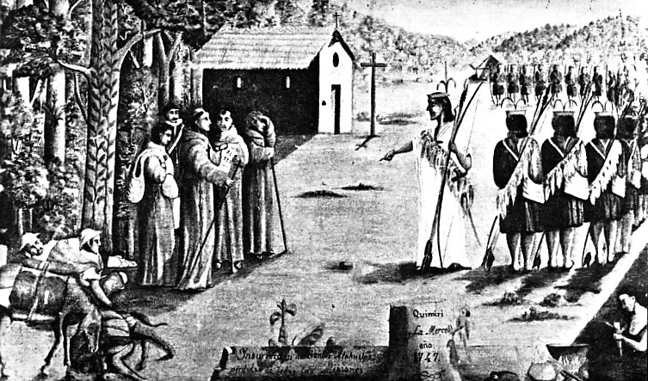
  04
A ‘second conquest’?
Local responses to Bourbon reforms: Popular unrest
Protests in the colonies: anti-colonial or ancien regime?
‘’Long live the King and death to bad government’
Juan Santos Atahualpa facing franciscan missionaries in Quimiri. Missionaries were considered accomplices in the exploitation of Amerindians.

Slide 35
  04
A ‘second conquest’?
Local responses to Bourbon reforms: Policing & repression
‘Where the Habsburgs used priests the Bourbons employed soldiers.’
David Brading, Miners and Merchants in Bourbon Mexico (1971).

Slide 36
  05
Legacies of the Bourbon reforms
  Elite disaffection and increasing hostility between local elites and Iberian Spaniards
  Rise of ‘creole patriotism’
  Damage to local industry (cheaper Spanish imports)?
  loss of legitimacy for the Spanish crown?
  prelude to independence?

Slide 37

Thank you!
See you next class!

