Slide 1
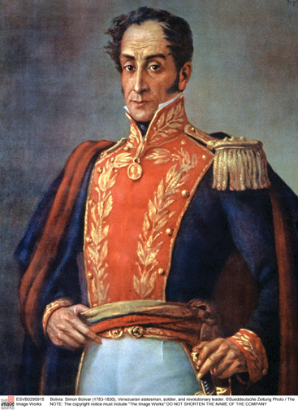
Latin American Wars of Independence
Latin American Themes and Problems 2025
Dr Liana Beatrice Valerio
(Adapted from the original lecture by Dr Rosie Doyle)

Slide 2
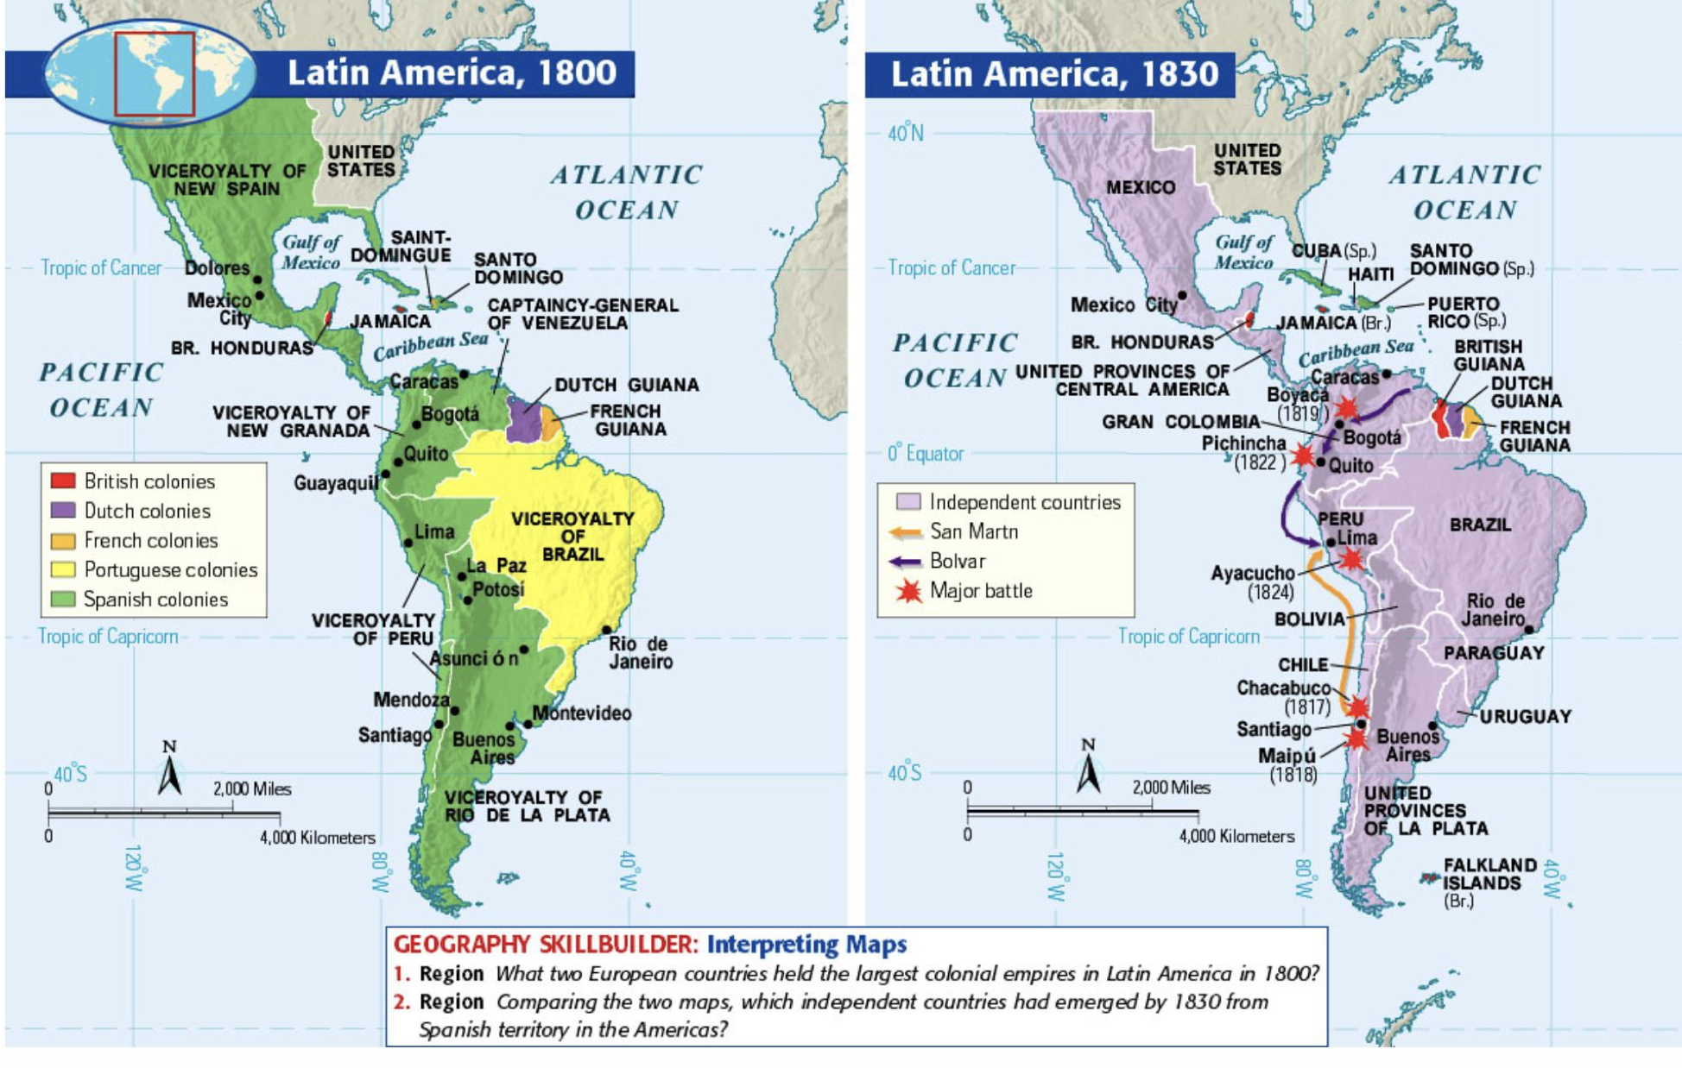
From Colonies to Nations, 1810-1825

Slide 3
Principle Lecture Aims
To illustrate the two classic explanations as to the causes that led to the Latin American Wars of Independence, followed by an overview of new areas of analysis.

Slide 4
Version 1
Buildup of anti-Spanish feeling (late 18th century), leading to: anti-Spanish independence movements from 1810
The significance of the Enlightenment: the circulation of ideas and discourses across the Atlantic (republicanism, natural laws, citizenship).
The emergence of new identities (creole patriotism) Bourbon Reforms eroded the ‘colonial pact’, leading to widespread dissatisfaction with Spanish rule
proto-nationalism, leading to:
Breakdown in colonial hegemony and the start of the wars of independence
Situates Latin American Revolutions in the context of the Radical Enlightenment, other Atlantic Revolutions (particularly the Haitian Revolution).

Slide 5
Version 1
Version 2
The other stresses the contingent, conjunctural nature of the collapse of colonial rule, linked to Europe and the Wider Atlantic. It’s all about:
Contemporary crisis in the Hispanic / Iberian World
One version stresses the antecedents to the outbreak of independence. It’s all about:
Pre-existing issues.

Slide 6
Version 2
Napoleonic Wars, especially Napoleon’s invasion of the Iberian Peninsula in 1807, leading to: breakdown in political consensus in the Hispanic world

Slide 7
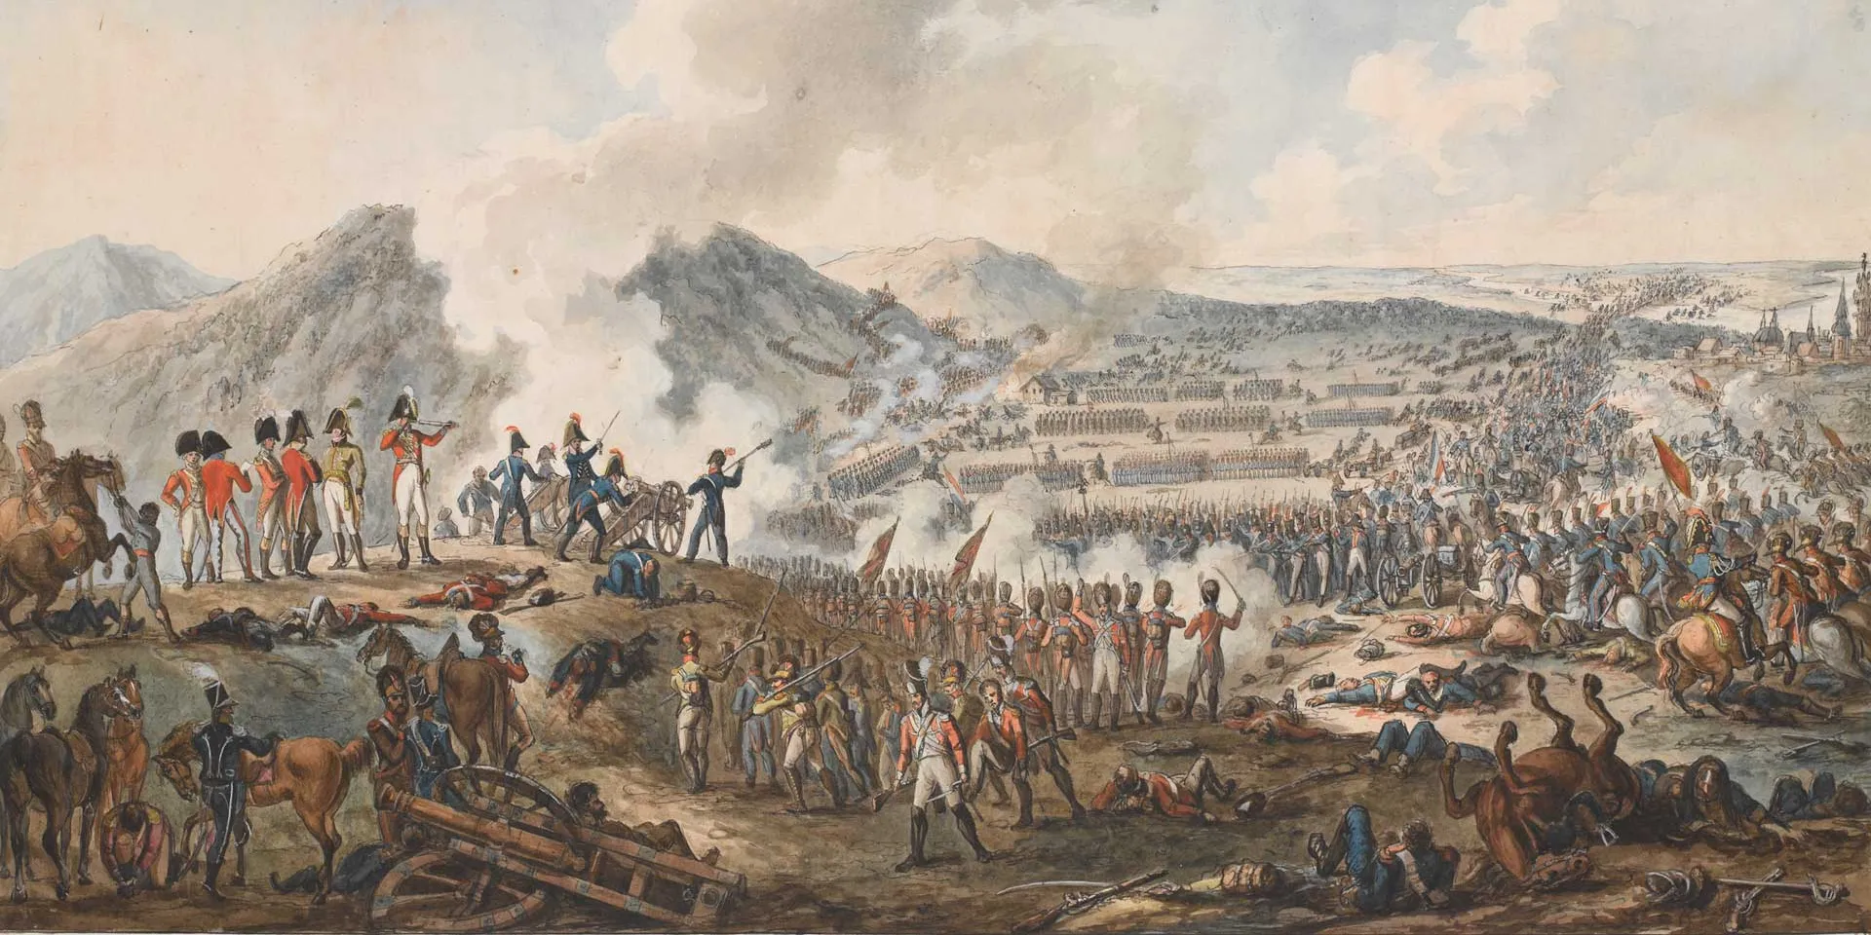
Crisis in the Iberian World
1807: Napoleonic troops invaded the Iberian peninsula, leading to the Peninsular War (1808-14)
The Battle of Talavera, 28 July 1809

Slide 8
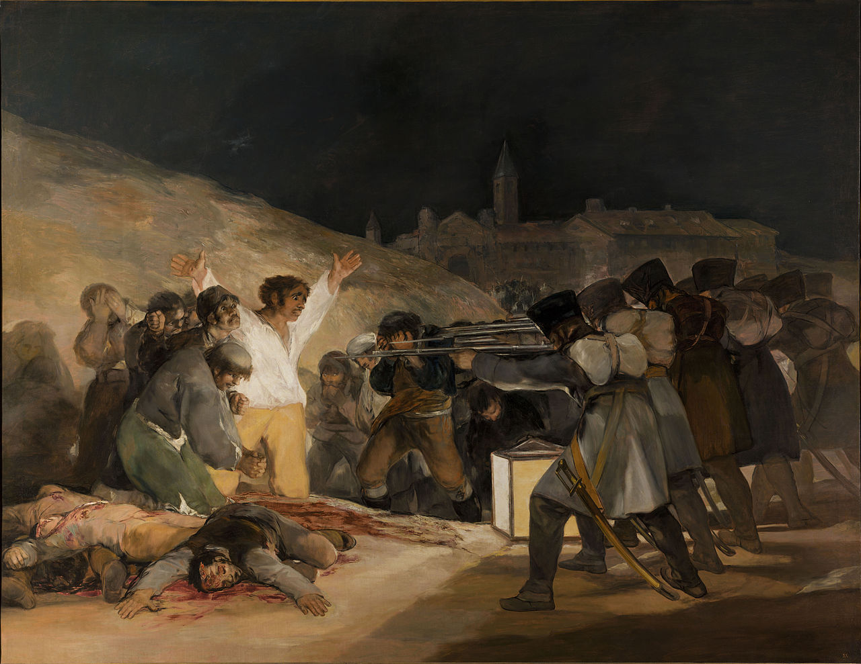
Francisco Goya, The Third of May, 1808 (1814)

Slide 9
Crisis in the Iberian World: Two Consequences
Two consequences:
1. In 1807 the Portuguese royal family fled to safety in Brazil = Portugal was governed from Brazil until the defeat of Napoleon.
2. Breakdown in colonial authority in Iberian America.

Slide 10
Crisis of Authority in the Americas
As news that, in 1808, French forces had captured the entire Spanish royal family reached the Americas, different colonial administrations reacted differently:
1. Some cities set up ‘juntas’ (local governing bodies) to govern until the return of the ‘legitimate’ Bourbon monarchs.
2. While, in other regions, colonial authorities maintained control and condemned the juntas as illegitimate and seditious.
Conflict quickly broke out between these different groups…

Slide 11
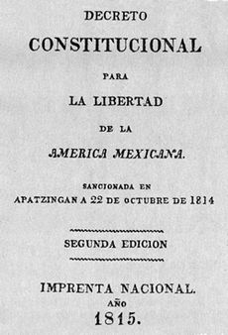

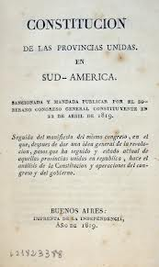
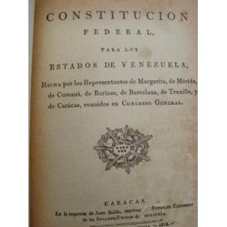
Crisis of Authority in the Americas
By 1812 many regions had declared outright independence from Spain.
Much circulation of ideas in the public space.

Slide 12
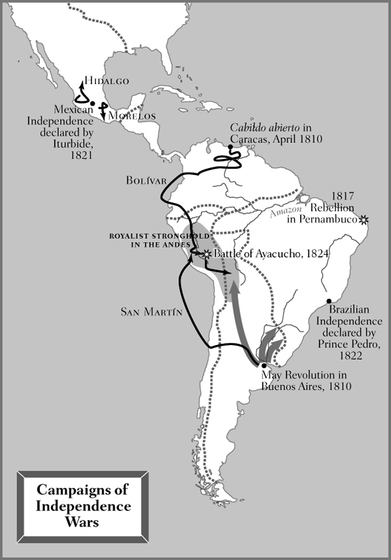
Spanish “Reconquest”, 1815-1821
Spain sent thousands of troops to the Americas in an attempt to quell rebellion.
The largest continent of about 12,000 troops was dispatched in 1814.
Nonetheless, most of the royalist troops fighting against the insurgents were locals.

Slide 13
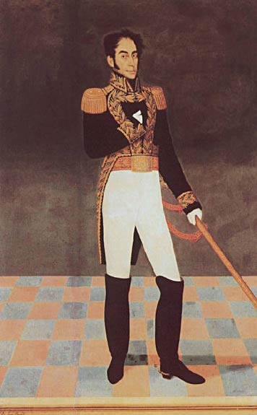
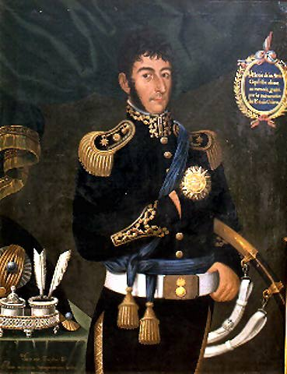
Crisis of Authority in the Americas
The period from 1810 to 1815 was characterised by outright civil war between loyalists and insurgents.
Simón Bolívar, a wealthy creole from Venezuela, led insurgent forces in northern South America.
José de San Martín, a professional solider, led the insurgent campaign in southern South America

Slide 14
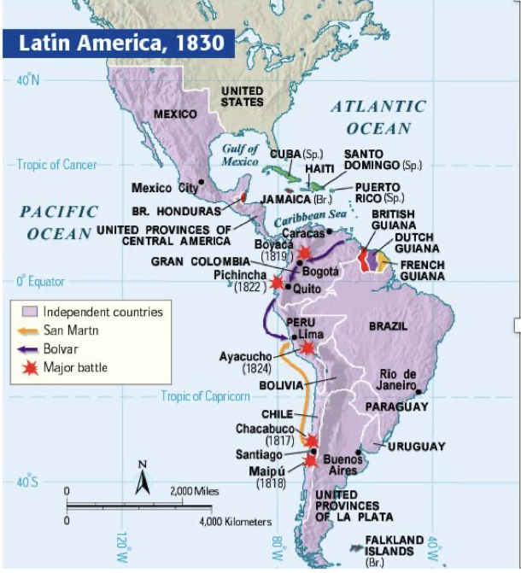
Ultimate military victory by insurgent forces: ‘last’ battle: Battle of Ayacucho (1824)

Slide 15
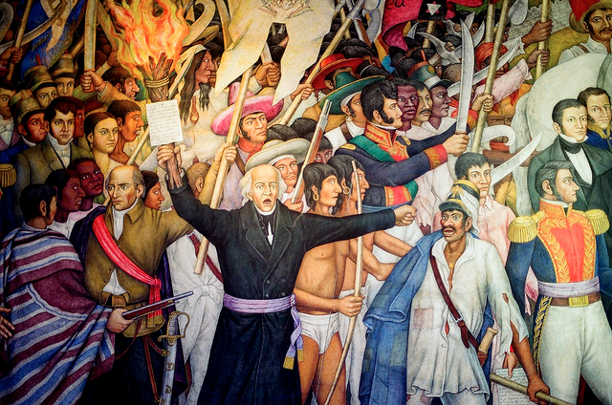
Mexico
Grito de Dolores, 1810
Miguel Hidalgo (1753-1811), parish priest

Slide 16
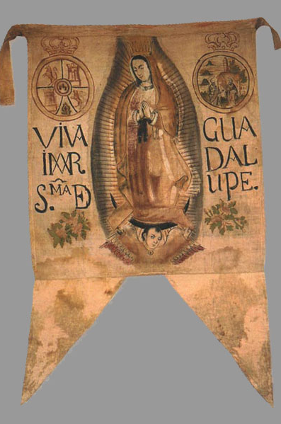
Hidalgo’s Flag
Hidalgo’s flag, showing the Virgin of Guadalupe. He leads a mass popular rebellion.
Hidalgo executed in 1811.
Rebellion continued under other leaders…

Slide 17
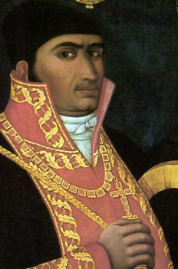
José María Morelos
1821 Treaty of Córdoba ends conflict.
Coronation of Iturbide as Agustín I of Mexico (1822)
Agustín de Iturbide, former royalist officer turned insurgent, became emperor of a newly independent Mexico.

Slide 18
Brazil
Royal family fled to Brazil in 1807, resided in Rio de Janeiro until the defeat of Napoleon.
Anti-Napoleonic forces that remained loyal of the House of Braganza then asked the royal family to return to Portugal.
All returned, aside from the crown prince Pedro…

Slide 19
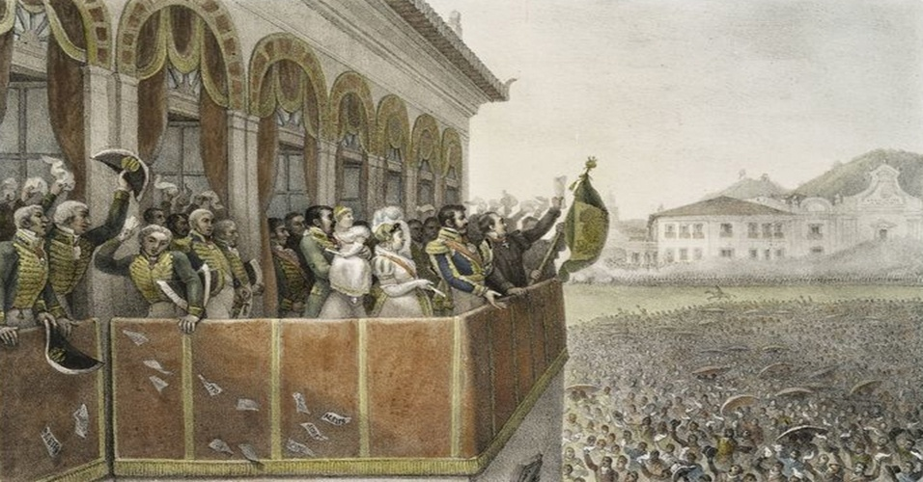
The Fico, Dom Pedro I, 1822

Slide 20
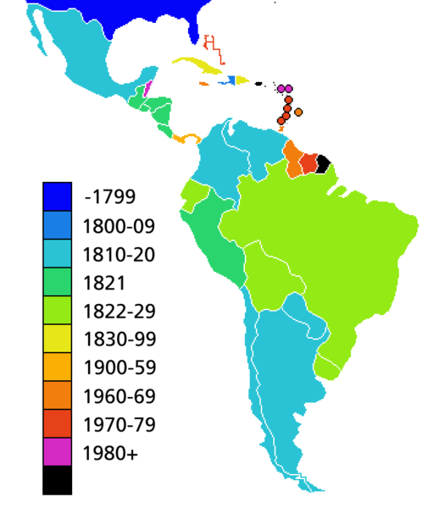
The Timing of Political Independence

Slide 21
How Have Historians Approached the Wars of Independence?
Nationalist Historiographies
Structural Analyses
Analyses of Political Culture
Social Histories
New Trends…

Slide 22
Nationalist Historiographies
Nationalist historiographies focused on creating a pantheon of national heroes and founding fathers, producing grand, romantic narratives, and naturalising the nation state as the unit of analysis.
Written from the 1820s onwards
Search for ‘precursors’ and ‘antecedents

Slide 23
Structural Analyses
Structural analyses of underlying economic and political forces:
Breakdown of the ‘colonial pact’ through the Bourbon reforms.
Late colonial riots not as precursors but as disputes about the moral economy.
Less focused on the nation; more interested in class
Written particularly from the 1960s onwards

Slide 24
Analyses of New Political Cultures
Analyses of political culture
Focus on the development of modern political structures such as elections and constitutions, and the rise of a public sphere.
Finds evidence for widespread engagement with these new political practices.
View Spain and its colonies holistically: all experienced the advent of modernity.
Particular emphasis on the rise of electoral democracy during the Peninsular War.

Slide 25
Social Histories
Social histories of independence
A ‘history from below’ focused on the experiences of non elite groups such as enslaved people or indigenous communities.
Questions whether political independence resulted in significant change to social structures.
Challenges the importance of independence as a watershed (1750-1850)

Slide 26
Current Areas of Interest
The rise of new political practices such as elections and the extent to which these practices were embraced by non-elites.
Changes in social structures such as those related to gender norms.
The importance of the Atlantic context: the US war of independence, the French Revolution and the Haitian Revolution.
Legacies, commemorations, resonances, memorialization, appropriation?

