Slide 1
Africa in the Post-Cold War World

Slide 2
Introduction
‘History has passed its sentence on colonialism, imperialism and settlerisim… We the African people of Kenya – nay Africa – are now the executors of the sentence passed by history now!’
KANU Office, Cairo, 1960

Slide 3
Introduction
What happened?
  Legacies of colonialism & decolonisation
    Inequalities
      Katanga in Congo; Biafra and Nigeria
    Contested visions of independence
      Angola
    Divisions of wars of independence
      Kenya
    Deep effects of colonial rule
      Language, culture and education (Achebe & Ngugi)

Slide 4
Introduction
What happened?
  Post-colonial global context of Cold War
    Need to access funds for development to deliver on promise of independence
    Preference of superpowers for stability
      Propping up of regimes
        Mobutu in Congo; Mengistu in Ethiopia; Moi in Kenya
  End of Cold War? End of History (Fukuyama)?

Slide 5
Introduction
Immediate effects of the end of the Cold War
  War (Somalia, Zaire/DRC), peace (Namibia, South Africa, Mozambique)
Longer-term effects
  Structural Adjustment (SAP) & democratisation:
  Planned economies to free markets & authoritarian rule to ‘Third Wave of Democracy (Huntington)’
  Security & new economic relationships in new millennium

Slide 6
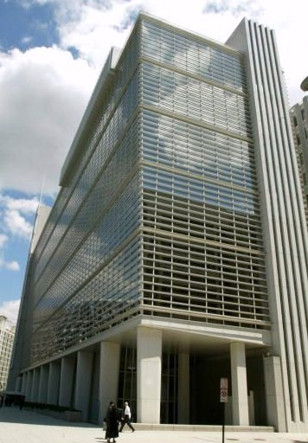
Origins
1970s
  Oil crises of 1973 & 1979
Early 1980s
  Project-based aid not working
  Low returns on aid
  Low amounts of aid
World Bank’s Berg Report of 1981
  More aid
  Internal rather than external causes of crisis
Mexico 1982
  Fear of default

Slide 7
Aims
To provide loans when no other funds available
Short-term
  Alleviate deficit
Long-term
  Foundations for sustainable growth
    Required conditions

Slide 8

Conditionality
Conditions imposed:
  Currencies revalued
    Exports
  Export crops
    Flowers
  Urban bias reduced
    Incentives for farmers
  Reduction of state control
    Public services
    Nationalisation
    Subsidies
  IFI supervision of budgetary process

Slide 9
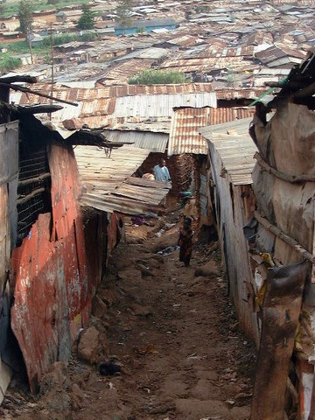
Results
Economic
  Growth?
  Informal economy
Social
  Slowing of urbanisation
  Declining living standards
  Inequality

Slide 10
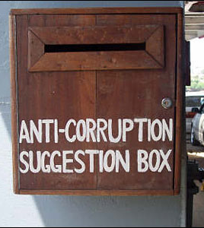
Results
Political
  Corruption
  Reduction of state capacity
    Crisis of legitimacy
  Limited control of budgets
    Crisis of sovereignty

Slide 11
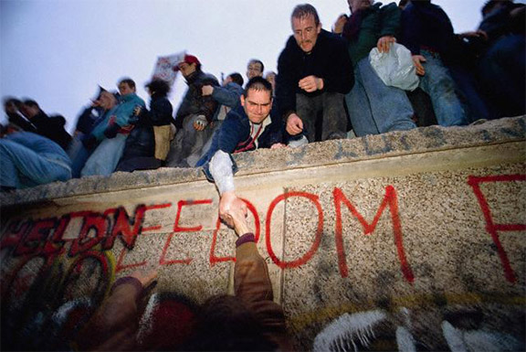
Democratisation
Early 1990s
  Failure to deliver growth blamed on implementation
    Use of non-state actors (NGOs – local & international)
    Reform of state institutions
      ‘Good governance’
  Good governance = multi-party elections
  Demand for reform from within
    “Second Liberation” (Anyang’ Nyong’o)

Slide 12
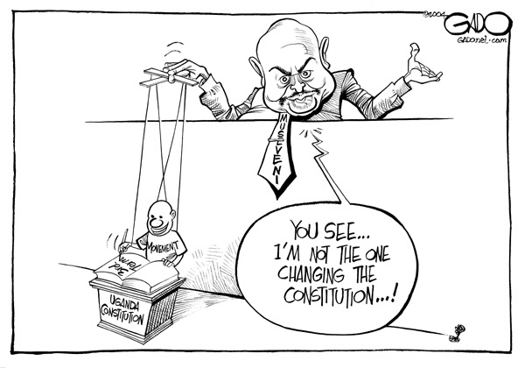
Democratisation
Democratisation part of conditionality from early 1990s
  Aspiration rather than aim
  Adherence with economic conditions more important
    Uganda & Rwanda

Slide 13
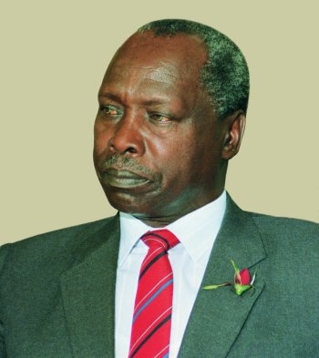
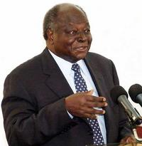
Democratisation
Democrazy in Kenya
  Elections 1992, 1997, 2002 & 2007
    Nothing Actually Really Changed?
    Survival of incumbents
      Some exceptions (Mobutu)
      Disorder as political instrument (Chabal & Daloz)
      Use of state resources
      Manipulation of electoral process
      Absence of debate on social & economic policy
        Rise of identity politics?
    Corruption

Slide 14

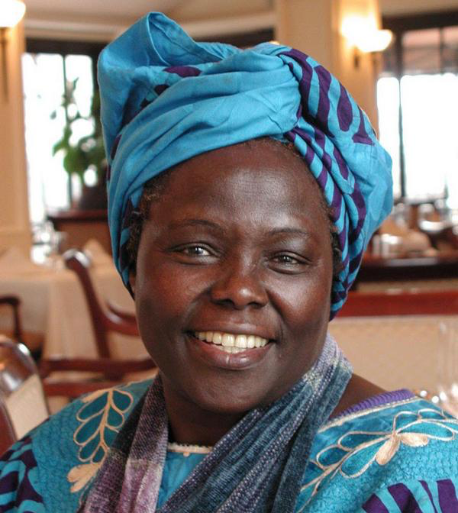
Democratisation
Expansion of civil society
  Churches
  Human rights
  Anti-corruption (Githongo)
  Environment (Maathai)
Freedom of speech
  Media
    FM radio stations
    Newspapers
  Mobile phones

Slide 15
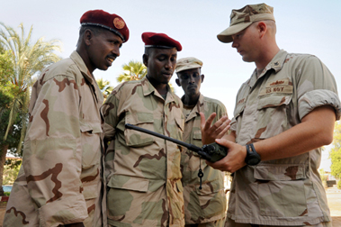
The New Millennium
Situation of relative weakness reset from c. 2000
  African economies as emerging markets in global financial crisis
    Investment rather than aid
  New/refreshed foreign powers
    China; Turkey; Russia
      Natural resources
  Security

Slide 16
Conclusion I: What Has Changed
Seeming inevitability of alignment with Western models of politics and economics no longer intact
  Politics
    Hybrid forms of government
      Authoritarian & democratic (variation though)
  Economic
    Paradox of SAPS
      Intended to stabilise economies & states
      Intended to induce major reforms that threatened stability
  Contradiction between SAP & democratisation
    SAP acted to restrict political choices
  Alternative options
    Security as leverage by states
    New powers

Slide 17
Conclusion II: What hasn’t changed?
The Gatekeeper State (Cooper) & Extraversion (Bayart).
  External orientation of economies;
  States role as gatekeeper ‘astride the intersection’ between sovereign territories & outside world.

