Slide 1
The united states and empire I:
Imperial amnesia?
Prof. Susan Carruthers

Slide 2
Where in the world is the United States?
The United States currently administers 16 territories as insular areas. Five of these are permanently inhabited: : Puerto Rico and the U.S. Virgin Islands in the Caribbean Sea; Guam and the Northern Mariana Islands in the Marianas archipelago in the western North Pacific Ocean; and American Samoa in the South Pacific Ocean.

Slide 3
Key issues
How did the US become such a vast state?
How do we explain the scattered, non-contiguous territories?
How should we characterize US power exercised beyond its borders?
  Benign? Alluring? Coercive? Oppressive? Militaristic?
Can we account for either/both dimensions of American power—within
and beyond national borders– without an understanding of empire?
How do ideas of American “exceptionalism” shape these debates about
US size/might/power?

Slide 4
An empire in denial?

Slide 5
George w. bush
“America has never been an empire. We may be the only great power in history that had the chance, and refused — preferring greatness to power and justice to glory.”
Speech delivered at the Ronald Reagan Presidential Library
November 19, 1999
https://www.globalsecurity.org/wmd/library/news/usa/1999/991119-bush-foreignpolicy.htm

Slide 6
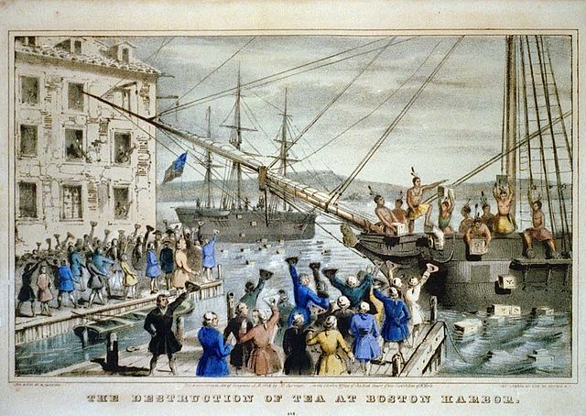
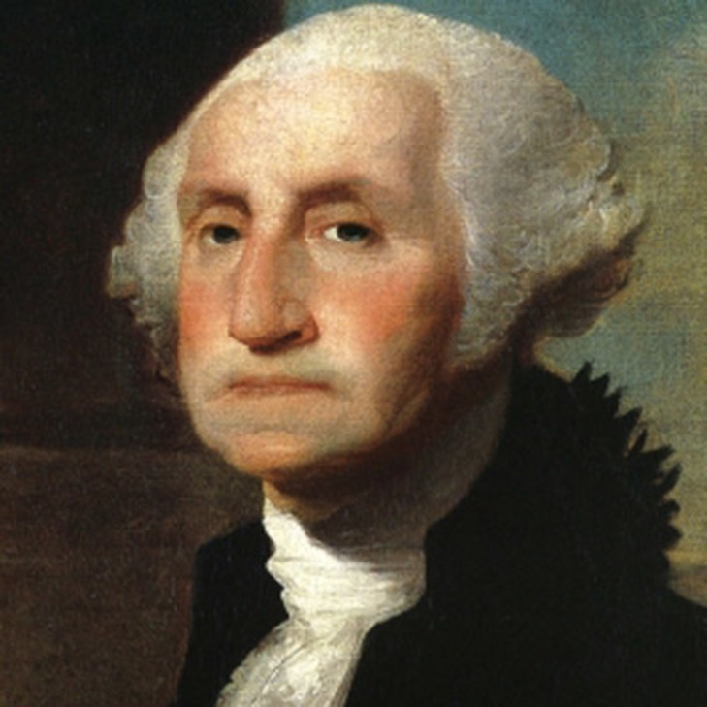
A history grounded in anti-colonial struggle
Nathaniel Currier, "The Destruction of Tea at Boston Harbor”
1848
George Washington, 1st President of the United States
(1789-1797)

Slide 7

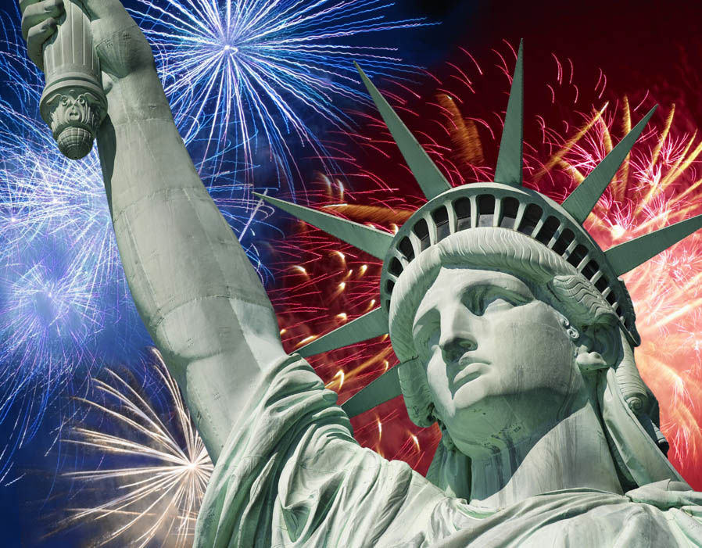
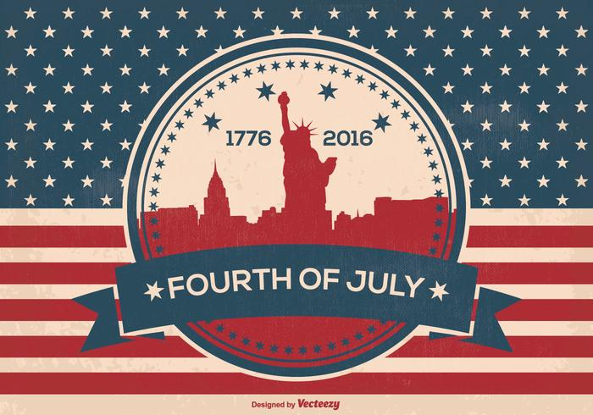

Slide 8
An “empire for liberty”
Explaining US continental growth

Slide 9
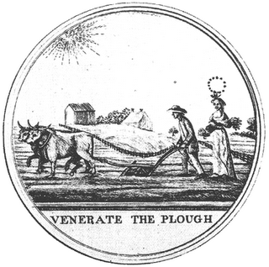
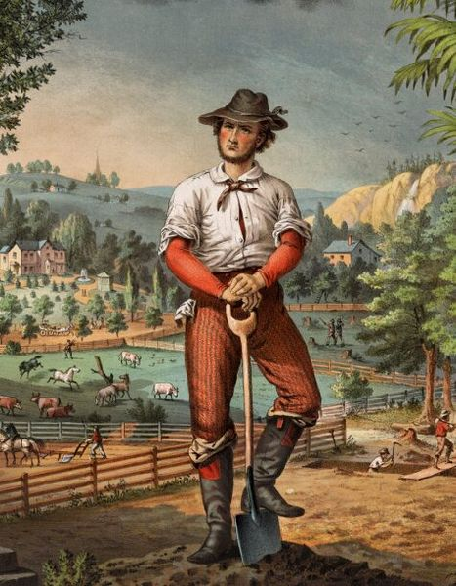
The republican ideal
The yeoman farmer
as Jeffersonian ideal.

Slide 10
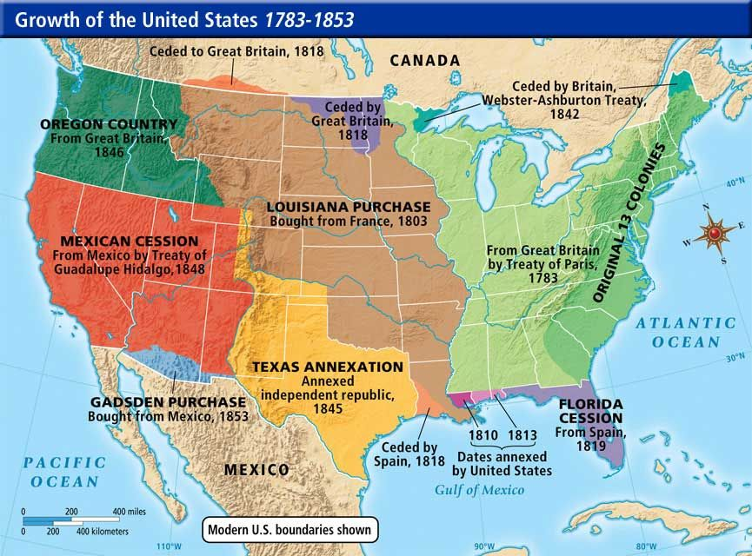

Slide 11
Manifest
Destiny
an articulation
of US
exceptionalism

Slide 12
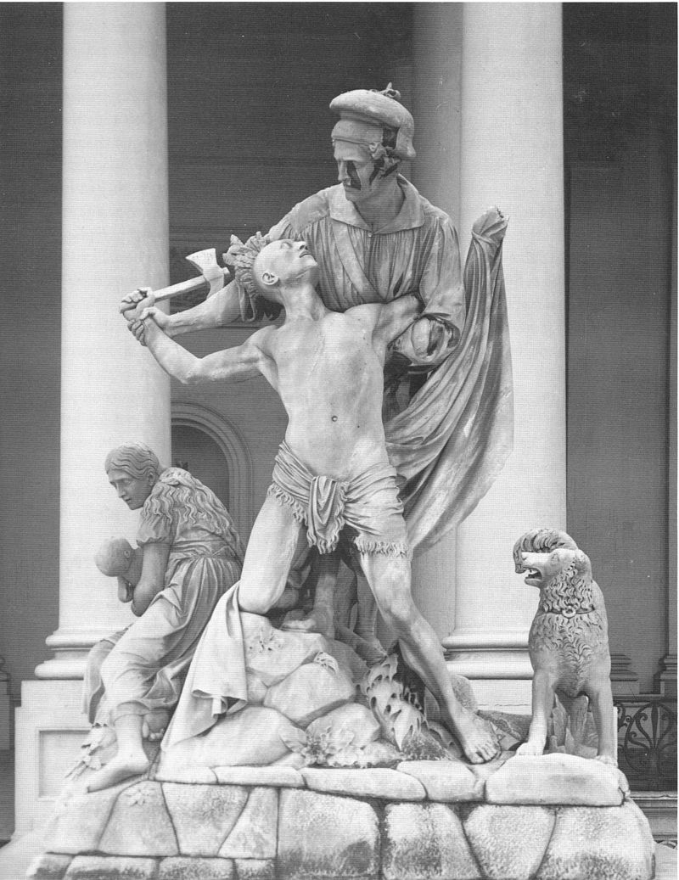
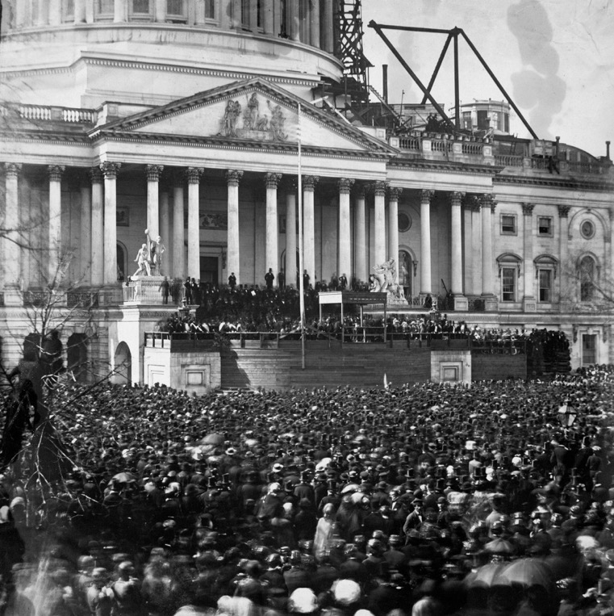
A nation menaced: violence as self-defence
Horatio Greenough’s The Rescue stood outside
the US Capitol Building from 1853 until 1958,
Seen here during Lincoln’s inauguration in 1861.

Slide 13
1898: An imperial aberration?
War with Spain over Cuba and the Philippines

Slide 14
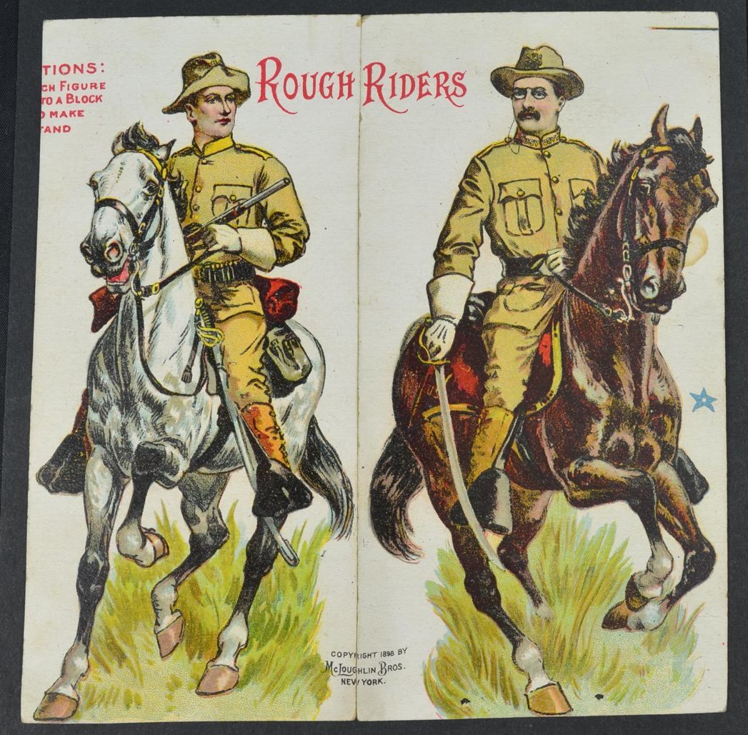
T.R. (Theodore Roosevelt)
and the Rough Riders—
victorious in a
“Splendid Little War”
against Spain fought in/over
Cuba
1898

Slide 15
“open door” imperialism
The pursuit of markets and materials

Slide 16
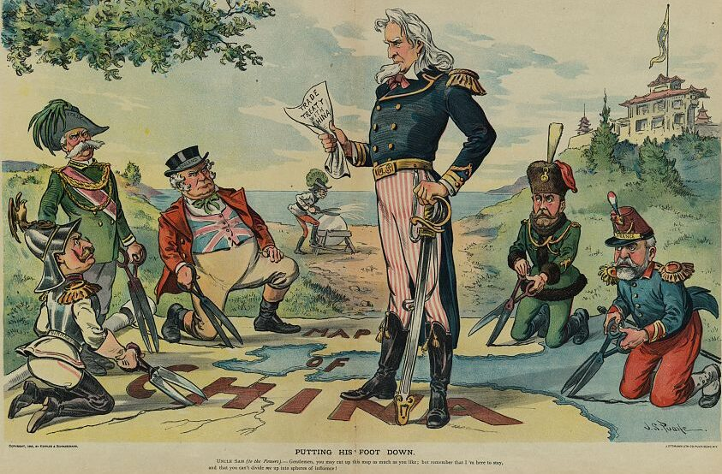
"Putting his foot down" Uncle Sam in 1899 demands Open Door while major powers plan to cut up China for themselves; Germany, Italy, England, Austria, Russia & France are represented by Wilhelm II, Umberto I, John Bull, Franz Joseph I (in rear), Uncle Sam, Nicholas II, and Emile Loubet. Punch Aug 23, 1899 by J. S. Pughe

Slide 17

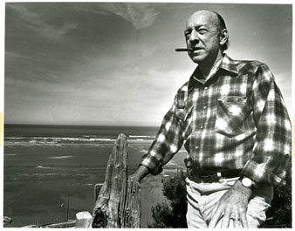
“Revisionism” and the Wisconsin School
(1959; revised, 1962)
William Appleman Williams (1921-90)

Slide 18

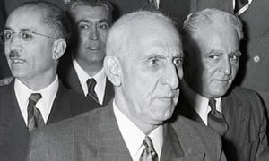
Covert interventions and regime change
“CIA admits role in 1953 Iranian coup”
The Guardian, 19 Aug., 2013
https://www.theguardian.com/world/2013/aug/19/
cia-admits-role-1953-iranian-coup
Mohammed Mosaddeq is described in one US document as 'mercurial, maddening, adroit, and provocative'. Photograph: Bettmann/Corbis
Overthrowing Arbenz (1954)

Slide 19
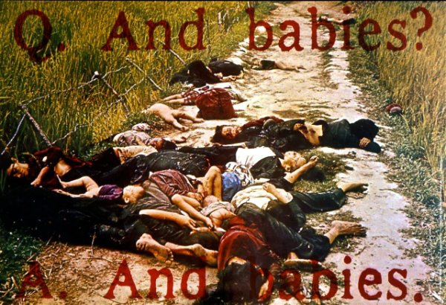
Vietnam as an imperialist war
This poster was created by the Art Workers Coalition (AWC), a group of New York City artists who opposed the war. The poster became a focus for the outrage that so many people around the world felt about the U.S.A.’s war in Vietnam.
The My Lai Massacre (March 1968) became representative of the many war crimes committed in Vietnam.
http://www.redlineartworks.org/section652294_311497.html

Slide 20
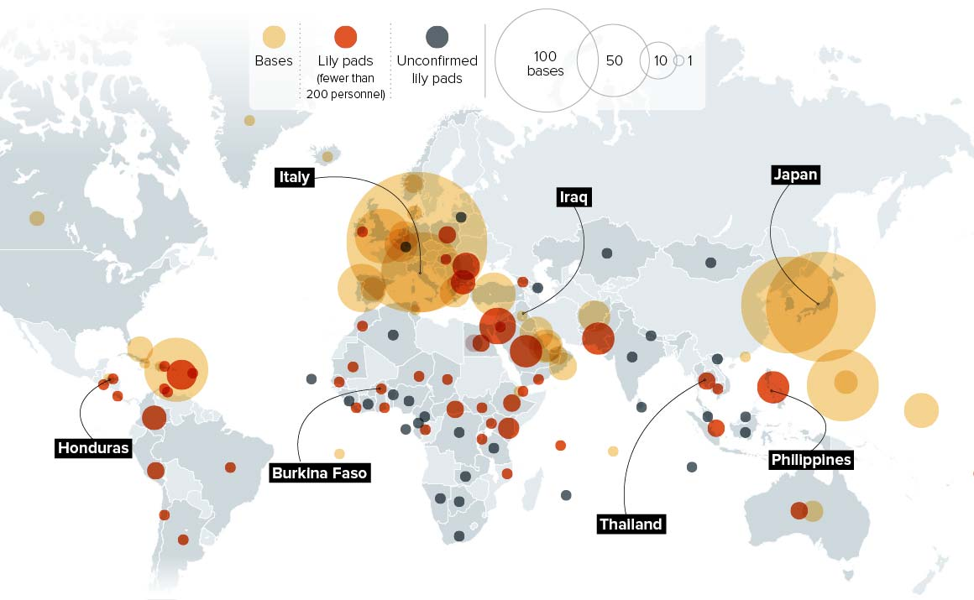
US military power overseas (2015)
https://www.politico.com/magazine/story/2015/06/us-military-bases-around-the-world-119321

Slide 21
An empire of attraction?

Slide 22
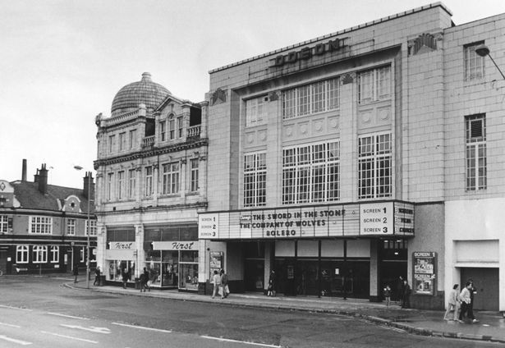

In 1940, Coventry boasted 23 cinemas. Now the city has 3.

Slide 23
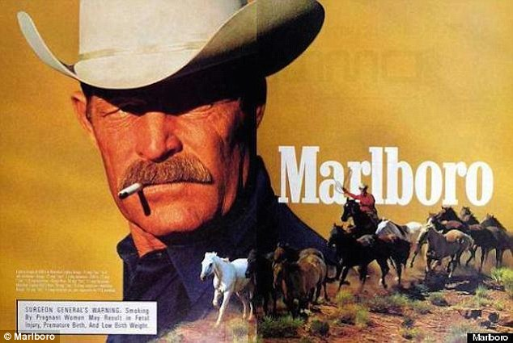
Land of the free?
The Malboro Man character
used from 1954 to 1999

Slide 24
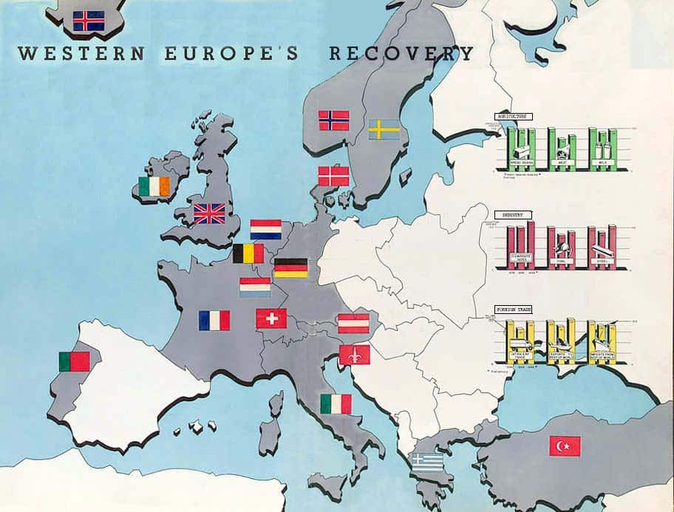
“Empire by
Invitation”?
Geir Lundestad
The Marshall Plan (1948)
$13 billion

Slide 25
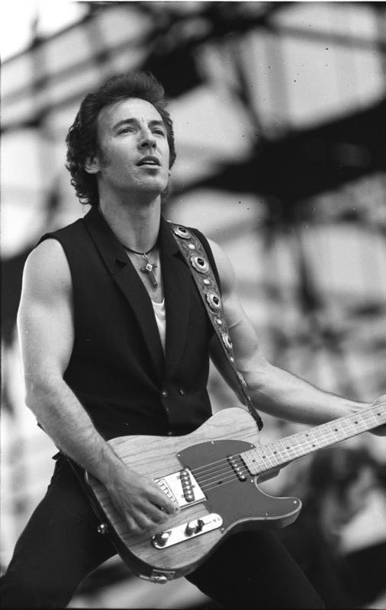
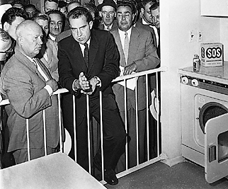
The cultural cold war:
a stunning US victory?
Nixon and Krushchev
in Moscow, 1959 Bruce Springsteen in East Germany,19 July 1988

Slide 26
9/11 and the “rediscovery” of empire

Slide 27
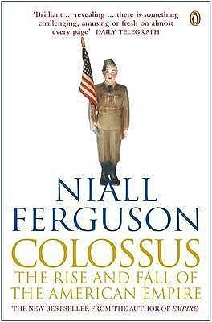

Empire reinvigorated?
.
New York Times Magazine, 5 Jan 2003: SM22
2004
2002

