Slide 1
US empire: part II
Susan Carruthers

Slide 2
Us imperialism: a unique case?
US imperial amnesia/denial: the US doesn’t “do” empire and never has
US exceptionalism
And yet…. a history of territorial expansionism and power
projection in the Americas and beyond
A continent-spanning state with far-flung, non-contiguous “territories”
A vast network of overseas military bases
And a period of global hegemony, dating from at least 1945 (if not before).

Slide 3
The “greater” United States
The United States currently administers 16 territories as insular areas. Five of these are permanently inhabited: Puerto Rico and the U.S. Virgin Islands in the Caribbean Sea; Guam and the Northern Mariana Islands in the Marianas archipelago in the western North Pacific Ocean; and American Samoa in the South Pacific Ocean.

Slide 4
https://www.politico.com/magazine/story/2015/06/us-military-bases-around-the-world-119321

Slide 5
1898: an imperial “moment”?
Debating the acquisition or non-acquisition of
overseas colonies

Slide 6
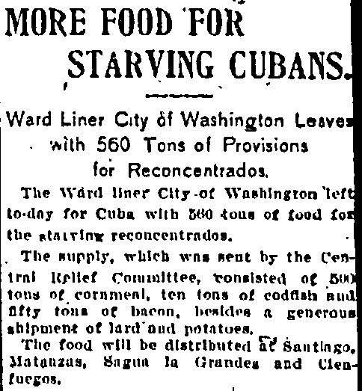
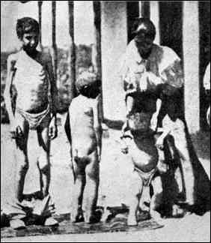
The disintegration of spanish rule in cuba
Cuban nationalist struggle against Spanish rule (1895-98)
General Valerio Weyler dispatched from Spain to quash
nationalist uprisings in Cuba.
“Butcher Weyler” soon became a hate-figure: his reconcentrado policy decried as a brutal network of concentration camps by US commentators.
Victims of Weyler's policy of re-concentration.
From: "Liberty: The Story of Cuba" by Horatio S. Rubens

Slide 7
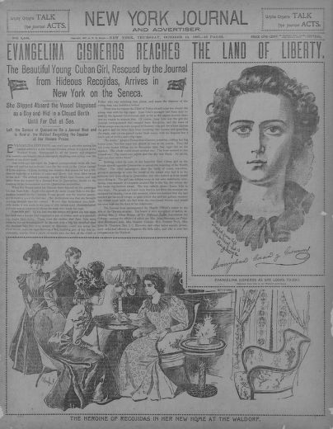
military intervention as a hUmanitarian mission or gendered rescue story
New York Journal
and Advertiser
Oct. 14, 1897

Slide 8
“We respect our mothers, our sisters and daughters. Fighting brutality against women and children is not the expression of a specific culture; it is the acceptance of our common humanity — a commitment shared by people of goodwill on every continent. … The fight against terrorism is also a fight for the rights and dignity of women.”
First lady, Laura Bush, November 2001
https://www.washingtonpost.com/blogs/post-partisan/wp/2015/11/18/so-much-for-the-west-saving-muslim-women-from-terrorism/?noredirect=on&utm_term=.476ff3e3e619
https://www.amnesty.org.uk/womens-rights-afghanistan-history

Slide 9
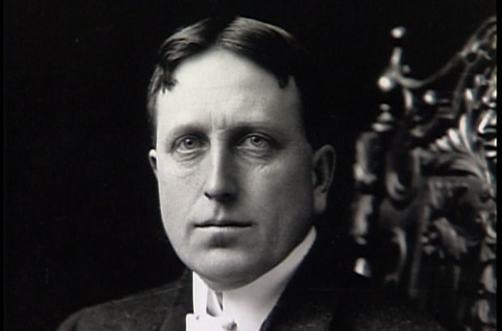
The first “Media war”?
Joseph Pulitzer
William Randolph Hearst

Slide 10
Remember the maine, to hell with spain!
Is it a Spanish act of
sabotage or an accident
that leaves the US ship
wrecked in Havana harbour?
Either way—
a casus belli.
Congress appropriates
$50m for war.

Slide 11
TR and the Rough Riders
Theodore Roosevelt and soldiers under his command
in Cuba.
TR (1858-1919)
McKinley’s assistant
Secretary of the Navy.
Popularity boosted by
the “splendid little war”
In Cuba
26th US President
1901-1909

Slide 12
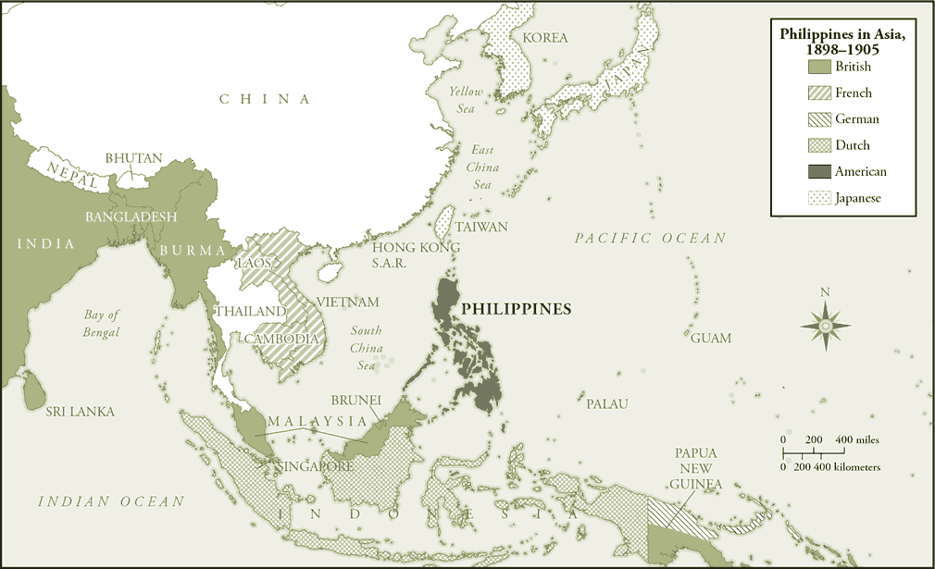
Meanwhile, across the pacific…

Slide 13
What propelled US expansion overseas?
Historians have suggested a variety of factors/explanations:
Commercial and financial interests’ search for greater profits abroad
A “crisis of overproduction”– the US needed new markets for its products overseas as inequitable distribution of wealth internally constricted domestic consumption (Walter LaFeber)
Empire as a mechanism to manage the internal pressures of an increasingly industrialized, urbanized and ethnically diverse population
“big navy” advocates successfully pressed McKinley to strengthen US sea power overseas– arguing that more coaling stations and bases would aid US commercial interests, while projecting national power
Inter-imperial rivalry. The US didn’t want to lose out in the “great game” of empire, and so acquired colonies primarily to pre-empt rivals

Slide 14
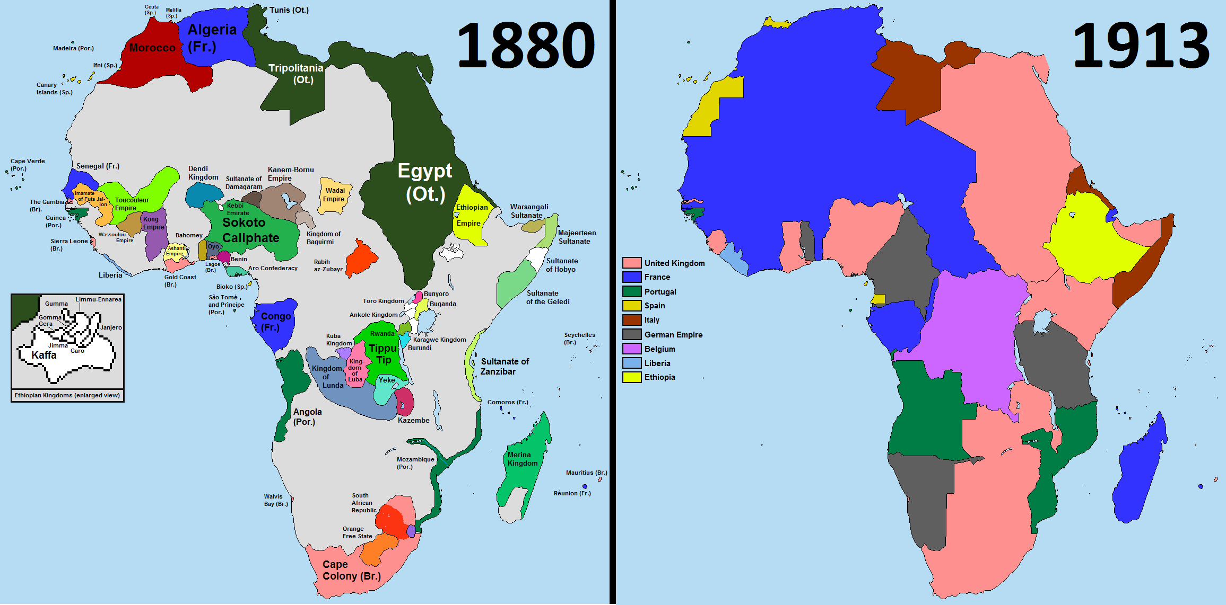
A global ‘age of empire’
European imperial power appeared to be waning in the Americas,
but ascendant elsewhere.
This trend was particularly evident in the “Scramble for Africa.”
Powerful new players-- particularly unified and rapidly industrializing Germany– were also now on the scene, competing with Britain, Russia, and the US for global predominance.

Slide 15
WhAT NEXT?
A colonial united states?

Slide 16
What next in the Philippines?
President McKinley explains the epiphany whereby he realized the US would assume colonial control over the Philippines
I thought at first we would take only Manila; then Luzon; then other islands, perhaps, also.
I walked the floor of the White House night after night… I went down on my knees and prayed Almighty God for light and guidance more than one night. And one night late it came to me this way...
That we could not give them back to Spain– that would be cowardly and dishonorable;
that we could not turn them over to France or Germany– our commercial rivals in the Orient—that would be bad business and discreditable;
that we could not leave them to themselves– they were unfit for self-government— and they would soon have anarchy and misrule over there worse than Spain’s wars; and
that there was nothing left for us to do but to take them all, and to educate the Filipinos, and uplift and Christianize them, and by God’s grace do the very best we could by them, as our fellow-men for whom Christ also died. And then I went to bed, and went to sleep and slept soundly.

Slide 17
The “white man’s burden” and imperial rationalization
TAKE up the White Man's burden -
Send forth the best ye breed -
Go bind your sons to exile
To serve your captives' need;
To wait in heavy harness
On fluttered folk and wild -
Your new-caught sullen peoples,
Half devil and half child.
Theodore Roosevelt, soon to be vice-president and then president, sent the poem to his friend, Senator Henry Cabot Lodge, commenting that it was “rather poor poetry, but good sense from the expansion point of view.”
The White Man's Burden: The United States and the Philippine Islands (McClure’s Magazine, 1899), Rudyard Kipling

Slide 18
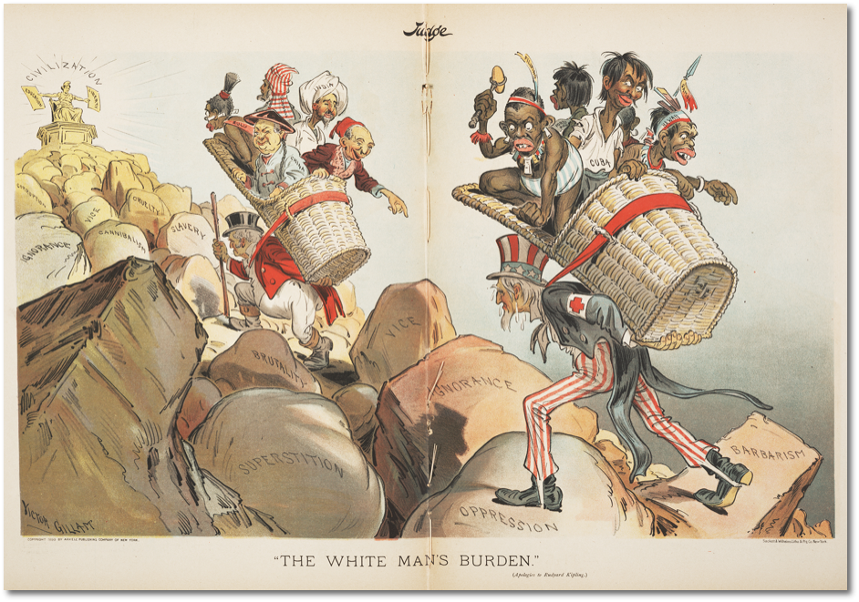
Empire as
Fool’s errand?
Artist: Victor Gillam
Source: The Ohio State University Billy Ireland Cartoon Library & Museum
“The White Man’s Burden (Apologies to Rudyard Kipling)” Judge, April 1, 1899

Slide 19
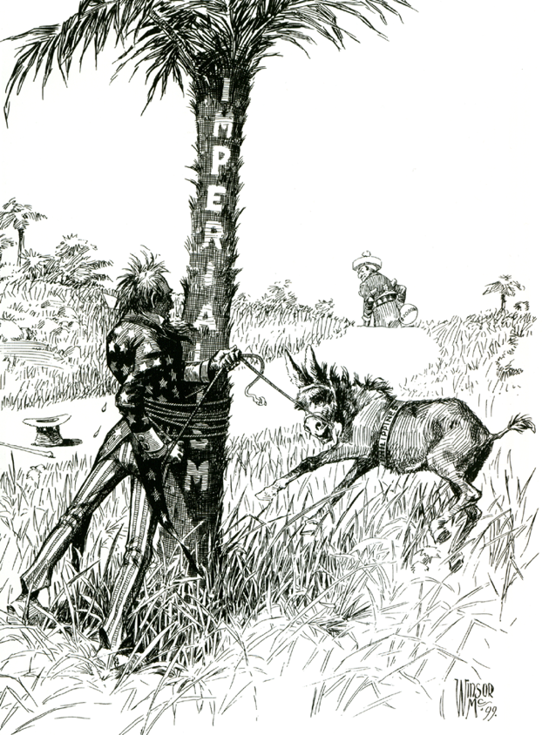
Varieties of US anti-imperialism
“progressive” anti-imperialism: empire is intrinsically exploitative—
a vehicle for the commercial interests of corporate capitalism
racially motivated anti-imperialism: turning the Philippines into a US colony
would open the door to “unfit” peoples seeking entry the US–
whether as immigrants hoping for admission and citizenship
and/or to the Philippine islands claiming US statehood
some women’s suffrage groups also opposed empire on the grounds that
Filipino men would be enfranchised while US women continued to
be denied the vote

Slide 20
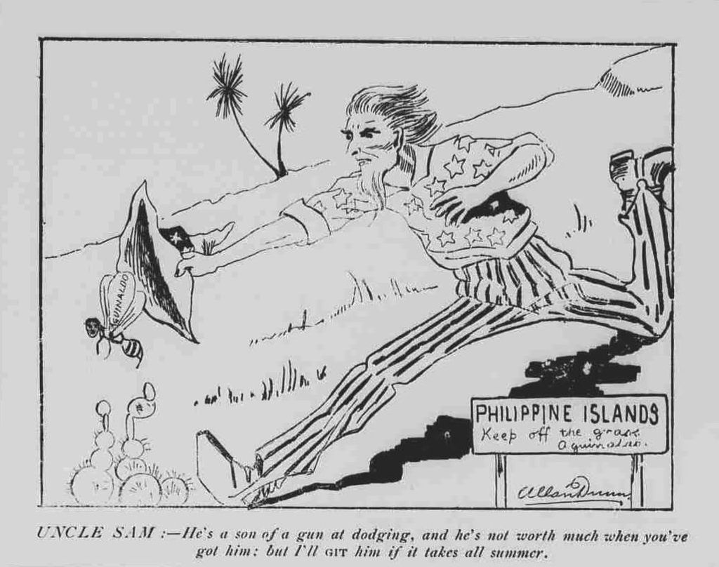
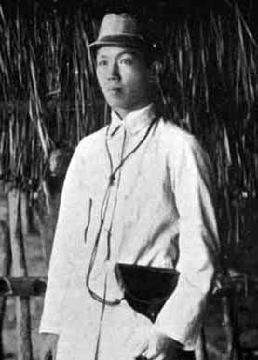
The elusive
Emilio Aguinaldo:
President of the first
Philippine Republic;
then “insurgent in chief,”
and latterly US ally
By Uncredited cartoonist for Austin's Hawaiian Weekly, September 23, 1899
http://chroniclingamerica.loc.gov/lccn/sn85047152/1899-09-23/ed-1/seq-7/ Chronicling America

Slide 21
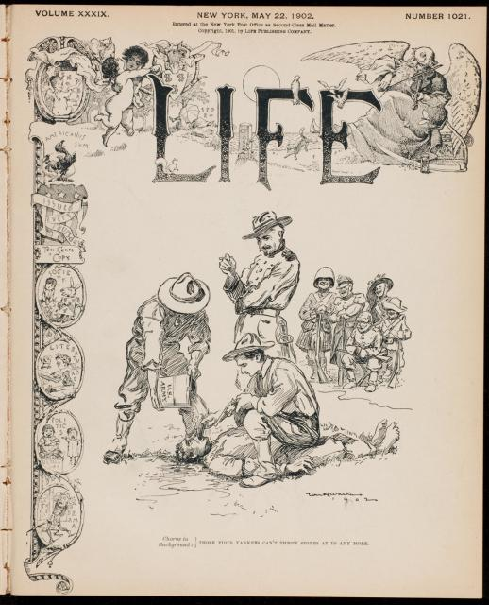
Counter-insurgency
and atrocity
A media scandal
over atrocities—
or “cruelties”--
perpetrated by US troops
and their Filipino allies.
Life magazine (cover)
May 22, 1902
Tagline reads:
“Chorus in the background:
Now those pious Yankees
Can’t throw stones at us
any more.”
http://documents.law.yale.edu/system/files/images/70_life_mag_1902_witt_9399-007.preview.jpg

Slide 22
IMPERIAL VARIEGATION
The Philippines: US colonial rule
Counter-insurgency war against Filipino nationalists-- largely, but not entirely-- ended by 1904
Very limited participation of elite Filipinos in government
US touts achievements in “uplift”: education, healthcare, sanitation etc.
US retained control over the Philippines until 1942 when Japan invaded
1946: Philippine independence granted
The US acquired other former Spanish territories, including Puerto Rico and Guam.
US interests (largely in the sugar and fruit industries) also overthrew the indigenous government
of Hawaii and declared the islands a republic, later to become a US state in 1959.

Slide 23
“Indirect” dominance
Cuba
The Platt Amendment (1901)
Set limits on Cuba’s right to negotiate treaties with– or borrow from— foreign powers
Gave US the right intervene if Cuba were threatened internally or externally
Guantanamo Bay naval base leased in perpetuity

Slide 24
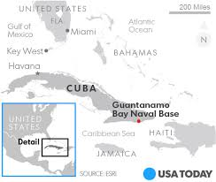
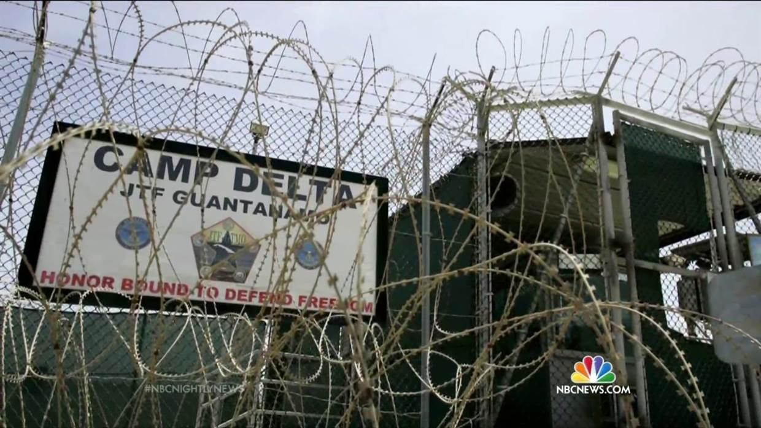
As of December 2017, there were 41 prisoners
incarcerated at Camp Delta in Cuba.
https://www.humanrightsfirst.org/sites/default/files/gtmo-by-the-numbers.pdf

Slide 25
Conclusions

