Slide 1
Empire & Aftermath The British Occupation of Egypt: Sovereign Default and Technocratic Imperialism
James E. Baldwin

Slide 2
Different forms of imperial domination
Military occupation
Direct rule
Client states
Cultural dominance: westernization
Economic dominance: peripheralization
Debt

Slide 3
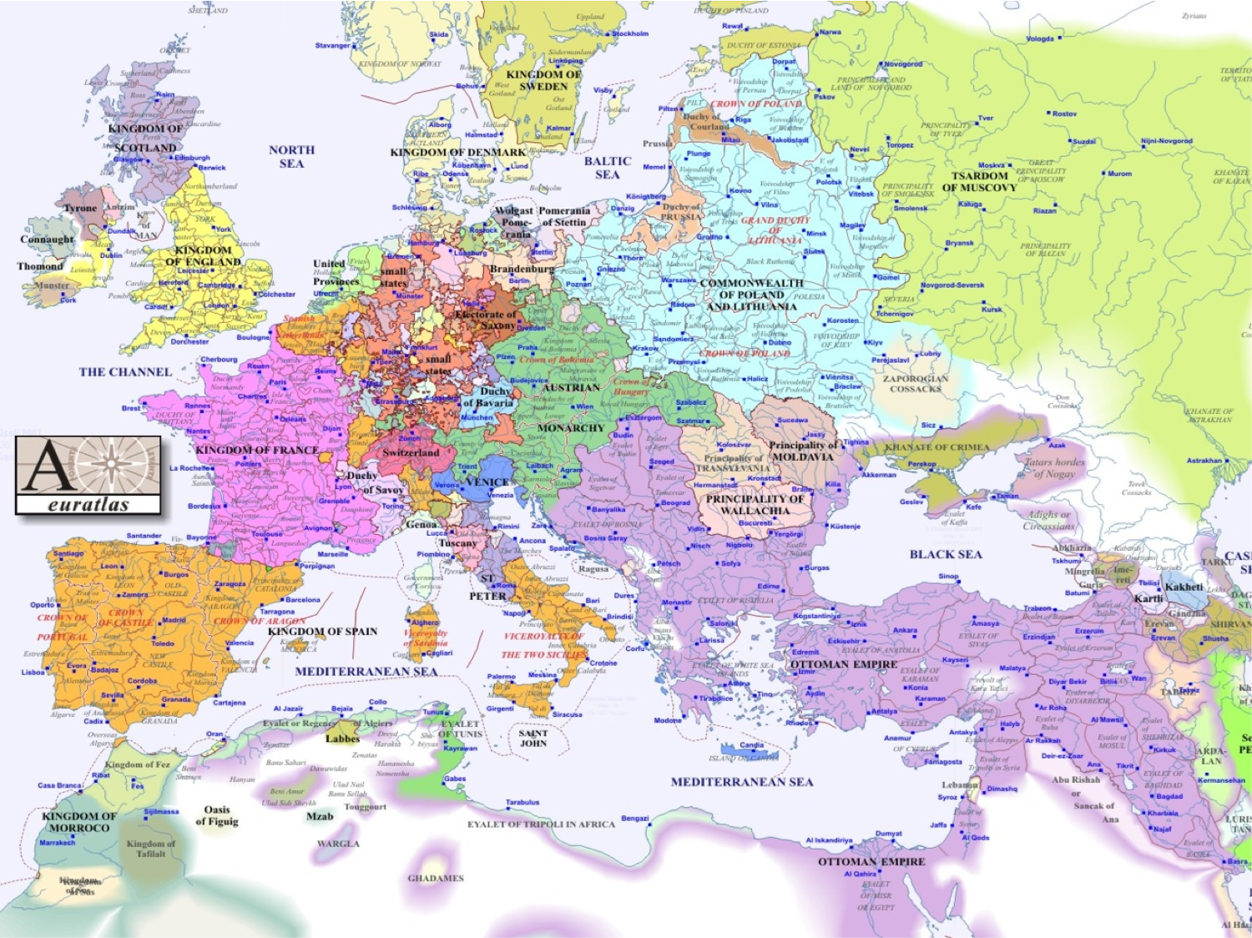

Slide 4
Egypt under Ottoman rule
Ottomans conquered Mamluk Sultanate, including Egypt, Syria and Hejaz, in 1517.
Agriculturally rich: the empire’s breadbasket.
On trade routes: coffee, spices, African slaves.
Strategic position: access to Yemen and Muslim holy cities, control of pilgrimage.
Wealthy and restive Egyptian elite often difficult to control.
France invades and occupies Egypt in 1798; Ottomans expel French in 1802 but rely on British assistance.

Slide 5
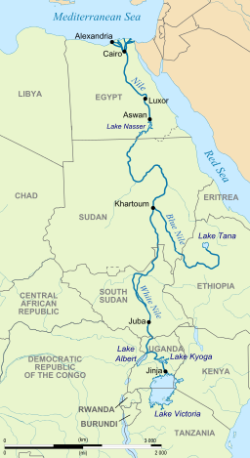

Slide 6
Egypt under Ottoman rule
Ottomans conquered Mamluk Sultanate, including Egypt, Syria and Hejaz, in 1517.
Agriculturally rich: the empire’s breadbasket.
On trade routes: coffee, spices, African slaves.
Strategic position: access to Yemen and Muslim holy cities, control of pilgrimage.
Wealthy and restive Egyptian elite often difficult to control.
France invades and occupies Egypt in 1798; Ottomans expel French in 1802 but rely on British assistance.

Slide 7
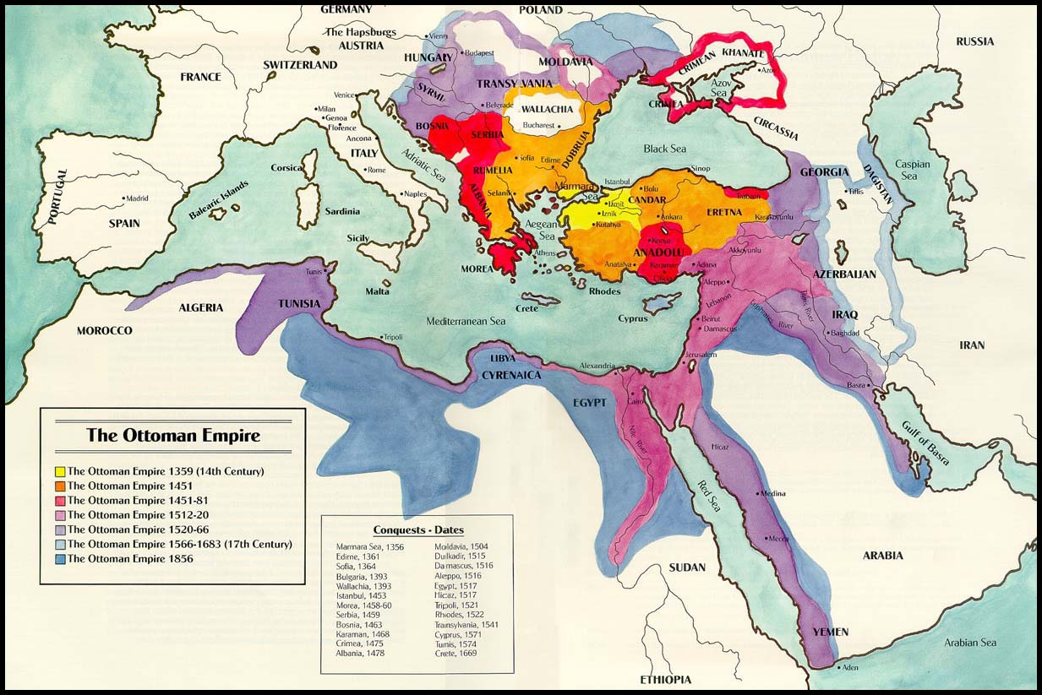

Slide 8
Egypt under Ottoman rule
Ottomans conquered Mamluk Sultanate, including Egypt, Syria and Hejaz, in 1517.
Agriculturally rich: the empire’s breadbasket.
On trade routes: coffee, spices, African slaves.
Strategic position: access to Yemen and Muslim holy cities, control of pilgrimage.
Wealthy and restive Egyptian elite often difficult to control.
France invades and occupies Egypt in 1798; Ottomans expel French in 1802 but rely on British assistance.

Slide 9
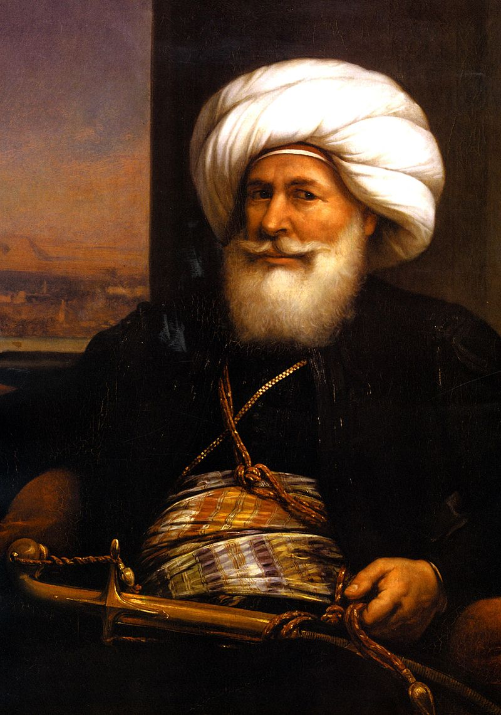
Mehmed Ali
Ottoman-Albanian military commander.
Took part in Ottoman campaign against French in Egypt.
Appointed governor of Egypt in 1805.
Modernizes Egyptian government, creates reformed army, increases revenues.

Slide 10
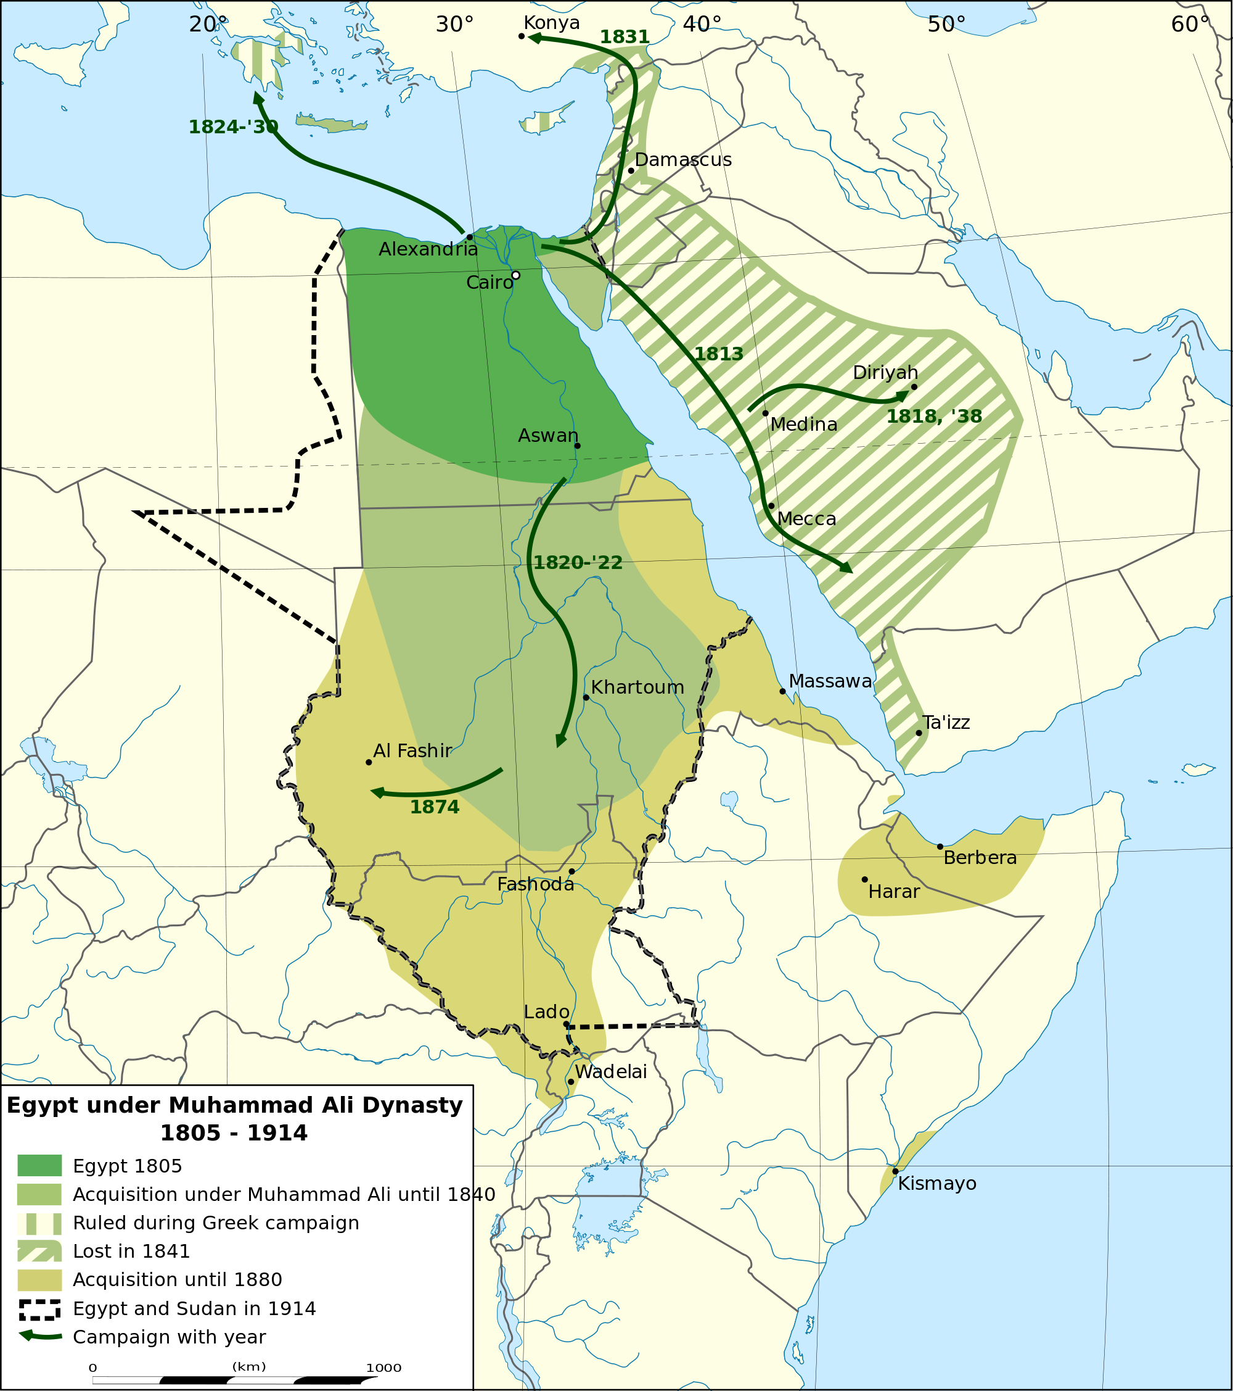

Slide 11
Reforms of Mehmed Ali and his descendants
Modernized, conscription-based army.
Centralized government: modern bureaucracy in Cairo.
New hospitals and medical schools using modern western medicine.
Law reform: hybrid Islamic/French legal system.
Transformation of agriculture, prioritization of cash export crops cotton and sugar.
New city centers in Cairo and Alexandria with modern amenities and Parisian architecture.
Infrastructure: improved irrigation, paved roads, bridges, railway, telegraph, Suez canal.

Slide 12
Egyptian government borrowing
Khedive Saʿid Pasha begins borrowing from foreign lenders on his own account in late 1850s.
First Egyptian government bond issued in 1862.
Several more bonds issued in 1860s, listed on Paris and London stock exchanges.
Real interest rates high: between 7.5% and 10%.
Domestic borrowing: landowners given discount for paying several years’ taxes in advance.
Credit crunch in 1875, after Ottoman government defaults.

Slide 13
International financial control
Egypt defaults in 1876 and is pressured by creditors into accepting significant external interference in financial affairs.
Caisse de la dette publique: British, French, Italian, Austrian and Russian directors.
Managed specific revenue streams, collecting taxes and directing them to bond repayments.
Egyptian government needed permission of Caisse to spend remaining revenue.
Briton appointed Minister of Finance and Frenchman appointed Minister of Public Works.
Ottomans depose Ismail Pasha in favor of his more compliant son Tawfiq Pasha.

Slide 14
British occupation
Nationalist revolt against government of Tawfiq Pasha in 1882, led by army officer Ahmed ‘Urabi.
Britain invades and occupies Egypt in order to restore Tawfiq Pasha and protect European communities; ‘Urabi exiled.
Occupation problematic within European diplomacy: principle of Ottoman territorial sovereignty was championed by Britain.
Egypt not formally annexed until 1914; before this power wielded by British consul-general, backed by occupying army.

Slide 15
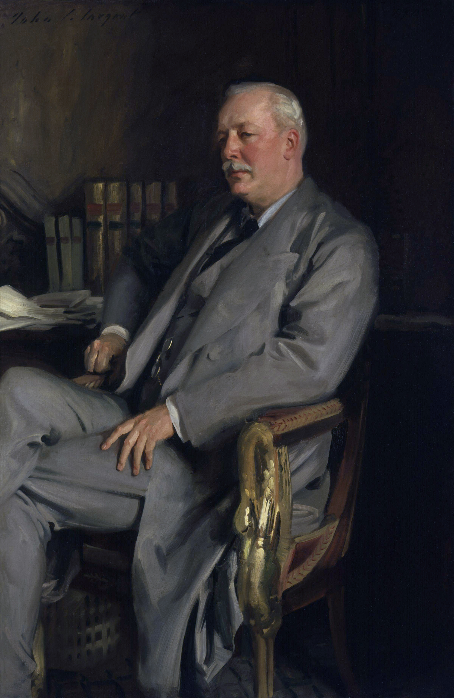
Lord Cromer

Slide 16
Lord Cromer
Evelyn Baring, 1st Earl of Cromer, member of the Baring banking dynasty
Educated at Royal Military Academy, served in army in Corfu and Malta
Private secretary to the viceroy in India, 1872-76; Indian experience forms his attitude to British imperial rule
No sympathy for local autonomy or for educational development; believed firm rule by benevolent British ruling class was best for Britain and for colonies
Served in Egypt as Controller-General of Finance Ministry 1879-80
Returns to Egypt in 1883 to become consul-general, serves until 1906

Slide 17
British policy in Egypt
Focus on fiscal reform and infrastructural development
Cromer increases revenues and halves the proportion of revenue spent on debt servicing during his tenure
Improvements to irrigation such as Nile barrage at Cairo and Aswan dam greatly increase agricultural yields
Benefits flow primarily to large landowners
Egyptian economy friendly to foreign capital
Banks and large industrial companies have large foreign shareholdings; again benefits from economic development unequally distributed

