Slide 1
Postcolonial India – I: 1947-1977

Slide 2
Colonial Inheritances/The Burdens of the Postcolonial State
Political and administrative integration: one nation, two or many? Partition: violence and troubled borders. Nation-building posing a set of problems which endure.
Form to be adopted by the new nation-states of South Asia, in the context of the postwar global order: capitalist or socialist?
Generalized social and political crisis at the time of Independence.

Slide 3
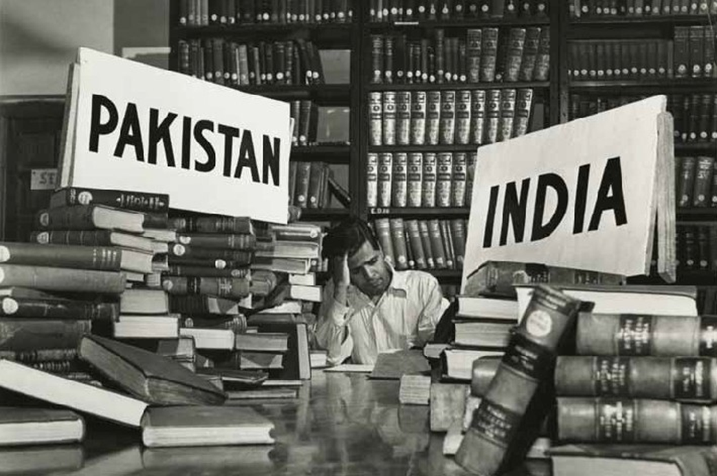
Partition

Slide 4
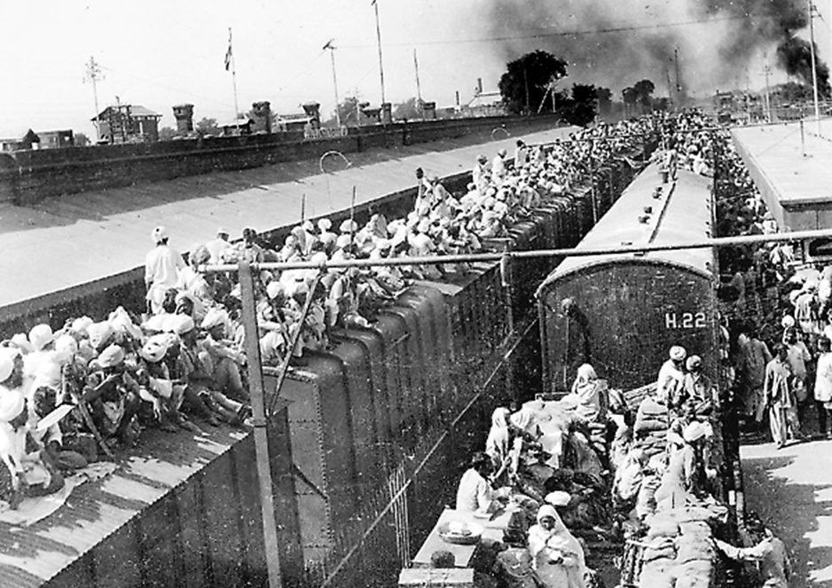
Partition: refugee exodus

Slide 5
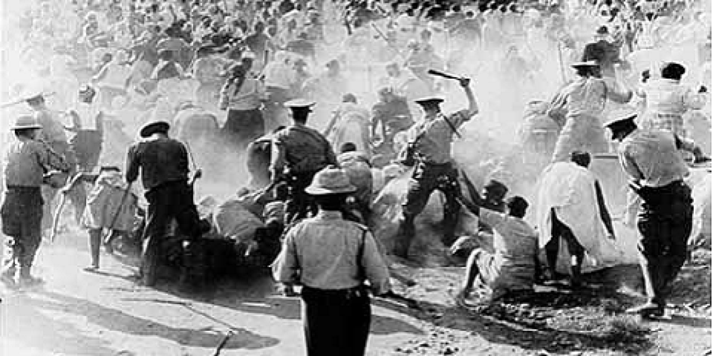
The late 1940s in India

Slide 6
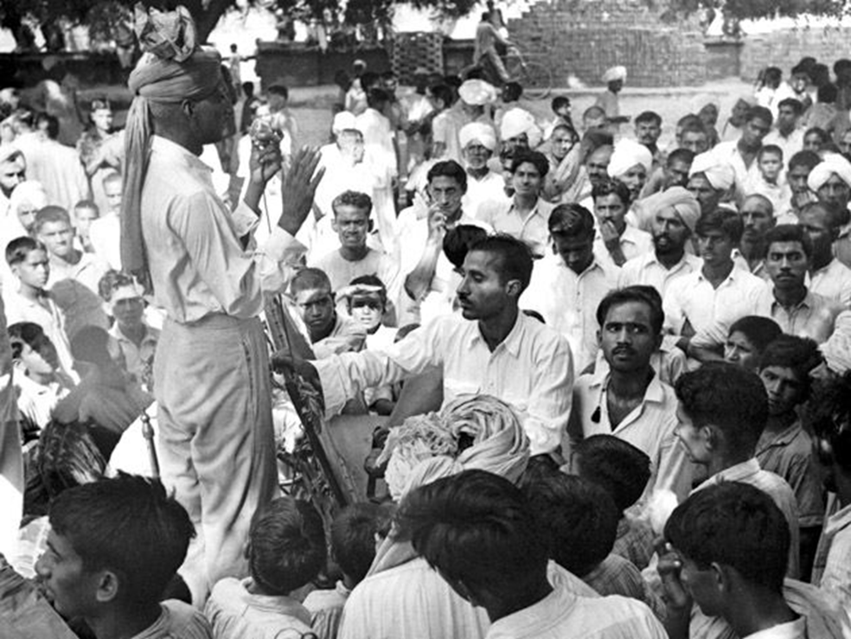
The first general elections, 1951

Slide 7
The Nehru era, 1947-1964
Strong emphasis placed on ‘socialism’ in the rhetoric of the new Indian state.
In practice: a state-led developmental capitalism.
Complicated by the social alliances the state rested on: enduring power of rural elites.
Politics: Congress governments, till 1970s, confronting an ‘empty right’ and an ‘overpopulated left’
Foreign policy: non-alignment; peaceful coexistence; ‘progressive’ and independent stances on world affairs. Crisis of China war (1962).

Slide 8
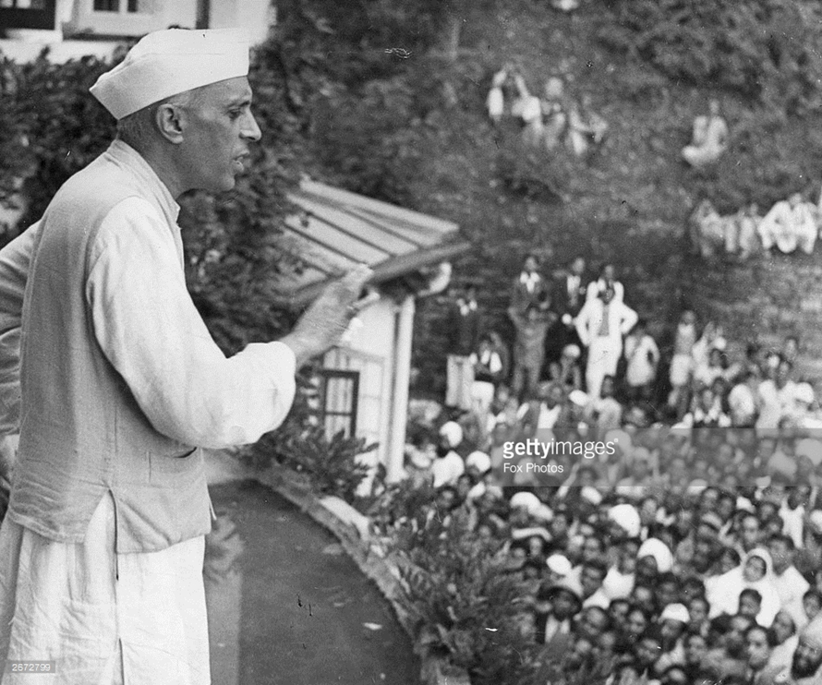
Nehru

Slide 9
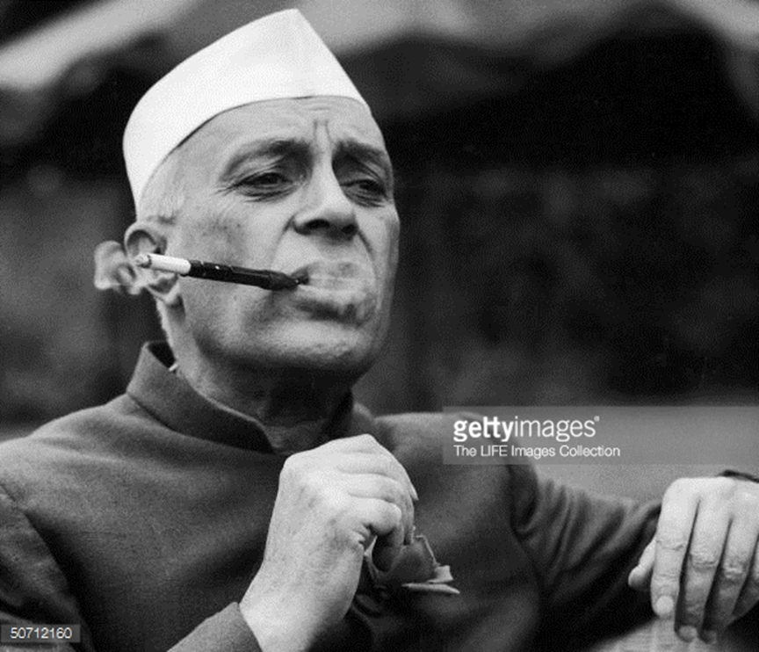

Slide 10
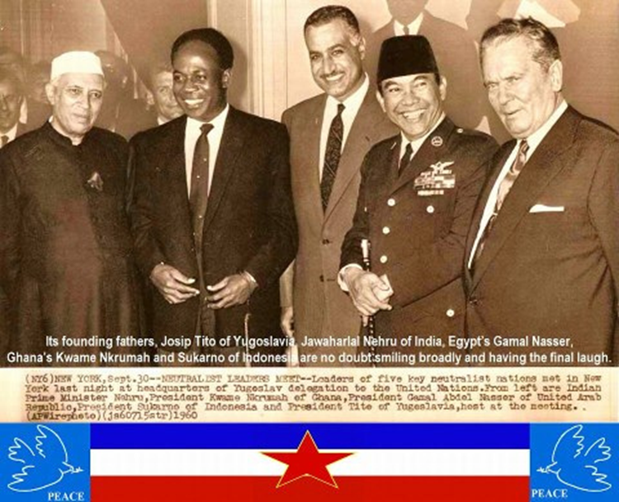
Non-Aligned Movement

Slide 11
Crisis: The Indira Gandhi Years (1966-1977)
Personalized, authoritarian, populist style of rule emerging
Initial ‘left’ push: bank nationalization, etc.
Instability despite large electoral majorities: a) external shocks (economic crises, Bangladesh war), b) internal crises: broad popular movements against Indira Gandhi, labour unrest
Proclamation of Emergency (1975-77): first and to date only suspension of democracy in postcolonial Indian history.

Slide 12
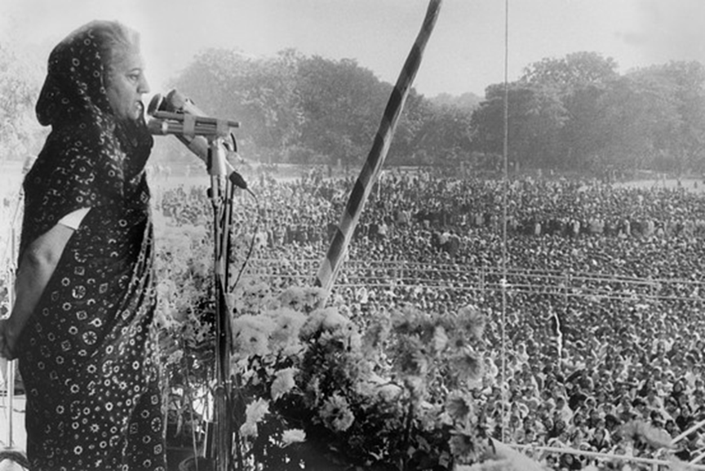
Indira Gandhi addressing a rally

Slide 13
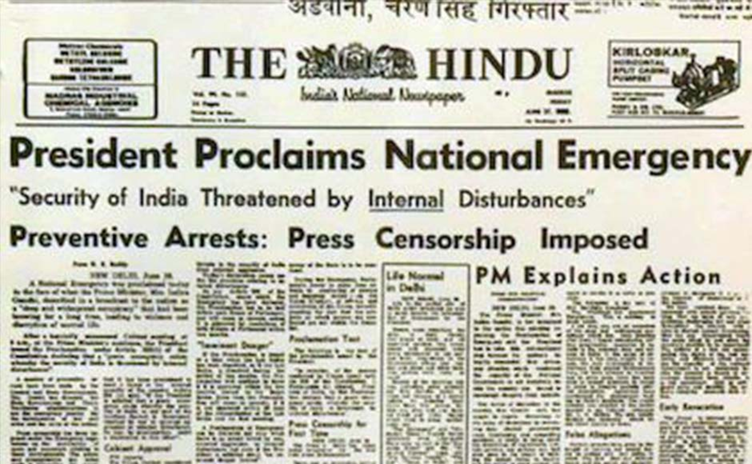
The Emergency (1975-77)

Slide 14
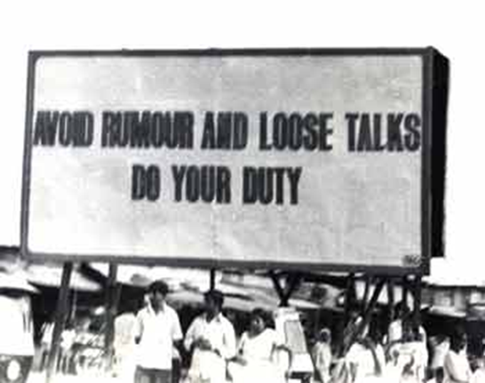
The Emergency: the state instructs its citizens

Slide 15
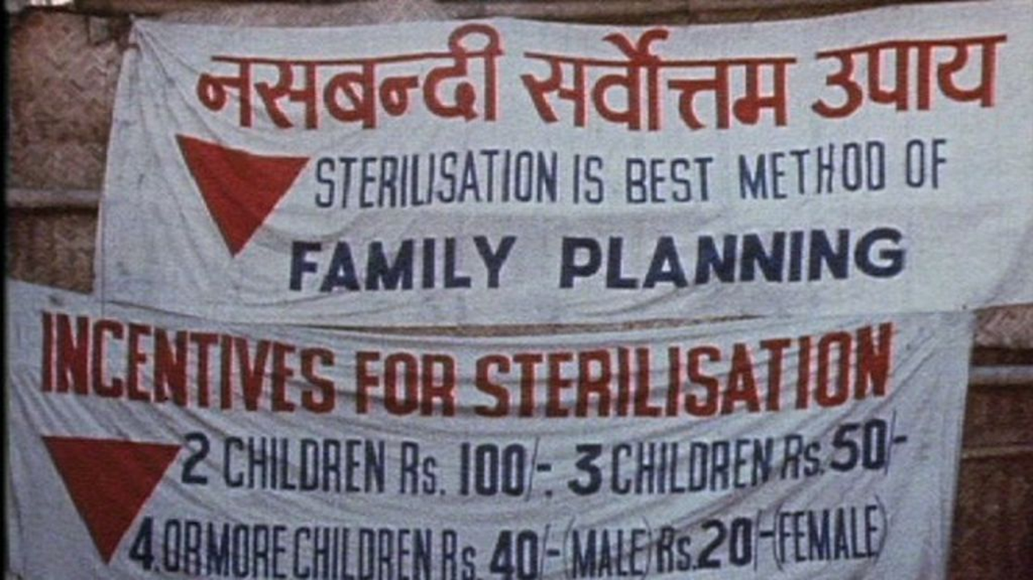
The Emergency: the state sterilizes its citizens

Slide 16
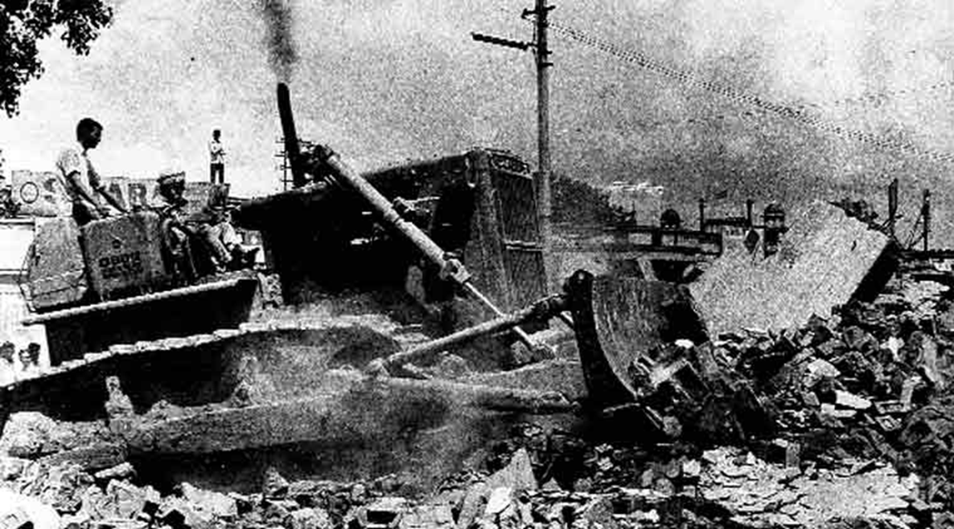
The Emergency: the state evicts its citizens

Slide 17
Recap: independent India till 1977
Single-party rule: till 1977, Congress under Nehru and Indira Gandhi utterly dominant
‘Nehruvian socialism’: state-led capitalist growth; strong presence of organized labour and Left; non-alignment; friendly relations with USSR, less so with USA
Secularism: commitment to non-discrimination on religious lines a key claim of the state
1977 onwards: significant shifts on all these fronts

Slide 18
Key shifts: 1977 - present
Deepening of democracy
At the same time, narrowing/hollowing-out of democratic institutions. Democracy perceived to be in permanent crisis.
Economic reversals: ‘liberalization’ and ‘globalization’ of economy
India and the world: reversal of key doctrines and stances

Slide 19
1. The ‘deepening’ of democracy
Multi-party democracy effectively comes into being by end of 1970s: Congress no longer as secure.
Beneath this: assertion of rising peasant groups and claims to political power. Manifested in regional political parties.
Rise of lower-caste politics: Dalits and OBCs (Other Backward Classes/Castes)
Citizens’ movements; human rights groups. Mass social movements and ‘civil society’.

Slide 20
2. At the same time: crises of democracy?
Growth of systematic political violence; money and muscle-power in elections; political elites repeatedly revealed as corrupt and venal
Rise of communalism (organized hatred and conflict between religious communities): most significantly, massive growth of Hindu Right. Communal riots becoming a major feature. Rise of BJP: secularism in crisis
Multiple and large-scale human rights violations

Slide 21
2. At the same time: crises of democracy?
Growth of systematic political violence; money and muscle-power in elections; political elites repeatedly revealed as corrupt and venal
Rise of communalism (organized hatred and conflict between religious communities): most significantly, massive growth of Hindu Right. Communal riots becoming a major feature. Rise of BJP: secularism in crisis
Multiple and large-scale human rights violations

Slide 22
3. Economic transformations
Since 1991: New Economic Policy – ‘liberalization’ and ‘neoliberalism’: ascendancy of private capital
Earlier consensus on state-led industrialization, planning, strong public sector reversed. Liberalization of import-export policies, currency, capital flows, trade, labour markets.
Similarities and differences with the collapse of both welfare capitalism (Western Europe, US) and state socialism (USSR, Eastern Europe, China, Vietnam)
Alongside economic growth, sharp rise of economic inequality. Persistence of mass poverty; sharp social conflicts.

Slide 23
4. India and the world
End of ‘non-alignment’ after end of Cold War: new closeness to US and Israel
Militarism and emphasis on militarized conceptions of national security
1998 nuclear tests: India’s role in triggering South Asian nuclear arms race
Sharpening conflicts on India’s borders: Kashmir and North-East; rise of terrorism, insurgency and counter-insurgency

