Slide 1
Imperialism & Empire
Empire & Aftermath
October 2016

Slide 2
Empires in History
Large territories that control millions of people, and have common internal characteristics: management of diverse peoples to exploit resources; communication and transport systems organised to serve the priorities of the imperial centre (metropolis); an imperial project that imposed unity throughout the system (Barbara Bush)
Empire was/is about power through territorial expansion, for material gains and to secure hegemony over vast, subordinated areas
Empires tend to justify and legitimise themselves through ideology
Long history of Empires in recorded history, e.g. Roman Empire; Byzantine Empire; Islamic Caliphates; Mongol Empire; Mughal Empire of North India; Ottoman Empire; Chinese Empire
Rise of modern European empires after 1492. How and why?

Slide 3
Lecture Structure
Historical overview of European/Western Imperialism
Economics
Political & Strategic
Nationalism
Ideology & Culture
Decolonisation
Conclusion: The Aftermath of Empire
Afterword: Post-colonialism

Slide 4
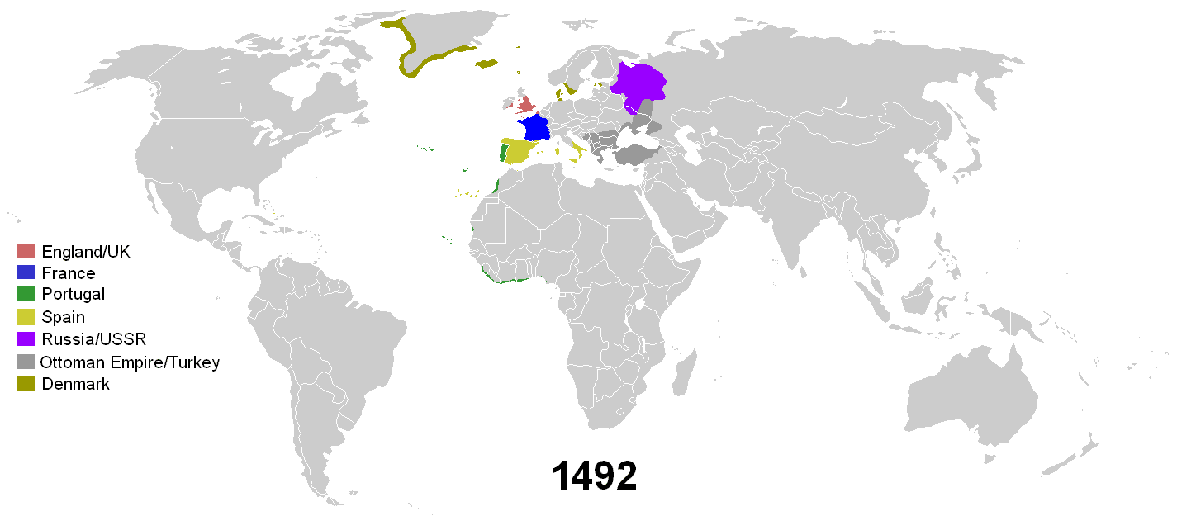

Slide 5
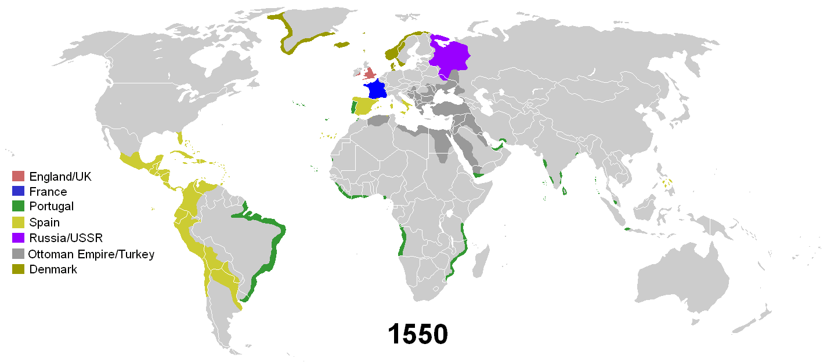

Slide 6
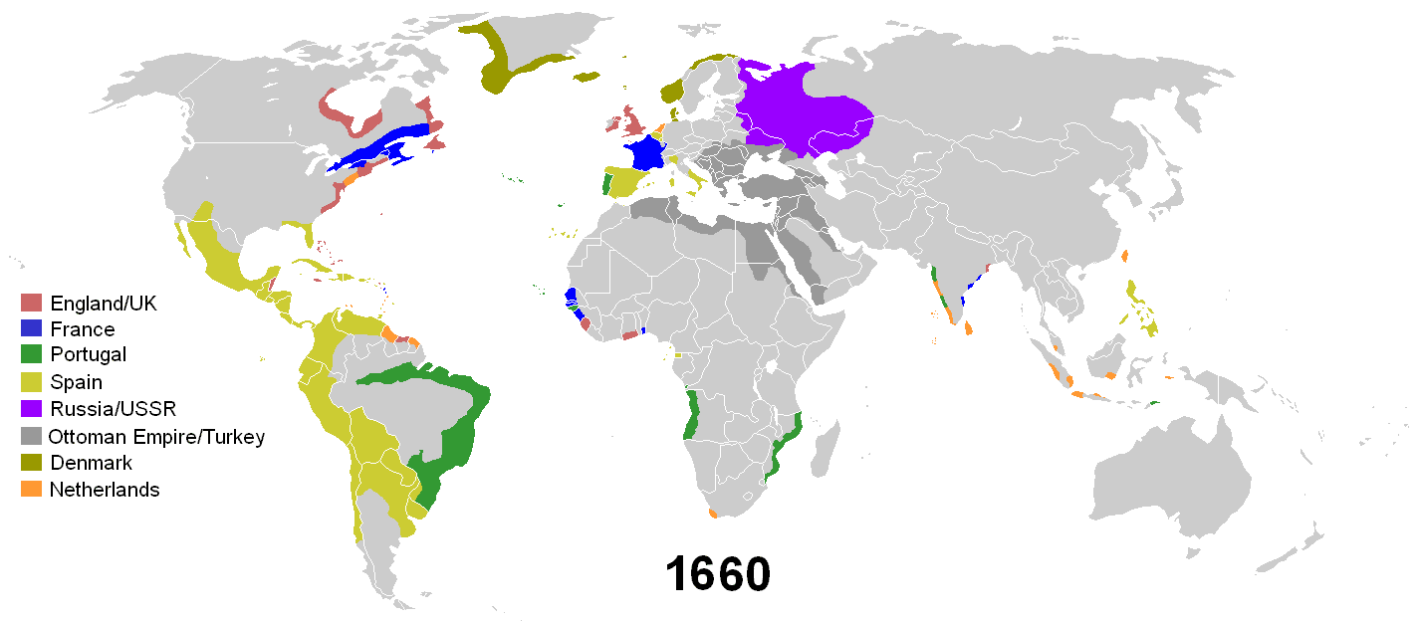

Slide 7
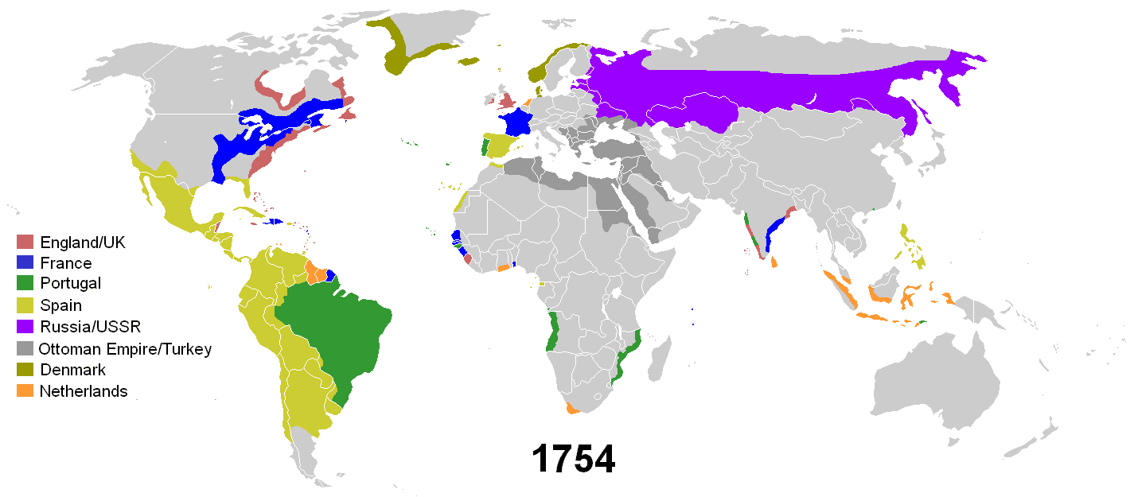

Slide 8
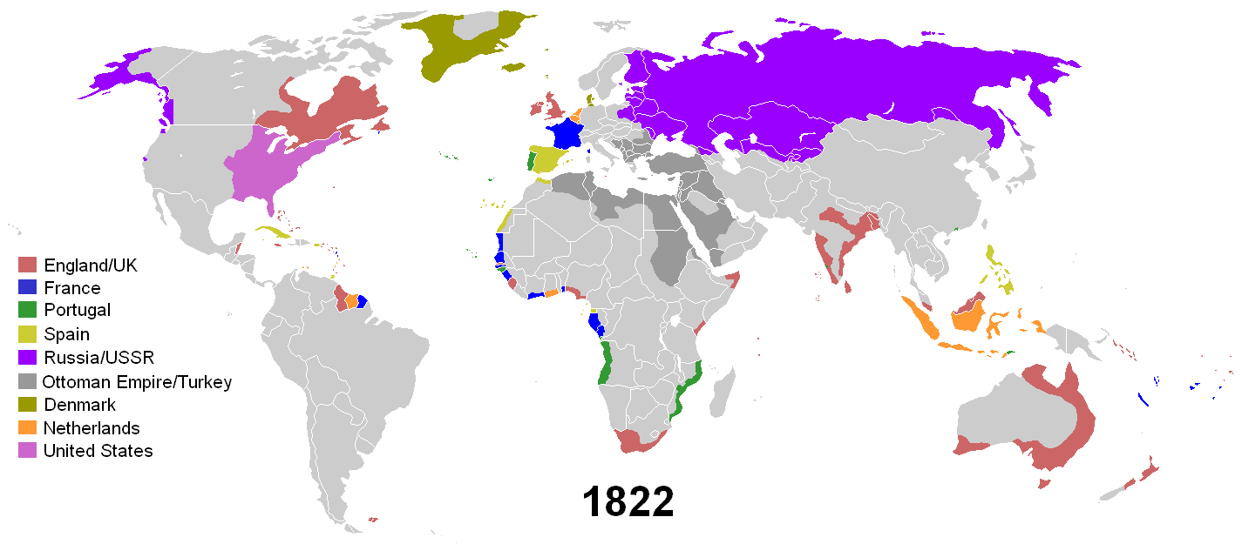

Slide 9
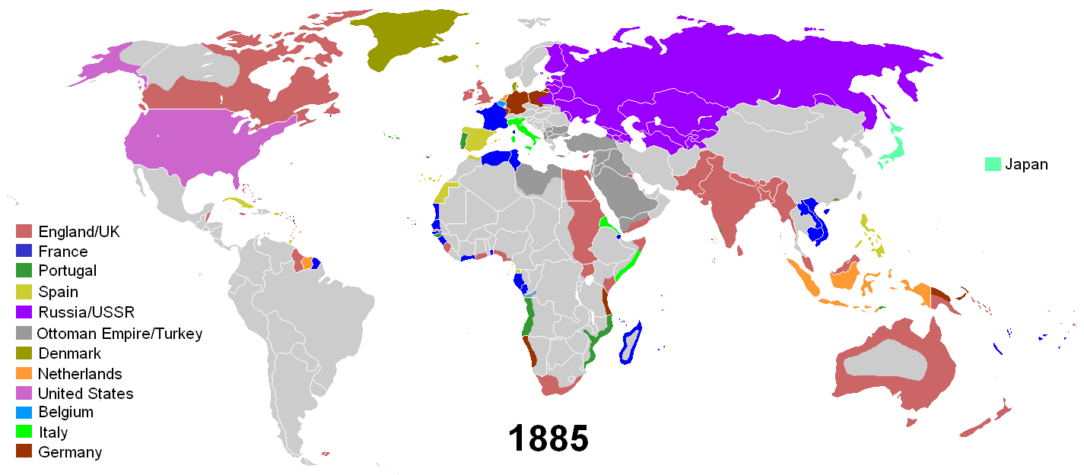

Slide 10
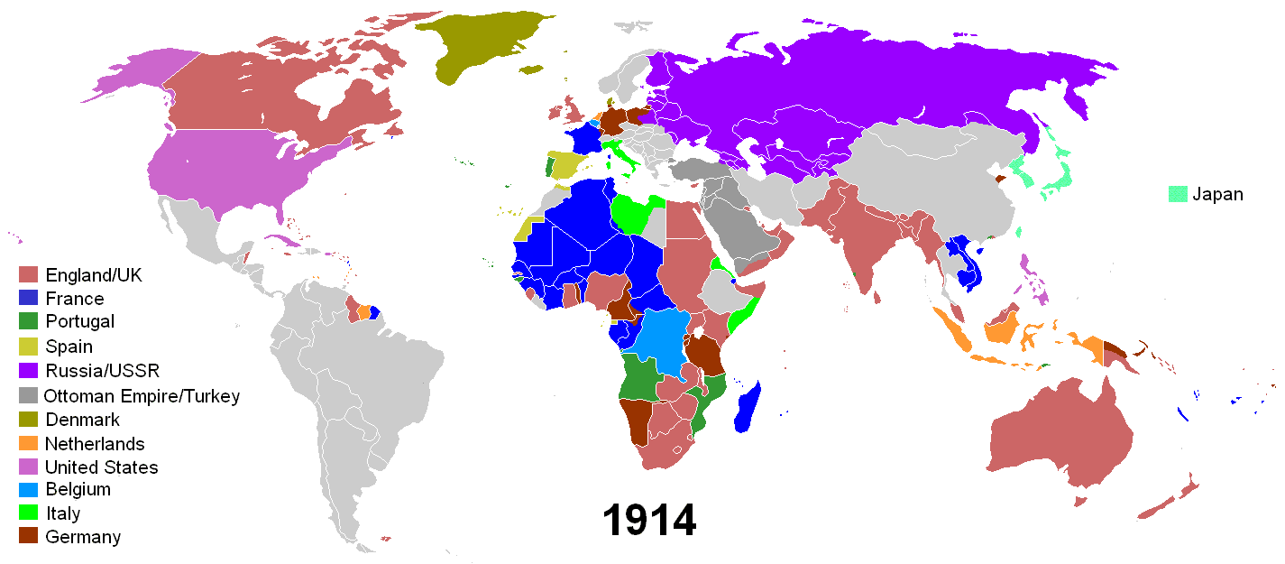

Slide 11
Economics
Industrialisation and technical development in the West produced an insatiable demand for raw materials: Oil, Rubber, Timber, Cotton, Minerals, Metals, etc.
Mass consumption at home produced expanding market for foodstuffs produced across the globe: Sugar, Tea, Coffee, Cocoa, Fruits, Grain, Meat, etc.
Transformation of non-Western world into complex of colonial and semi-colonial territories. Many evolved into specialised producers of products for export: Malaya (rubber); Brazil (coffee); Chile (nitrates); Uruguay (meat); Cuba (cigars)
Rise of more globalised economy - dense web of transactions, communications, movements, activity
Competition between imperial powers: resources, markets, power.
‘I have yet to find a plausible explanation of modern imperialism (1880 to c.1960s) which convinces me that economics was not the prime motive’. Barbara Bush, Imperialism & Postcolonialism (Harlow, 2006), p.21.

Slide 12
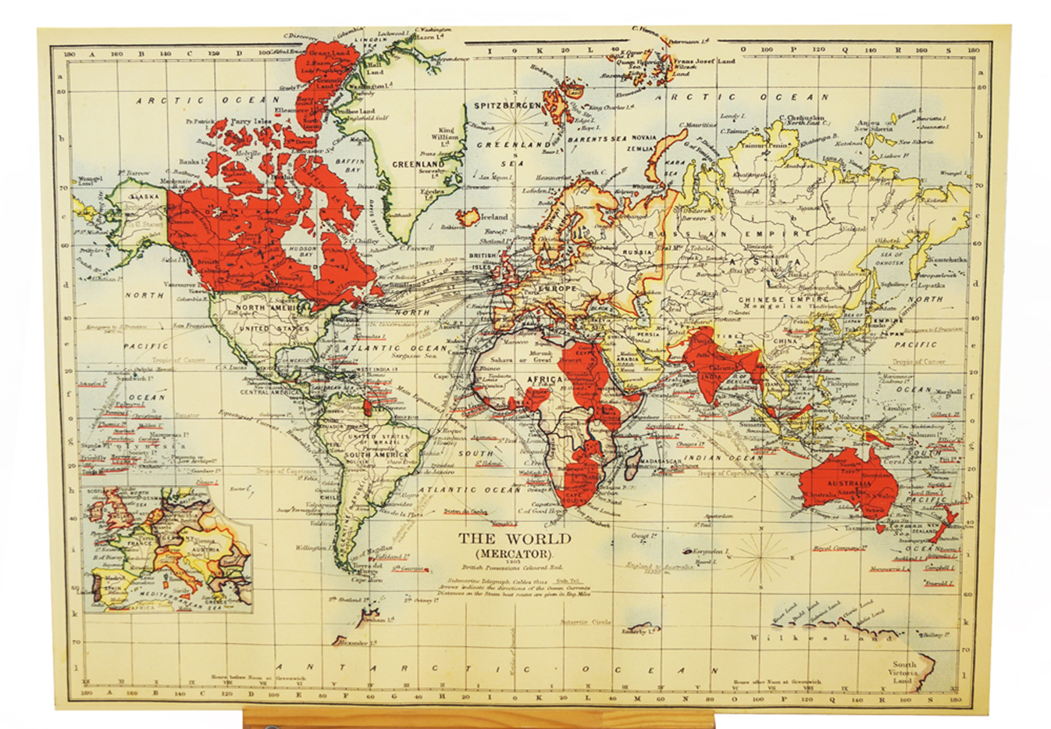
Map of British Empire, 1903: British colonies coloured red

Slide 13
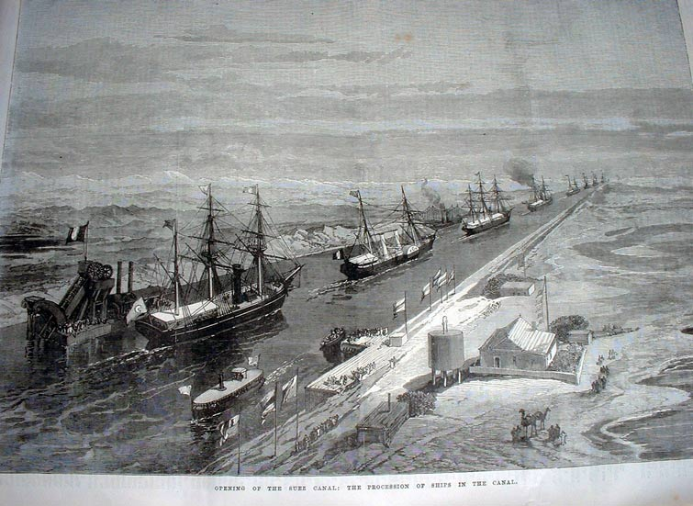
Political & Strategic motives
Should not separate economic motives from politics and strategic considerations.
Strategic element to spread of imperialism: Britain, India, Suez Canal
Political importance of owning colonies
Symbolic value of imperialism

Slide 14
Nationalism
Imperialism closely related to rise of nationalism in 19th century: the belief or political ideology that involves an individual identifying with or becoming attached to one's nation
Linked with industrialisation, urbanisation, growing power of state to project power overseas.
Nationalism and conflict within Europe made European states more aware of their competitors abroad, more inclined to stake out their claim.
Nationalism reinforced competition between imperial powers, e.g. Scramble for Africa.
Social Imperialism
Responding to anti-colonial nationalism: more interventionist?

Slide 15
Ideology & Culture
All empires justified and legitimised themselves through ideology - spreading a superior civilisation and promoting order over disorder. Modern European empires depicted themselves as benevolent, humanitarian, morally righteous.
Civilising Mission: colonial subjects depicted as childlike, uncivilised, backwards, weak. Perceived material and moral superiority of European/Western civilisation. Firm belief in the irreconcilable difference or ‘otherness’ of subordinated people.
Imperial racism elaborated over 19th century – connected to new ideas about scientific racism and Social Darwinism.
‘Racism is the psychology of imperialism, the spirit of empire, because racism supplies the element that makes for the righteousness of empire. Hence racism is not simply a by-product of empire but... part of the intestines of empire.’ J.N. Pieterse, Empire and Emancipation; Power and Liberation on a World Scale (London, 1990), p.223.
Cultural logic of imperialism: view of non-Western world as genetically inferior. System of categorisation in which certain races, societies, cultures perceived as weak, primitive, barbaric, undeveloped.
Imperialism as much cultural/ideological as political/economic.

Slide 16
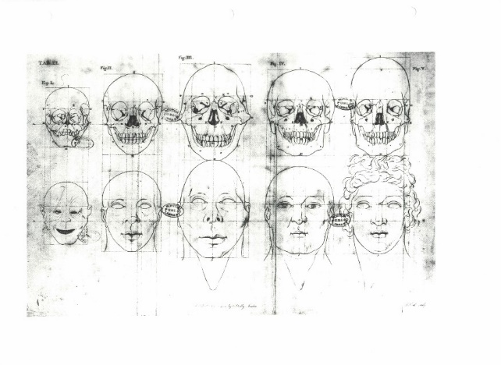
Petrus Campus, Dutch anatomist, created this illustration of ‘facial angles’ in the late 18th century.

Slide 18
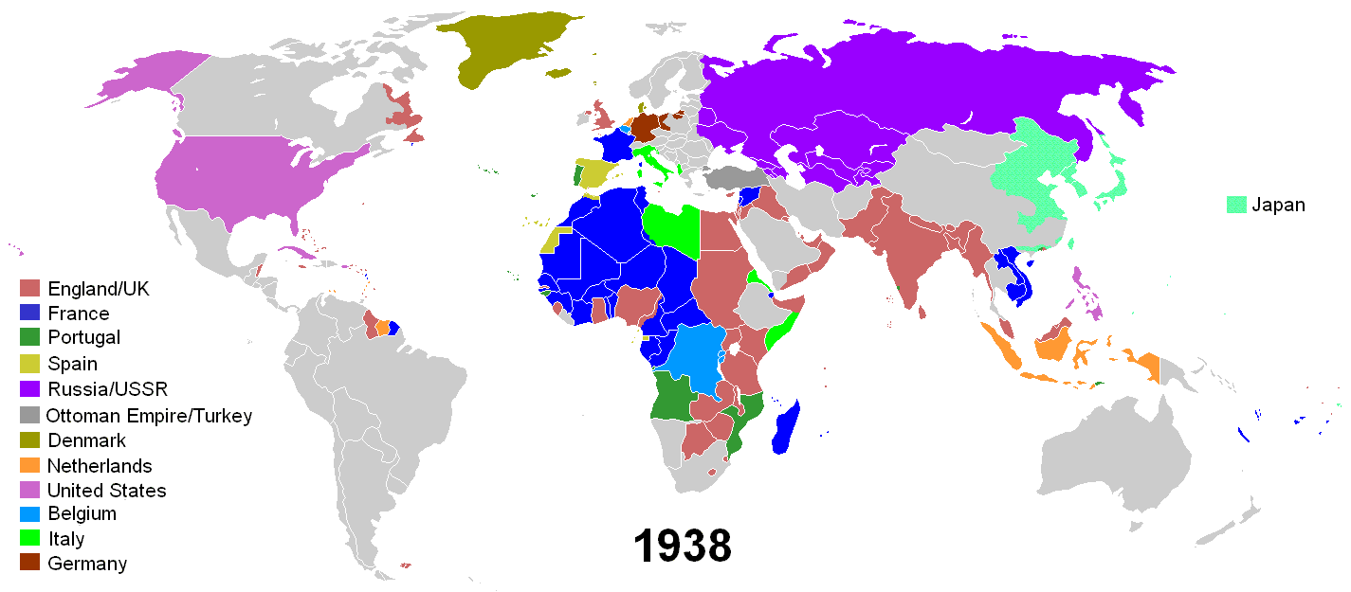

Slide 19
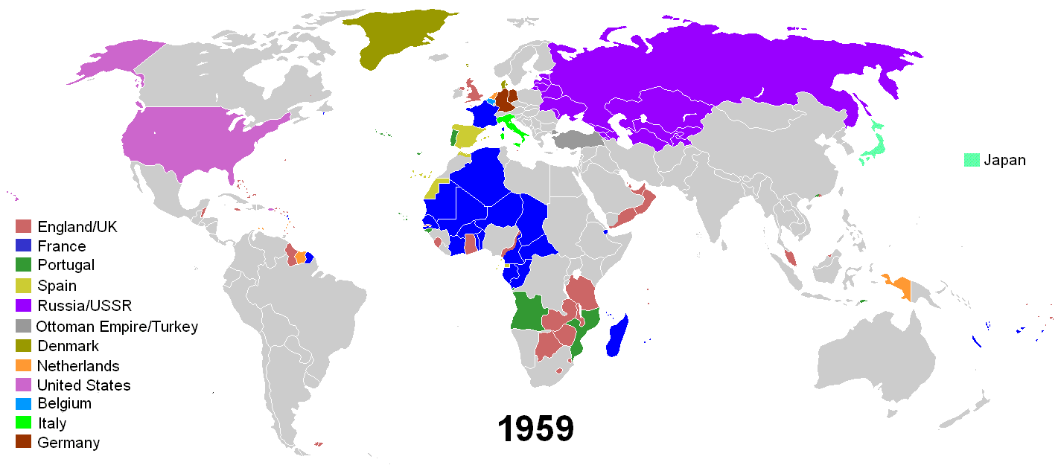

Slide 20
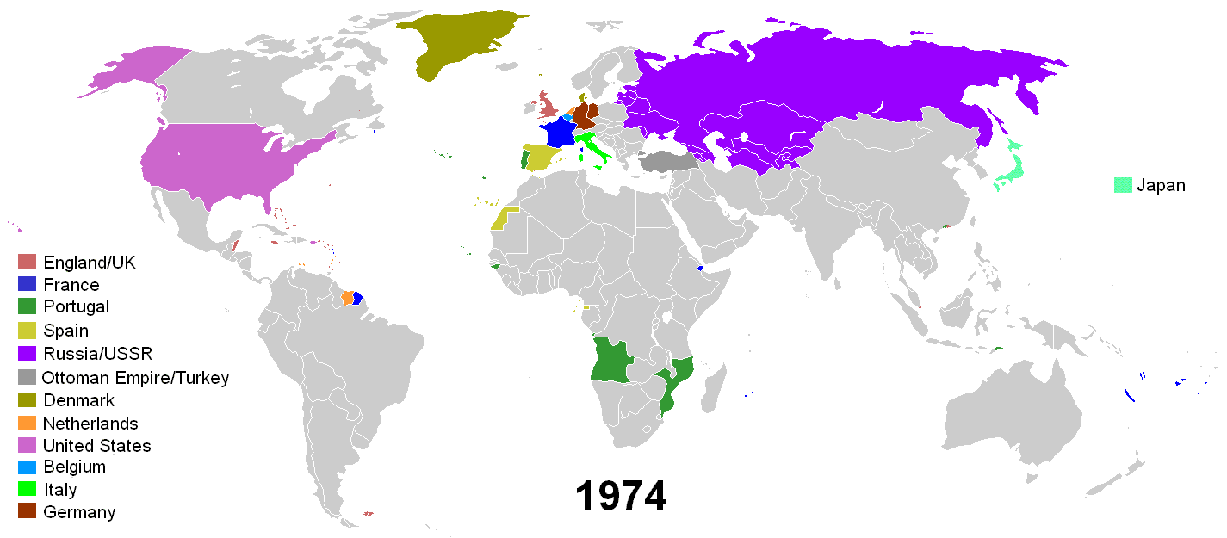

Slide 21
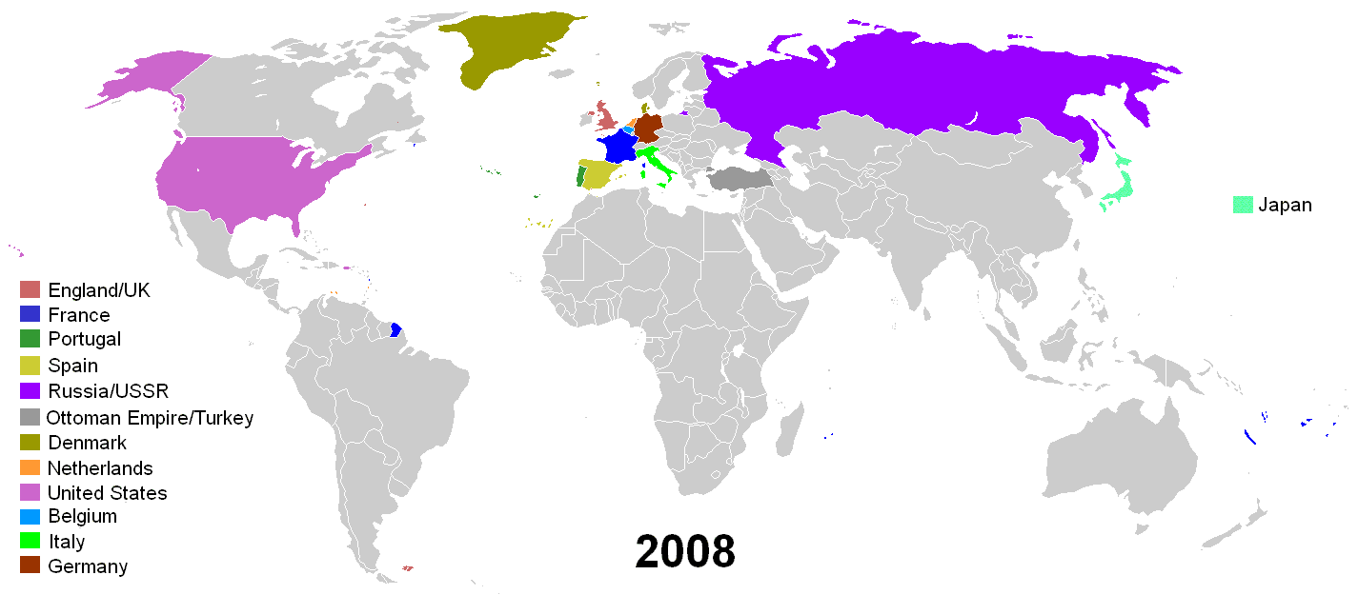

Slide 22
Conclusion: The Aftermath of Empire
World Wars and Great Depression shook structures of world imperialism in first half of twentieth century
Age of Empire formally over by the end of the 1960s. But what is the 'aftermath'?
Rise of newly independent ‘Third World’ after 1960s: changed composition of UN, lobbied for greater opportunities and participation. But have forms of manipulation and exploitation continued in new forms and under new names?
Neo-colonialism: global capitalism; widening inequality; global media; rise of MNCs
Accelerating pace of globalisation - force for good, or new form of imperialism?
Echoes and legacies of Empire at home?

Slide 23
Afterword: Postcolonialism
Academic discipline: set of intellectual methods that analyse, explain, respond to cultural legacies of colonialism and imperialism
The study of the effects of colonialism on cultures and societies. Postcolonial theory does not presume the end of colonialism, ‘post’ never just means ‘after’
Cross-disciplinary: draws from across the humanities and social sciences
Critical purpose is to account for, and combat the residual effects (social, political, cultural) of colonialism upon the peoples once ruled by the Mother Country
Politics of knowledge: addresses and analyses the politics of knowledge (how ideas are created, used and disseminated) of colonialism and neo-colonialism – how and why imperial regimes represented colonisers and colonised subjects
Postcolonialism usually conceptualised as a political, ethical and literary theory, anti-colonial in character

