Slide 1
Empire & Aftermath
The Ottoman Empire in the Nineteenth and Twentieth Centuries

Slide 2
What is an empire?
The term “empire” has little analytical clarity.
European colonial empires are our paradigm, but we apply the term to other states that were very different.
The names the Ottomans used to describe themselves:
Devlet-i ‘Aliyye (Sublime State)
Memalik-i Mahruse (Well-Protected Domains)
Devlet-i Ebed-muddet (Eternal State)

Slide 3
What were the features of the Ottoman Empire?
Land-based, with mostly contiguous territory.
Multiethnic and multilingual.
Religious diversity.
Complex political arrangements.
Other examples: Tsarist Russia, Qing China, Mughal India, Habsburg Monarchy.

Slide 4
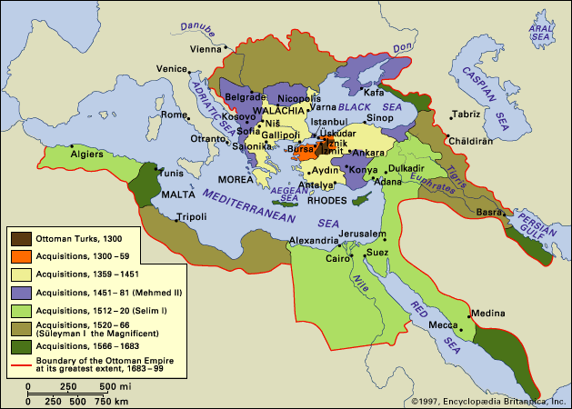

Slide 5
How did it differ from European colonial empires?
Lacked clear metropole / colony distinction.
Race not as important, and no binary racial division (as in white / non-white in the European empires).
Muslims were privileged, but this worked differently to racial privilege because non-Muslims could become Muslim.

Slide 6
What were key divisions in pre-reform Ottoman Empire?
Muslim / non-Muslim.
Muslims privileged in various ways by Islamic law.
Non-Muslims pay jizya poll-tax.
‘Askeri (ruling class) / re’aya (ruled).
‘Askeri included military, government administrators, judiciary. Exempt from certain taxes.
Re’aya included rest of subjects, Muslim and non-Muslim.

Slide 7
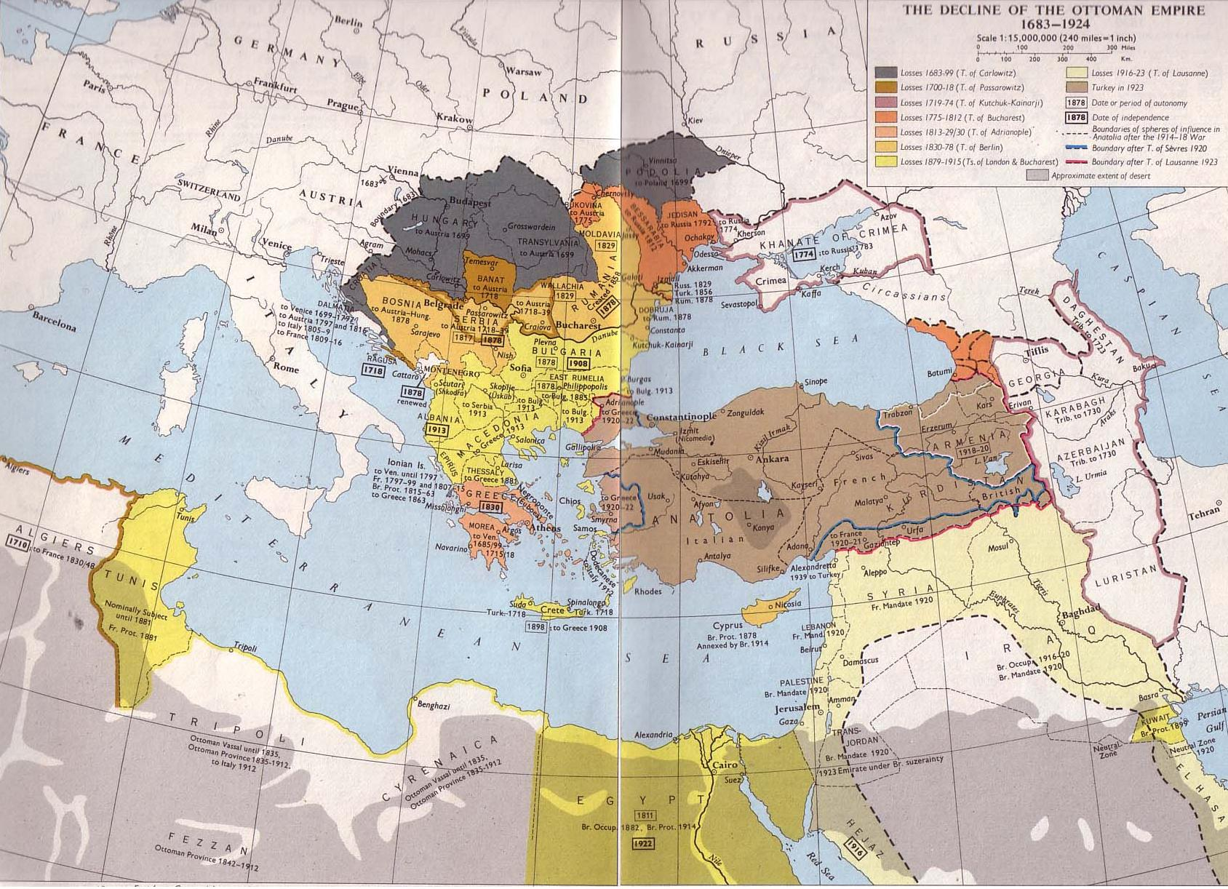

Slide 8
Tanzimat 1839-1856
Hatt-i Sharif Gulhane, 1839
Abolition of tax farming
Military conscription
Elimination of corruption
Applies to all Ottoman subjects
Islahat Ferman, 1856
Guarantees equality of all subjects, Muslim and non-Musim
Equal obligations to military service, state employment, admission to state schools

Slide 9
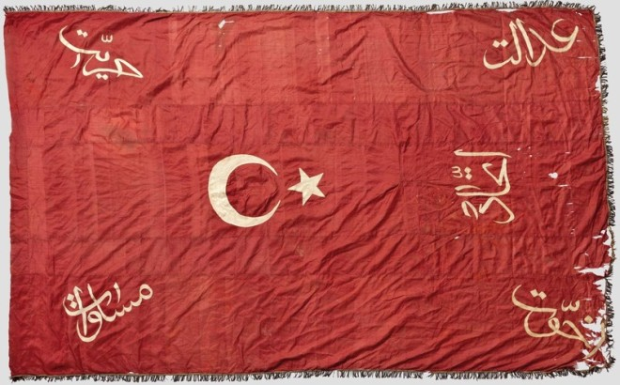

Slide 10
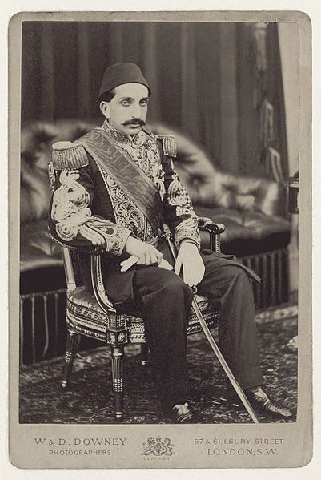

Slide 11
Revitalized Islam under
Abdulhamid II
Islamic identity designed to counter nationalism among Muslim communities.
Still a reformist, but with an Islamic and authoritarian orientation.
Codifying shari’a law.
Expansion of state school system.
Use of title “caliph.”
Harsh crackdowns on Armenian and Bulgarian nationalist agitation.

Slide 12
Ottoman Orientalism
Internalisation of European representations of ‘the East’
Ottoman modernisation supplants discourse of religious subordination by a notion of temporal subordination
Justifies reform and discipline of so-called ‘backward peripheries of a multi-ethnic/religious empire’
Ottoman elites subscribe to an ‘East’ that can be redeemed – ‘awakening’ of modern Eastern identity

Slide 13
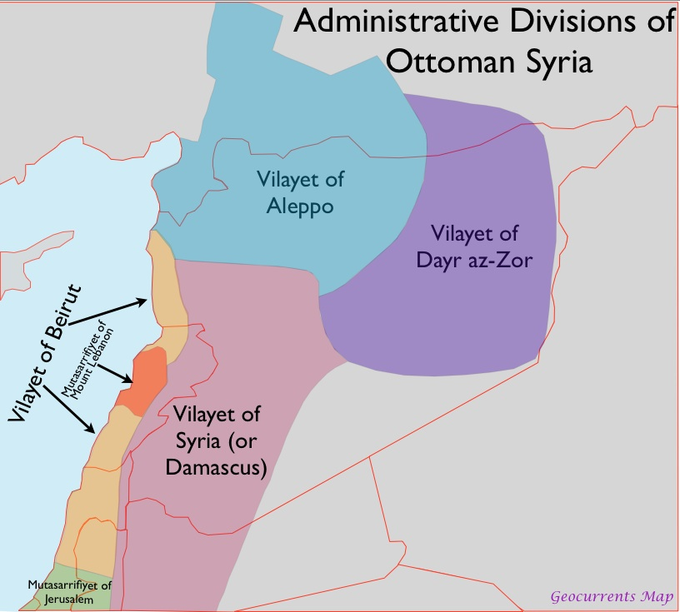
Mount Lebanon, 19th c.

Slide 14
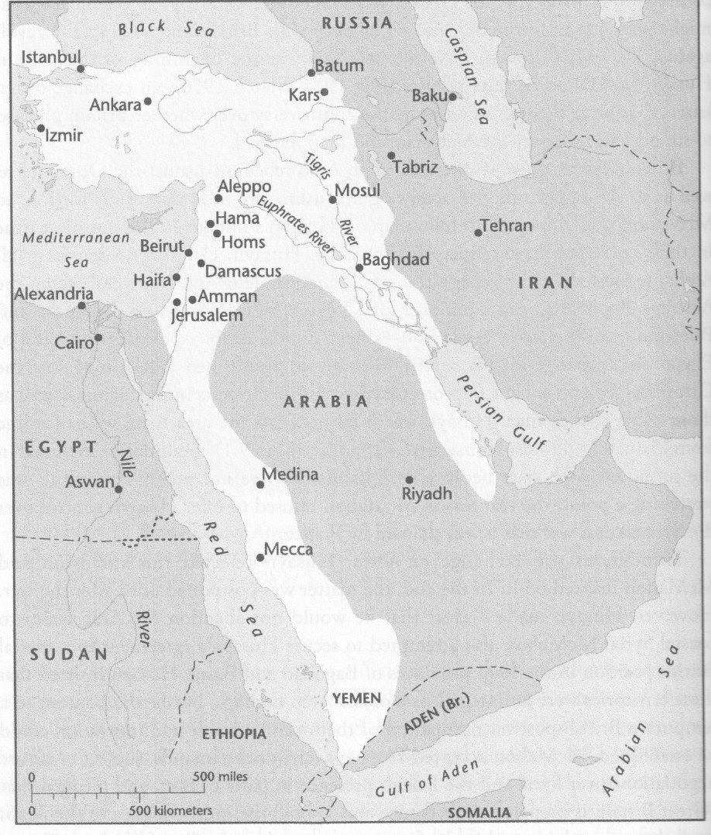
Ottoman Empire, 1914

Slide 15
Turkish nationalism
Associated with pan-Turkism, but most nationalists concerned with narrower group of Ottoman Turks.
Drew on contemporary European racial theorists.
Argued for dominance of Turks over both Muslim and non-Muslim subject groups of empire on grounds of natural intellectual, physical and moral superiority.

Slide 16
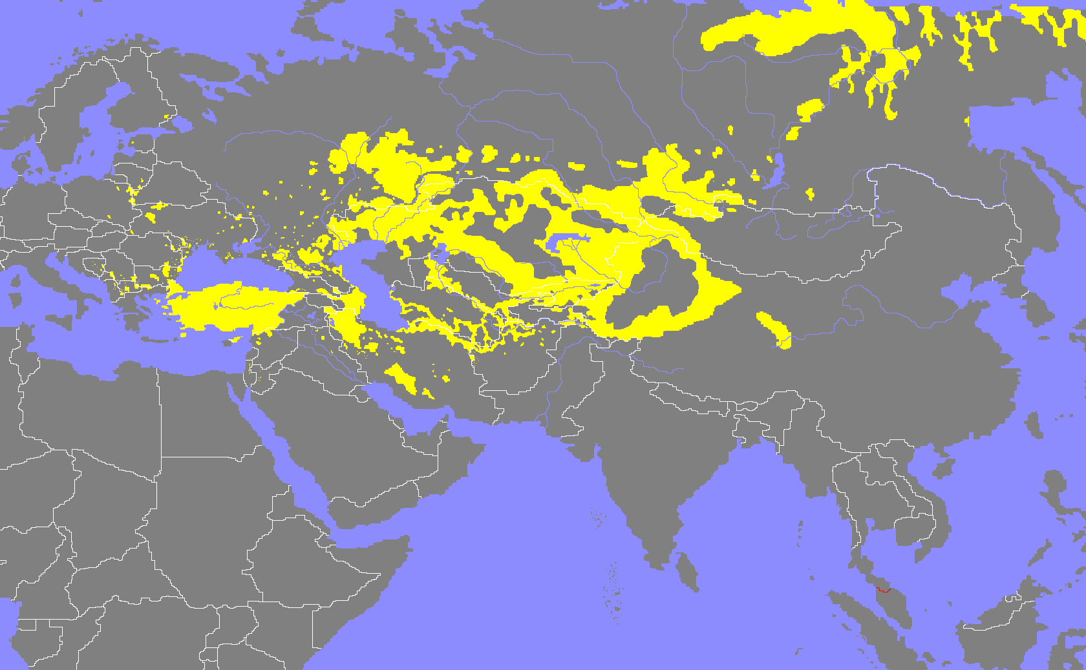
Notes:
The map is a map of Turkic populations to illustrate pan-Turkism, although the lecture focused on the narrower Turkish nationalism in the Ottoman domains.

