Slide 1
The Public sphere
Dr Imogen Peck
University of Warwick

Slide 2

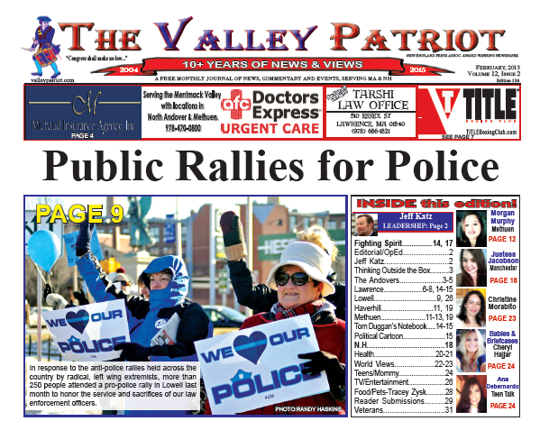
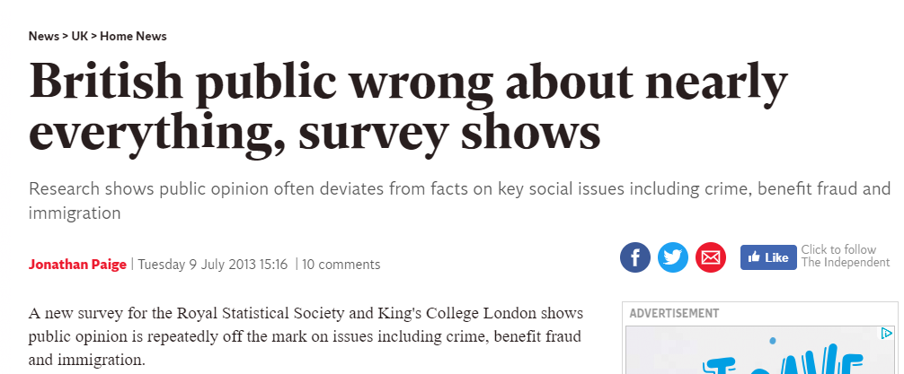
What do we mean by ‘the public’?

Slide 3
Three questions
(1) What is ‘the public’?
(II) What does it have to do with Enlightenment?
(III) Did it have an impact on the radicalism and revolution of the late 18thc?

Slide 4
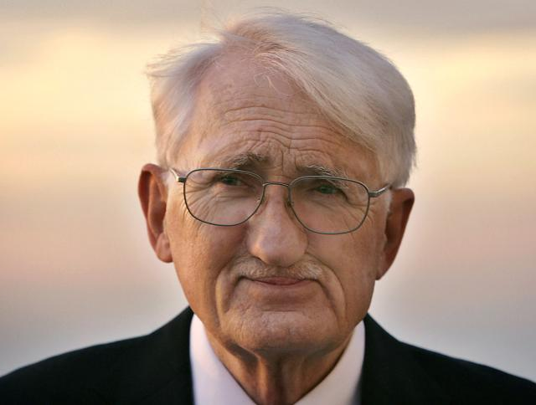
Jurgan habermas
What are the conditions under which rational, critical, and genuinely open discussion of public issues becomes possible?
The Structural Transformation of the Bourgeois Public Sphere (1962, trans into English 1989)

Slide 5
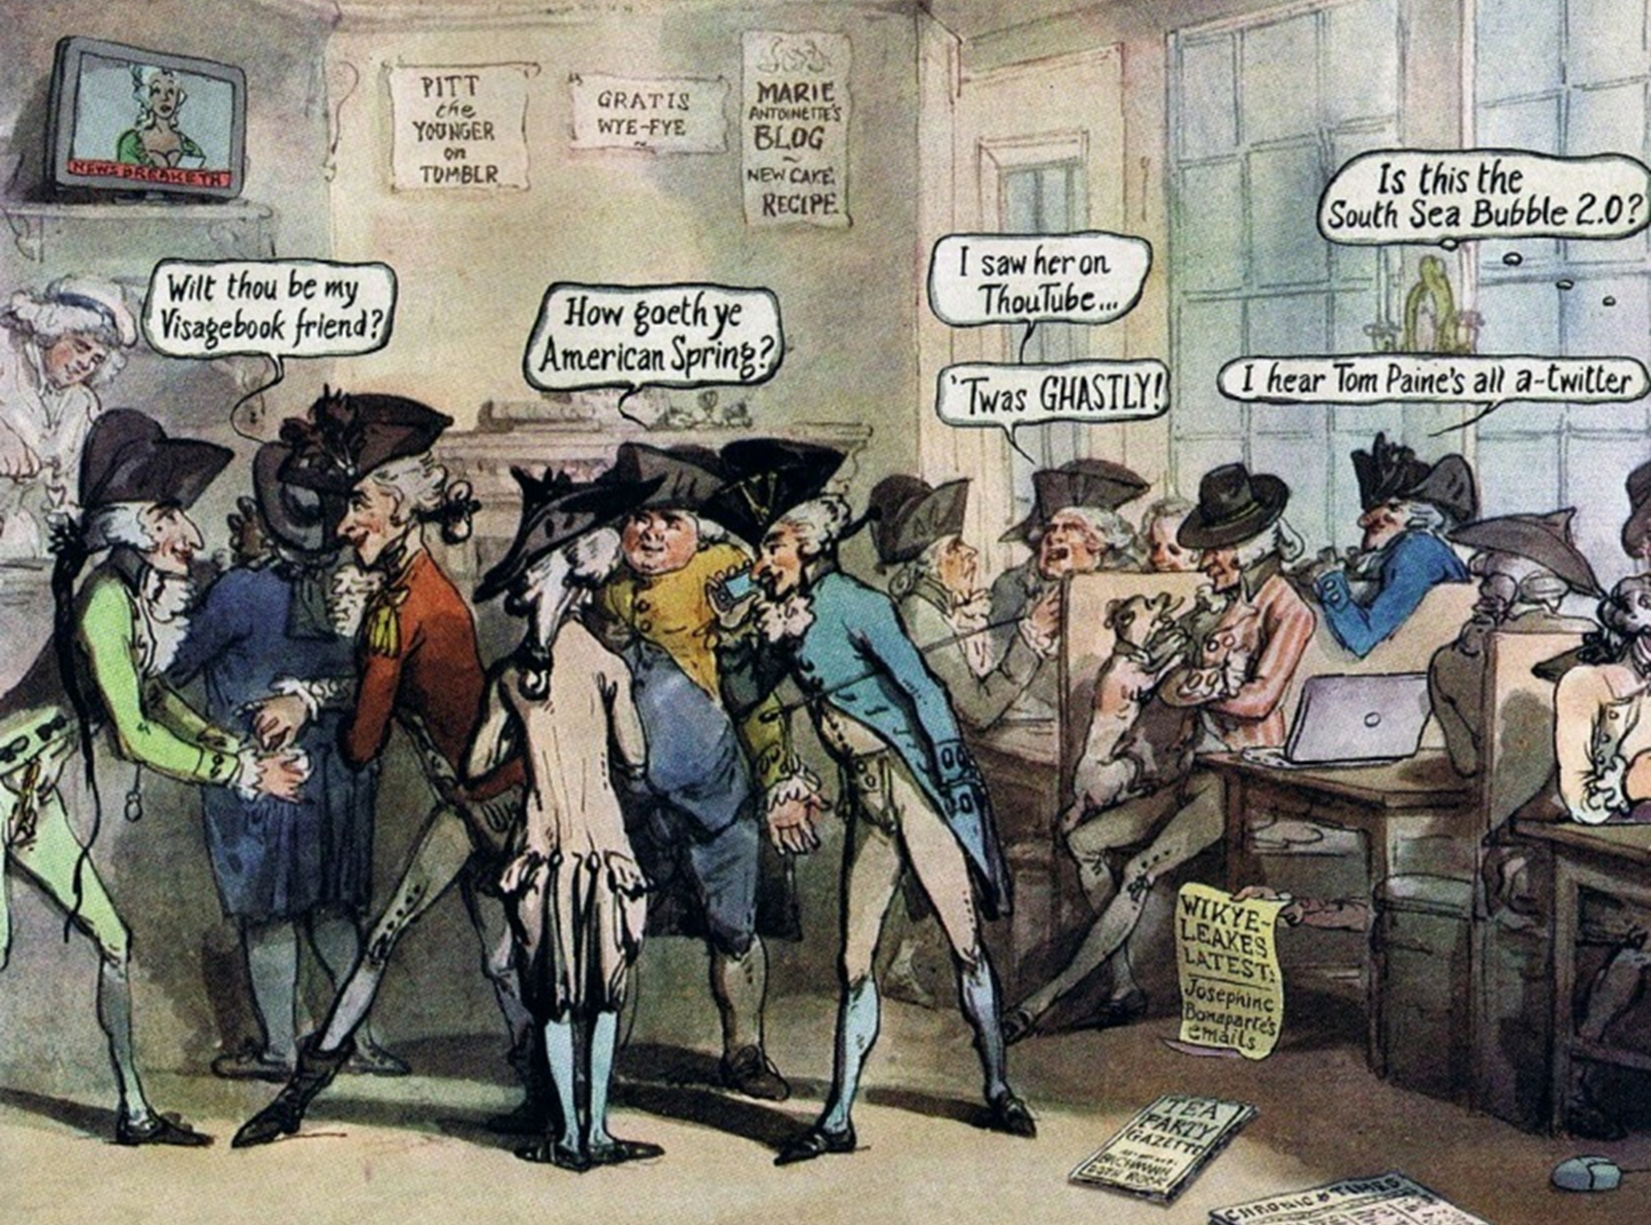
Habermas and The ‘BOURGEOIS public sphere’
- A space of rational-critical debate
- Where private individuals come together to form a ‘public’
- Where ‘public opinion’ is formed and expressed, often in critical opposition to the state or traditional institutions

Slide 6
By the ‘public sphere’ we mean first of all a realm of our social life in which something approaching public opinion can be formed. Access is guaranteed to all citizens. A portion of the public sphere comes into being in every conversation in which private individuals assemble to form a public body. They then behave neither like business or professional people transacting private affairs, nor like members of a constitutional order subject to the legal constraints of a state bureaucracy. Citizens behave as a public body when they confer in an unrestricted fashion -- that is, with the guarantee of assembly and association and the freedom to express and publish their opinions -- about matters of general interest’.
(Habermas ,’The Public Sphere: An Encyclopedia Article’, New German Critique 3 (1974), 49)

Slide 7
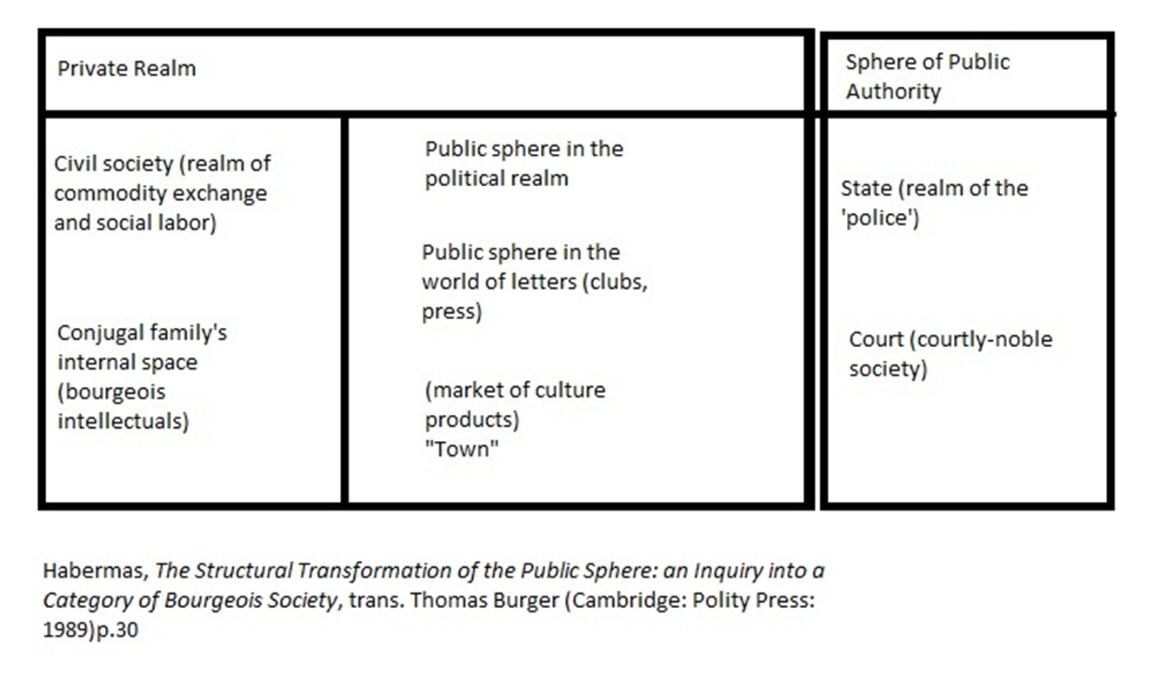
the public and the private in habermas

Slide 8
Where did the public sphere come from?
(I) Rise of the nation state (leads to emergence of society as a distinct realm)
(II) Rise of capitalism (socioeconomic power develops beyond total grasp of state, society acquires growing autonomy)
State + Capitalism = new bourgeois family
Sentiment, sociability, individuality, education
These new attributes get projected onto public domains (print, clubs, theatres, salons)

Slide 9
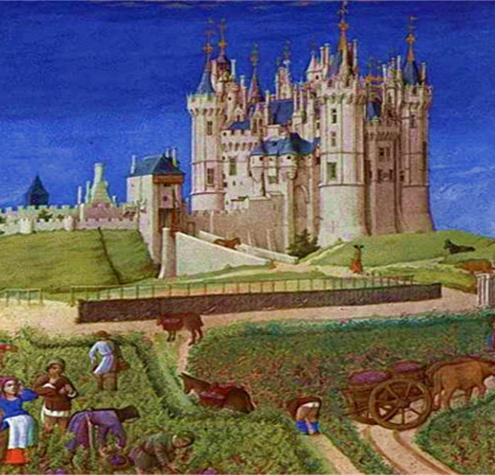
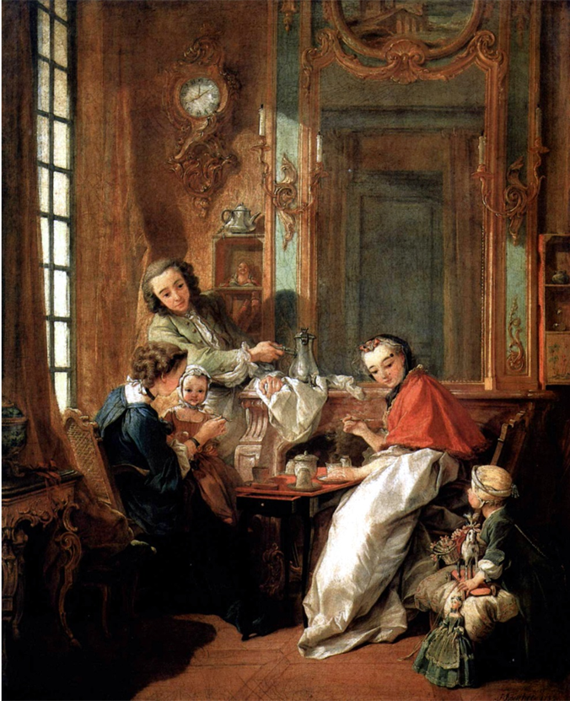
FROM THIS…
TO THIS…

Slide 10
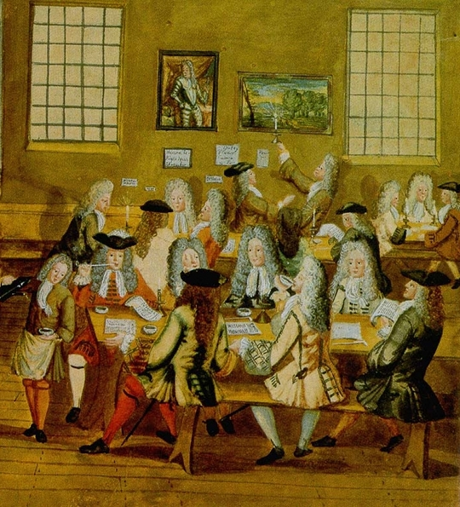
Critiques of Habermas’ ‘bourgeoisie public sphere’
(I) Issues of chronology
(II) How bourgeoisie was it?
(II) How oppositional was it?
(III) Exclusion and the public sphere

Slide 11
‘The early bourgeois public spheres were composed of narrow segments of the European population, mainly educated, propertied men, and they conducted a discourse not only exclusive of others but prejudicial to the interests of those excluded.’
‘The very emphasis on rational-critical debate implies an incapacity to deal fairly with “identity politics” and concerns for difference.’
Craig Calhoun, Introduction, Habermas and the Public Sphere (Massachussetts: MIT press, 1992), p.3

Slide 12
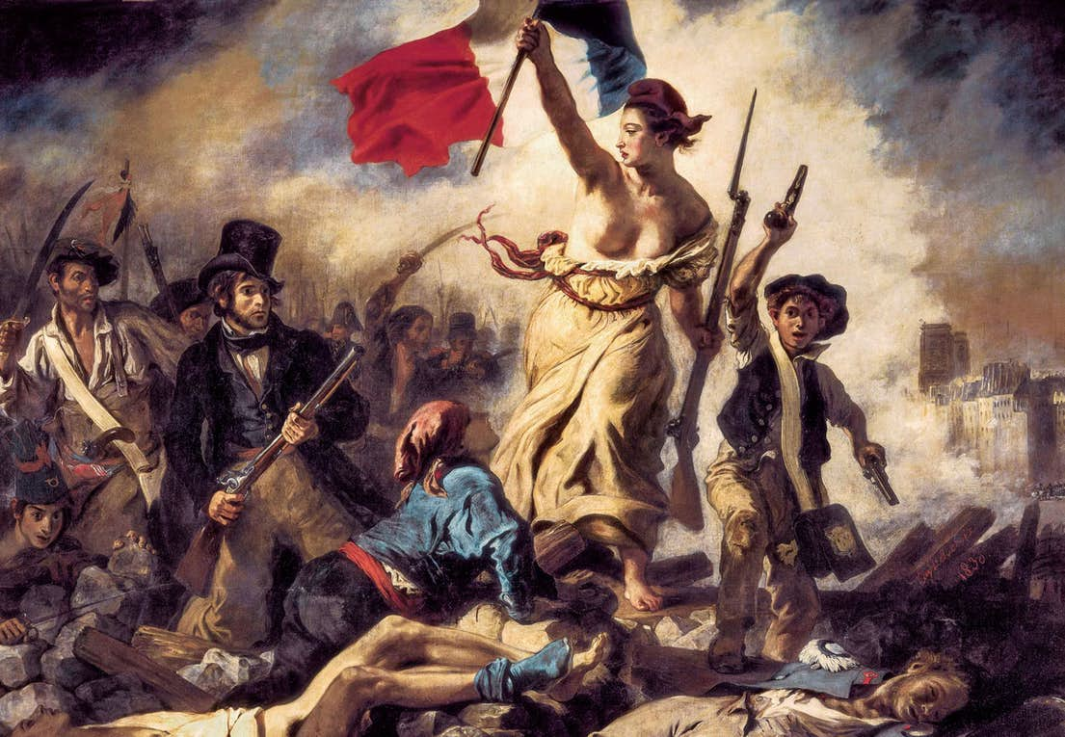
Historians engaging with habermas
The emergence of the public/public sphere as a way of explaining the radicalism that led to the French Revolution.
- Robert Darnton – content and diffusion of public opinion
- Roger Chartier – rise of print prompts rise of scepticism

Slide 13
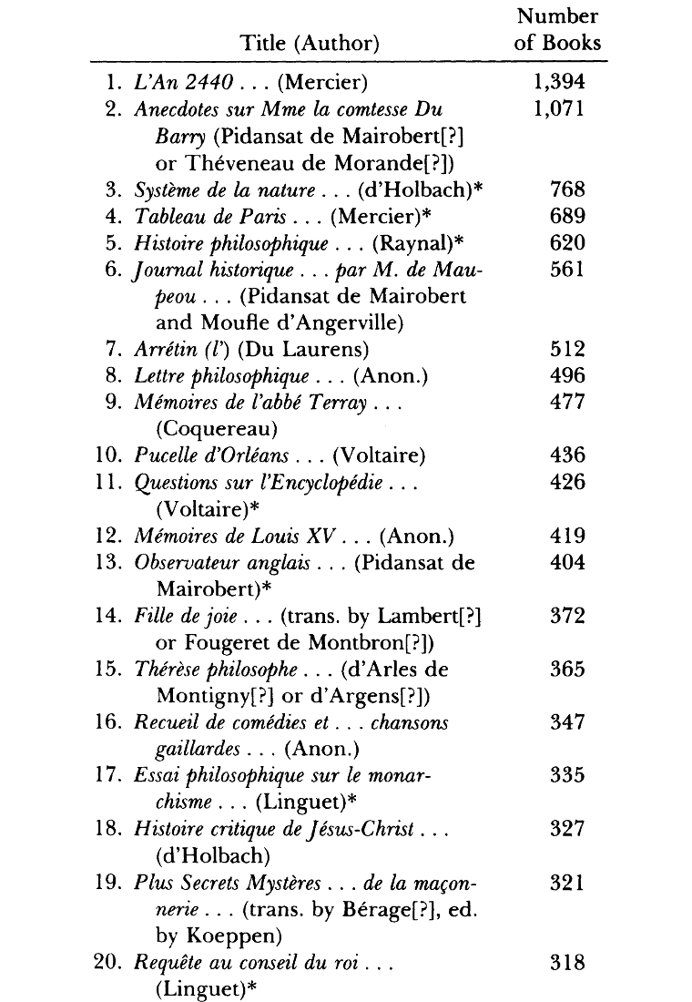
Robert darnton: forbidden bestsellers
The Forbidden Best Sellers of Pre-Revolutionary France (1995)
- Content of public opinion matters and shapes politics (the origins of the French Revolution)
- Irreverence, slander in the form of bestselling historical narratives: e.g. Anecdotes sur Madame las contesse Mme du Berry (Louis XV’s scandalous mistress)
- Desacralisation thesis: monarchy is not divine or infallible: it has fallen into despotism

Slide 14
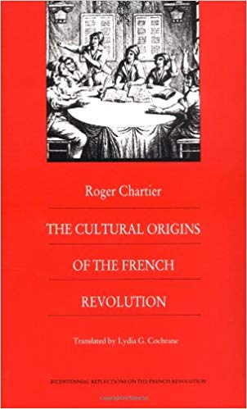
Roger chartier: Cultural Origins of the French Revolution (1991)
- Critical mindset and skepticism developed with the proliferation of print.
- Individuals learn to discern fact from fiction.
- From intensive reading (bible) to extensive reading (news, liberals, things you know you shouldn’t take at face value).
- Critical stance towards texts leads to critical stance towards authority.

Slide 15
Where were the publics?
- Print culture
- Theatres
- Clubs
- Drinking publics (coffee houses, pubs)
- Salons

Slide 16
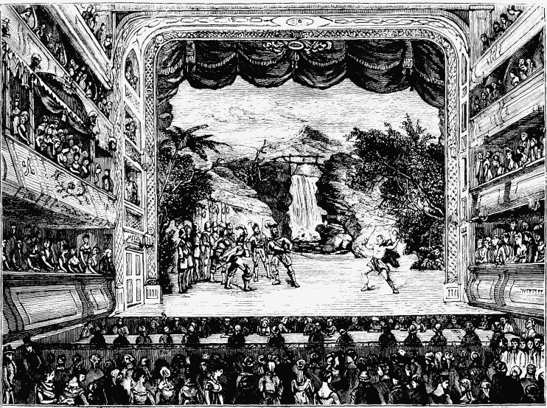
theatres
Drury Lane, London (left): seating capacity increased from 1,000 in 1732 to 3,600 by 1792.
Comedie Francaise, Paris: attendance went from 117,000 people annually between 1715 and 1750 to 165,000 annually between 1750 and 1770.

Slide 17
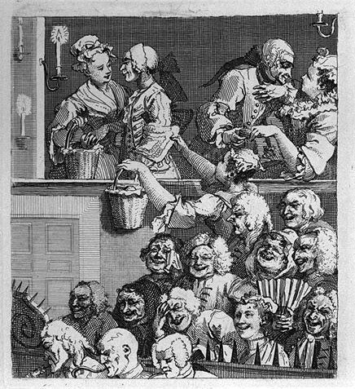
The court of public opinion
‘I believe we shall find the town [i.e. the theatre going public] in general to be justly and actually the governor of the stage, as it now stands: for tho’ it be in the power of a manager to produce what actors and what pieces he pleases, yet the town, if they differ from him in opinion, will immediately bring him over to theirs’.
London Journal
‘the public is the only jury before whom the merits of an actor or actress are to be tried, and when the endeavours of a performer are stampt by them with the seal of sanction and applause, from that there should be no appeal’.
Theatrical Guardian
‘The Laughing Audience’, William Hogarth (1733)

Slide 18
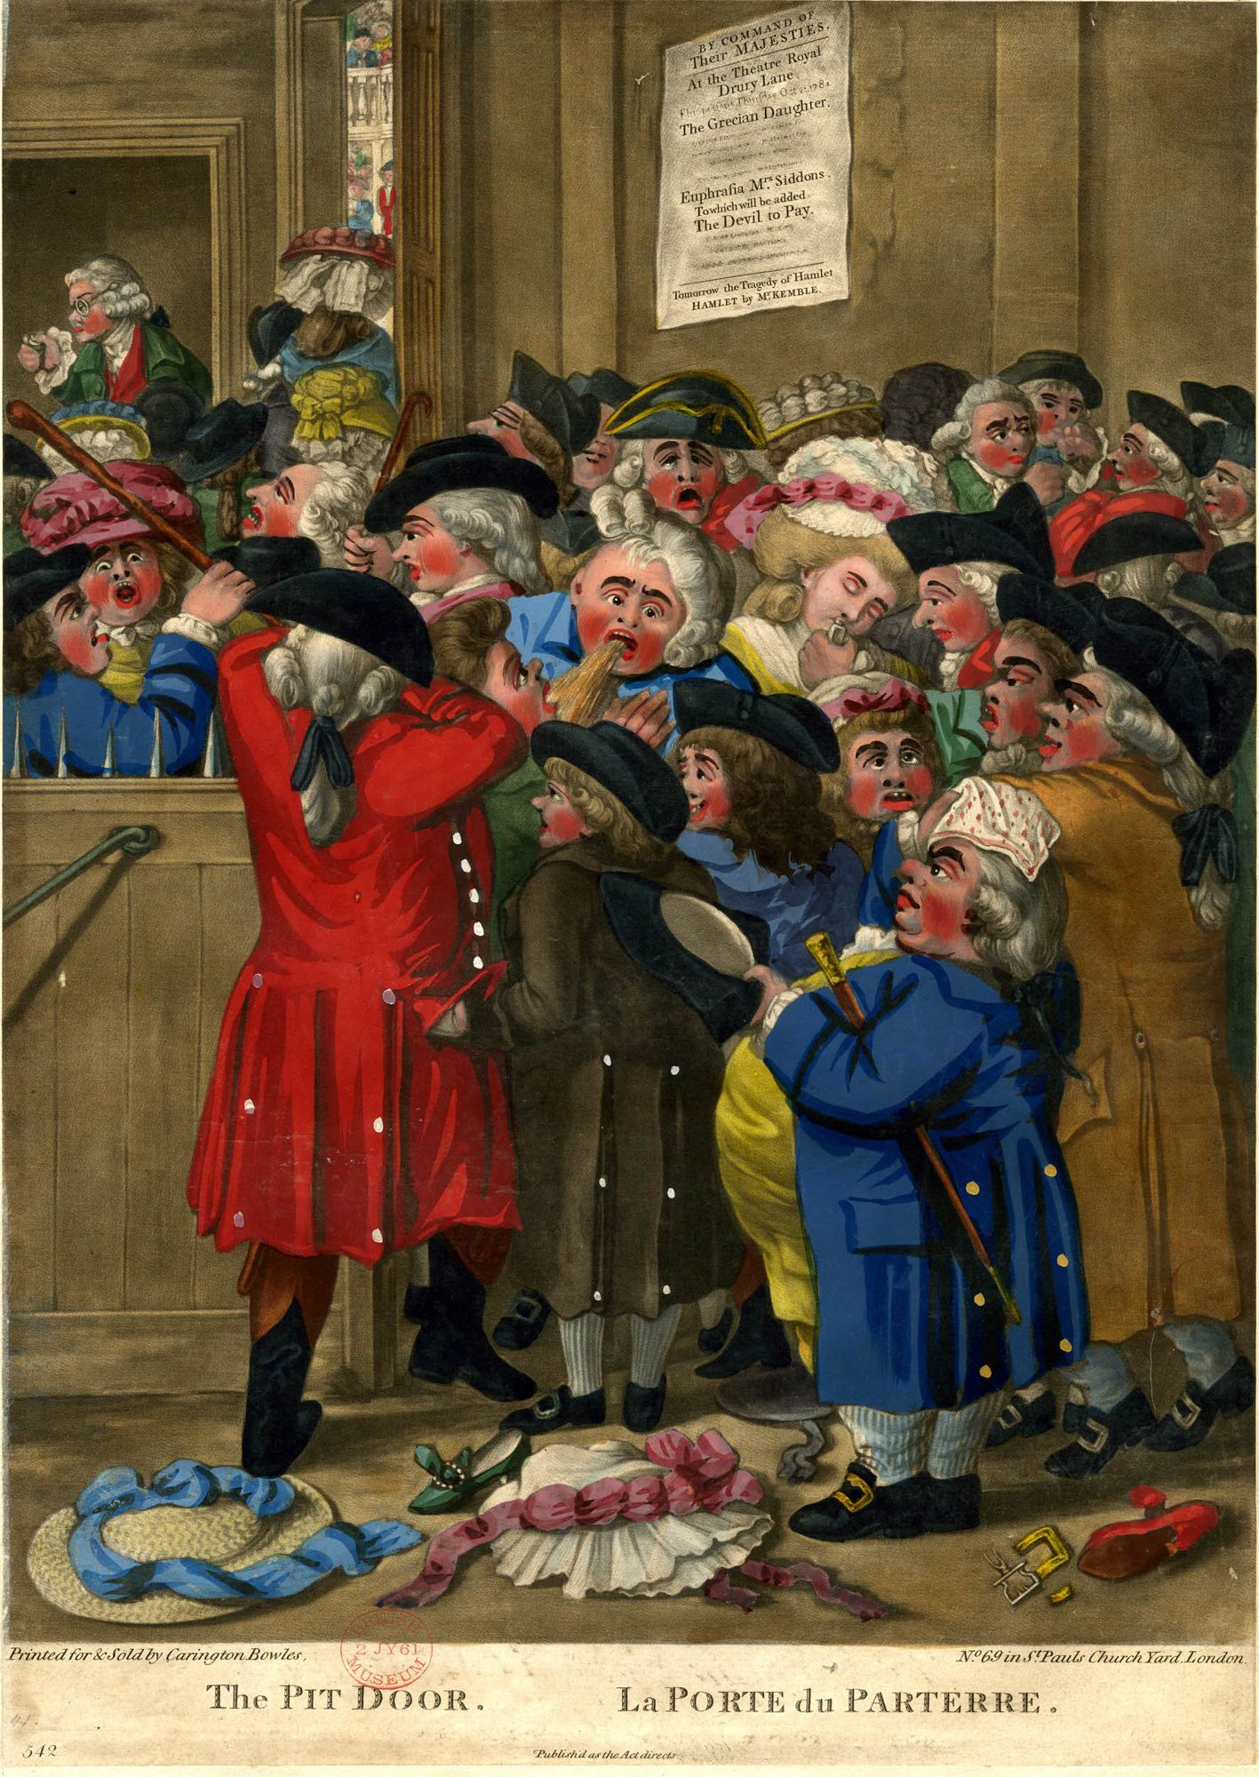
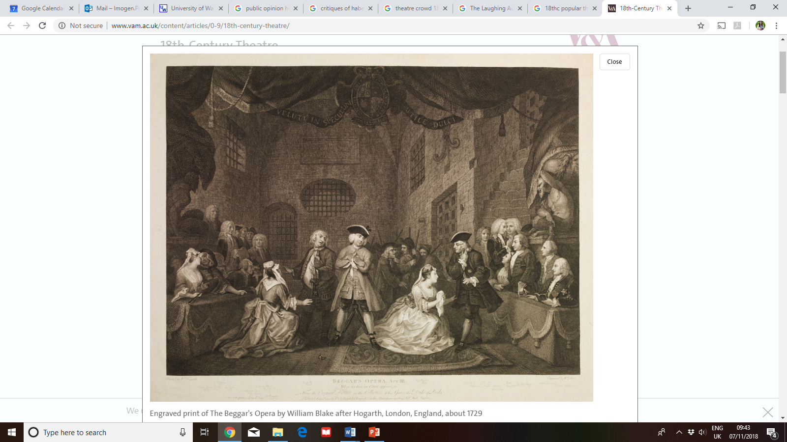
theatre as enlightenment?
Left – ‘The Pit Door’ (1784). Depicts the chaos of buying tickets at the pit door of the Theatre Royal, Drury Lane.
Above – Engraved print of The Beggars Opera, by William Hogarth (1729)

Slide 19
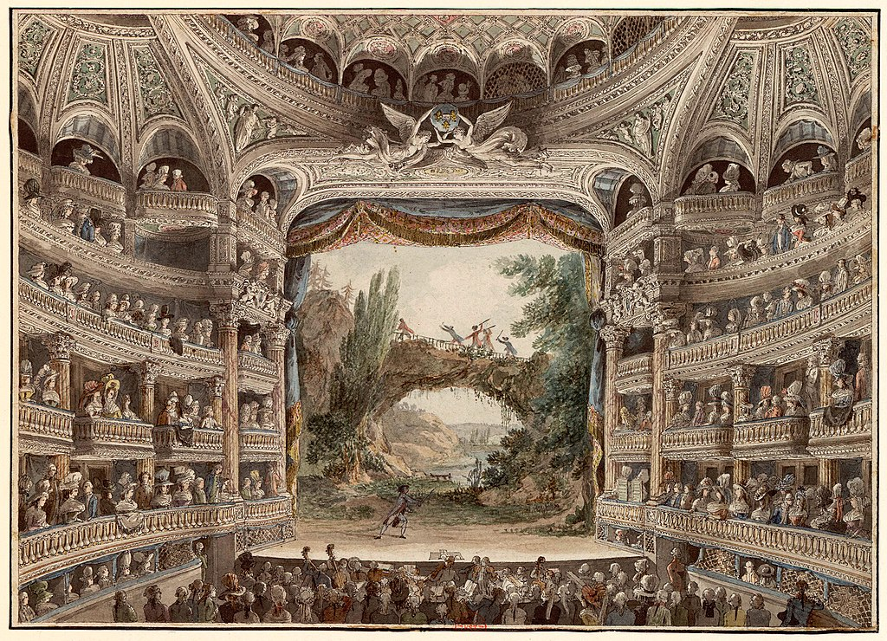
Theatre in France
Interior of the Comedie Francaise, c. 1790

Slide 20
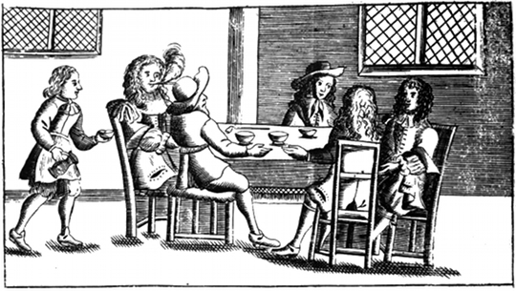
Drinking spaces: public houses and coffee houses
‘A coffeehouse is like apolitical stock exchange, where the most gallant and wittiest heads of every estate come together. They engage in wide-ranging and edifying talk, issue well-founded judgments on matters concerning the political and the scholarly world, converse sagaciously about the most secret news from all courts and states, and unveil the most hidden truths’.
Theodor Johann Quistrop
Early image of a coffee house, c. 1674

Slide 21
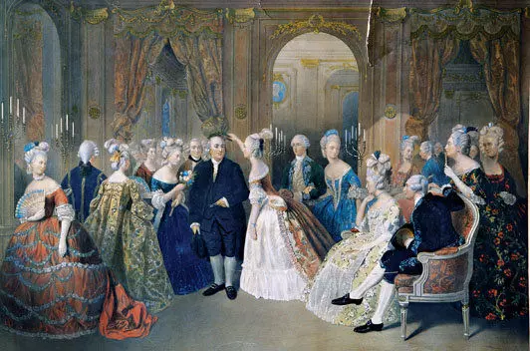
salons
Benjamin Franklin visits a salon in 1780s Paris

Slide 22
bibliography
Jurgan Habermas ,’The Public Sphere: An Encyclopedia Article’, New German Critique (1974)
Craig Calhoun, Habermas and the Public Sphere (1992)
Roger Chartier, Cultural Origins of the French Revolution (1991)
Robert Darnton, The Forbidden Bestsellers of Pre-Revolutionary France (1995)
Keith Baker, Inventing the French Revolution (1990)
Hurgan Habermas, The Structural Transformation of the Bourgeoise Public Sphere (1962)
Jan Van Horn Melton, The Rise of the Public in Enlightenment Europe (2001)
Juraj Kittler, The Enlightenment and the Bourgeoise Public Sphere (2012)
Bonnie Calhoun, ‘Shaping the Public Sphere: English Coffeehouses and French Salons and the Age of Enlightenment’, Colgate Academic Review (2012)

