Slide 1
Health and Beauty Lecture:
Tanning Culture
Lecture Aims/Questions
Explore the intertwined relationship between health and beauty in Britain through the lens of tanning culture.
Explore when, why and how were distinctive tanning technologies invented and mass-produced in the 20th century.
Explore who used tanning technologies and why certain groups were stigmatised.
What was the changing role of the mass media in tanning-related advertisements and, later, skin cancer campaigns?
Dr Fabiola Creed | Fabiola.creed.1@warwick.ac.uk

Slide 2
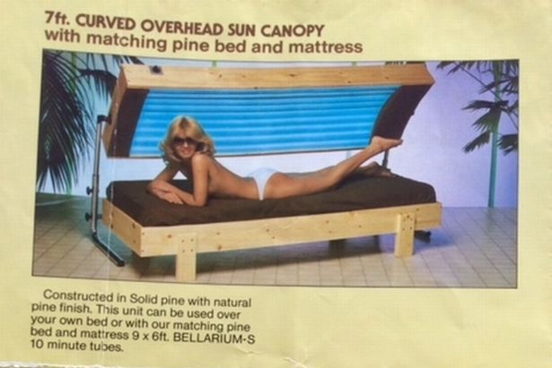

Definitions
What’s a tan? A ‘natural tan’ develops when a person’s skin is exposed to ultraviolet radiation. This exposure activates our melanin production, typically darkening it; however, it also damages skin cells and increases the risk of skin cancer development regardless of a person’s skin colour.
Ultraviolet (UV) Rays/Radiation, which UV lamps, sunbeds and the sun emits.
Sunbed: a body-sized electrical machine containing UV-ray panelled lamps, not outdoor sunbed sun loungers made from cloth, plastic, or metal.
Dihydroxyacetone (DHA) fake tan is a chemically developed UV-free tanning serum that develops without UV exposure.

Slide 3
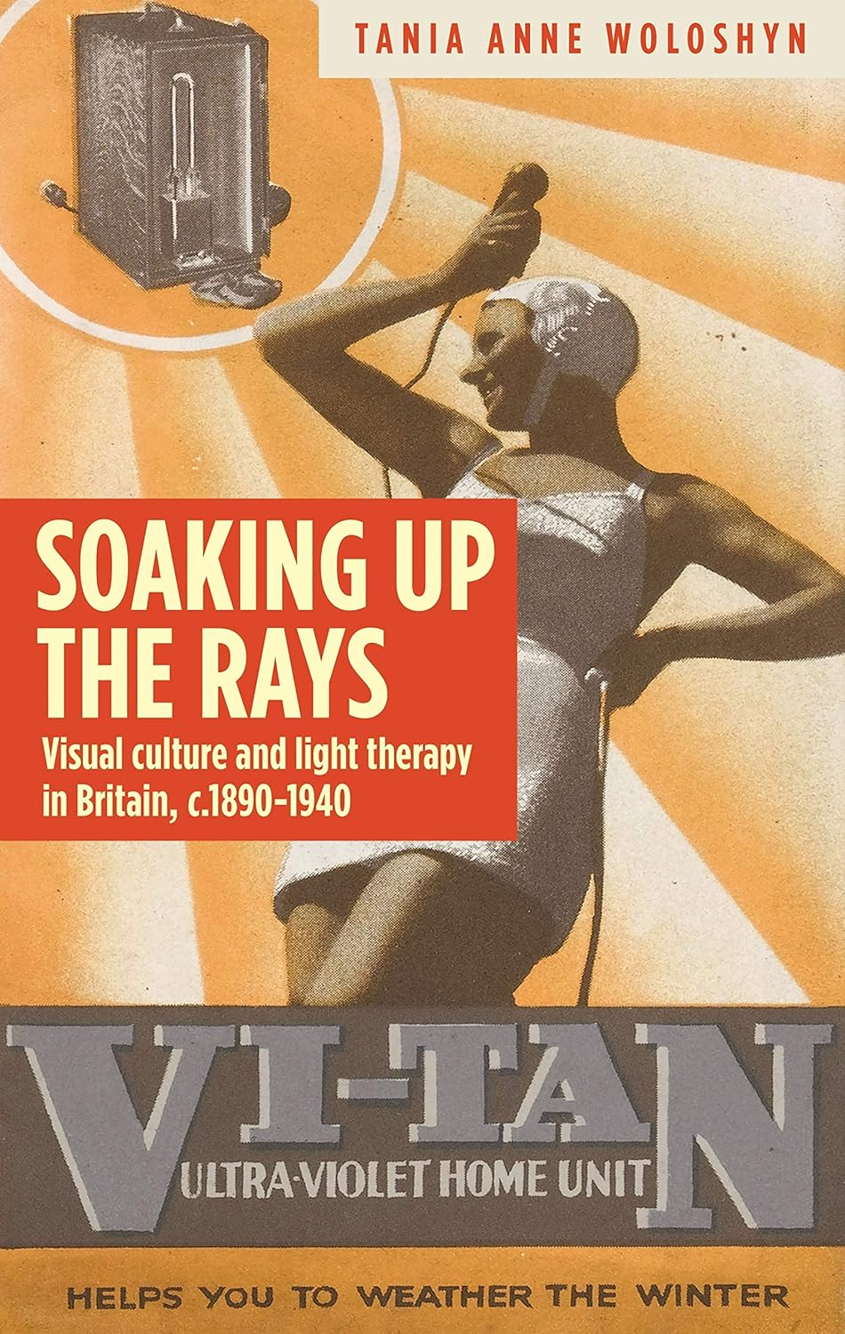



Tanning Culture in Ancient Civilizations?
Key scholars of tanning culture and sunlight technologies:
Britain focused: Simon Carter and Tania Woloshyn.
America: Daniel Freund, Hansen Devon, Sally Romano, Kerry Segrave.

Slide 4
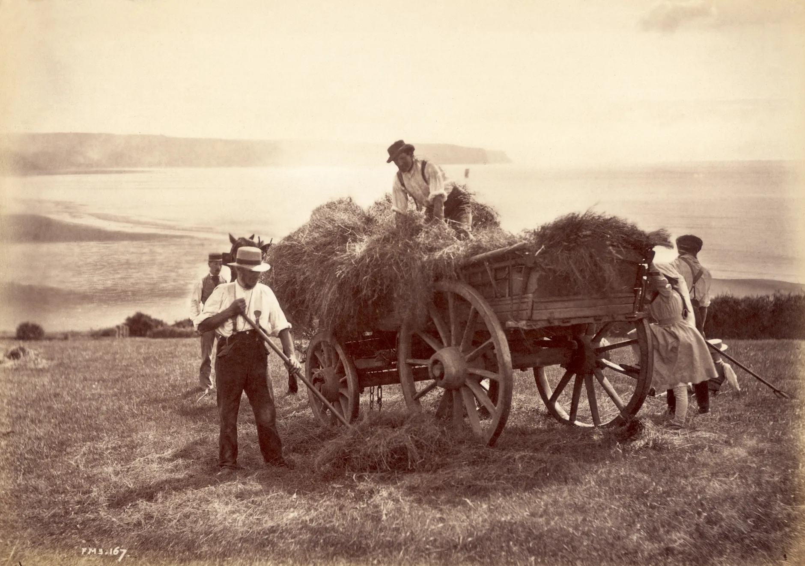
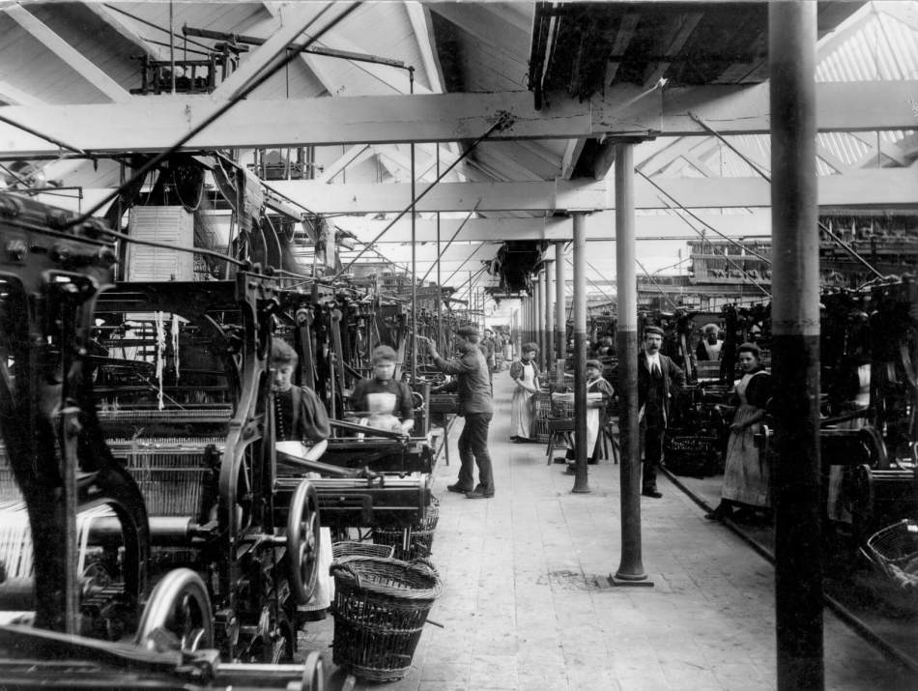
Tanning Culture in Europe, 1500-1800s.
1500s to mid-1700s: White Europeans ORIGINALLY idolized pale skin because tanned skin was more commonly seen as a mark of class/race inferiority, associated with most enslaved people and agricultural labourers who worked outside under the sun’s rays.
____________________________________________________
The 1800s onwards: However, the shift of labourers to indoor factory work following the Industrial Revolution and urbanisation changed the cultural meaning of skin; pale white skin now symbolized ‘economic inferiority’, and later ‘wickedness’ in aristocratic white codes of beauty
(e.g., Dorian Gray (1890) and Dracula (1897).
Oxfordshire, 1898. Source: Historic England Archive. HT13127.

Slide 5
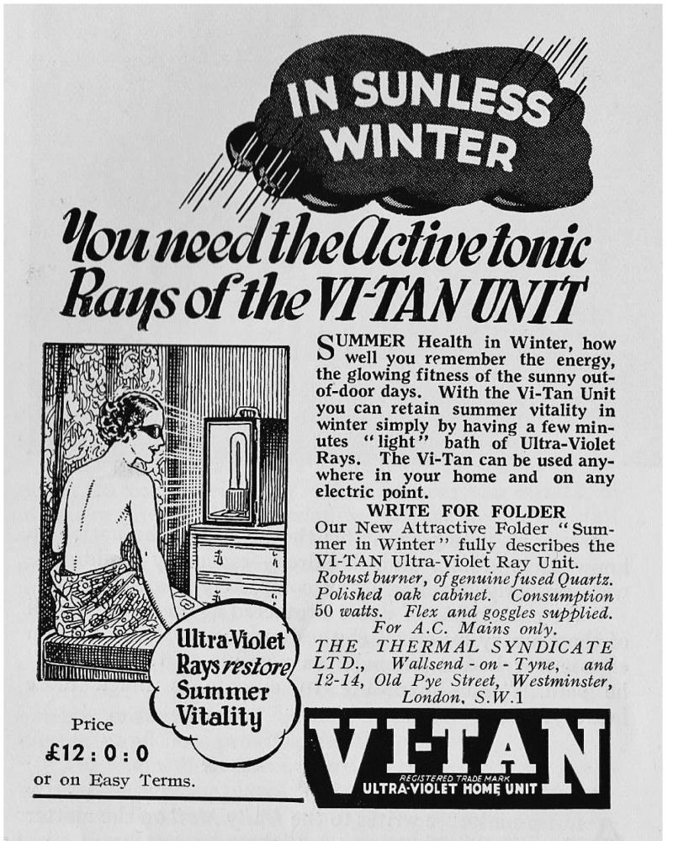
Tanning Culture, 1890s-1940s:
The Invention of UV-lamps
Medicalised introduction, 1890s: UV lamps were used by physicians as a cure against many infections or skin diseases (mainly tuberculosis, rickets, and psoriasis) and mental health issues (equivalents of depression).
_______________________________________________
Commercialised from 1930s onwards: UV lamps were sold by British health and beauty provider Boots for everyday health enhancement (Tania Woloshyn, Soaking up the Rays)
Advertisement for the ‘Vi-tan’ mercury vapour lamp in Sun Bathing Review, 4:17 (1937), 180. Hawk Editorial, publisher of H&E Naturist magazine, www.henaturist.net.
From: Chapter 4, Vanguard rays Copyright © Tania Anne Woloshyn 2017

Slide 6
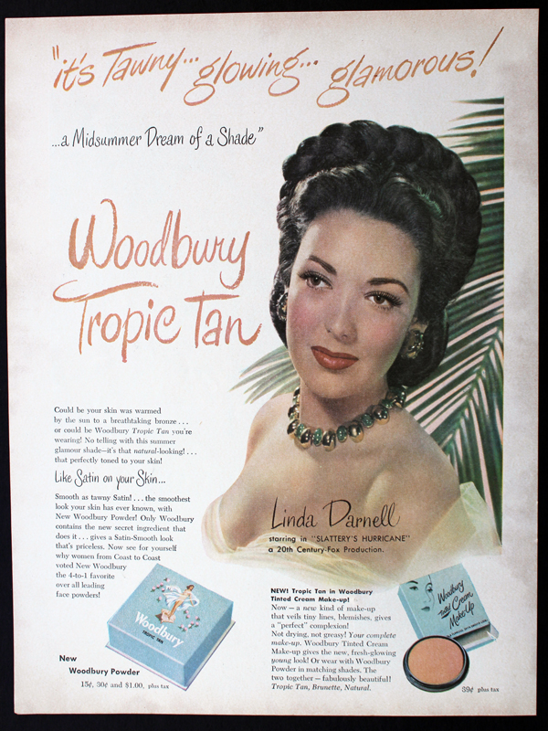
Tanning Culture, 1950s:
Cosmetics and the Discovery of DHA.
Changing fashions in cosmetics (‘Riviera’ (1952), ‘Sun Glow’ (1952’ and ‘Tawny’ (1957) darker face powders).
Tea bags and gravy browning…
Beta-carotene supplements, or large numbers of carrots?
The accidental discovery of DHA fake tan …

Slide 7
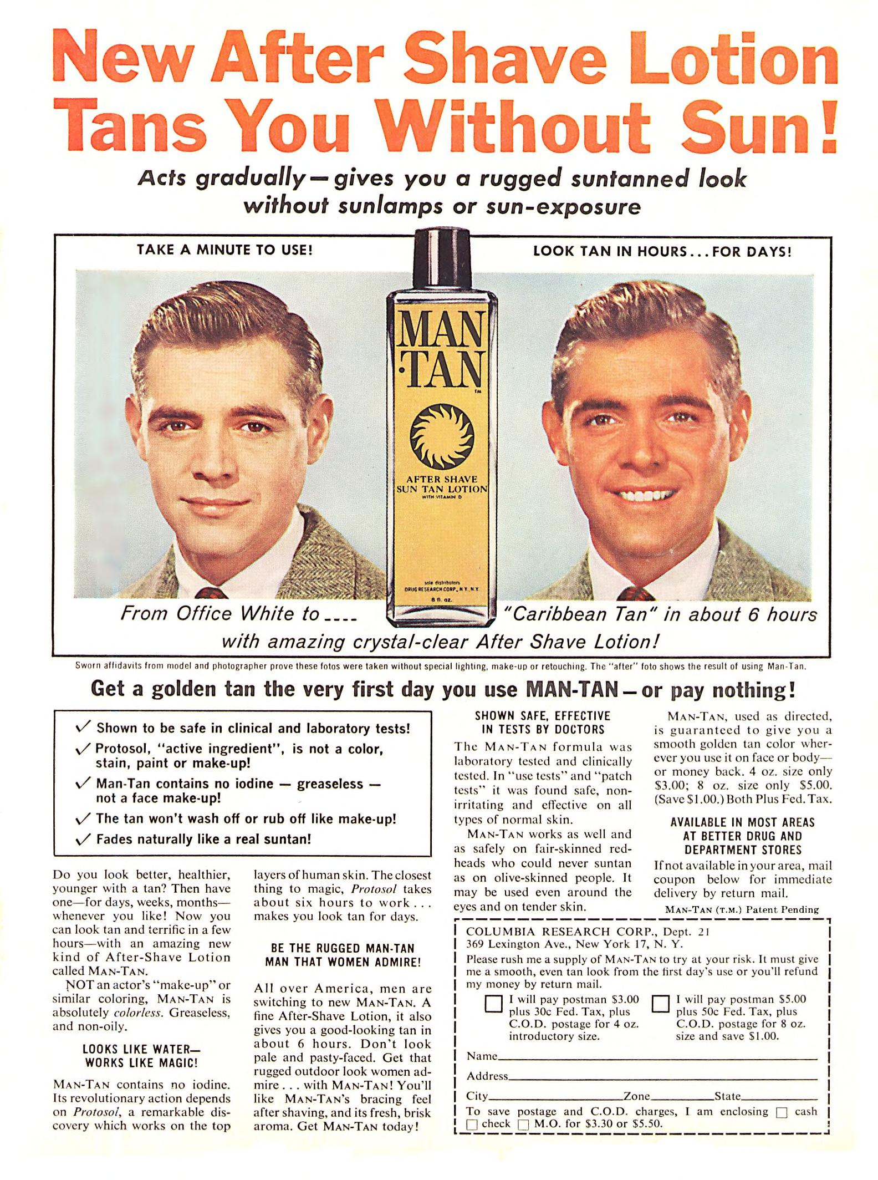
Tanning Culture, 1960s:
The New DHA fake Tan Industry.
Ellanby Laboratories: ‘Night Tan’ for women (1960, London)
‘He-Tan’, and ‘Man Tan’ for men (1960, London).
‘Amber Solaire’s ‘Golden’ and ‘Tanfastic’ (1960, UK):
https://www.youtube.com/watch?v=0ZOdeeT8oCk
(Bobby Darin, American jazz, country and blues singer, 2 mins)
Was DHA a failed product of the 1960s …. ?

Slide 8
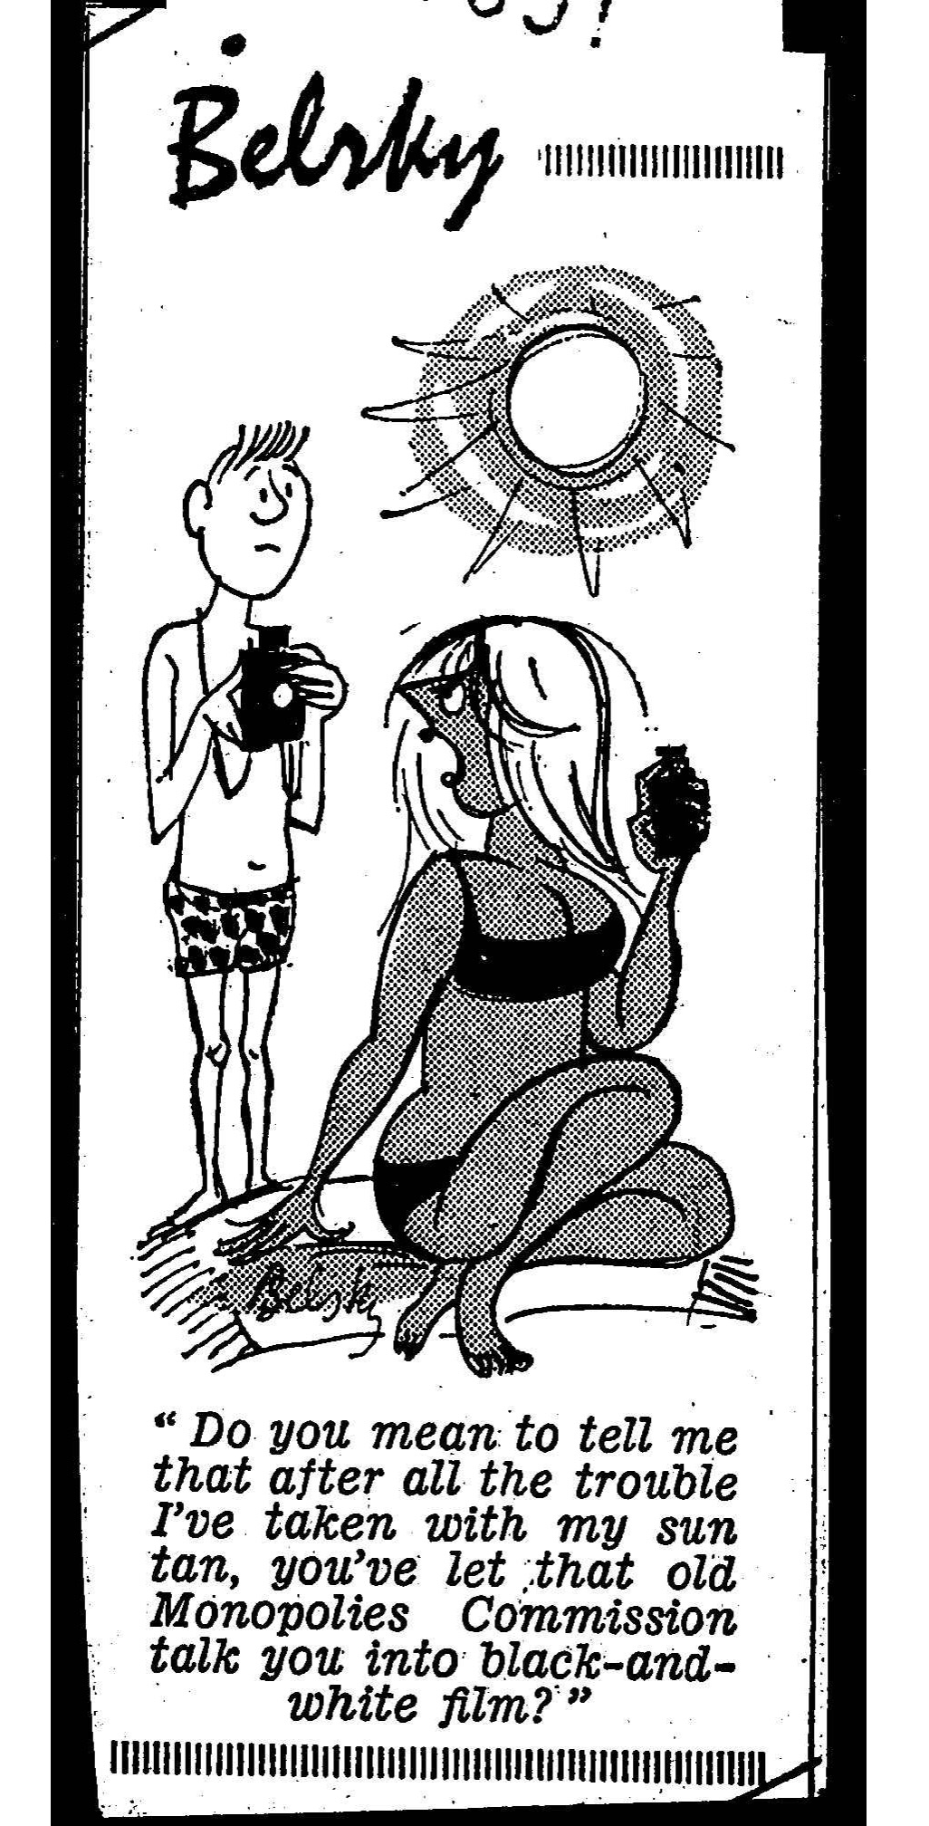
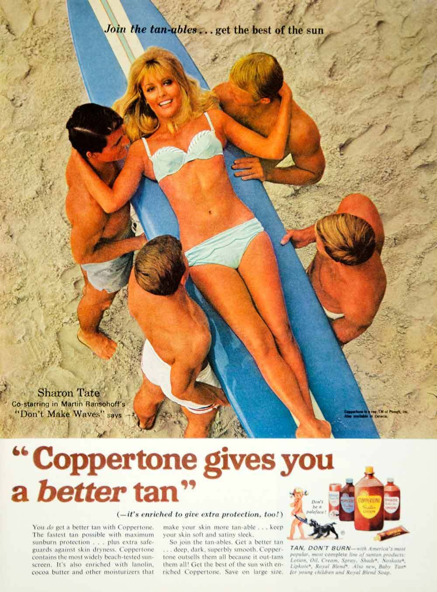
Tanning Culture, 1960s, cont.
Sharon Tate Coppertone Sun Lotion Campaign (1967).
Overseas holiday packages to warmer climates, like Spain and Italy became much cheaper than staying in Britain.
The consequent ‘boom’ in the sunblock, sun lotion … or just tanning oil industry? https://www.youtube.com/watch?v=aGEZO7GDEl8
Changes in more exposing fashion/clothing (swimsuits).
Improved visual technologies:
colour television, print press and photography.
Kodak commercial, The Sun, 29 April 1966

Slide 9
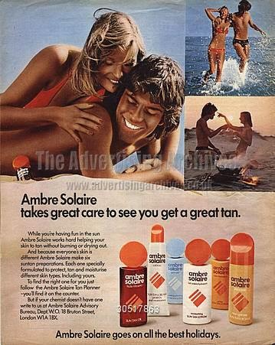
Tanning Culture, 1970s:
‘Duo’ DHA Fake Tan.
1973: American Food and Drugs Administration (FDA) approval of DHA.
Greater medical support for vitiligo/skin depigmentation patients to use DHA.
New ‘Duo’ range, which combined DHA and weak UV-blocking ingredients…

Slide 10
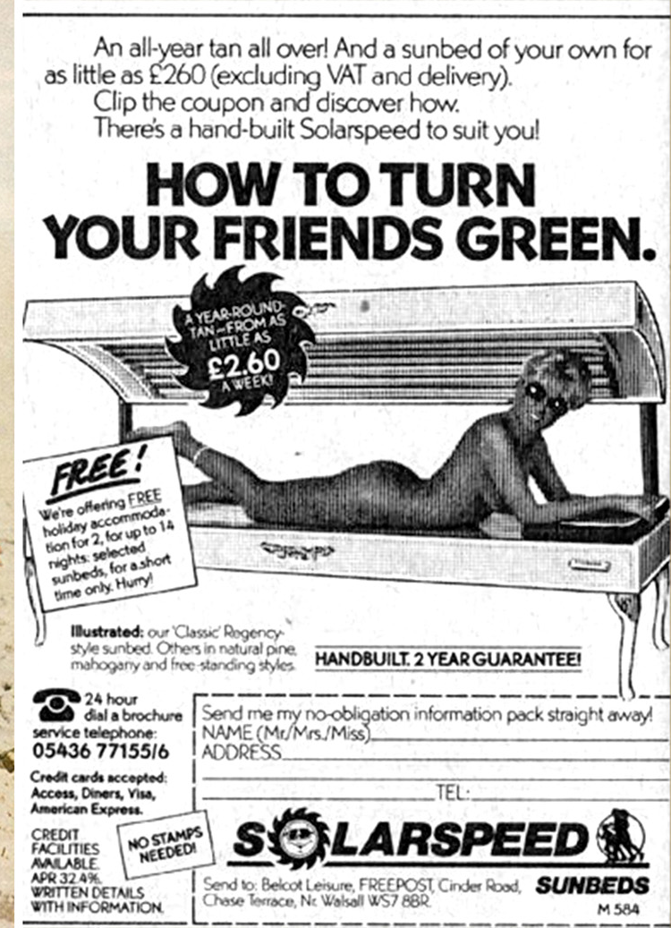
Tanning Culture, 1970s:
The Invention of the ’Sunbed’.
Inevitable progression from the sunlamp?
Invented by German Scientist, Friedrich Wolff, for German athletics.
1977: first sunbed salon in Berlin, spreading to Europe and North America.
1978: one-off sunbeds added to beauty salons and gyms in Britain.
1980: Sunbed only shops and salons spread through Britain.

Slide 11

Sunbed Tanning: Political/Economic Factors, early 1980s.
Source: Manchester Metropolitan Film Archive, BBC North West Regional News Collection,’ Film of sunbeds which are being manufactured by a local firm in Kirkby for tourists in Southport.’, Film Item 4, 14 January 1982.
Margaret Thatcher's support for independent entrepreneurs, private businesses, and new franchises (Enterprise Allowance Scheme).
Economic Instability, rising oil prices: Collapse in manufacturing industries (coal and steel), rising unemployment levels, and skilled manufacturing labourers desperate for jobs where their skills/experiences were directly transferable.

Slide 12
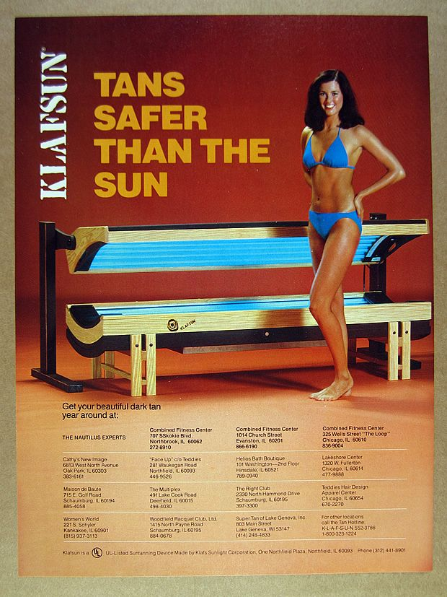

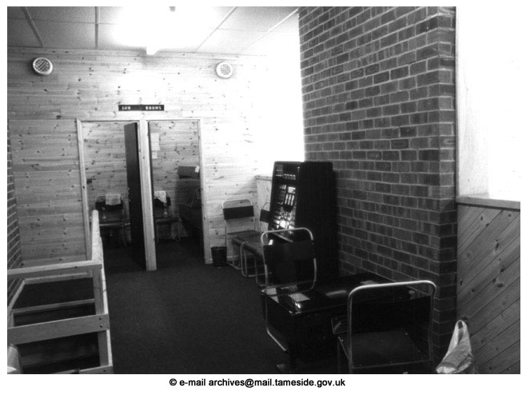
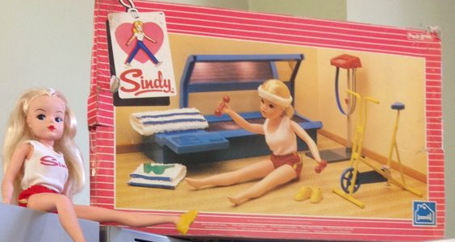
Sunbed Tanning: Public Health/Health Consumerism Factors, early 1980s.
Sources: Tameside Local Studies and Archives, Sid's Sports Centre, sunbed rooms and waiting area.
[Photograph, late 1970’s], 1982 sunbed advert, and ‘Keeping Fit’ Sindy Doll (1984).

Slide 13
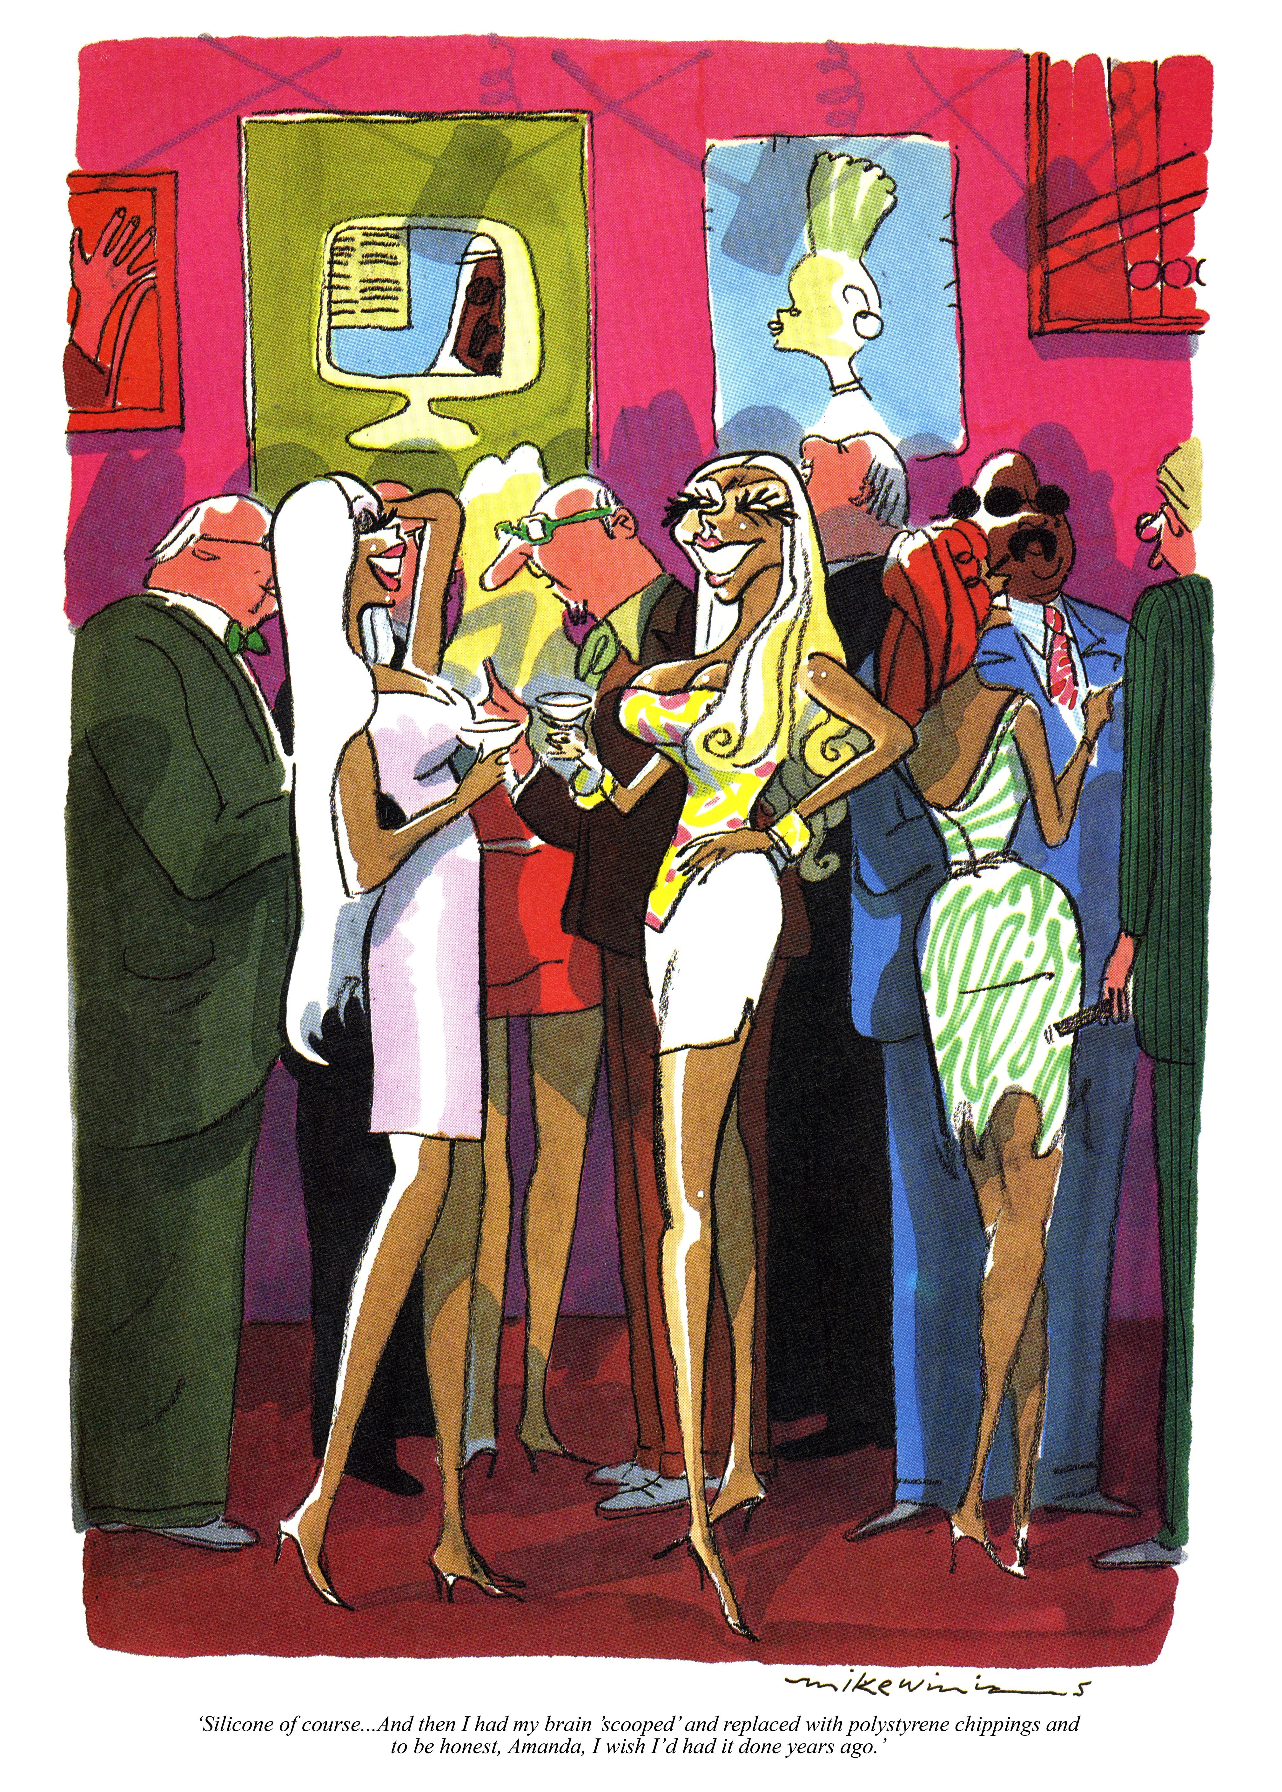
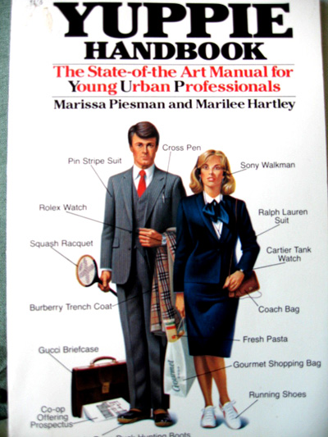
Anti-Sunbed Tanning: Hostile Political, Economic and Consumer Climate (1990s).
‘Suntanned Bimbo and gold-digging escorts’, Punch magazine, May 1990.

Slide 14
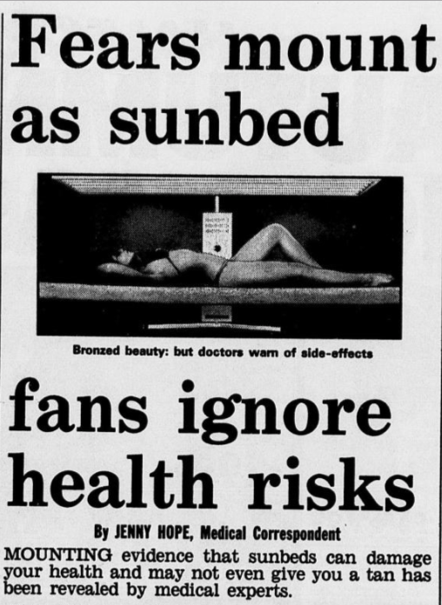
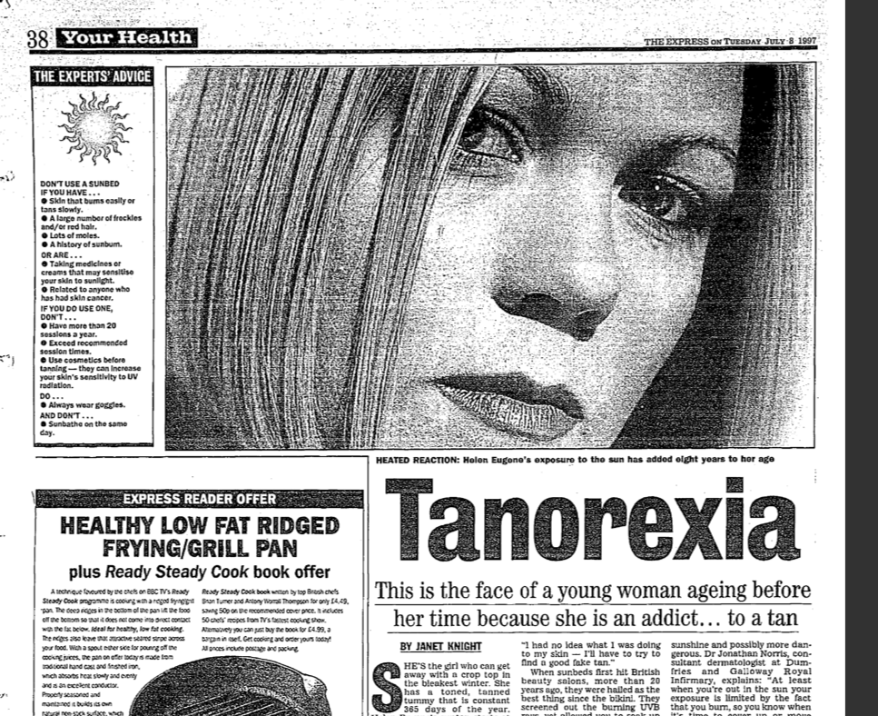
Anti-Sunbed Tanning: Skin Cancer Confirmed
and the Pathologising of Sunbed Users .. ‘Tanorexia’ (1990s).
Jenny Hope (Medical Correspondent), ‘Fear mount as sunbed fans ignore the health risks’, Daily Mail, 5 October 1990., p.23.
The Express, July 1997.

Slide 15
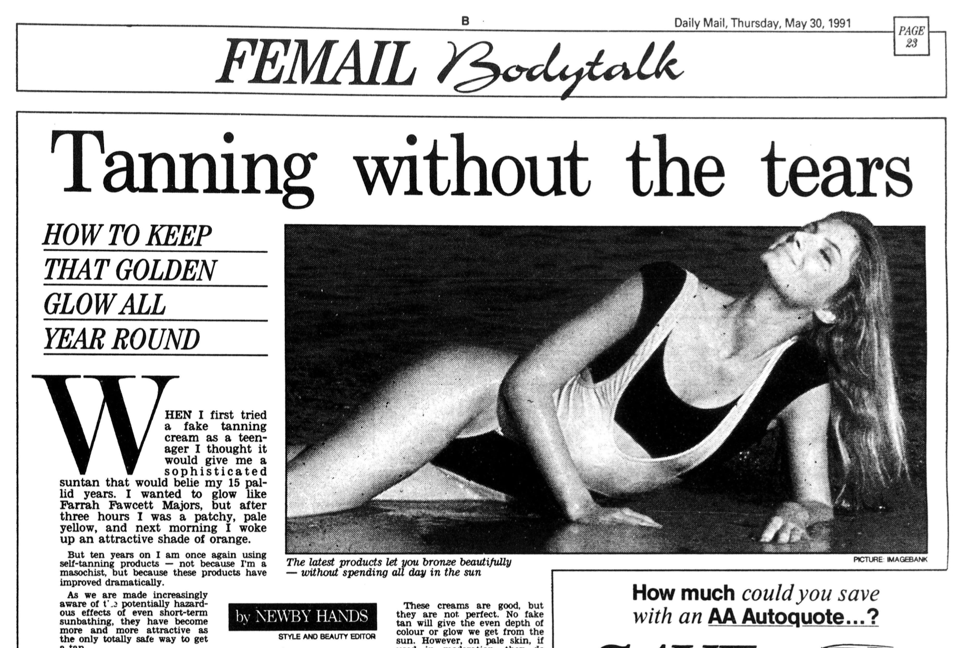
Tanning Culture, 1990s: DHA Fake Tan vs. Sunbeds

Slide 16

Cont.
DHA Fake Tan
advertising of new
beauty salon
tanning treatments --->
The Tanning Shop’s sunbed advertising of their new sunbeds ---------->
Meanwhile, cultural background = tanned playboy
model, Pamela Anderson’s, Baywatch television era
(1989-99).

Slide 17
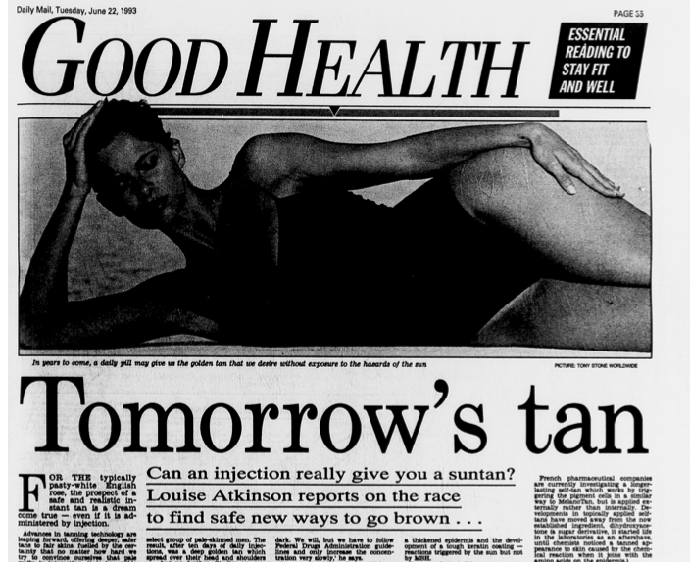
Tanning Culture, 1990s: The Invention of ‘Medical’
Tanning Injections, Melanotan.
Laboratories around the world are working together to develop Melanotan (Britain, Australia, North America).
Professor Mac Hadley (University of Arizona): ‘Medical’ in nature? … to protect ‘vulnerable, fair-skinned people against skin cancer and medically treat people pigment-based skin concerns, such as hypersensitivity, albinism and vitiligo.
Professor Patrick Riley (UCL): Purely a ‘cosmetic’ technology.

Slide 18
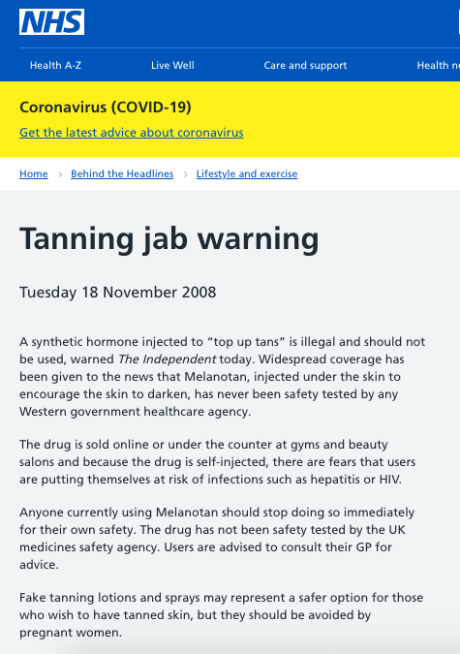
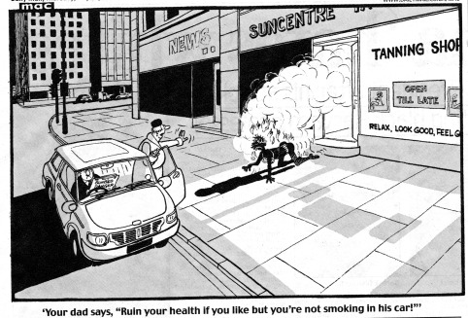
21st century/today: Melanotan Injections combined with Sunbeds?
‘Your dad says, "Ruin your health if you like but you're not smoking in his car.”’ Daily Mail, 30 July 2009.

Slide 19

Conclusion (1/3): When, how and why were tanning technologies discovered/invented?
‘Revolutionary’ health enhancers? Medical cures/treatments? Skin cancer preventers? Safer tanning alternatives? Immunce boosting virus preventers?
Or, for commercial ‘health’ and beauty companies, is the main objective to profit from public health concerns …. ?
(Virginia Berridge and Kelly Loughlin, Medicine, the market and mass media: producing health in the twentieth century; Virginia Berridge, ‘Electronic cigarettes and history’, Lancet, 383, 9936, (2014))
Email advertisement to my inbox, The Tanning Shop
(sunbed company), UK, May 2021.

Slide 20
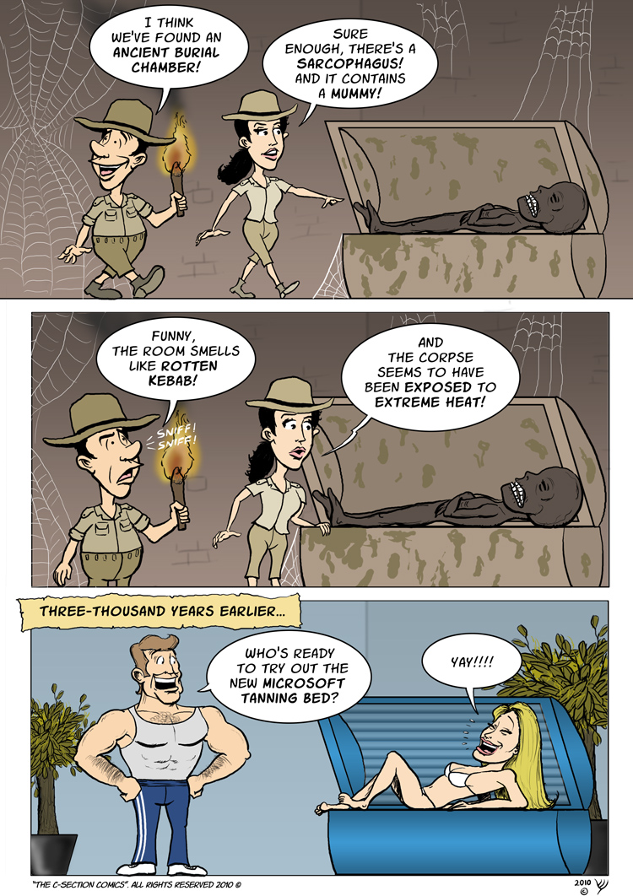
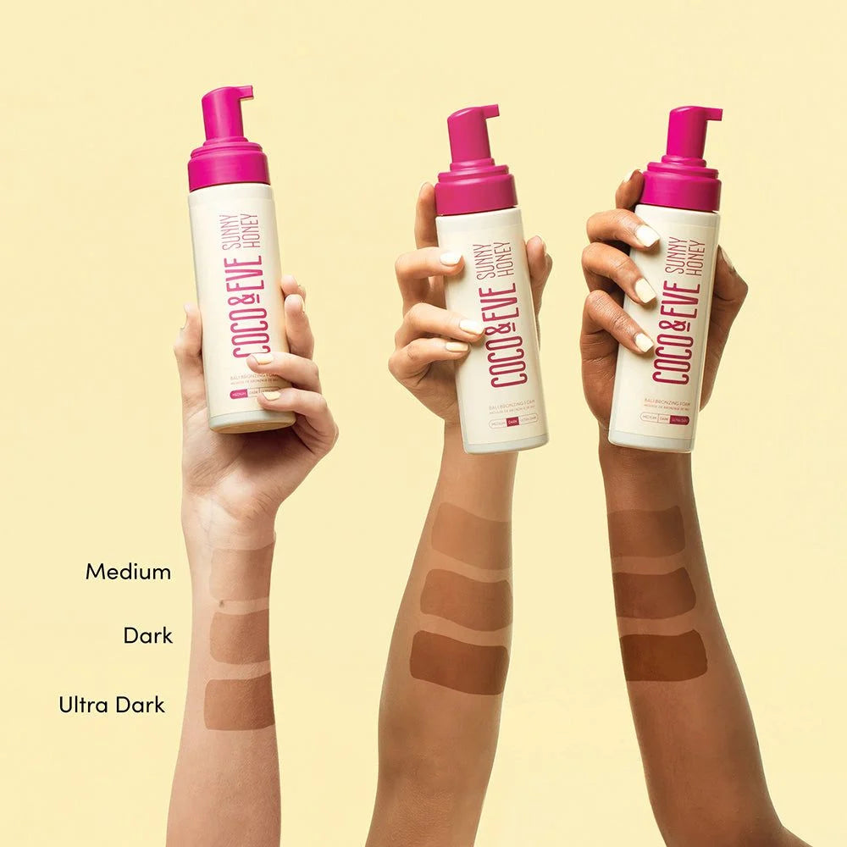
Conclusion (2/3): Who used tanning technologies, where and why? And why were some tanning consumers shamed?
Medical patients, athletes, and then everyday consumers following the medicalisation and later commercialisation of UV rays, 1890s to 1970s/80s (Woloshyn, Soaking the Rays).
Working-class stigma: yuppies and now ‘chav’ stereotypes by the 1990s.
Originally only white people but very recently, also brown and black people tied in with Black Beauty politics in Britain.
Coco & Eve DHA fake tan advertisement, 2023.

Slide 21

Conclusion (2/3): What was the changing role of the mass media in pro-tanning advertising and later ‘anti-’tanning skin cancer campaigns?
Media functioned as a switchboard for pro-tanning advertisements and anti-tanning cultures by the late 20th century.
Providers are usually the ‘first expert’ informers of their new products in the media ... until the government and public health intervene, which can take a while and can sometimes be too late, especially for ‘addictive’ products (psychologically/physiologically)
Accompanying visuals and culture-bound rhetoric can often weaken health education messages by conveying a contradictory message…
Source: Women Magazine Collection 1, ‘No, you can’t use the microwave as a tanning booth for Barbie’, Good Housekeeping, 2003.

Slide 22
‘Methods of changing skin colour, whether permanently or semi-permanently, will become [even] more varied and sophisticated’
Nina Jablonski (anthropologist of human skin colour), Skin: A Natural History (University of California Press, 2013), p.­185.
Thank you for listening.

