Slide 1
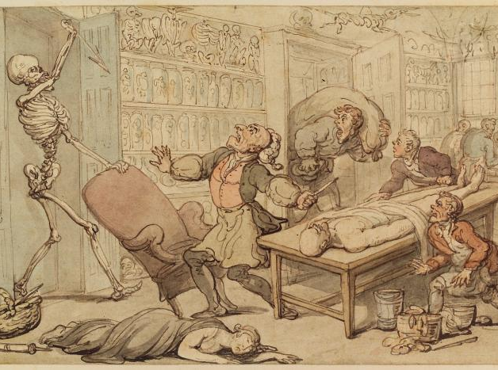
Death, Dissection and Anatomy
HI176: Mind, Body and Society
Elise Smith
Thomas Rowlandson, ‘Death in the Dissection Room’ (1815)
N.B. This presentation contains images of human remains.

Slide 2
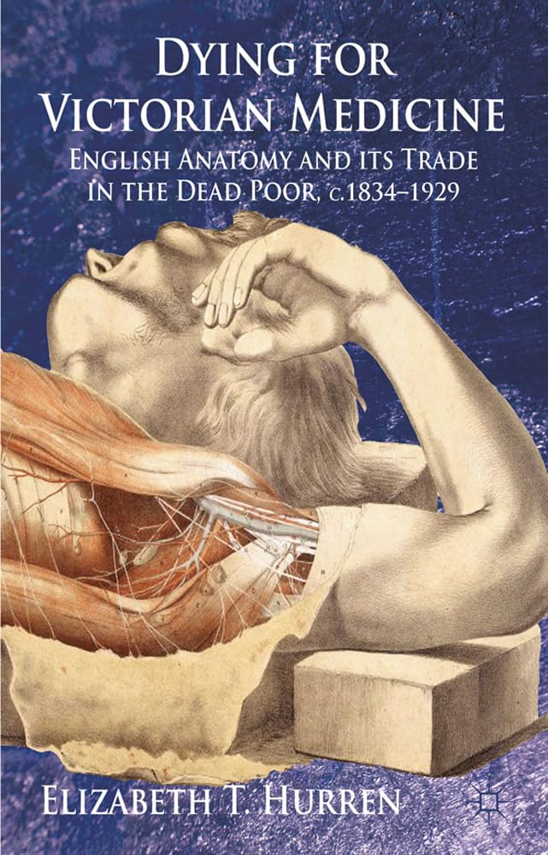
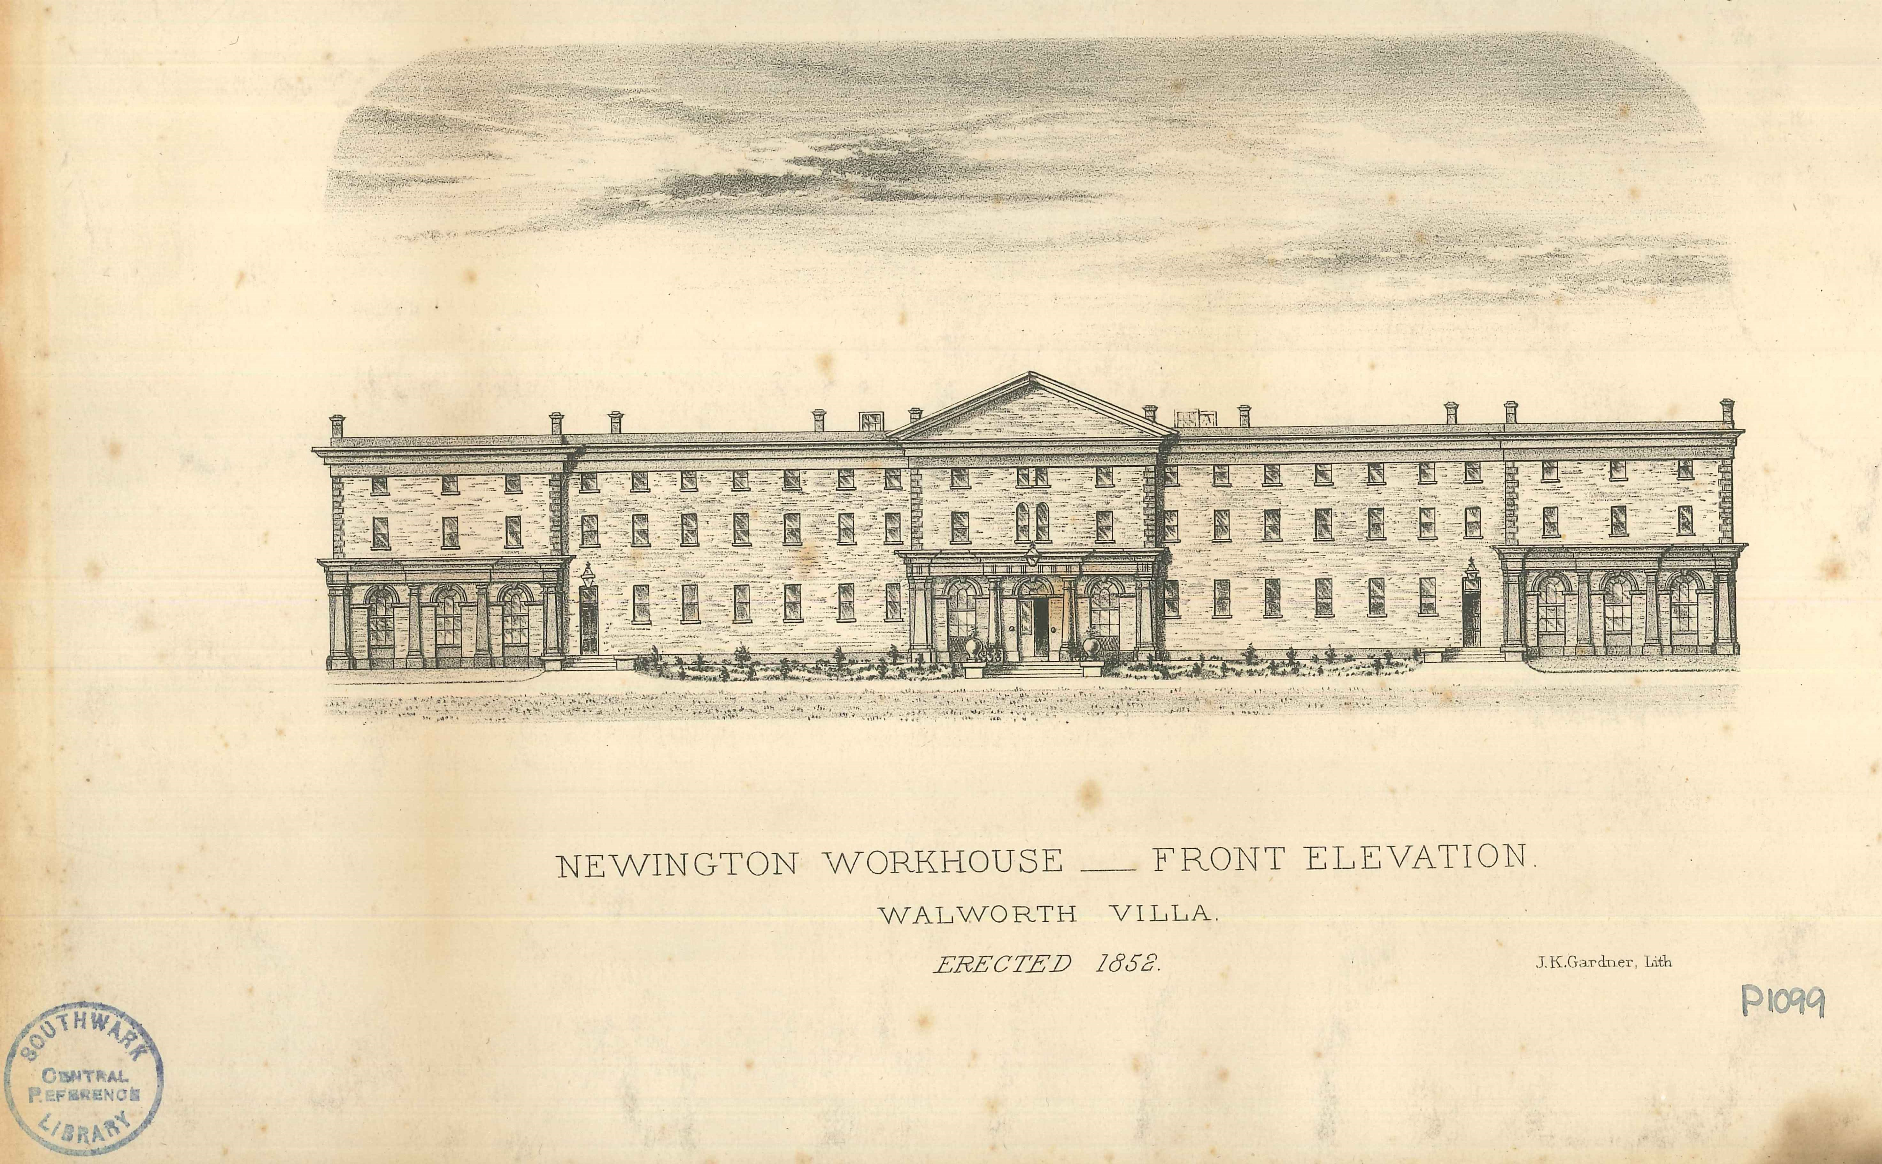
A Workhouse Death, 1857

Slide 3
Lecture Structure
Focus on 18th and 19th century Britain: education, belief systems, practices, and legislation.
Medical education and the necessity of dissection—cutting into the dead to serve the health of the living.
Popular, legal and religious beliefs surrounding the treatment of the dead which were often at odds with the medical profession’s requirements to dissect cadavers. Ethics in conflict!
Graverobbing and the trade in cadavers to supply anatomy schools.
Legal solutions and ramifications.

Slide 4
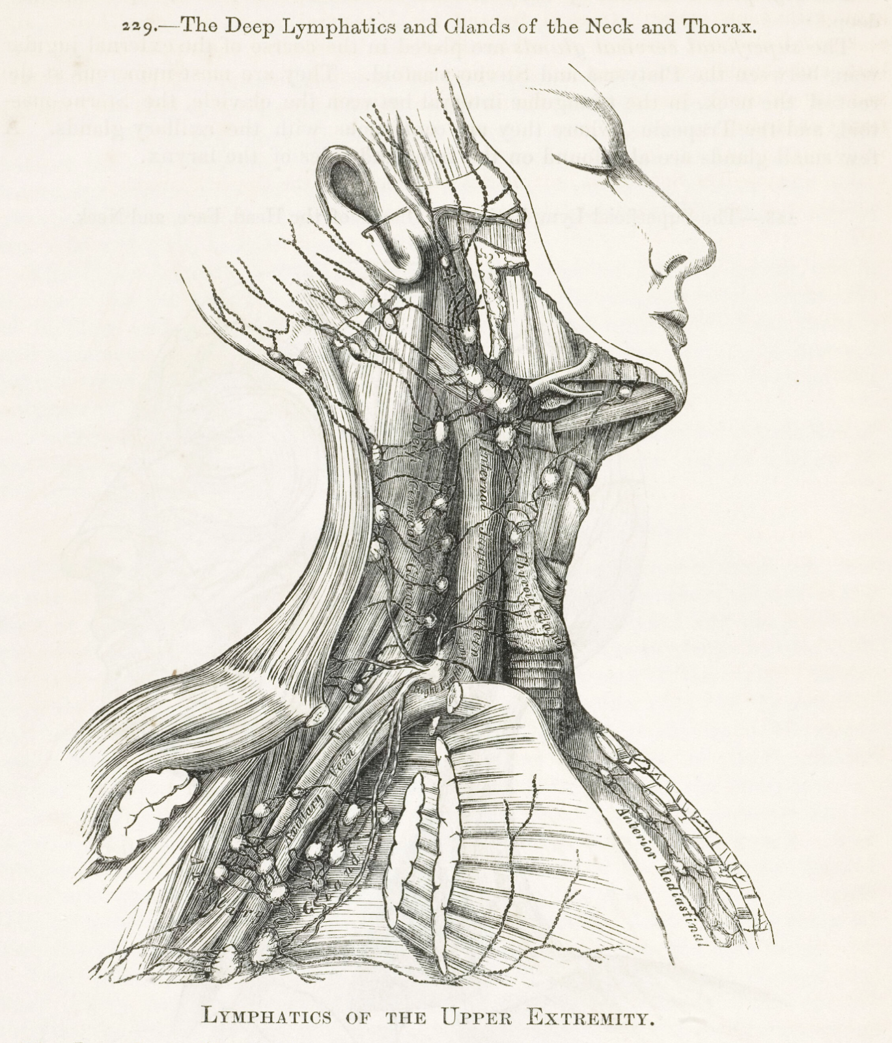
Medical Education and Dissection
Accurate knowledge of anatomy, obtained through first-hand experience of dissection, integral to medical education by the 18th century.
Practice became more frequent; no longer seen as a punishment, but as a scientific necessity.
Institutionalisation: Anatomy chairs established at major medical schools; private schools founded; proliferation of anatomical museums.
By the start of the 19th century, dissection experience a requirement for medical licenses.
Henry Gray’s Anatomy (1858)

Slide 5
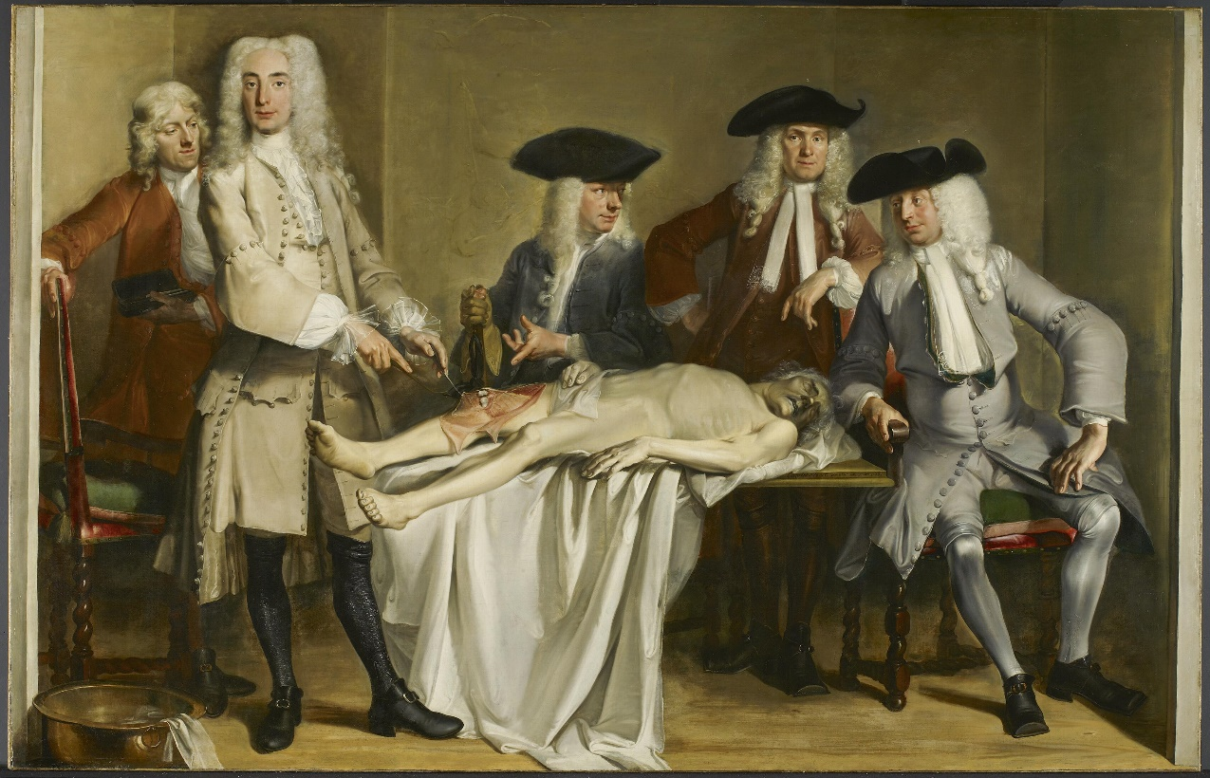
Cornelis Troost, Professor Roell’s Anatomy Lesson (1728)

Slide 6
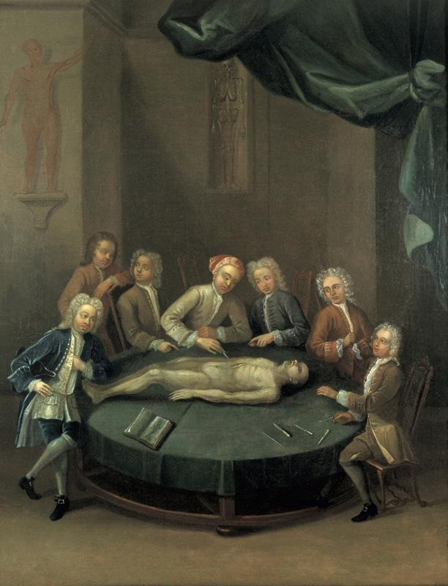
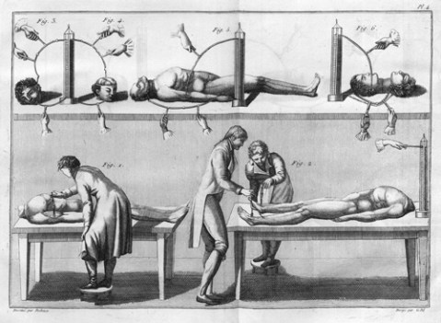
Medicalised Bodies: From Research to Reanimation
William Cheselden’s anatomical demonstration, c.1740
Galvanism Experiments, 1804

Slide 7
Popular Understandings of Death and the Body
Death often occurred in the household, in the presence of family, rather than in hospitals amongst medical practitioners. Higher mortality levels, but public not inured to death. Grief and mourning were publicly (and privately) expressed.
Death and the proper posthumous treatment of bodies were of concern to the living, although complex and bound by religion, class, ethics and ideology.
The idea of a ‘decent’ burial was important for Christians of all denominations.
Superstitions about the treatment of the dead survived into this period.

Slide 8
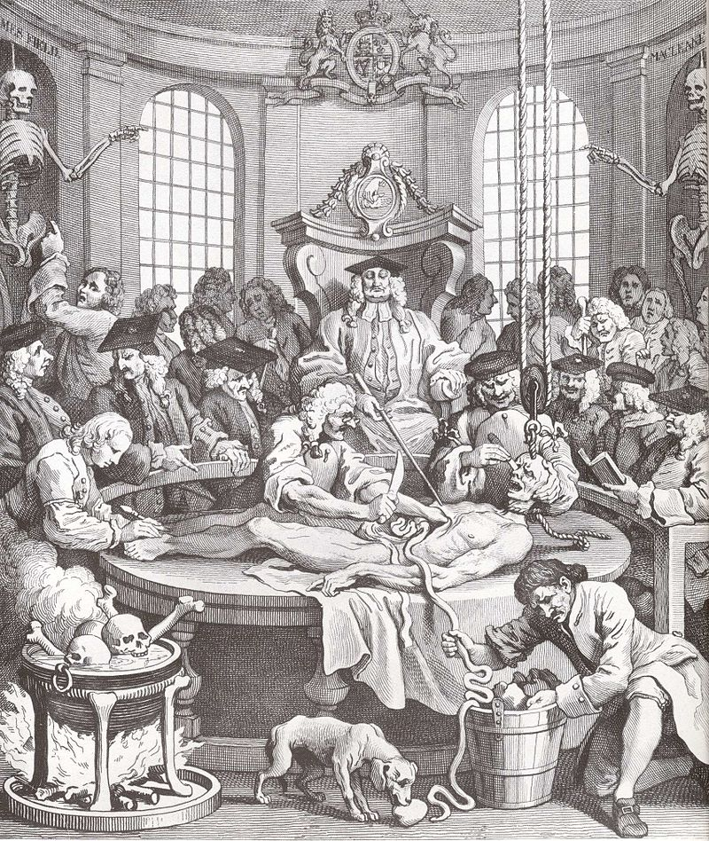
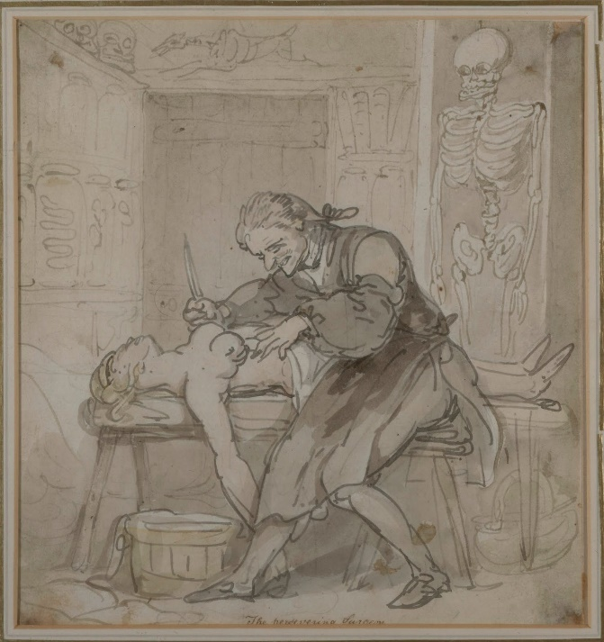
Popular Perceptions of Dissection: Desecration, Cruelty, and Perversion
William Hogarth’s Four Stages of Cruelty (1751)
The Persevering Surgeon by Thomas Rowlandson (c. 1780s)

Slide 9
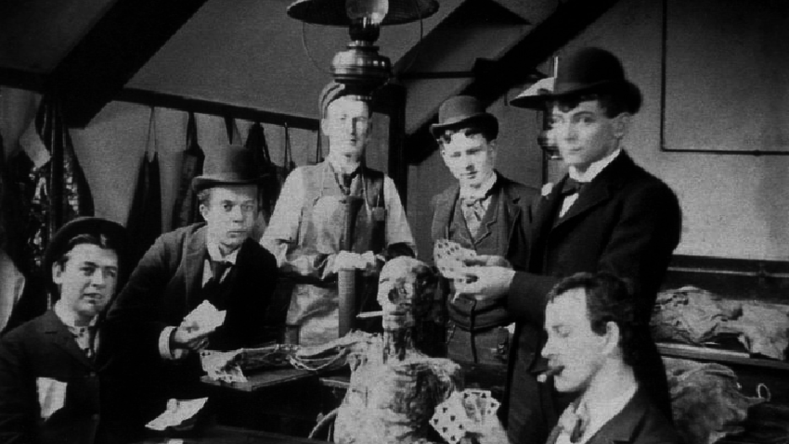

Slide 10
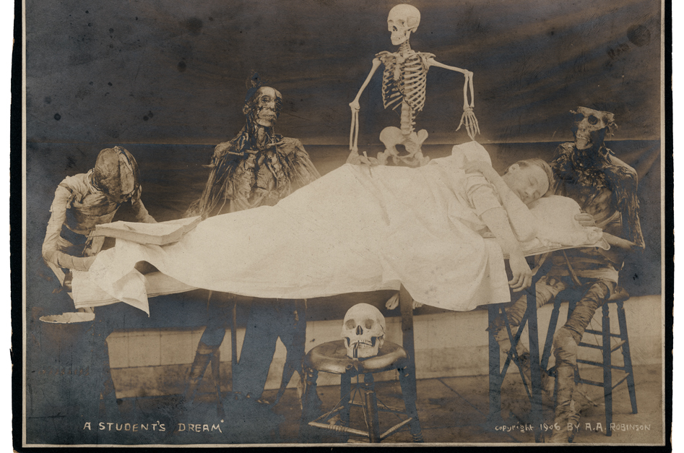

Slide 11
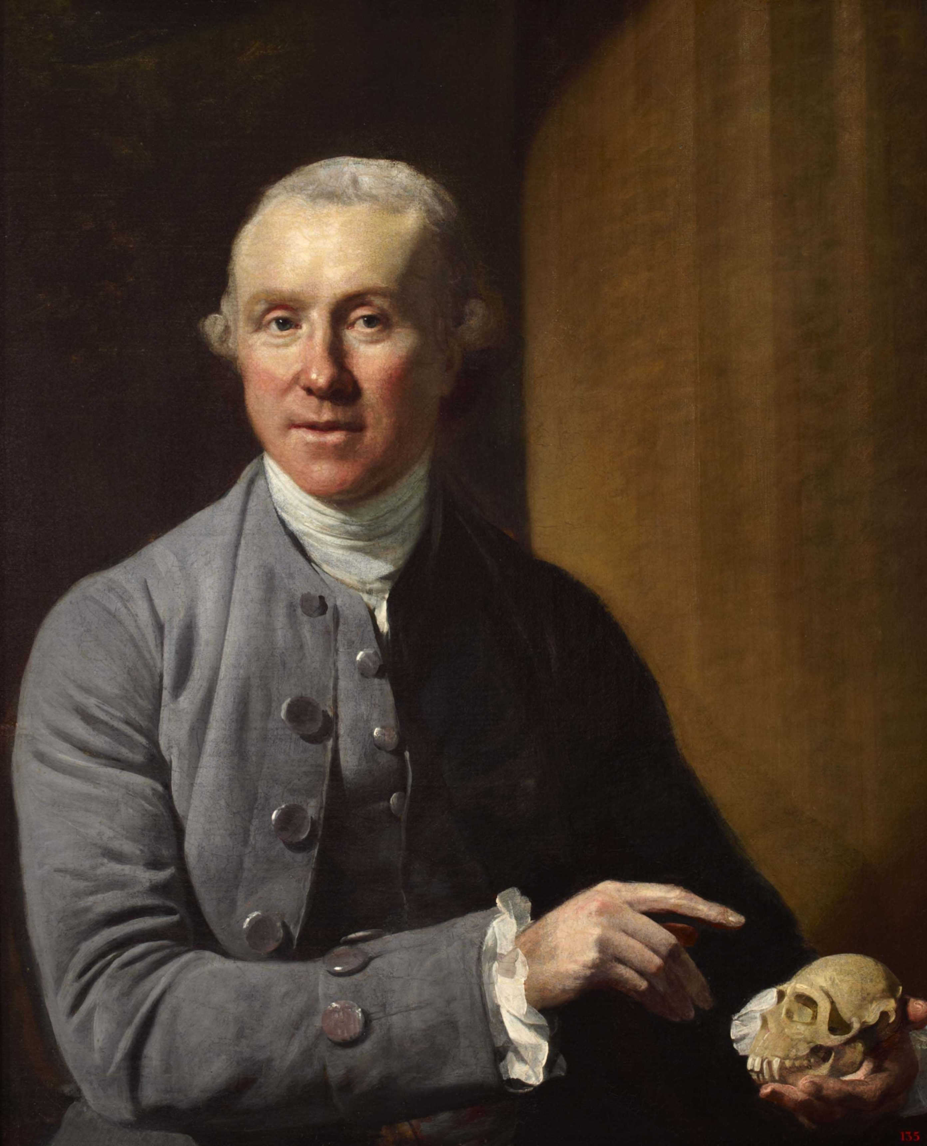
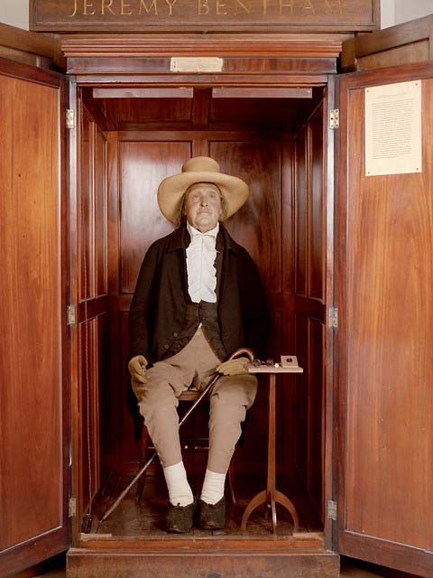
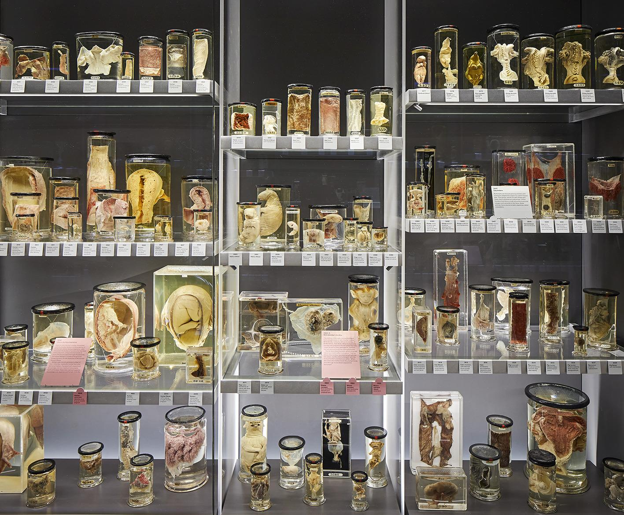
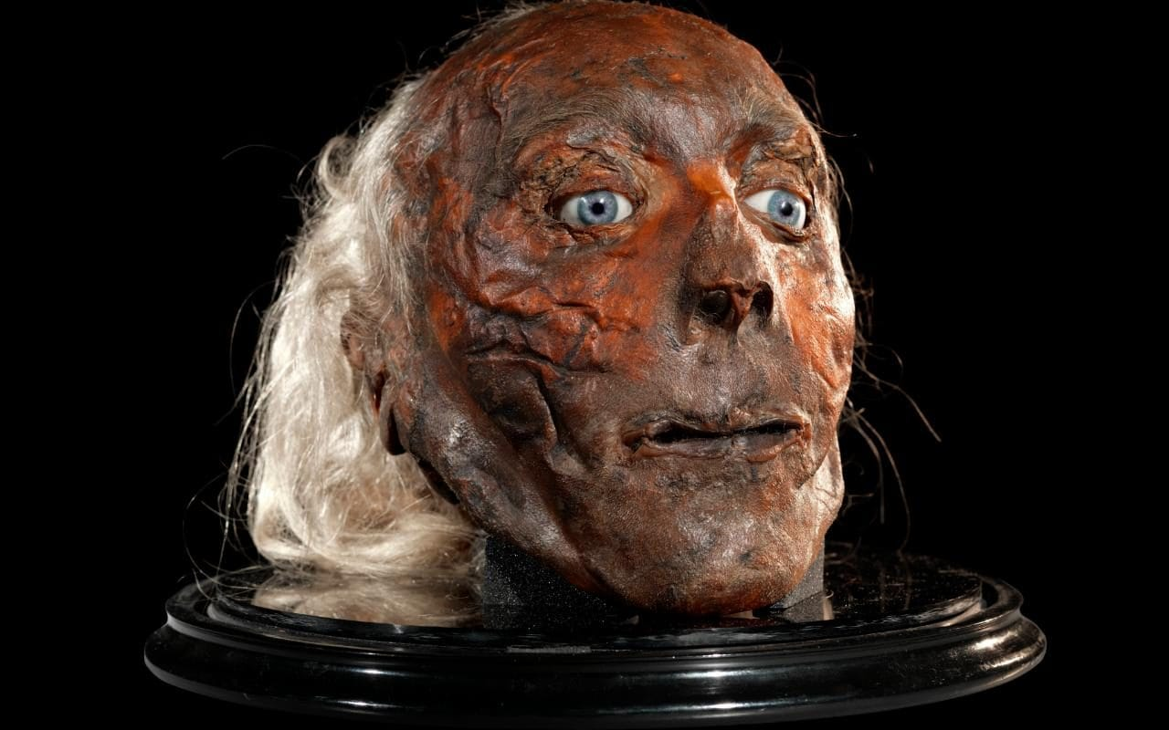
Death on Display
Macabre curiosity fueled the growth of anatomy museums—many exclusively for medical students, but some were open to the public.
The Hunterian Museum at the Royal College of Surgeons—John Hunter’s collection acquired in 1799 and put it on display.
William Hunter taught anatomy at the Royal Academy of Arts, training artists using dissection and living models.
Jeremy Bentham, who helped to draft the 1832 Anatomy, donated his body for dissection and mummification. Still on display at UCL.
John Hunter (1728-1793)
Jeremy Bentham’s ‘Auto-Icon’,
University College London
Hunterian Museum

Slide 12
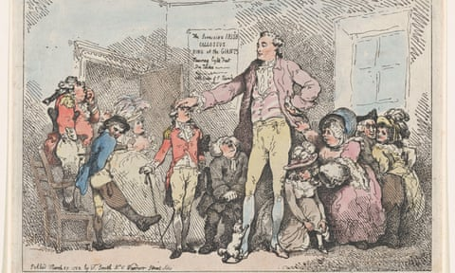
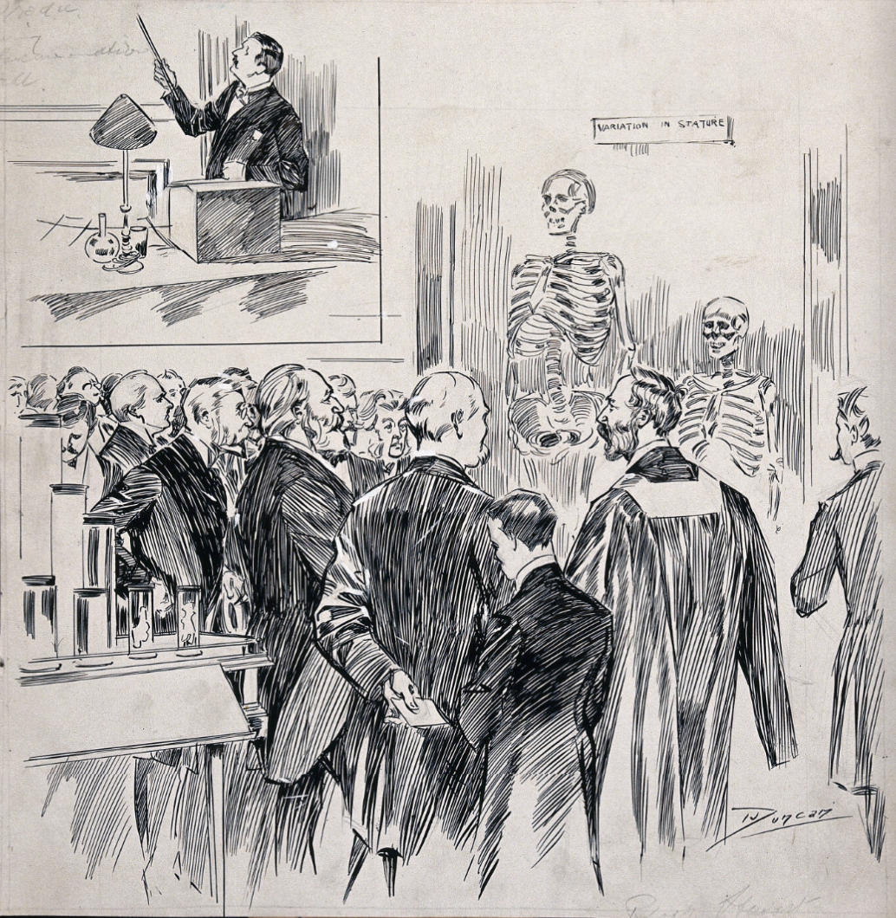
Charles Byrne (c.1761-1783)
Thomas Rowlandson (1785)
Sketch of RCS spectators and specimens, by J. A. Duncan, 1900

Slide 13
Supply and Demand
There were often insufficient cadavers available to meet the needs of medical education in this period.
The legal supply of bodies came from the gallows, or from the ‘unclaimed’ poor who died in public institutions such as workhouses.
Criminals could sell their bodies to anatomists before their executions, using the funds to pay for additional food or alcohol in prison. Alternatively, anatomists could pay hangmen for the bodies of the executed.
The 1752 Murder Act stipulated that criminals must also suffer post-mortem punishment, including dissection.

Slide 14
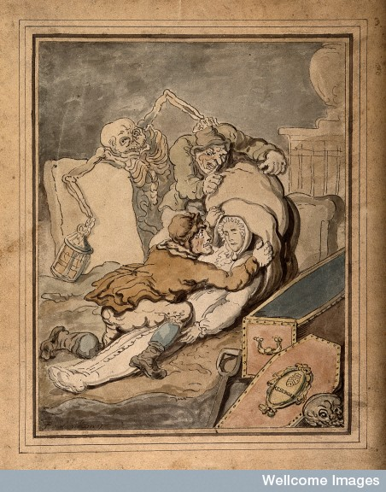
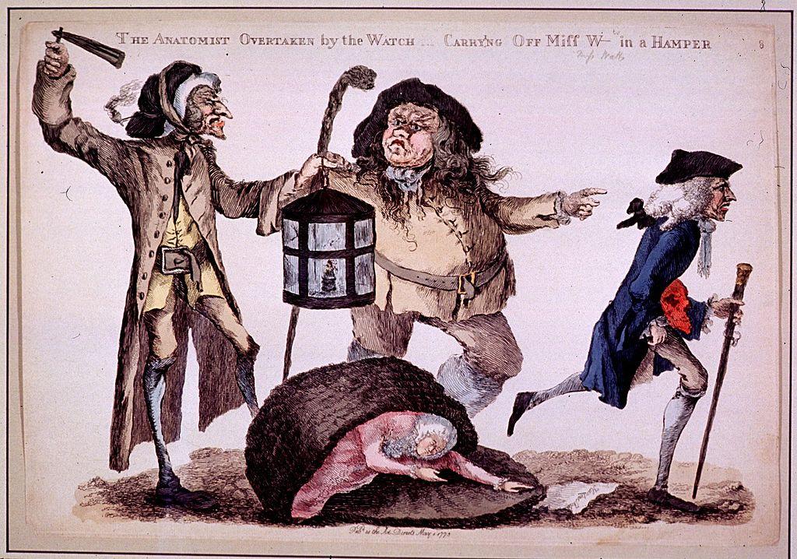
Grave Robbing
The Anatomist Overtaken by the Watch, by William Austin, (1773) depicts John Hunter running from the scene.
Thomas Rowlandson (1775)

Slide 15
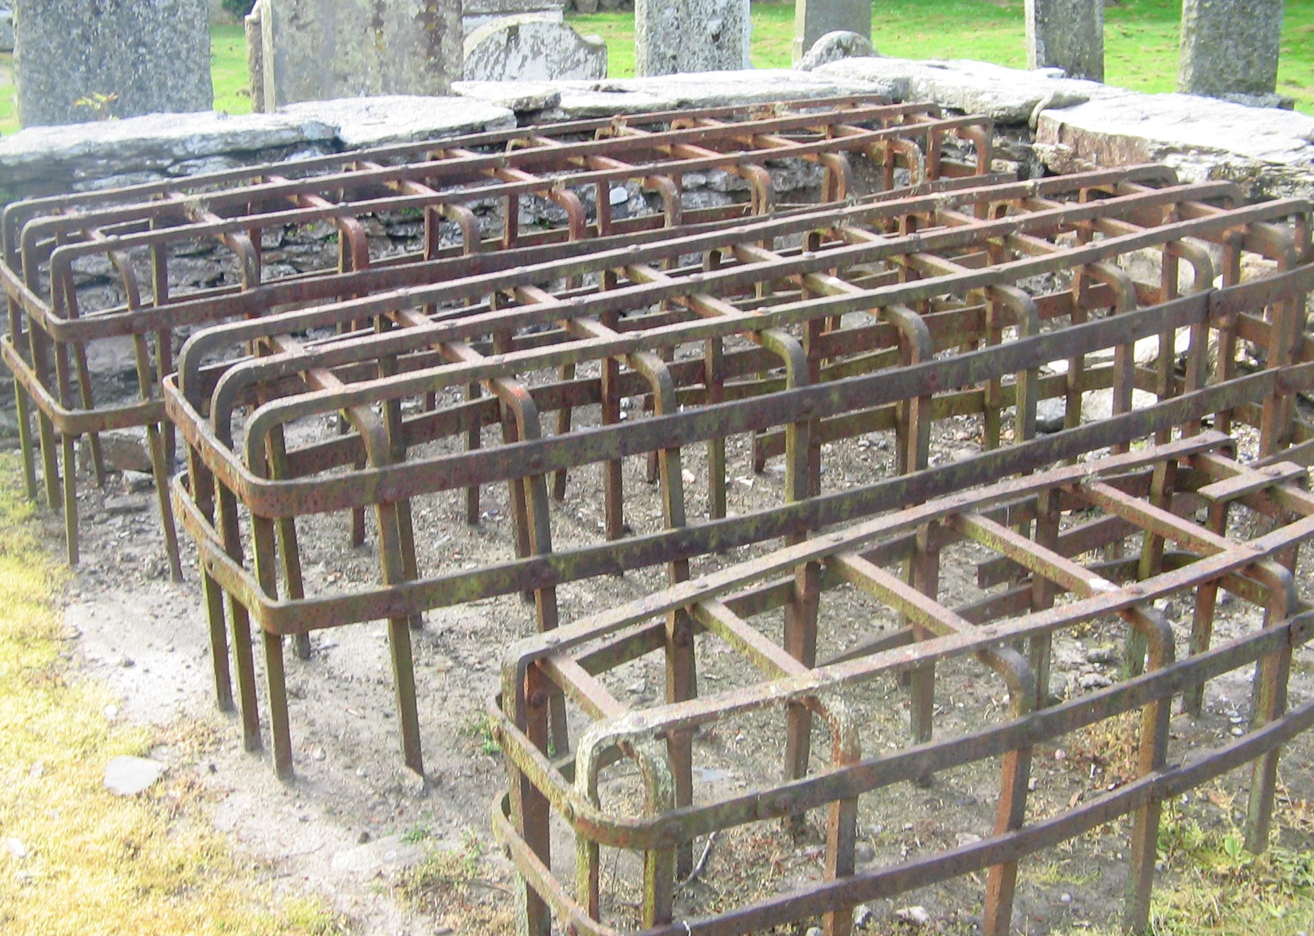
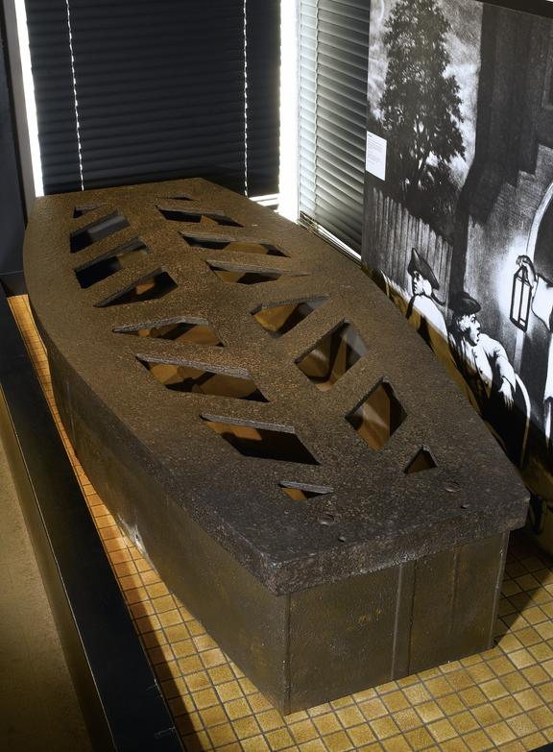
‘The Golden Age of Bodysnatching’
Medical schools increasingly resorted to underhanded methods of securing corpses for dissection, including paying for professional grave-robbers (‘resurrection men’).
Increased public anxiety about ‘body snatching’ led to resentment towards anatomists and pressure for government intervention to provide a legal supply of bodies for dissection.
Various methods were tried to deter grave robbing, including the use of night watches at graveyards following burial, and ‘mort-safes’ to protect graves from theft.
Bodies not legally considered ‘property’, and thus practice occurred on a knife-edge of legality.
‘Mort-safes’ in Churchyard at Logierait, Scotland
Iron mort-safe,
early 19th century
(Science Museum)

Slide 16
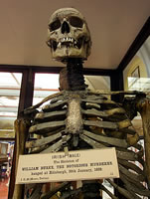
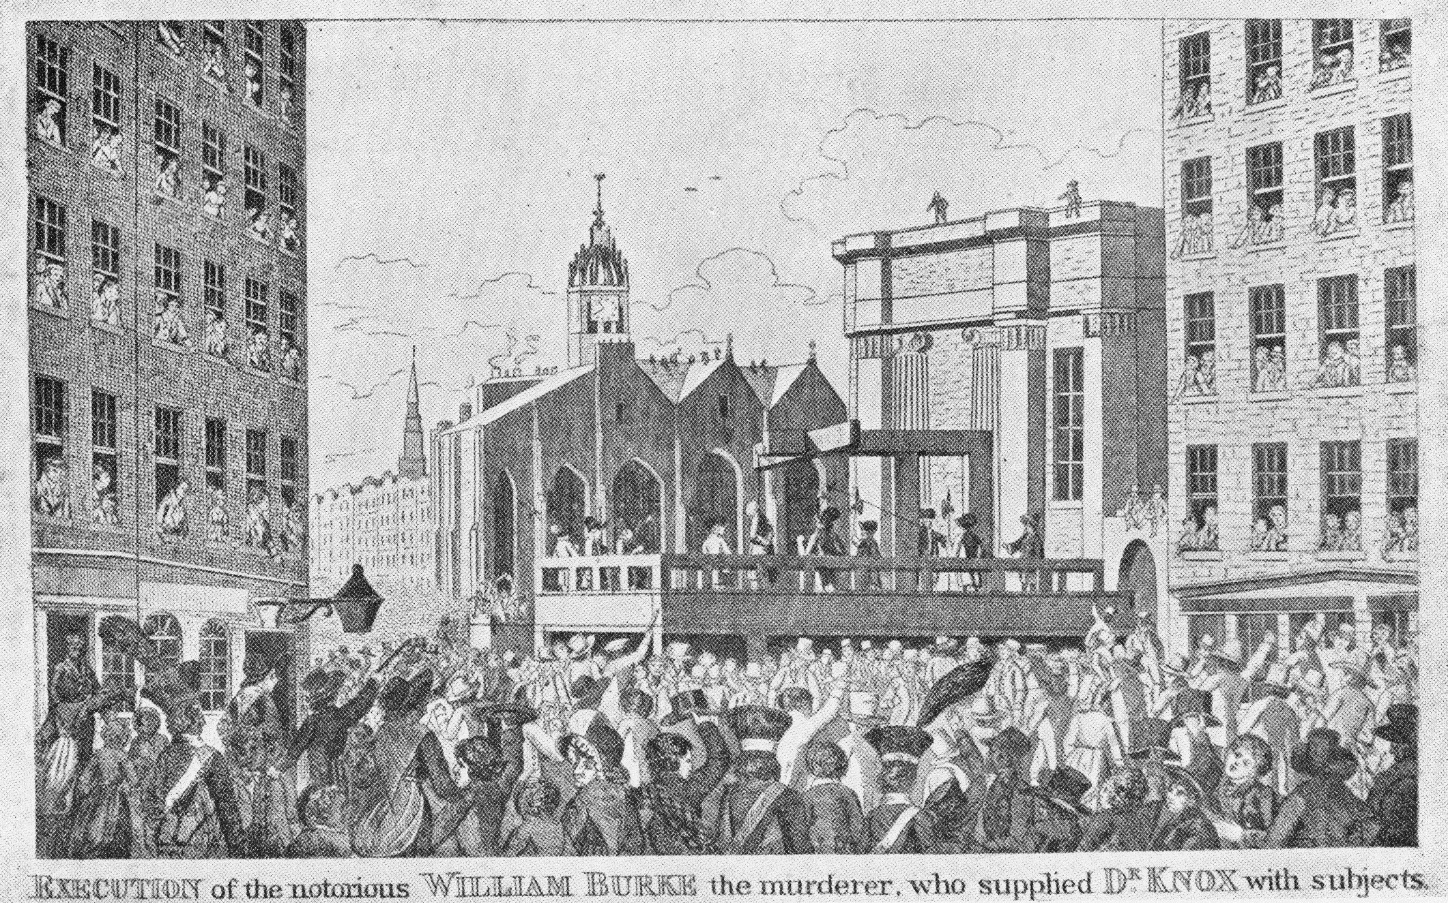
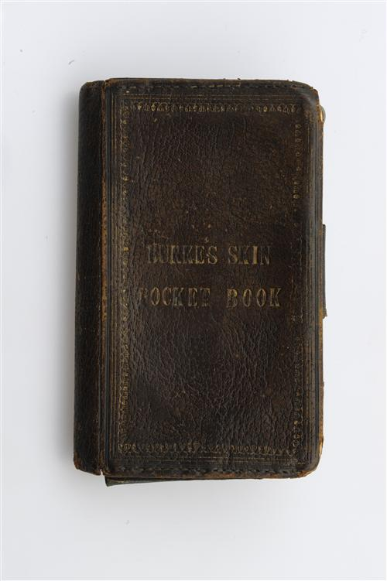
Burke and Hare
Over ten months in 1828, William Burke and William Hare murdered 16 people in Edinburgh and sold their bodies to the anatomist Robert Knox, who dissected them in his anatomy school.
‘Burking’ came to refer to their method of luring victims to their lodgings and suffocating them while drunk. Widespread panic over potential copycat cases.
Hare escaped punishment by testifying against Burke, who was found guilty at trial and sentenced to death by hanging, 28 January 1829.
Burke dissected by Alexander Monro; his body parts were made into artefacts.
William Burke’s skeleton,
Edinburgh Royal College of Surgeons
Burke’s execution in 1829 attracted 25,000 spectators
Pocket book made from Burke’s skin,
Edinburgh RCS Collections

Slide 17
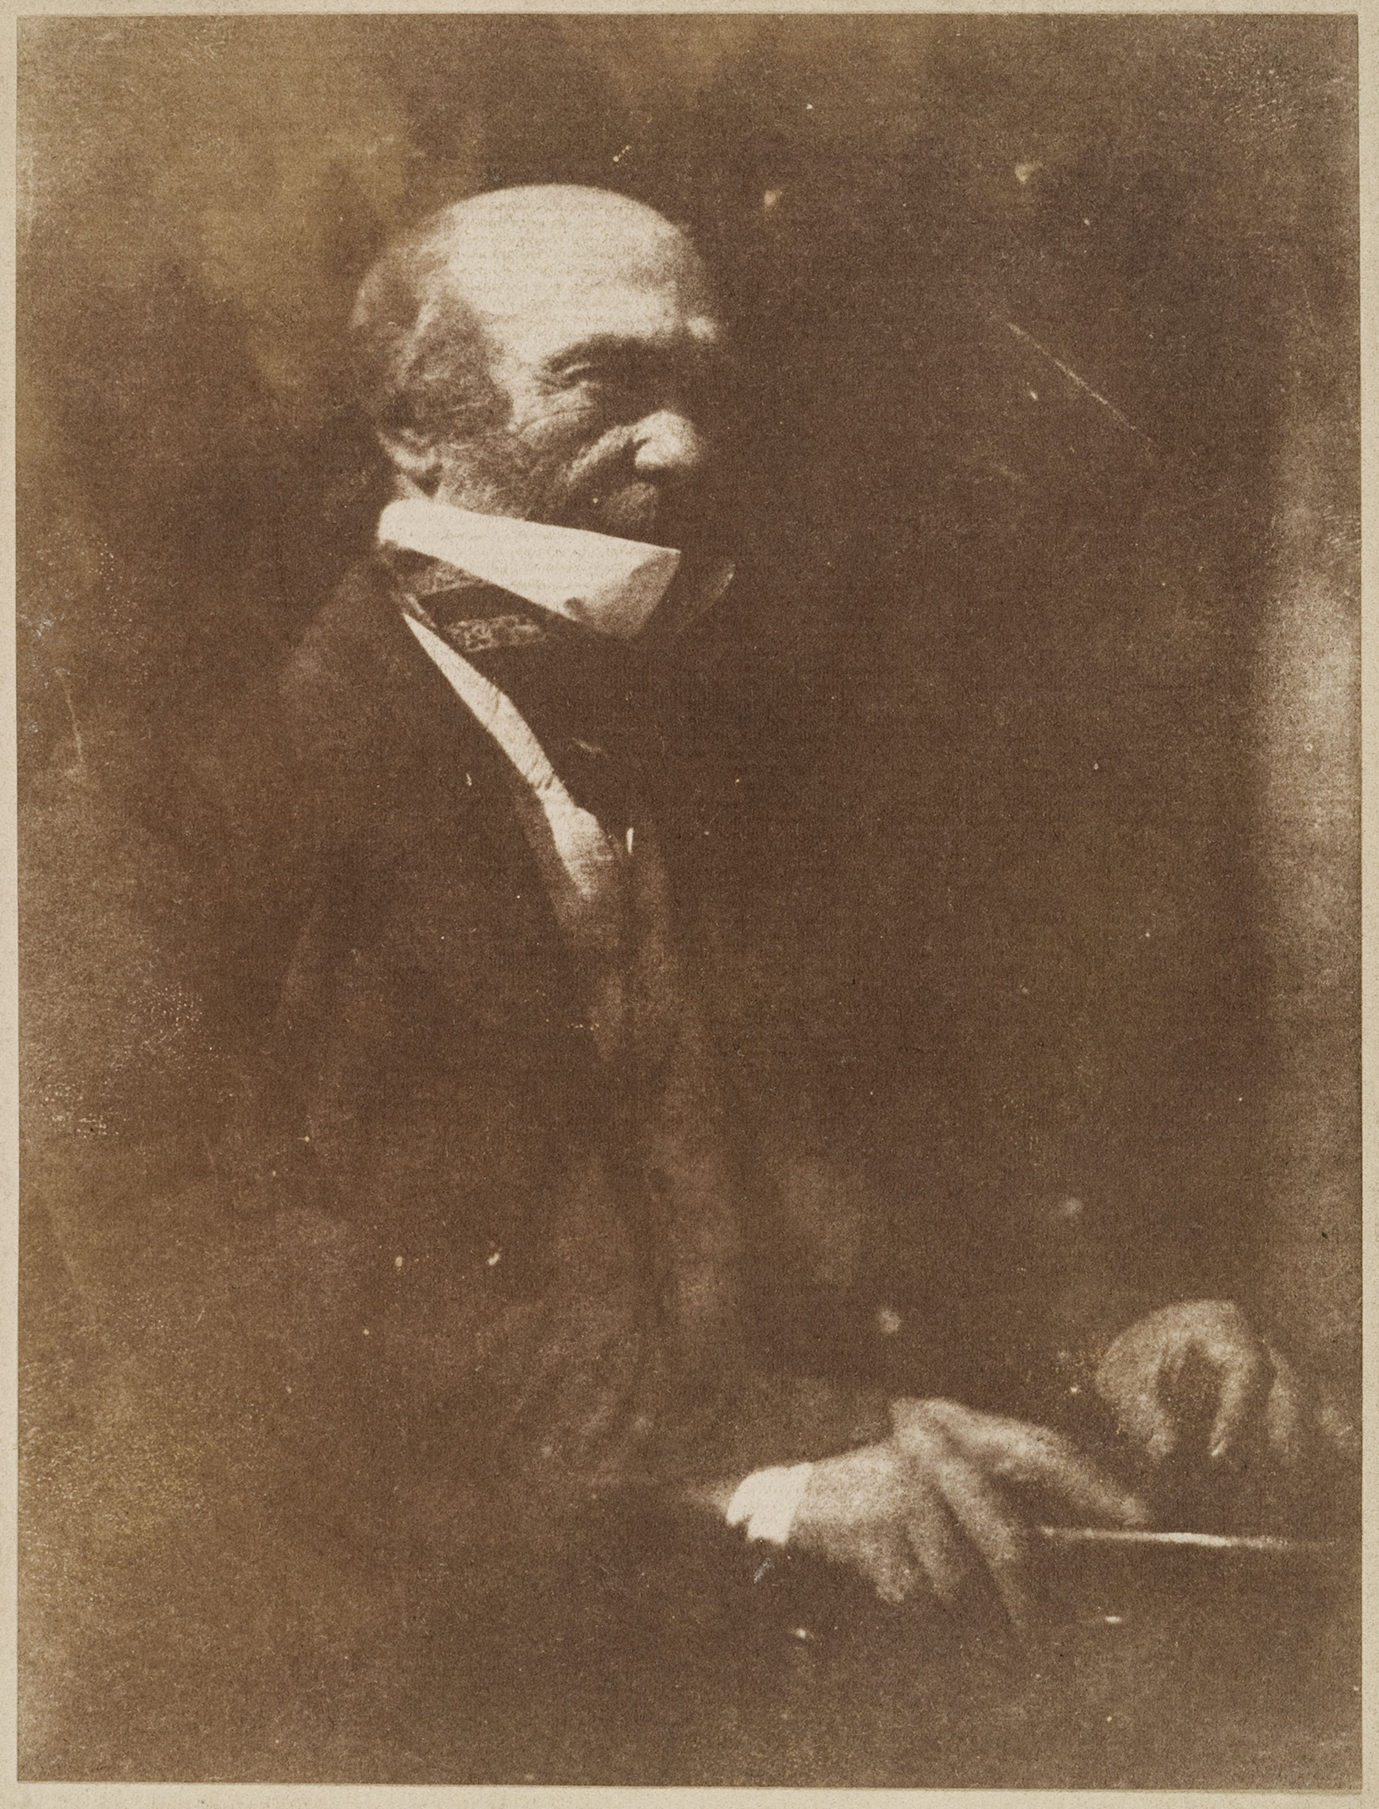
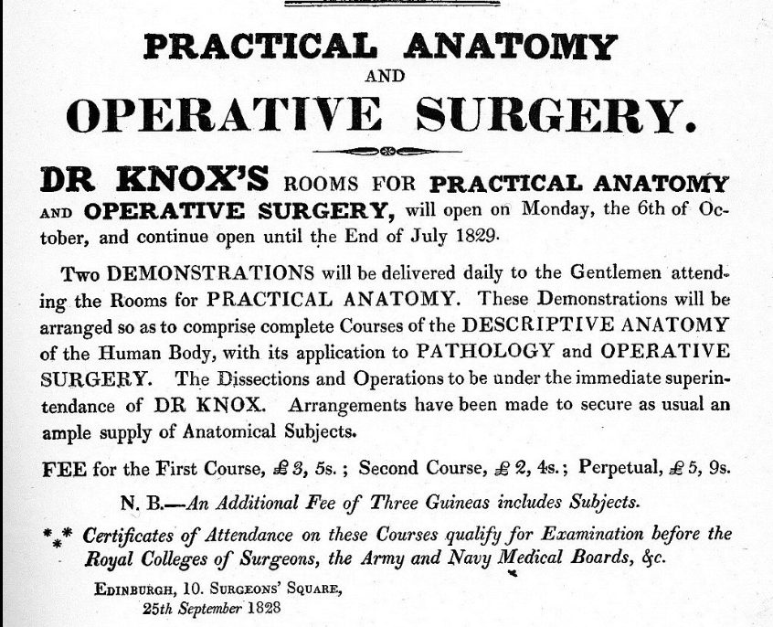
‘Burke’s the butcher / Hare’s the thief / Knox the boy the buys the beef’
Robert Knox, Edinburgh lecture ad, 1828
'A particular Account of the Extraordinary Demolition of an Anatomical Theatre at Aberdeen’, (1831) National Library of Scotland.
Robert Knox, 1791-1862

Slide 18
The 1832 Anatomy Act
Burke and Hare scandal put pressure on Parliament to resolve problem of legally supplying bodies for dissection.
Select committee to draft recommendations in 1829—making bodies of unclaimed poor from workhouses, prisons, and hospitals available to medical schools.
Anatomy Act passed in 1832 and included provisions for licensing anatomists and appointing inspectors to regulate the supply of dead bodies.
Act sought to remove the association between criminality and dissection by removing it as a penalty for the executed.
By providing unclaimed bodies of the poor from state institutions, the supply of cadavers for medical education was resolved, but still construed as a punishment for poverty—posthumous desecration of the poor without their consent.

Slide 19
Seminar questions
‘Practical experience of dissecting a human body was an essential requirement of anatomical study in late eighteenth- and early nineteenth-century Britain’. Discuss.
To what extent did popular and religious beliefs over the treatment of the dead body impact upon the supply of cadavers for anatomical demonstration in the eighteenth and early nineteenth century?
How was the anatomical study of the dead justified for the benefit of the living in the eighteenth and early nineteenth century?

