Slide 1
Doctoring the Nation: The Rise of Eugenics
Mind, Body and Society

Slide 2
Aims/Structure of Lecture
1. Introduce eugenics as a prime example of ‘doctoring the nation’ between the 1880s and 1940s
2. Demonstrate that this went beyond Nazi Germany
3. Examine the reasons for the rise of this mode of ‘doctoring the nation’
4.Consider reasons for its particular association with Nazi Germany

Slide 3
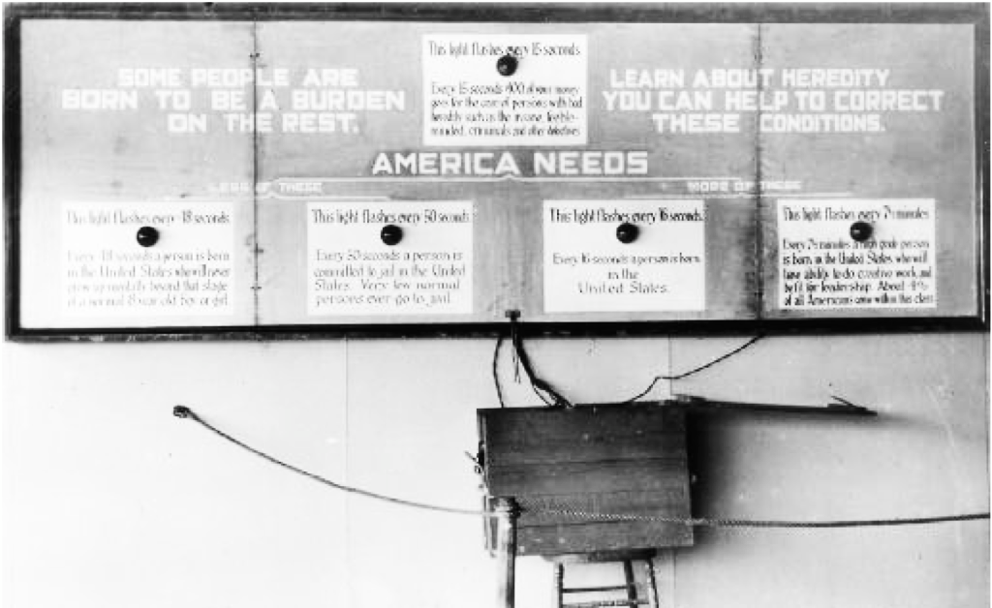
1. Eugenics as a way of ‘doctoring the nation’
Eugenics in the USA
The Oregon Experience
A display from the American Eugenics Society at a fair in Topeka, KS, in 1929. The sign on the top, for example, reads: “Every 15 seconds, $100 of your money goes for the care of persons with bad heredity, such as the insane, feeble-minded, criminals, and other defectives.”
Photo American Philosophical Society

Slide 4
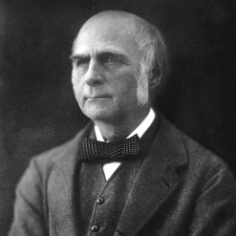
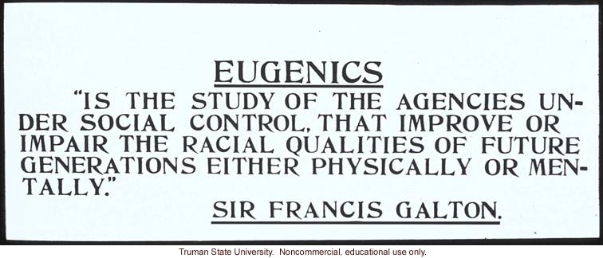
What was eugenics?
Term coined in 1883 by British scientist Francis Galton (1822-1911), cousin of Charles Darwin
Galton builds on work of Darwin to extend interest in variation, the role of heredity, and the question of (un)natural selection when it came to man

Slide 5
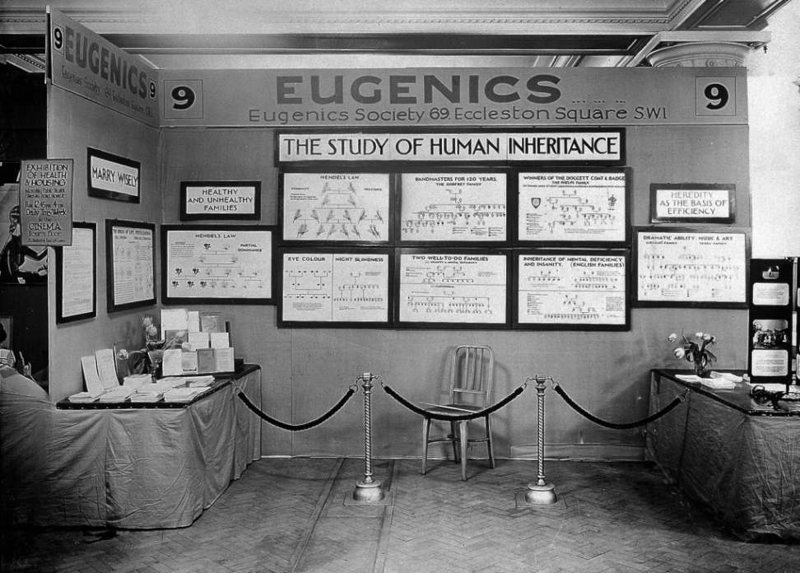
Eugenics becomes a science and a movement
1904: setting up of the Eugenics Record Office (later the Eugenics Laboratory) at UCL
1907: Eugenics Education Society founded (from 1926 The Eugenics Society)
1908 first edition of the Eugenics Review
Eugenics Society never more than 1000 members (high proportion of professionals) but influence of idea extends much further

Slide 6
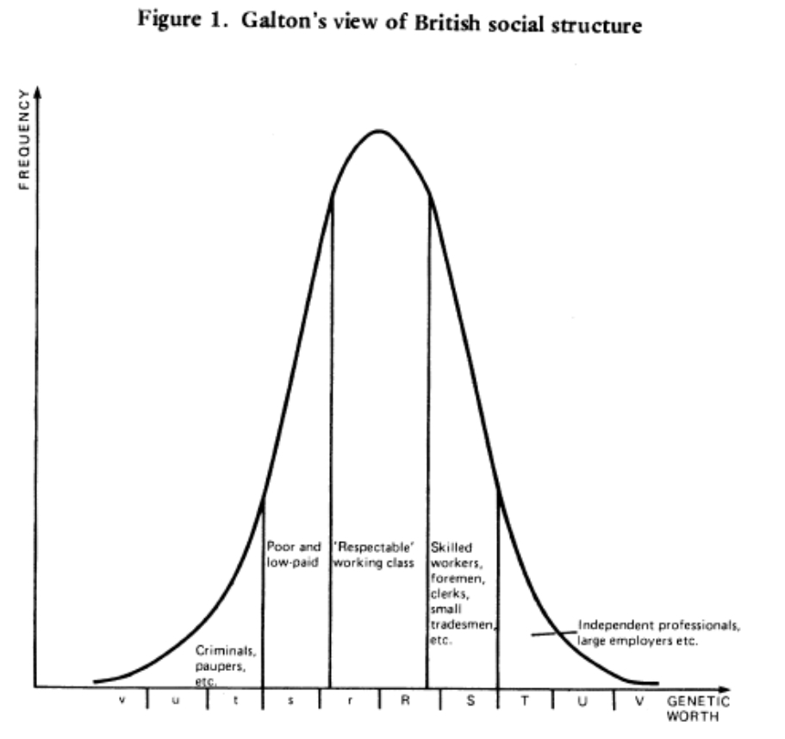
Eugenics as a prime example of ‘doctoring the nation’
Interested in the variation of qualities (eg intelligence) across a population
Draws attention to those at either extreme
Theory of heredity offers clue to how society might adjust the mean to minimise social problems and maximise ability of population

Slide 7
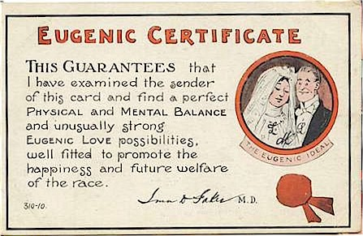
Positive eugenics
Encouragement of the fit to breed: education and propaganda
Leads to consideration of incentives
Consideration of marriage advice and certificates of fitness
Encourages use of mental testing to create a ladder of opportunity in education
Often meritocratic

Slide 8
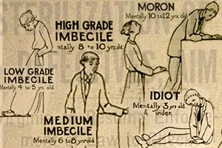
Negative eugenics
Birth control
Immigration control
Sterilisation
Segregation
‘Euthanasia’
Particular focus on ‘mental defectives’, ‘feeble-minded’, mentally ill, physically handicapped –but also alcoholism, criminality…

Slide 9
2. Demonstrate that this went beyond Nazi Germany

Slide 10
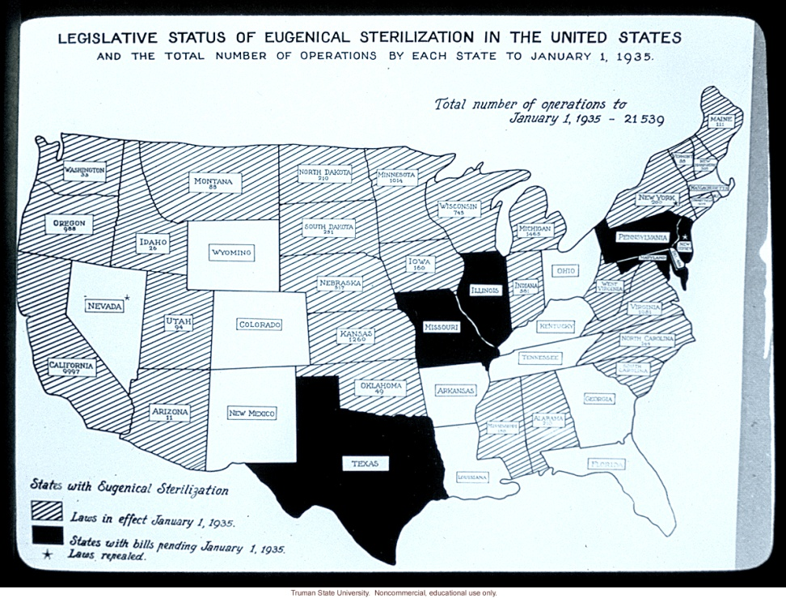
Compatibility with liberal regimes
British roots and continuing leading role
Support from leading writers and intellectuals including many on the left such as H.G. Wells and George Bernard Shaw
British Mental Deficiency Act 1913
USA, Canada, Australia: immigration control
USA: introduction of sterilisation in large number of states by 1930s
Canada: forced sexual sterilisation in Alberta 1929, British Columbia 1933, differentially targeting women, institutionalised people, First Nations.

Slide 11
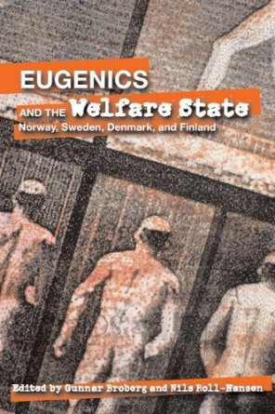
Compatibility with social democracy
Denmark, Finland, Norway and Sweden all introduce eugenic laws in 1930s
By 1970 estimated 170,000 sterilised

Slide 12
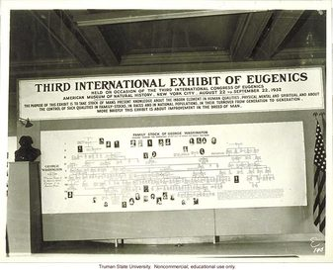
Becomes an international movement
International eugenics conferences beginning in London, 1912
Part of being a modern nation
Extends across Europe, to North and South America, to White Dominions, and even to Russia and to colonial regimes

Slide 13
3. Reasons for the rise of this mode of ‘doctoring the nation’

Slide 14
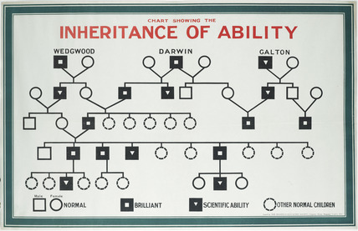
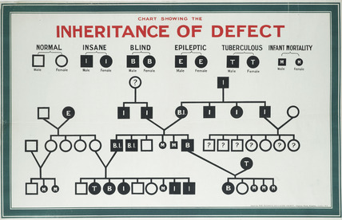
Science and pseudo-science
Victorian cult of measurement (Galton)
Longer-terms cultures of breeding
Emerging science of heredity
Modernist attractions of science of eugenics
Science or pseudo-science?

Slide 15
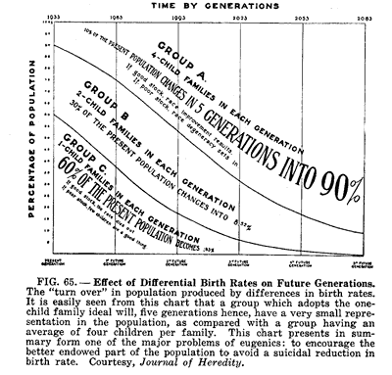
The demographic transition
From late 19th century a fall in fertility in western nations
Concern in Britain about decline being most marked in middle-classes and among professionals
In France, fear of overall population decline by early 20th century (encourages positive forms of eugenics)
Moral objections to birth control focus attention on segregation and ‘treatment’
Link to women’s groups, birth control advocates, and even sexual liberals

Slide 16
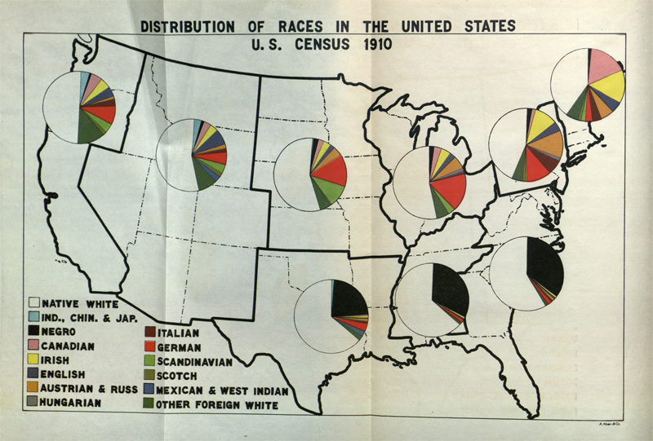
Nation building era
Heightened concern about international competition and ‘national efficiency’
Era of nation building and interest in defining the nation (eg post WWI)
Immigrant nations concerned about racial mix
And let’s not forget about eugenics in empire and post-imperial nation-building, e.g. South Africa, where it served to underpin practices of ’racial’ segregation and discrimination.

Slide 17
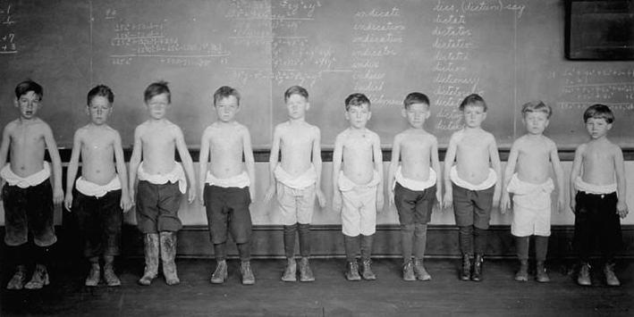
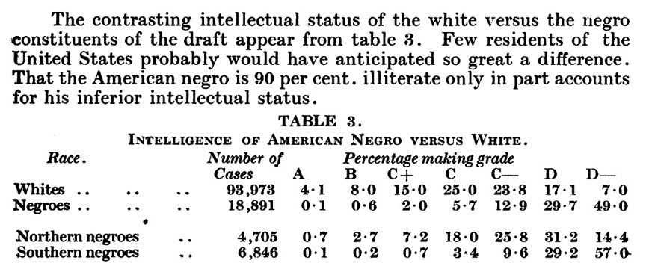
New ways of seeing /ranking population
Population problems and differences exposed by rise of mass education, mass enlistment (WWI) and growing scale of asylums, prisons, workhouses
Spread of anthropometric techniques and emergence of new tools such as the social survey and the psychological test to rank individuals.

Slide 18
New ways of seeing and ranking population
Among laboring men and servant girls there are thousands like them [feebleminded individuals]. They are the world’s “hewers of wood and drawers of water.” And yet, as far as intelligence is concerned, the tests have told the truth. … No amount of school instruction will ever make them intelligent voters or capable voters in the true sense of the word.
… The fact that one meets this type with such frequency among Indians, Mexicans, and negroes suggests quite forcibly that the whole question of racial differences in mental traits will have to be taken up anew and by experimental methods.
Children of this group should be segregated in special classes and be given instruction which is concrete and practical. They cannot master, but they can often be made efficient workers, able to look out for themselves. There is no possibility at present of convincing society that they should not be allowed to reproduce, although from a eugenic point of view they constitute a grave problem because of their unusually prolific breeding. (pp. 91-92)
Lewis Terman, Professor of Education at Stanford University and originator of the Stanford-Binet intelligence test
‘Which face is prettier?’ IQ test question for 6-year old children. Each pair must be ranked ‘correctly’.
Full article here
For a longer read on eugenics and testing in the UK: Eugenics, Testing and Race
For a longer read on eugenics and testing in US education: Rethinking Schools
Notes:
Reproduction of an item from the 1908 Binet–Simon intelligence scale, that shows three pairs of pictures, and asks the tested child, "Which of these two faces is the prettier?" Reproduced from the article "A Practical Guide for Administering the Binet-Simon Scale for Measuring Intelligence" by J. W. Wallace Wallin in the December 1911 issue of the journal The Psychological Clinic (volume 5 number 7)

Slide 19
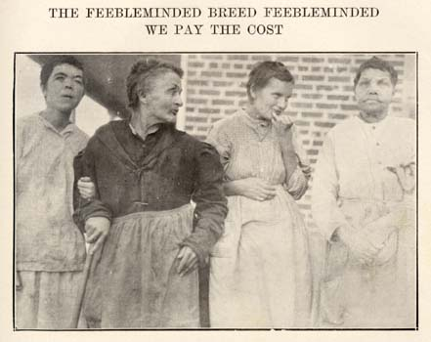
The challenges of a welfare state
Explaining failures: the ineducable; the recidivist, the unemployed
Opportunities for new experts to test, identify, segregate, and treat the unfit
Growing concern about the capacity and cost of solution of segregation (particularly as welfare state faces economic crises of war and depression, and as it becomes more ambitious)

Slide 20
4. Nazi Germany: an exceptional case?

Slide 21

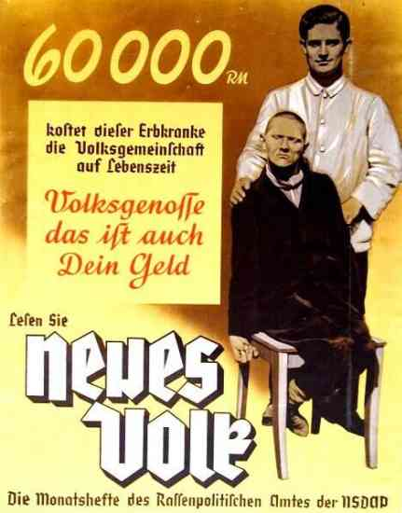
Why Nazi Germany stands out
Importance of ideology of national fitness and purity to politics and culture: ‘the ‘racial state’
Leader in psychiatric and genetic science
Opportunities from a sympathetic state
Degree of economic problems via depression and mobilisation of economy in WWII
Scale of sterilisation policy (375,000)
Use of ‘euthanasia’ for mentally handicapped (Action T4 – 70,000), sterilisation for clinical conditions from epilepsy to deafness and alcoholism
Genocide of racialised as well as medicalised populations (despite early role of Jewish elites in German Rassenhygiene/eugenics movement)

Slide 22

Yet German eugenics has roots before Nazi era
Sterilisation Law introduced before Nazis come to power
Follows example of USA
Eugenics and an interest in ‘race hygiene’ well established (1st society 1905)
Germany already a leader in eugenic sciences of psychiatry and genetics, eg via Kaiser Wilhelm Institute (and has financial support from Rockefeller Foundation into 1930s)
Deaths of mentally ill in German asylums in First World War (140,000)

Slide 23
Concluding thoughts
Strong position of science in German culture
Key importance of a regime able and willing to ignore rights of individual (compulsory rather than voluntary sterilisation); and of limited opportunities for organised opposition
Key importance of wartime situation in radicalising situation, though most extreme policy of euthanasia still remains secret and encounter opposition
But far from unique in seeing eugenics as a tool to ‘doctor the nation’
Broader structural factors: demography; nation-building; economics and welfare; medical science; new visibility
And it is worth noting that eugenic practices of ‘doctoring the nation’– in the form of efforts to eradicate hereditary diseases, for example -- have not disappeared even today.

