Slide 1
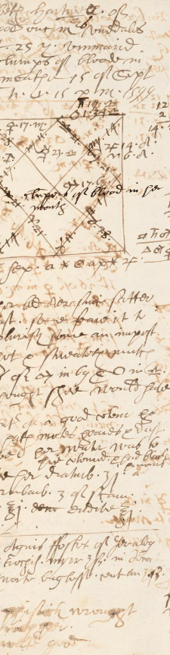
Early Modern Drugs
Dr. Michael Bycroft
21 October 2026
HI176: Mind, Body and Society

Slide 2
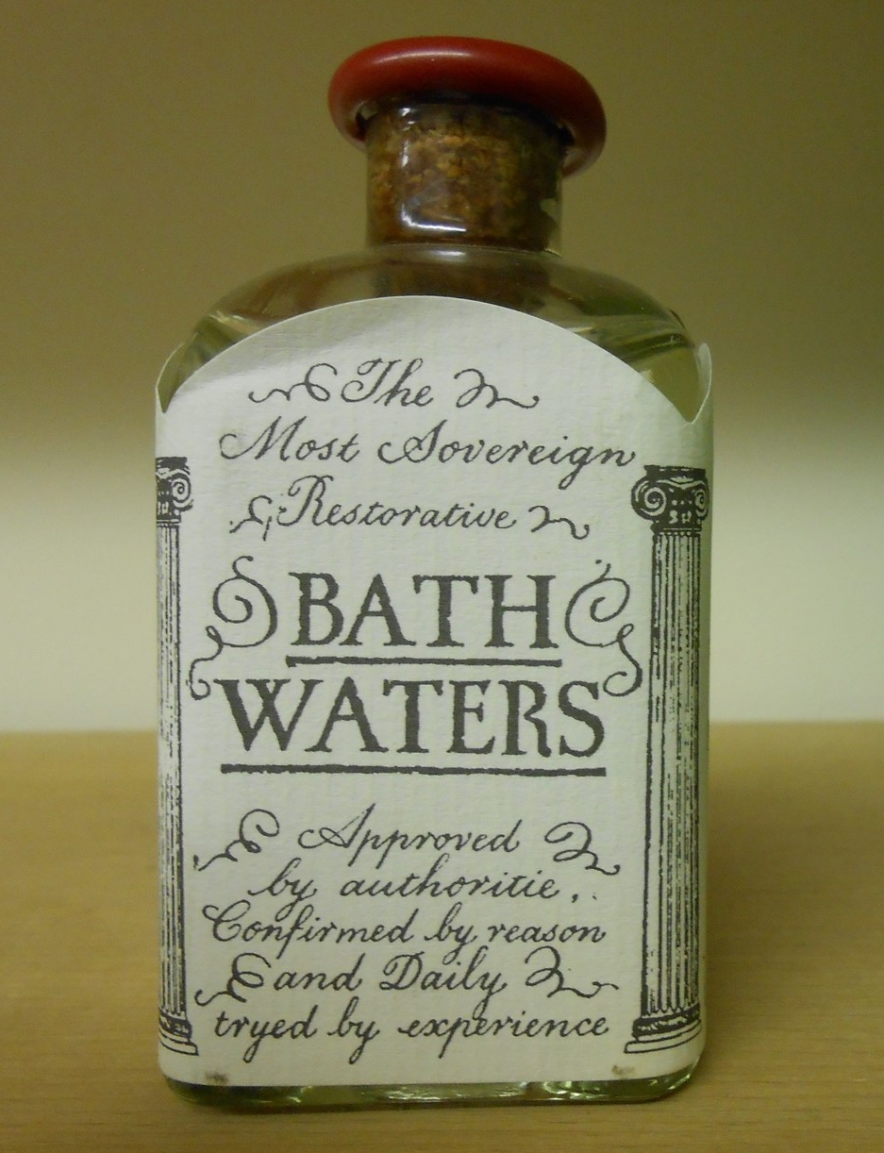
20th-century imitation of 18th-century bottled water from Bath, with text based on an 18th-century advertisement
Photo: MB

Slide 3
The drug Establishment
Scientific Academies
Households
Empires

Slide 4
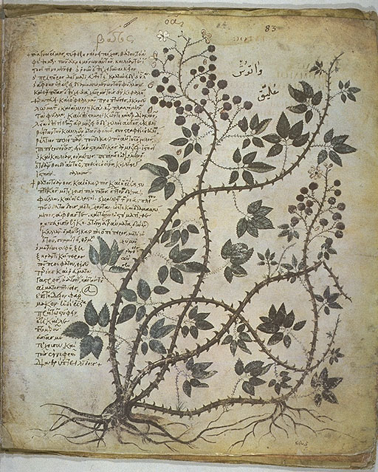
Dioscorides, De materia medica (On Medical Materials), originally written in Greek, c. AD 60
Image: from the Vienna Dioscurides, a 6th-century illustrated manuscript now held at the Austrian National Library
Credit: Wikimedia Commons / Austrian National Library

Slide 5
We can determine [the medical effect of a drug] by either of two methods, one by sense [via experimenti] and the other by reason [via rationis]. Determination by sense involves recognising it through the medicine’s activity, while determination by reason draws on the very substance of these medicines.
-- Galen (129 – c. 216 AD), On Simple Medicines

Slide 6
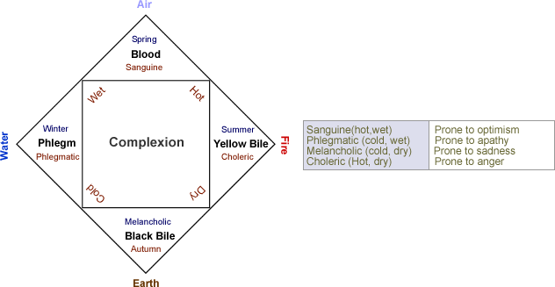

Slide 7
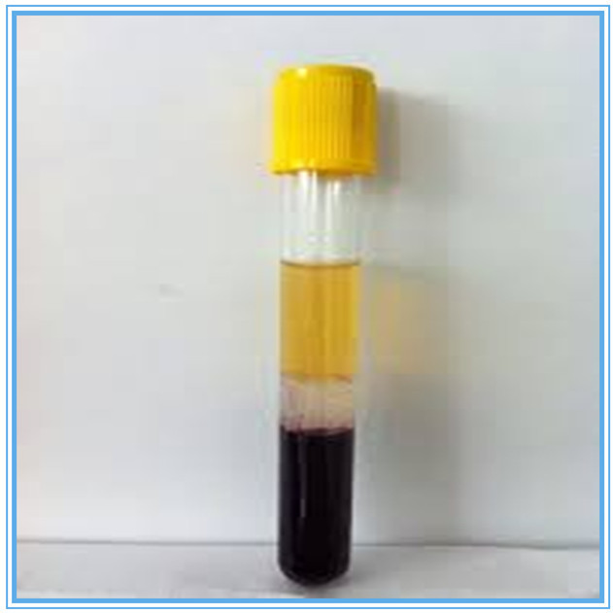
‘Yellow bile’
‘Phlegm’
‘Black bile’

Slide 8
The medicine should be kept free from every [accidental] complexional quality
The patient taking it should be suffering from the illness to which the medicine is appropriate
It should be given by itself
It should be of a degree opposite the illness
We should try it not just once but repeatedly
It should be given to the right subject, so that we should try it on a man and not on an ass
-- Peter of Spain’s Commentary on Isaac Israeli’s Diete universals, 1230s

Slide 9
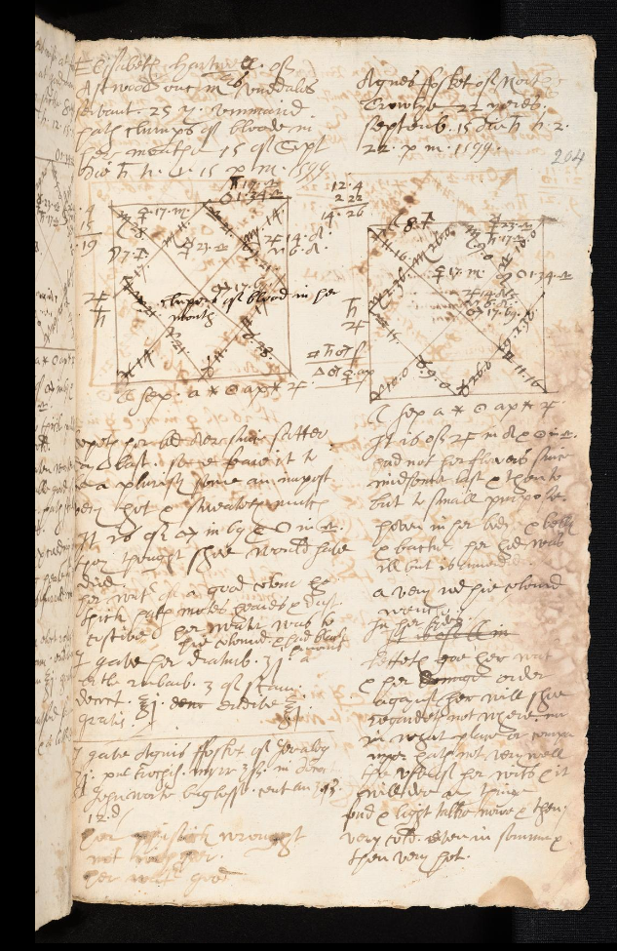
A page from the casebook of Richard Napier, an astrological physician living in London around 1600
Image: www.casebooks.lib.cam.ac.uk

Slide 10
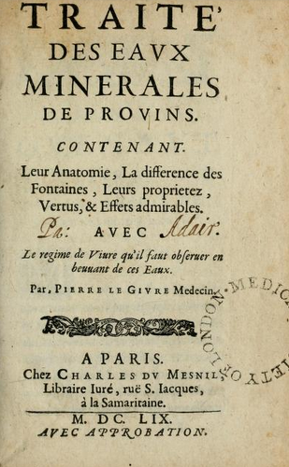
‘Treatise on the mineral waters of Provins,
Containing their anatomy, the difference between the springs, their properties, virtues, and admirable effects
By Pierre le Givre, doctor
Paris, 1659’
Image: Gallica / National Library of France

Slide 11
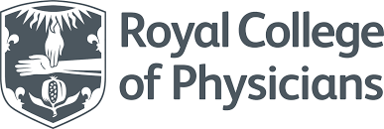
Royal College of Physicians logo, 2019 – est. 1518

Slide 12
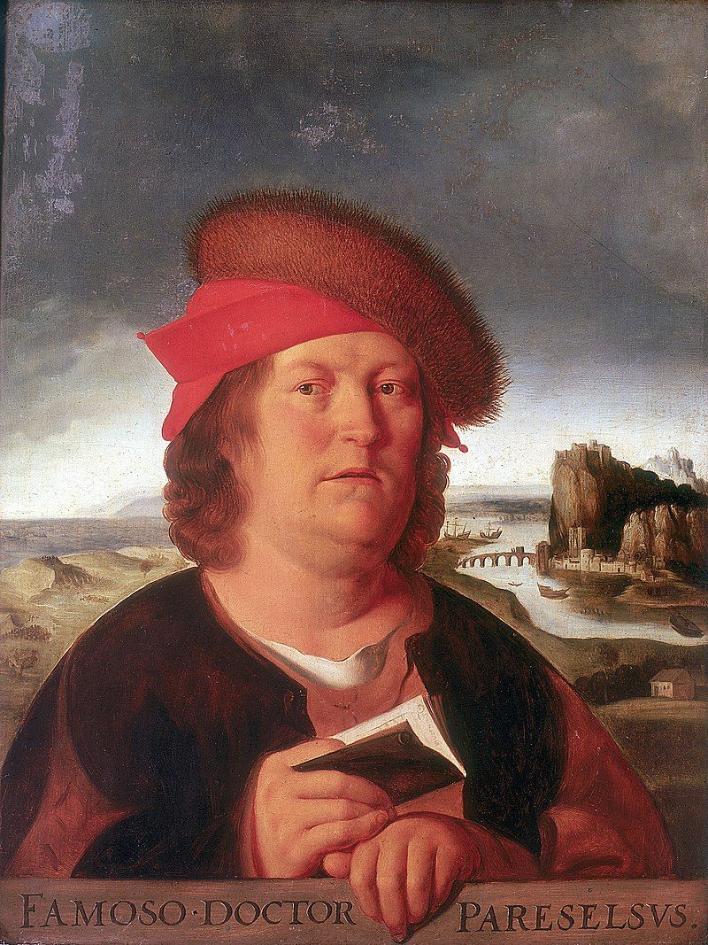
Theophrastus Bombast von Hohenheim (aka Paracelsus)
Painting by the Flemish artist Quentin Matsys, c. 1520s
Image: Louvre / Wikipedia

Slide 13
2. Scientific Academies

Slide 14
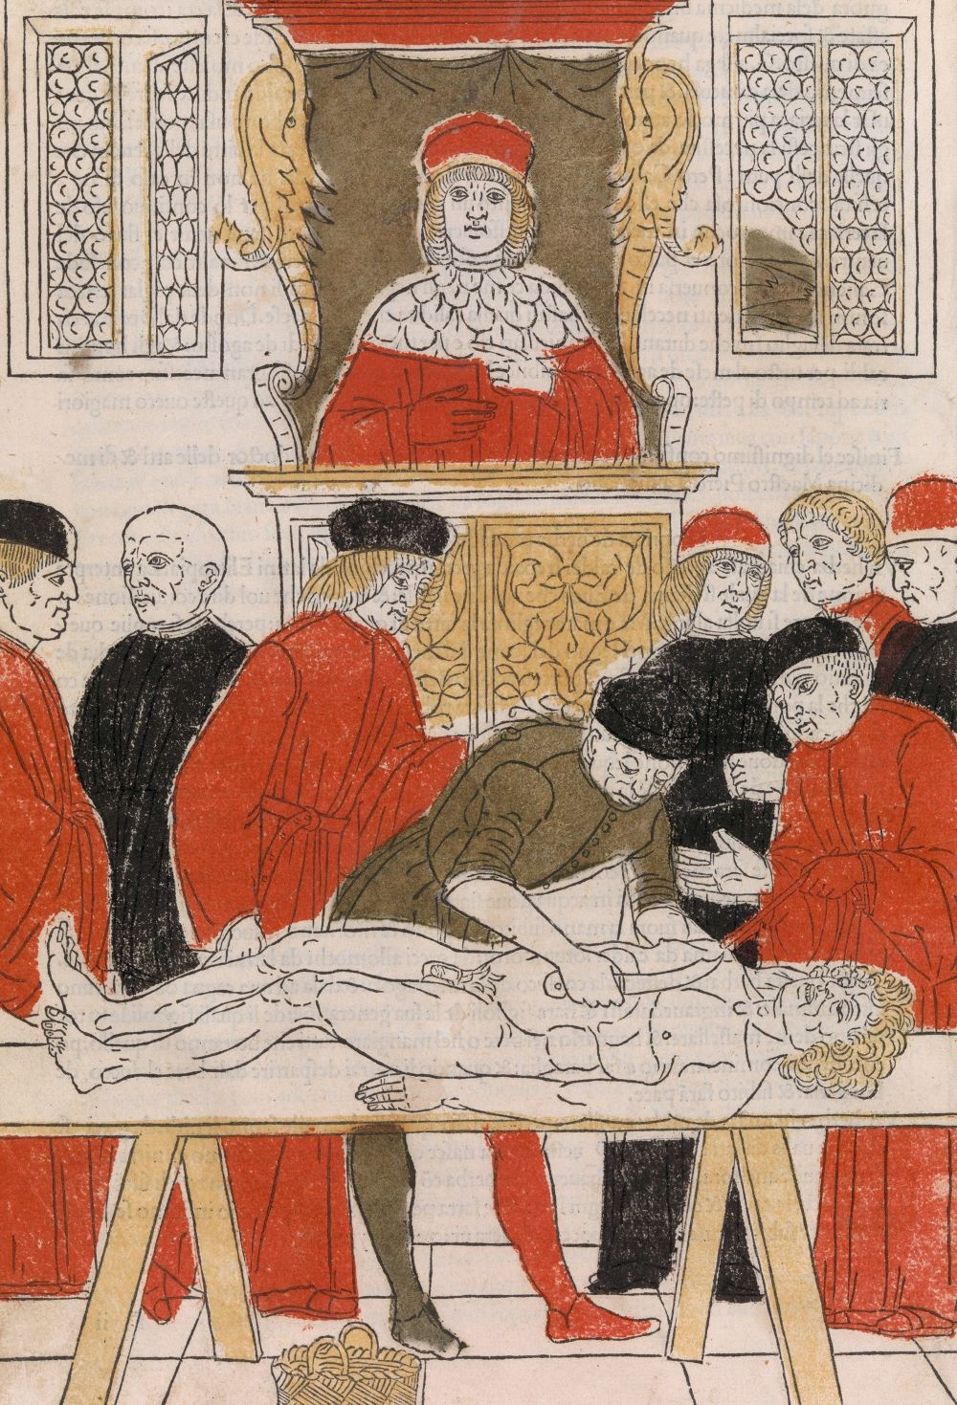
A standard Late Medieval University dissection
Image from Fasciculo di medicina, ed. Jonannes de Ketham [?], 1493/4
Credit: Metropolitan Museum, New York

Slide 15
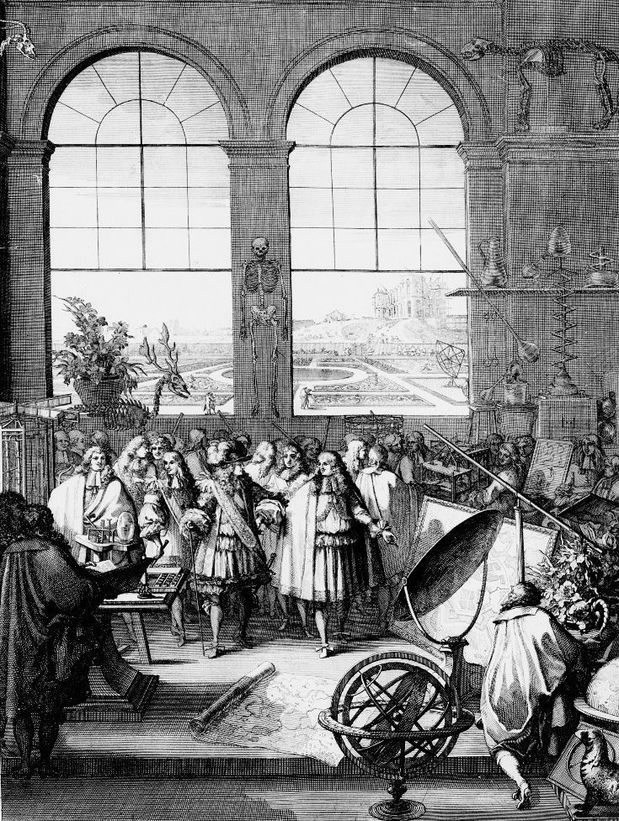
Louis XIV in (fictional) visit to a meeting of the Paris Academy of Sciences, showing King’s Garden, Royal Observatory, and Jean-Baptiste Colbert.
Frontispiece of botanical work published by Academy in 1676
Image credit: Wikipedia

Slide 16
The ancients...did not neglect experimental philosophy, as people usually suppose. The works of Hippocrates alone would be enough to show the spirit that guided philosophers then. Rather than the systems, at best ridiculous and at worst fatal, that modern medicine created, we find there many well-observed and well-ordered facts.
-- from article “EXPERIMENTAL” in the Encyclopédie of Denis Diderot and Jean le Rond d’Alembert, vol. 6, 1756

Slide 17
Of all remedies known to medicine, both ancient and modern, none have been more successful through the ages than mineral waters, especially against chronic illness.
The members of this Academy...have since their establishment been particularly concerned to discover the principles by which these waters have their effects, so that a better knowledge of these principles will enable us to more reliably identify the diseases against which they can be usefully deployed.
-- Gilles-François Boulduc, Mémoires de l’Académie royale des sciences, 1735

Slide 18
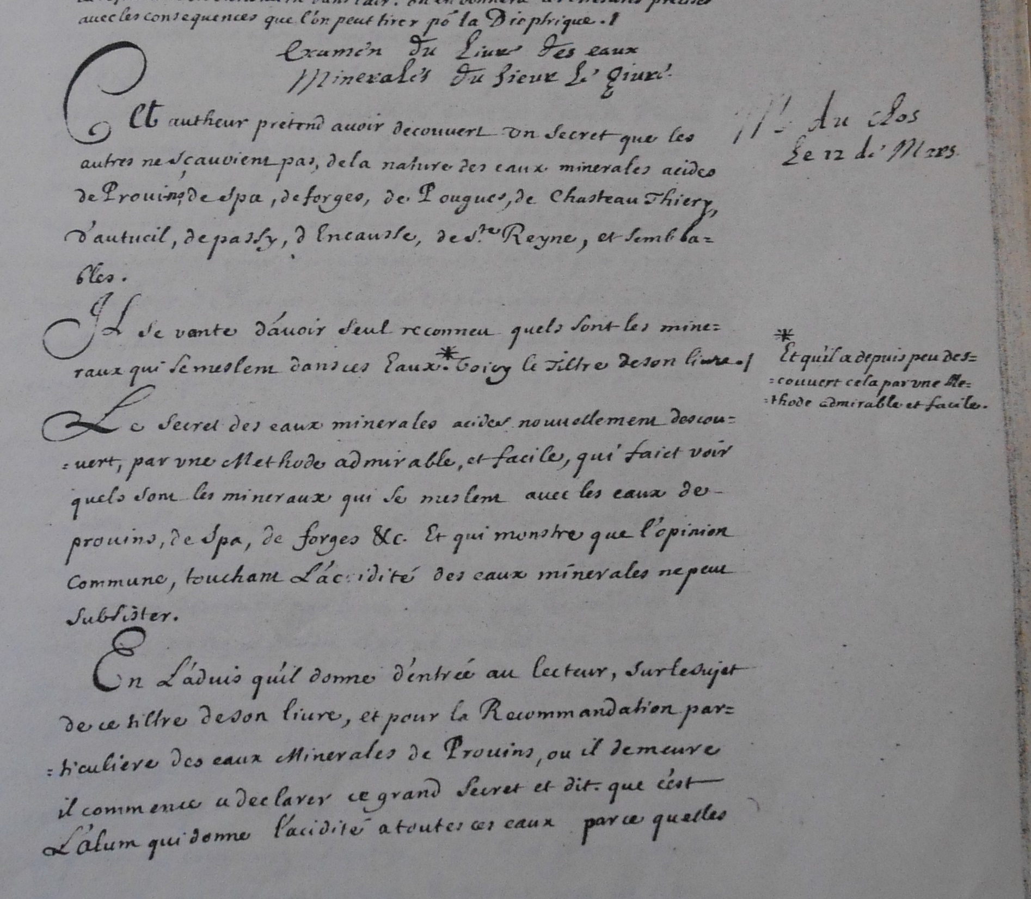
“Examination of the book on mineral waters by Pierre le Givre”
Minutes of the Parisian Royal Academy of Sciences, vol. 1
Photo: MB

Slide 19
Rainwater + iron filings
Provins mineral water

Slide 20
‘guesses might be made from [waters’] taste and smell, but essentially their composition was known from their effects’
-- Lawrence Brockliss
??

Slide 21
3. Households

Slide 22
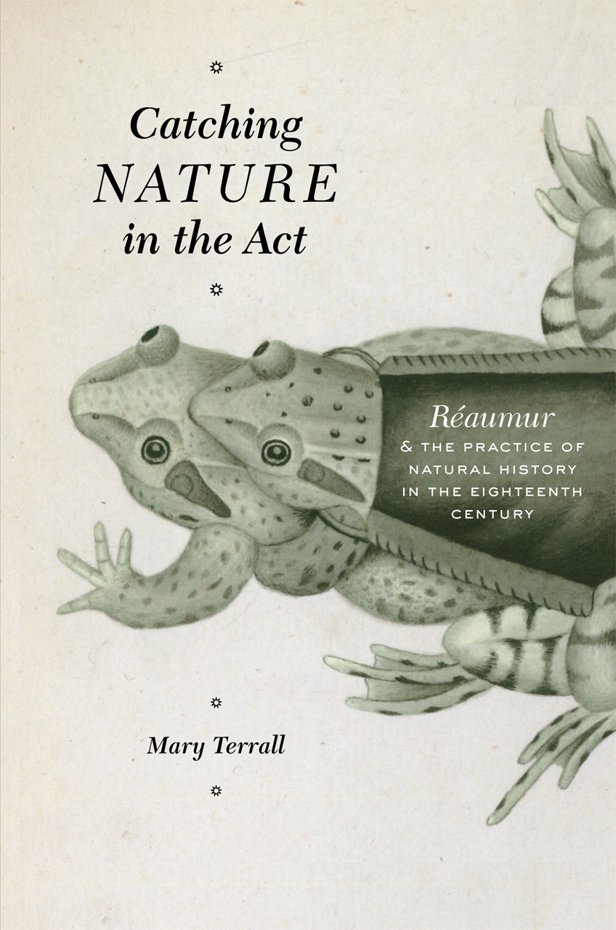
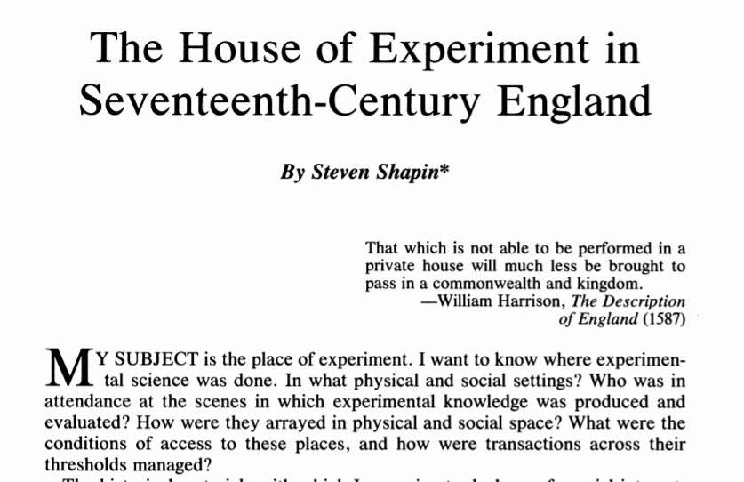
1988 article
2014 book

Slide 23
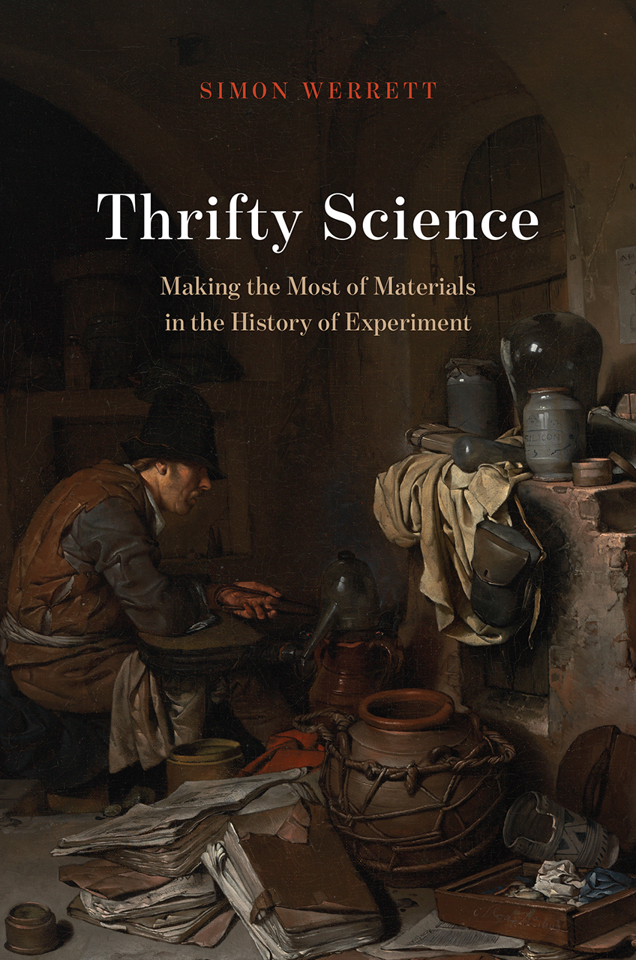
2019 book

Slide 24
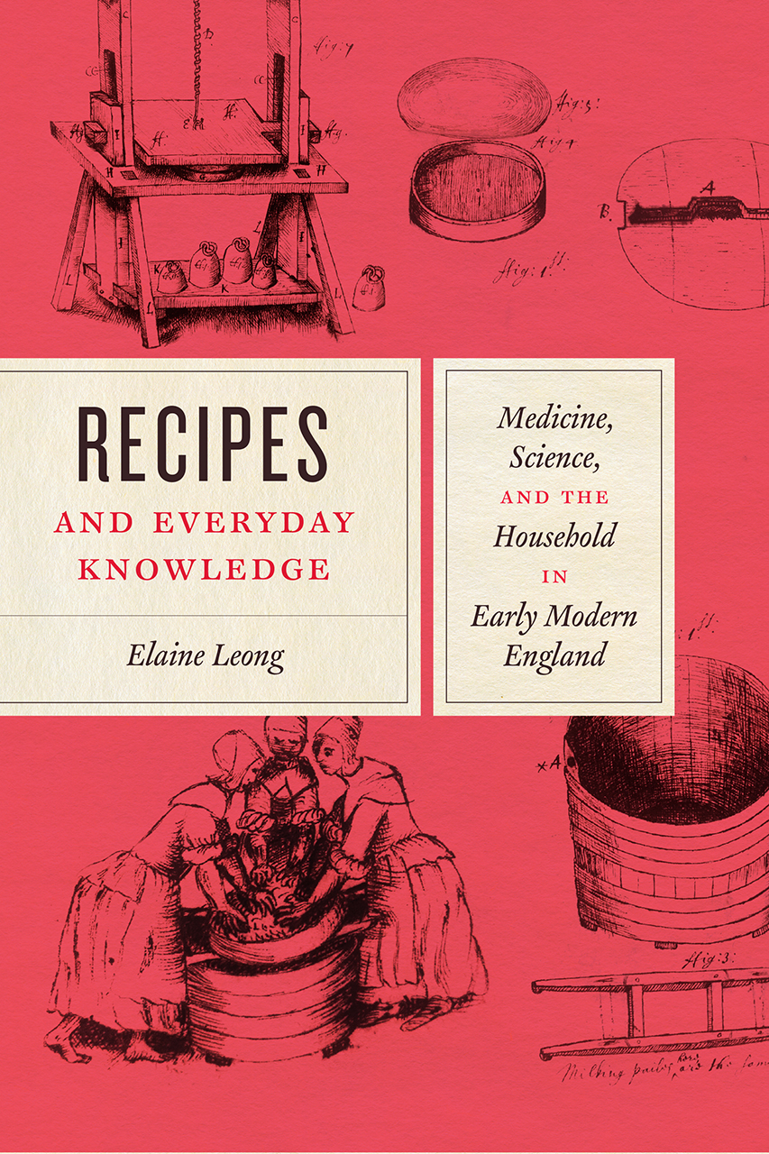
2018 book

Slide 25
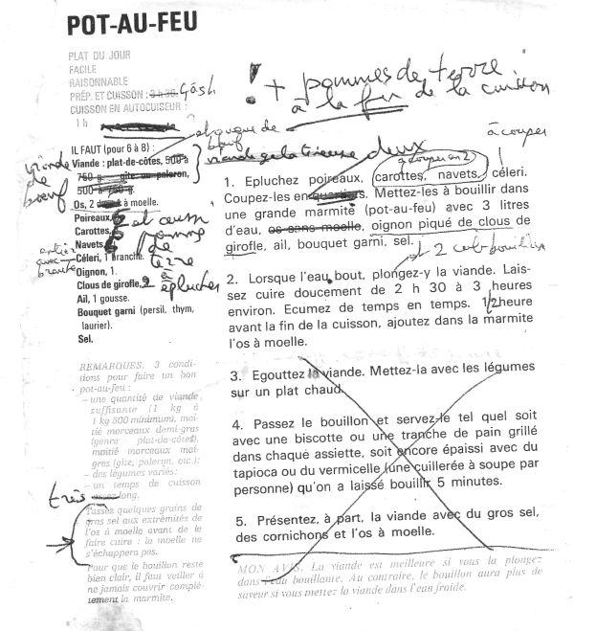
Twenty-first-century recipe, with testing

Slide 26
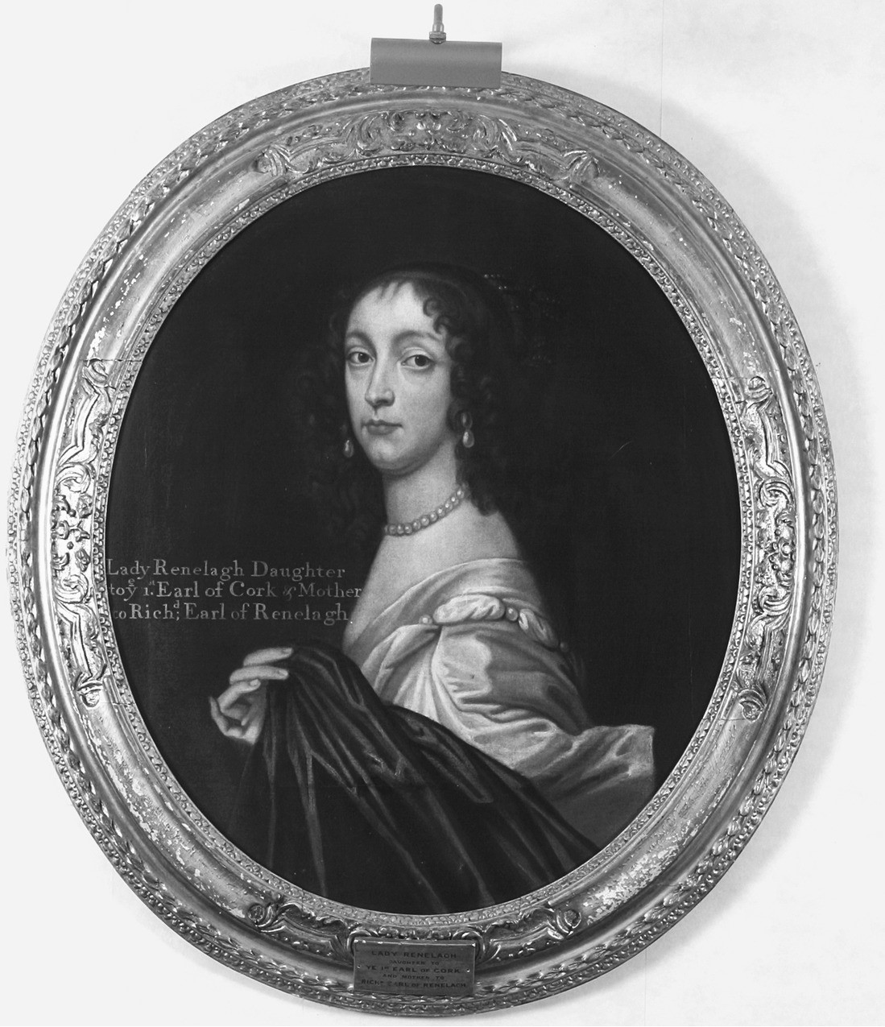
Portrait of Katherine Jones, Lady Ranelagh. The date of the portrait is unknown; it may be a later copy of an original.
From Michelle Dimeo, Lady Ranelagh: the Incomparable Life of Robert Boyle’s Sister (Chicago UP, 2021)

Slide 27
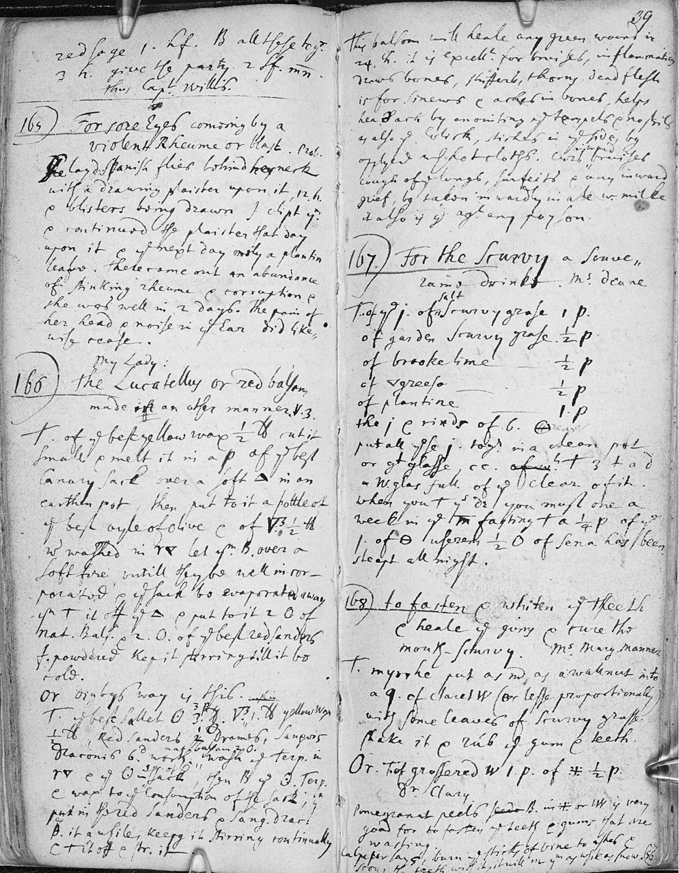
Copy of a medical recipe book compiled by Lady Ranelagh, “My Lady Rennelagh’s Choice Receipts,” not in her hand
From Dimeo, Lady Ranelagh

Slide 28
3. Empires

Slide 29
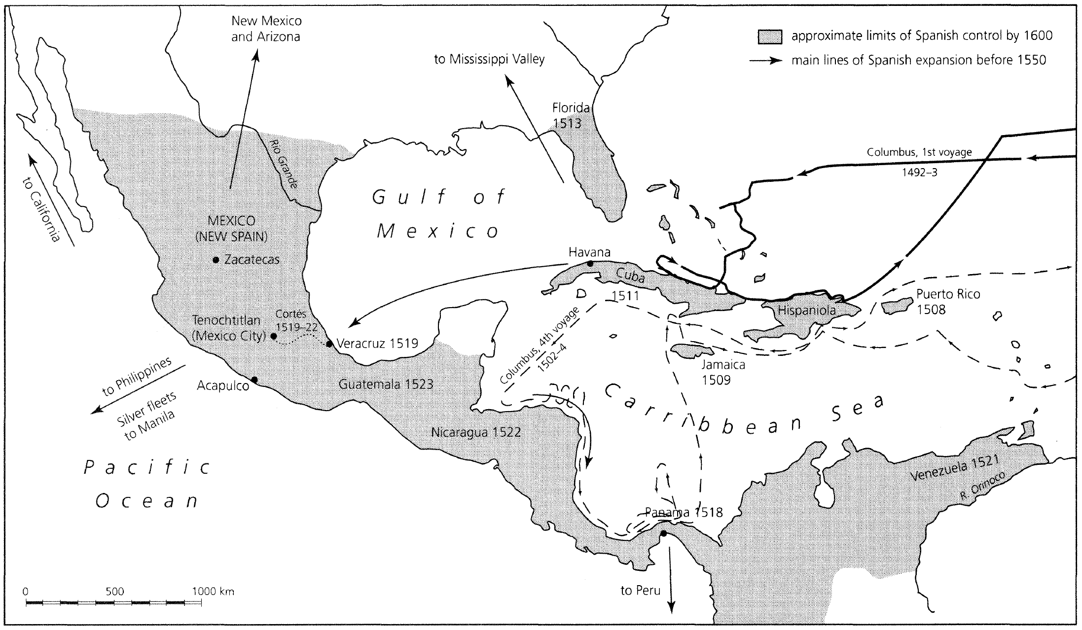
Santo Domingo
Spanish Exploration and Conquest in the Americas, 1492-1600
From David Arnold, The Age of Discovery, 1400-1600 (2002)

Slide 30
Balsam
balsam highly prized in West since antiquity, but in short supply
1528 – Antonio de Villasante, resident of Santo Domingo, claims to find new variety of balsam on Hispaniola
obtains right to exploit it from Spanish crown
but must present ‘a very complete report’ about the tree to Council of Indies
‘This balsam, by experience, shows already that it is beneficial for the diseases I have mentioned’ (Villasante’s report)
Experience = preparing from tree, testing on patients
no reference to Galenic theory of humours, since Villasante addressing practical men – Spanish entrepreneurs and bureaucrats, not physicians

Slide 31
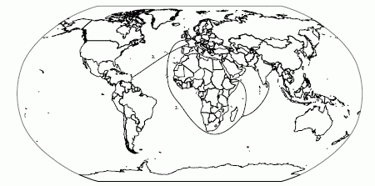
1
3
2
French coffee trade routes, 1670–1730:
The Levantine route, between Marseille and Cairo via the Mediterranean Sea
The East Indies route, from St. Malo via the Cape of Good Hope to the Mascarene Islands (inc. La Réunion and Mauritius), the Indian trading outposts, and the Yemen
The American route, between western French ports and the Caribbean colonies, inc. Martinique and Guadeloupe
From Spary, Eating the Enlightenment: Food and the Sciences in Paris, 1670-1760 (2012)

Slide 32
Conclusions
early modern drug-testing is a thing!
a strong drug establishment in Europe
emerging alternatives
wider historical significance of drug-testing
medical history is where the action is

