Slide 1
The Early Modern Body
Dr Sophie Mann

Slide 2
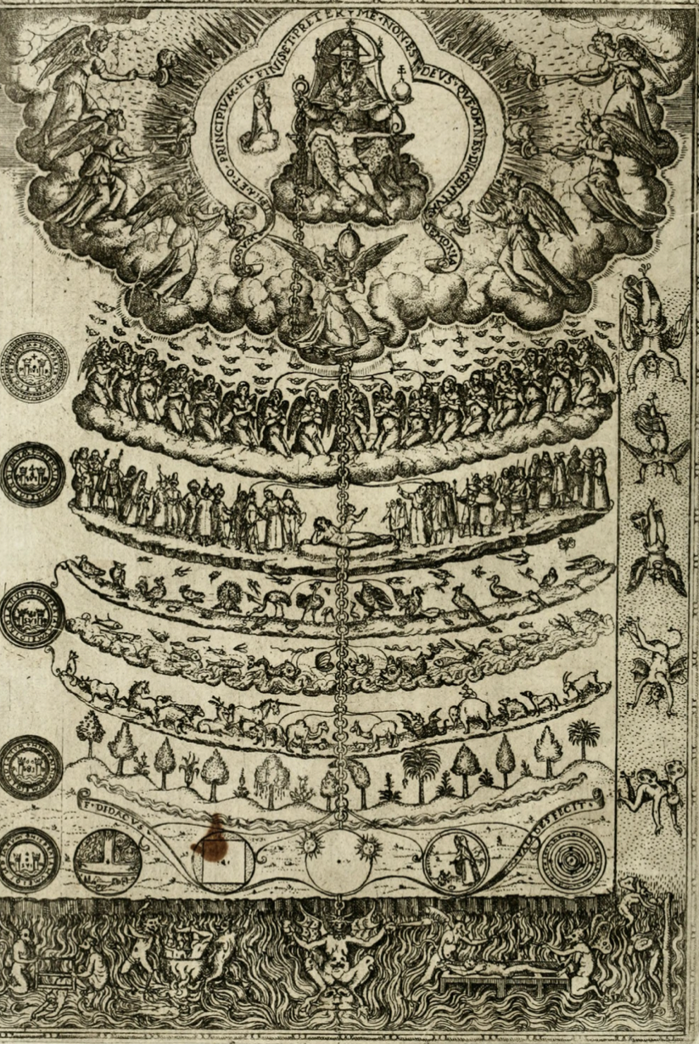
The Great Chain of Being, 1579

Slide 3
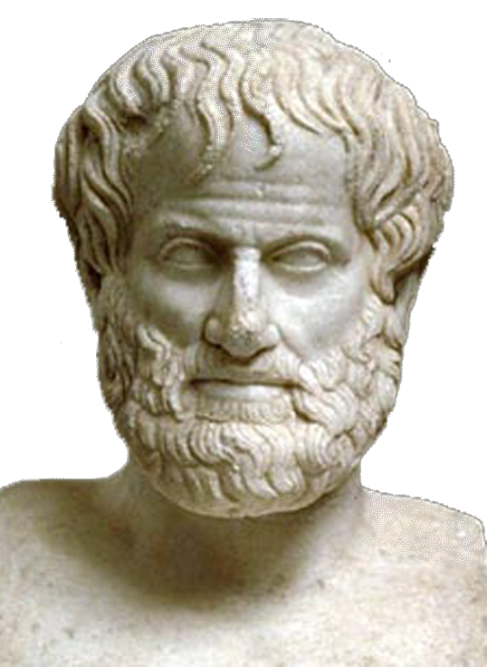
Some of his writings:
On the heavens
On sleep and sleeplessness
On animals
On the soul
Virtues and vices
Meteorology
Metaphysics
On Longlivity and Shortness of Life
Poetics
Generation and Corruption
And many, many more …
Aristotle, 384 BC – 322 BC

Slide 4
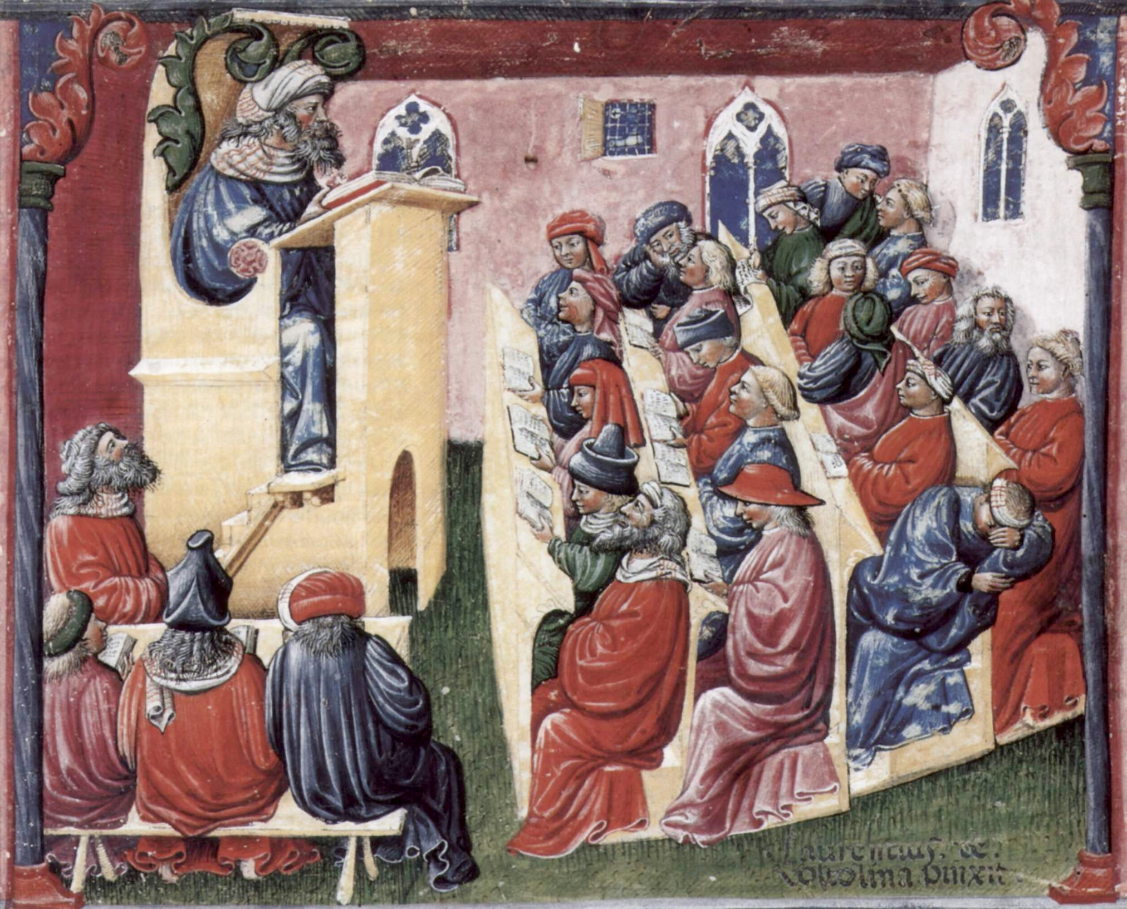

Slide 5
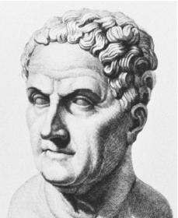
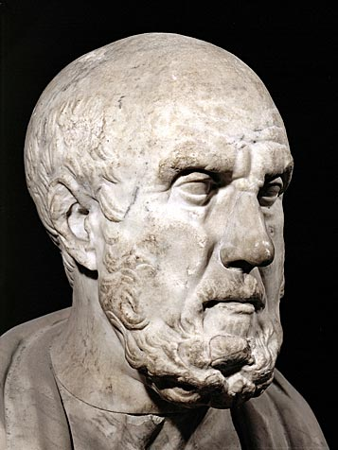
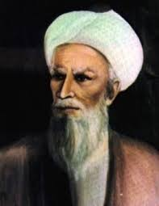
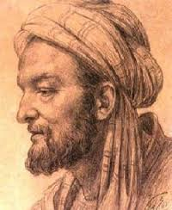
Galen of Pergamon, 130 AD – 200 AD
Hippocrates of Cos, c. 460 – c. 370 BC
Avicenna (Latinate form of Ibn-Sīnā),
c. 980 AD – 1037 AD
Rhazes, 854 AD – 925 AD

Slide 6
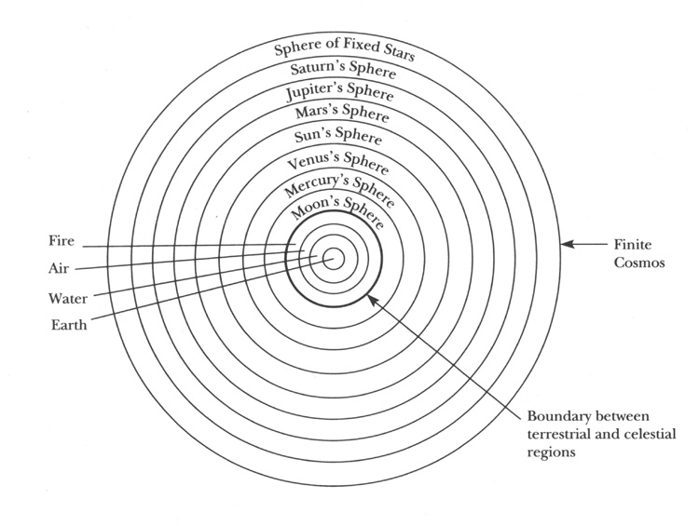
Aristotelian cosmos

Slide 7
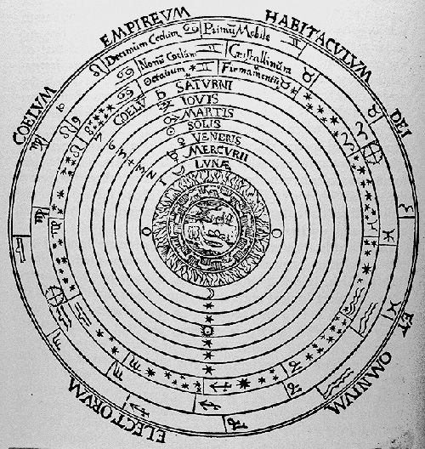
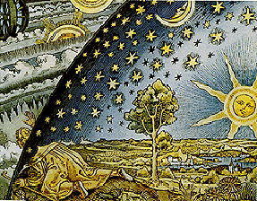

Slide 8
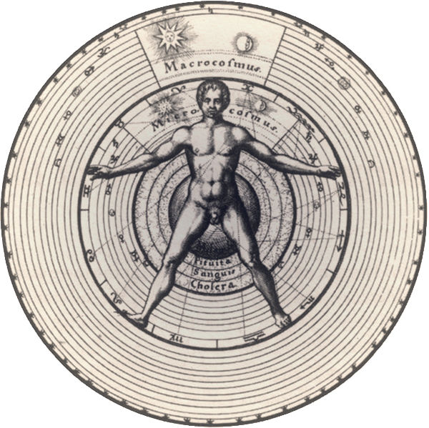
Micro-Macrocosm – Man as the mirror of the wider cosmos

Slide 9
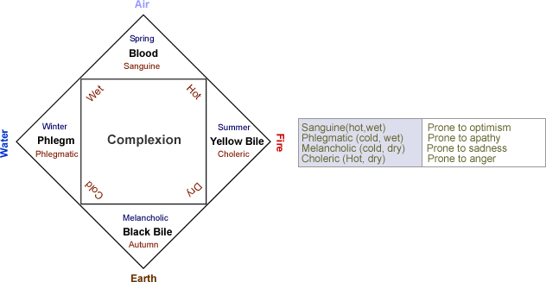

Slide 10
the six-non naturals: air, food and drink, sleeping and waking, motion and rest,
excretions and retentions, and the passions of the soul

Slide 11
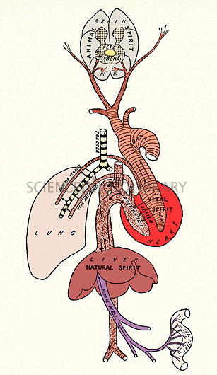
Spiritus: a subtle vapour produced in the blood and disseminated throughout the body by the arteries and nerves. It was considered to be the central source of activity in the living body.
Three forms:
1. natural spirit: resided in the liver, the center of
nutrition and metabolism
2. vital spirit was located in the heart, the center of
blood flow regulation and body temperature,
3. animal spirit was animal spirit was created in the
brain, the center of sensory perceptions and
movement.

Slide 12
“The soul … being united to bodily substance … useth the spirite: which is the most universall instrumente of the soul … the soul directeth it, and guideth it vnto more particular instruments, for more speciall and priuate vses, as to the eye, to see with; to the eare to heare; to the nose to smell; to the bowells, stomack, and liuer, to nourish, to the heart, to maintaine life: and to other partes, to the end of propagation: this is all performed by the selfe same, one, and single spirite. …
I know commonly there are accompted three spirits: animall, vitall, and naturall”
Timothie Bright, A Treatise of Melancholy … with the Physicke Cure (1586), 46-7.

Slide 13
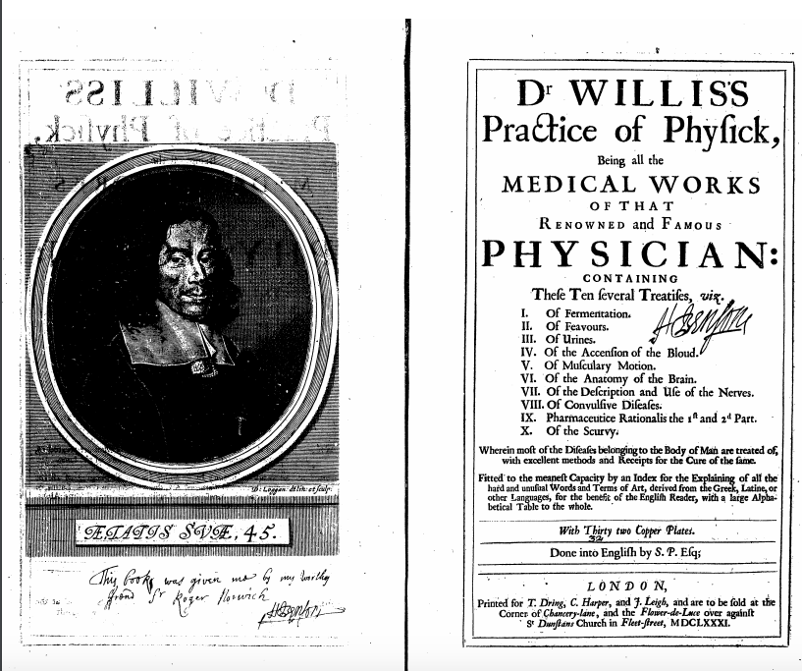

Slide 14
Dr Willis provides a commentary on how ‘Devout Affections’ influenced the physical qualities of the body…
“The Soul orders the Spirits inhabiting the Brain into sacred Conceptions and Notions; by the Influence of the same Spirits, the Bosomes of the Heart are also so affected that they cause the Blood to Centre, and to be more fully drawn into them … [which] produces in the Heart and Blood variety of Motions”.
Thomas Willis, Dr Willis’s Practice of Physick (London, 1681), see pages 41-7.

Slide 15
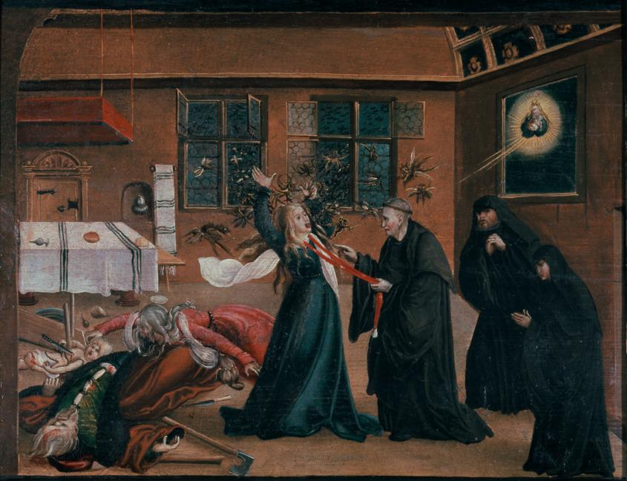

Slide 16
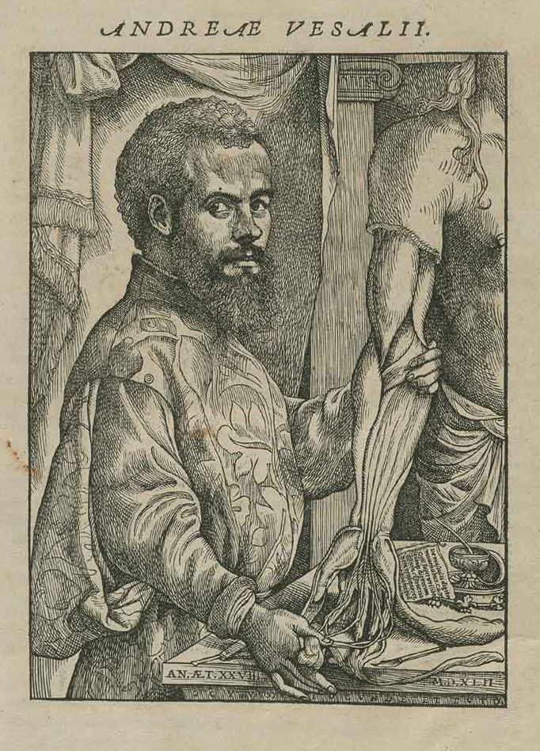
Andreas Vesalius
(b.1514 – d.1564)
Flemish anatomist, physician, and author of one of the most influential book on human anatomy: De humani corporis fabrica [on the fabric of the human body]

Slide 17
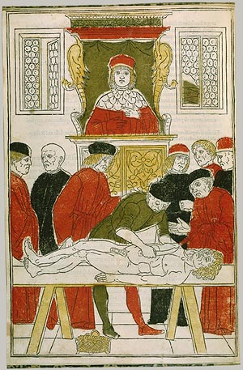
A ‘traditional disssetion
Joannes von Ketham, 1493

Slide 18
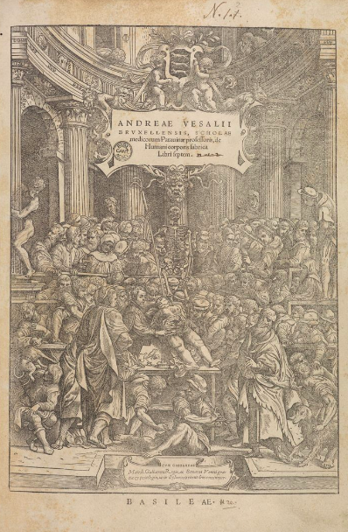
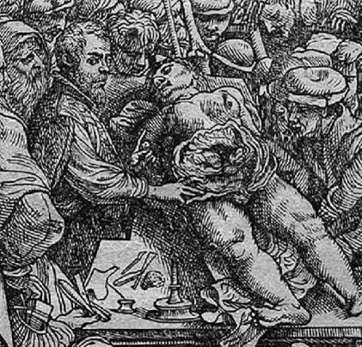

Slide 19
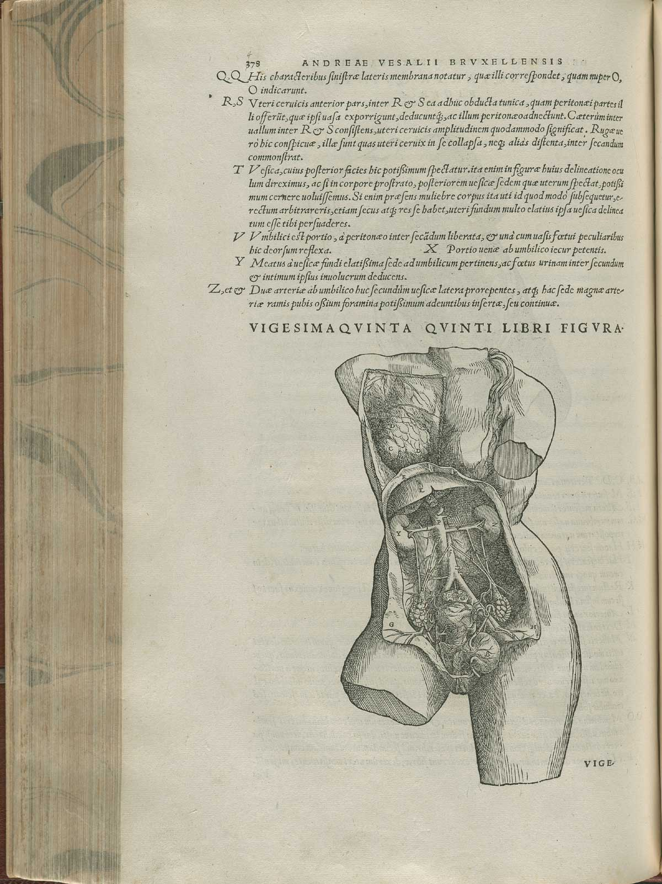
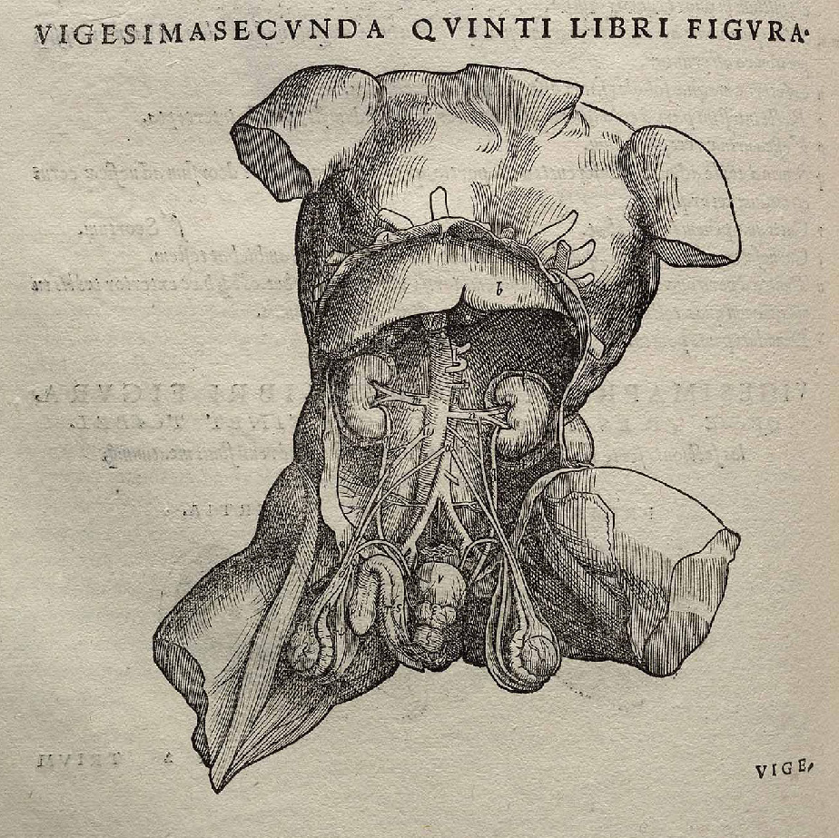

Slide 20
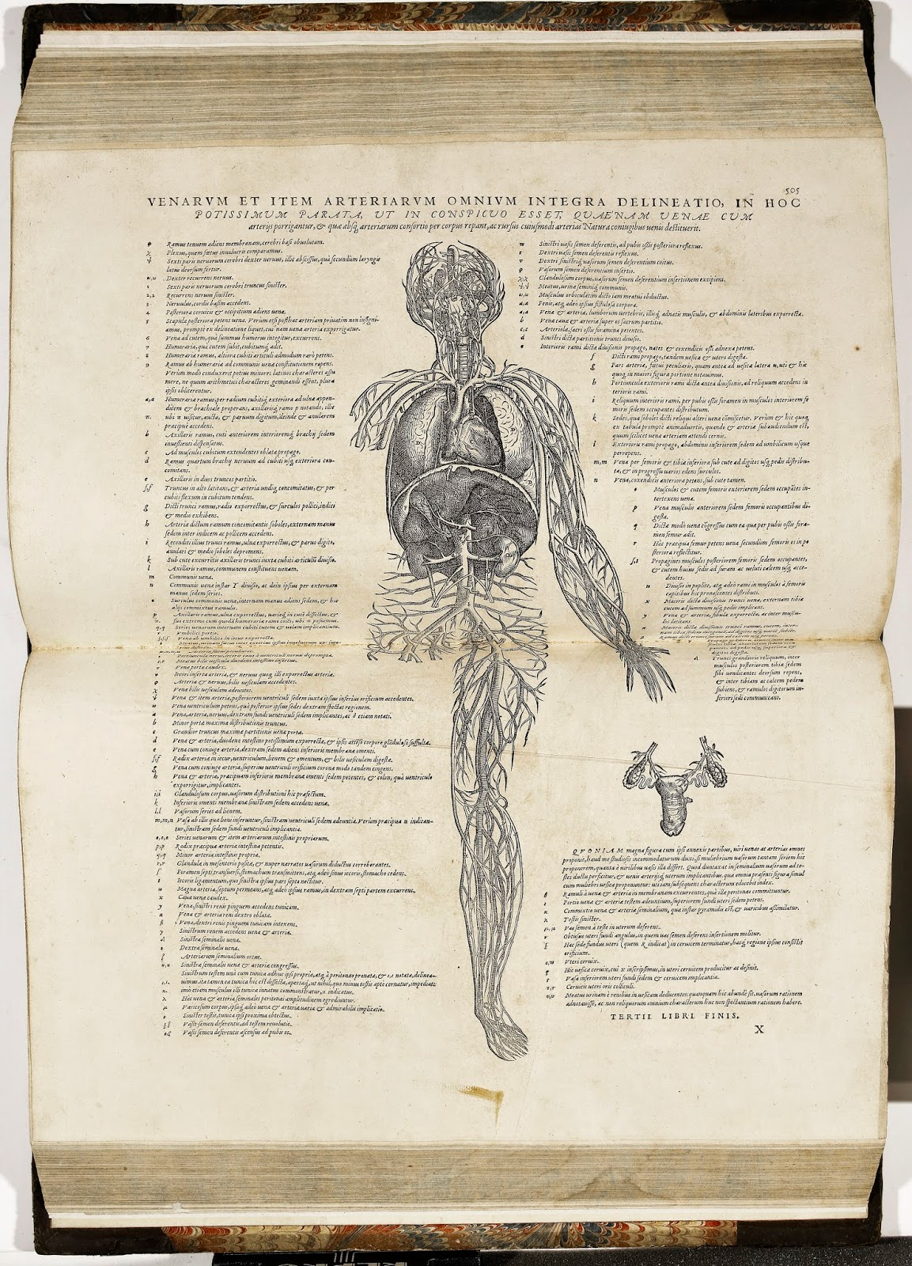

Slide 21
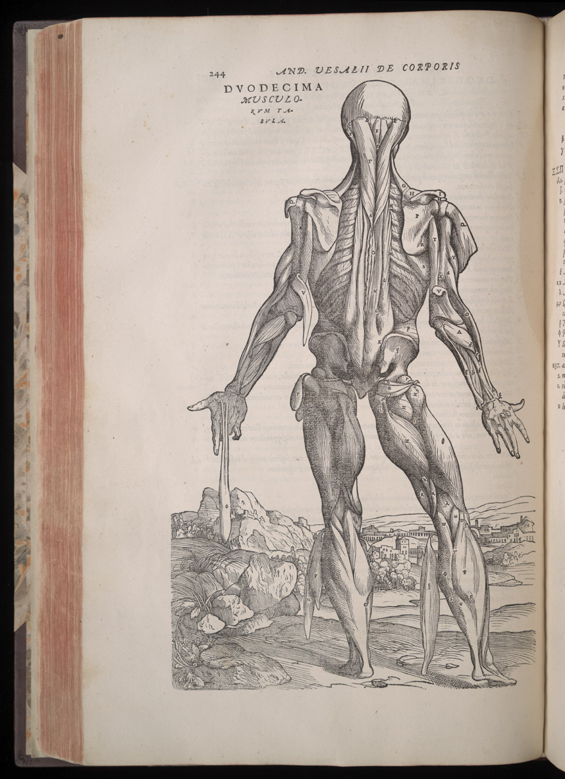
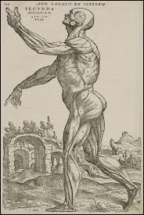

Slide 22
‘Let them use their hands…as the
Greeks did and as the essence of
the art demands’
Book 1: skeleton
Book 2: myology, all the muscles and their relations
Books 3 and 4: venous, arterial and nervous systems
Books 5-6: organs of the abdominal and thoracic cavities and the brain
Book 7: he reports own experiments and vivisections

Slide 23
‘the liver may make the thicker blood and the natural spirit and the heart make the blood that rushes through the body with the vital spirit and thus these organs may bring material to all parts of the body through channels reserved for them, so…the brain prepares the animal spirit.’
‘doctors must (if they don’t wish to approach the art rashly, not to prescribe and apply remedies for ailing members improperly) consider those faculties that govern us … especially, besides all this, (if our minds can attain it) what is the substance and the essence of the soul.’

