Slide 1
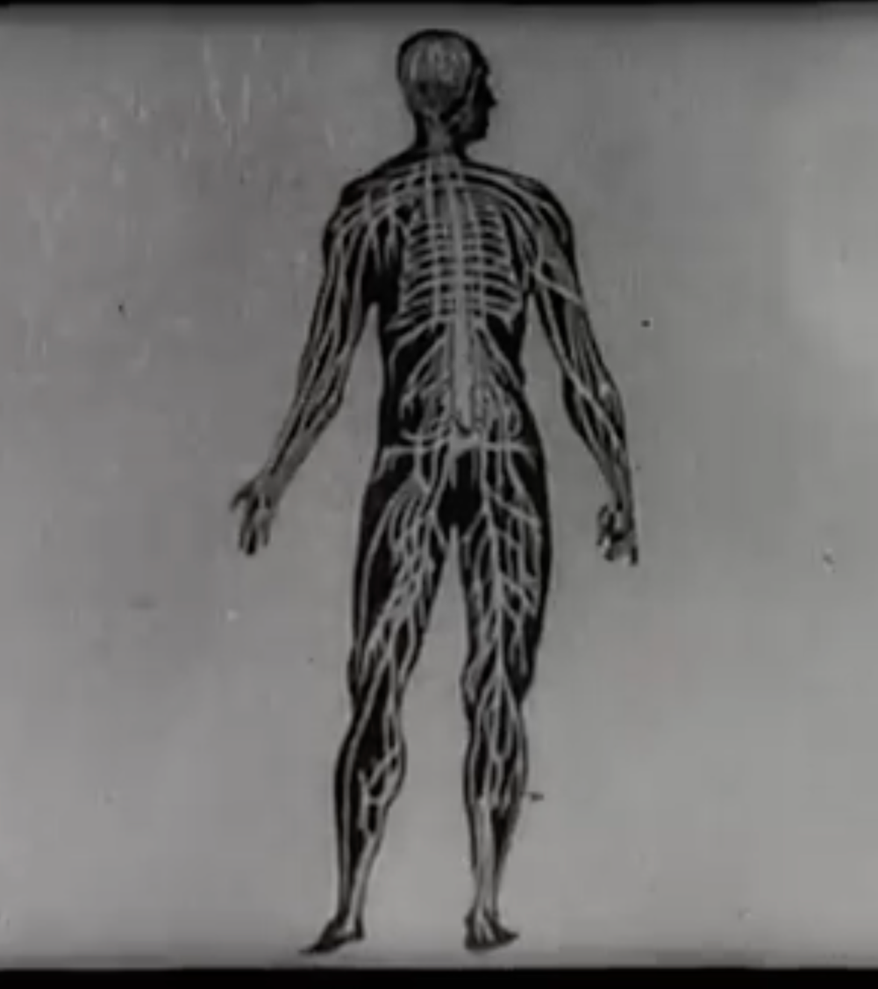
Film and Medicine
Dr Anna Toropova
Anna.Toropova.1@warwick.ac.uk

Slide 2
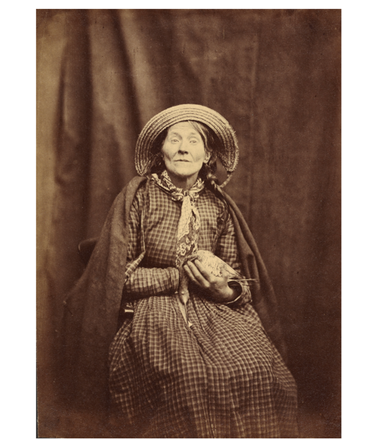
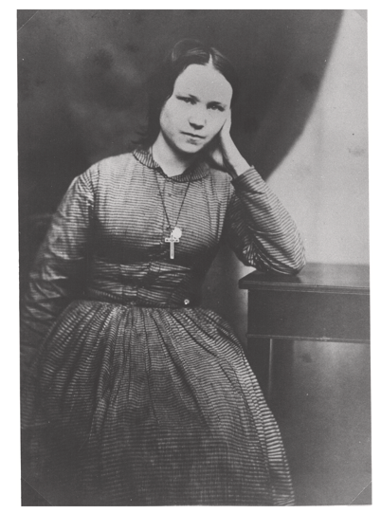
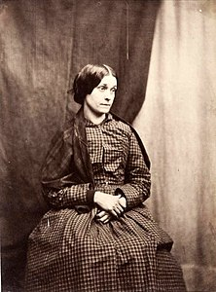
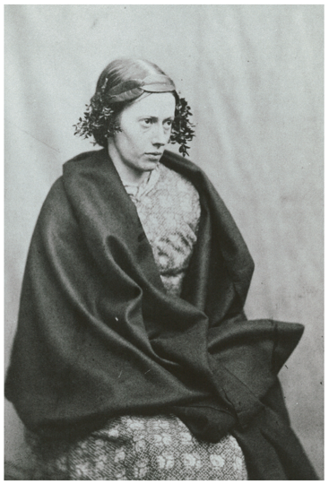
Hugh W. Diamond: The ‘Father of Psychiatric Photography’
‘The Photographer, on the other hand, needs in many cases no aid from any language of his own, but prefers rather to listen, with the picture before him, to the silent but telling language of nature– It is unnecessary for him to use the vague terms which denote a difference in the degree of mental suffering […] the picture speaks for itself with the most marked pression’, Diamond (1856)

Slide 3
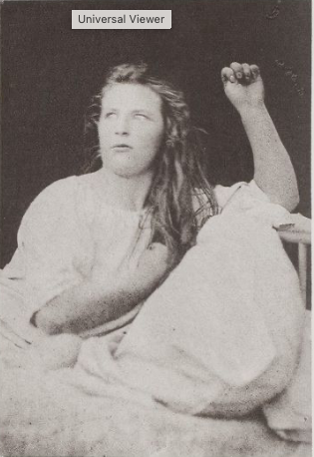
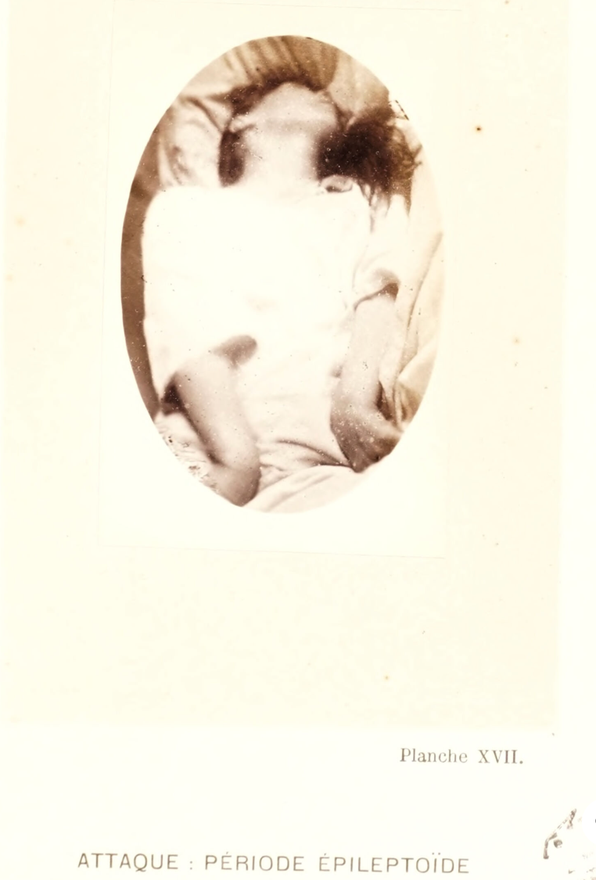
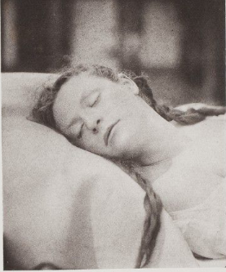
Jean-Martin Charcot’s Photographic Studio at the Salpêtrière
Iconographie photographique de la Salpêtrière (1876-1880)
https://collections.library.yale.edu/catalog?f%5Bproject_identifier_tesi%5D%5B%5D=57&q=&search_field=all_fields

Slide 4
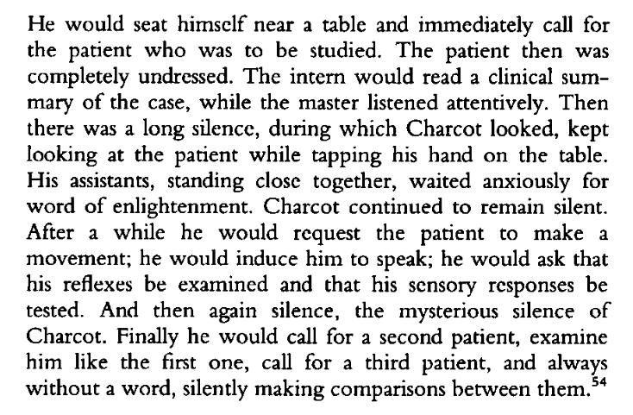
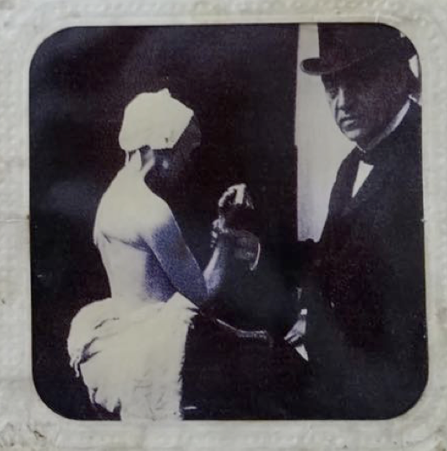
Jean-Martin Charcot & Sight-Based Diagnosis

Slide 5
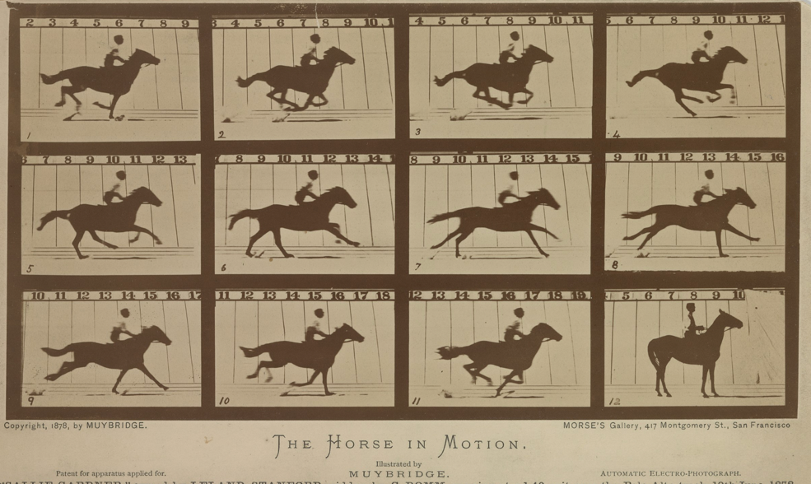
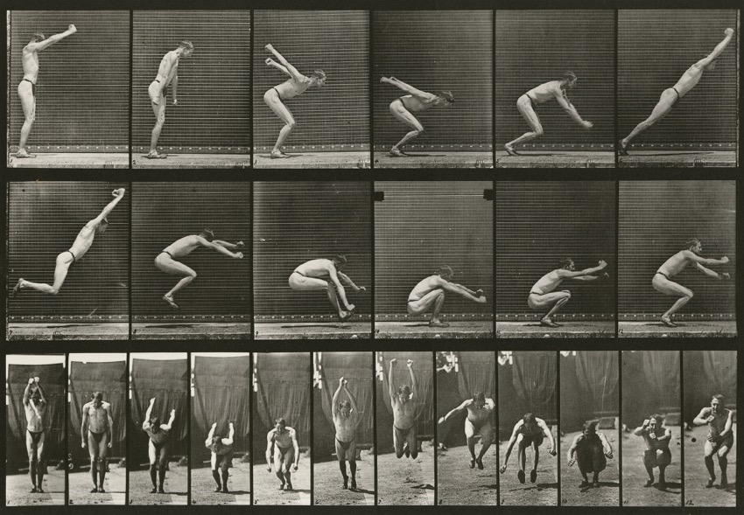
Eadweard Muybridge
Eadweard Muybridge, The Horse in Motion (1878)
Eadweard Muybridge, Animal Locomotion Series (1887)

Slide 6
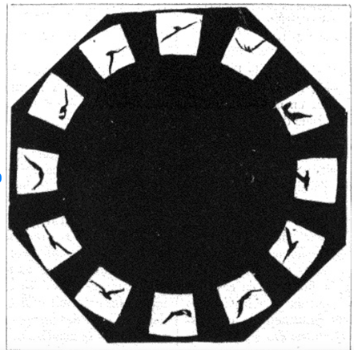
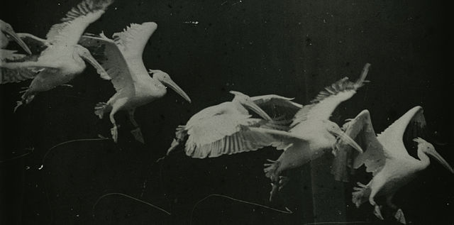
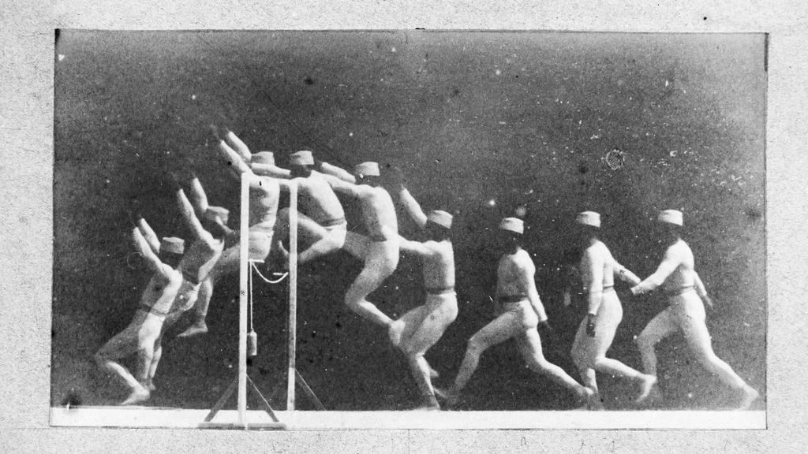
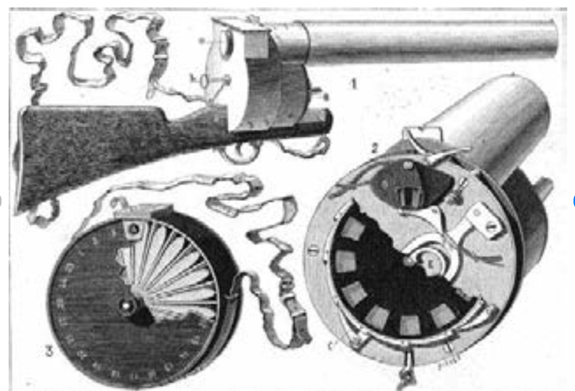
Étienne-Jules Marey
Chronophotography
‘I have been able to construct, in the shape of a hunting rifle, a machine that photographs twelve times a second the object under aim; each image requires, in terms of exposure time, only 1/720th of a second’
Photograph showing phases of movement of a man jumping a hurdle, Étienne-Jules Marey, c 1892
Marey’s Photographic Gun, La Nature, April 1882

Slide 7
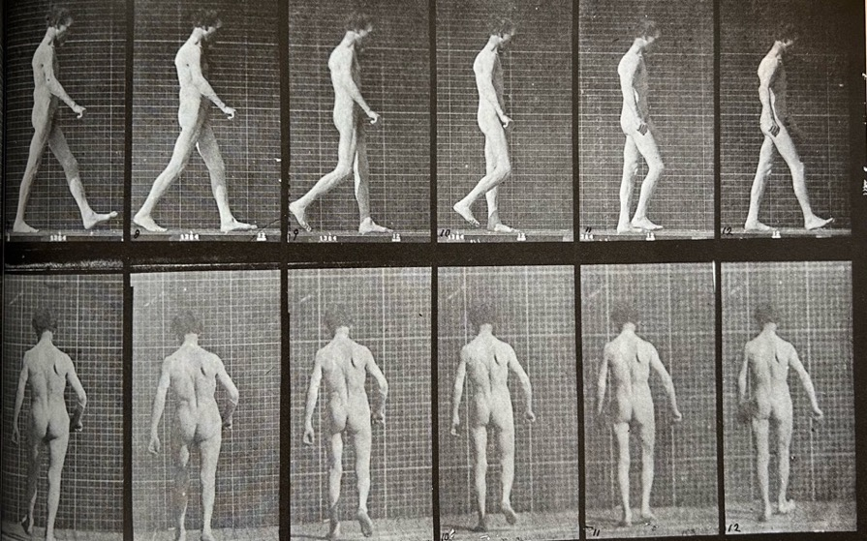
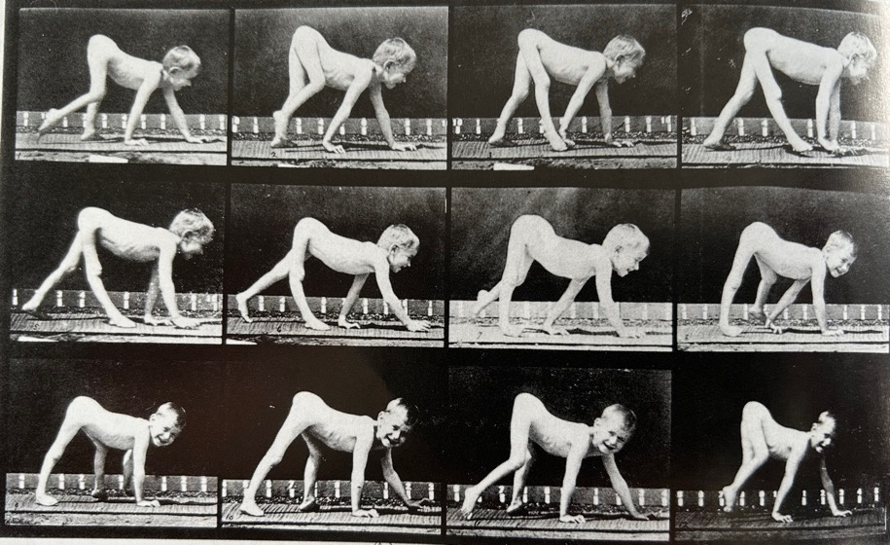
Eadweard Muybridge, Animal Locomotion (1887), ‘Locomotor ataxia’, plate 546
‘Infantile paralysis, child walking on hands and feet’, Plate 539

Slide 8
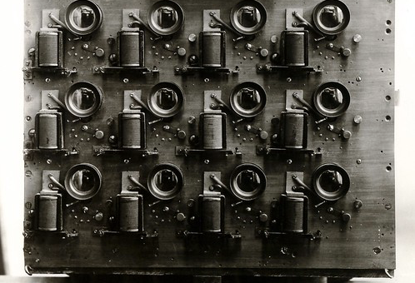
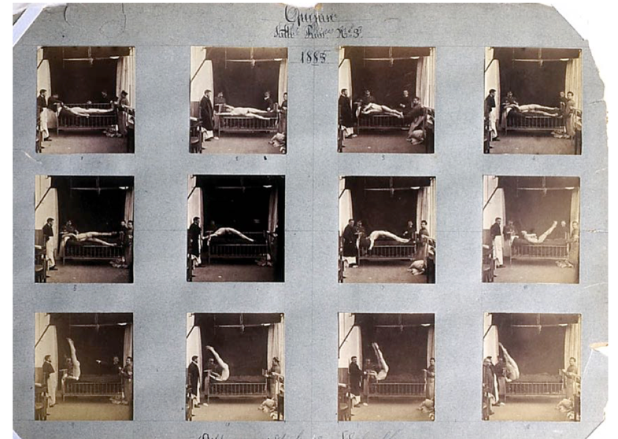
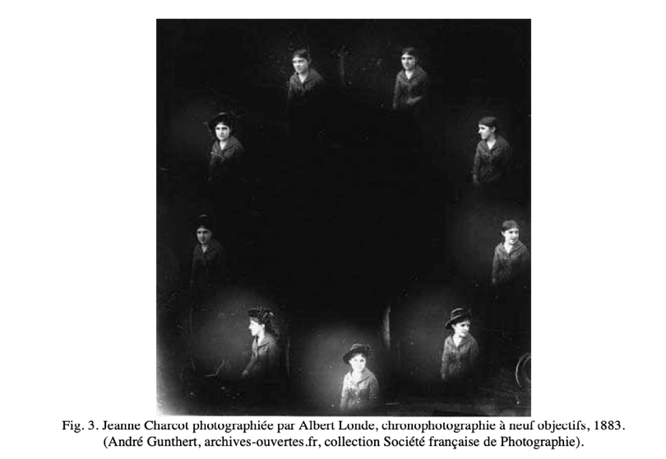
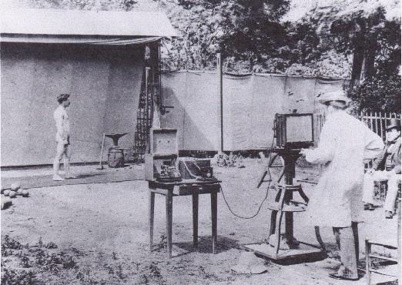
Albert Londe at the Salpêtrière

Slide 9
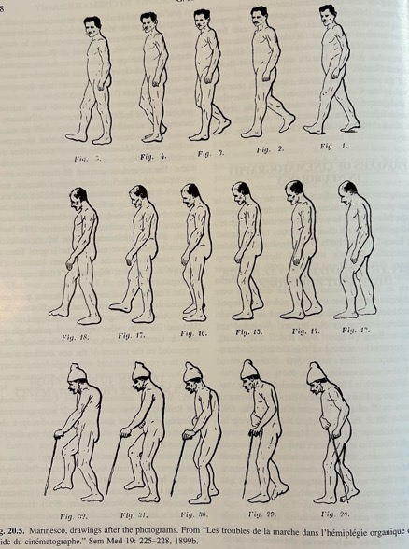
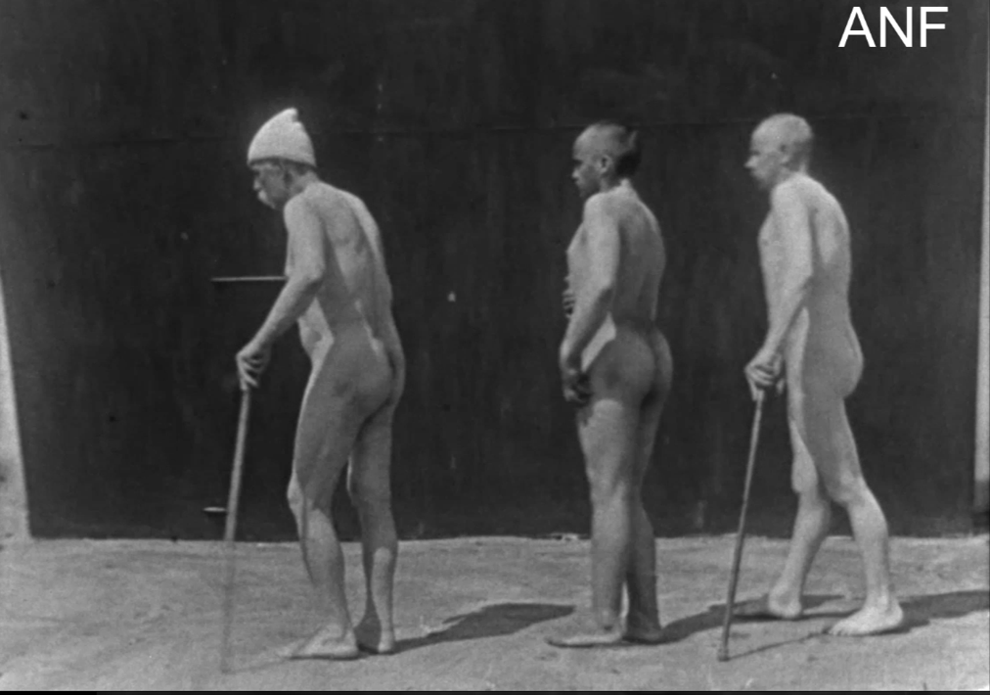
Cinema and Neurology: Georges Marinescu
‘Cinematograms’
Walking Troubles of Organic Hemiplegy (Marinescu, 1898)

Slide 10
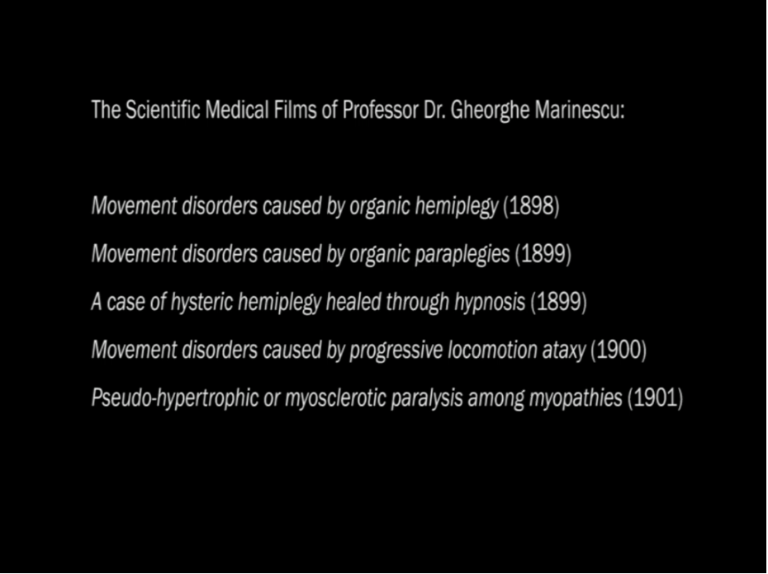
Gheorghe Marinescu
Movement Disorders Caused by Organic Hemiplegy (c. 1898)

Slide 11
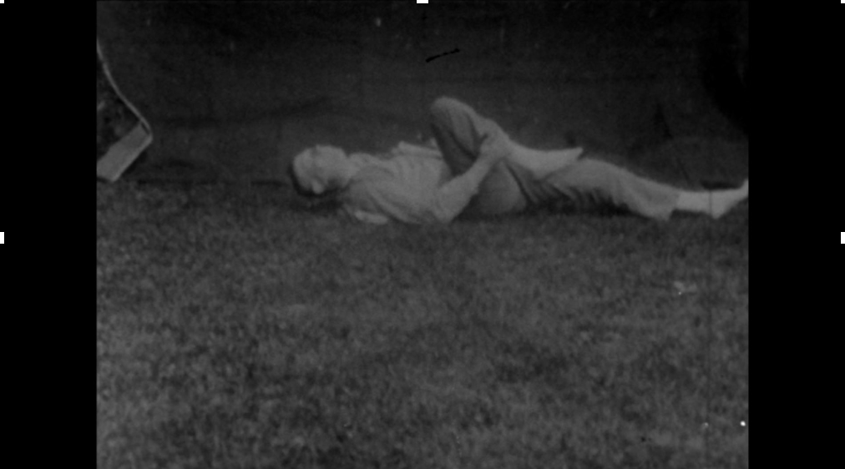
The Body out of Control: The Epilepsy Biographs of Walter Greenough Chase and William Spratling
Epileptic Seizure Nos 1-9 (Walter G. Chase, 1905)

Slide 12
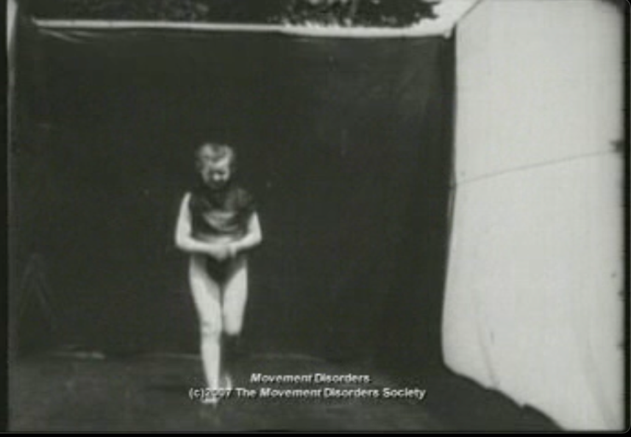
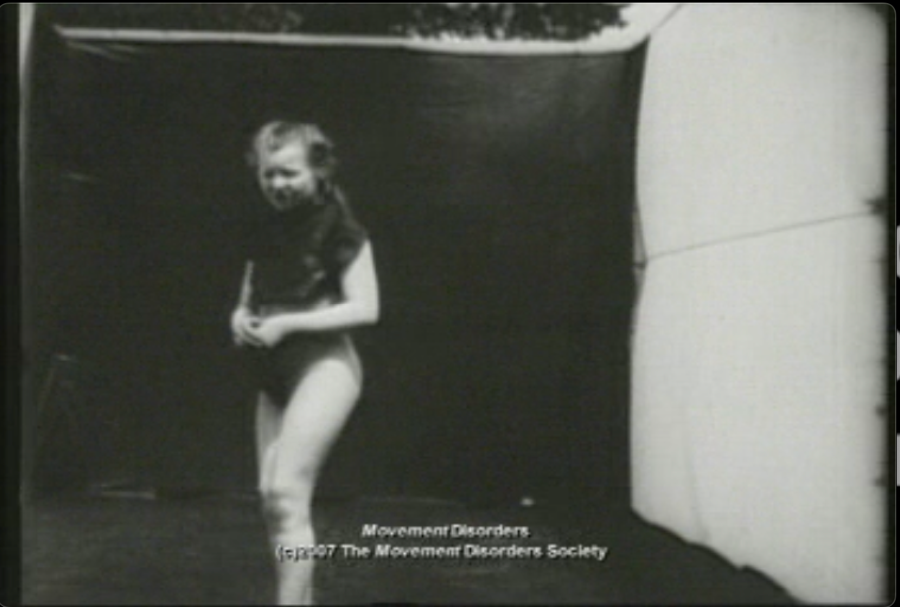
Arthur Van Gehuchten
Films of female patients diagnoses with ‘hysterical chorea’
‘We observed a typical case of saluting chorea in a young girl of 15. Each movement consisted of a flexion of the left knee and a swinging forward and backward of the trunk over the lower limbs’, Les Maladies nerveuses (1920)

Slide 13
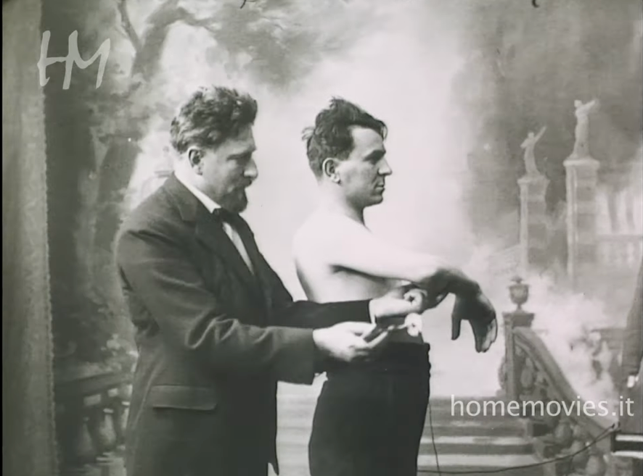
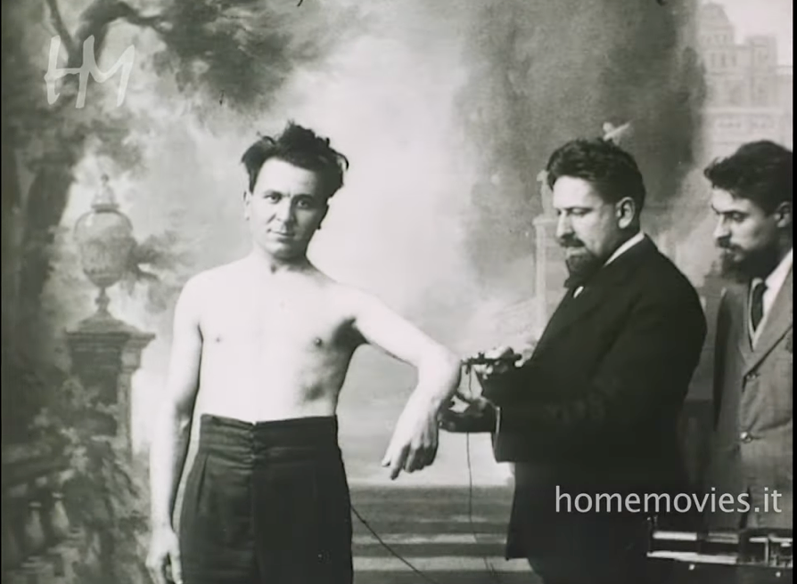
Vincenzo Neri
Medical film collection of Vincenzo Neri (1908-1928)

Slide 14
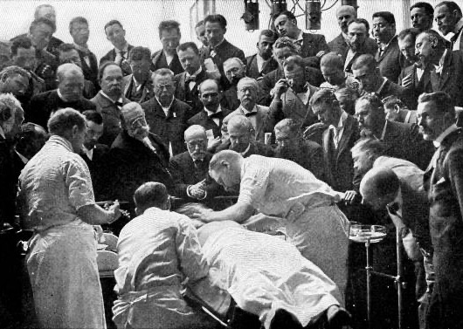
The Promise of Film for the Researcher
Allows the capture, fixation, and detailed study of the functions of the human body
Substitute for live demonstration in medical training:
‘How often does it happen to the professor that a patient fails during a lecture, that a manic suddenly changes his mood, a catatonic suddenly fails to perform his stereotyped movements […] Once the filming is done, the pictures are available for reproduction at any moment. Film is always “in the mood”. There are no failures’, Hans Hennes (1910)

Slide 15
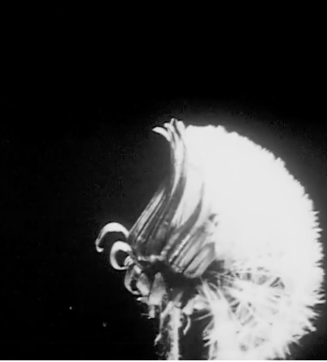
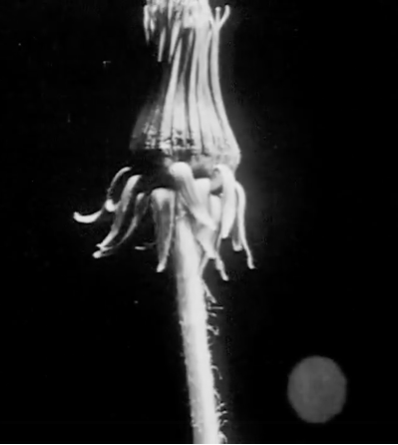
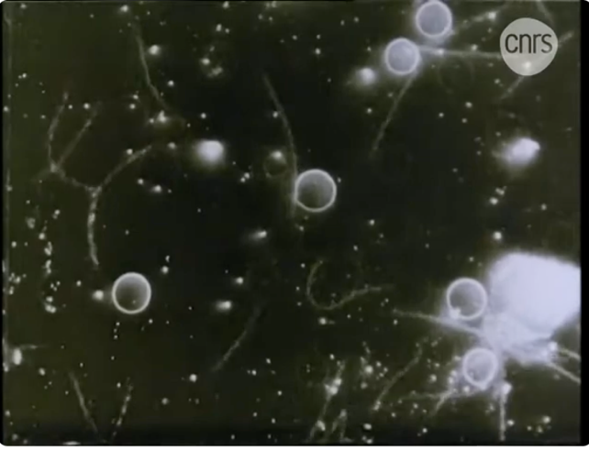
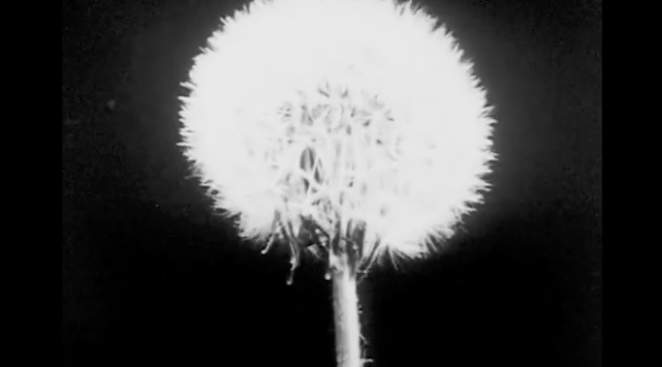
Experiments with and on Film
Time-lapse Photography
Microcinematography
Jean Comandon, The Growth of Plants (1929)
Jean Comandon, Syphilis Spirochaeta Pallida (1909)

Slide 16
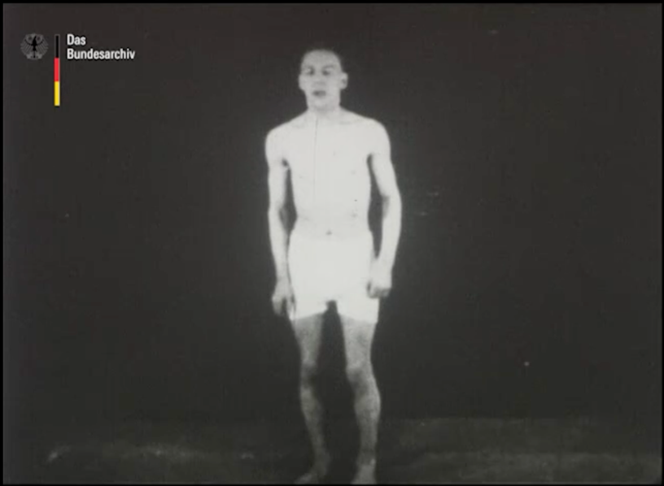
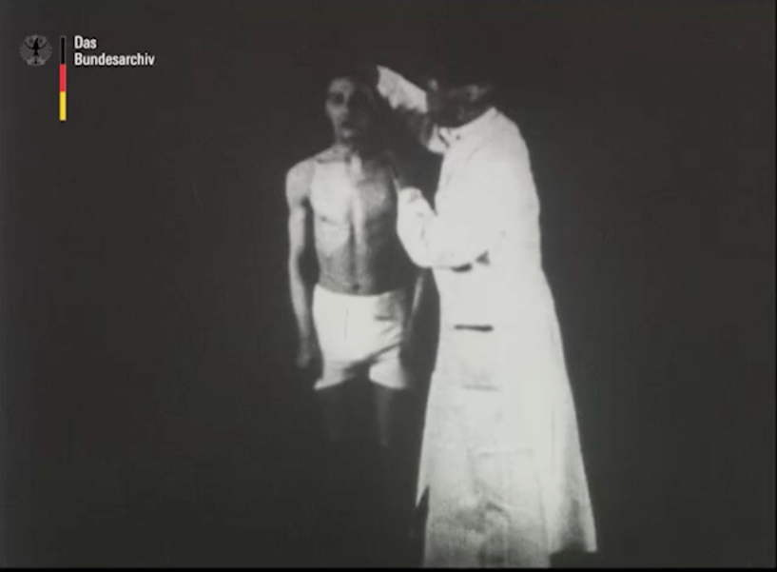
Medical Cinematography during WWI
Max Nonne, Funktionell-motorische Reiz- und Lähmungs-zustände und deren Heilung durch Suggestion in Hypnose (1917)
https://www.deutsche-digitale-bibliothek.de/item/SDFYZAWA7R277PGNHXHULFYIUN4RPCKD

Slide 17
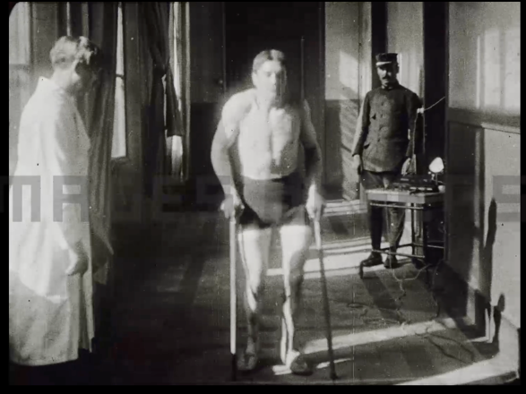
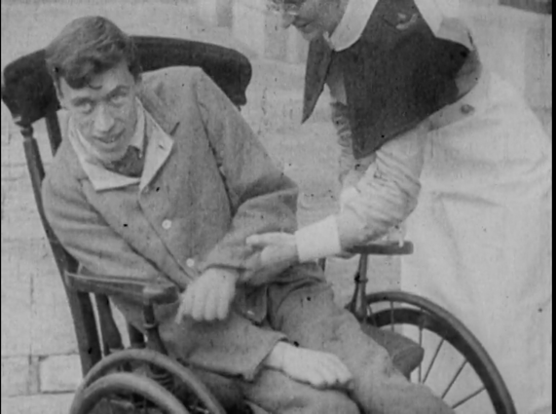
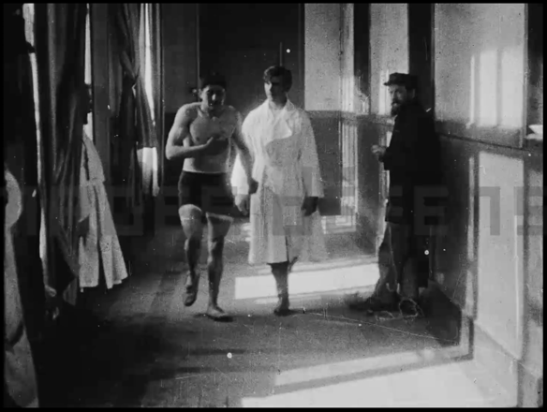
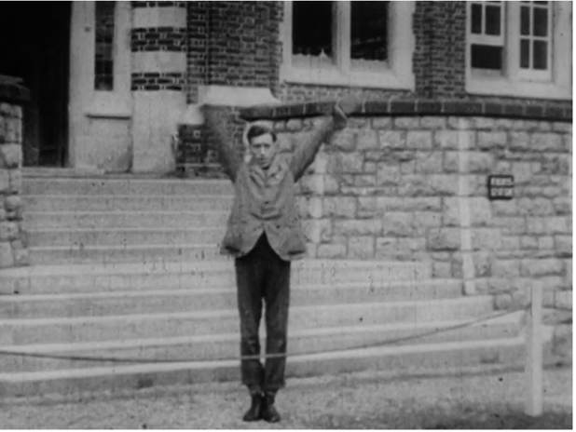
Les progrès de la science française au profit des victimes de la guerre, une grande découverte du docteur Vincent (1916)
War Neuroses (Arthur Hurst, 1917):
https://wellcomecollection.org/works/p5993re4

Slide 18
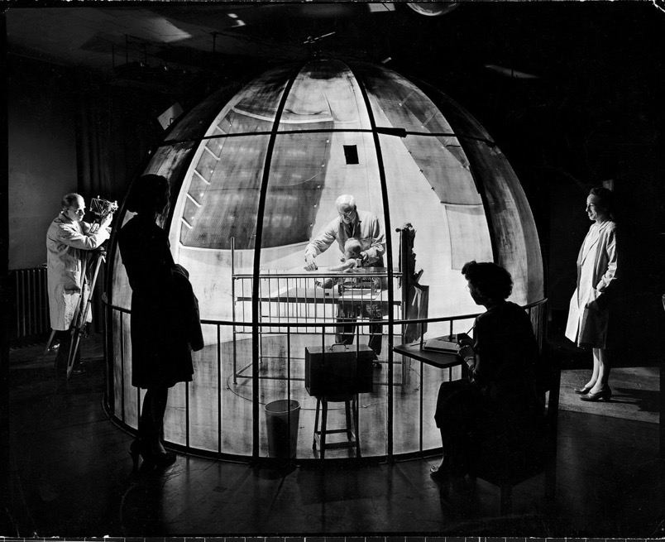
Arnold Gesell’s Photographic Dome at the Yale Psycho-Clinic
‘The camera has become an almost universal servant of science. In some domains the photographic lens has literally supplanted the human eye…’
‘the camera is in a sense, mightier than the psychological eye. The living eye can see but it cannot record. This is just what the camera can do for us. It can supply aeriated optical records – records which do not fade with time nor warp with prejudice, but which perpetuate with impartial fidelity the configuration of the original event’.

Slide 19
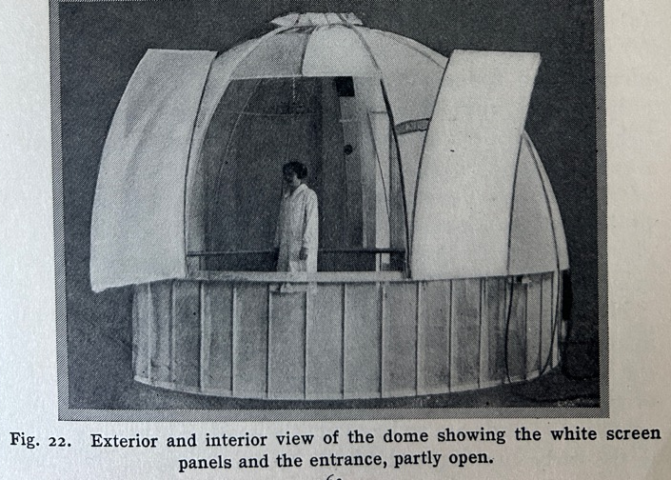
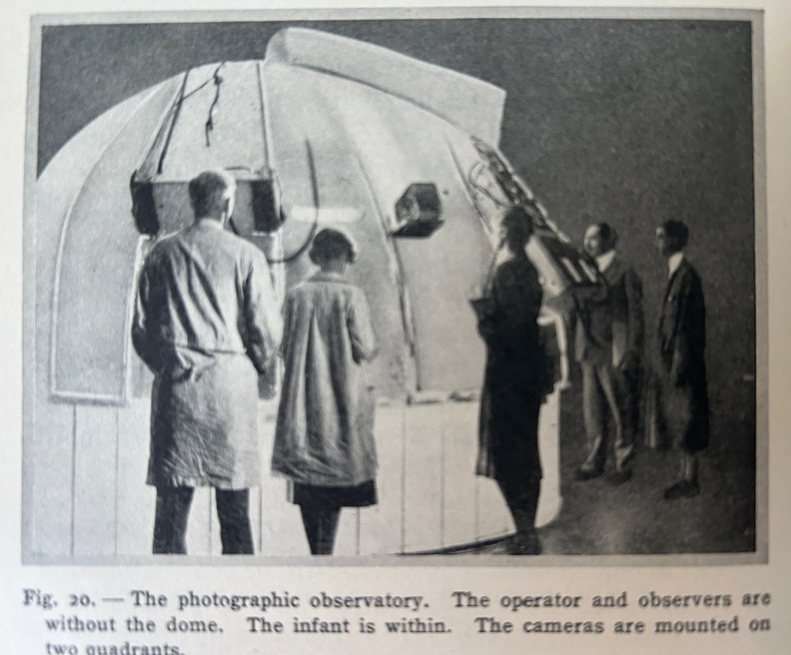
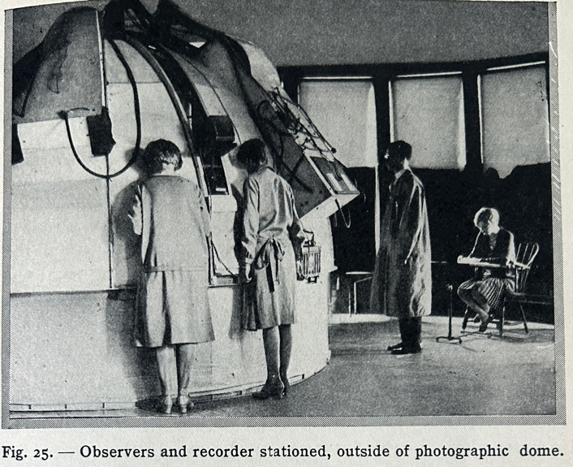

Slide 20
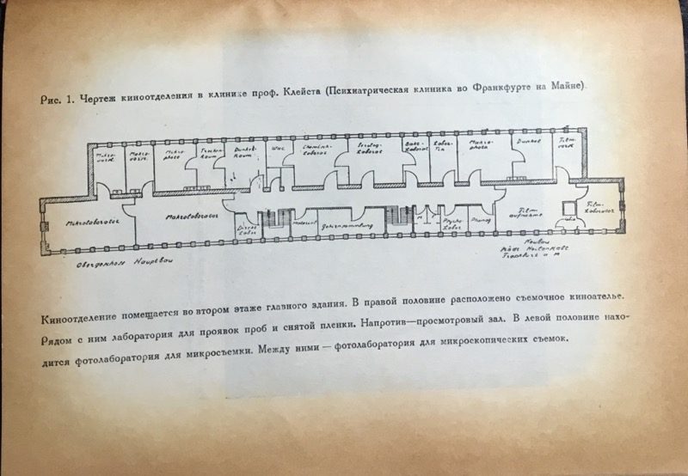
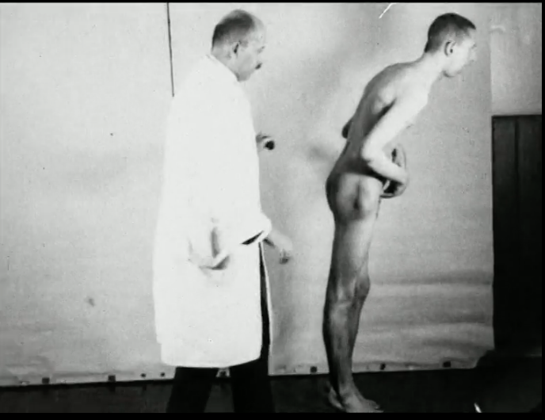
Karl Kleist at the Frankfurt Psychiatric Clinic
Floorplan of the film department at Kleist’s Psychiatric Clinic
Epidemic encephalitis (Kleist,1930)

Slide 21
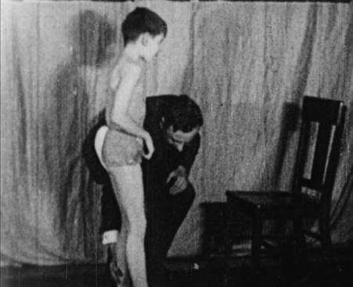
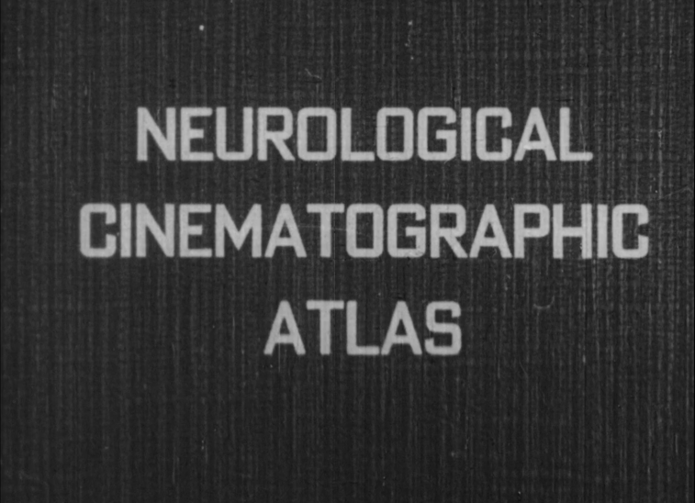
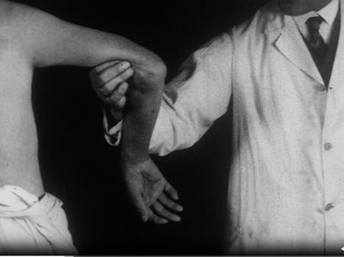


The Neurological Gaze
Lisa Cartwright: ‘visuality and the biological body converge […] they appear in a postempirical psychiatric configuration of degeneracy, eugenics, and heredity’
Film stills from:
Epidemic encephalitis (S. P. Goodhart, 1944)
Catatonia: Psychomotor akinesis and parakinetic hyperkinesia (Karl Kleist, 1925)

Slide 22


Cinema as ‘a Hypnotic Agent’
The Testament of Dr. Mabuse (Lang, 1933)

Slide 23



Soviet Studies of Film Spectators in the 1920s
The questionnaire
The ‘Psycho-diagram’

Slide 24




Soviet Studies of Film Spectators
Investigations at the Pedological Film laboratory, late 1920s

Slide 25


The Wiring of Film Spectators: William Marston
‘Dr. Marston is measuring changes in the blood pressure and respiration of two women, a blonde and a brunette, as they watch love scenes with Greta Garbo and John Gilbert’. Image source: William M. Marston, ‘Bodily Symptoms of Elementary Emotions’, Psyche 38 (1929): 70–86, 71

Slide 26



The Payne Fund Studies (1929-1933): The impact of cinema on children and young people

Slide 27


The Health Enlightenment Film
Thomas Edison’s films on tuberculosis:
Still from Temple of Moloch (1914)
Unhooking the Hookworm (1920)

Slide 28




Shock tactics
Case Study: Do Not Spit on the Floor (Shirokov, 1929, USSR)

Slide 29





The Phobic Gaze:
Stills from Do Not Spit on the Floor

Slide 30





Entertainment and Enlightenment: Playfulness and Satire

