Slide 1
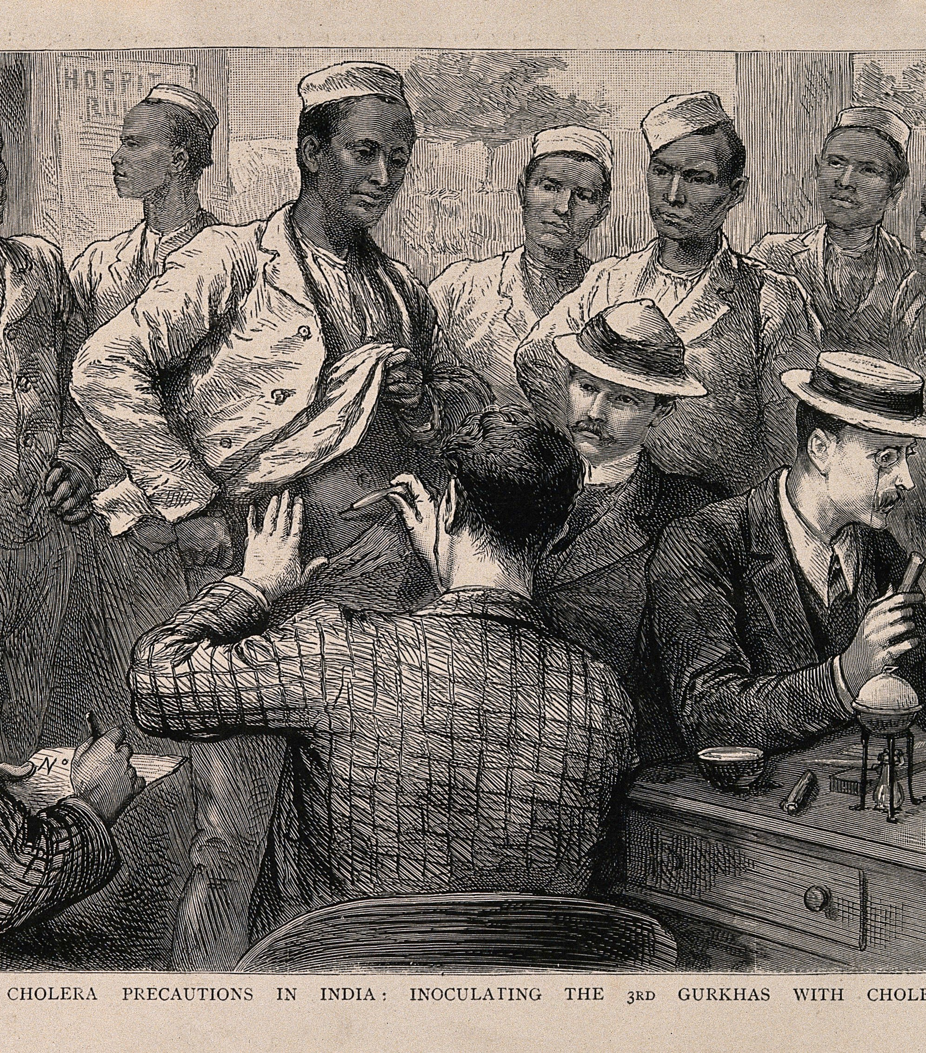
Medicine and Empire
HI173 Empire and Aftermath
Week 5—Lecture by Elise Smith

Slide 2
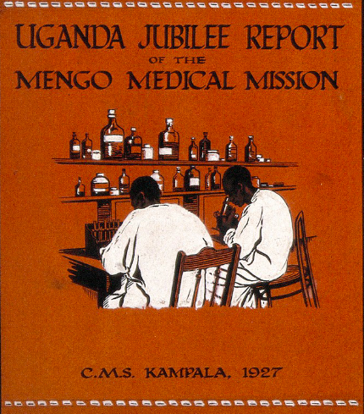
Outline
Disease and colonisation: ally or obstacle?
Acclimatisation and the racialised body
Tropical medicine
Medicine as a ‘tool of empire’

Slide 3
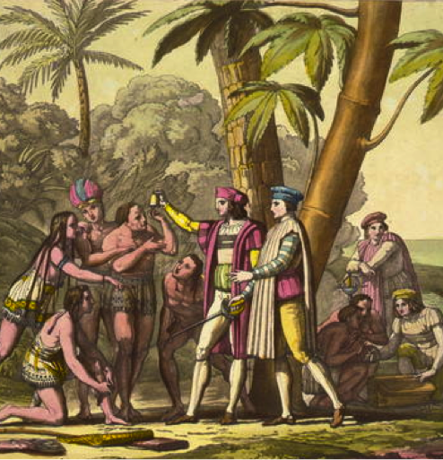
Disease and Empire: The Columbian Exchange
‘Why were the Europeans able to conquer America so easily?’ -Alfred Crosby, The Columbian Exchange (1972), p.35
Traditional interpretations:
Superior technology, military ability
‘Black Legend’: Butchery and brutality, especially by the Spanish
Crosby’s revisionism: infectious European diseases, particularly smallpox, played a major role in depopulating the Americas
Crosby uses modern epidemiological knowledge about smallpox to explain how it could have killed 1/3 to ½ half of population.
Not only disease itself, but disorder caused by disease, weakens resistance to colonization.
Subsequent historians have challenged this explanation, noting that smallpox is not necessarily virulent and that it mistakenly presents imperialism as a passive process (‘biological determinism’).

Slide 4
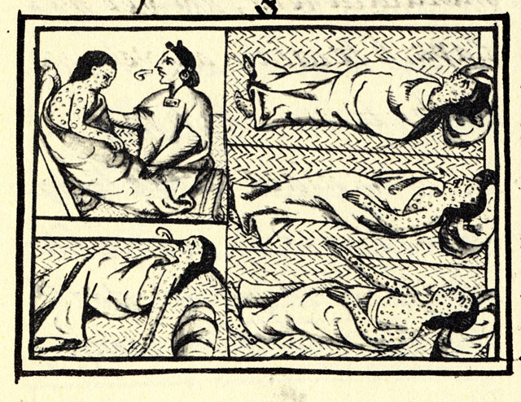
Disease: ‘Ally’ or ‘Weapon’ of Imperialism?
Spread of epidemic diseases undoubtedly contributes to European conquest of the Americas, and later territories in the Pacific (Australia, New Zealand) in the nineteenth century.
A destabilizing force.
Asymmetric consequences spur religious conversions.
Disease also actively weaponized with plans to distribute smallpox blankets (1763 incident at Fort Pitt, Pennsylvania)—early form of biological warfare?

Slide 5
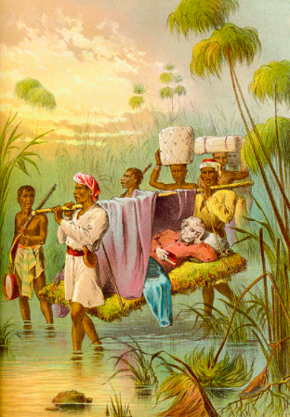
…But also an obstacle to colonization.
'Tropical’ diseases such as yellow fever and malaria cause high European casualties, especially in the Caribbean, Africa.
Waves of epidemics influence colonial wars fought amongst European power scrambling for control of lucrative Caribbean territories.
Disease also inhibits exploration of African interior (e.g. 1841 Niger expedition, missionary exploration)
West Africa earns reputation for being ‘the white man’s grave’ (mortality levels from disease about ¼ during early 19th century).
Observation that Africans more immune prompts questions about European capacity to survive in hot climates.

Slide 6
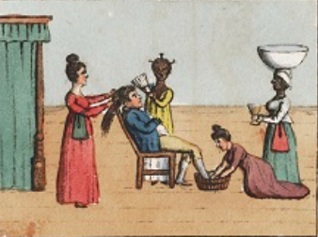
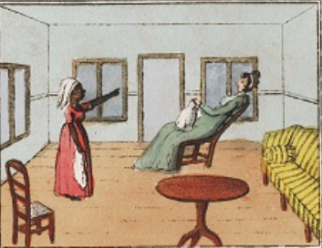
‘Acclimatisation’ and Racialised Medicine
Emerging racial theory provides basis for assumption that peoples are innately suited to the climate of their place of origin.
A period of ‘seasoning’ is necessary to adjust to different locales.
Advice on how to survive the tropics proliferates in the eighteenth-century: modifications to dress, diets, habits.
Strategies involve geography, favouring settlements in cool, high places.
Varying degrees of optimism and pessimism over European ability to adapt to new surroundings.

Slide 7
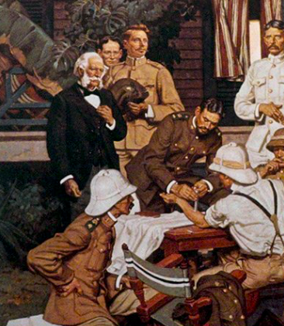
Tropical Medicine
Research into ‘tropical’ diseases such malaria and yellow fever became a distinct medical specialization in the 1890s.
Drew from germ theory (bacteriology) and laboratory techniques to study origins, vectors, rates of transmission, means of prevention.
Associated with discovery that insects were a vector for diseases such as malaria, sleeping sickness, yellow fever, bilharzia.
With causes identified, it was possible to control the spread of diseases (netting, chemicals…).
Despite founding of institutions such as the London School of Tropical Medicine in Europe, research institutes in the Global South became locus for this branch of medicine.

Slide 8
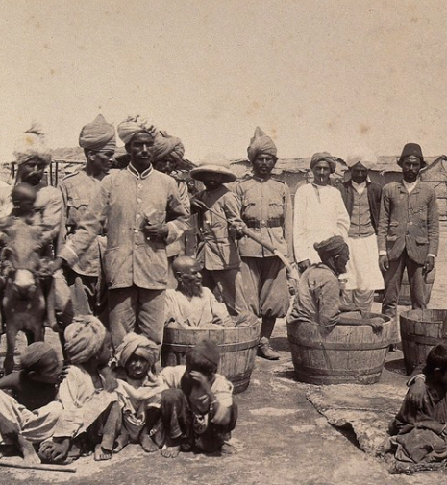
A ‘Tool’ of Empire?
Drugs like quinine helped Europeans to expand into tropical areas, esp. throughout Africa.
Tropical medicine and sanitary reforms secured European power despite minority rule. Due to enclavism, medical benefits generally went to Europeans and not local populations.
Esp. in India, epidemics threatened profit and health of Europeans, leading to unpopular public health measures: vaccination campaigns (smallpox), disinfection methods (plague—see image), quarantine (cholera), and forced medical inspections/confinement (venereal diseases).
Despite resistance, these measures could help bolster the ‘civilizing mission’ image of empire: spreading western science, decontamination.
Missionary medicine focused on providing practical care to indigenous peoples (e.g. midwifery) to facilitate conversion to Christianity. Saving souls by saving bodies, and undermining traditional medicine.

Slide 9
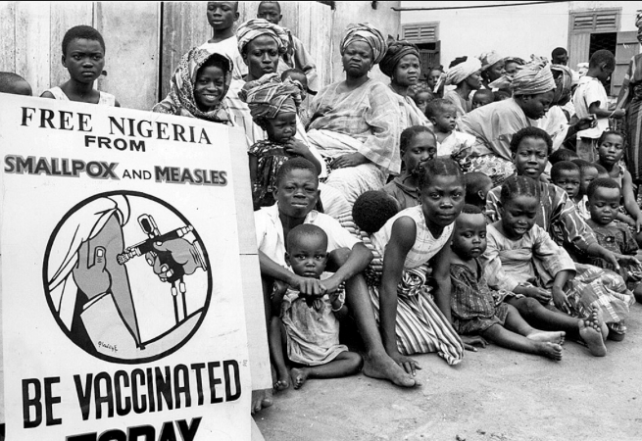
Decolonising Medical History
Narrative that spread of Western medicine of benefit to the Global South still persists (humanitarian aid)
Yet transfer was never one-way: Europeans often learned how to survive the tropics from the peoples they colonized.
European and indigenous medicine often worked in tandem; assimilation and adaptation amongst practitioners on both sides.
The health of local populations rarely prioritised.
European presence often exacerbated disease (overcrowding, dislocation, poor resource management, malnutrition, stress).
Also sometimes the vectors of the very diseases they have sought to cure.
Imperial legacies and lack of consideration to local cultures has made it harder to treat/eradicate diseases.

