Slide 1
Medicalisation and morality
Mind, Body and Society
Week 13
Roberta Bivins (H3.30)

Slide 2
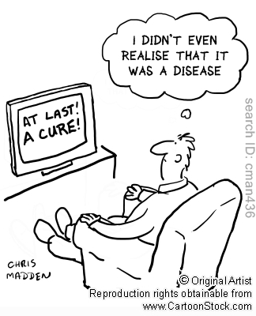
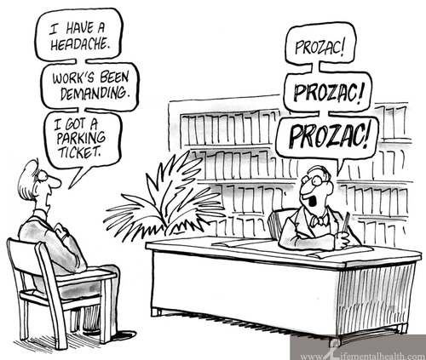
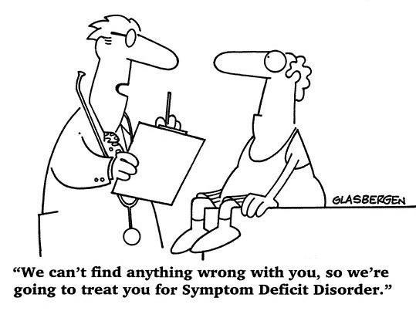
‘Medicalisation’? What’s that all about?
We use the term ‘medicalisation’ to described the process by which a behaviour, natural phenomenon, or aspect of the human condition comes to be defined as a pathology which requires medical study, intervention, or surveillance.

Slide 3
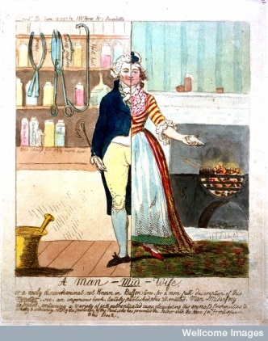
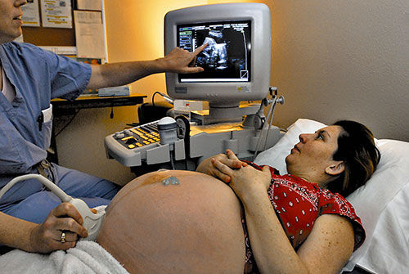
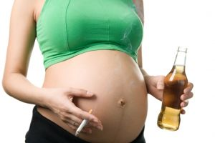
Medicalisation: Building on Birth
From women’s work and ‘waiting on nature’ to a medical crisis in need of a medical (man’s) solution to…
… scientific motherhood and the medical management of birth, infant care and ideal (or not) motherhood.

Slide 4
How (& why) was childbirth medicalised?
Consumer demand (birth was risky, dangerous and much feared; women – and men – sought solutions in the new knowledge of anatomy, then germ theory, etc)
Provider competition (the abundance of medical men rendered them desperate to establish a foothold in families, and eager to eliminate the powerful threat of midwifery)
Fashion!
New spaces and tools intended to improve birth and its outcomes (forceps, anaesthesia, antisepsis, lying-in and then general hospitals, antenatal checks and postnatal advice)
Increased social pressure on women to comply with specific models of ‘ideal motherhood’ – eugenic, hygienic, dietetic, and ‘scientific’.

Slide 5
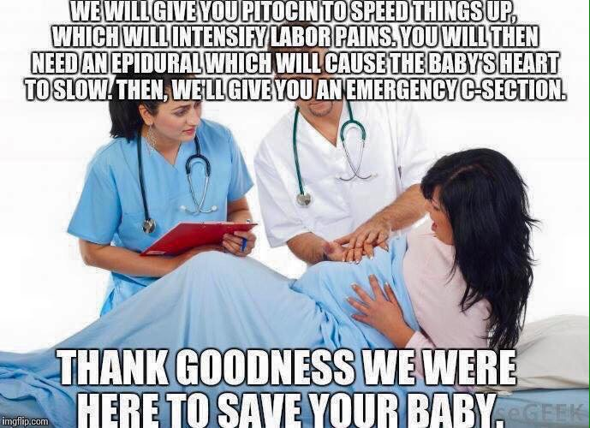

Slide 6
So what can the medicalisation of birth/reproduction tell us about at medicalisation more generally?
To understand medicalisation, we need to look at:
Interest: who benefits and in what ways?
Social forces: are there significant changes or developments that might trigger new interpretations of a given behaviour/condition?
Morality and ‘normality’
New technologies?
Effects of (medical) surveillance on individual and group indentities and freedoms

Slide 7
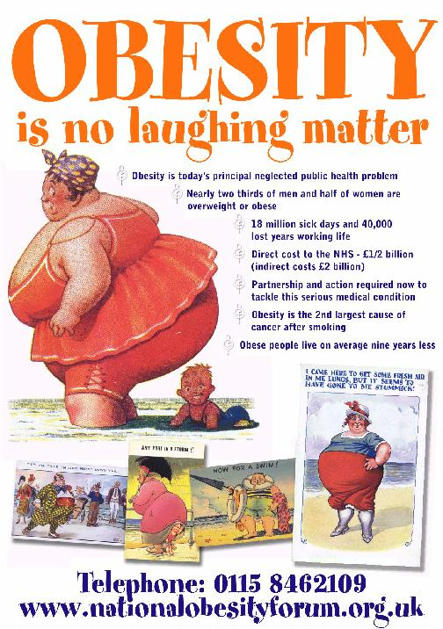
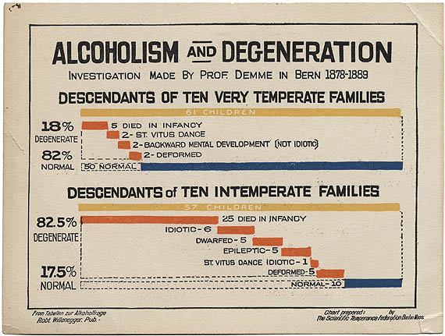
From perfect motherhood to perfect ‘lifestyles’: medicalising alcoholism & obesity
Scientific Temperance Federation. ‘Alcoholism and Degeneration’, Boston, ca. 1910.

Slide 8
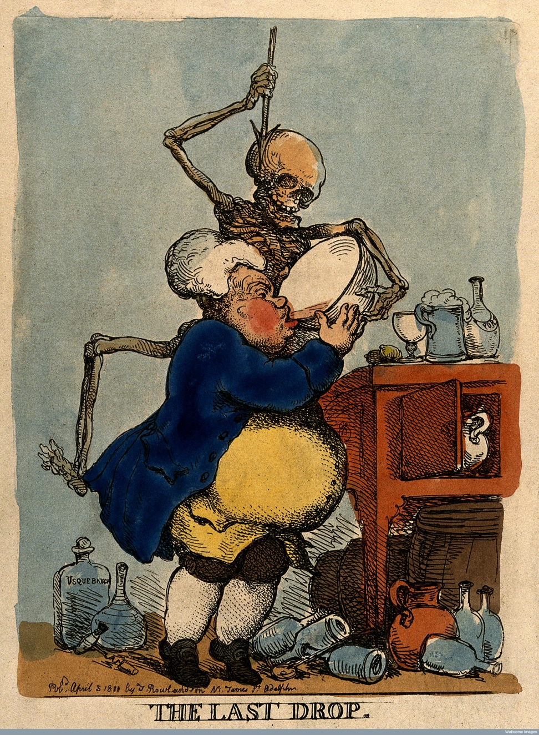
Doctors colonise Dram Drinking
“We, the undersigned, do hereby declare that, in our opinion, ardent spirits cannot be regarded as a necessary, suitable, or nourishing article of diet; that they have not the property of preventing the accession of any complaints, but may be considered as the principal source of numerous and formidable diseases, and the principal cause of the poverty, crime, and misery which abound in this country; and that the entire disuse of them, except under medical direction, would materially tend to improve the health, amend the morals, and augment the comfort of the community.”
‘589 medical men of the first eminence…of this kingdom’
‘the condition inebriety is well-distinguished from the vice drunkenness’ because’ irresistible’, ‘intermittent’, ‘hereditary’, and ‘associated with a nervous temperament’. George Miller Beard c. 1871
Notes:
http://hansard.millbanksystems.com/commons/1834/jun/03/drunkenness
The House divided—Ayes 64 Noes, 47: Majority 17. Select Committee appointed to inquire into the causes of the great increase of habitual Drunkenness among the labouring classes of this kingdom
Second quote reporting on Dr Beard, in Habitual Drunkards' Act of 1879, with an account of a visit to the American Inebriate Homes, February 2, 1880
On openlibrary.org https://archive.org/stream/habitualdrunkard00alfouoft#page/8/mode/2up p.12

Slide 9
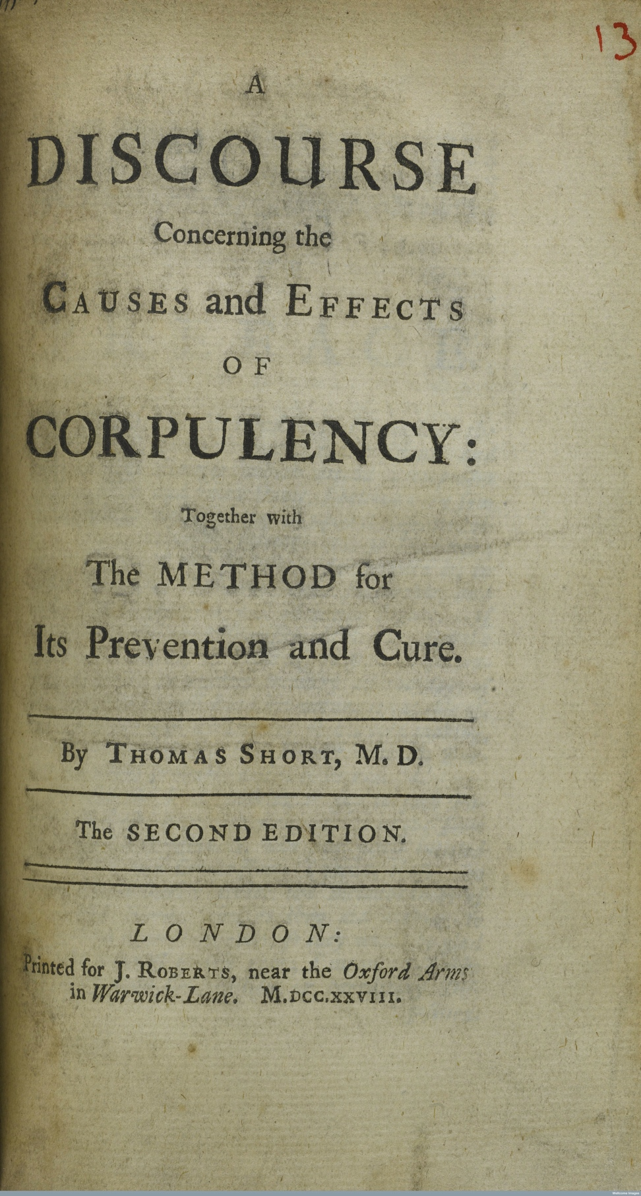
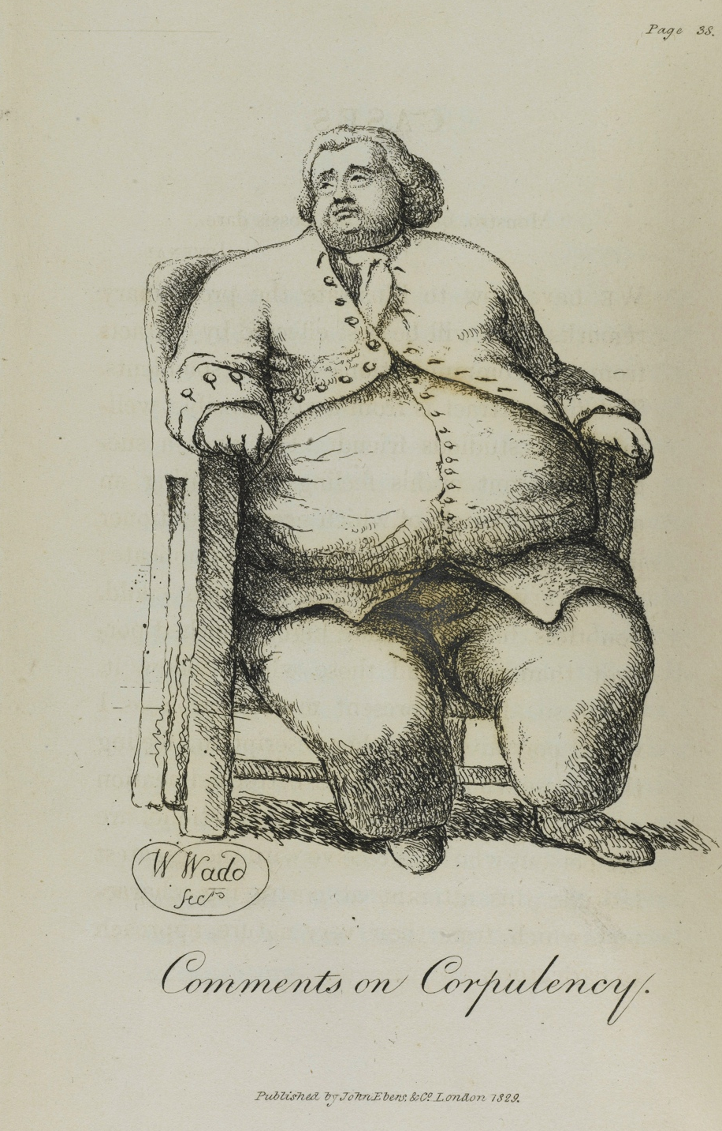
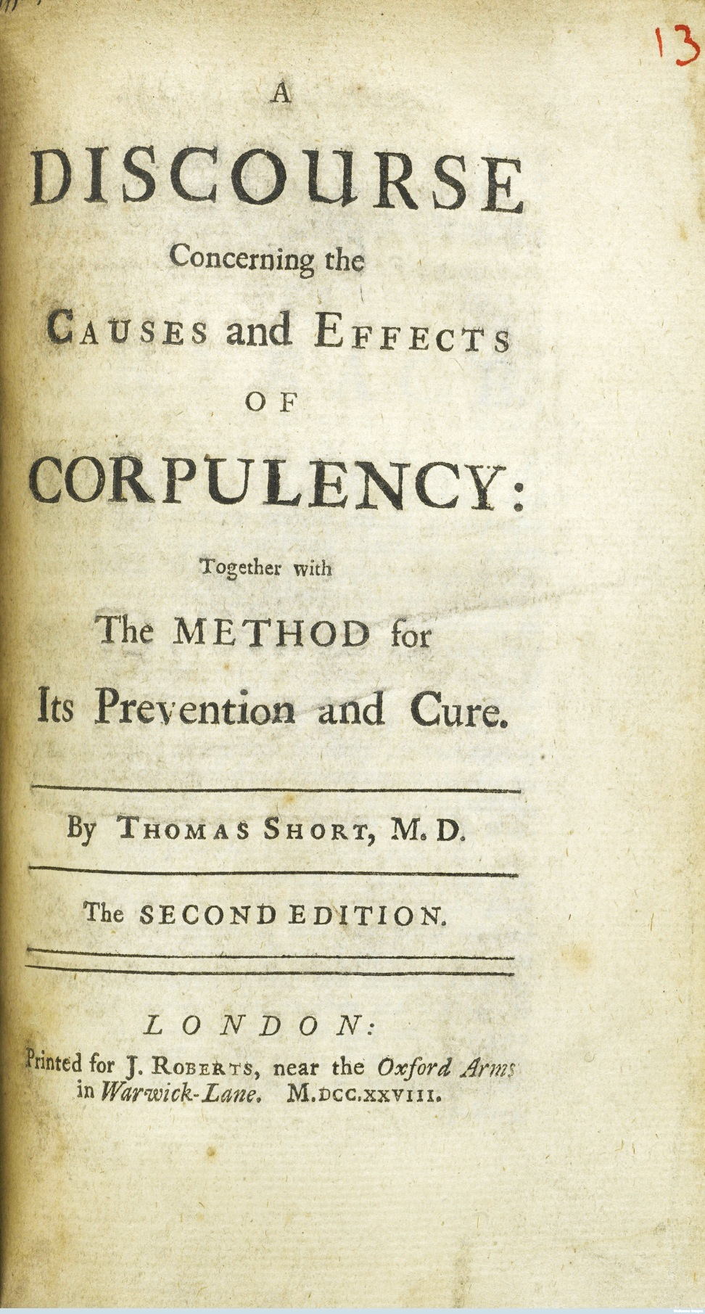
…and Corpulency
Notes:
A discourse concerning the effects of corpulency together with the method for its prevention and cure by Thomas Short. Royal Humane Society (London, England)
1781

Slide 10
‘a fiery flood of disease, of crime, and of physical and mental destruction…’
‘of all the single evils that afflict our common country, the increased and increasing prevalence of drunkenness, among the labouring classes, including men, women, and children, is the greatest; … it is not only an evil of the greatest magnitude in itself, but that it is the source of a long and melancholy catalogue of other evils springing directly from its impure fountain; and as its daily operation is to sap the very foundations of social happiness and domestic enjoyment, he who may be instrumental in arresting its fatal progress, will be conferring an in, estimable benefit on his country, and rendering a valuable service to mankind.’
James Buckingham, MP for Sheffield, House of Commons, 1834
Notes:
http://hansard.millbanksystems.com/commons/1834/jun/03/drunkenness

Slide 11
From Medicalisation to Legislation
1834 Select Committee appointed ‘to inquire into the causes of the great increase of habitual Drunkenness among the labouring classes of this kingdom’
1868 ‘Dipsomania’ appears in medical dictionaries; habitual drunkenness defined as a mental disorder
1872 Licensing Act creates a crime of public drunkenness and prompted some rioting by restricting opening hours
1876 Society for Promoting Legislation for the Control and Cure of Habitual Drunkards founded at instigation of a doctor
1879 Habitual Drunkards Act allowed the (voluntary) incarceration of drunks to asylums for treatment; led to police circulation of photo albums of drunks to pubs
1898 Habitual Inebriates Act allowed criminals who acted under the influence of drink to serve time in (in addition or in substitution to) ‘any State inebriate reformatory’.
Notes:
http://hansard.millbanksystems.com/commons/1834/jun/03/drunkenness
Inebriates Bill: http://hansard.millbanksystems.com/lords/1895/jun/21/inebriates-bill
http://www.open.ac.uk/Arts/history-from-police-archives/Met6Kt/Crime/crmCrCrim.html
Habitual Drunkards' Act of 1879, with an account of a visit to the American Inebriate Homes, February 2, 1880
On openlibrary.org https://archive.org/stream/habitualdrunkard00alfouoft#page/8/mode/2up

Slide 12
From ‘vice’ to ‘disease of the will’
‘the condition inebriety is well-distinguished from the vice drunkenness’ (because’ irresistible’, ‘intermittent’, ‘hereditary’, and ‘associated with a nervous temperament’).
George Miller Beard c. 1871
‘medical treatment can assist men in carrying out their intention to become sober, but it cannot create that intention. At the outset, what must take place is a change in the alcoholic's character.’
British Journal of Inebriety, 1906
Notes:
A. T. Shearman, 'The effect of alcohol on feeling', British Journal of Inebriety (1906), 34.

Slide 13
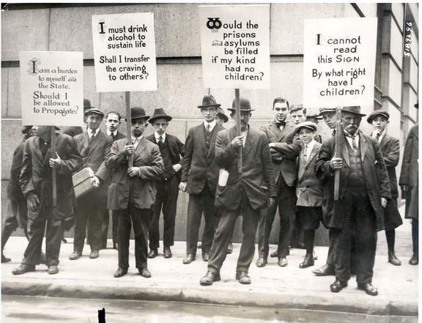
Transmitting and Inheriting Alcoholism
Outcome of medicalisation?
Impact on those ‘diagnosed’?
Social impacts?
Did medicalisation augment or circumvent moralisation of conditions?
Notes:
Title: Eugenics Demonstration on Wall Street
Description: Four impoverished men hired by "The Medical Review of Reviews" carry signs with the eugenics slogans, "I am a burden to myself and the State. Should I be allowed to propagate?," "I must drink alcohol to sustain life. Shall I transfer the craving to others?," "Would prisons and asylums be filled if my kind had no children?," and "I cannot read this Sign. By what right have I children?" This demonstration was one of a series of events organized by Frederic Robinson and Edward Bernays of The Medical Review of Reviews' Sociological Fund Committee including the eugenics play "Damaged Goods," the motion pictures "The Inside of the White Slave Trade" and "The Drug Terror," and meetings such as the "Symposium on Euthanasia" and "Symposium on the Sterilization of the Unfit."
Image ID: 2003
Creation
Date: October 27, 1915
Creator
Name: Underwood & Underwood
City, State: New York City, New York
Collection
Name: Classified File
Genre: Photograph
Additional
Information: Original Underwood & Underwood caption: "Human Interrogation Points Enlisted by Eugenic Forces. A curious looking group of men invaded Wall Street the community of sleek bankers, spick and span brokers and well groomed clerks and office boys, carrying signs on which some very pertinent questions were asked. As intended by the Eugenic Forces which employed the men to parade the financial district, they were soon the center of a mass of a thousand. The signs explain themselves. One of the bearers said he was employed by a medical society at 206 Broadway. This is the office of the editor of the Medical Review of Reviews who recently offered a prize of $1000 for the 'perfect eugenic marriage.'"

Slide 14
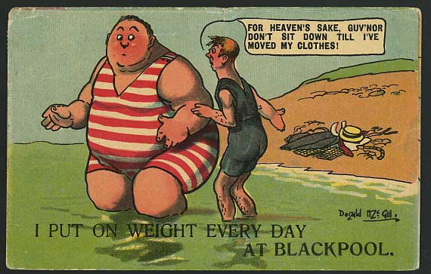
So what about Corpulence?
Notes:
Donald McGill 1913

Slide 15
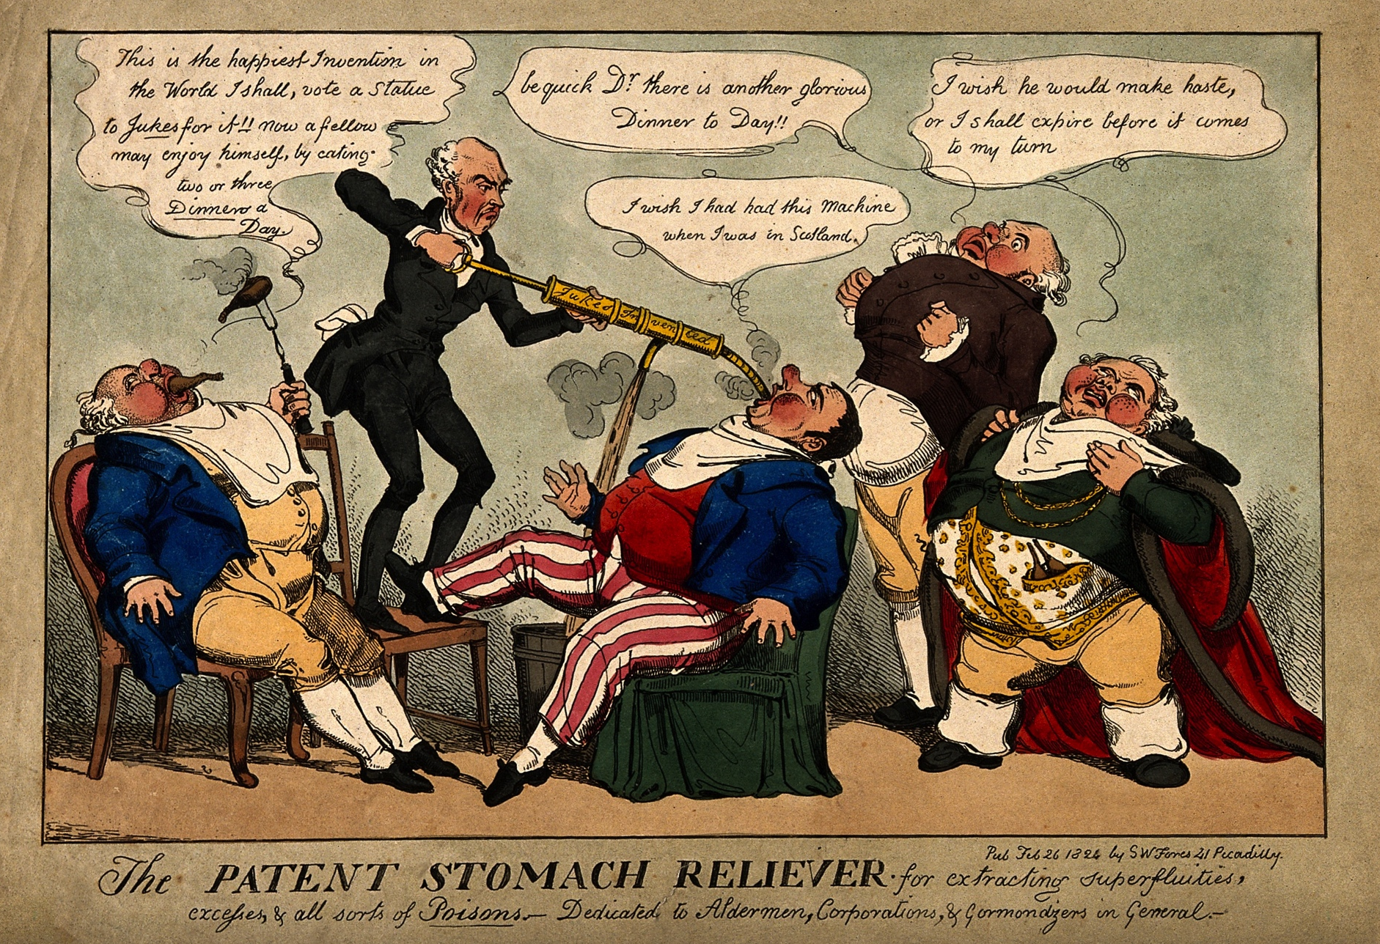
Certainly seen as a vice, and one of indulgence…

Slide 16
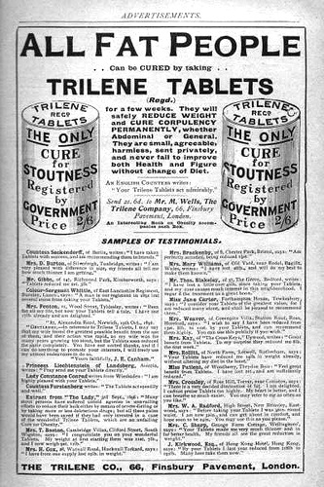
But no legislative response, despite medicalisation & claims of national importance.
‘The solution of this apparently simple problem of what is the weight of a healthy man? would be a valuable boon to society. …
An investigation so simple, and so valuable, should not be omitted. In making statistical inquiries, the government would do well to … combine the height and weight with the other questions, when taking the census... We should then see more clearly than we do at present, what trade, occupation, or locality, as most conducive or deleterious to life and health. These points… would afford most useful information on matters connected with the social and commercial welfare of the country.’
John Hutchinson, 1846

Slide 17
From a healthy plumpness…
“The popular expression applied to persons of a rounded form, moderate embonpoint, clear skin, and a ruddy color,—that they are ‘in good condition,’—accords with science. This condition is most commonly accompanied by healthy internal organs, a very desirable and hopeful state. . . . until it [fat] becomes burdensome, it is generally disregarded.”
“In so far as lightweights are concerned we must confess that we are more afraid of them than of over‐ weights” (Edward H. Hamill 1907)
Notes:
John Gardner (1875: 83–84) presented this common medical opinion of body weight in post–Civil War America (Czerniawski, 277)
Hamill commenting on Shepherd, George R. (1907) “The relation of build to longevity,” in Abstract of the Proceedings of the Seventeenth Annual Meeting of the Association of Life Insurance Medical Directors of America. New York: Knickerbocker: 46–66.
Czerniawski, 280.

Slide 18
… to dangerous corpulence.
‘What we call a normal weight is not an arbitrary established standard like fashion in dress, but is a weight which corresponds with a bodily symmetry with which we have long associated certain qualities which are universally admired. . . . A certain amount of fat is essential to an appearance of health and beauty. It is one indication that the state of nutrition is good. . . . We all agree that excessive fat makes one uncomfortable and unattractive.’
Elmer Verner McCollum and Nina Simmonds (1925: 93)
“Obesity, or excessive corpulence, is not only an unlovely condition, it is a dangerous condition: it increases susceptibility to a number of diseases . . . [and] reduces life expectancy.”
Michael G. Wohl (1945: 791) Temple University School of Medicine
Notes:
Czerniawski 287

Slide 19
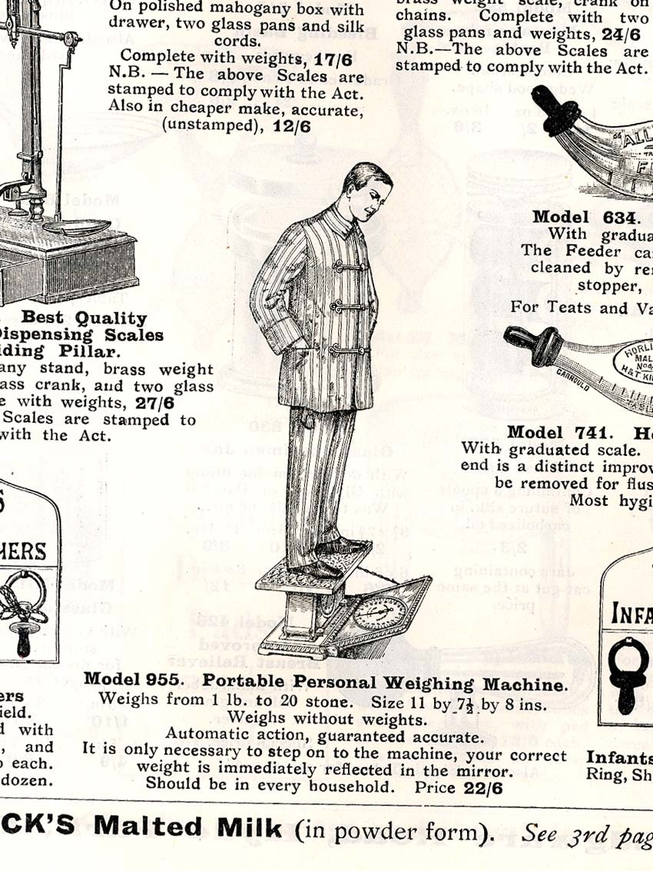
‘Should be in every household’: selling health through the bathroom scale
Garrold, 1911

Slide 20
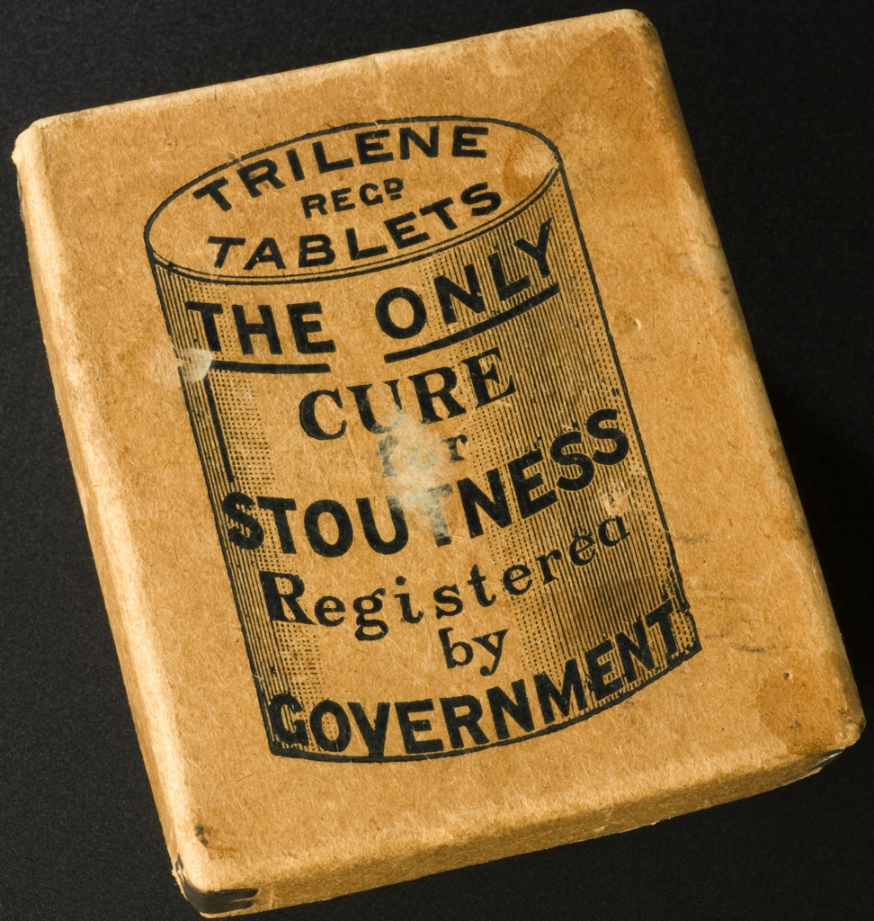
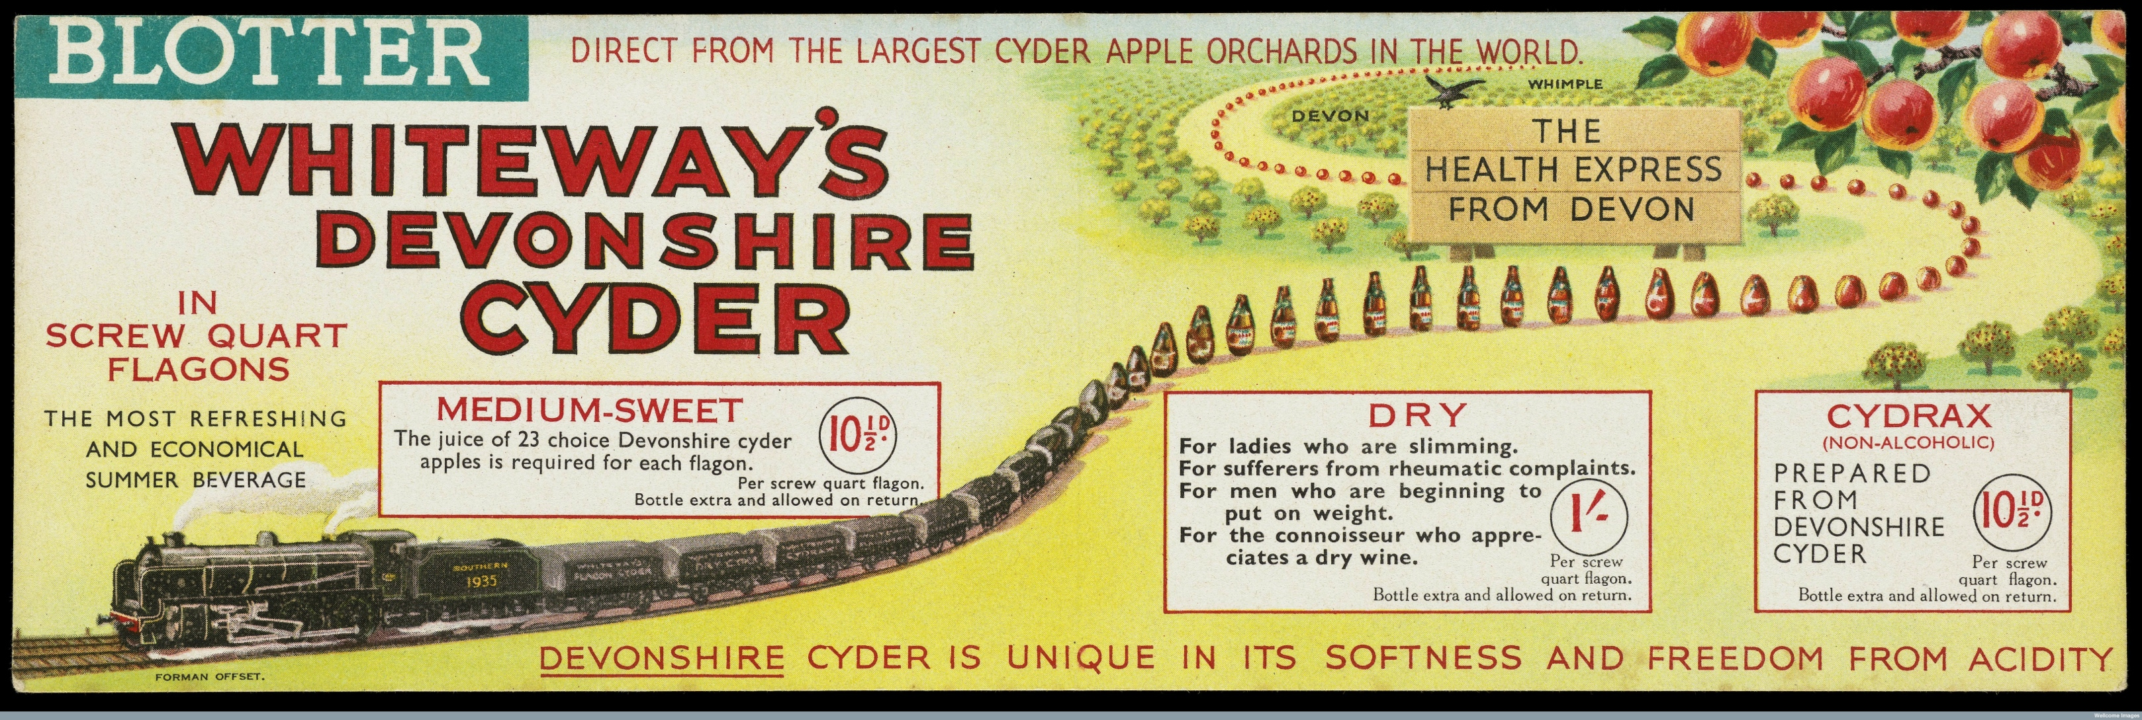
‘Curing’ Stoutness, Selling Slimming

Slide 21
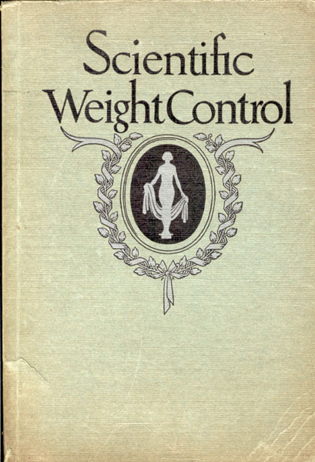
‘Scientific Weight Control’ at Home
James M Booher, MD (ed). Scientific Weight Control: An improved system for reducing or increasing weight, Together with an Explanation of the Benefits to be Gained from Weighing Daily. (Chicago: Continental Scale Works, 1925).
104 pages ; showing use; cover detached, and pages dog-eared, but not annotated)

Slide 22
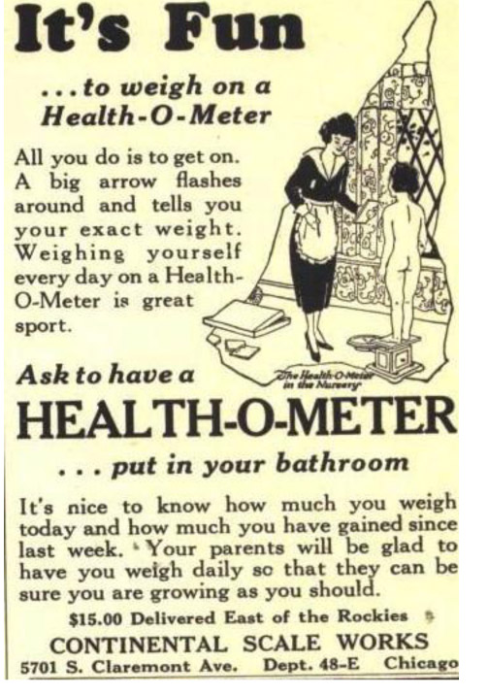
Self-Surveillance for the ‘thinking thousands’
‘placed in your bathroom, it will instantly become an integral and artistic part of it, just as weighing daily has become an inseparable part of the morning toilette of the thinking thousands’
‘unvarying accuracy’
‘the subconscious deterrent to improper eating’
‘procurable at any department hardware, physicians’ supply or drug store’.
← Continental Scale Works, 1920s
Notes:
Text comes from 1929 Health-o-meter ad, reproduced in Taschen, All-American Ads of the 20s, author Steven Heller, ed. Jim Heimann

Slide 23
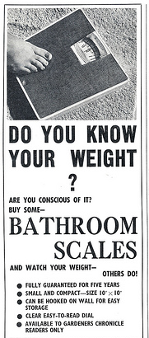
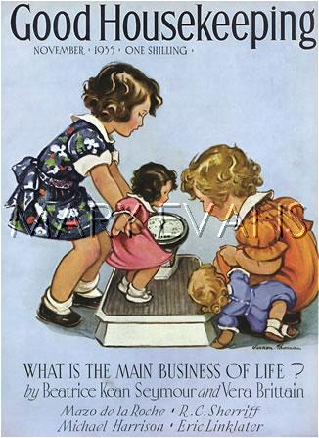
Cultures of Self-Surveillance: ‘Watch your weight – others do!’
Good Housekeeping UK , 1935
←
Gardeners’ Chronicle,
UK
1966 →

Slide 24
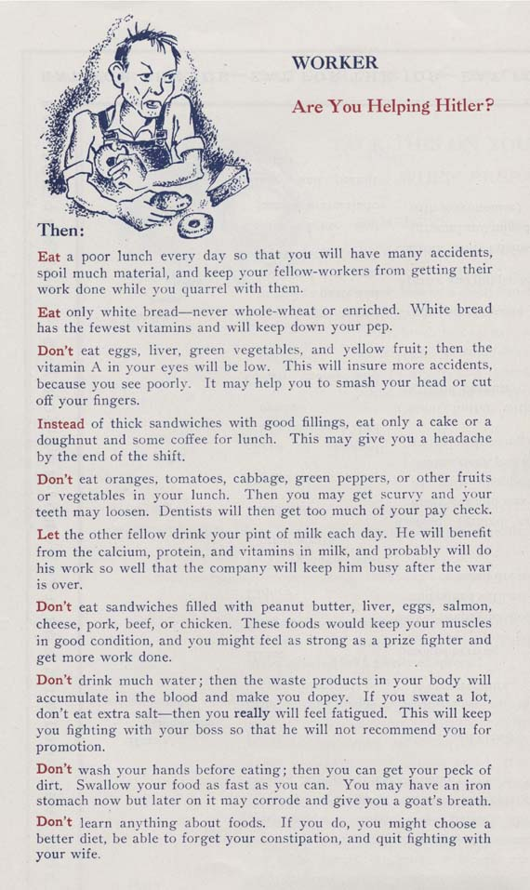
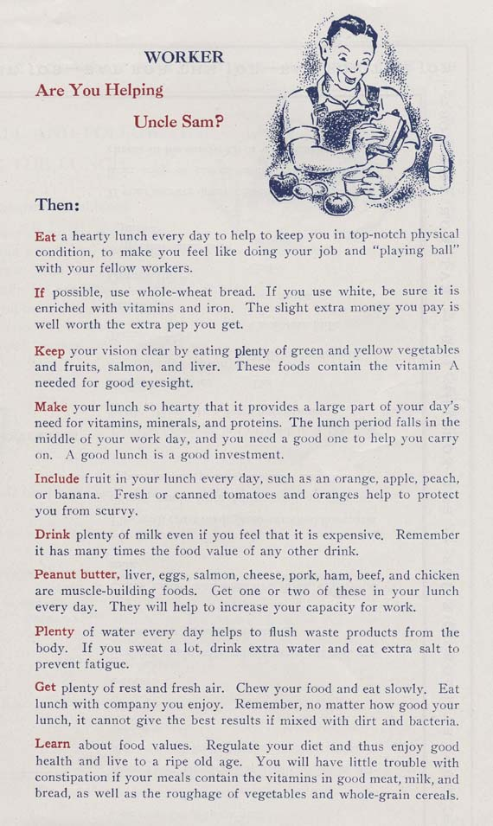
Healthy Diet, Moral Diet? Eating for your country
Notes:
Cornell Bulletin for Homemakers. War Emergency Bulletin 38. June, 1942. "Are You Helping Hitler? Are You Helping Uncle Sam?’ This 1942 Cornell war emergency bulletin entitled Eat Well to Work Well, encouraged people to support Uncle Sam by eating particular foods. Cornell received a letter from the Director of the Office of War, Nutrition Services, requesting that the bulletin be translated into Polish and Italian so that it could be distributed to industrial workers in metropolitan, immigrant communities. The Nation was unified in the war effort, and home economists were ready to do their part.

Slide 25
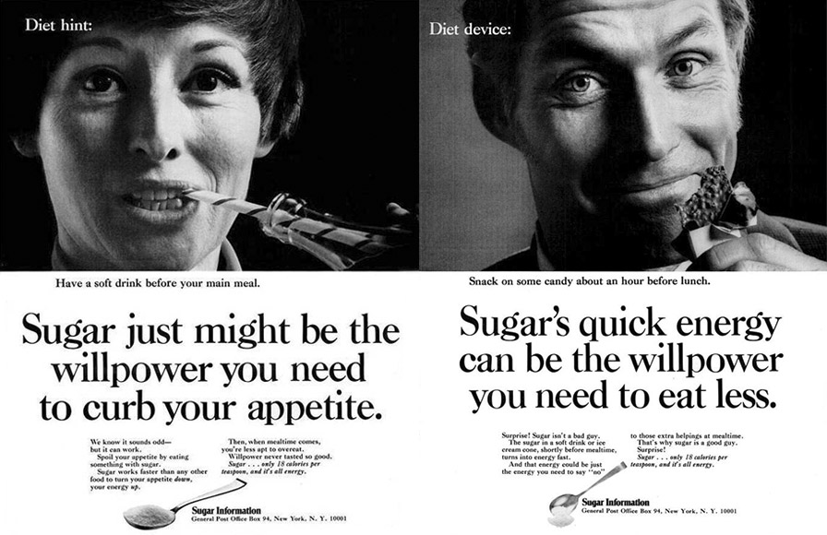
But after rationing, fat stays funny (and food stays a free market) …

Slide 26
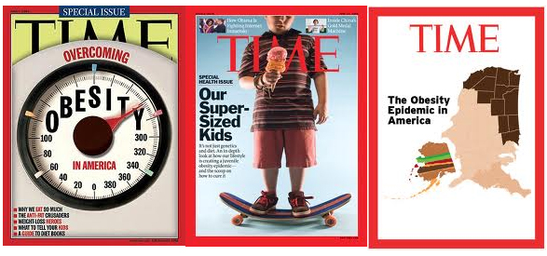
until… OBESITY EPIDEMIC!!!

