Slide 1
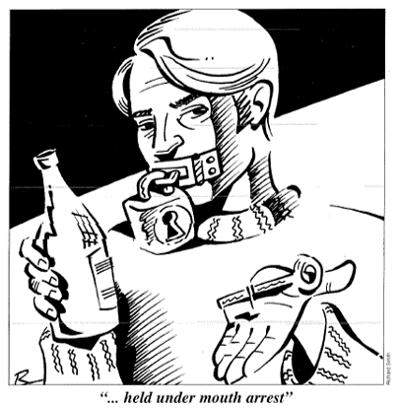
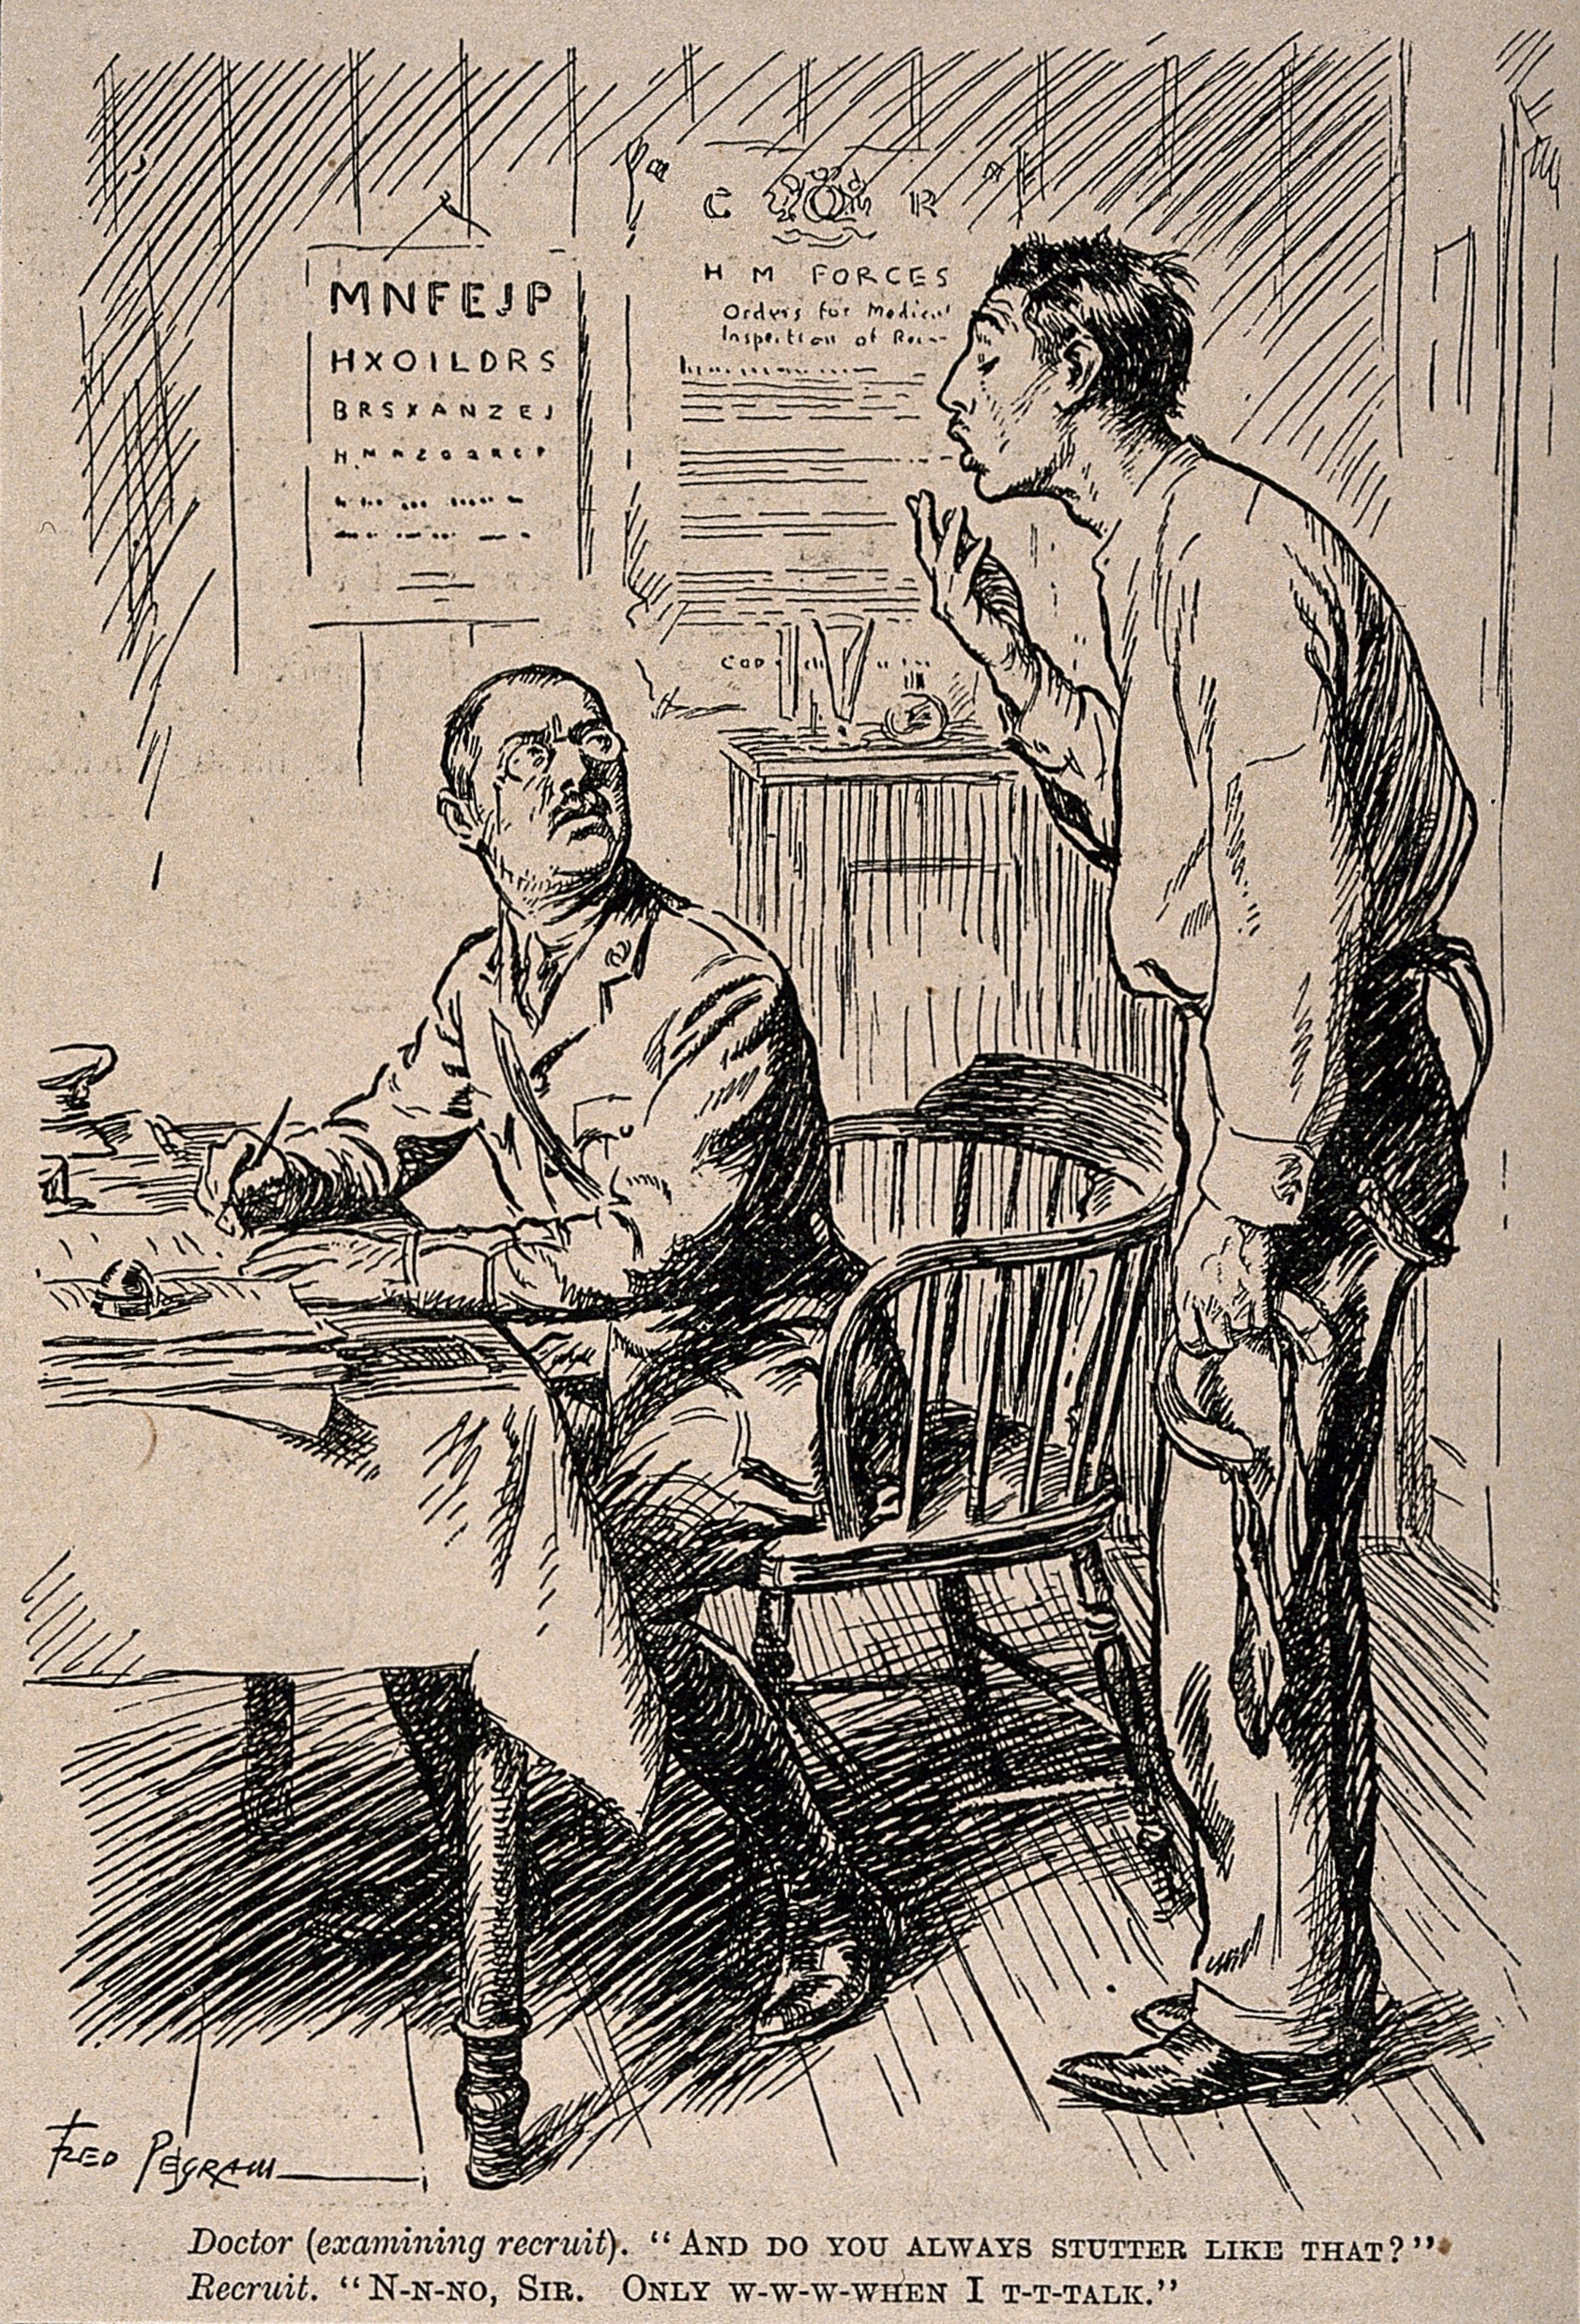
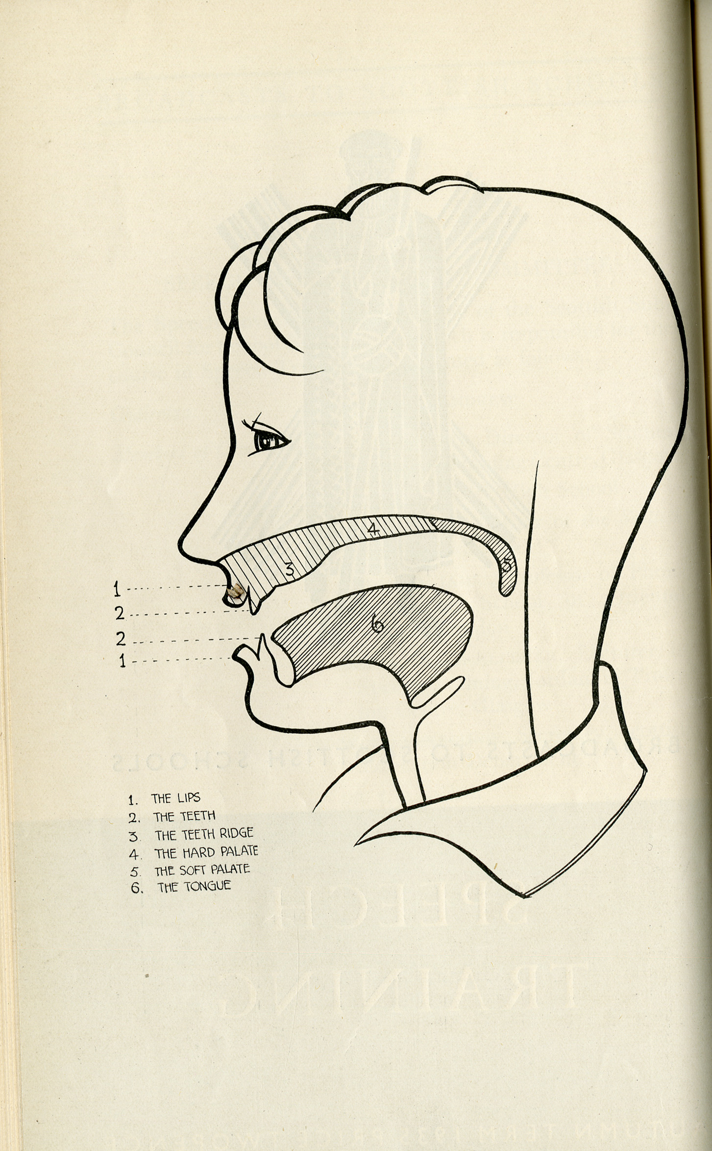

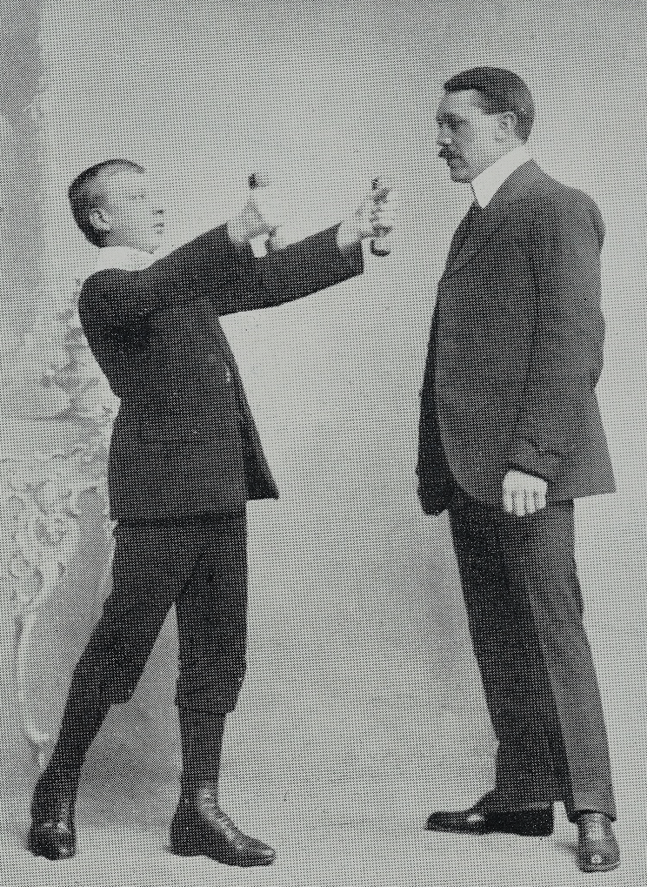
Speech Pathologies
Mind, Body and Society (week 18)
Andrew Burchell
andrew.burchell@warwick.ac.uk

Slide 2

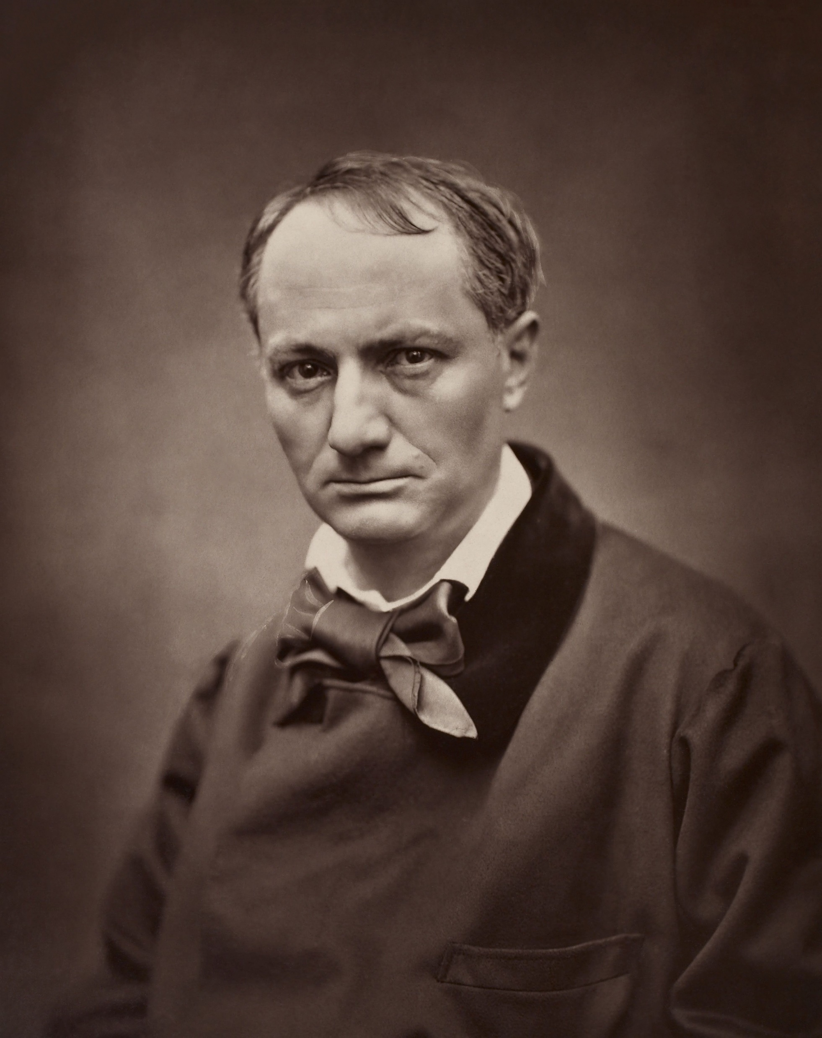
Samuel Johnson (1707-1784)
Charles Baudelaire (1821-1867)
‘It hath pleased almighty God this morning to deprive me of the powers of Speech’
‘…writing my whole name is now a great task for my brain’

Slide 3
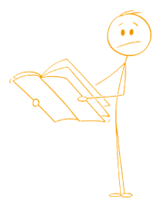
Activity
How many ways can you think of to describe a “good” voice or a “bad” voice?

Slide 4
Implying a ‘wrong’ part of the body
(‘Nasal’, ‘throaty’)
Places and communities
(Prejudices against regional/national variations)
Tactility and movement
(‘Mellifluous’, ‘rough’, ‘soft’)
Voice as experienced by listener
(‘High/low-pitch’, ‘quiet/loud’)

Slide 5
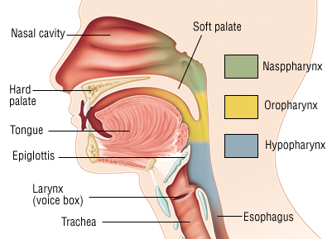
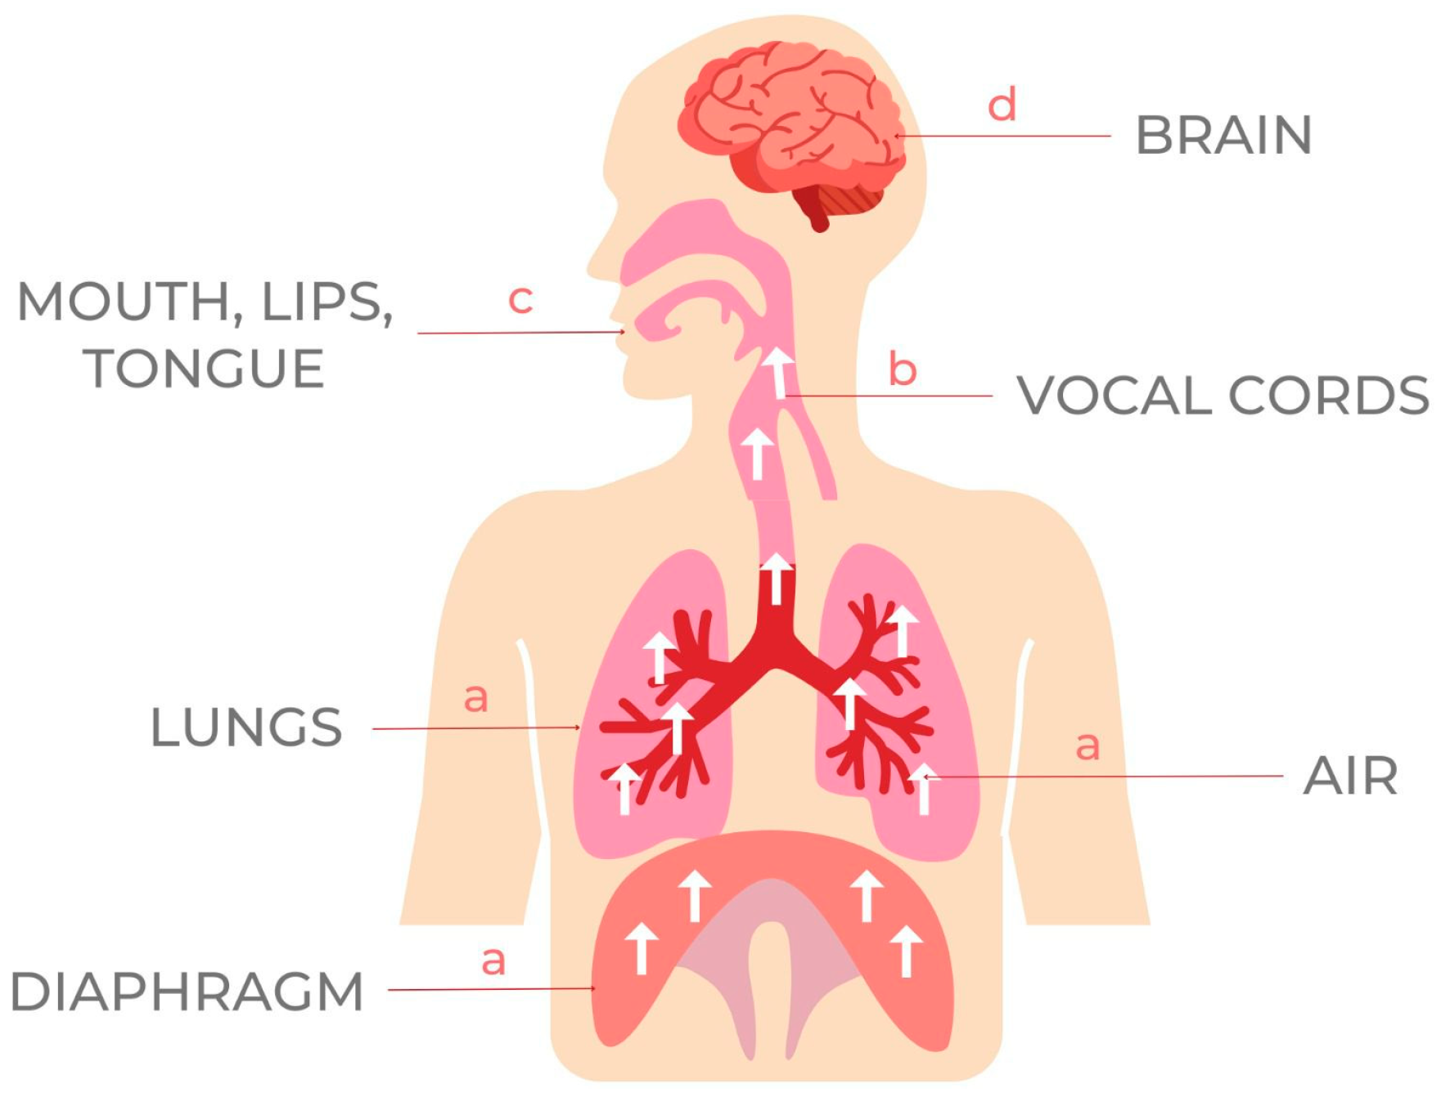
Shift towards more ‘scientific’ understanding of voice
Voice as gendered, racialised
Assumption that modernity means shift from ‘oral’ to ‘written’ cultures
Communities of vocal ‘difference’

Slide 6
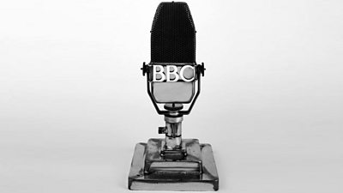


Slide 7
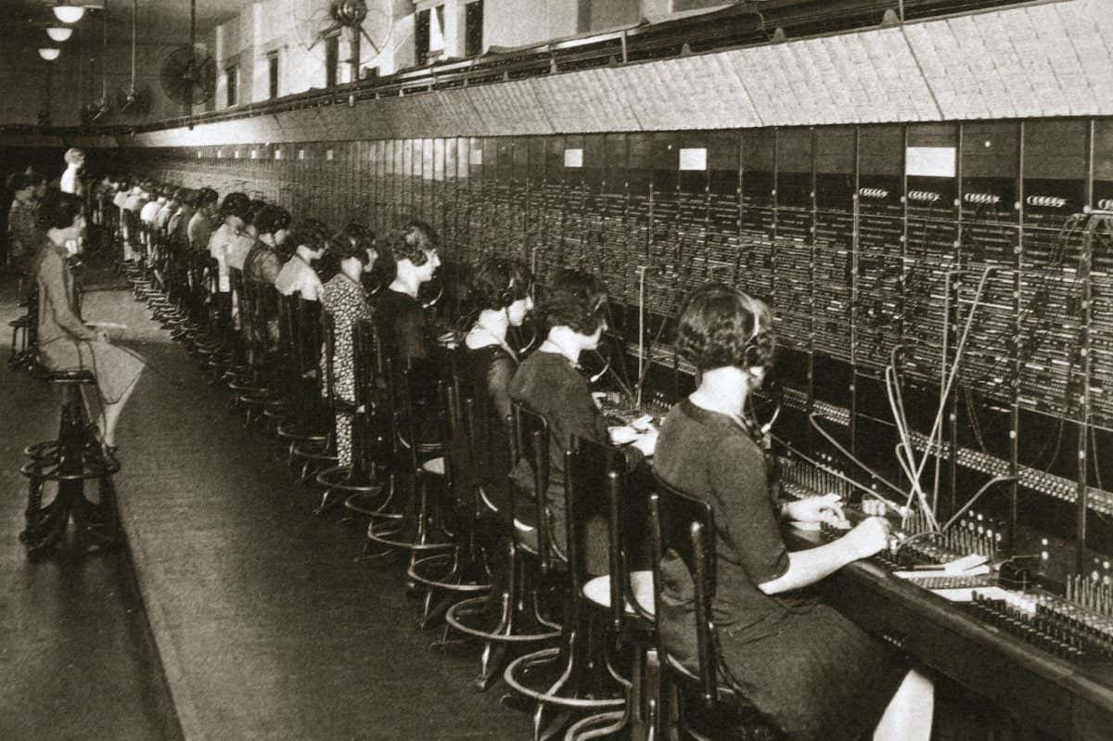
Early C20 Telephone Exchange
Competition to find ‘Girl with Golden Voice’

Slide 8
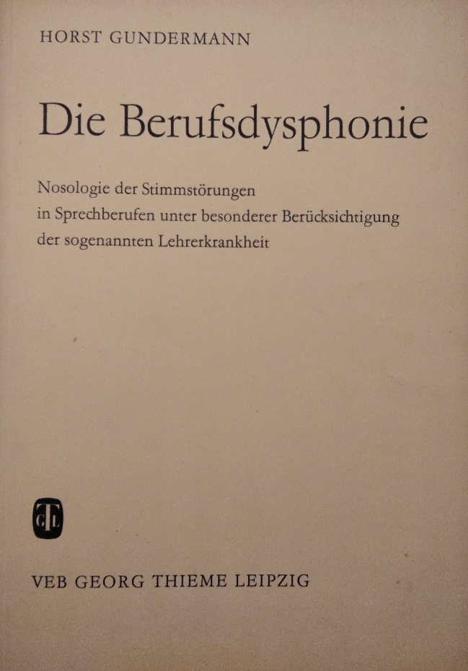
BERUFSDYSPHONIE
BERUF
+
DYSPHONIE
‘Profession’
‘Dysphonia’ (pathology of speech)
Lehrerkrankheit
(‘Teacher-illness’)

Slide 9
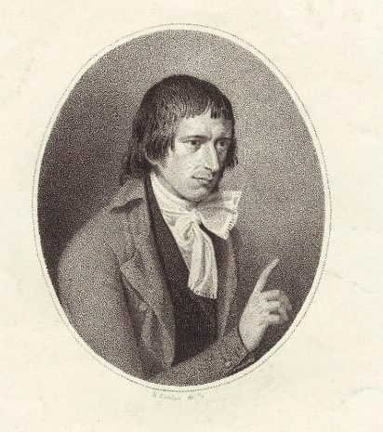
CONTESTED EXPERTISE
Nineteenth-century medical professionals disagreed on causes of stammering or speech loss…
…and whether it was even ‘medical’!
Concern around ‘quackery’
Broader vocal culture: male ‘oratory’ vs feminine ‘accomplishment’
John Thelwall (1764-1834)

Slide 10
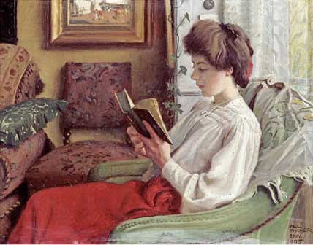
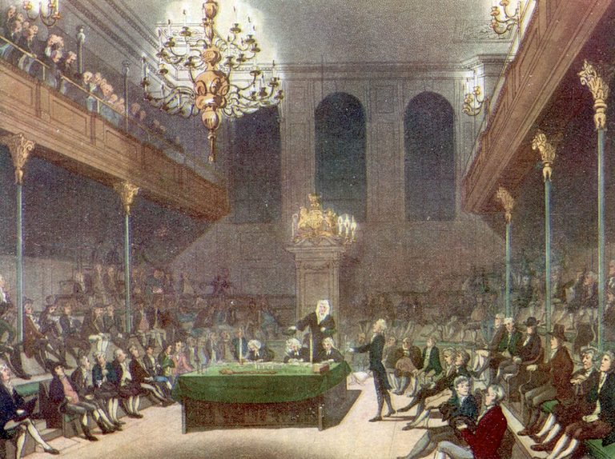
CONTESTED EXPERTISE
Nineteenth-century medical professionals disagreed on causes of stammering or speech loss…
…and whether it was even ‘medical’!
Concern around ‘quackery’
Broader vocal culture: male ‘oratory’ vs feminine ‘accomplishment’

Slide 11
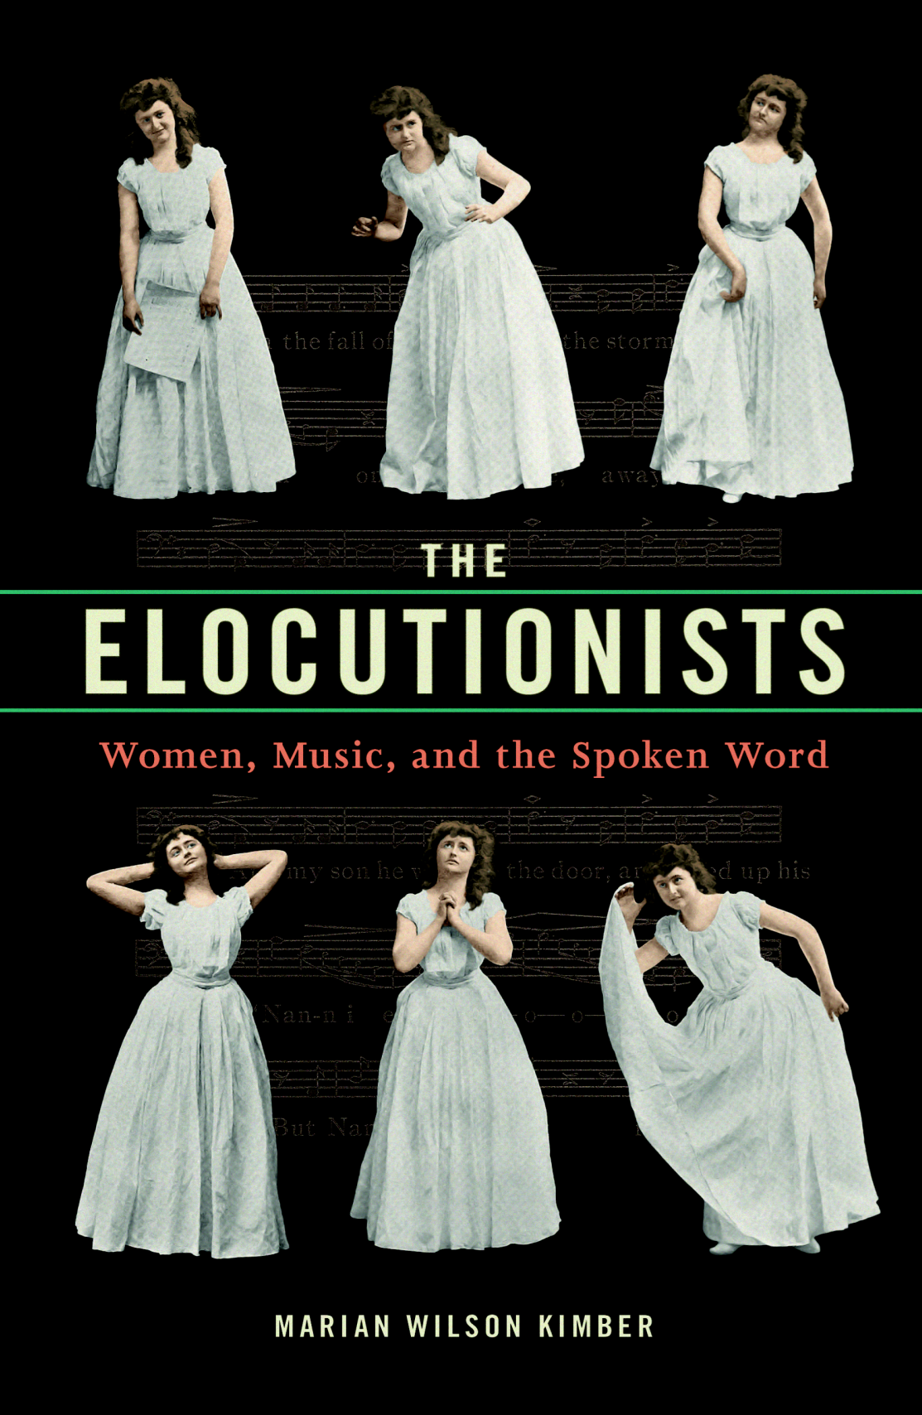
ELOCUTION
Nineteenth-century performances at the boundary of the ‘spoken’ and the musical
Voice ‘production’ (singing vs spoken)
Nation-state and emergence of ‘standard’ pronunciation and canon
Highly feminised endeavour

Slide 12
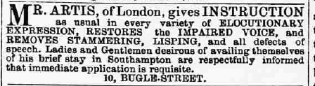

ELOCUTION
Beginning of twentieth-century – interest in elocution and vocal ‘improvement’
‘Professionalisation’ of elocution and creation of examinations
Drawing from medical understandings of the voice to train actors and children in recitation
Hilda Wooler (1903-1997) recites ‘The Poultice’ (unknown author), Accrington, November 1993
Lancashire Archives, NSWA/MOORE, interview recorded by Benita Moore

Slide 13
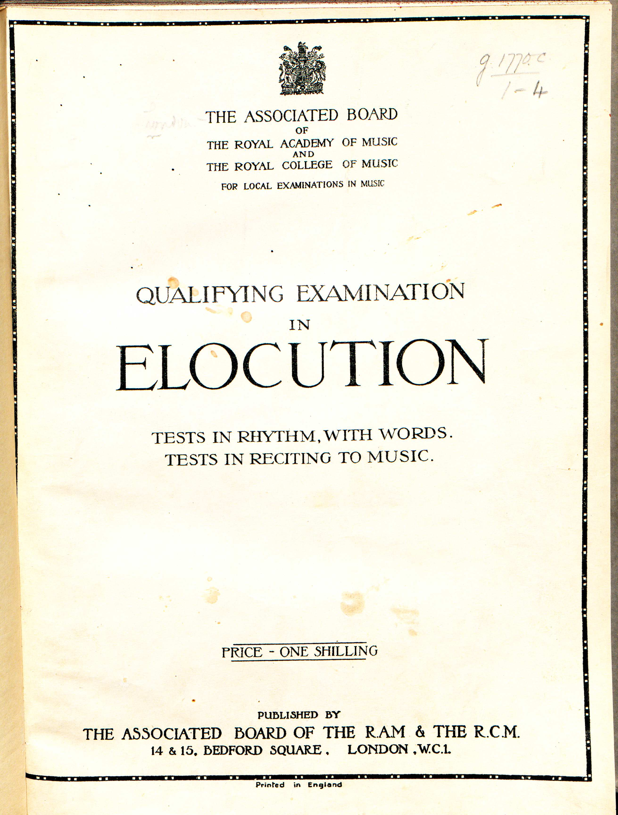
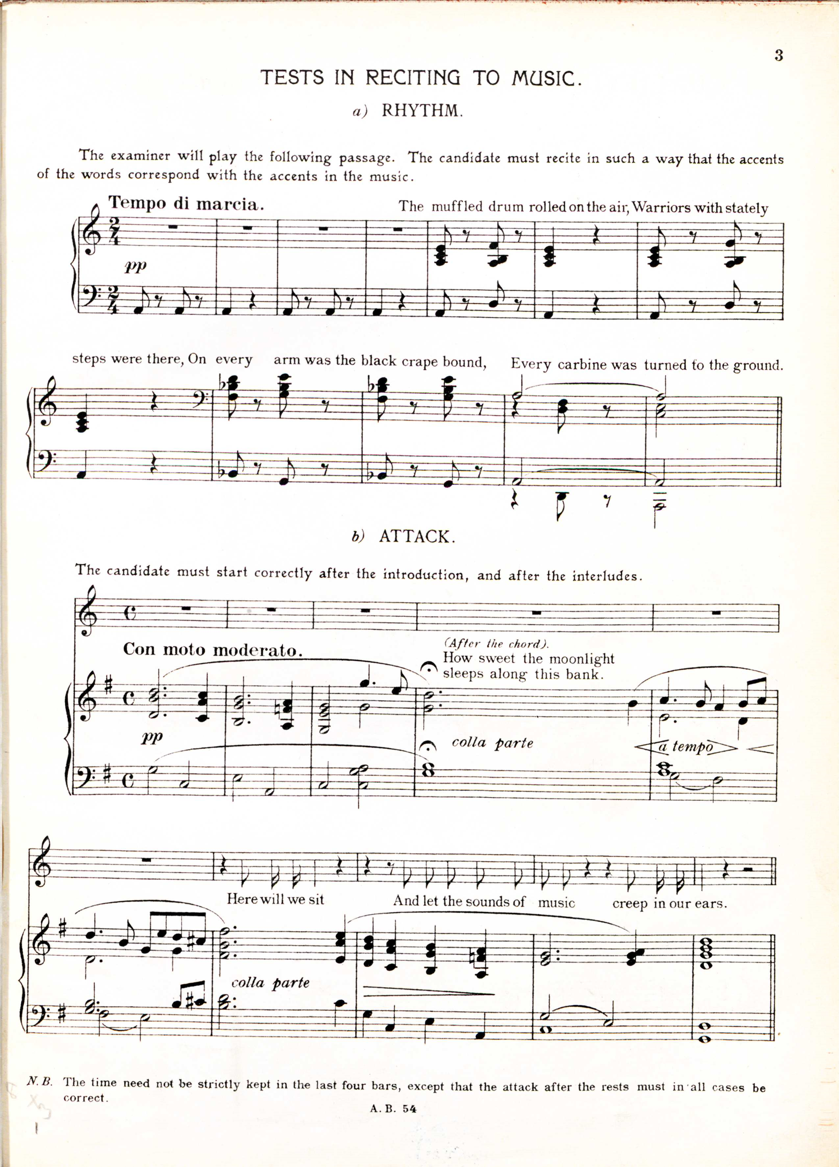
1921

Slide 14
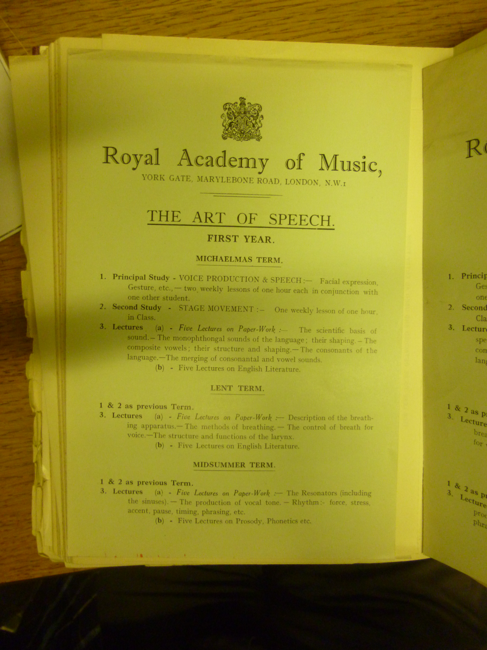
1932

Slide 15
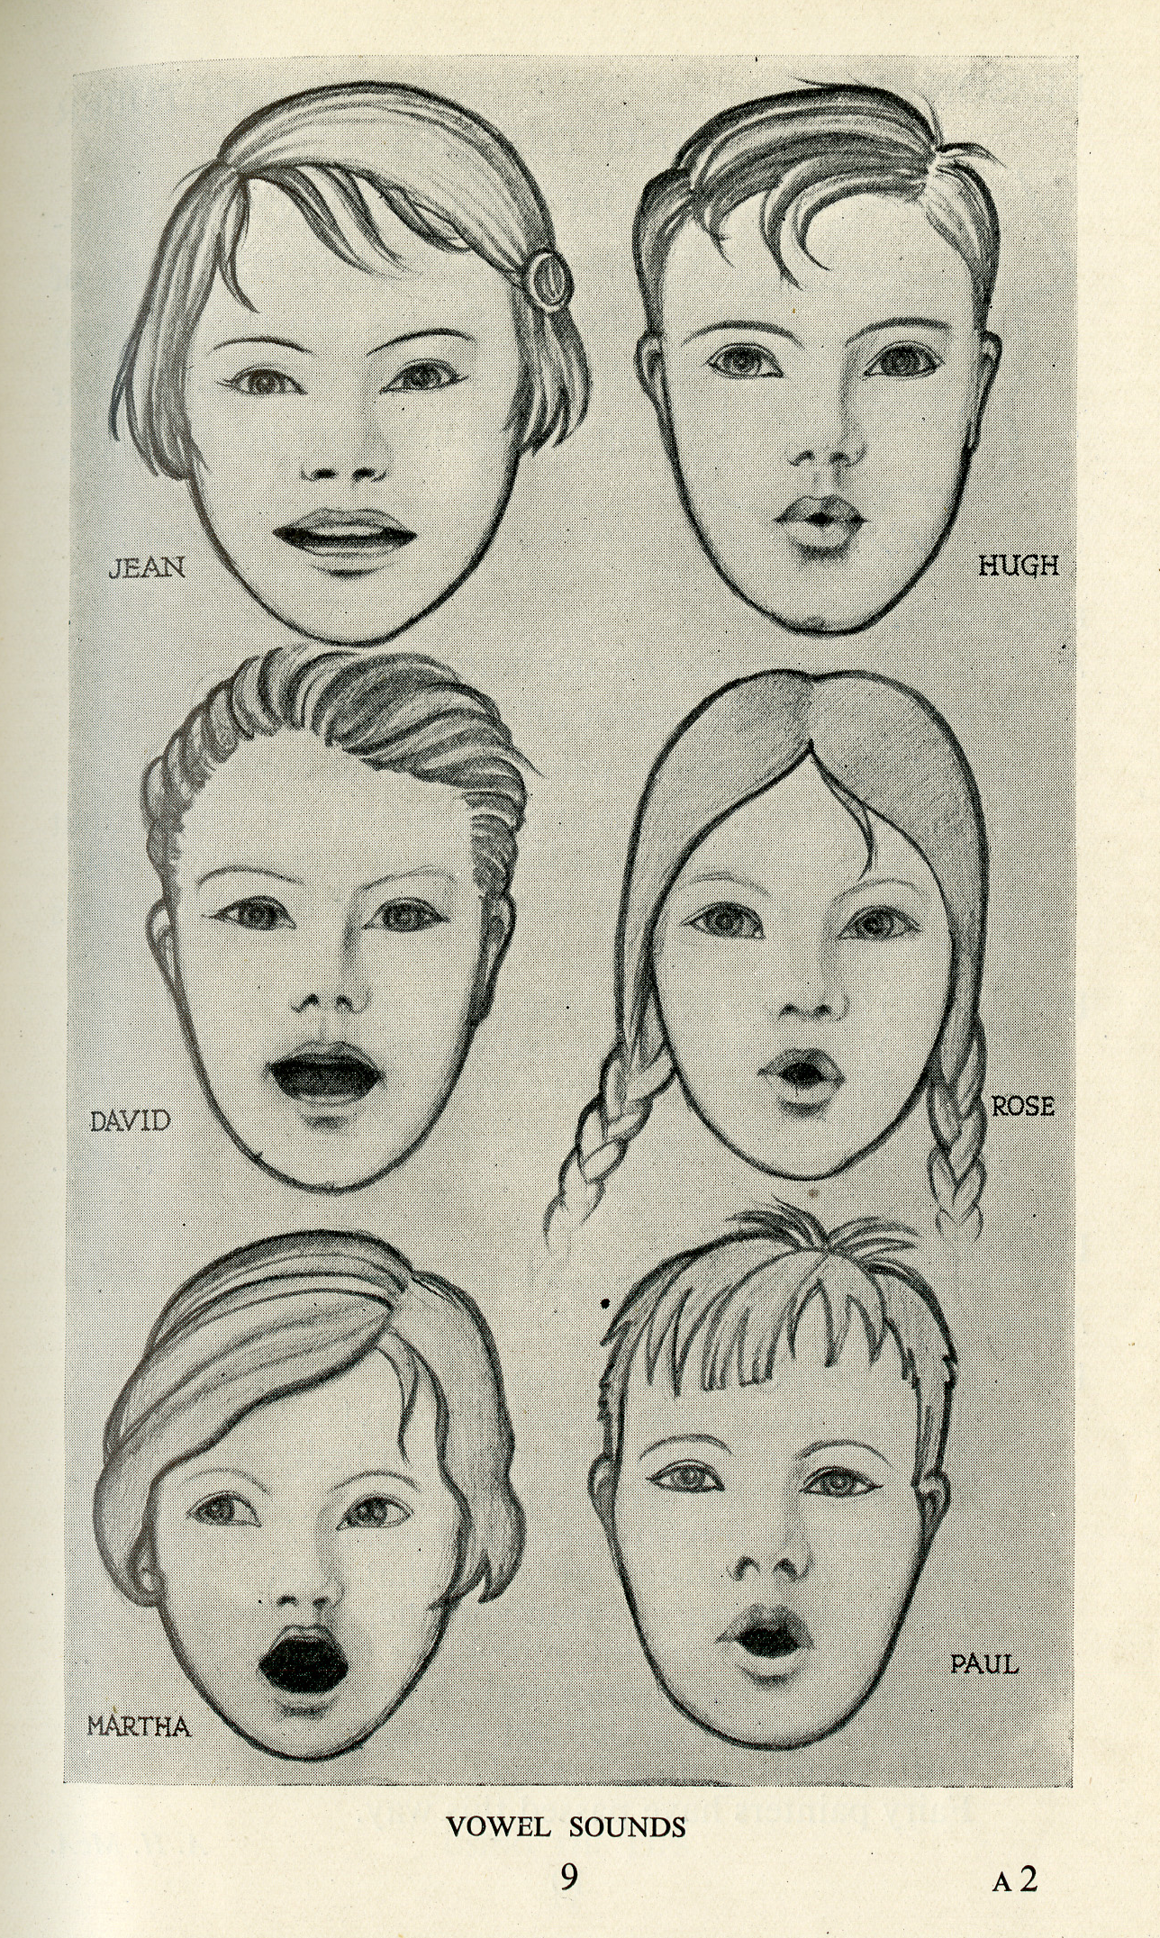
Speech Training for Scottish Schools: Autumn Term 1935 (BBC)

Slide 16
Class, elocution and the limits of voice?
I was a pupil of Mrs R.A. Waddington at Blackburn and she was a real— what you might call “lady”. Most of her pupils were well-to-do. I should think I was the poorest who went, because her fees were very high. And I— my mother said “Do you realise, Hilda, it’s going to cost a lot of money?” I said “Mother, I don’t think you’ll ever regret it. Please let me do that.” And so she did do, didn’t she, Gladys? [her sister, in the room during the interview]
Hilda Wooler (1903-1997) interviewed by Benita Moore, November 1993
Lancashire Archives, NSWA/MOORE

Slide 17
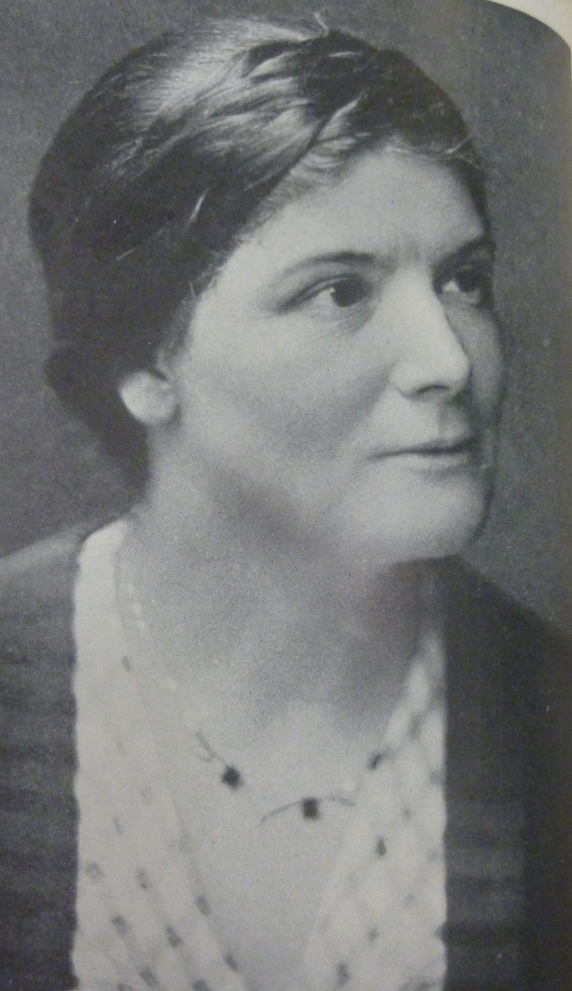
Class, elocution and the limits of voice?
‘There is no single form of speech which in Scotland is universally regarded as “correct”. Dialectical characteristics are found even in educated Scottish speech, and as long as these are not too inacceptable for social or vocational reasons, the Committee see no reason why a Speech Training course should seek to eliminate them or attempt to impose any arbitrary standard of pronunciation. On the other hand, there are current in the speech of most localities faults of indistinctness and unintelligibility…’
The course seeks to ‘awaken in the children an interest in their own speech mechanism and in their own spoken language’.
Speech Training: Broadcasts to Scottish Schools: Autumn Term 1935 (preface)
Anne McAllister (1892-1983)

Slide 18
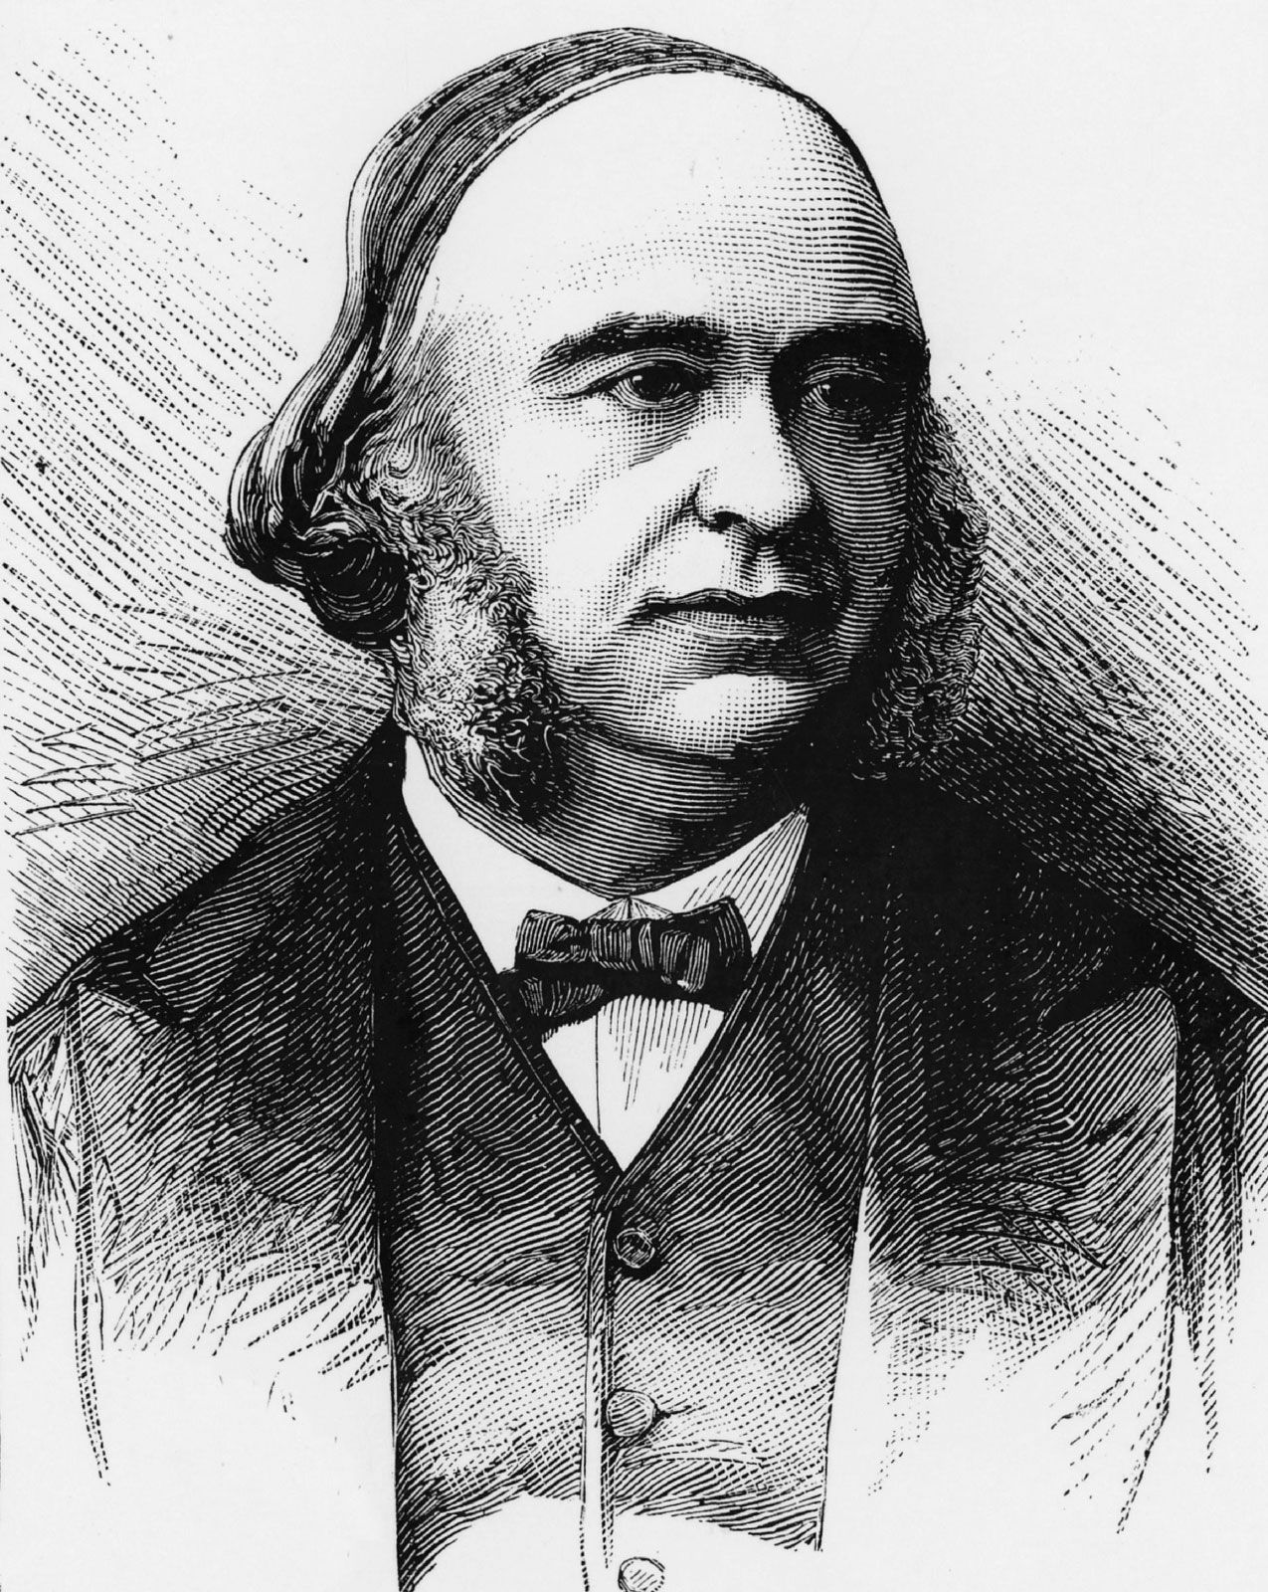
SCIENCE OF THE VOICE
French anatomist and anthropologist – interested in craniometry (skull measurement) and racial science
First anatomist to identify lesions on frontal lobe of the brain for those with aphasia (‘Broca’s area’)
Key evidence for link between physicality of the brain and language/communication
Paul Broca
(1824-1880)

Slide 19
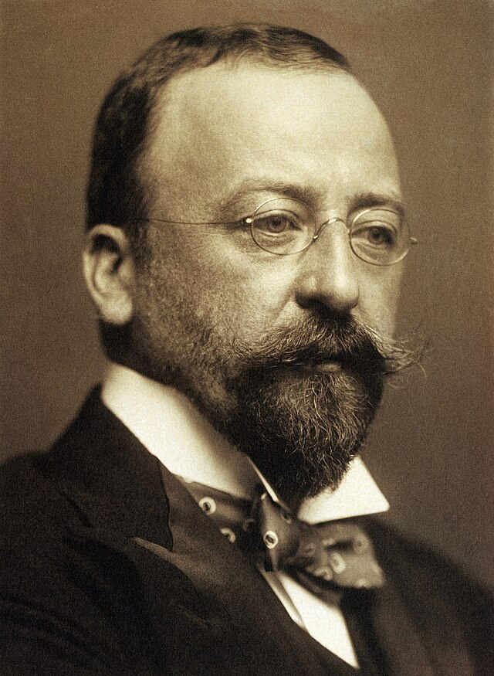
Henry Head
(1861-1940)
First World War satirical print

Slide 20

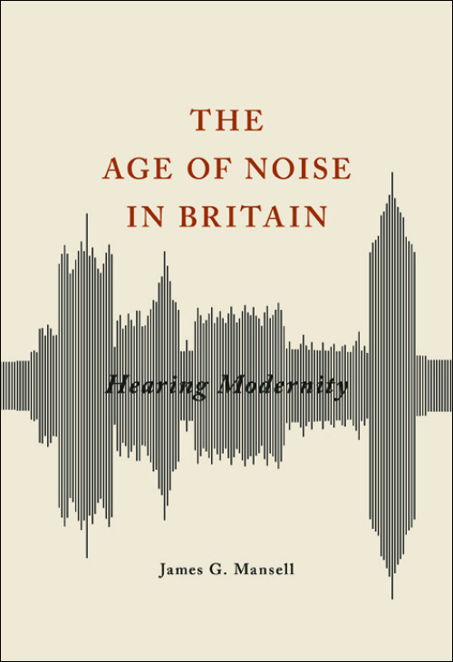
Stammering and forms of aphasia as key symptoms of shell-shock
Neurological or nerve-based theories of causation (physical cause in the body) and ‘shattered nerves’
Freudian/psychoanalytic explanations (the breakdown of language)
Inter-war belief in the dangers of ‘excessive noise’

Slide 21
Head and his colleagues employed ‘Vocal Therapists’ (all female) to treat soldier-patients’ symptoms
Transition away from ‘experiential expertise’ of the ‘self-cured stammerer’
Relaxation and play therapy for children; psychologisation
Feminised profession

Slide 22
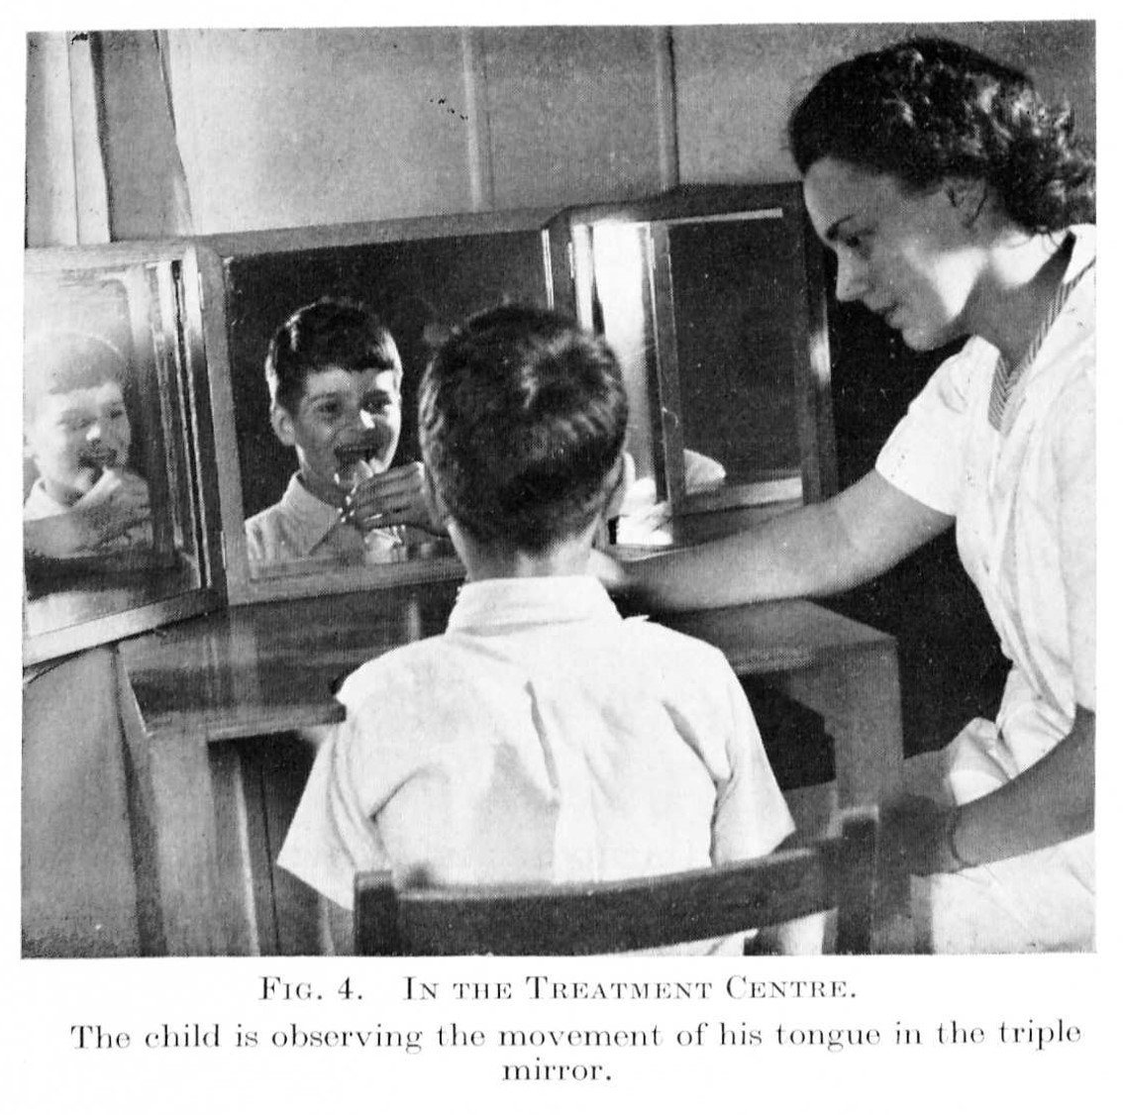
Head and his colleagues employed ‘Vocal Therapists’ (all female) to treat soldier-patients’ symptoms
Transition away from ‘experiential expertise’ of the ‘self-cured stammerer’
Relaxation and play therapy for children; psychologisation
Feminised profession

Slide 23
Head and his colleagues employed ‘Vocal Therapists’ (all female) to treat soldier-patients’ symptoms
Transition away from ‘experiential expertise’ of the ‘self-cured stammerer’
Relaxation and play therapy for children; psychologisation
Feminised profession

Slide 24
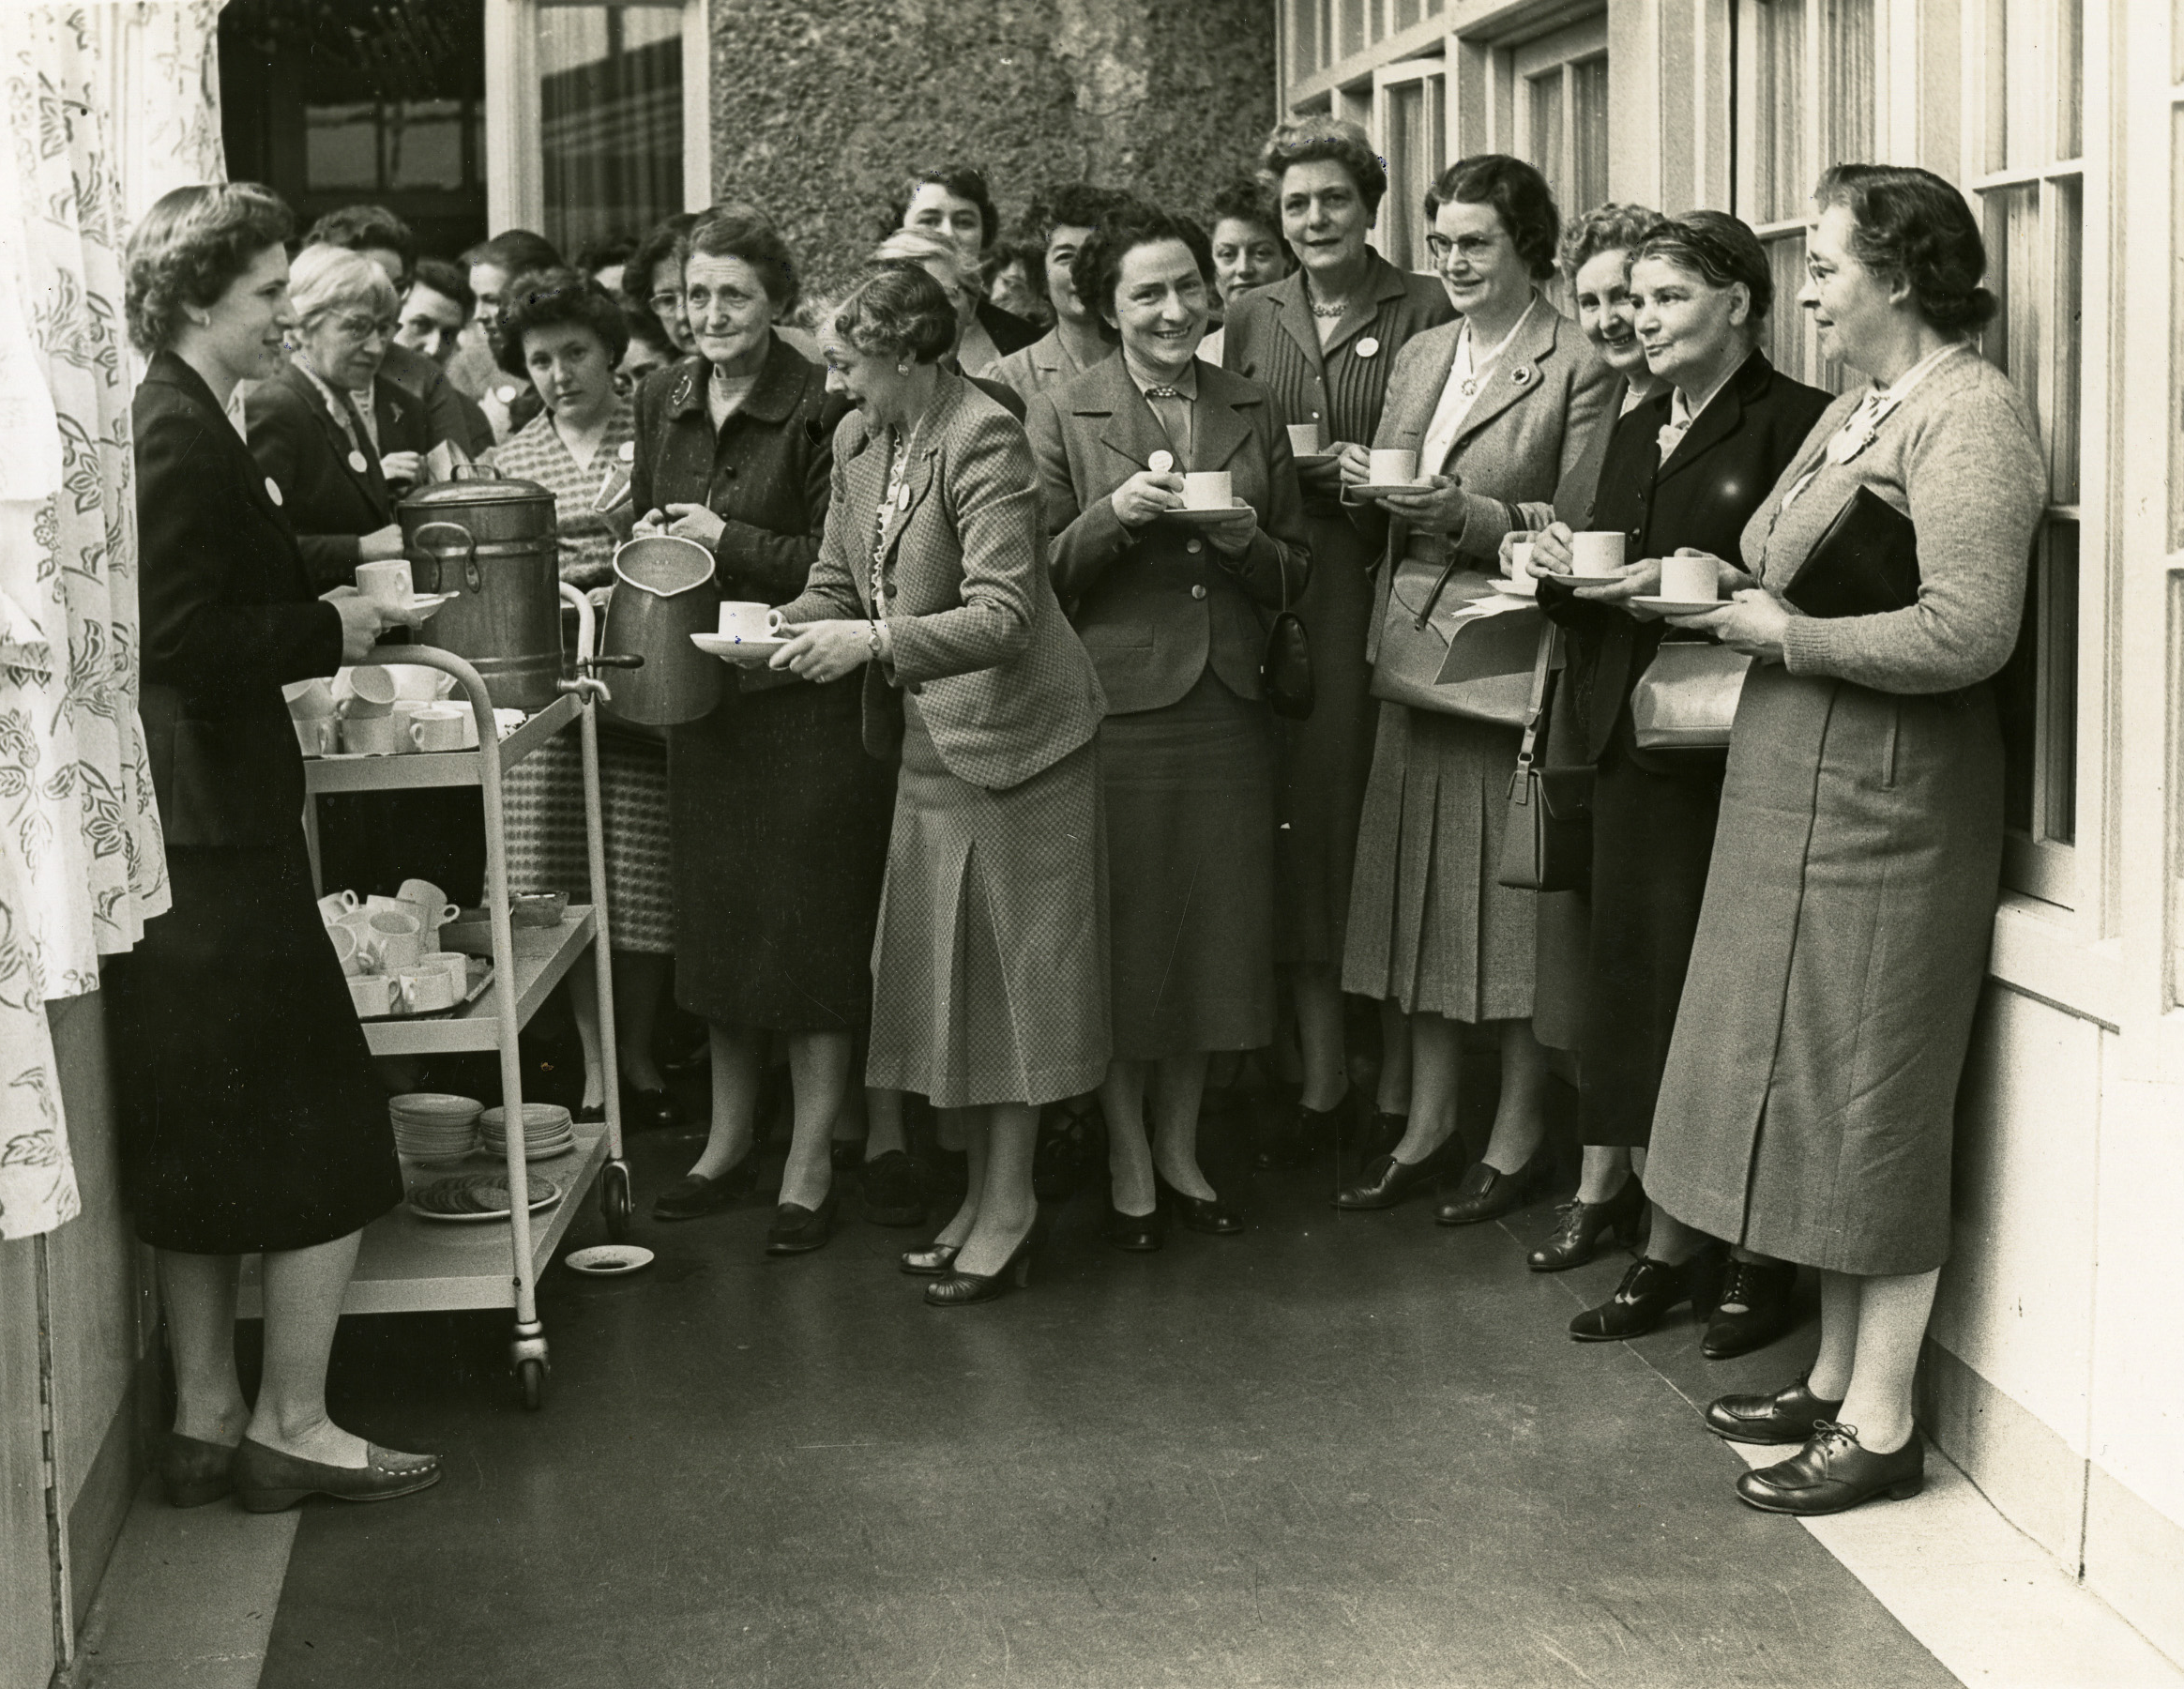
Head and his colleagues employed ‘Vocal Therapists’ (all female) to treat soldier-patients’ symptoms
Transition away from ‘experiential expertise’ of the ‘self-cured stammerer’
Relaxation and play therapy for children; psychologisation
Feminised profession
College of Speech Therapists (UK) (founded 1945)

Slide 25
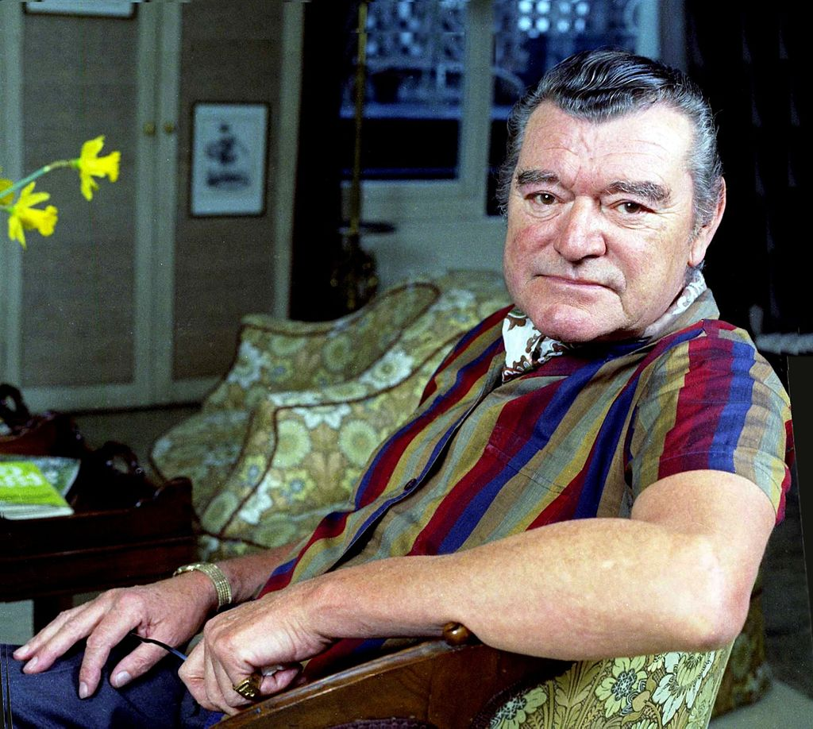
COMMUNITY
Disability rights discourses from 1960s onwards.
Creation of ‘dysfluency’ studies.
Shift from ‘stammerer’ to ‘person who stammers’.
Foundation of organisations: Association for Stammerers (1978), Jack Hawkins Club (mid-1970s: for laryngectomy patients).
Jack Hawkins (1910-1973)

Slide 26
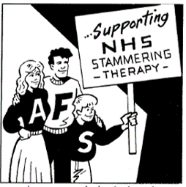
Tensions within these movements
Should parents be allowed to join?
Is stammering even a ‘disability’?
Discussions over humour
Speaking Out, Spring 1996, p. 5

Slide 27
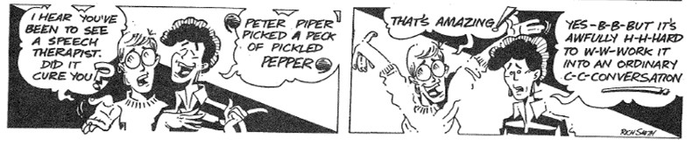
Speaking Out, Autumn 1990, p. 9

Slide 28
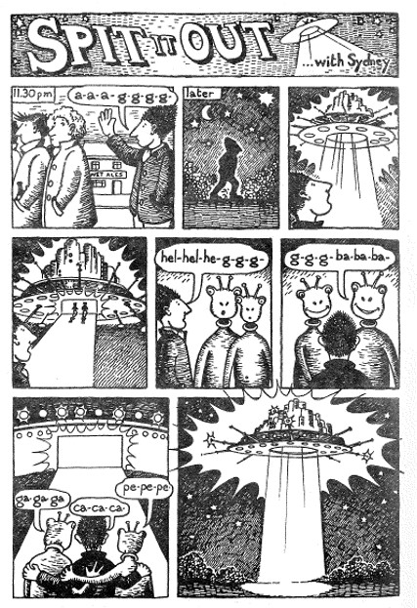
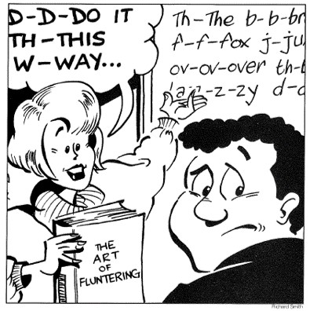
Speaking Out, Spring 1996, p. 5
Speaking Out, Spring 1982, p. 2

Slide 29

COMMUNITY AND VALORISING DYSFLUENCY
JJJJJerome Ellis and ‘the clearing’
A space that can hold meaning and draw individuals together.
Listening and dialogue with people who stammer as a creative and active practice.
Stammering and temporality (alongside race).

Slide 30
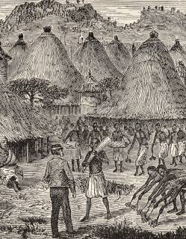
RACIALISING THE VOICE
JJJJJerome Ellis: ‘Are black people humans? The jury’s out … and who’s on the jury?’ (Loops of Retreat)
Nineteenth-century: idea that ‘primitive’ languages were inherently pathological…
…but also of ‘disease of civilisation’ and role of language
Aphasia tests, migration and elephants

Slide 31
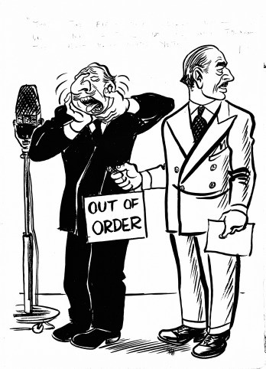
RACIALISING THE VOICE
JJJJJerome Ellis: ‘Are black people humans? The jury’s out … and who’s on the jury?’ (Loops of Retreat)
Nineteenth-century: idea that ‘primitive’ languages were inherently pathological…
…but also of ‘disease of civilisation’ and role of language
Aphasia tests, migration and elephants
‘It’s those north Welsh towns, again…’

Slide 32
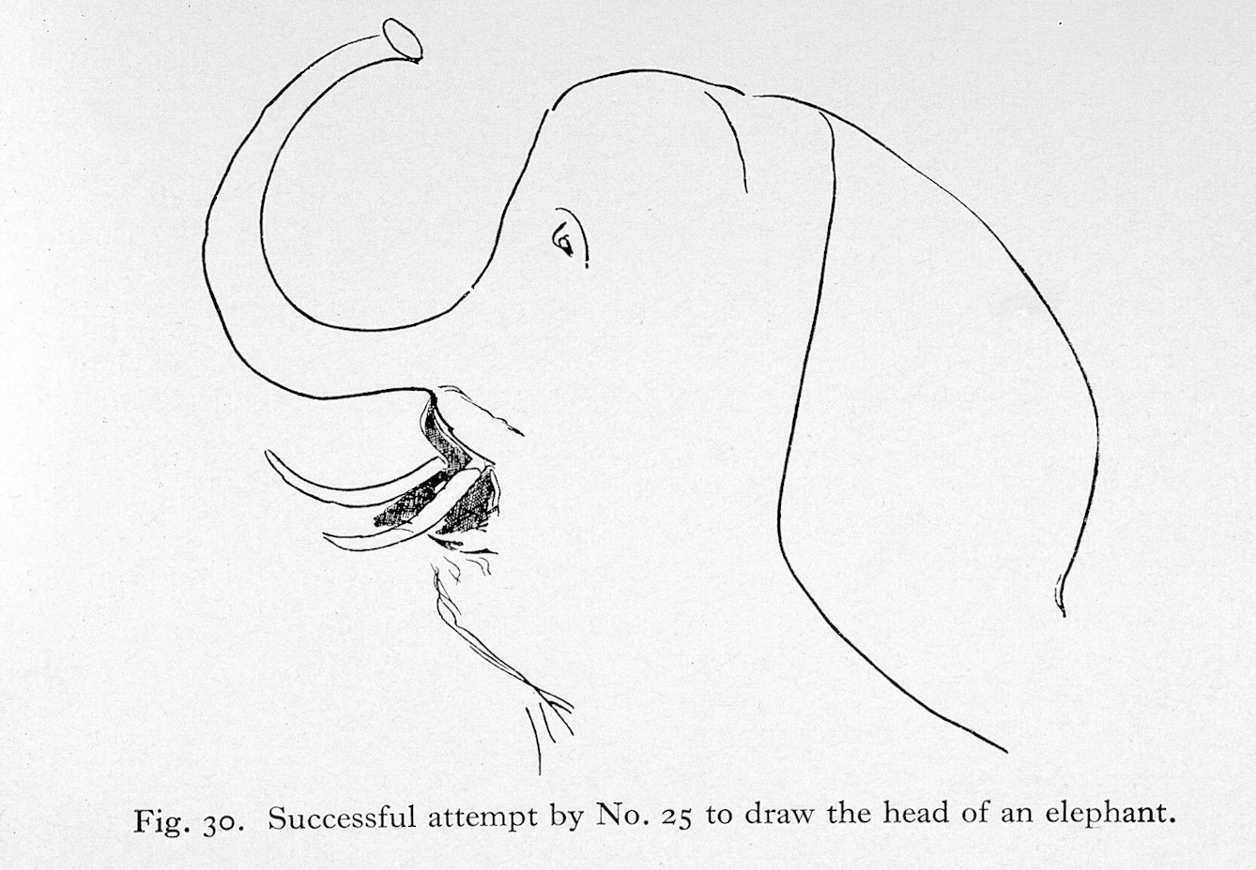
RACIALISING THE VOICE
JJJJJerome Ellis: ‘Are black people humans? The jury’s out … and who’s on the jury?’ (Loops of Retreat)
Nineteenth-century: idea that ‘primitive’ languages were inherently pathological…
…but also of ‘disease of civilisation’ and role of language
Aphasia tests, migration and elephants
You can read Tom Parkinson’s essay ‘Aphasia and drawing elephants’ here.

Slide 33
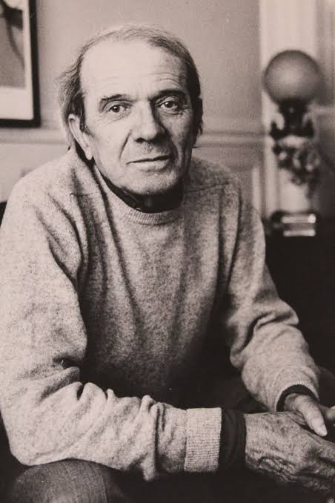
DOES STAMMERING LIBERATE US?
‘When a language is so strained that it starts to stutter, or to murmur or stammer… then language in its entirety reaches the limit that marks its outside and makes it confront silence.’
‘…when it is a matter of digging under the stories, cracking open the opinions, and reaching regions without memories, when the self must be destroyed, it is certainly not enough to be a “great” writer and the means must remain forever inadequate. Style becomes nonstyle, and one’s language lets an unknown foreign language escape from it, so that one can reach the limits of language itself and become something other than a writer’.
Gilles Deleuze (trans. Daniel W. Smith and Michael A. Greco), ‘He stuttered’ from Essays Critical and Clinical (London: Verso, 1998), p. 113
Gilles Deleuze (1925-1995)

Slide 34

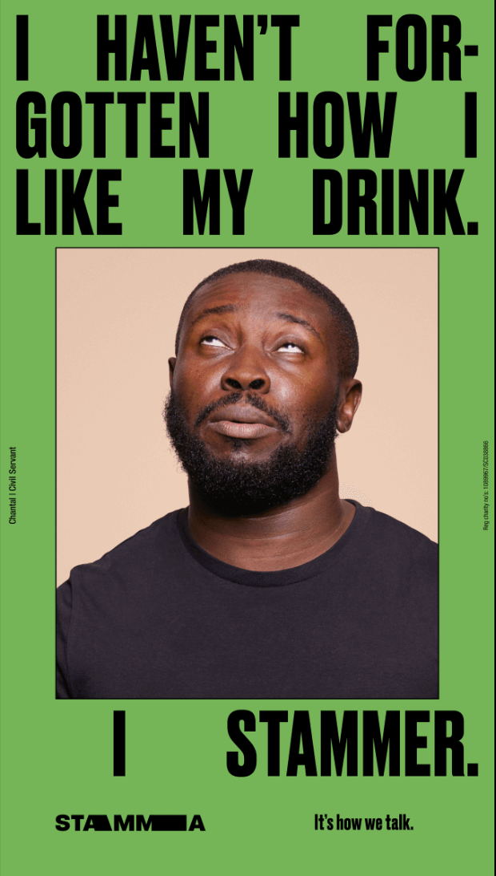

Slide 35
‘The idea implicit here [in Deleuze] [is] that standard, fluent language confines us, and that the best liberation from this confinement comes through some amalgamation of literary and pathological forms…’
‘…this uniquely modern viewpoint – that eloquence and fluency are the problem and dysfluency the solution – surely begs some rethinking. It should be asked why literary theory turns so consistently through the twentieth century to the realm of speech pathology to describe both the forms of literary experimentation and our culture’s occasional need for language breakdown. It should also be asked whether it is possible to have a theoretical approach to disordered speech that […] manages to avoid the many pitfalls I have laid out thus far, namely, metaphorization, stigmatization, and glorification.’
Chris Eagle, Dysfluencies, pp. 161-162

Slide 36
WHY SHOULD WE CARE ABOUT SPEECH FOR THE
HISTORY OF MEDICINE?
as a way of expanding our understanding of ‘health’ beyond physical illness (social well-being, communication)
demonstrate connections between art and medicine (aesthetics of the voice)
illuminates class, gender and race
pay attention to our own biases in assumptions around voices

Slide 37
