Slide 1
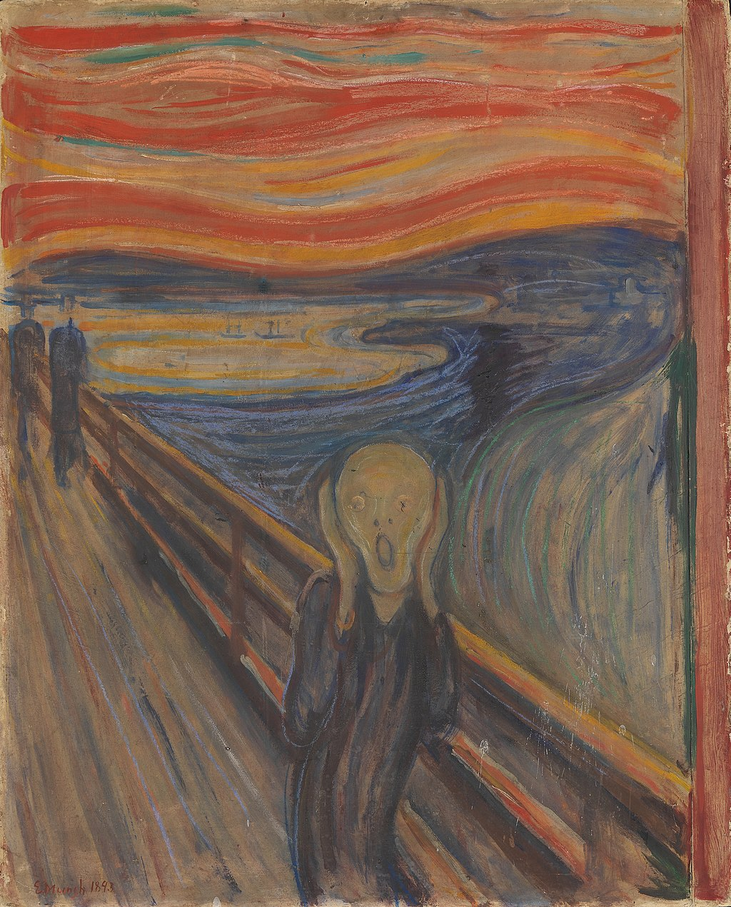
HI176: Mind, Body and Society
Week 8: Disenchantment, Degeneration & Desperate Remedies
Dr Jamie Banks
jamie.banks@warwick.ac.uk
FAB 3.52: Thursdays, 10.00 – 12.00

Slide 2
By the end of this lecture, you will develop a better understanding of:
- the reasons for a growing disenchantment with asylums as places of treatment in the mid-to-late nineteenth century.
- the influence of ideas such as ‘degeneration’ on contemporary attitudes towards the mentally ill.
- the emergence of new desperate remedies for the treatment of the mentally ill.

Slide 3
“The Wasteland”
- Rollins: “The picture of asylums at the end of the Victorian era was one of unremitting gloom”
- this reflected a growing pessimism in the ability of asylum to cure patients.
- The period after ~ 1860 was defined by a dramatic swelling of the asylum population, increasingly with ‘incurable lunatics’
- In short, asylums were becoming increasingly overcrowded, inefficient, ineffective, leading to concerns that they served as little more than places of confinement.

Slide 4
Pauper patients % Curable
1844
County Asylums 4,244 15%
Provincial Licensed houses 1,920 33%
1860
County Asylums 17,432 11%
Provincial Licensed houses 2,356 15%
1870
County Asylums 27,890 8%
Provincial Licensed houses 2,204 13%

Slide 5
Redefining Mental Illness
- Several possible explanations were offered for this dramatic increase in the asylum pop.
- Some argued that this reflected a more accurate recording of case of mental illness, or an increase in frequency of mental illness.
- However, Scull (1993) argues that this increase represented a broadening of was deemed to be ‘insanity’, coming to include diabetics, epileptics, “drunks”, people with learning disabilities, etc.
- In short, Scull argues that asylum essentially became ‘dumping grounds’ for unwanted or unmanageable members of society.

Slide 6
Cure or Confinement?
- The view that asylums were increasingly places of confinement, rather than cure, were also shared by contemporaries:
- Yellowlees, 1884: ‘Every county or district should have two kinds of asylums for lunatic paupers: one a hospital fully equipped for the best means of treatment…. Another devoted to chronic cases, receiving no patients from the cure asylum.”
- Jenners-Furst, 1895: “The treatment of imbeciles … is totally different from that required for the insane … more adequate provision should be made for this afflicted class.”

Slide 7
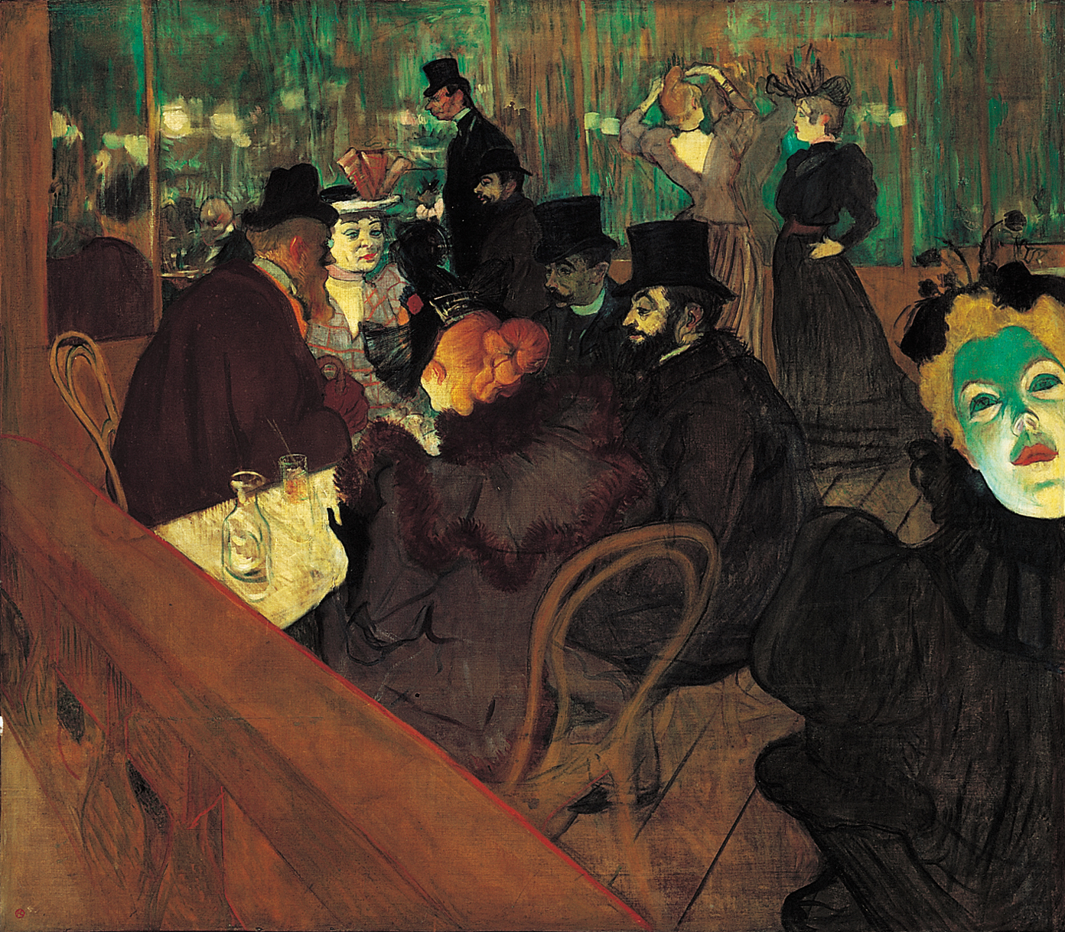
“Degeneration”
- Growing disenchantment with the asylum coalesced with the equally pessimistic outlook of new cultural ideas such as ‘Degeneration’.
- Influenced by Darwinian (Origin of Species,1859) theories of evolution, degeneration emphasized the hereditary disposition of various groups to madness and inferiority of the insane
- Range of ‘forms’ of degeneration: moral, physical, cultural, sexual, and mental.
- Heggie (2008): Degeneration was a ‘fairy story’, reflecting anxieties about the ‘fitness’ of European society at the cusp of the 20th century.

Slide 8
Degeneracy & Psychiatry
- The use of Degeneration theory as an explanation of mental was esp. influential in France.
- Bénédict Morel: The ‘father of degeneration’ in 1850. Proposed a 4-stage schema of transmission of hereditary defects, with each generation getting worse, leading to idiocy and insanity.
- Max Nordau: Author of the ‘Degeneration’ (1892). Argued that the ‘degeneracy’ evident in French society manifested itself through discernible psychiatric symptoms.

Slide 9
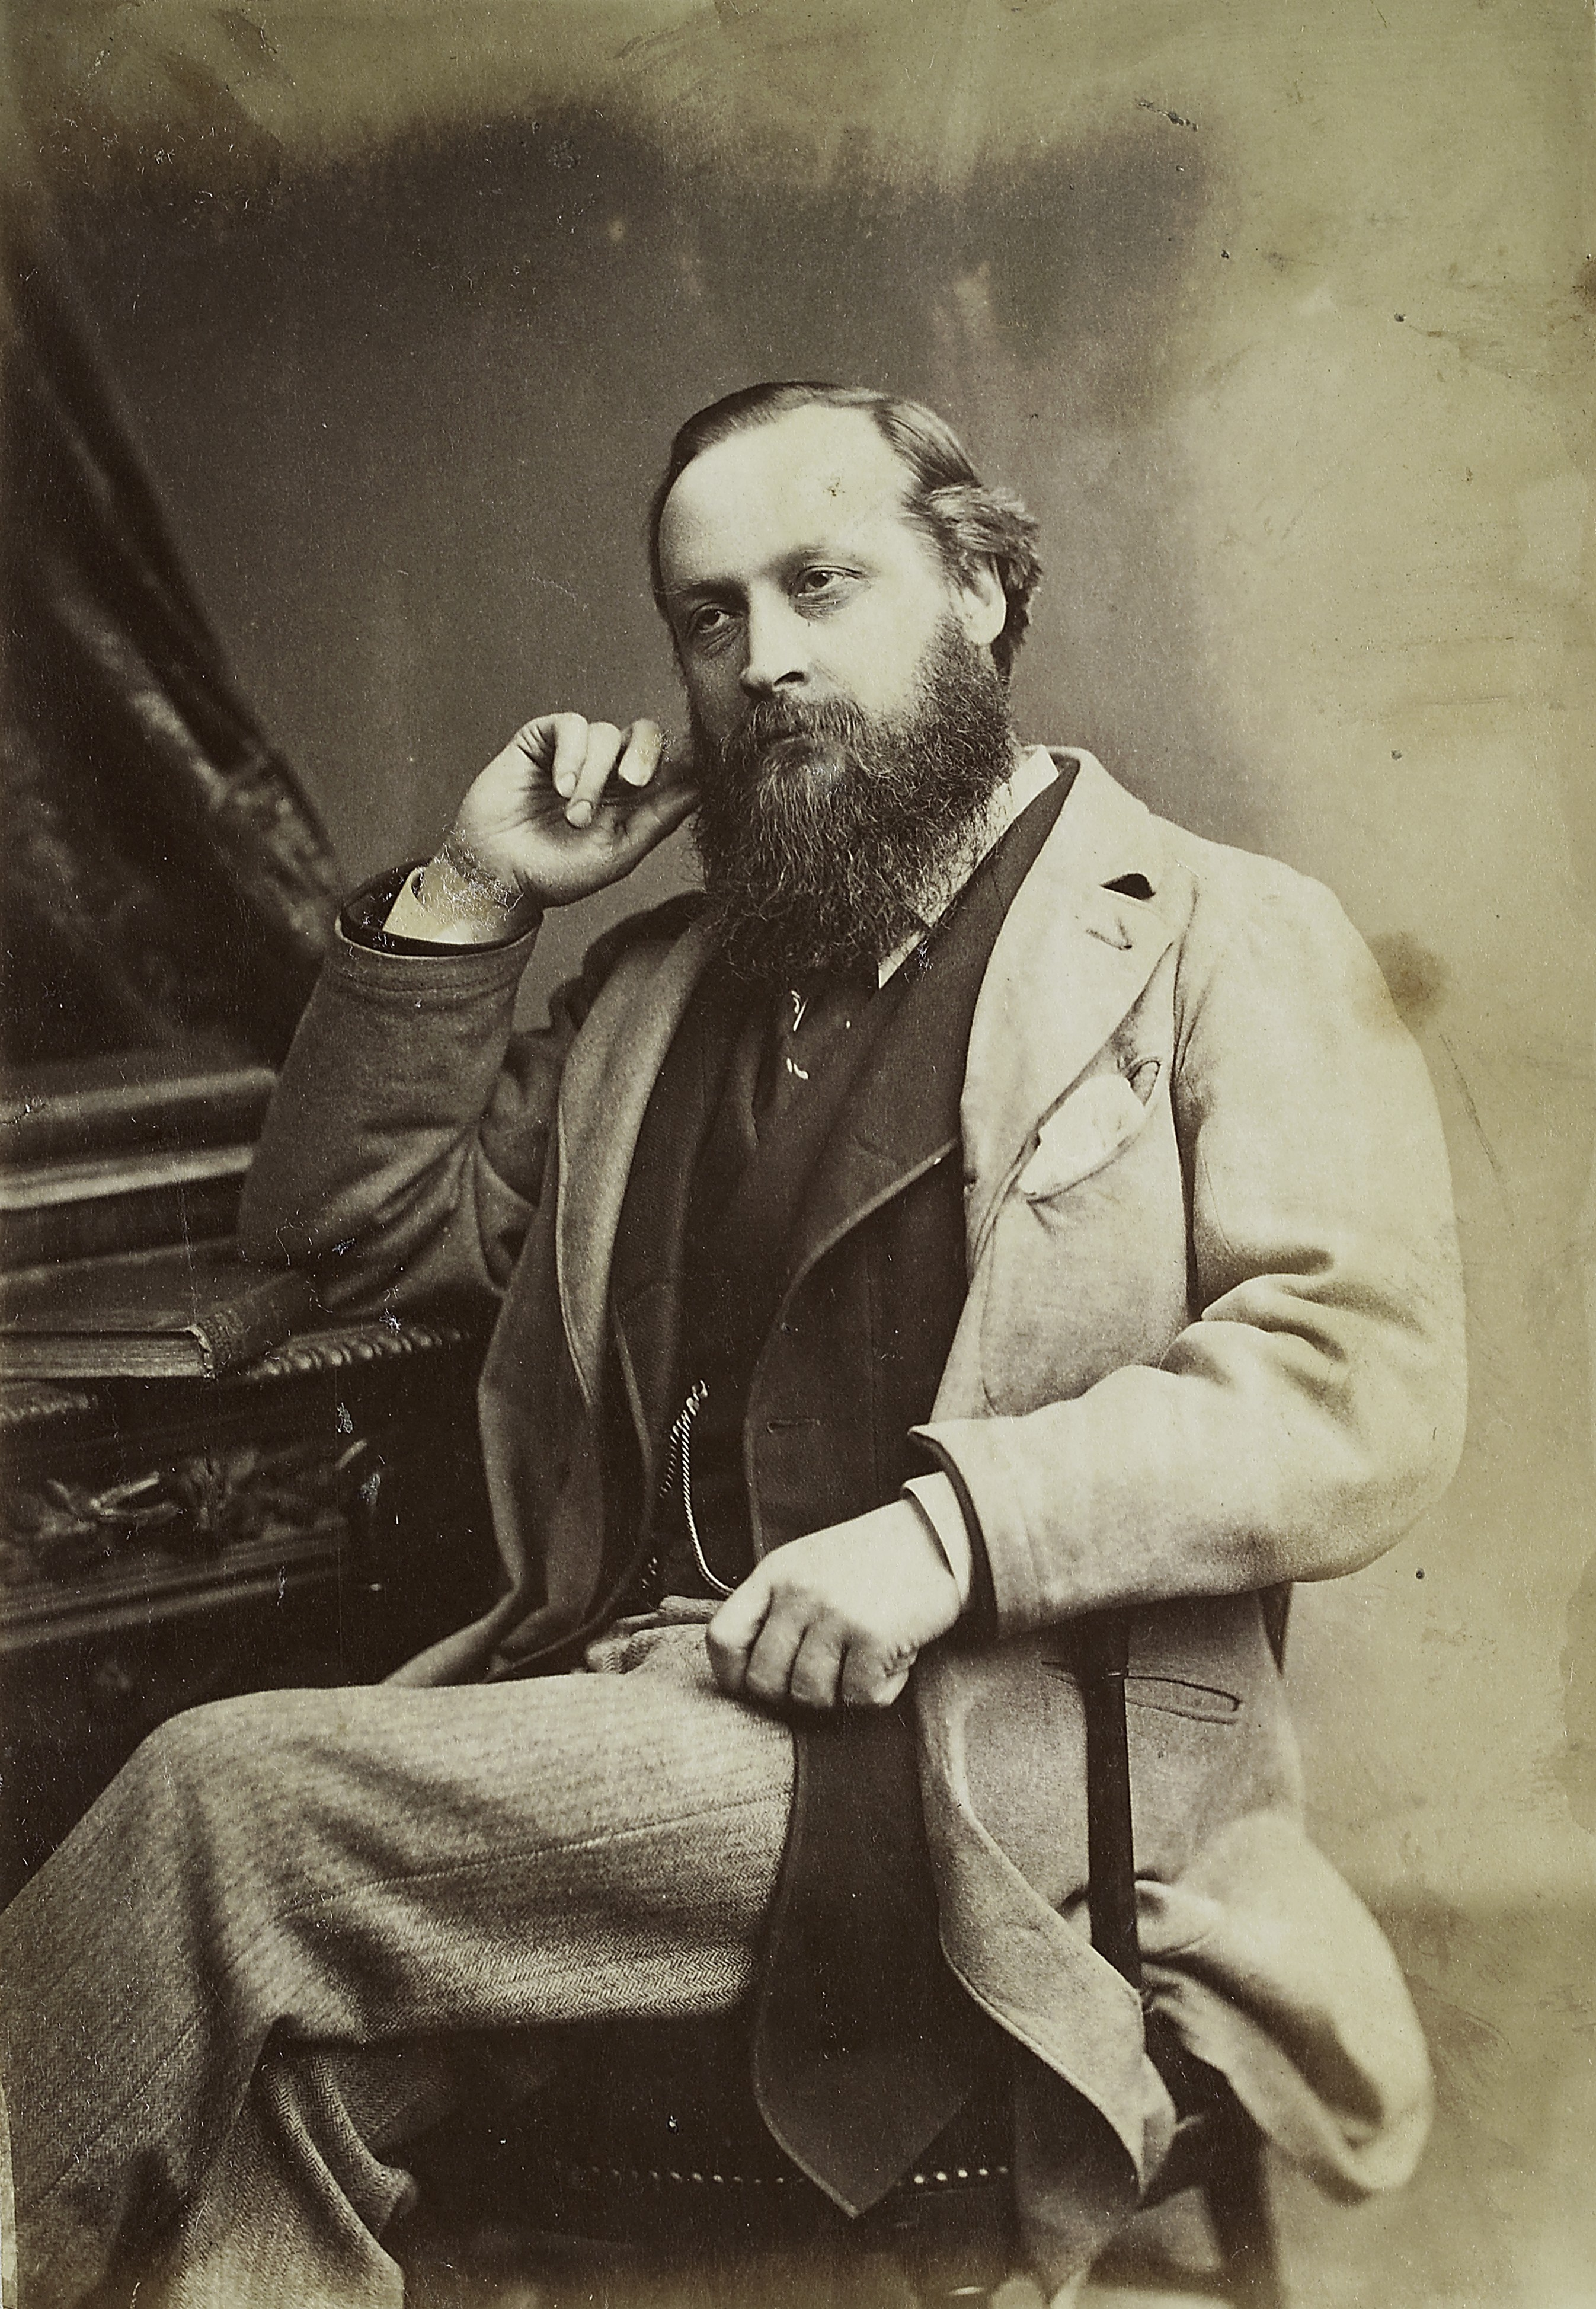
Degeneracy & Maudsley
- Across the pond, the ‘standard-bearer’ for degeneration in Britain was Henry Maudsley
- ‘perhaps the leading British psychiatrist of his day’, Maudsley was a prolific author, editor of the Journal of Mental Science, and Fellow of the Royal College of Physicians.
- he was also a ‘dour, serious man’; pessimistic of the benefits of institutional care and steadfast in the belief that insanity was physiological
- “There is a destiny made for each one by his inheritance; he is the necessary organic consequent of certain organic antecedents…”
Maudsley, The Pathology of Mind (1879).

Slide 10
Degeneracy & the Asylum
- Whilst predating degeneracy theory, concerns about the hereditary causation of various forms of mental illness increased during the mid-to-late 1800s.
- Brookwood Asylum, Surrey: 4% patients associated with hereditary causes 1870-72, compared to 40% in 1890-2.
- The grim determinism of degeneration and heredity ‘explained’ asylums’ apparent lack of success, reasoning that mental illness was the irreversible product of mental degeneration.
- It also provided a neat explanation for conditions then beyond contemporary understanding, i.e. General Paralysis of the Insane or, rather, tertiary syphilis.

Slide 11
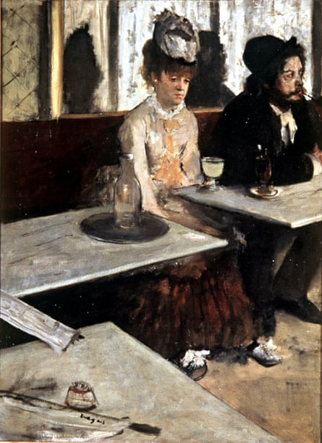
Alcoholism and Degeneracy
The 19th c. saw the growing shift from the ‘moralisation’ to ‘medicalisation’ of ‘problematic’ alcohol consumption; seen as problem of ‘hereditary degeneration’.
Prestwich: by 1870, 22% of male patients in the Sainte-Anne asylum (Paris) were admitted for alcoholism; 80% of patients admitted by the police.
Increasingly, French psychiatrists sought to ‘redefine’ alcoholism, to remove ‘incurable’ cases from their purview.

Slide 12
Biological psychiatry
- Towards end of 19th century, there was increased emphasis on psychiatry research, esp. in Germany and the US.
- This research was driven by a search for physical evidence of cause of mental disease, esp. through post-mortem examinations and patient’s pathology.
* The fruits of this research included the discovery of the syphilis spirochaete (spinal bacteria), in 1913.
- This biological approach facilitated the understanding of mental illness as fundamentally rooted in the brain.
- Prompted a range of ‘somatic’ therapies in the late 19th century and first half of 20th century.

Slide 13
‘Chemical Restraint’
- Whilst not necessarily a ‘cure’, the mid-to-late 1800s saw the increased use of various intoxicants to manage the asylum population.
- Early experiments included the use of opium, morphine, and cannabis, later followed by synthetic drugs such as chloral hydrate and paraldehyde.
- Growing use of the drugs lead to claims that they have effectively replaced physical restraint. Maudsley (1871): “does putting patients in chemical restraint really benefit them?”
- Ironically, substances such as chloral hydrate and paraldehyde, phased out for being addictive, were subsequently replaced with barbiturates, and later benzodiazepine.

Slide 14
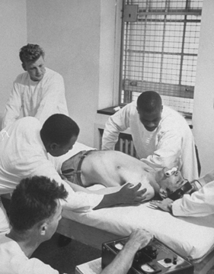
Somatic therapies
- The ‘biological turn’ in Psychiatry also saw the advent of several ’’Desperate remedies’; often be radical and dangerous, they spurred by the urge to ‘do something’
Fever therapy late 19th – early 20th centuries
Prolonged sleep 1930s
Shock and coma therapies (insulin therapy 1930s; ECT first used 1938, heyday 1950s)
Lobotomy, 1935, heyday 1940s-1950s

Slide 15
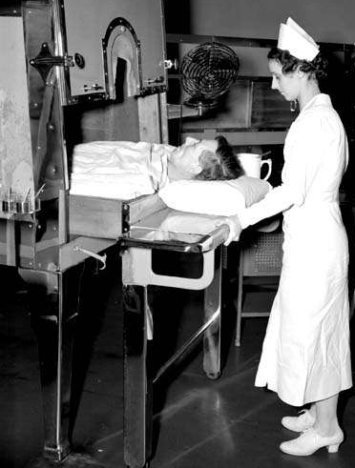
Pyrotherapy
- The use of ‘fevers’ to treat mental illness was recommended by Phillipe Pinel, the pioneer of ‘Moral Management’.
- The ’modern’ use of fever therapies, however, were systematized by the Austrian neuro-psychiatrist Julius Wagner Jauregg, who won the Nobel Prize in 1927.
- Following observations that those suffering from ‘General Paralysis’ recovered after fevers, Jauregg started experimenting with injecting patients with malaria parasites in 1917.
- Remained in regular use until the adoption of Penicillin as a cure for syphilis in the 1940s.

Slide 16
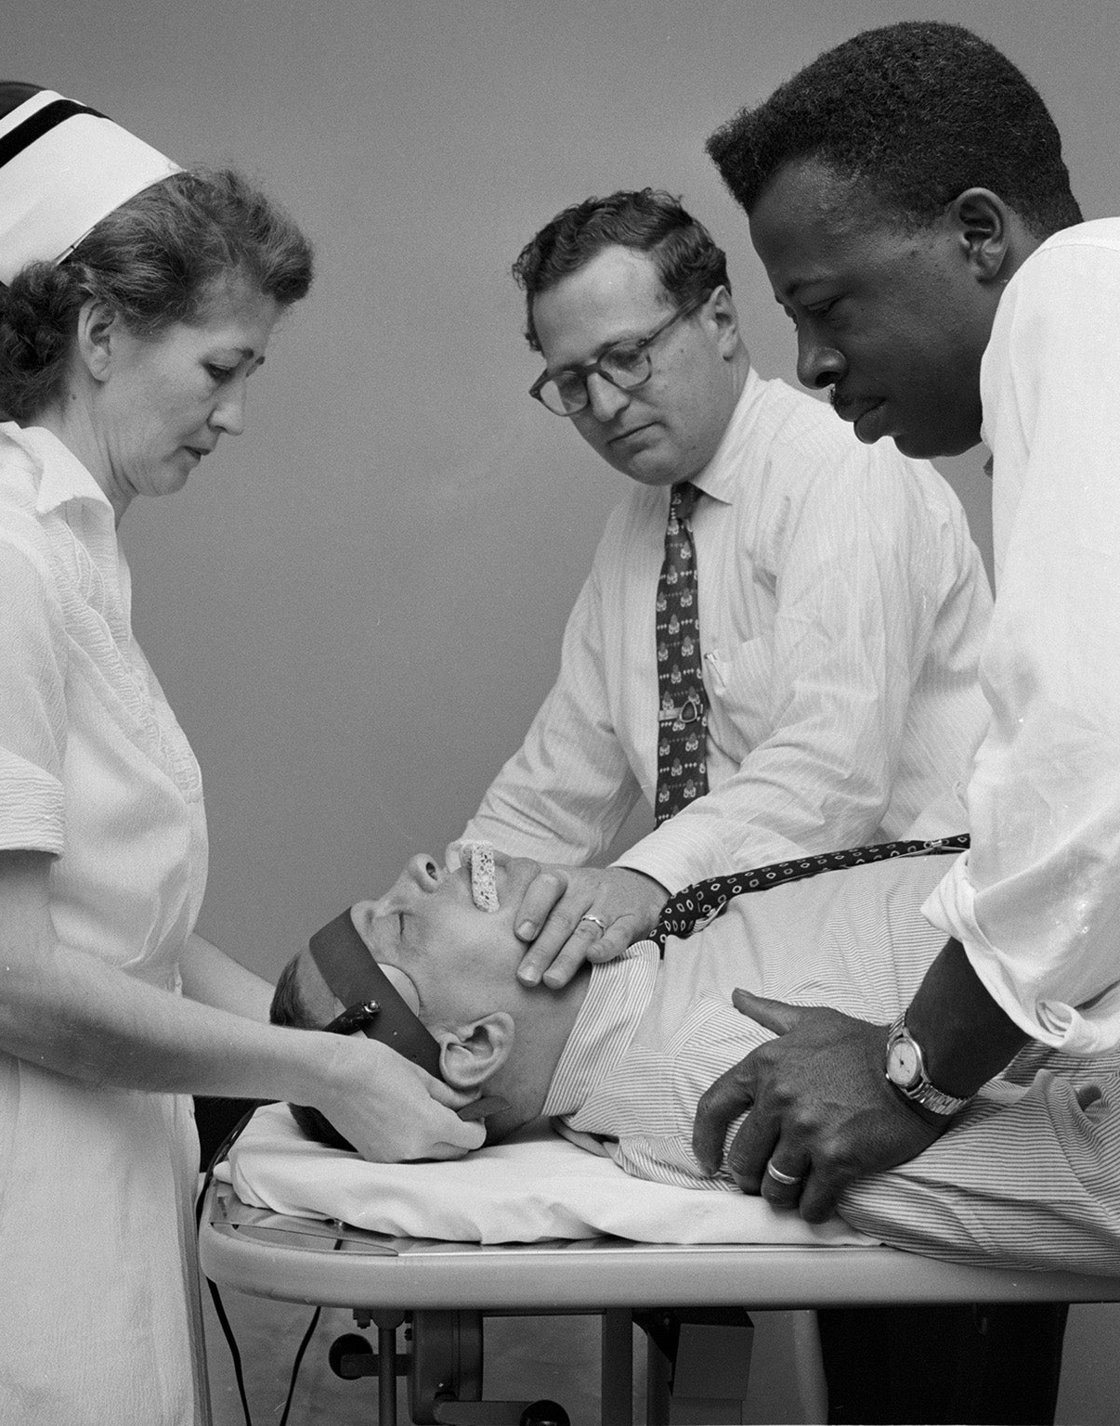
Electroconvulsive therapy, ECT
- First conducted by Italian psychiatrist Ugo Cerletti in 1938, inspired by prior experiments with animals.
- widespread across Europe and North America, replacing more dangerous drug induced-convulsions.
- primarily used to treat depression and schizophrenia, on the basis patients should be ‘jolted’ out of their illness.
- Increasingly vilified by movies such as One Flew Over the Cuckoo’s Nest and made increasingly redundant by the adoption of anti-depressants.

Slide 17
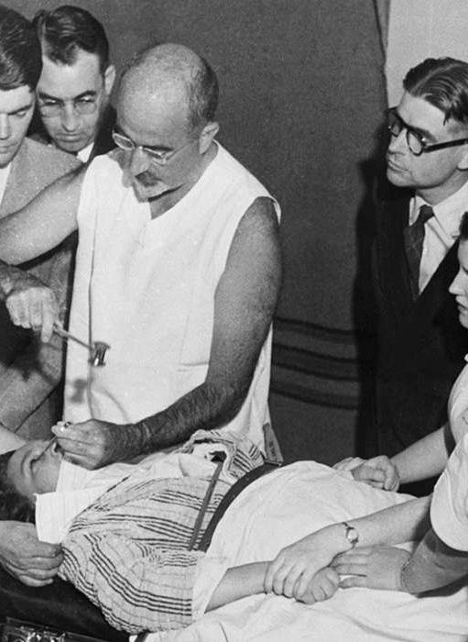
Lobotomy
More dramatic still were lobotomies, which entailed the cutting of connections between the frontal lobe and rest of the brain.
Whilst first performed by Antonio Egas Moniz in 1935, their value was evangelised US neurologist Walter Freeman, who performed first US lobotomy in 1936.
Billed as a treatment for depression, schizophrenia and compulsive disorders, lobotomies could leave patients in a near-vegetative state.
Increasingly unpopular by the 1950s, being banned in various places by the 1970s.

Slide 18
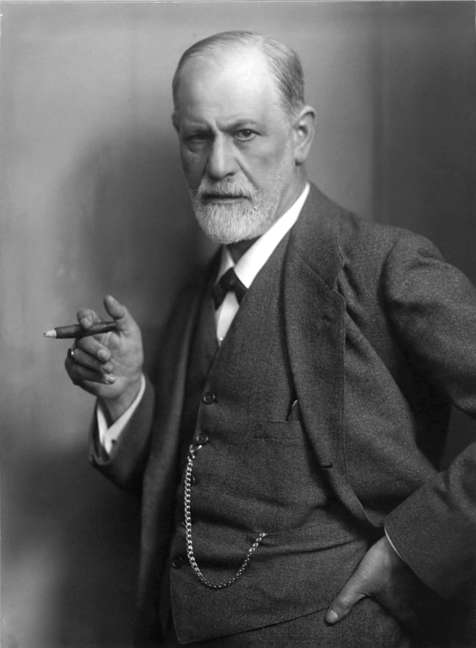
Psychoanalysis
- new physical interventions were also accompanied by the raise of talking-therapies.
- The first, or at least most famous, was psychoanalysis, pioneered by the Austrian Neurologist Sigmund Freud.
- central to Freud’s theories was the distinctions between the conscious (ego) and unconscious mind (ide), with mental illness and personality disorders seen to stem from between them.
- despite their significant, psychoanalytic approaches were infrequently used in asylums, remaining the preserve of private couches for much of the early-20th c.

Slide 19
Concluding Thoughts
- The nineteenth century saw an increasing disenchantment with the curative potential of asylum, partially due to overcrowding and the growing range of patients admitted.
- This growing pessimism was buoyed by equally pessimistic ideas such as ‘degeneration’, which saw the causes of mental illness as irreparably rooted in patients.
- However, this period also saw the growing “scientific-ation” of psychiatry through experimentation, which increasingly saw mental illness as rooted in the brain.
- This had its own consequence, namely the rise of numerous ‘desperate remedies’ which potentially did more harm than good.

