Slide 1
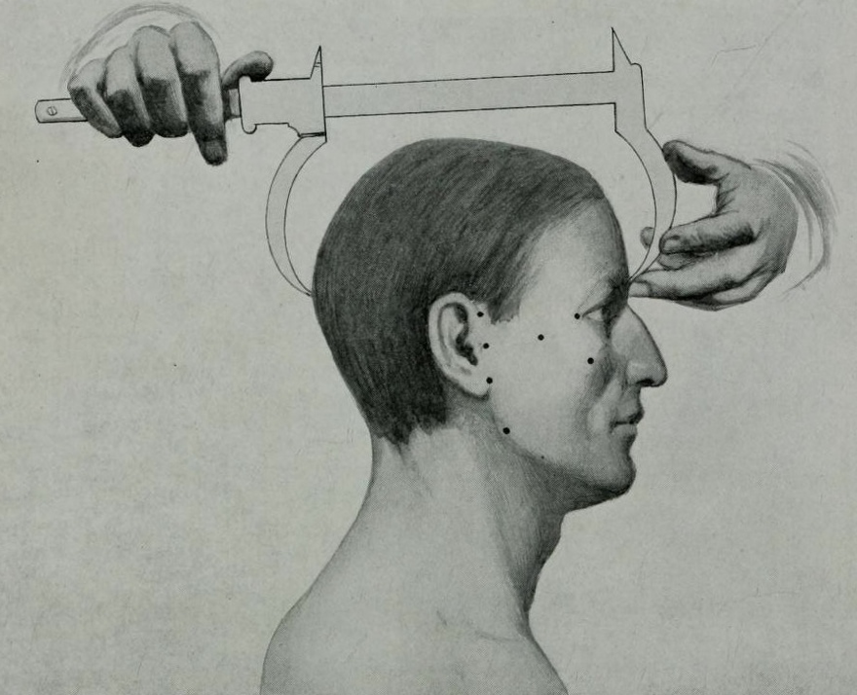
Measurement and Classification
Lecturer: Elise Smith
Mind, Body, and Society—Week 7

Slide 2
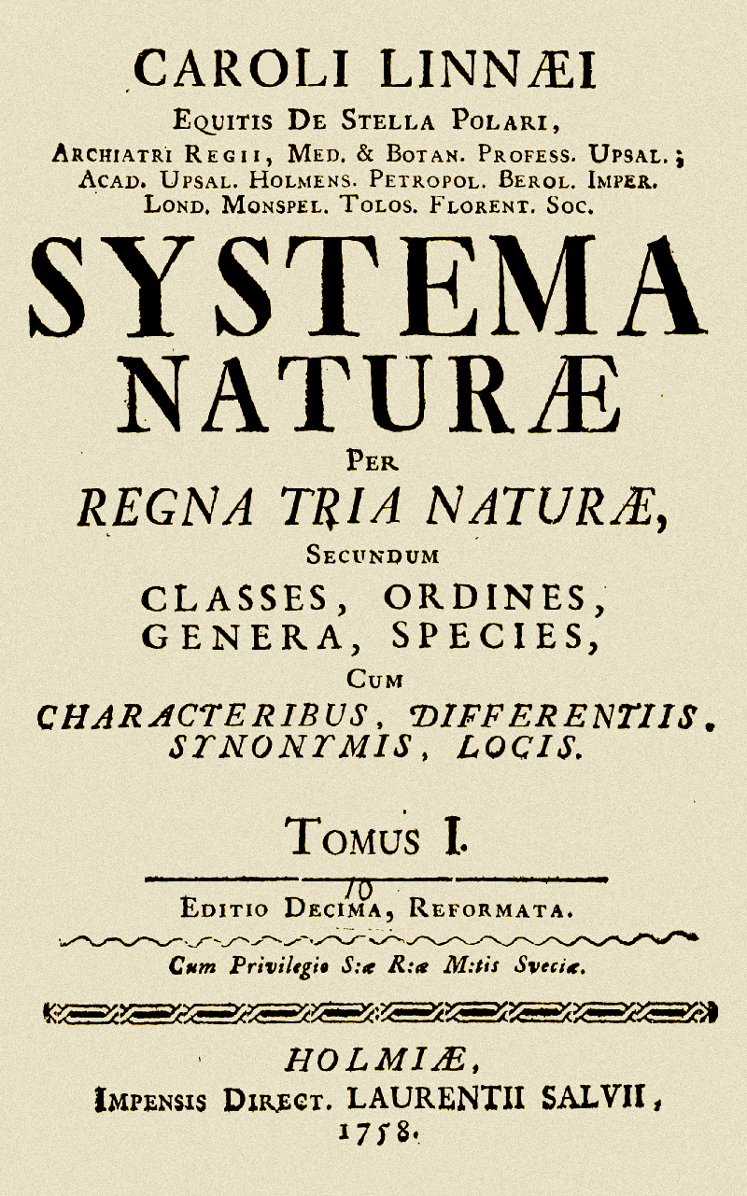
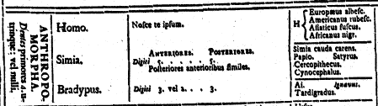
Linneaus: Classification and the Human Races
‘The Americanus: red, choleraic, righteous; black, straight, thick hair; stubborn, zealous, free; painting himself with red lines, and regulated by customs.
The Europeanus: white, sanguine, browny; with abundant, long hair; blue eyes; gentle, acute, inventive; covered with close vestments; and regulated by laws.
The Asiaticus: yellow, melancholic, stiff; black hair, dark eyes; severe, haughty, greedy; covered with loose clothing; and regulated by opinions.
The Afer or Africanus: black, phlegmatic, relaxed; black, frizzled hair; silky skin, flat nose, tumid lips; females without shame; mammary glands give milk abundantly; crafty, sly, careless; anoints himself with grease; and regulated by will.’ (10th Ed., 1758)

Slide 3
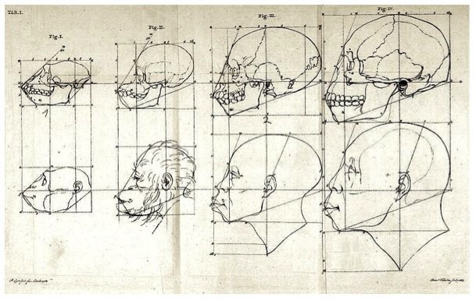
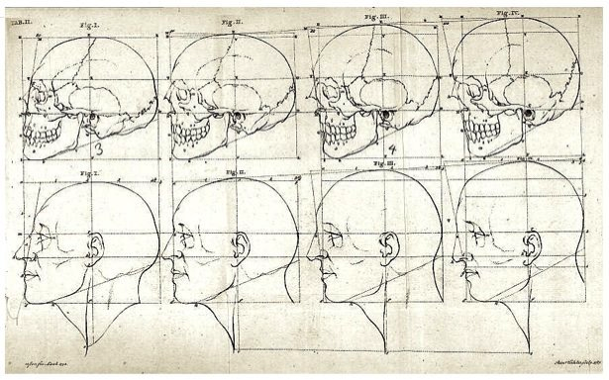
Petrus Camper (1722-1789) and the Facial Angle
Camper, Paul, Über den natürlichen Unterschied der Gesichtszüge (Berlin, 1792)]
-A measurement of the slope of the face: an ‘objective’ racial characteristic?

Slide 4
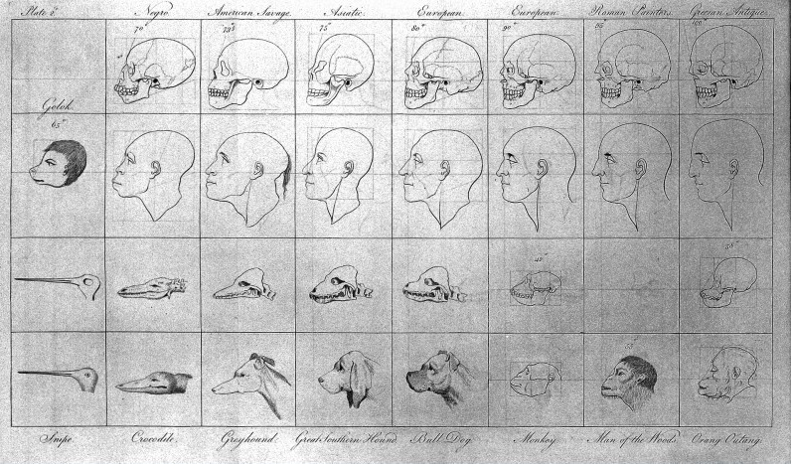
The Facial Angle and Gradation of Species
-The facial angle is used to show a ‘gradation’ from animals with a low (acute) angle to those with progressively flatter faces--from dogs to apes to humans.
Amongst the human types, Europeans have a higher facial angle (close to 90 degrees),
approaching the Ancient ideal shown in sculptures. Africans are depicted as being furthest
from this ideal, and closest to apes. Used to argue for European superiority according to
Ideas not dissimilar to evolution.

Slide 5
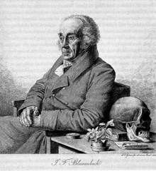
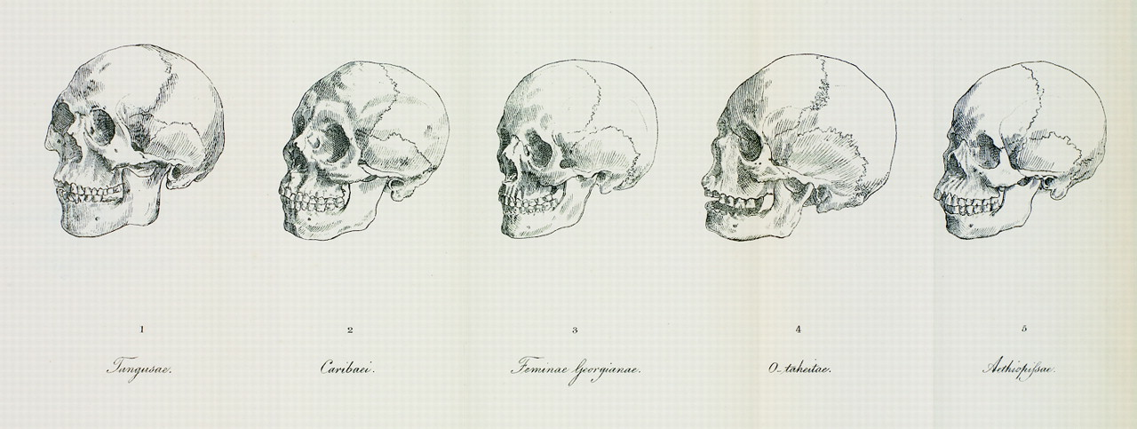
Johannes Blumenbach (1752-1840)
-On the Natural Variety of Mankind (1777)
-Collected human crania (~245 examples)
-’Let us follow nature herself, and we shall
reckon up the various shapes of the head in
the various nations.’
-Five racial types: Caucasian, Mongolian, Malayan, Ethiopian, American (1781)
-Cranial form a characteristic racial feature (qualitative, not quantitative…yet)

Slide 6
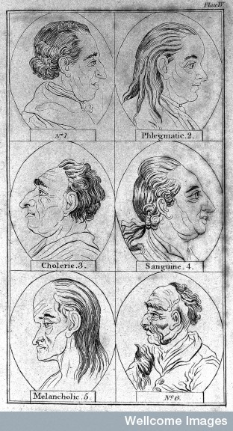
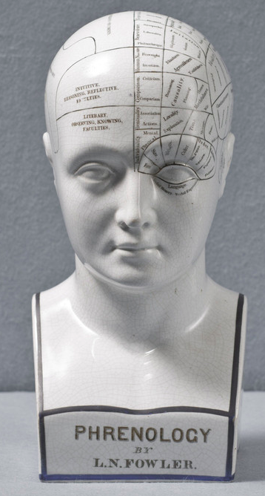
Physiognomy and Phrenology:
Matching external and internal traits
-Lavater’s Essays on Physiognomy (c.1775)
-Facial features reveal personality
-Gall and Spurzheim (c.1800)
-Head bumps correlated with character traits

Slide 7
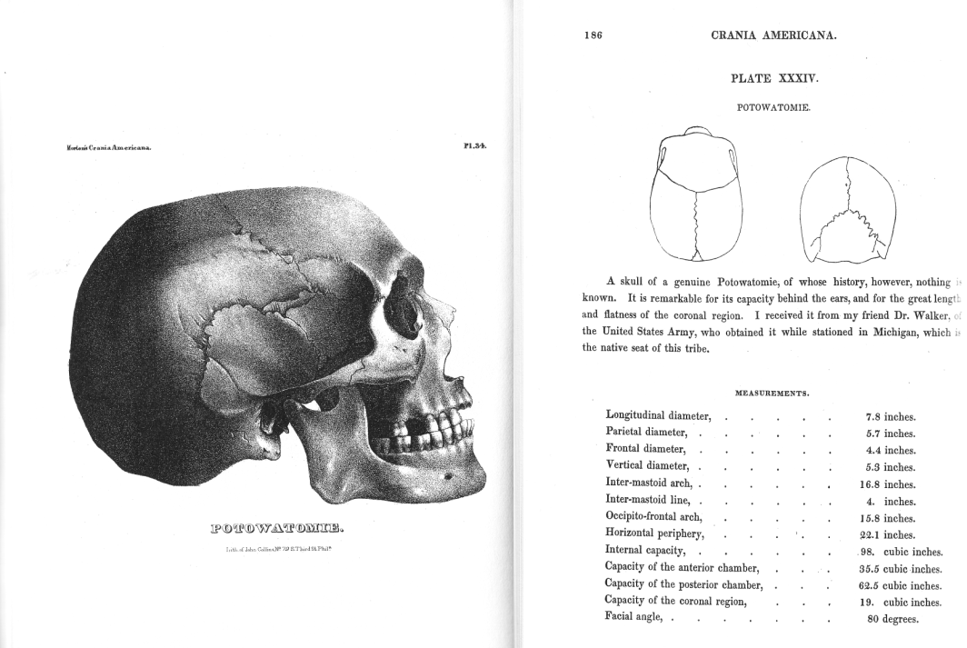
Samuel George Morton, Crania Americana (1839)
Samuel George Morton, Crania Americana (Philadelphia, 1839)

Slide 8
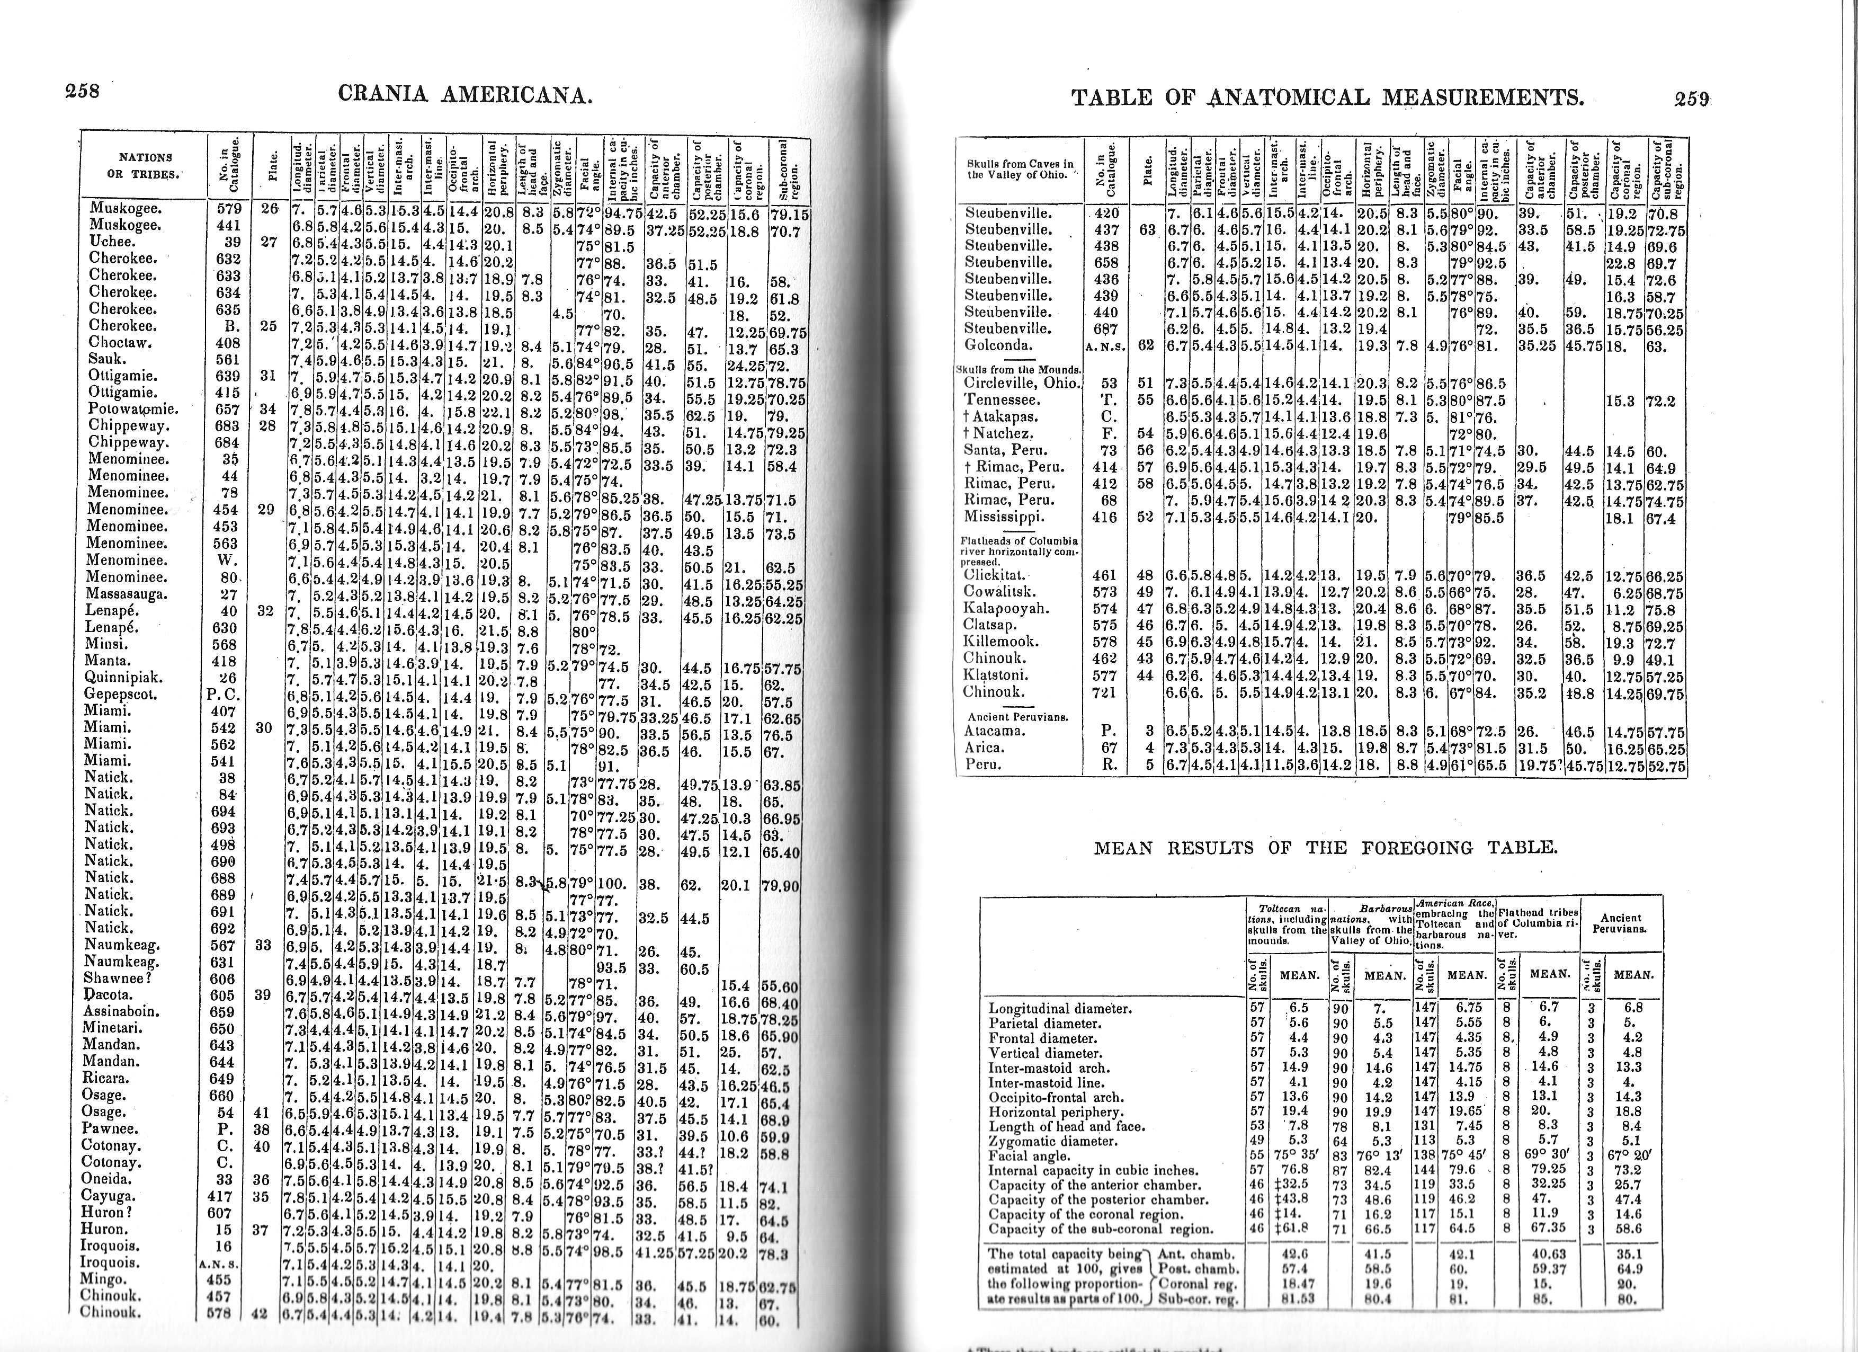
Morton, Samuel George, Crania Americana (Philadelphia, 1839)

Slide 9
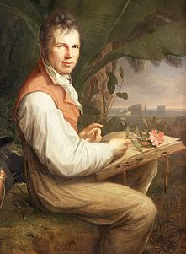
Craniology: a ‘science’ of race?
‘[Crania Americana is a work] equally remarkable for the profundity of its anatomical views, the numerical detail of the relations of organic conformation, the absence of those poetical reveries which are as the myths of modern physiology, and the generalizations with which your Introductory Essay abounds.’
Alexander von Humboldt (1769-1859)
by Friedrich Georg Weitsch (1806)
-Alexander Humboldt to Samuel George Morton, 17 January, 1844

Slide 10
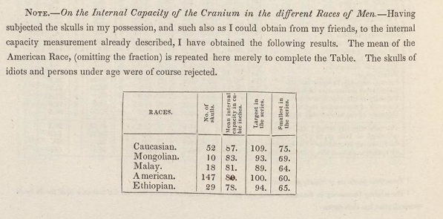
Samuel George Morton, Crania Americana (Philadelphia, 1839), p.260

Slide 11
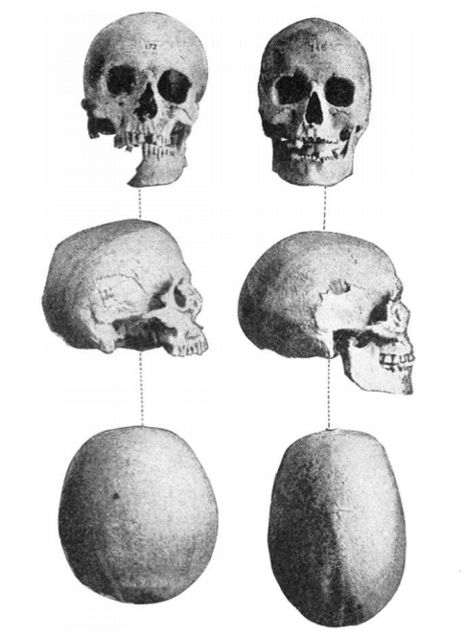
‘Round Heads’ and
‘Long Heads’:
The Cephalic Index
(Height/Breadth
Ratio)
c.1840s
Representation of brachycephalic (left) and dolichocephalic (right) skull types
[Haddon, A. C., The study of man (London, 1898)]

Slide 12
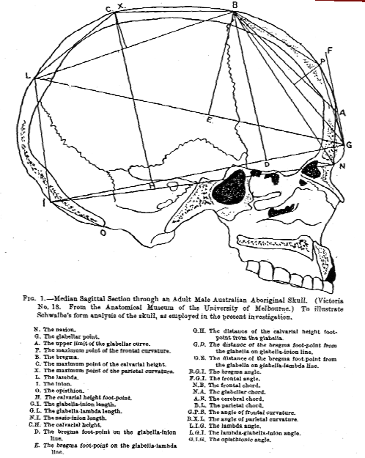
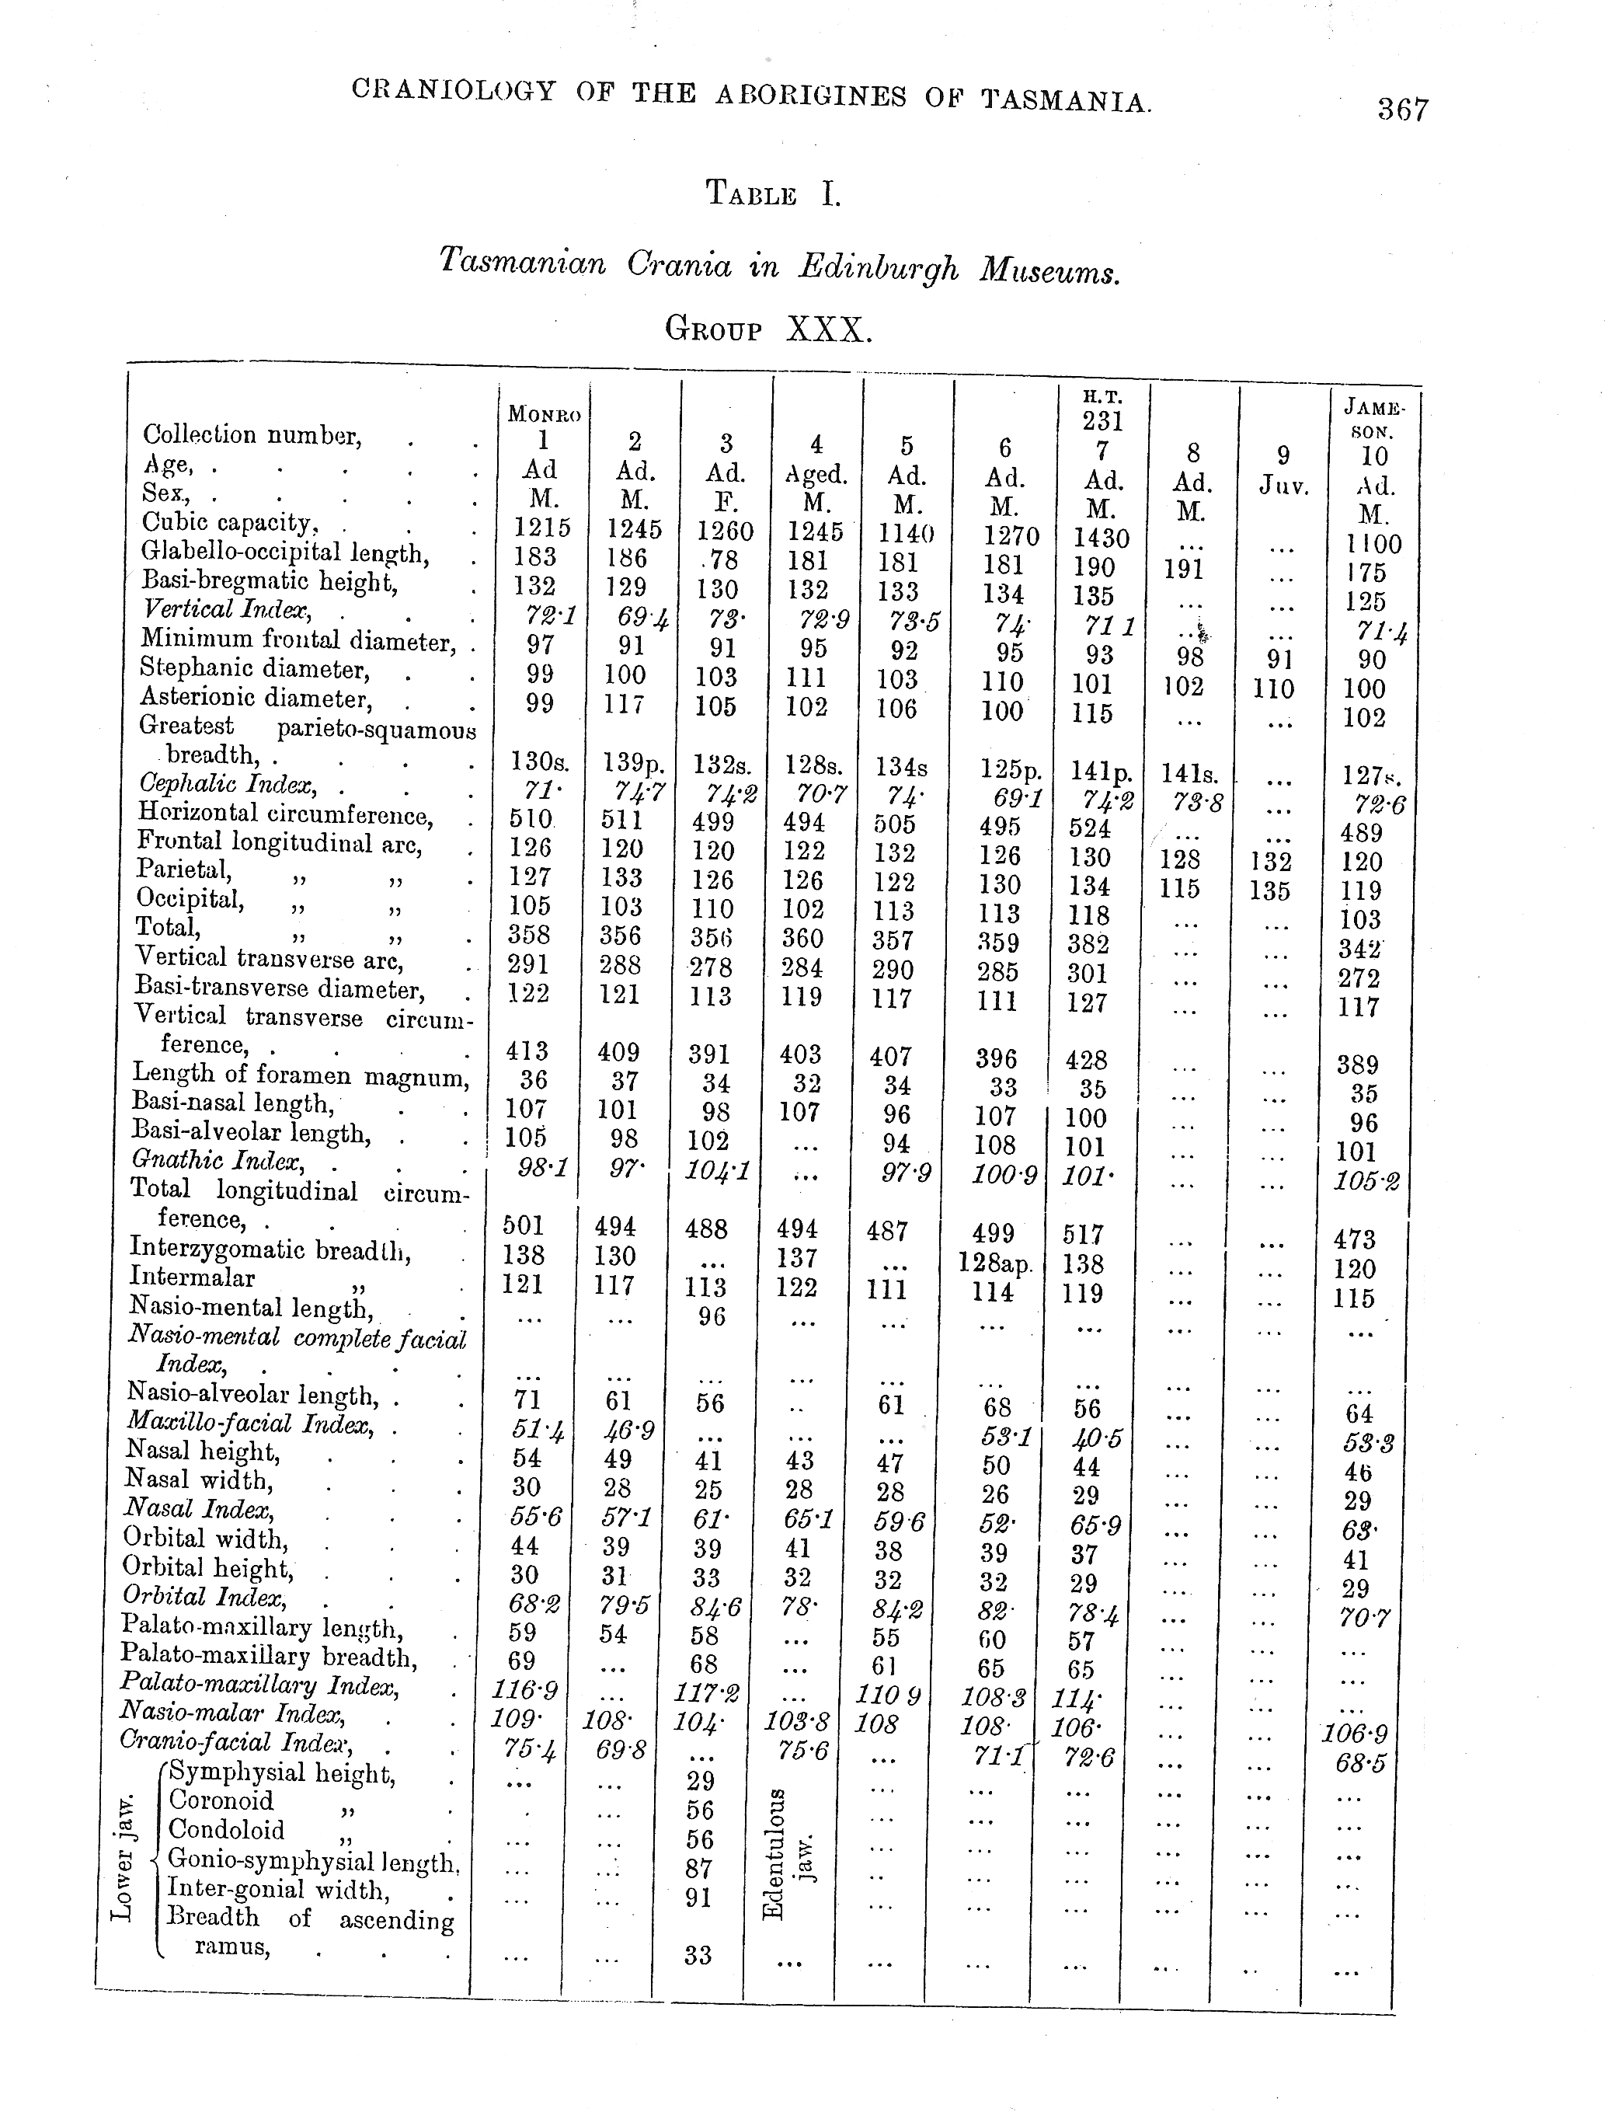
CRANIOMETRY: THE STUDY OF SKULL MEASUREMENTS
Berry, R. J. A. and A. W. D. Robertson, ‘The place in nature
of the Tasmanian Aboriginal as deduced from a study of his calvarium’ (1910-1911)
Turner, William, ‘The craniology, racial affinities, and descent of
the Aborigines of Tasmania’ (1908)]

Slide 13
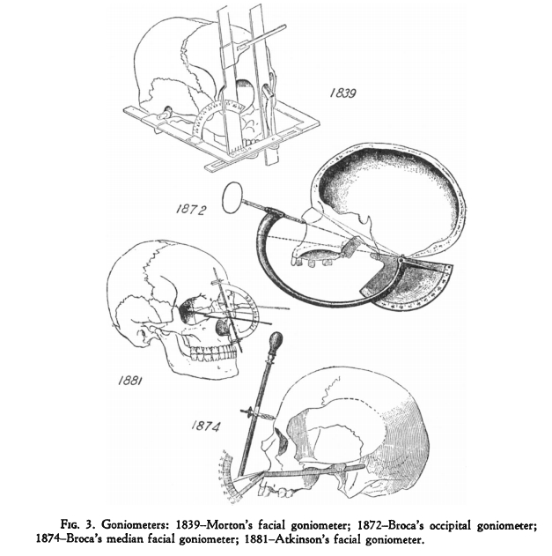
Science, Measurement, and Objectivity
“The application of precise methods of measurement marks a definite phase in the development of most branches of modern science, and thus craniometry, a comprehensive expression of all methods of measuring the skull (cranium), provides a striking landmark in the progress of anthropological studies.”
Lucile E. Hoyme, ‘Physical Anthropology and its Instruments: An Historical Study,’ Southwestern Journal of Anthropology (1953), p.417
-W.L.H. Duckworth, ‘Craniometry’,
Encyclopaedia Britannica (11th edn. Cambridge, 1911), VII, 372

Slide 14
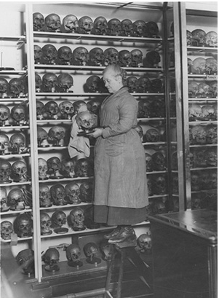
Institutional Support
-Craniological collections established at
all major medical and natural history
museums
-Craniometry taught in medical schools
-Findings presented at scientific meetings
-Papers published in major scientific
journals (e.g. Nature, Transactions of the
Royal Society)
-Anthropologists admitted to the British
Association for the Advancement of
Science in 1884
Image credit: Hunterian Museum, Royal College of Surgeons

Slide 15
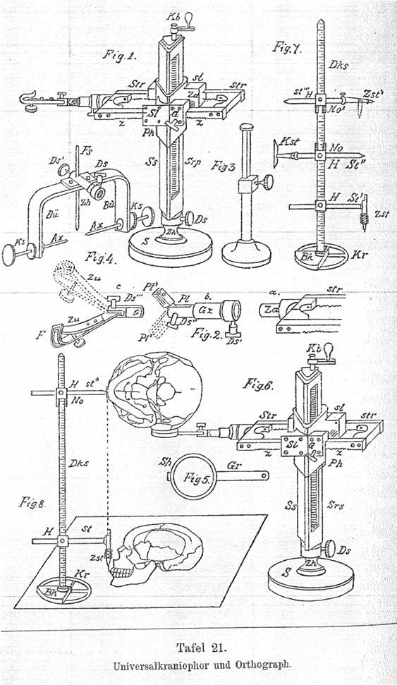
‘Universalkraniometer’
‘The spoiled child of anthropology’
‘[The average craniologist lies] buried beneath a mighty mountain of figures, many of which have little morphological value and possess no true importance in distinguishing the finer differences of racial forms.’
-Daniel John Cunningham, ‘Opening address, section H: anthropology’
Nature (26 September, 1901), p. 540.
Very precise measurements with refined instruments gives an apparent exactitude which appears to be more scientific than it really is.’
-Physical measurements in anthropology’, Nature (July 6, 1899), p.234-5
Aurel von Torok, Grundzüge einer systematischen Kraniometrie (Stuttgart, 1890)

Slide 16
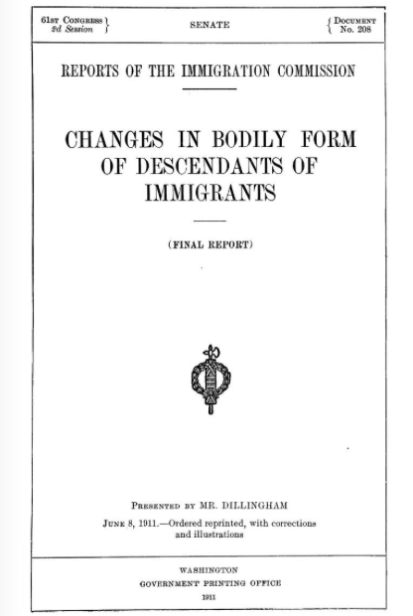
Discrediting Craniometry
c.1900-1910
-Inability to match cranial dimensions
and intelligence.
-Investigation of immigrant families in
USA by Franz Boas (1858-1942) reveals
‘cranial plasticity’: immigrant children
born in America have a markedly different
cephalic index from their parents.
-Cranial form not ‘immutable’ indicator
of racial type but subject to change in a
single generation

Slide 17
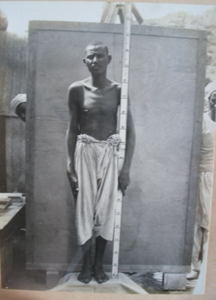
From Craniometry to Anthropometry
Anthropometry: measurement of the human body (heights, weights, limb dimensions, etc.)
-Linked to ideas around
racial classification,
identification, and
degeneration
-Marks ‘types’ as well as
‘healthy’ and ‘unhealthy’
bodies
-Also incorporates faculties
(vision, strength) that can
be measured as well as
physical dimensions
Anthropometrical Photograph,
Gebel Moya, 1912-1913

Slide 18
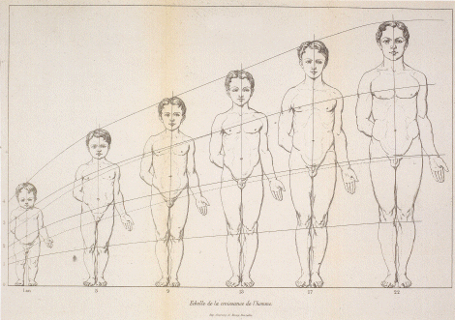
Quetelet’s ‘Average Man’
-Adolphe Quetelet (1796-1874): Belgian statistician who studies heights and weights
(proposing the body-mass index), linking these to various ages and occupational
categories (c.1835)
-Studies distribution of variation of these traits according to a normal curve (variation
around the average): produces the idea of the ‘median man’ as representative of type.
-Also studies link between criminality and age/gender/class/anthropometric indices.
A. Quetelet, Anthropométrie ou mesure des différentes facultés de l'homme. (Brussels, 1871)

Slide 19
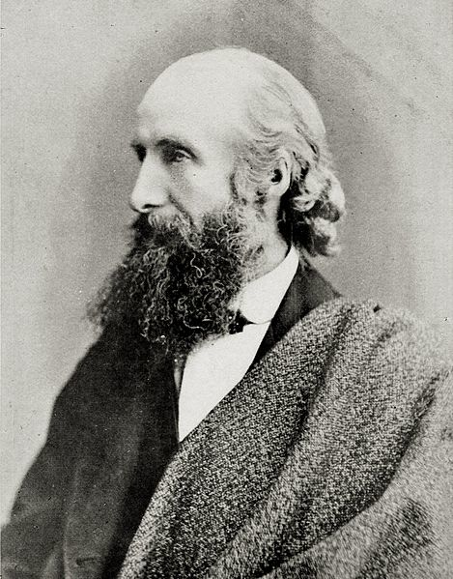
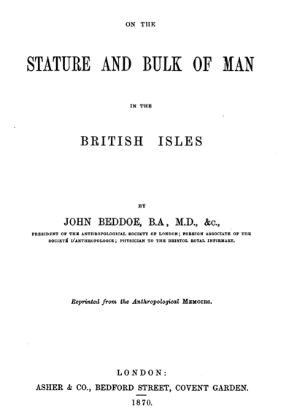
QUESTIONNAIRE:
AGE
OCCUPATION
HEIGHT
WEIGHT
EYE COLOUR
HAIR COLOUR

Slide 20
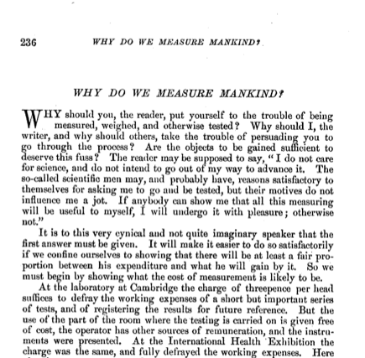
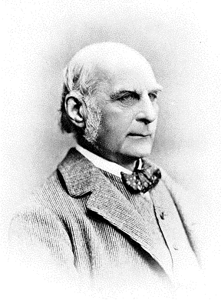
Francis Galton, 1822-1911:
‘Father of Eugenics’

Slide 21
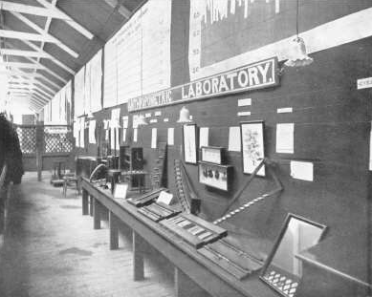
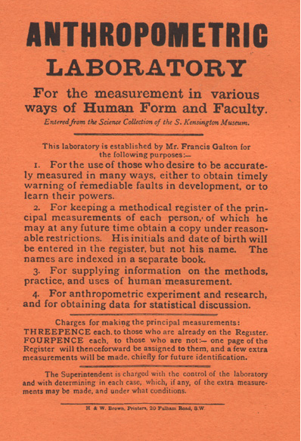
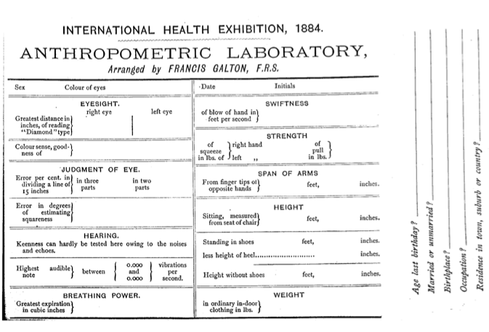

Slide 22
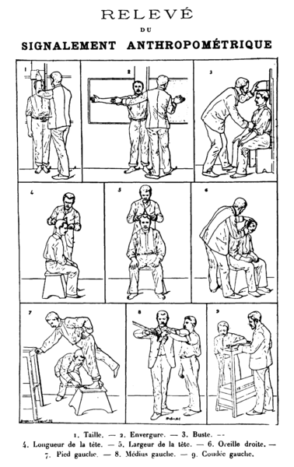
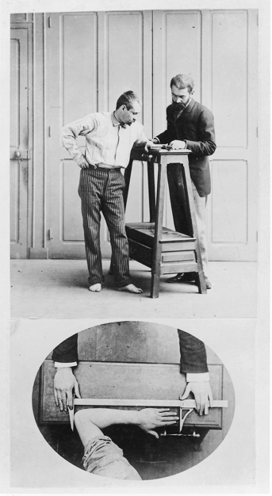
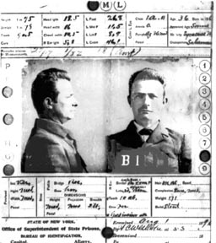
BERTILLON’S CRIMINAL ANTHROPOMETRY, C.1870s
-Cesare Lombroso uses anthropometric measurements to delineate criminal types
AND identify criminals by recording their measurements (which can be shared across
districts). Photography and fingerprinting also form part of this identification process.

Slide 23
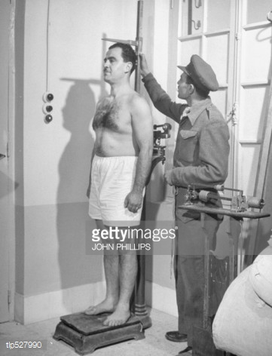
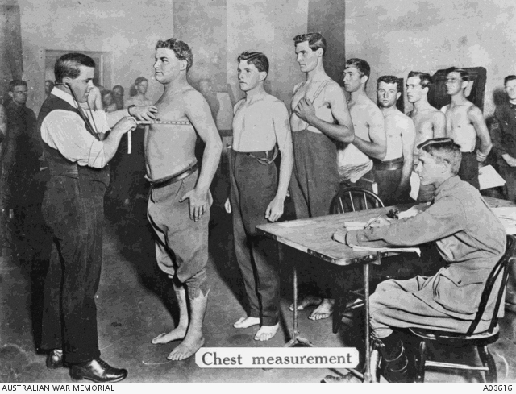
Measuring the ‘National Physique’
-Military physicals used to establish basic standard of fitness
-In Britain, fears of degeneration as many recruits don’t pass muster (c.1900)
-Institution of School Medical Inspections (1907) to keep track of physical development
and arrest decay

