Slide 1
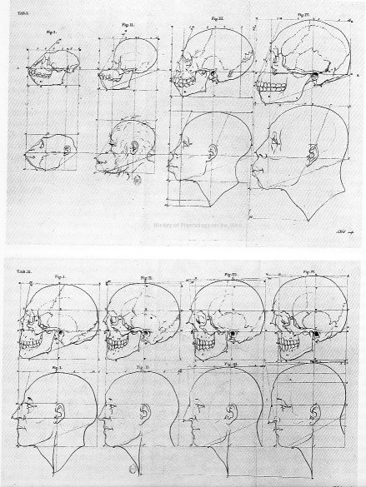
Measurement and classification
HI176 Mind Body and Society
Week 11

Slide 2
Outline
The ‘allure of numbers’ Part 1
  Measuring heads to establish hierarchy: from phrenology to craniometry
  Measuring bodies to establish identity: from suspect imperial subjects to suspect criminal bodies (to fingerprints)
The ‘allure of numbers’ Part 2
  The rise of quantification in medicine
  Generating ‘normal’ bodies

Slide 3
Why measure the human body to produce ‘truth’– and what KINDS of truth can be (re)produced?
Notes:
Searching bodies for medical, hierarchical, or identification ‘truths’ is rooted in longer tradition of reading the physical body for signs of moral, spiritual or intellectual traits.

Slide 4
Questions to think with…
What kinds of truths?
  Hierarchical (so, social and cultural)
  Medical
  Identificational
Why measure?
Why the body?

Slide 5
Measuring ‘Bumps’, Seeing ‘Character’: Phrenology

Slide 6
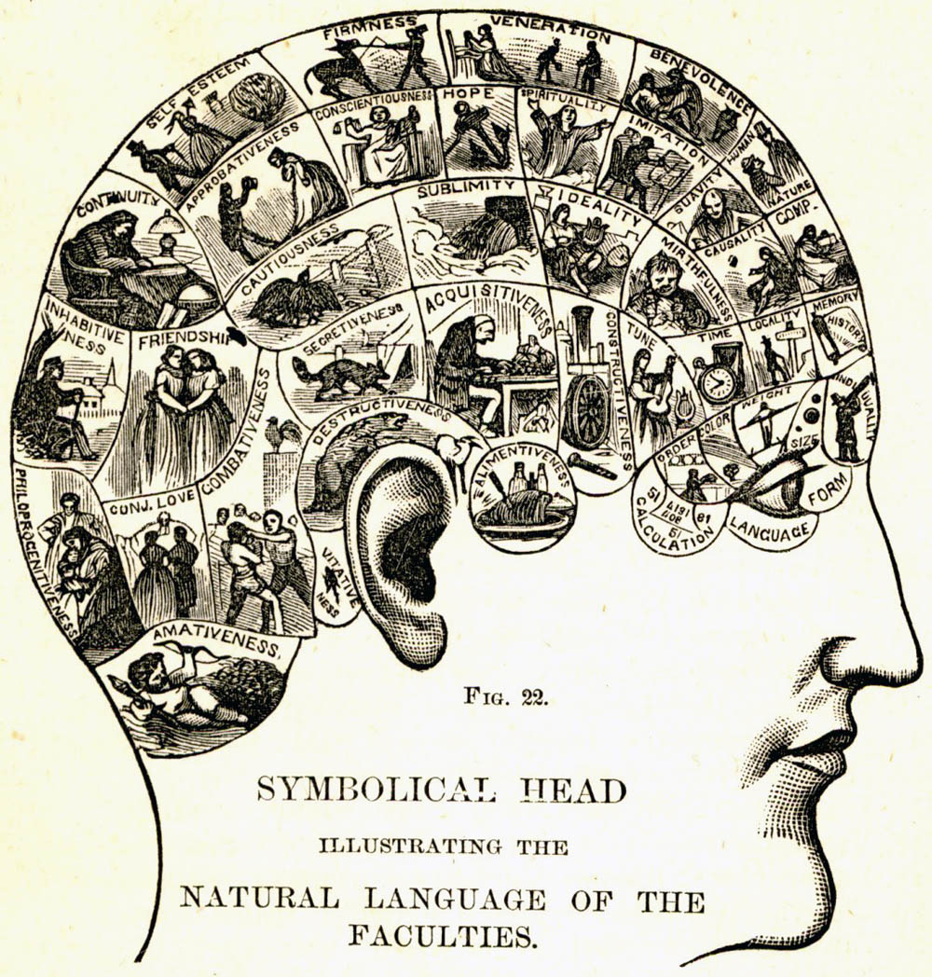
Phrenology and the bumpy path to the embodied mind…

Slide 7
Phrenology
Key points
Propounded by Franz Joseph Gall (1758-1828), phrenology was based in the idea that the brain had approximately 26 ‘organs’ or ‘mental faculties’, each of which represented a particular trait or propensity (such as intelligence, acquisitiveness, and self-esteem).
These ‘organs’ could be perceived and compared via minute measurement of the contours of the skull.
While Gall believed that the innate organs shrank or grew with use, others argued that they were fixed and determined character.
Phrenology was enormously popular, and sparked developments including craniology, but also contemporary ideas of a modular brain with ‘speech centres’ etc.

Slide 8
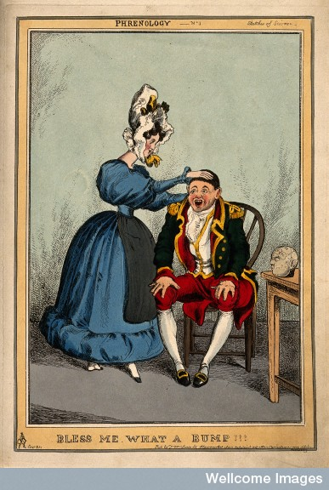

Slide 9
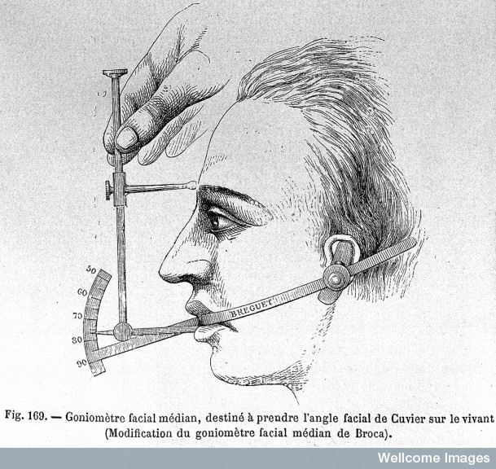
Craniology/
Craniometry

Slide 10
Craniometry
Key Points
Where phrenology measured the skull as a way to measure the mind and personality, craniometry measured skulls to determine the volume of the brain and through it to identify and rank the ‘races of man’; the sexes; and the classes.
Petrus Camper popularised the idea of the ‘facial angle’:
  ‘The two extremities of the facial line are from 70 to 80 degrees from the negro to the Grecian antique: make it under 70, and you describe an ourang or an ape.’ (Original claims made c. 1770, and about ‘classical beauty’ rather than ‘race’ per se. Camper's Works, p. 42, translated by Cogan, 1821.)
Alternately, the ‘cranial index’ (height vs width of skull) was easy to measure, and allowed similar evolutionary claims to be made.
Craniometry became an essential part of physical anthropology, and of scientific racism.

Slide 11
The Racial Brain
‘The great importance of craniology has struck anthropologists with such force that many among us have neglected the other parts of our science in order to devote ourselves almost exclusively to the study of skulls.... In such data, we hoped to find some information relevant to the intellectual value of the various human races’
Paul Broca,1861
(BUT:
‘It is a natural tendency of men, even among those most free of prejudice, to attach an idea of superiority to the dominant characteristics of their race.’
Paul Broca, 1861)

Slide 12
The gendered brain
(sample size: 7 male skulls, 6 female skulls)
‘We might ask if the small size of the female brain depends exclusively upon the small size of her body. Tiedemann has proposed this explana­tion. But we must not forget that women are, on the average, a little less intelligent than men, a difference which we should not exaggerate but which is, nonetheless, real. We are therefore permitted to suppose that the relatively small size of the female brain depends in part upon her physical inferiority and in part upon her intellectual inferiority.’
Paul Broca, 1861
In the most intelligent races… there are a large number of women whose brains are closer in size to those of gorillas than to the most developed male brains. This inferiority is so obvious that no one can contest it …[women] represent the most inferior forms of human evolution and …are closer to children and savages than to an adult, civilized man. … Without doubt there exist some distinguished women, very superior to the average man, but they are as exceptional as the birth of any monstrosity, as, for example, of a gorilla with two heads; consequently, we may neglect them entirely
Gustave Le Bon, 1879.

Slide 13
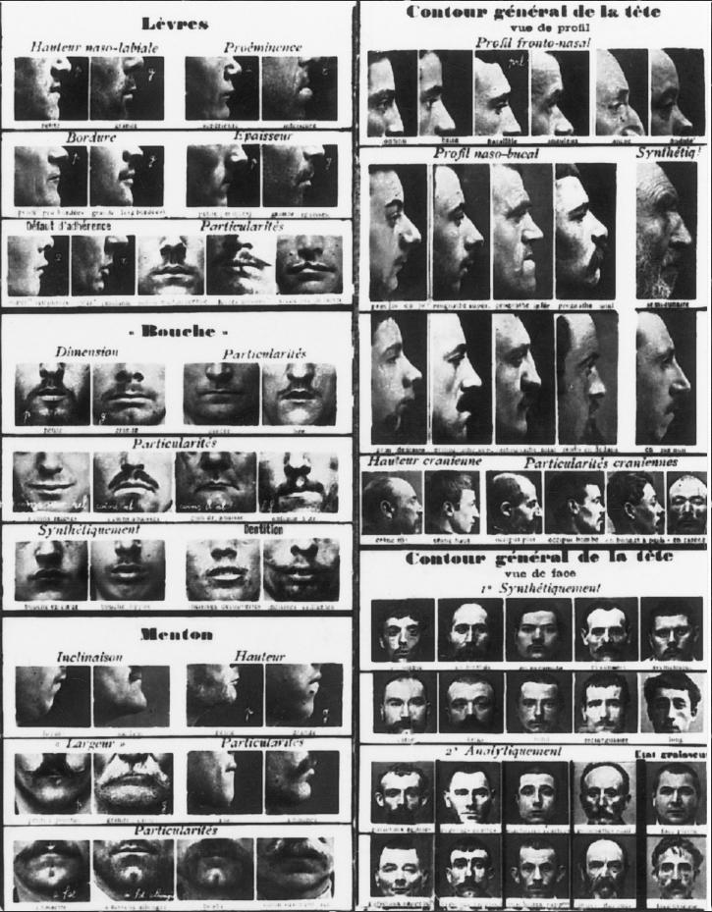
Anthropometry
Literally, ‘the measurement of man’;
Like craniometry, anthropometry was closely associated with the idea that measuring the body could reveal data about mental as well as physical aptitudes and traits;
In parallel, and tying into fears about degeneracy, systems of anthropometric measurement were developed to identify individuals and ‘types’ (and thus to allow both reactive and pro-active identification of criminals). Among the most important of these systems was Bertillonage.

Slide 14
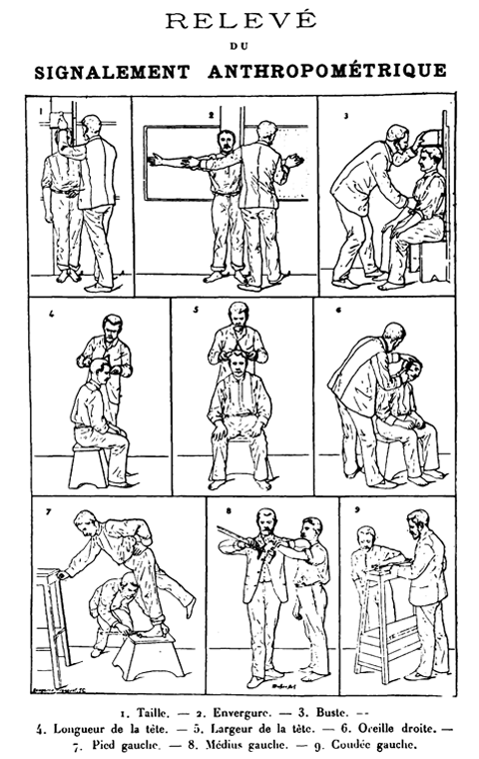
Bertillonage as a surveillance system:
Key Features
Use of standardization for:
  Measurements taken,
  Mode of measuring
  Mode of notation
  Mode of filing and accessing results
Ability to locate and SHARE results:
  ‘portait parlé
  Abbreviations designed for use with telegraphy

Slide 15
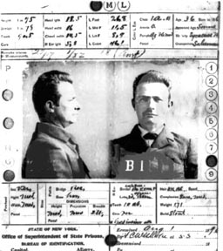
Segregating the ‘criminal race’
The context:
Late 19th c. sees increasing fear of the ‘recidivist criminal’ – and the radicalised poor.
The problem: how to identify this mobile, urban and wily population?
c. 1870s, Cesare Lombroso popularises idea of biological, rather than moral criminality – making the identification of potential rather than actual criminals a possibility

Slide 16
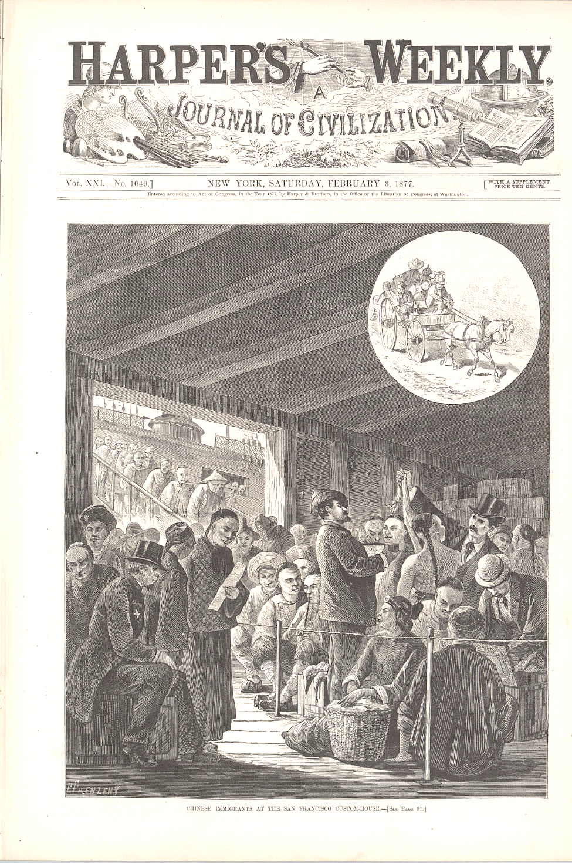
Who would be ‘suspect’?
The mobile poor (‘vagrants’, ‘gypsies’, most immigrant groups)
Non-whites
‘degenerates’
Prostitutes
Colonial populations

Slide 17
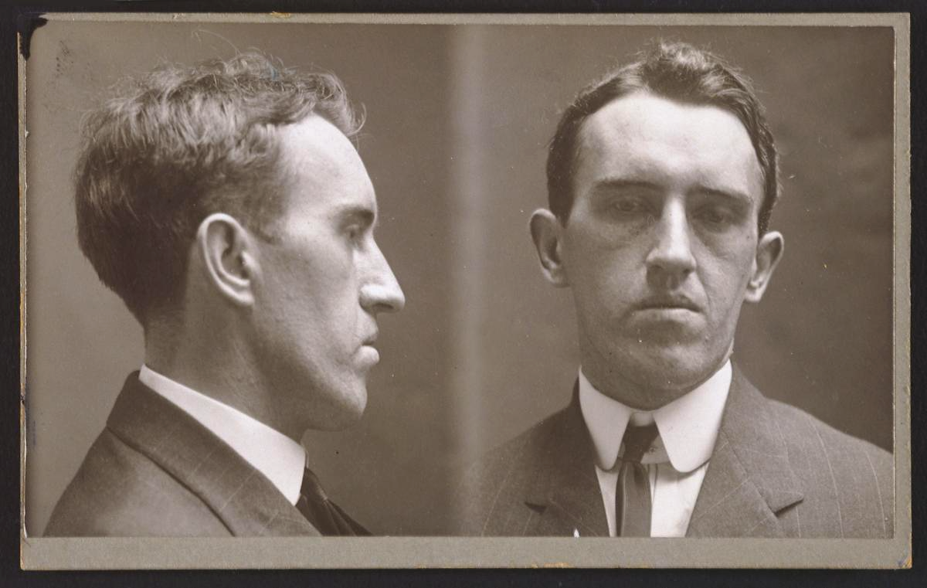
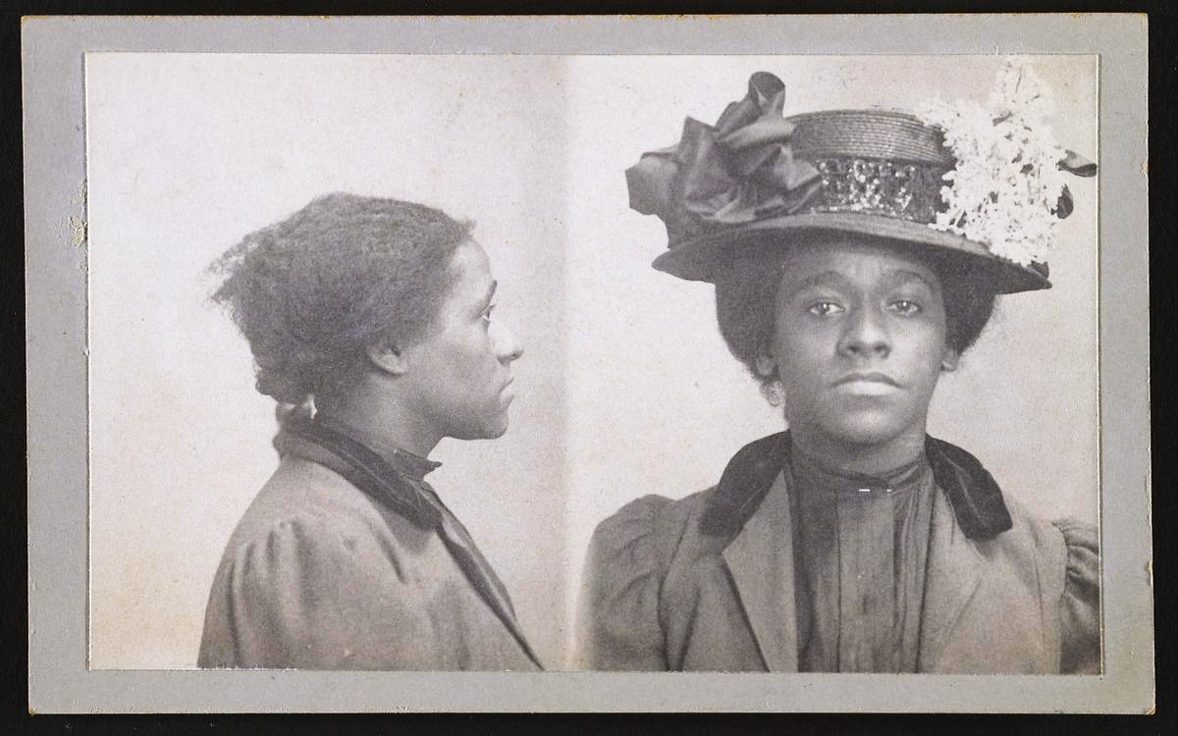
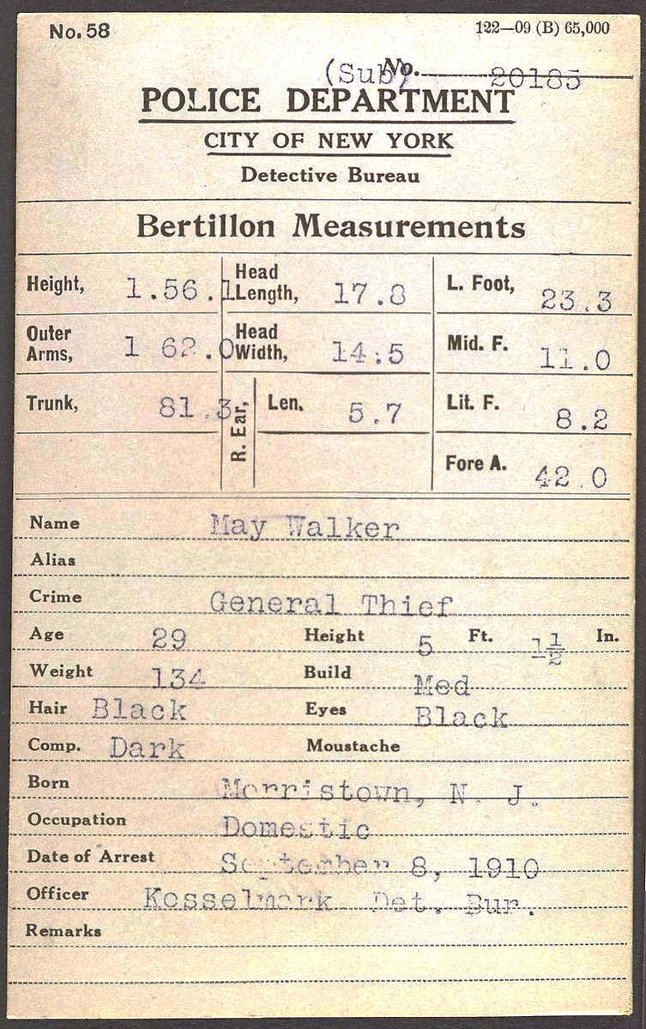
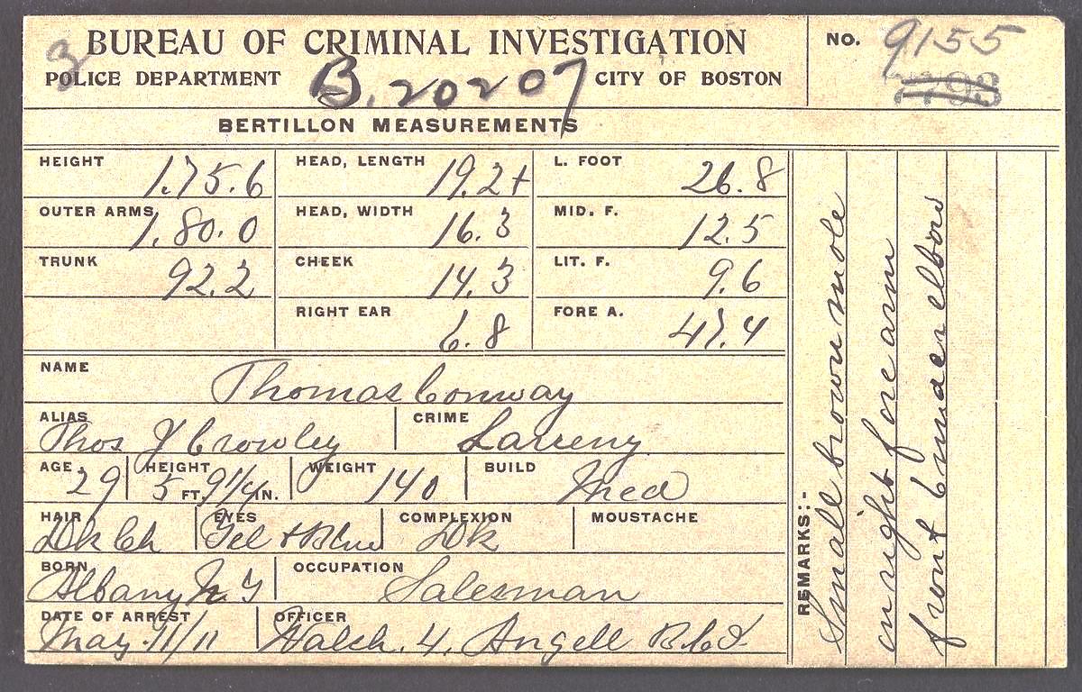
Bertillonage in action, NYC

Slide 18
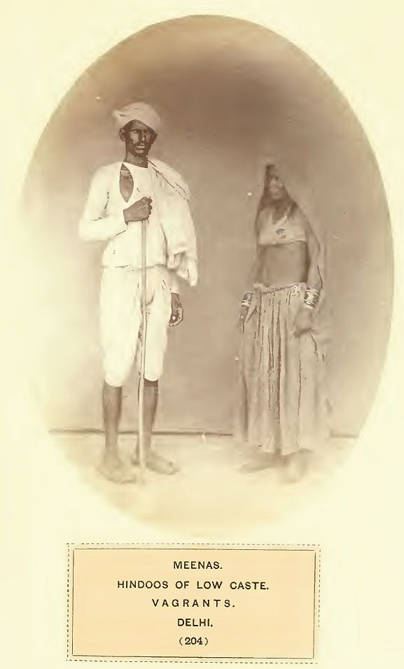
The People of India
(London: India Museum, 1868)
Anthropometry and Empire: Pre-History

Slide 19
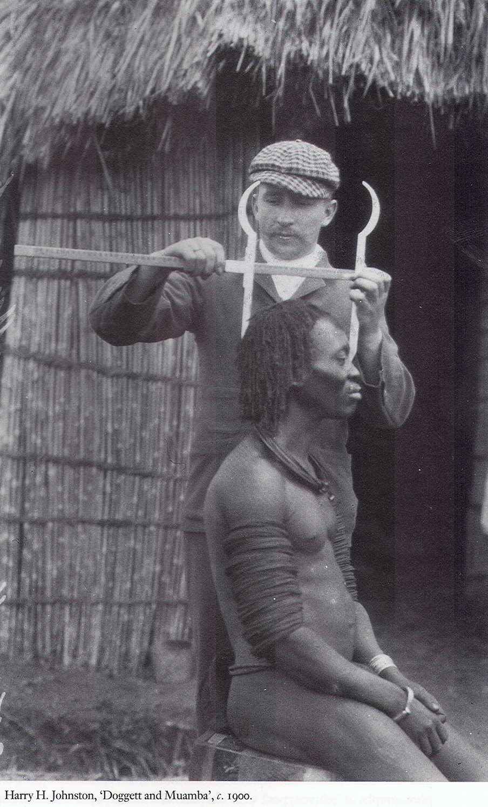
Anthropometry in Empire
Used as a mode of knowing and understanding subject populations, their needs, and their peculiarities
Used as a mode of identifying and thus controlling ‘homogenous’ and unrecognizable subject individuals

Slide 20
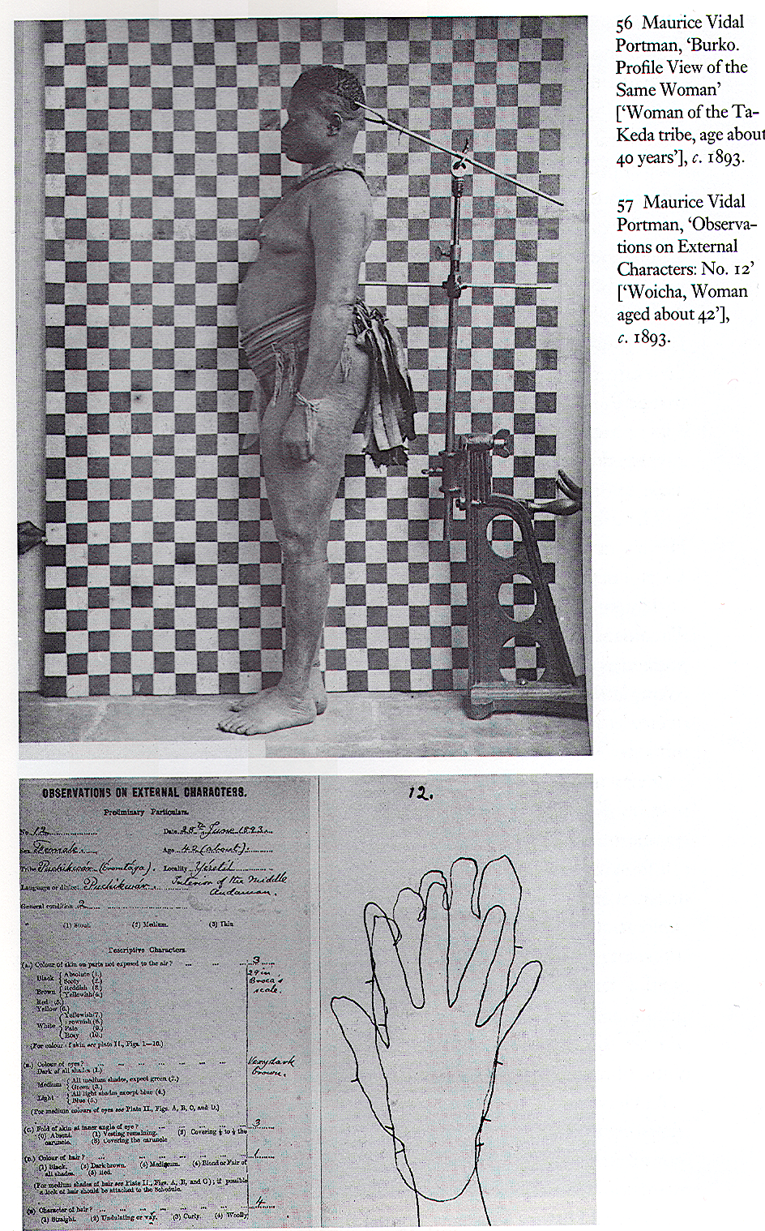
Anthropometry and Empire
Empire/colonies as a test bed for practices later deployed in Europe (for criminals)
Broader societal interest in wake of Darwin and with rise of ‘social Darwinism’ and eugenics

Slide 21
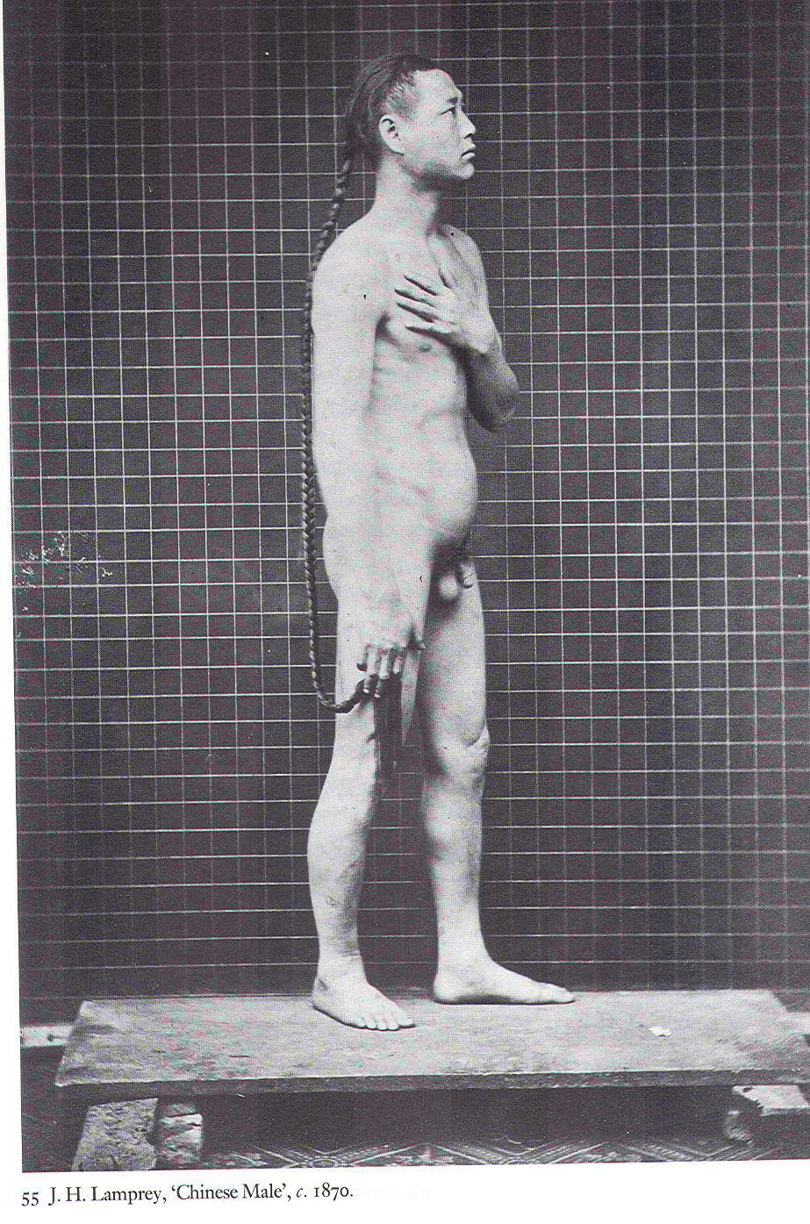
Anthropometry and Empire
Increase in interest following ‘Sepoy Mutiny’ of 1857
“such a survey will be a help to good government … instead of being a mere scientific luxury, as it might be in Europe, it was almost an administrative necessity in Bengal” Risley, 1891

Slide 22
Controlling India, identifying Indians
Desperate administrative need for conclusive forms of identification in relation to:
      Taxes
      Property ownership
      Business contracts
      Pension rights
      Crime
Conviction that all Indians were inherently deceptive, whether for gain, or from a desire to please – and therefore indigenous testimony was totally untrustworthy

Slide 23
Identity for Empire
Finger prints were regarded as especial value in ‘identifying persons of other races…’
Thus they were perfect for the colonies, where:
‘The natives are mostly unable to sign; their features are not readily distinguished by Europeans; and in too many cases they are characterised by a strange amount of litigiousness, wiliness and unveracity.’ Galton, 1892

Slide 24
From Anthropometry to Imperial Fingerprints
“…We may classify human beings and human features but cannot bring about or find a precise agreement between any two; we have white men, red men and yellow men; we have well ascertained and defined types of humanity; we have in each type classifications of hair, eyes, noses, mouths and so on; but … a large residue of difference between any two individuals remains as it were a recurring decimal which cannot be distinguished; the difference between each human face and every other of its species. ... We know that it is there, but we cannot in any case completely define the details.
But in the case of finger impressions, there is no question of dealing with those evanescent expressions which so largely contribute towards recognition of the identity of the human face. The exact differences in such impressions may be pointed out with as much certainty as the differences between the maps of two countries…”
[Emperor vs Sahdeo - cited in K J Aiyer, Law and Practice of Evidence in Criminal Cases in India and Pakistan (Allahabad, 1949) p.461.

Slide 25
Measuring (and making) the ‘normal’ body
So: ‘the Allure of numbers’ in biology and anthropometry rested in part on the often unexamined assumption that:
measurement = precision= objective ‘truth’
What was the ‘allure of numbers’ in medicine?
Notes:
Military Fitness and Civilian Health in Britain during the First World War
J. M. Winter
Journal of Contemporary History , Vol. 15, No. 2 (Apr., 1980) , pp. 211-244

Slide 26
Quantification and Surveillance
The study of diseases and of the deformities, to which they give place, has shown the benefits derivable from corporeal measurements; but in order to recognise whatever is an anomaly, it is essentially necessary to have established the type constituting the normal or healthy condition.
Auguste Quetelet, 1830
Notes:
A. Quetelet, “Sur la Taille Moyenne de l’Homme dans les Villes et dans les Campagnes,
et sur l’Age ou la Croissance est Complètement Achevée,” Annales d’Hygiène Publique,
1830, 3 : 24 –26 quoted in Lawrence T. Weaver, ‘In the Balance: Weighing Babies and the Birth of the Infant Welfare Clinic,’ Bulletin of the History of Medicine, Volume 84, Number 1, Spring 2010, pp. 30-57.
See also J. Rosser Matthews, Quantification and the Quest for Medical Certainty (Princeton, N.J.:
Princeton University Press, 1995).

Slide 27
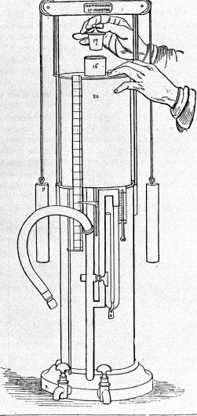
Medicine and Technologies of Measurement
Standardised, calibrated instruments ‘permitted doctors, whether able or inept, to make accurate judgements. No exquisite sensory training was required to obtain or understand the data.’
John Hutchinson, 1846

Slide 28
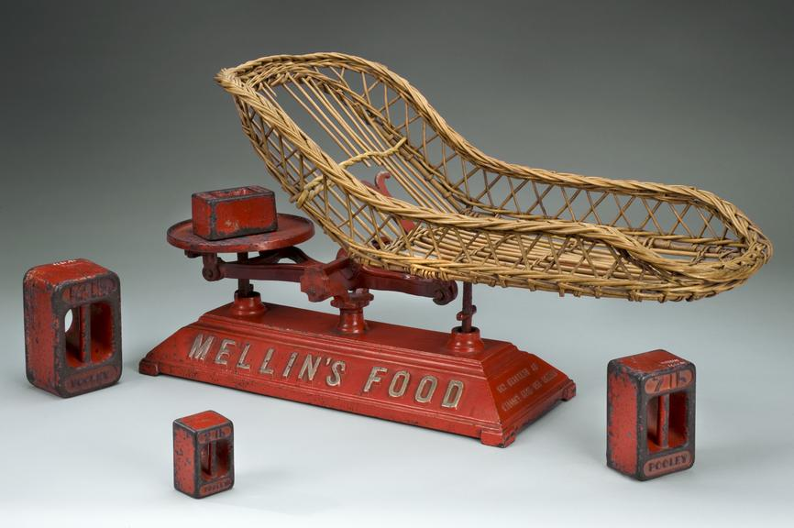
Crucially for our purposes, this emerges in a culture of infant – and then adult -- gravimetric surveillance focused on weight/height ratios

Slide 29
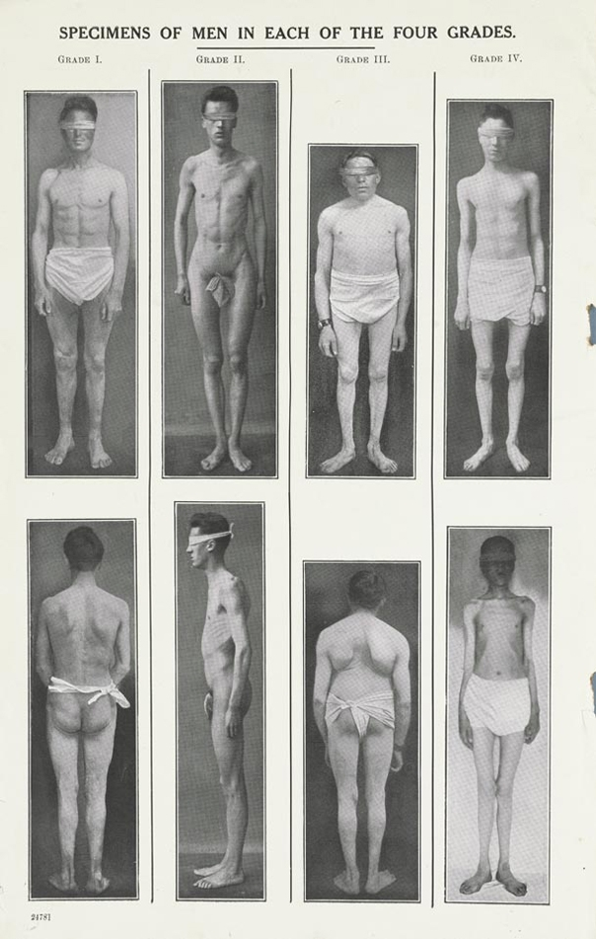
Measuring (making?) the ‘normal’ body
Mass recruitment in the wars of the mid and late 19th c and early 20th c (e.g. the Boer Wars, WWI) prompts mass measurement of young men of all classes.
Expectations about the male body – height, fitness and health – contradicted by the bodies of working classes and poor. 40-60% of such recruits to the British Army failed their physicals, exposing high levels of malnutrition, and deep social inequalities,& sparking panic about ‘degeneration’.
Notes:
Specimens of men in each of the four grades, 1920 by Image: Wellcome Library, London
Military Fitness and Civilian Health in Britain during the First World War
J. M. Winter
Journal of Contemporary History , Vol. 15, No. 2 (Apr., 1980) , pp. 211-244

