Slide 1
Medical Authority
Mind, Body and Society--Week 23

Slide 2
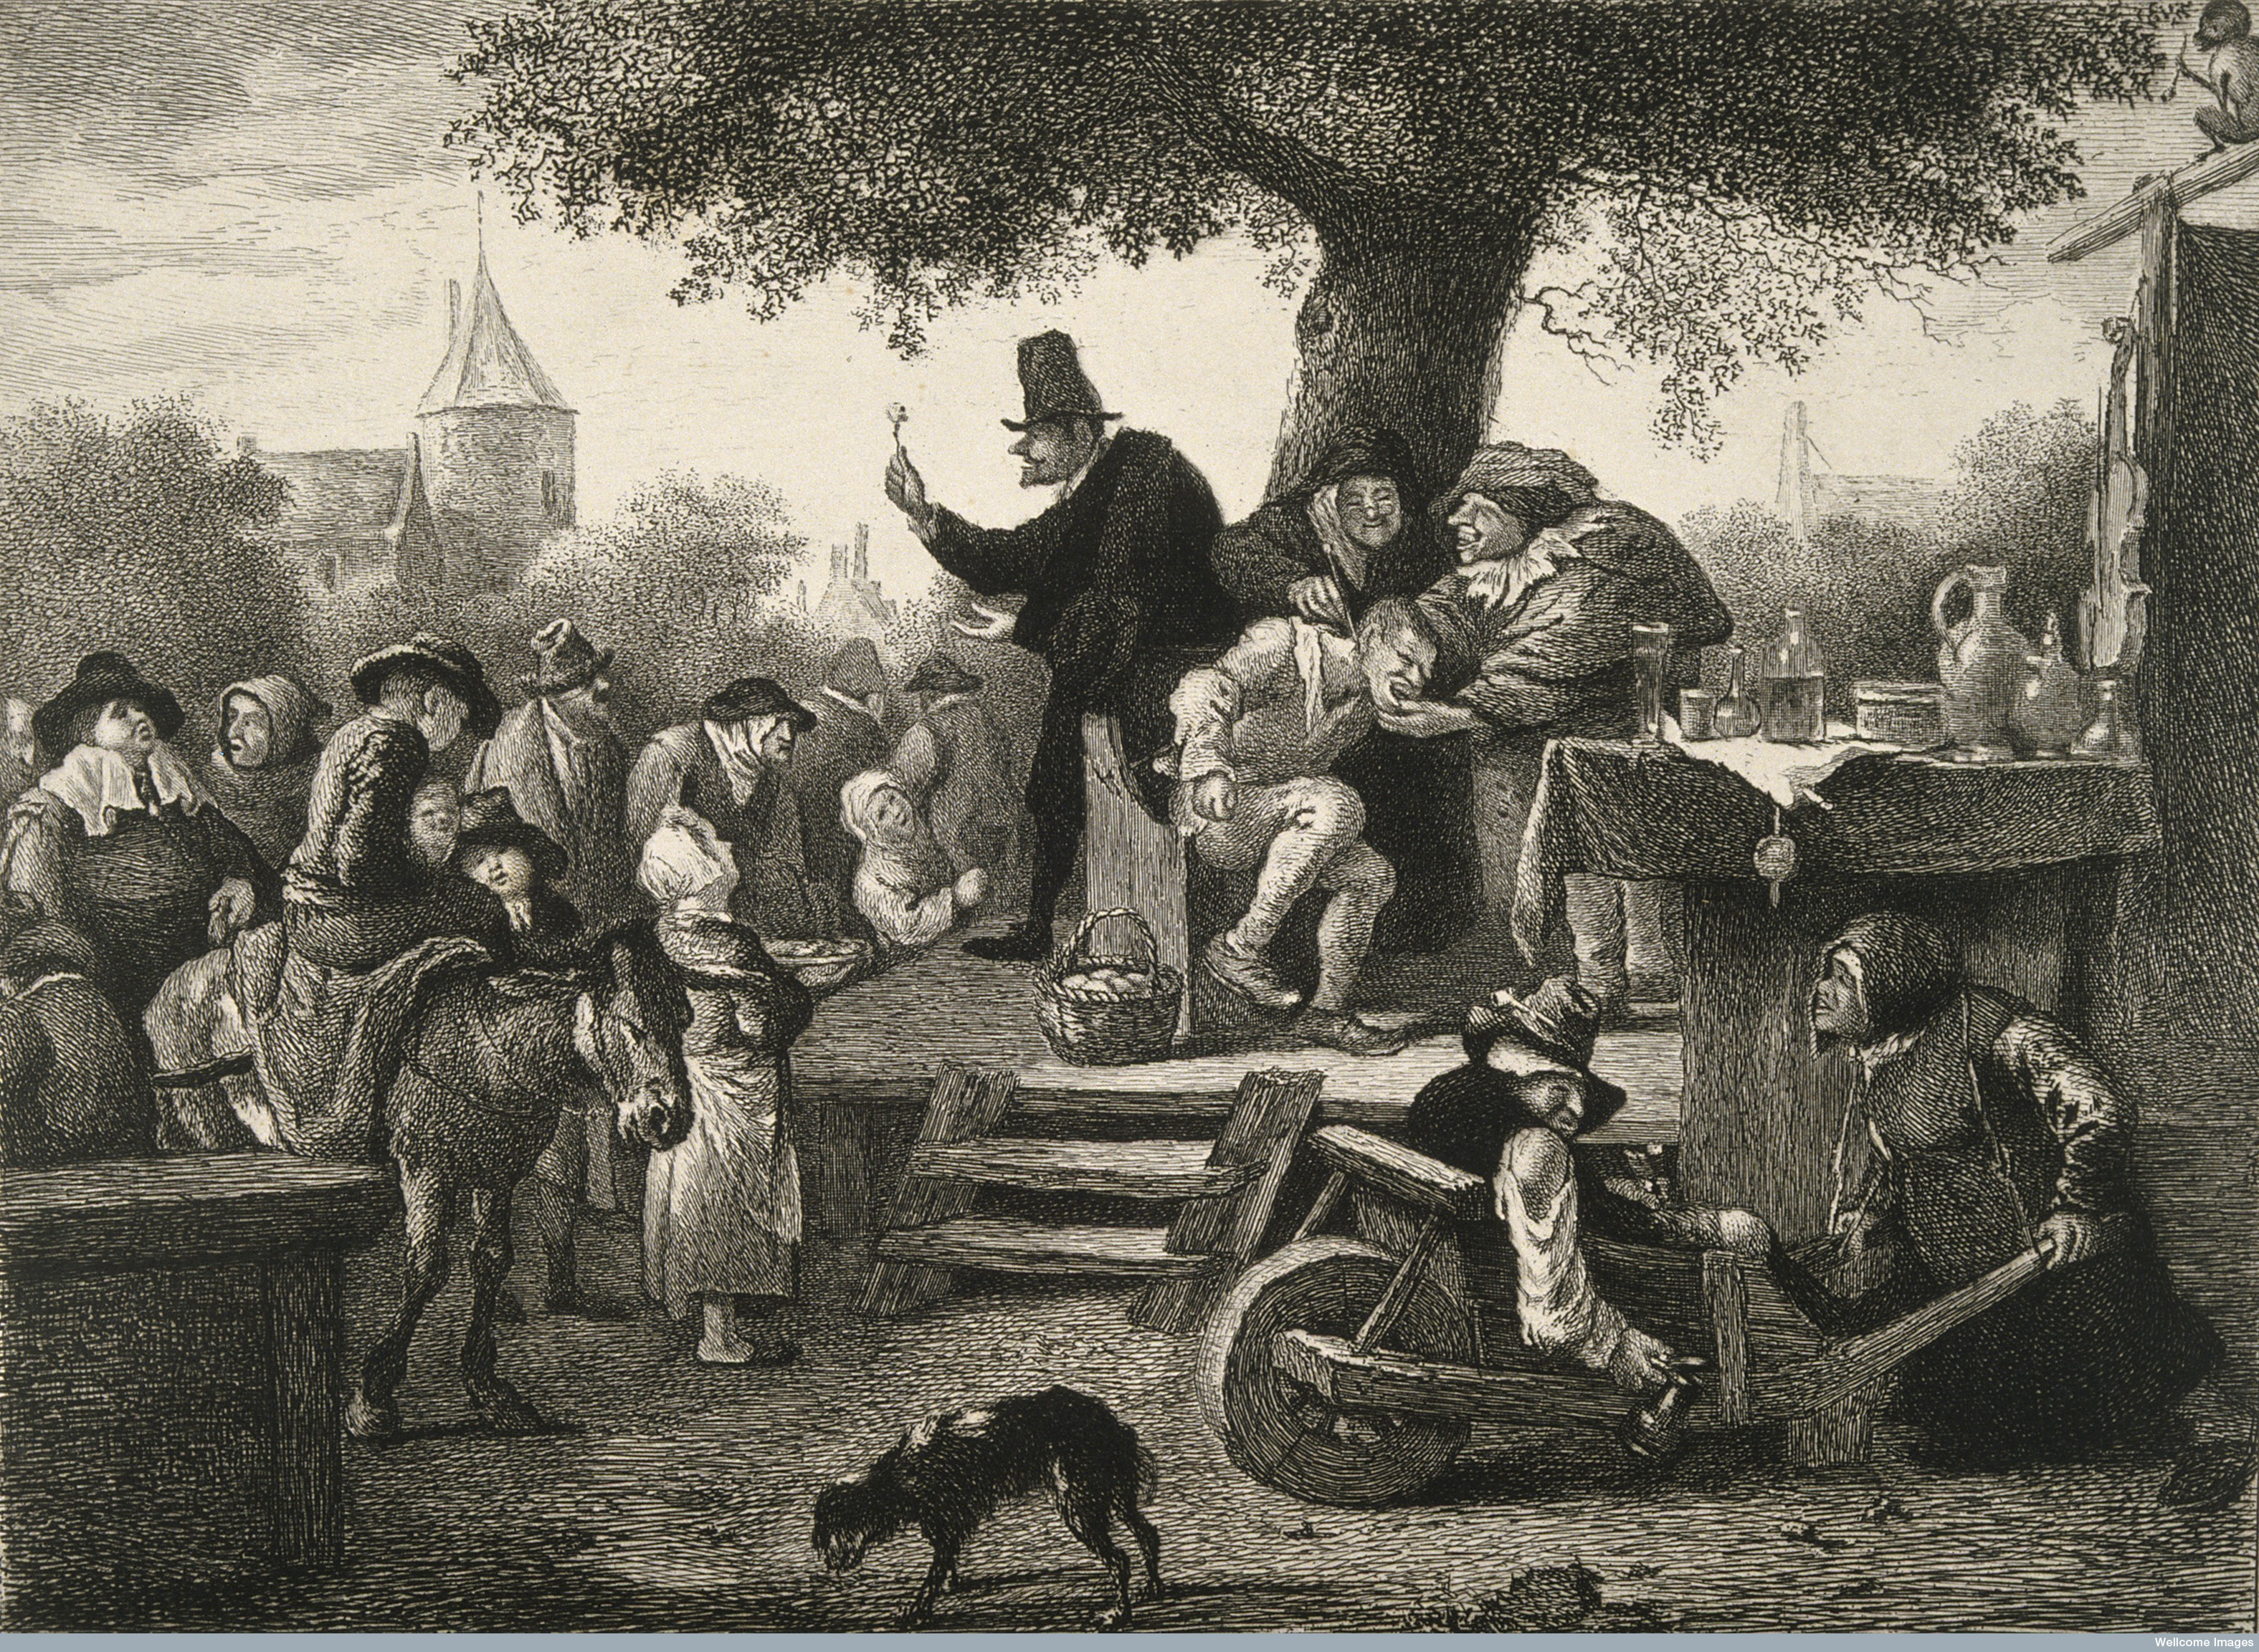
Recap: The Medical Marketplace
Medical professionalism develops with expansion of anatomical knowledge, medical training: College of Physicians of London (1518)
No monopoly: ‘folk medicine’, quacks, itinerant dentists, midwives, faith healers all compete with learned physicians.
Therapies of questionable value; reputations based on diagnostic skill, anatomical knowledge

Slide 3
Pre- ‘Scientific’ Medicine
Hierarchy of Causes:
Primary/Remote: Divine/Cosmological
Atmospheric/Environmental
Proximate/Immediate: Patient’s experiences, temperament, lifestyle, predisposition….
Miasmatic theory of causation (but disease only takes seat in certain individuals)
Holistic view of disease; affects whole body
Lack of disease specificity

Slide 4
From the Birth of the Clinic to Birth of the Laboratory: Observation, Pathology and Physiology
French clinical medicine focuses on observation: connecting symptoms to lesions
Diseases are situated in specific organs
Doesn’t explain the cause of disease (how do lesions appear?)
Rise of experimental medicine to study physiology: Francois Magendie (1783-1855) and Claude Bernard (1813-1878)
An Introduction to the Study of Experimental Medicine (1865)
Use of dissection, and vivisection, to show the function of organs in normal (healthy) and abnormal (diseased) states

Slide 5
An Introduction to the Study of Experimental Medicine (1865)
“In a word, I consider hospitals only as the entrance to scientific medicine; they are the first field of observation which a physician enters; but the true sanctuary of medical science is a laboratory; only there can he seek explanations of life in the normal and pathological states by means of experimental analysis… In my opinion, medicine does not end in hospitals, as is often believed, but merely begins there. In leaving the hospital, a physician, jealous of the title in its scientific sense, must go into his laboratory; and there, by experiments on animals, he will seek to account for what he has observed in his patients, whether about the action of drugs or about the origin of morbid lesions in organs or tissues. There, in a word, he will achieve true medical science. Every scientific physician should, therefore, have a physiological laboratory; and this work is especially intended to give physicians rules and principles of experimentation to guide their study of experimental medicine, that is, their analytic and experimental study of disease. The principles of experimental medicine, then, will be simply the principles of experimental analysis applied to the phenomena of life in its healthy and its morbid states.”
-Claude Bernard

Slide 6
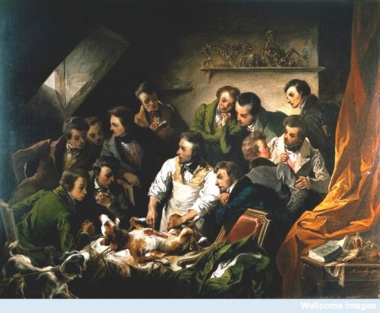
Vivisection and Physiology
Emile-Edouard Mouchy (1832)

Slide 7
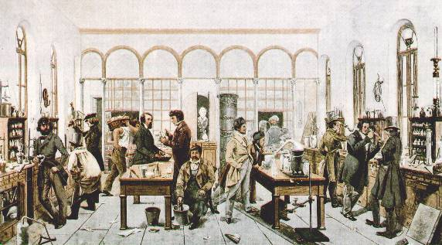
Medicine and Biochemistry
Liebig laboratory (1840)
Associated with mid-century German universities and research institutes
Justus von Liebig (1803-1873) and the body as chemical system
Measuring intake and output to determine internal processes
Rudolf Virchow (1821-1902) and cellular pathology
Disease as a dynamic process originating in the body

Slide 8
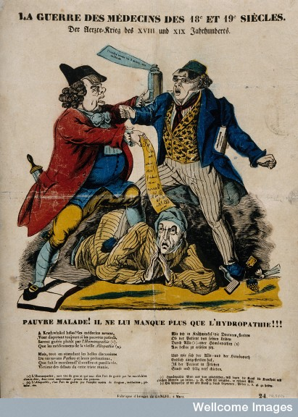
Homeopathy
Developed by Samuel Hahnemann (1755-1843) in 1810
Law of similars: ‘like treats like’
Law of infinitesimals: drugs become more potent the more they are dissolved.
Popular in nineteenth century, esp. in France and United States, but doesn’t withstand laboratory tests/clinical trials

Slide 9
Randomised Controlled Trials (RCTs)
Divides participants into groups, one of which receives drug/intervention, one of which is the ‘control’ group which does not.
System is blind; intended to reduce bias
First major RCT performed by Medical Research Council in 1948, ‘Streptomycin treatment of pulmonary tuberculosis’—statistical proof of treatment’s success
Later results more ambiguous; findings not always consistent, definitive.
Establishes ‘placebo effect’

Slide 10
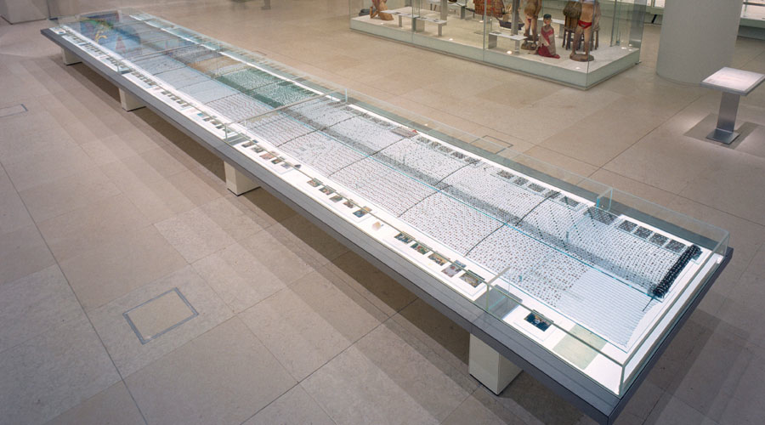
A LIFETIME OF PILLS
‘Cradle to Grave’ – Pharmacopoeia (British Museum)
http://cradletograve.org

Slide 11

Side Effects
https://www.youtube.com/watch?v=MzMqIGzXli8&feature=youtu.be&t=81

Slide 12
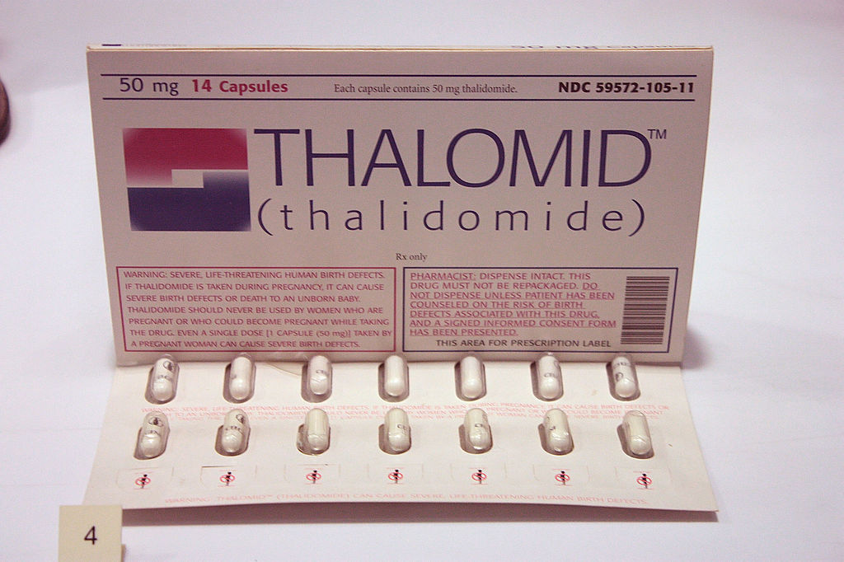
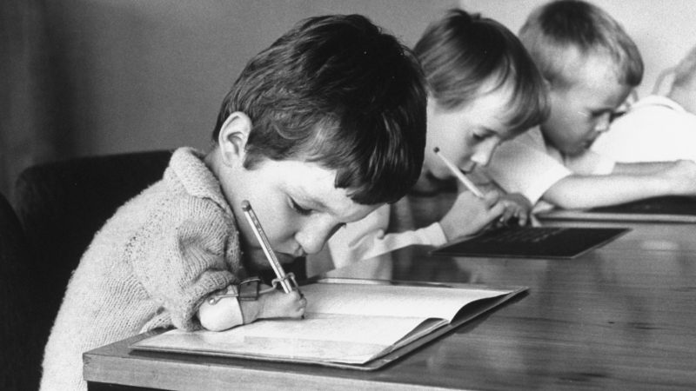
Thalidomide Scandal (1960s)

Slide 13
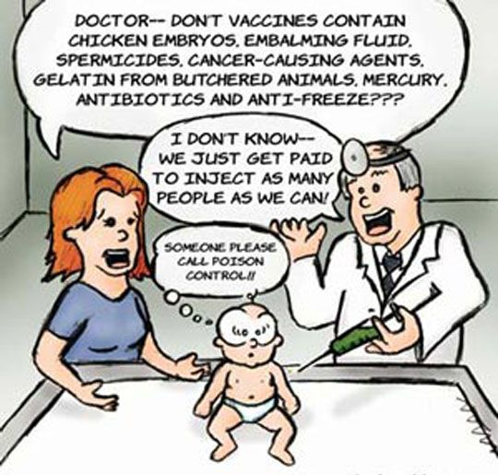
Backlash and Mistrust

