Slide 1
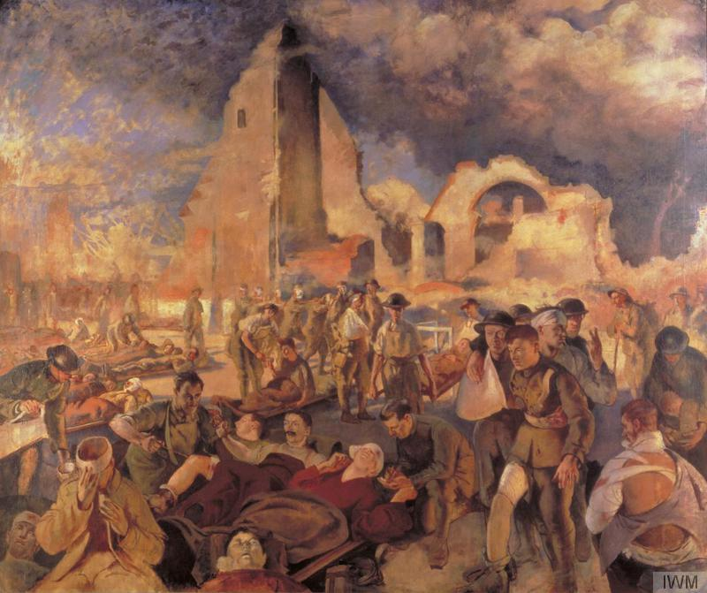
Military Medicine
Lecturer: Elise Smith
Mind, Body, and Society
Week 9

Slide 2
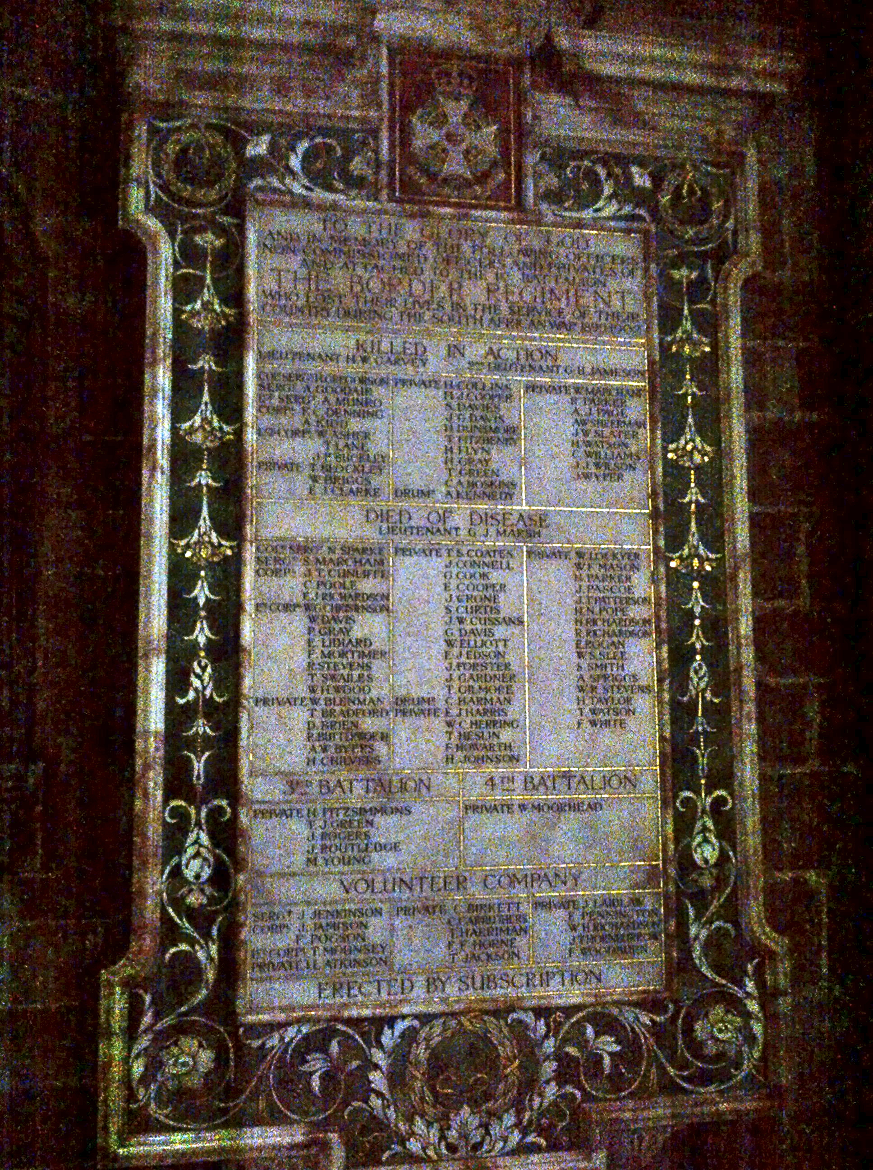
-Prior to the Russo-Japanese War of 1904-5, conflicts were marked by more casualties from disease than wounds.
-The prevention and treatment of disease has therefore always been central to military medicine.
-It has also focused on the maintenance of overall health of the armed forces, including mental and sexual health, and all areas of hygiene (diet, exercise, living conditions)

Slide 3
OUTLINE
The rise of military medicine
Imperial warfare and tropical medicine
Professionalisation and modernisation
Medicine and charity in wartime
The medical ‘balance sheet’ of war

Slide 4
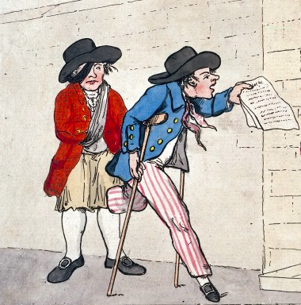
Military medicine pre-1850
The ‘military revolution’ of the C16-C17: technological and strategic changes create need for standing armies, organised navies.
The state provides care for professional soldiers and sailors, assumes (some) responsibility for those disabled in service.
Care for veterans a sign of state munificence and patriotism.
‘Two disabled veteran sailors’ (1790)
Wellcome collection

Slide 5

Hotel des Invalides, Paris (est. c.1678)

Slide 6

The Painted Hall, Royal Hospital for Seamen, Greenwich (est. 1694)

Slide 7
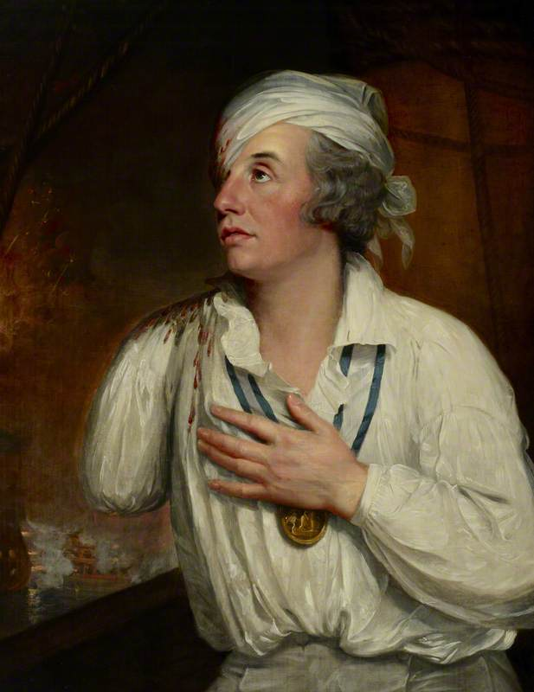
The state of Military Medicine, c.1800
Practitioners on limited contracts; often using military service as a form of professional advancement
Very little training; limited regulations; surgeons expected to supply own equipment
Expected to treat injuries; prevent, treat, and investigate disease (e.g. James Lind’s research on scurvy, c.1750)
No status in military (uniform, rank), but work with officers on hygiene provisions (cleaning, inspections, discipline)
Emphasis on disease prevention leads to reforms: improved diet, living conditions, sanitation, ventilation
Admiral Horatio Nelson, wounded at the Nile (~1800), National Maritime Museum

Slide 8
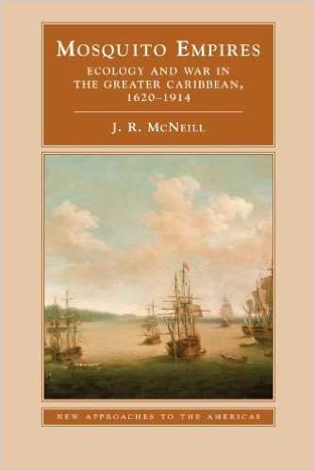

Military Medicine and Imperial Warfare
Exploration and colonisation lead to European encounters with new diseases, especially tropical diseases (malaria, yellow fever)
European armies/navies become vectors of disease: the ‘Columbian Exchange’
Tropical disease particularly becomes a factor in European warfare over colonies: e.g. successive epidemics determine control of Caribbean

Slide 9
‘The White Man’s Grave’
Philip D. Curtin has suggested that European mortality in West Africa was 30%-70% in the late C18, impeding efforts to colonise and control the continent.
Experience suggested that certain seasons and regions were less deadly: medical topography
Experimenting with treatments for tropical diseases: cinchona bark (quinine) ultimately proves effective for malaria—mortality halved through its use c.1850
American military researchers in Cuba determine mosquito is vector of yellow fever c.1901

Slide 10
Medicine and ‘Modern Warfare’
Civil War c.1860s: first industrial war, need to effectively mobilise resources, preserve manpower
Rapid professionalisation of military medicine: uniforms, pay raises, certification and training, officer status.
Harrison and Cooter: As military is modernised, medicine is ‘militarised’: becomes more hierarchical, regimented, discipline-focused: detecting malingering.
Emphasis on returning men to active service quickly and efficiently.
Structure of care follows industrial management: prioritisation, specialisation, assembly-line techniques

Slide 11

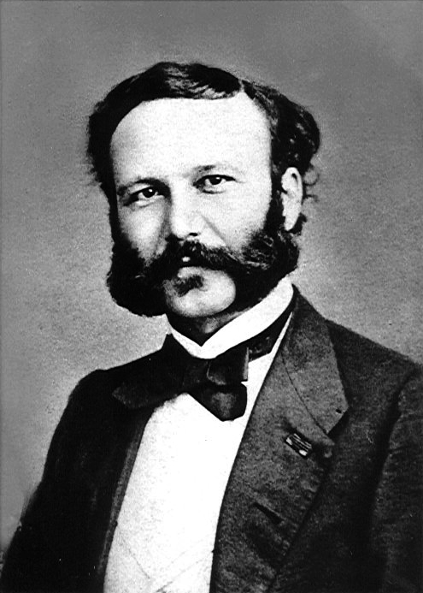
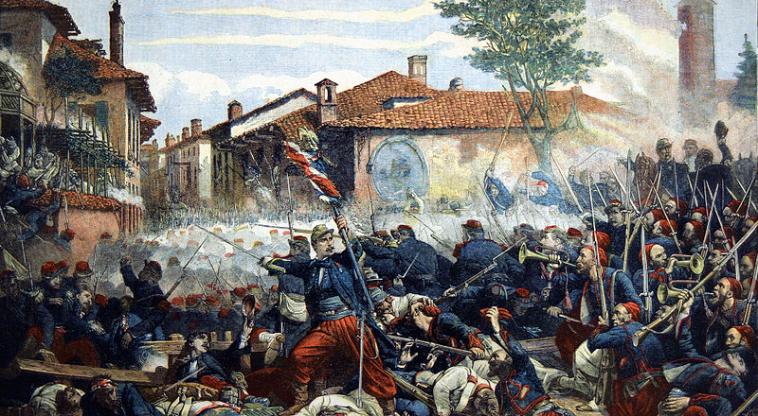
Military Medicine and Charity
Henri Dunant, A Memory of
Of Solferino (1862)

Slide 12
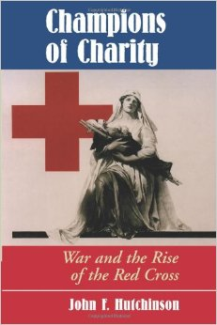
Charitable Interventions: Critiques
View that charities like the Red Cross absolved state of responsibility for care of wounded, disabled, and transferred burden of care from public to private hands (e.g. Florence Nightingale)
In the process using civilians to do the military’s work (harder to control provisions, training, etc.)
Theory that charities help to ‘humanise’ war: they reassure participants
Dependency on the state to operate means they are not neutral/independent

Slide 13
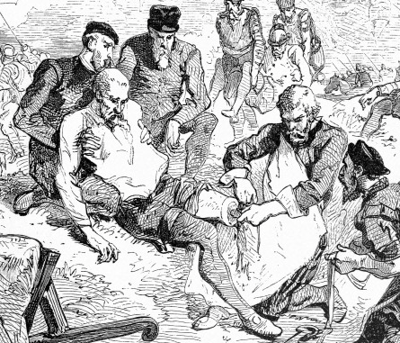
Is war ‘good’ for medicine?
INNOVATIONS:
  Ligatures (C16)
  Preventing scurvy
  Controlling tropical
    diseases
  Blood transfusions
  Treatment of shock
  Facial reconstruction
  Psychiatric theory
  Rapid treatment: casualty clearing stations, field surgery, airlifts, etc.

Slide 14
…the ‘goodness’ of war
BENEFITS:
  State funding and resources for medical research
  Catalyst for specialisations: orthopedics, psychiatry, cosmetic surgery
  Opportunities for women (doctoring, nursing)
  Civilian health improves in some ways: better nutrition in wartime (Jay Winter thesis)
  Emphasis on civilian welfare, particularly care of children, as their health is integral to nation’s future military vigour.

Slide 15
Problems
Some developments very limited (eg. treating gas-asphyxia)
Certain specialisations favoured; others (including care of women and children, chronic illnesses) lose out.
Funding dries up when wars are done—disabled veterans denied long-term care
Relationship between doctors and patients becomes adversarial as discipline a part of military medicine.
Loss of autonomy: medical ethics suspended (experimentation darkest side of military medicine)
Health of civilians may deteriorate during wartime as a result of shortages in provisions and care.

