Slide 1
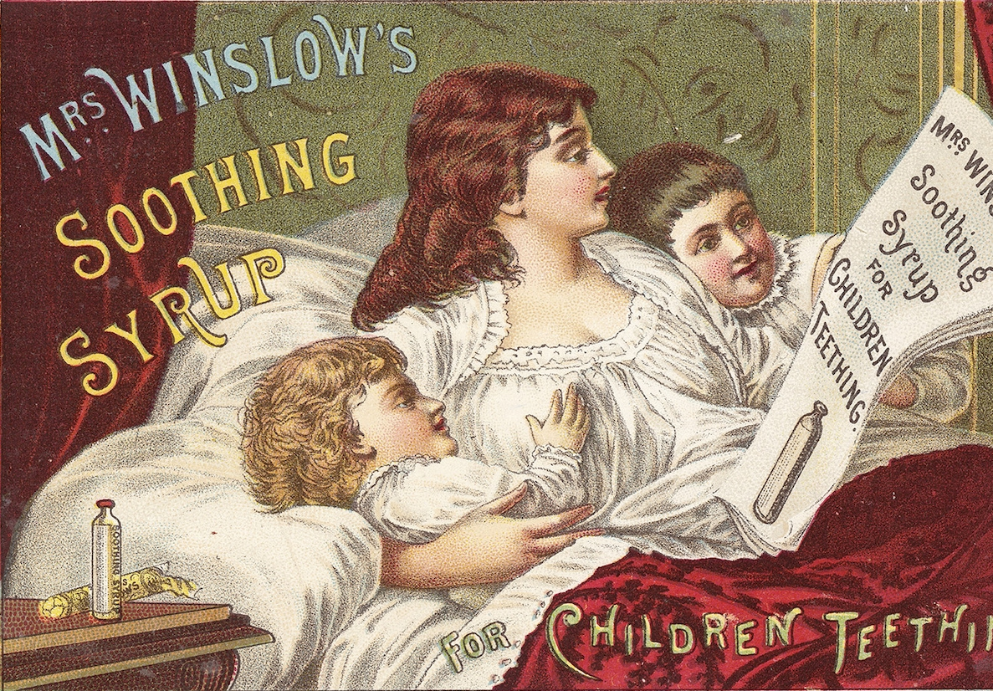
HI176 Mind, Body and Society
Week 3: Intoxicants
Dr Jamie Banks
jamie.banks@Warwick.ac.uk
FAB 3.52: Thursdays, 10.00 – 12.00

Slide 2
During this lecture (and seminar), you will develop an understanding of:
- The uses and importance of opium-based preparations in Victorian medical culture.
- Some of the reasons why access to opiate-based medicines was restricted during the nineteenth century.
- How broader social and cultural changes shaped the development of medical knowledge, and practice.

Slide 3
Much of this lecture is based on the core reading:
Virginia Berridge, ‘Victorian Opium Eating,’ Journal of Victorian Culture, 21.4 (1978).
An excellent starting point for further reading is:
Virginia Berridge, Opium and the People: Opiate Use and Drugs Control in Nineteenth and Early Twentieth Century England (London: Allen Lane, 1981).

Slide 4
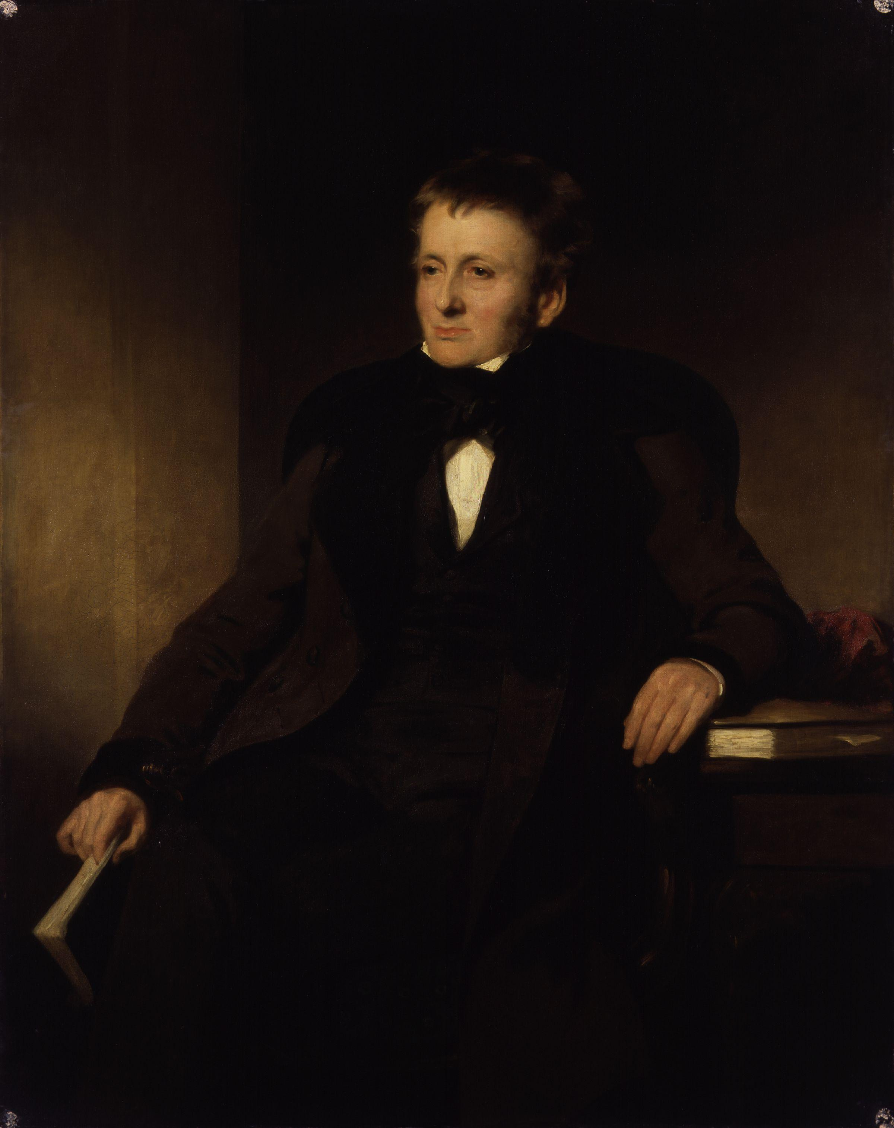
Opium & the People
- In the popular imagination, opium use is most readily associated with men such as De Quincey, who penned The Confessions of an English Opium Eater.
- De Quincey, however, was symptomatic of the freely used, and widely available, nature of opium during the nineteenth century.
- Opium was the drug of the people in early-to-mid Victorian era, offering many a cheap, readily available, and easily administrable form of treatment.

Slide 5
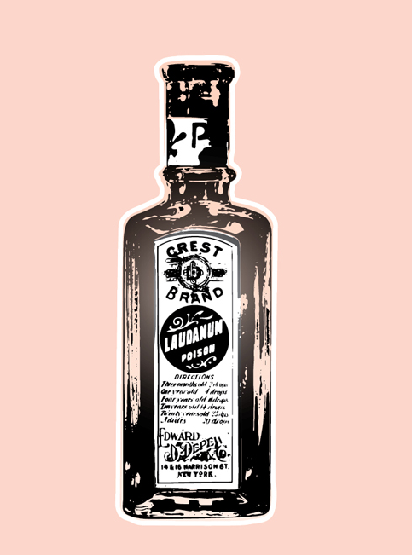
What kinds of Preparations Could People Buy?
A noted by Berridge, a wide variety of different opiate-based medicines were available during this period. The most common were raw opium and laudanum.
Raw Opium: was the unprocessed gum exuded from poppies. This was often sold “penny sticks.”
Laudanum: was a tincture of opium, dissolved in alcohol.
These were just two amongst a wide range of preparations, including: “opium with chalk, Dover’s powder, opiate confection, tincture of soap and opium, opium vinegar, troches of liquorice with opium, liniments, paregoric tincture, suppositories, and clyster, etc.”

Slide 6
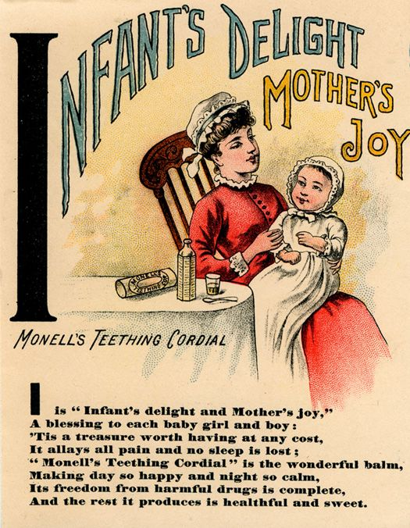
Patent Medicines
Victorians could also purchase a wide variety of ‘patent medicines,’ containing varying quantities of opium compounded with other substances. Examples included:
Dover’s Powder: a mixture of opium and ipecac, often used to induce sweating and treat the onset of fever.
Jeremie’s Opiate: a mild opium-based preparation, used to treat a variety of different ailments.
Godfrey’s Cordial: a mixture of laudanum and sweet syrup/molasses, often used to sedate children.
Paregoric: a mixture of opium and camphor, used to soothe various forms of cough.

Slide 7
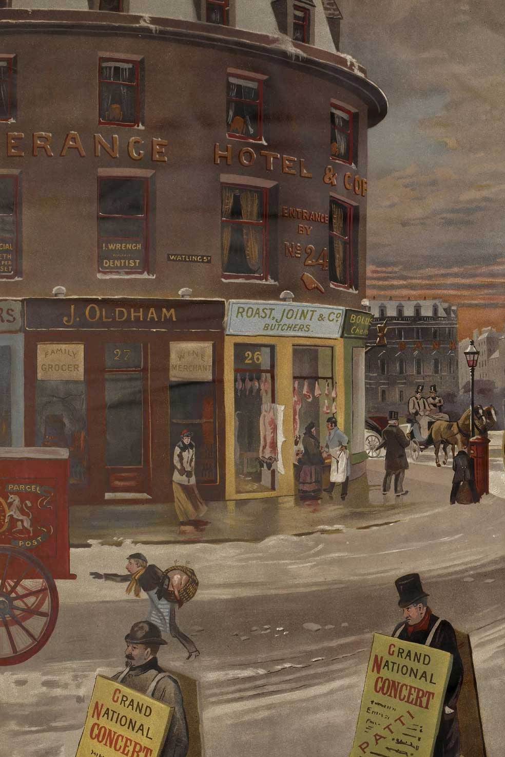
Where could people buy them?
- Until the introduction of the Pharmacy Act in 1868, there were no regulations respecting who could buy or sell opium.
- In consequence, opium preparations were freely available for all sorts of shops, including apothecaries and chemists, but also grocers, corner-shops, and even country traders and hawkers.
- This made opium very easy to procure but it also meant its was, at times, sold without sufficient care or attention.

Slide 8
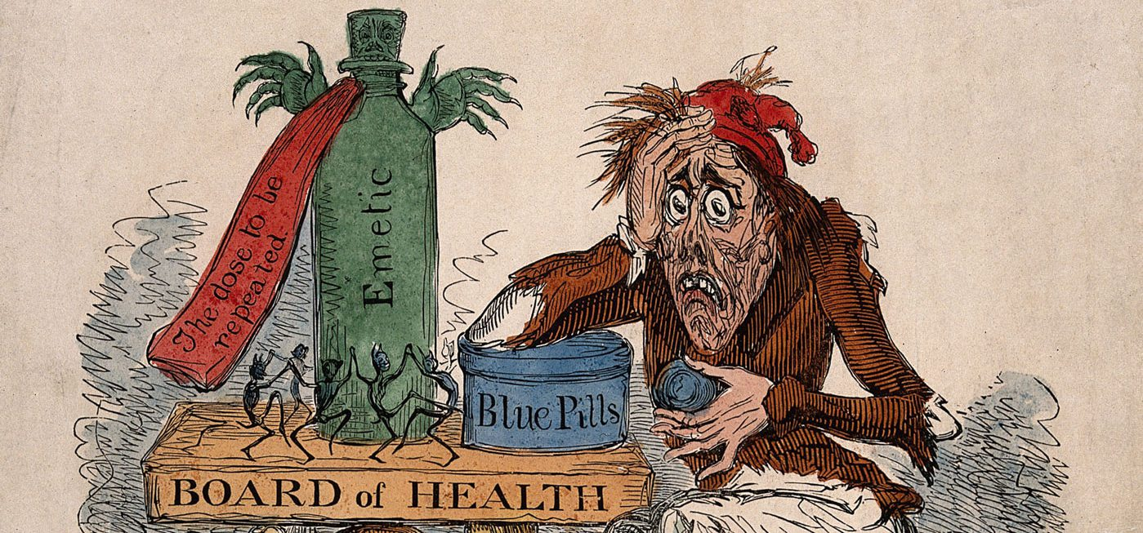
Why did people use them?
As Berridge suggests, its perhaps quicker to list the conditions that opium was NOT used to treat. Some of the most common were:
- Pain: Opium is an incredibly effective analgesic, used to manage the pain which accompanied all forms of ailments.
- Gastro-intestinal illness: Opium causes a reduction of bowel movements, useful in treating diarrhea, dysentery and cholera.
- Fevers: There was much debate about whether opium was a febrifuge, often being used by those suffering from ague on the Fens.

Slide 9
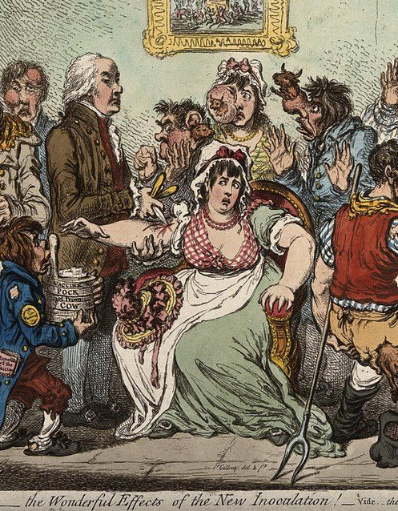
The Bigger Picture
Beyond opium’s pharmacological properties, there were several broader reasons why Victorians relied upon opium, such as:
- a lack of access to proper medical care throughout much of this period.
- the lack of specific courses of treatment for a wide range of illnesses.
- the cheapness of opium, relative to the costs of medical services.
- a longer cultural-tradition of self-medication, and medical autonomy.
- a suspicion of medical intervention and authority.

Slide 10
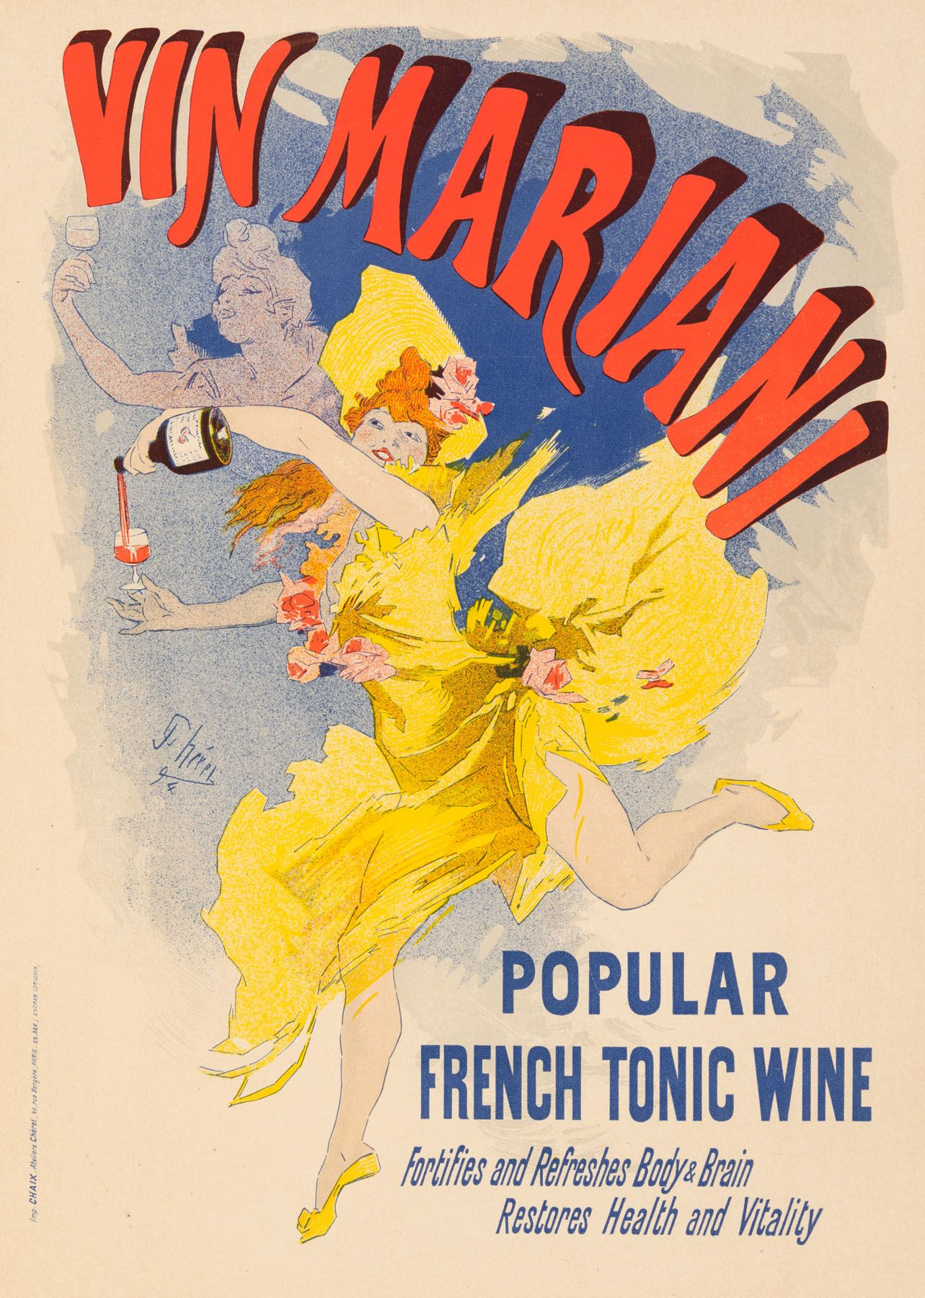
Cannabis & Coca
Besides opium, preparations of coca and cannabis were also experimented with in Britain and the US.
- By the 1880s, Spillane notes that coca tonics were the most common form of packaged remedy in the US, often combined with other stimulants such as alcohol.
- Similarly, Mills notes that following the experiments of William O’Shaughnessy, cannabis was used in the treatment of both “female complaints” and insanity.

Slide 11
Regulation
- By the end of the 1800s, the once unregulated and wide-available market for opium-based remedies in Britain came under increasing forms of restriction.
- This represented the convergence of a variety factors, including: moral panics, the ‘professionalization’ of medicine, changes in medical knowledge and practice, and the influence of British imperialism.
- Together, these factors illustrate both changes in medical practice and how these were rooted in broader social and cultural changes in Victorian society.

Slide 12
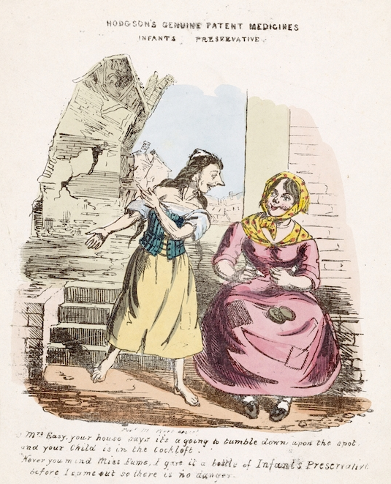
Moral Panics
Attitudes towards opium were hardened by the often tragic (and increasingly sensationalized) consequences which occasioned improper use, including:
- Self-poisonings: often due to a lack of standardization and the haphazard sale of these preparations.
- Infanticide: arising from the use of opiate-based syrups, such as Godfrey’s cordial, by working mothers to sedate children.
- Crime: specifically, concerns that opium was being used to facilitate the commission of robberies, etc.

Slide 13
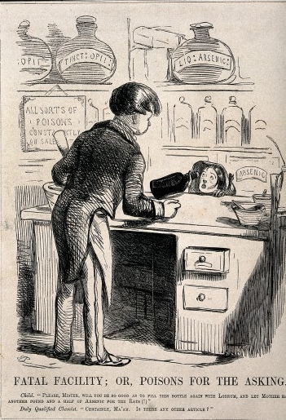
The Professionalization of Medicine
Growing calls to restrict access to opiate-based medicines also aligned with the ‘professionalization’ of various branches of medicine.
- As early as 1841, the Pharmaceutical Society sought to create a professional body to support and further its interests.
- In seeking to emphasis their ‘transformation from ‘tradesmen to medical professionals’, pharmacists demanded a monopoly over the right to sell certain “poisons.”
- This was partly achieved through the Pharmacy Act of 1868, which restricted who could sell various poisons, such as arsenic, as well as the need for their effective labelling.

Slide 14
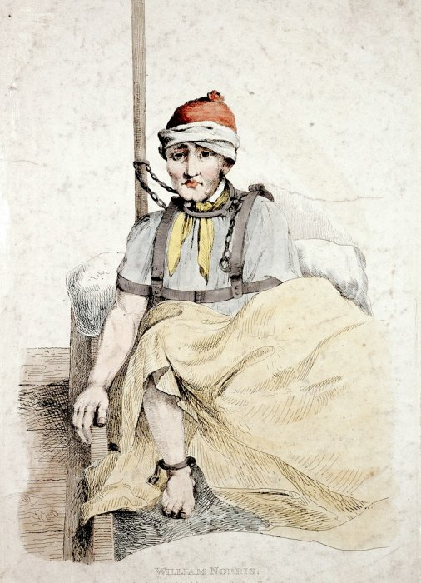
Changing Practices
The 19th century also saw fundamental changes in contemporary medical practice. This included the more sparing use of opium, due to questions about its efficacy. For instance:
- Opium’s use as a sedative was increasingly usurp by newer and (seemingly) less-harmful substances, such as Quinine, Chloral Hydrate, and Bromide.
- There were growing, ethical concerns about the use of intoxicants as a form of ‘chemical restraints’ in Victorian Asylum, which was seen to go against the principles of ’moral management’
- Opium’s efficacy as a treatment for diseases such as cholera was increasingly called into question, both in both Britain and India.

Slide 15
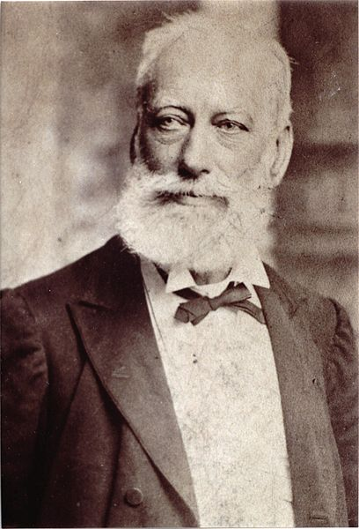
The Emergence of ‘Addiction’
The last quarter of the 19th century also saw the emergency of new ideas about the effects of drugs such as opium, most notably the ‘disease theory of addiction.’
- Prior to this, the habitual use of drugs was seen as a ‘moral failing,’ attributable to individual failings rather than the pharmacology of a certain substance.
- Increasingly, however, men such as Norman Kerr (pictured) argued that substances such as opium caused ‘addiction’, which needed to be managed and treated by medical authorities.
- Despite this, the dichotomy between addiction as a ‘disease’ and a ‘vice’ was never absolute, with close ties between Kerr and temperance organizations.

Slide 16
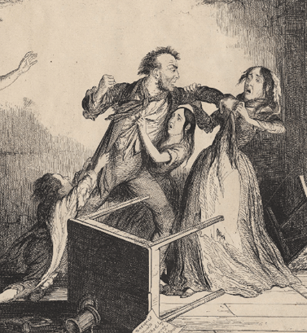
Temperance
Specific anxieties about opium were also underpinned by broader social, cultural, and political concerns in Victorian Britain. There were manifested in social and cultural influence of the “temperance” movement.
- Temperance societies had existed since the 1600s, but the Victorian-era saw them become major arbiters of social and political change.
- Initially concerned with alcohol, various societies also became interested in the ‘intemperate’ consumption of substances such as opium.
- As noted, there was also a close relationship between temperance societies and addiction specialists, with the moralism of temperance bleeding into the disease theory of addiction.

Slide 17
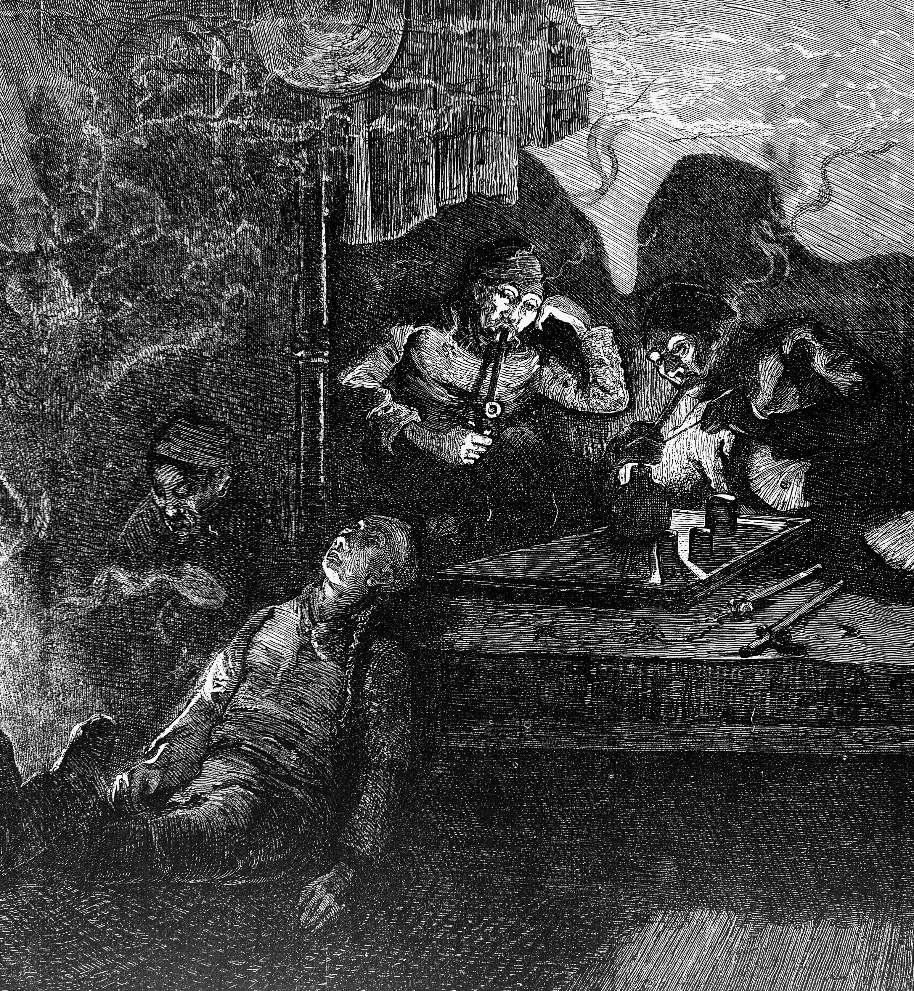
The Empire Strikes Back
The temperance campaigns of the 19th century also “exposed” how the consequences of empire were increasingly felt in the metropole. Most notably, the growing presence of Chinese communities in London.
- An increasingly common genre of temperance tracts in the Victorian era were investigations into ‘Darkest England,’ which exposed the middle-classes to the alien existences of their lower-class counterparts.
- This included those living in close-proximity to the urban poor, such as the Chinese seafaring communities of the East End, who smoked opium as a pastime.
- In stressing the ‘exoticism’ and ‘otherness’ of such practices, these accounts increasingly presented opium as ‘foreign vice’, to be avoided by the respectable classes.

Slide 18
Conclusions
- A wide array of opiate-based preparations were freely available to purchase in the early-to-mid 19th century.
- These were used to treat a variety of different ailments, in the absence of affordable access to medical ‘professionals’
-Growing concerns about these preparation reflected moral panics about misuse, as well as changing ideas about medical and medical practice.
- They also reflected broader social ideas about individual self-restraint and fears about the consequences of empire.

