Slide 1
Mind, Body and Society
Lecture 9, term II, 2025
The History of the History of Medicine
Dr Claudia Stein

Slide 2
What are we going to look at today? The Historiography of Medical History
‘Historiography’ has two meanings:
1. A body of work written on a specific historical topic (e.g. the historiography of the history of anatomy or the historiography on the history of medicine and war)
2. The study of the changing theories and methodology used by historians and the development of history writing as an academic discipline.
We are going to focus on the second meaning of ‘historiography’: the changing theories and methodologies historians of medicine have been using since the field became a discipline at the beginning of the 20th century.

Slide 3
History as an academic disciplines uses many different theories and methodologies
Theory:
A theory is a system of assumptions posited to explain a specified set of phenomena, past and present.
Methodology:
A methodology is often a whole set of methods developed in line with a theory about. Methodologies help to research the theoretical claims (e.g. statistics, written documents, visual or material objects, oral history).

Slide 4
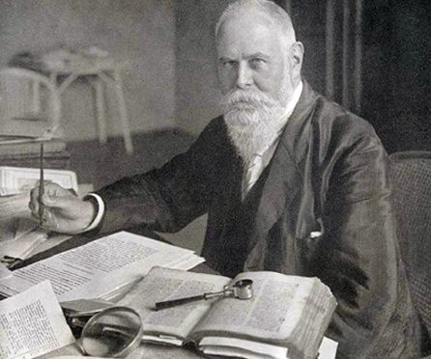
When does the history of medicine as a discipline begin?
Sudhoff, a practicing physician himself. founded the first
Institute for the History of Medicine in Leipzig/Germany
in 1906.
‘History’ becomes part of the education and training of physicians.
Sudhoff’s focus was on classical,
medieval and early modern
medicine. His sources were
mainly ‘written’ sources (in Latin, Greek). The aim was to translate sources and check whether they were original. (philology).
But he was also a ‘big’ promoter
of the field in the wider public and loved to deal with material objects
Karl Sudhoff, 1853-1938

Slide 5
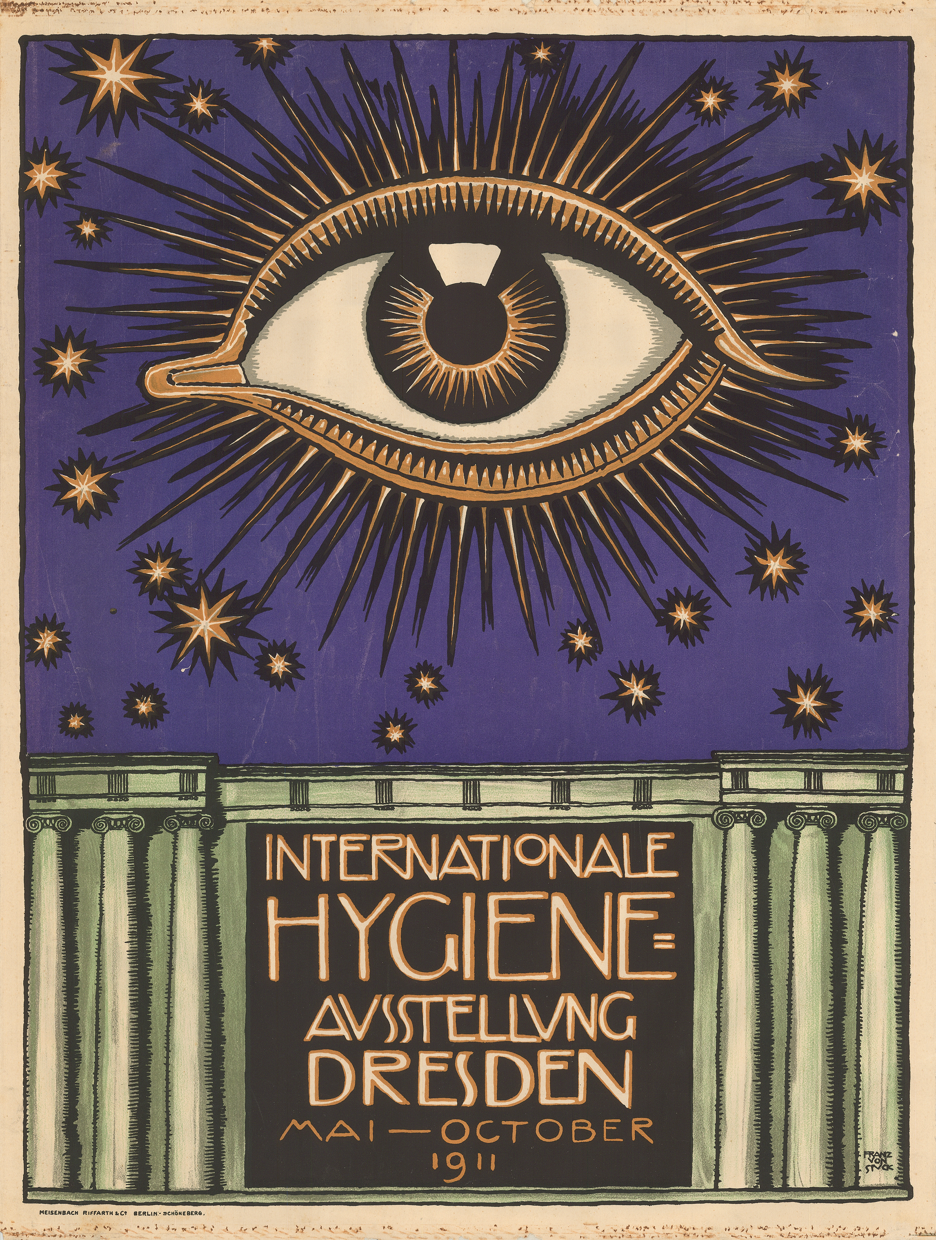
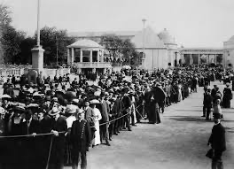
He organized the historical and ethnological section at the Internation Hygiene Exhibition
Dresden in 1911
5 million international visitors came to see it

Slide 6
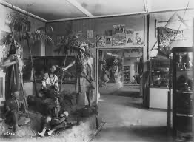
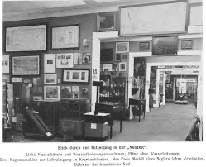
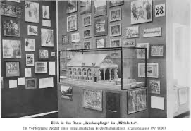
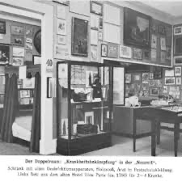
Sudhoff’s sections were the biggest success of the entire exhibition…

Slide 7
Sudhoff believed that the most important task for a historian of medicine was not to simply empirically collect source materials (written sources in libraries and archive or objects from museums) but to understand through the source the collective ‘spirit’ of the period in which these sources were produced.
The historian was to ‘identify’ what ‘spirit’ (Geist) – perhaps we might say zeitgeist today – drove people in the past to write their texts and produce the objects.
He believed each historical period was governed by a special ‘spirit’ which infused meaning to all human products in that period. This spirit was not visible or understandable to the people in the past but could be ‘divined’ by the historian through their engagements with the sources.
Sudhoff’s history and that of his time was a history of the medical profession and
its discoveries.

Slide 8
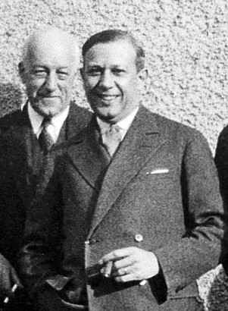
History of medicine as ‘social history’
Born in Paris of Swiss parents, Sigerist grew up in Paris and Zurich. He then studied philology at the University of Zurich and oriental languages at University College and Kings College, London. He returned to Zurich to complete a medical degree and served as a medical officer in the Swiss army. He then worked with Sudhoff in Leipzig
Director at John Hopkins University
Institute for the History of Medicine,
1932-1937
He believes in ‘social medicine’ (i.e. medicine for all) and is fascinated by the medical system of the USSR.
His 1937 book, Socialized Medicine in the Soviet Union, created a sensation. Sigerist portrayed the radically transformed health care system of the Soviet Union as a model for public health and medical care worldwide, the final stage in a long historical evolution of health care organization.
Henry E.Sigerist, 1891-1957

Slide 9
The History of Medicine before 1960s:
the analysis of text (very much focused on classical, medieval and early modern medicine)
History that focused on ‘thinking’ rather then medical ‘practice’; besides exceptions such as Sudhoff, history of medicine focusses on written sources.
History of ‘great men’, predominantly male doctors and scientists who progressively moved medical thinking and practice forward
In sum: history was to celebrate the success of medical progress and discoveries

Slide 10
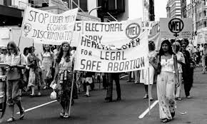
Everything changes in the 1960s and 70s……
Civil rights movement, women’s liberation movement. anti-war movements, anti-psychiatry movement, decolonization process.....traditional authorities were challenged (including that of the medical, mainly male, establishment).

Slide 11
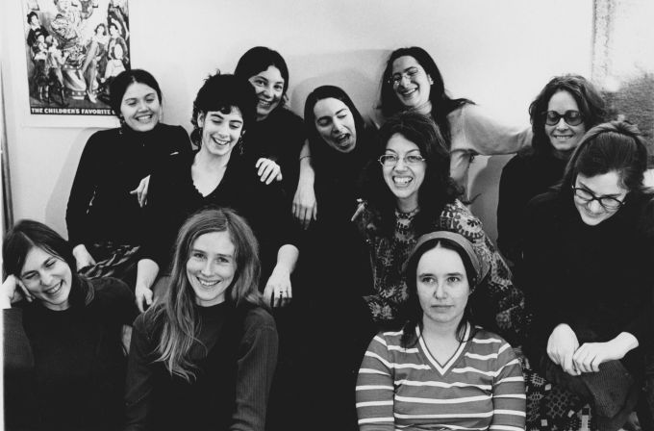
Founding members of ‘Our Bodies Ourselves’ of the Boston Women’s Collective

Slide 12
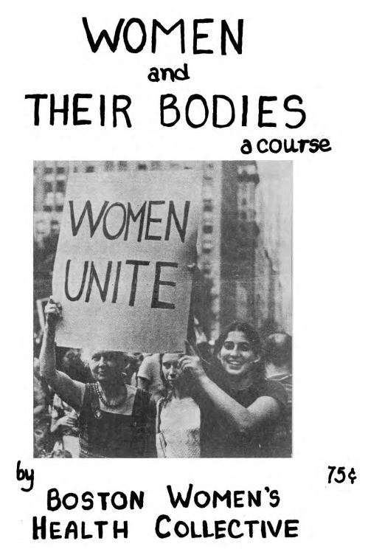

Slide 13
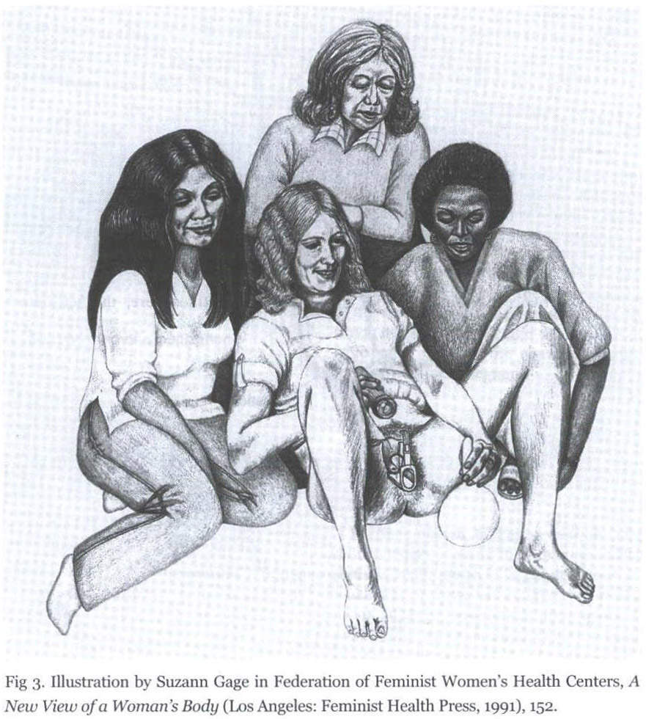
Vaginal self-examination
groups as a way to explore the female body and defy male medical domination over it
To know your body is to
have power! Look at your body
And be proud!

Slide 14
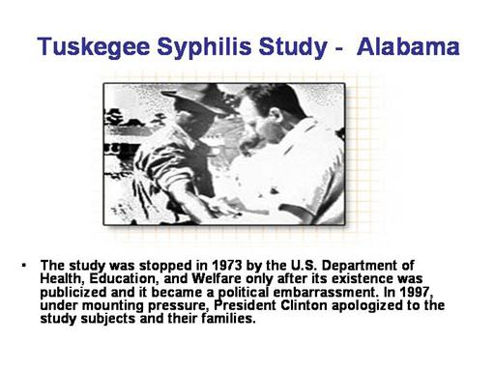
The authority of modern medicine is also shattered by various medical scandals…

Slide 15
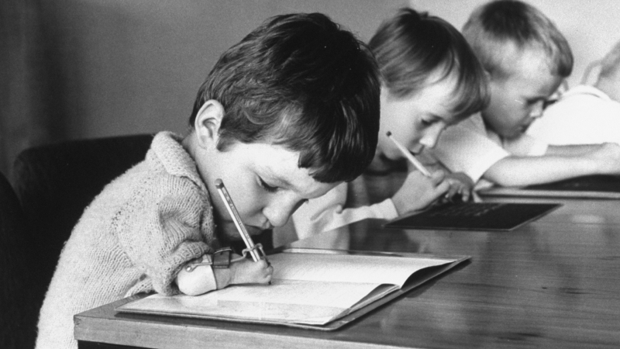
Thalidomide Scandal 1960s

Slide 16
This leads to a fundamental critique of the medical profession and the questioning of its ‘great heroes’ and progress stories produced by historians of medicine
Niklas Jewson, ‘The Disappearance of the Sick Man from Medical Cosmology’, Sociology, 10 (1976), 225-44
Ivan Illich, Limits to Medicine (1976);
-- Medical Nemesis: The Expropriation of Health (1974)
Influence of (neo)-Marxist understandings of power and historical development; everything is based on economic structures of a given society; suppression of the working classes (proletaria) by the economic elites (bourgeoisie). Medical doctors are identified by Marxists as central to the oppressive system of the bourgeoisie)
This neo-Marxist view is reflected in the term: Medicalisation
def. the process by which nonmedical human conditions and problems (being gay, or having a liking for alcohol) come to be treated as a biological condition, and thus turned into subjects of medical study.

Slide 17
The rise of a ‘new’ social history from the 1970s
Characteristics of the ‘new’ social history of medical history in the 1960s:
Medical historian are not long necessarily doctors but increasingly trained historians
Medical history used as a way ‘to empower’ those who are suppressed and exploited by the medical system (women, black community, indigenous groups, etc.)
Historians often on the political liberal left; neo-Marxist, this has effect on their understanding of how they understand how ‘power’ works (e.g. patient voice is ‘silenced’ by the medical profession).
A tendency to use sociology as an theoretical inspiration and method for work (quantitative data, sociological models and theories to explain how medicine operates in society, past and present.

Slide 18
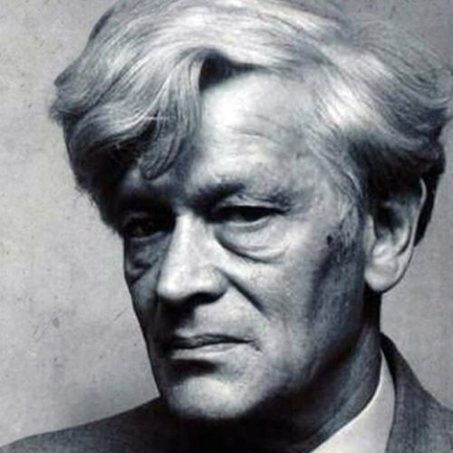
The ‘new’ social history of medicine is also shaped by developments in wider history writing in the 1970s: the history ‘from below’
The Making of the English Working Class,
1963
Aimed at discovering the ‘experience’ of the poor and neglected in history
The ‘history from below’ inspires many
Historians of medicine, particularly
early modernists
Re-discovery of that the power of history is its ‘story-telling’
But the new social history is still
focussed, mainly on Europe
Edward Palmer Thompson, 1924-1993

Slide 19
‘Cultural Turn’ from the 1980: the Cultural History of Medicine
Anthropology
The study of humans, past and present. It aims to understand the complexity of cultures across all of human history and thus draws and builds upon knowledge from the social and biological sciences as well as the humanities and physical sciences.
Influential is the work of the American anthropologist:
Clifford Geertz,’ Thick Description: Towards an Interpretative Theory of Culture’, in ibid, The Interpretation of Culture: Selected Essays (1973)
Major impact on the history of medicine. More interest in other cultures of medicine than European medicine.
Arthur Kleinmann, Patients and Healers in the Context of Culture (1980)

Slide 20
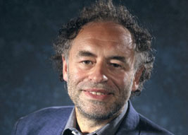
The ‘new’ cultural history of medicine
Porter’s article, ‘The Patient’s View: A History from Below’ is excellent example to see how scholars moved from the ‘new’ social history to ‘cultural’ history
Focus:
No longer only on Europe
Interest in the middling classes (no longer the only the poor and opressed)
Interest in medical ‘knowledge’ and how it is produced through medical ‘practices’ (no longer on ideas or institutions
Interest in new sources: material and visual culture of medicine (not only written sources)
Roy Porter, 1946-2002

Slide 21
The question of ‘power’and how it relates to ‘knowledge’ becomes central
The turn to a ‘cultural history of medicine’ also meant a turn away from a
Marxist-inspired understandings of ‘power’ (e.g. in the hands of a group of people (ruling class) or institutions; oppressive and cohersive (power is ‘negative’); some have power – some don’t; power relies on economic dominance; economic equality will be achieved – one day – through a revolution of the oppressed.)
Cultural historian increasing get interested in the question whether the use of ‘language’
is an ’act’ of power. How does everyday language but also language used in the sciences (such as medicine) is always an expression of power? Can language – an invention by humans --actually represent?
reality?
Linguistic Turn:
Analytical turn which problematized of language used in a given field of study. Also used to refer to the ‘turn’ to linguistic and language philosophy in the 20th century in the humanities and social sciences. It really takes off after WWII.

Slide 22
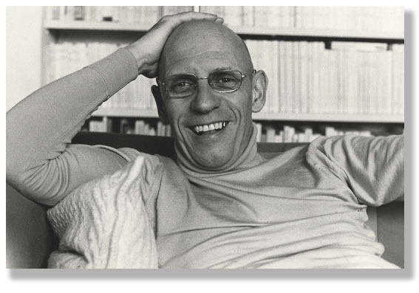
The most influential philosopher of language and historian who re-shaped the history of medicine
Michel Foucault 1926-1984

Slide 23
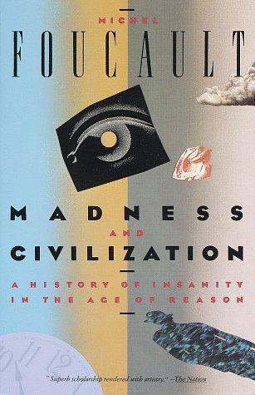


Foucault’s philosophical works are all ‘histories’ and most of the them dealt with the medicine and the life sciences from the Middle Ages to the present
Central Claims:
Foucault rejected Marxist understanding of power (eg. power is in the hands of a group of people who then suppress others groups)
He suggest that power is not necessarily oppressive but also seductive: it is ‘fun’ or pleasant and we do it to ourselves.
Power is always directed at the human body, aiming at making it ‘docile’ and obedient.
Power is always related to knowledge
Medicine/life sciences are central players in these strategies of power to make the human body docile
Medical/life sciences knowledge is not ‘neutral’ or ‘objective’ but part of the complex nexus of ‘power/knowledge’
Scientific/medical knowledge is not universally true; knowledge is not ‘discovered’ but always relative to specific society. Knowledge is not progressive.

Slide 24
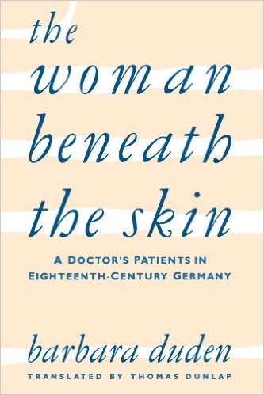
From the 1980s, the rise of a new trend in
the history of medicine
The History of the Body
The history of the body looks at how our
Current understanding of the body emerged in history.
it claims that the knowledge that is produced about the body is ‘relative’ to the time in which it is discussed – the understanding of the body is ‘socially-culturally’ constructed.

Slide 25
Where are we now? We are still doing a socio-cultural history of medicine but there are new trends….
Global approaches (global cultural history of medicine; drug trades; indigenous medical knowledge)
Medicine and health consumption/consumerism
Material and visual culture of medicine
Animals in the history of medicine
The history of emotion (developed out of the history of the body)

