Slide 1



TRACING THE CHILD: Minds, bodies, and emotions in twentieth century britain
Dr Jennifer Crane, Centre for the History of Medicine, University of Warwick

Slide 2
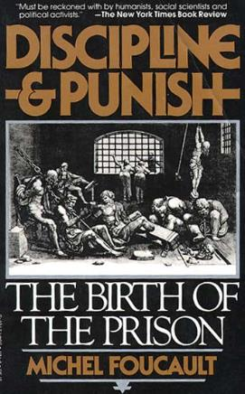
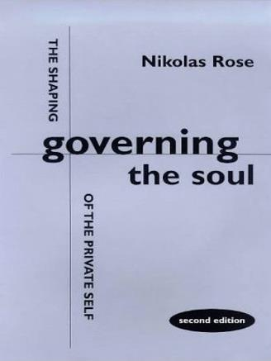
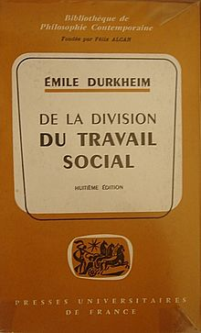
Does psychology only operate ‘from above’?

Slide 3
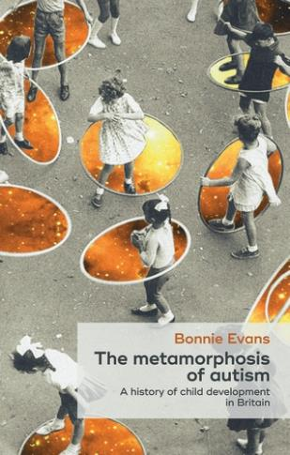
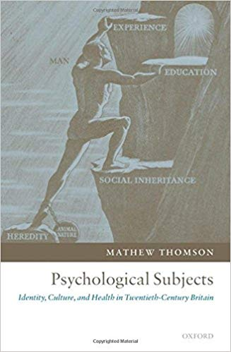
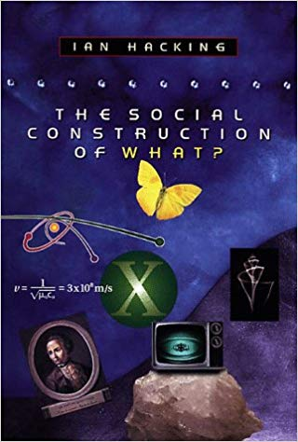
Does psychology only operate ‘from above’?

Slide 4
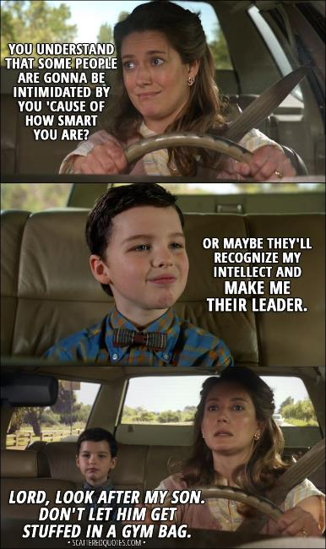
Does psychology only operate ‘from above’?
NO!
Psychology – and power – operate in complex ways. Members of the public criticise, reshape, negotiate psychological and medical practices in nuanced and multiple ways.
This becomes visible in my own research project into the experiences and emotions of gifted children . . . See excerpt from TV programme Young Sheldon across. . .

Slide 5
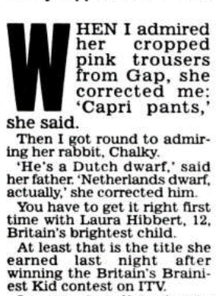
Children have challenged, accepted, and reshaped medical, psychological and political classifications
Daily Mail article, 2001

Slide 6
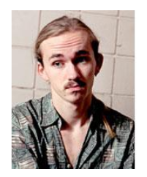
Children have challenged, accepted, and reshaped medical, psychological and political classifications
1971: American businessman Robert Graham establishes ‘Repository for Germinal Choice’, aiming to disseminate the sperm of Nobel Prize winners and geniuses to families in America. . .
240 children are born following use of this sperm bank
One of these children, Doron Blake, reaches 18 in 2001. He gives media interviews, notably with Slate, criticising the idea of ‘genius’. He states that: “The fact that I have a huge IQ does not make me a person who is good or happy. . .The thing I like best about myself is not that I’m smart but that I care about people and try to make other people’s lives better. I don’t think you can breed for good people.”

Slide 7
Why does this matter?
Helps us to think about the connections between the psychological, the physical, and the emotional

Slide 8
Why does this matter?
Helps us to think about the connections between the psychological, the physical, and the emotional
Looking at children specifically can reveal inequalities and oppression, and more about structural disempowerment

Slide 9
Why does this matter?
Helps us to think about the connections between the psychological, the physical, and the emotional
Looking at children specifically can reveal inequalities and oppression, and more about structural disempowerment
Cases where children have exercised agency reveals gaps in medical, psychological, and indeed political ‘power’. This matters!

Slide 10
Any questions?
Also if you want to discuss the lecture today, please do feel free to contact me, Dr Jenny Crane, by email at J.Crane.1@warwick.ac.uk. I’m more than happy to discuss your work, research, and ideas in this area!

