Slide 1
Post-War Mental Health

Slide 2
Aims of the lecture
Examine the expansion of ‘psychological medicine’ beyond the asylum to the broader population
Suggest the significance of the WWII as a turning point, and to provide examples of its impact in shaping life in post-war Britain
Highlight reasons for a critique of this development
Introduce consideration of the degree to which this became a global phenomenon in the post-war period

Slide 3
1. The move beyond the asylum

Slide 4
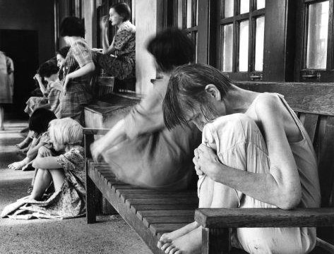
The limits of asylumdom
Early optimism of asylum had faded
Problems of growing size (1000+), overcrowding, incurablity
Cost in face of rising broader demands of welfare
Rise of eugenics

Slide 5
The move to ‘mental health’
Disillusion of doctors with asylum medicine
Desire to reach out to the milder cases who may be easier to cure
Rise of outpatient treatment, clinics, and child guidance services
Development of new ‘psychotherapies’
Interest too in prevention – promotion of ‘mental health’ and ‘mental hygiene’
But problems of resource, limited expertise, and reticence to talk about problems
Needs moment of crisis to make mental health a national priority

Slide 6
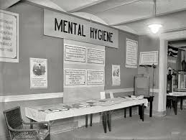

Slide 7
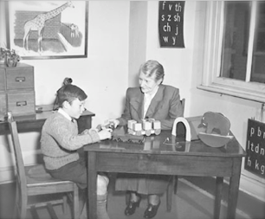

Slide 8
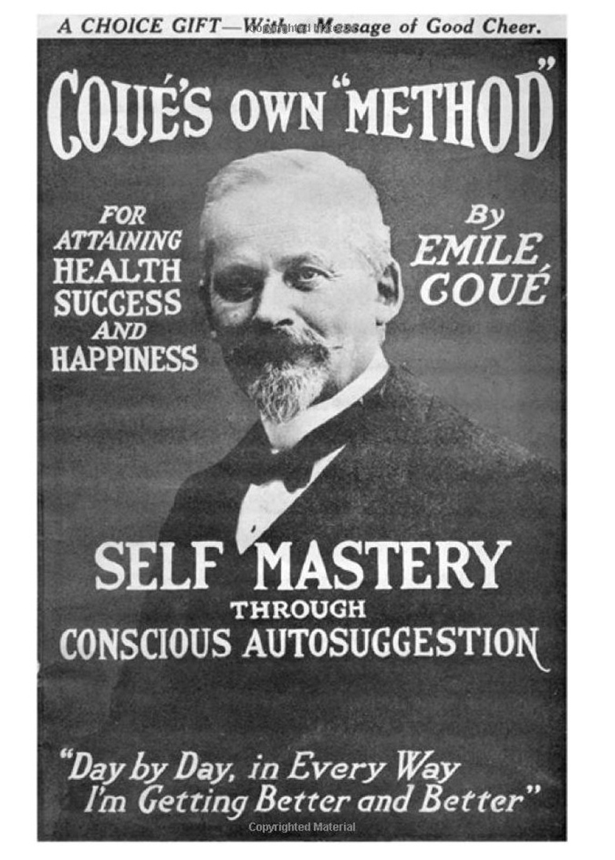

Slide 9
2. Impact of the World War II

Slide 10
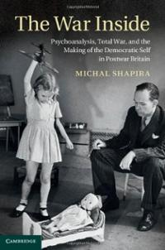
Democracy, War, and Mental Health
Political extremism, economic irrationality, and violence of war in mid-century encourages governments to consider psychology
In Britain, democracy now seen as a result and necessary condition for mental health

Slide 11
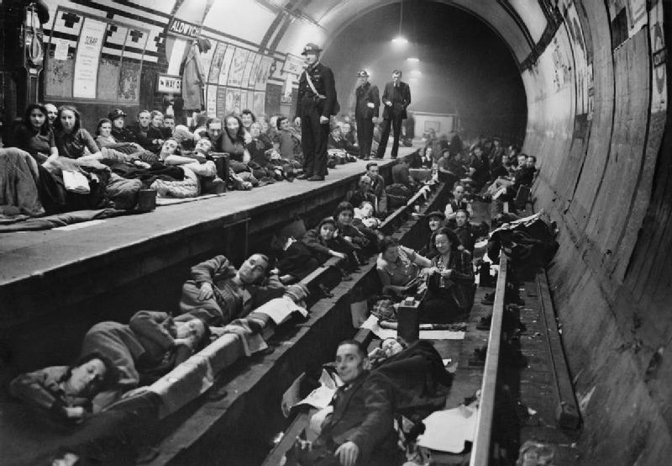
War as catalyst
Fear of mass mental breakdown via air attack following Guernica (legacy of ‘shellshock’)
Psychological strength (morale) seen as key to victory
Need for the state to resource expansion of psychological medicine to whole population

Slide 12
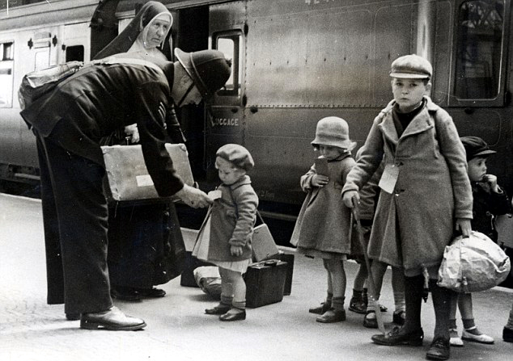
The psychological gaze and children
Psychological ‘experiment’ of mass evacuation focuses attention on children and separation
Studies of withdrawn children and emotional abuse in children’s homes
Evidence on children from camps
Children show capacity to cope in Blitz

Slide 13
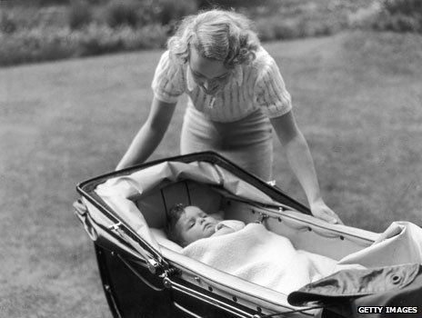
Implementing the psychological reproduction of democratic subjects
Via BBC radio and child-rearing literature reaches into family home (Donald Winnicott and John Bowlby)
Post-war withdrawal of support from nurseries
Progressive pedagogy in schools

Slide 14
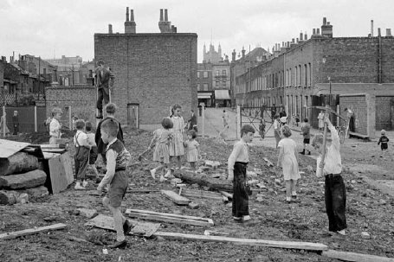
The adventure playground
Model of the wartime bombsite
A space for children (under supervision) to explore, make things from junk, and to develop through freedom and play

Slide 15
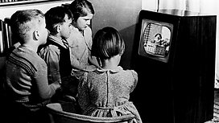
The virtual landscape of children’s television
Psychology informs efforts to design an ideal virtual environment for the child: safe, suited to the way the child sees the world, bringing the outside world into the protected realm of the family home

Slide 16
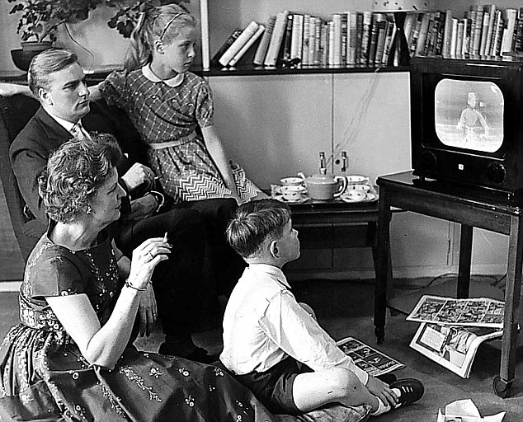
The post-war family
Thinking on mental health fosters ‘golden’ era of family life: increasingly focused on domestic space; home-bound mother; new expectations of fatherhood; smaller families
But historically this is not the norm but a rather unique period (Pat Thane)
Nuclear family just as central as welfare state to post-war settlement

Slide 17

A new form of governance
The pre-war efforts to control and regulate through the imposition of outside controls (eg via eugenics) limited via lack of resources and expertise, and by culture that supports individual liberties
The post-war culture of normative mental health works via advice and internalisation of norms: self-government
Nikolas Rose: an obligation to be free

Slide 18
3. The emergence of a new critique

Slide 19
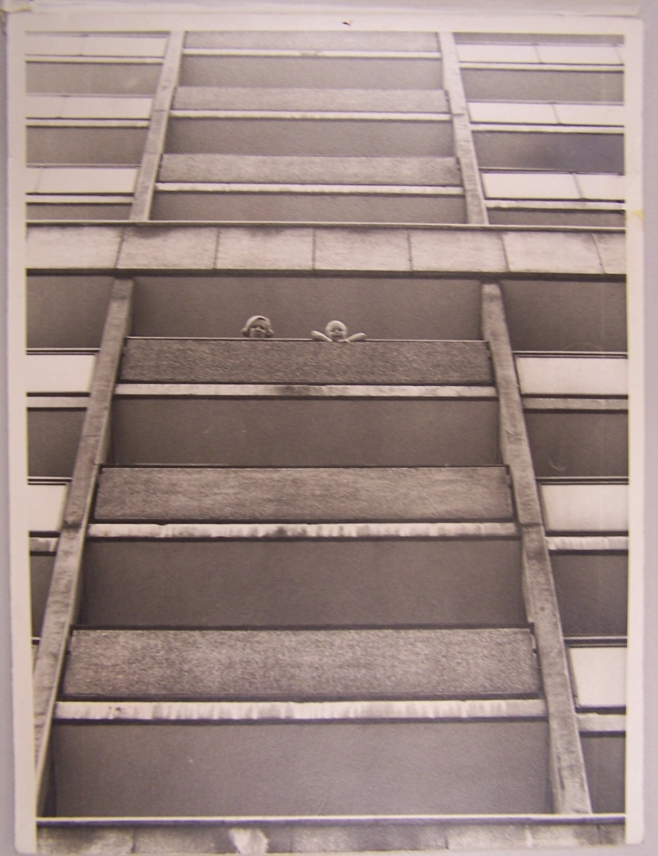
Social change exacerbates the situation
Post-war immigration
Breakdown of community with destruction of slums and relocation to high rise buildings
Recognition of persistence of poverty and social problems despite a welfare state
Rising divorce rates and instability of family structure
Close of asylums and move to ‘community care’ places responsibility on families at time of social breakdown

Slide 20
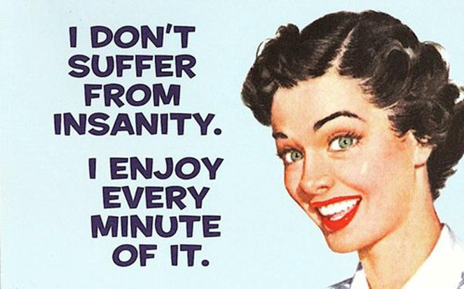
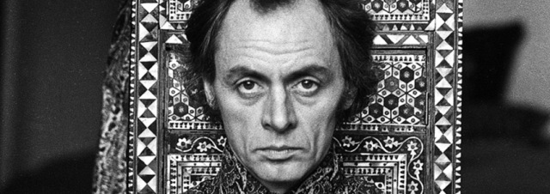
The counter culture
Normative family (& gender roles) challenged by feminism
‘Anti-psychiatry’ eg R.D. Laing questions ‘madness’ and sees family as cause rather than solution
Critiques of medical power: psychoanalysis; Electric Shock; tranquillisers
Challenge from transcultural perspective (high BME rates in mental health system)

Slide 21
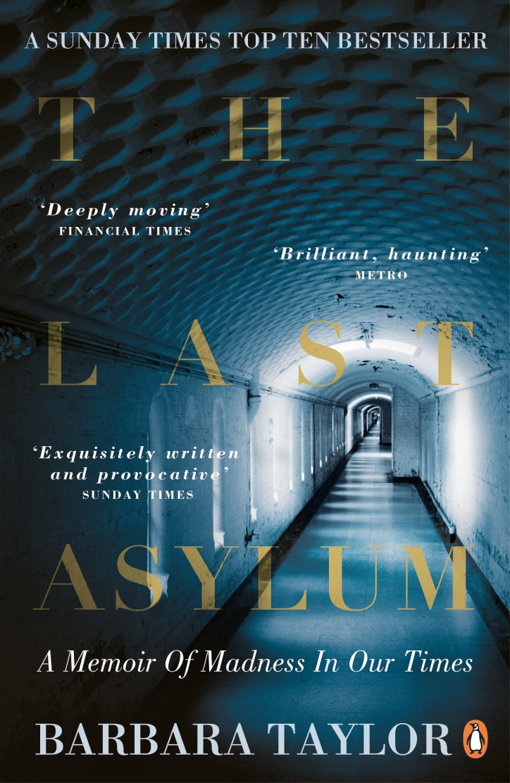
‘Cinderella’ of NHS
Mental health 25% of ‘burden of disease’ UK but 11% NHS funding; only 28% of those with mental health difficulties receive treatment; 1/3 GP consultations mental health related (NHS England, 2013)

Slide 22
4. Globalisation

Slide 23
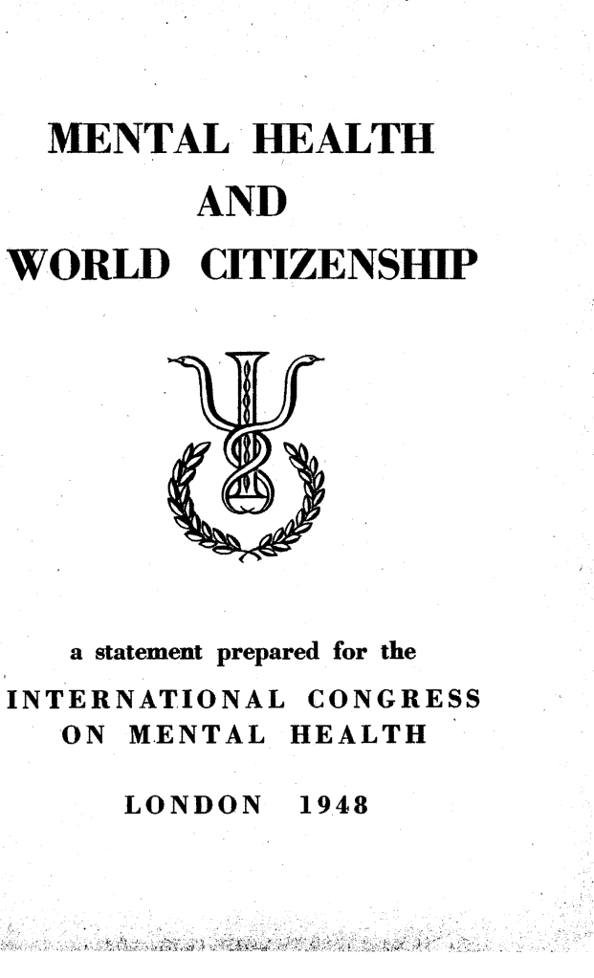
World Mental Health
1948 World Health Organisation defines health as ‘a state of complete physical, mental, and social well-being and not merely the absence of disease or infirmity’

Slide 24
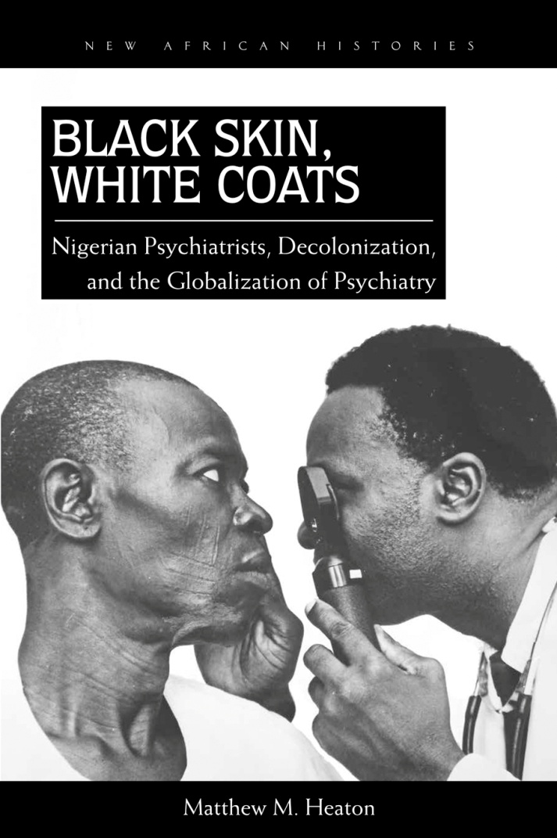
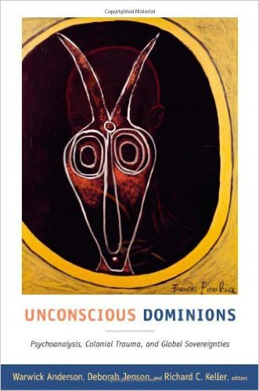
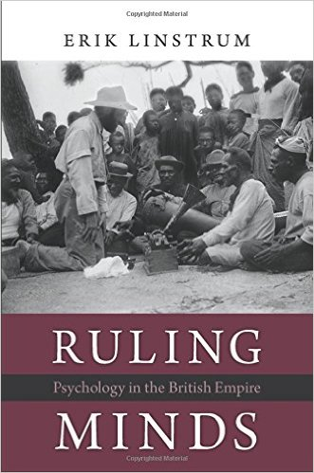
Globalisation of expertise

Slide 25
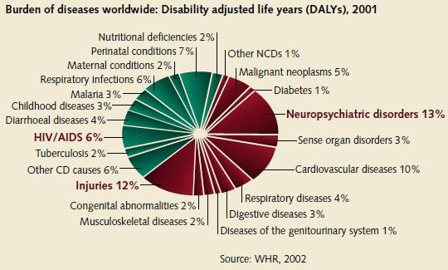
Global ‘burden of disease’

Slide 26
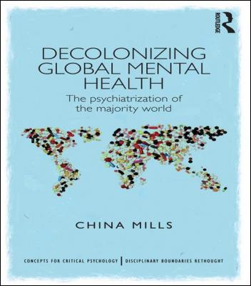
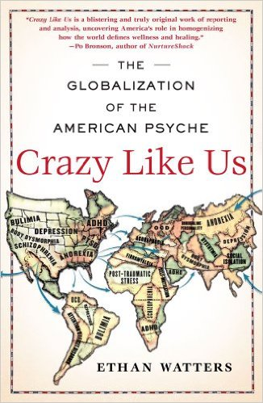
Critiques of Global Mental Health

Slide 27
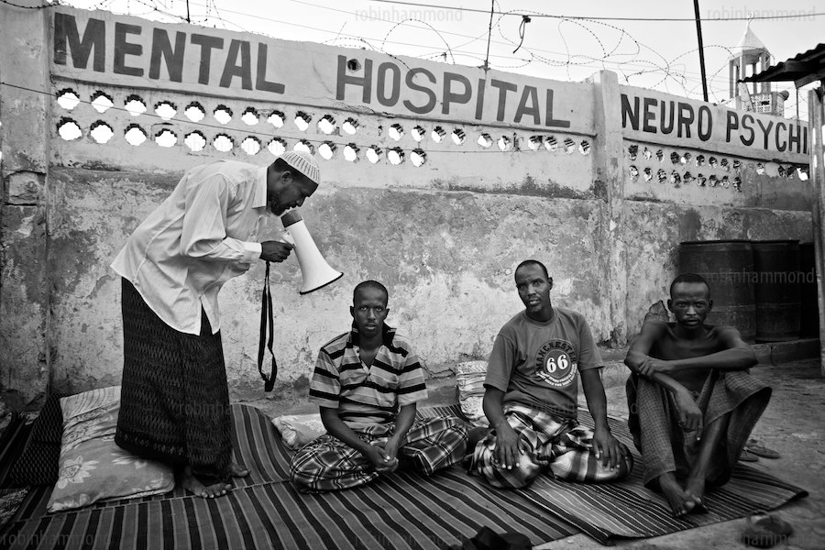
Global mental health inequalities

Slide 28
Concluding thoughts/questions
Is the history of mental health the history of a failed project, with rising levels of chronic mental illness (anxiety, depression, eating disorders …), and ongoing inadequacies in response?
If so, why? Does the answer lie in epidemiology (is mental illness a ‘disease of civilisation’), or in stigma, medical focus on physical disease, inequality, and economics?
Why has the expansion of mental health been viewed critically by some, and to what extent is this justified?

